Slide 1
DR Solution Introduction

Slide 2
This course covers:
  The definition of the DR system and its importance to enterprise service continuity
  Common solutions of the DR system
  Technology used by the DR system
  Success stories of the DR solution

Slide 3
On completion of this course, you will:
  Be able to describe the concept and importance of the DR system.
  Recognize advantages and disadvantages of common DR solutions.
  Have mastered the technical principles of the DR solution.
  Understand how to deploy a DR system based on typical applications for the DR solution.

Slide 4
DR Solution Overview
DR Solution Architecture
Common DR Technologies
DR Application Cases

Slide 5
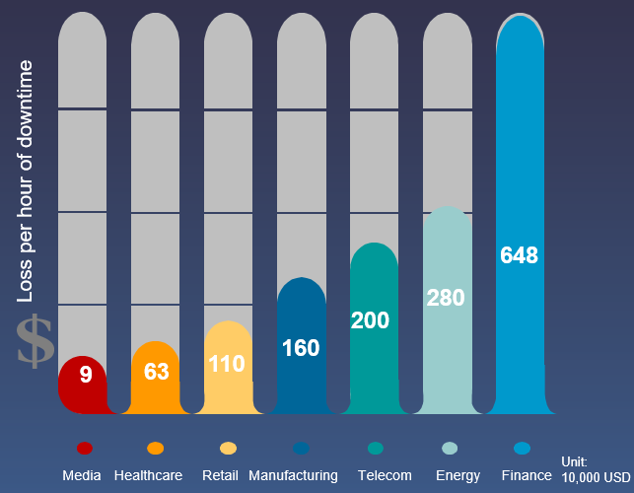


DR Requirements
Three risks: data loss, data damage, and service interruption. The loss caused by service interruption can reach millions of dollars per hour.
Regulatory compliance: financial compliance, security isolation, geo-redundant solution, and high service continuity
IT O&M: System disaster recovery simplifies IT O&M work and negates the impact of major events.
Enterprise: Avoid major losses and reduce enterprise risks.
Enterprise: Comply with policies and regulations, and meet industry regulatory requirements.
IT: Simplify O&M and avoid the impact of emergencies.
Notes:
DR system building — a necessary means to minimize disaster impact
Insurance statistics from an international agency in Switzerland
In 2004, the direct financial loss resulting from natural and human-induced disasters reached 123 billion US dollars worldwide.
In 2005, 400 catastrophes occurred worldwide and caused losses of more than 230 billion US dollars.
In 2006, the financial loss caused directly by natural and human-induced disasters was lower than expected at 48 billion US dollars.
The occurrence rate of natural disasters that can be measured was three times greater in the 1990s than the 1960s, while the financial loss was nine times greater.
Unexpected disasters cause huge losses.
According to IDC, among the companies that experienced disasters in the ten years before 2000, 55% collapsed when the disasters occurred. 29% collapsed within 2 years after the disasters, due to data loss, and only 16% survived.
Research from the University of Minnesota in the United States shows that 60 percent of companies who suffered disasters but did not have DR plans were unable to survive two or three years later. As enterprises become more dependent on data processing, this figure is likely to increase.

Slide 6
DR Challenges
Costly investment
Cumbersome management
Limited DR capability
High capital expenditure (CAPEX)
High purchase costs for infrastructure, such as servers, storage devices, and software
High basic construction costs for facilities such as equipment rooms.
High OPEX
Professional O&M support (implementation, training, and onsite support)
Long-term costs on resources such as water and electricity.
Multiple devices are not centrally managed.
Independent storage media, servers, and network management pages, complex workflows, and low efficiency
Complicated capacity expansion
The capacity is insufficient and needs to be expanded. The rollout period is long.
Poor security and DR capabilities
Data cannot be backed up outside of the data center, and infrastructure faults may cause extreme problems.
Poor agility
Capabilities such as disaster recovery and data sharing are restricted by physical locations of data. Applications and data cannot be separated. Agile applications and better DR features cannot be built.
Notes:
Diversified applications and inconvenient management: An increasing number of service systems are running in enterprise IT systems, and more and more applications require DR protection as a key service. Common applications include Oracle, DB2, SQL Server, and Exchange. The cloudification trend of IT systems is also becoming more and more obvious, and a large number of VMs need to be protected due to the lack of a unified management system.
Complex process, time-consuming, and error-prone: Different applications have different configurations and recovery processes, making configuration difficult. Service switchover and recovery need to be performed by professionals, which is time-consuming can result in errors. There is no automatic creation and deployment process.
Black-box operation, difficult to understand: Traditional service switchovers and drills are performed in black-box mode, which lacks visual effects and can be difficult to understand.

Slide 7
HA
High availability (HA) ensures that applications can still be accessed when a single component of the local system is faulty, no matter whether the fault is a service software fault, physical facility fault, or IT software/hardware fault.
In HA, users using a data center's services would be unaware of a machine breaking down. However, if a server in a data center breaks down, it takes some time for services running on the server to fail, but customers will be aware of the failure.
The key indicator of HA is availability. Its calculation formula is [1 – (Downtime)/(Downtime + Runtime)]. The following nines are used to represent availability:
  4 nines: 99.99% = 0.01% x 365 x 24 x 60 = 52.56 minutes/year
  5 nines: 99.999% = 0.001% x 365 = 5.265 minutes/year
  6 nines: 99.9999% = 0.0001% x 365 = 31 seconds/year
For HA, shared storage is usually used. In this case, RPO = 0. In addition, the active/active cluster HA mode is used to ensure that RTO is almost 0. If the active/passive HA mode is used, RTO needs to be reduced to the minimum.
Notes:
HA requires redundant servers to form a cluster to run applications and services. HA can be classified into two types:
Active/Passive HA:
The cluster consists of only two nodes (an active and a passive node). In this mode, the system provides services only on the active node.
When the active node is faulty, the passive node will take over the services.
Typically, CRM software like Pacemaker can be used to control the switchover between the active and standby devices and provide a virtual IP address to provide services.
Active/Active HA:
The cluster consists of only two active nodes. In this mode, if the cluster has multiple nodes, it is called a multi-master cluster.
In this configuration, the system runs the same load on all servers in the cluster.
Using the database as an example, the update of an instance will be synchronized to all instances.
In this configuration, load balancing software, such as HAProxy, is used to provide virtual IP addresses.

Slide 8
Disaster Recovery
A disaster is an unexpected event (caused by nature or human error) that results in severe faults or breakdown of the system in a data center. In such an event, services may be interrupted or perform at an unacceptable level. If the system unavailability reaches a certain level at a specific time, the system must be switched to the standby site.
Disaster recovery (DR) refers to the capability of recovering data, applications, and services in data centers at different locations when the production center is affected by a disaster.
In the DR mode, a redundant site is established in addition to the production site. If the production site is damaged due to a disaster, the redundant site can take over services from the production site to ensure service continuity. To achieve higher availability, customers even establish multiple redundant sites.

Slide 9
Relationship Between HA and DR
HA and DR are interrelated and complement each other. They overlap but also have significant differences.
Dimension | HA | DR
Scenario | HA refers to a local HA system. When one or more applications are running on multiple servers, ensure that the running applications are not interrupted when any server is faulty. The applications and system can be quickly switched to other servers. | DR refers to a remote (intra-city or remote) HA system. It is used to recover data, applications, and services when a disaster occurs.
Storage | Generally, HA uses shared storage. Therefore, data will not be lost (RPO = 0) and the switchover duration, that is, RTO, is considered. | Data replication is used for remote disaster recovery data. Based on different data replication technologies (synchronous and asynchronous), data loss often causes RPO to be greater than 0. However, remote application switchover usually takes a longer time. In this case, RTO is greater than 0.
Fault | Load switchover between servers in the cluster caused by a single faulty component. | Service switchover between data centers caused by large-scale faults.
Network | HA is used in LAN. | DR is used in WAN.
Cloud | HA is a mechanism that ensures service continuity in a cloud environment. | DR is a mechanism that ensures service continuity among multiple cloud environments.
Objective | HA is used to ensure high availability of services. | DR ensures data reliability and service availability.

Slide 10




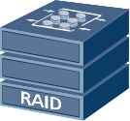
Differences Between DR and Backup
Backup: Backup is the process of copying all or parts of data sets from an application host's disks or a storage array to other storage media in a data center. A backup is a method of DR.
DR: A DR system consists of two or more sets of IT systems that are geographically far from each other. These IT systems provide the same functions and monitor each other's health status. In the event of an accident (such as a fire or an earthquake), applications on a broken-down system can be switched to other systems to ensure business continuity.
DC1
MA
MA
CS
iDA
iDA
MA
VTL/NAS
SAN
Backup & Archive Server
PTL
Production Center
Backup Center
DC1
DC2
APP
APP
APP
APP
OS
APP
OS
APP
OS
OS
OS
HA
OS
Cluster
Mirror
Generally, DR indicates the backup of data or application systems across equipment rooms, whereas backup refers to local data or system backup.
A DR and backup solution combines local backup and remote data replication to provide comprehensive data protection.
Notes:
Generally, backups are implemented using backup software while DR is implemented using replication or mirroring software. Their differences are as follows:
Data is in a different format after being processed by backup software and is available only after being recovered. However, replication or mirroring software does not change data formats but mounts data to hosts directly.
Backups offer a longer data protection period than replication or mirroring.
A backup is the last line of defence in data protection and is often related to archiving.

Slide 11
Main Indicators for Measuring a DR System
Recovery Point Objective (RPO) indicates the maximum amount of data that can be lost when a disaster occurs.
Recovery Time Object (RTO) indicates the time for system recovery.
The smaller the RPO and RTO, the higher the system availability, and the larger the investment required by users.
Data recovery
completed
Backup
started
Backup
completed
Point in time to which data is recovered
A fault or disaster occurs.
Recovery started
Time required for data recovery
Application
recovery
Backup window
00:00
RPO
06:00
RTO
12:00

Slide 12
Levels of DR Systems
Level | Definition | RTO | TCO
Data level | Builds a remote DR center to back up data remotely, which prevents data loss or corruption in the event of a disaster. The remote DR center is considered as a remote data backup center. Data-level DR cannot prevent service interruption if a disaster occurs. The recovery time for data-level disaster recovery is long, but the cost is low and facilities are easy to construct. The data source is essential to all key service systems. Therefore, data-level DR is indispensable. | The RTO is the longest (several days) because device re-deployment is needed to restore services. | Lowest
Application level | Builds a backup site that carries the same application system as the production site, and uses synchronous or asynchronous replication to synchronize data between the sites. This allows critical applications to recover within a specified time and minimizes losses. Data recovery is transparent to users, ensuring integral, reliable, and secure businesses. | Medium RTO (several hours) | Medium. The same system or a smaller system can be established at the backup site.
Service level | Requires all of the necessary IT technologies and infrastructures to achieve full-service DR. Most of the contents are from non-IT systems (such as telephones and offices). If a disaster damages the original office, a backup office is also needed on top of data and application recovery. | Shortest RTO (several minutes or seconds) | Highest

Slide 13
Global Standards for a Disaster Recovery System
According to SHARE 78, a disaster recovery system can be categorized into 7 tiers:
Expenses
Remote DR center
Tier 7: Near-zero or zero data loss, remote data mirroring, and automatic service switchover
Tier 6: Near-zero or zero data loss. Remote data mirroring ensures data integrity and consistency.
Tier 5: transaction integrity
Tier 4: Batch/online database image or log transmission
Available backup center
Tier 3: electronic vaulting
Tier 2: PTAM + Hot standby site
Time-based backup
Tier 1 – PTAM
15Min 1~4Hr 4~8Hr 8~12Hr 12~16hr 24Hr Days Weeks
RTO

Slide 14


Huawei Business Continuity and Disaster Recovery (BC&DR) Solution
FusionCloud
        Cloud server high availability
Remote DR center
Local production center
Intra-city DR center
        Cloud server disaster recovery
        Cloud server backup service
Geo-redundant DR solution
Active-passive DR solution
        Volume high availability
        Volume backup service
HyperMetro DC solution
Active-passive DR solution
Local HA solution
Private cloud
≥ 100 km
Hybrid cloud
≤100 km
        Cloud server backup service
Centralized backup solution and integrated backup solution
        Volume backup service
Converged data management
        Volume high availability
Traditional data center
Public cloud

Slide 15
DR Solution Overview
DR Solution Architecture
Common DR Technologies
DR Application Cases

Slide 16
Disaster Recovery and Backup Solution
Government
Finance
Transportation
Energy
Education
Healthcare
......
International
standard
China
standard
Cloud computing mode
Physical server mode
Consulting
Application-level DR
Application-level DR
Cooperation
delivery
Levels 6 to 7
Level 6
Active-active cloud DR
Same-city application-level DR
DR
selection
WAN application-level DR
Data-level DR
Data-level DR
Link
design
Level 4 to 5
Level 4 to 5
Database DR
Array replication–based DR
Active-passive cloud DR
CDP DR
Drill
switchover
Virtual storage DR
Level 3
Level 3
Backup
Service
delivery
Backup
VM backup
Backup software backup
Integrated backup
Evaluation
optimization
Levels 1 to 2
Levels 1 to 2
Notes:
Huawei provides professional services from strategic consulting, DR planning, and business implementation to continuous operations management by matching customer businesses and development policies.

Slide 17






DR Design Mode: Combination of Synchronous and Asynchronous Modes
High
Active-active
Synchronous disaster recovery: distance limit exists.
Asynchronous disaster recovery: no distance limit
Hot backup
2
3
Availability
Warm backup
1
1
Low
High
4
4
3
2
Cold backup
RPO: 0s. The two images are the same.
RPO: from 30 minutes to several hours, with data synchronized regularly
Low
Resource utilization
DR Mode | Reliability Solution | Disaster Recovery | Data Backup Requirement
Active-active | Cluster + Load balancing | Automatic | Real-time synchronous replication (< 100 km)
Hot backup | Cluster | Automatic | Real-time synchronous replication (< 100 km)
Warm backup | Manual intervention | Manual | Asynchronous replication (> 100 km)
Cold backup | Strong manual intervention | Manual | Same as above
Notes:
Hierarchical DR solution.

Slide 18


Active-Passive DR Solution
WAN
Production center
DR center
Disaster recovery management
VM
VM
VM
VM
VM
VM
VM
VM
VM
VM
VM
VM
Virtualization/Middleware/
Applications
Database
SAN
SAN
Synchronous/Asynchronous replication
Notes:
DR management visualization:
Deployment of DR management software and one-click commissioning
One-click DR drills and switchover and assistance for customized script tools, enabling one-click recovery of the backup service system
Mature and efficient DR services:
One-stop analysis, design, delivery, and drills for DR systems
Support for reusing legacy non-Huawei devices to perform DR solutions, saving money for customers

Slide 19

Active-Active DR Solution
WAN
Production center 1
GSLB/SLB cluster
(F5/L2800)
Data center 2
VM
VM
VM
VM
VM
VM
VM
VM
VM
VM
VM
VM
FusionSphere
/VMware
/WebLogic
/WAS cluster
Oracle, DB2, or SQL Server cluster
SAN
HyperMetro
SAN
V3 mid-range and high-end storage
Notes:
Gateway-free and efficient active-active DR
Reliable service-level architecture, ensuring zero data loss upon DC-level faults and 24/7 services.
No virtualization gateway on the active-active storage layer, reducing failure points and simplifying implementation and commissioning

Slide 20
Geo-Redundant DR Solution
Cascading architecture
Production center
Same-city DR center
Remote DR center
HyperMetro or synchronous/
asynchronous replication
A
Asynchronous replication
SAN
SAN
SAN
A
A
A
Parallel architecture
Production center
Same-city DR center
Synchronous/
asynchronous replication (HyperMetro)
A
Remote DR center
SAN
SAN
A
A
Asynchronous replication
SAN
A
Notes:
Short DR construction period and low delivery risks
DR construction period reduced by 30% from ten months to seven months
Cooperation of multiple vendors for efficient management, reducing project delivery periods
Effective evaluation and analysis of multiple services and applications to ensure rapid DR system construction
Ensuring effective verification of DR design and reducing project implementation risks
Visualized remote DR management
One-click visualized deployment and commissioning of DR management software
Devices in the production center, same-city DR, and remote DR centers are centrally managed and monitored, simplifying device maintenance.
The visualized management supports one-click DR testing and switchover and enables customers to customize scripts to recover the standby service system by one click, simplifying the management and maintenance of the DR system.

Slide 21
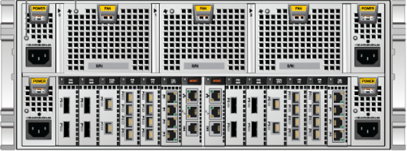

New DR Mode Evolution in Cloud Computing
High reliability in traditional data centers
Traditional cross-DC DR
Component redundancy and high device reliability
Dual-host hot backup
Mainly service data replication
The recovery process is complex and the recovery period is long.
High reliability in cloud computing data centers
Cloud computing cross-DC DR
App
App
App
App
VM: WEB
OS+Apache
VM: WEB
OS+Apache
OS
OS
OS
OS
VM: APP
OS+J2EE
VM migration
VM: APP
OS+J2EE
Cloud management platform
VM: DB
OS+DB
VM: DB
OS+DB
Storage
All service data and running environment data are replicated and managed in an integrated manner.
The recovery process is simple and the recovery period is short.
Automatic migration of VMs (including services)
Notes:
The centralized and cloudified IT system has demanding requirements on business continuity, including the requirements on networks, data security, and service reliability.

Slide 22


Implementation of Cloud Active/Passive Data-Level DR
DR center (passive)
Production center (active)
APP
APP
APP
APP
APP
APP
ESC/CRM/OMM
APP
APP
OS
APP
OS
APP
ESC/CRM/OMM
OS
APP
OS
APP
OS
OS
OS
OS
OS
OS
OS
OS
Management data replication
IP SAN
IP SAN
VM data replication
Production storage pool
DR storage pool
IP network
Protected LUN
FC network
Protected LUN copy
Unprotected LUN
Notes:
The cloud management platform is deployed in the production center and DR center.
Set a synchronization policy to periodically replicate cloud management data and service data (VM) from the production center to the DR center.
During service planning, two types of LUNs are supported: protected LUNs and unprotected LUNs. VMs that require DR are created on protected LUNs and array replication is only configured for protected LUNs to save storage space in the DR center.
When the production center is faulty, the DR center uses the DR management software to restore VMs in one-click mode.

Slide 23
DR Solution Overview
DR Solution Architecture
Common DR Technologies
DR Application Cases

Slide 24
Major Disaster Recovery Technologies
Applications
Applications
Database management system
Host layer
Database management system
OS
OS
File system
Application replication
Database replication
Logical volume replication
File system
Raw devices/volumes
Raw devices/volumes
Device I/O driver
Device I/O driver
IP
SAN-based network layer
SAN
IP
SAN
Array layer
Disk array
NAS
Disk array
NAS
Notes:
Host-based DR technology:
Data replication software is installed on hosts in the production center and the DR center. Remote switchover software can also be installed at the host layer to form a complete application-level DR solution.
This data replication mode has low costs, mainly in software procurement, and is compatible with servers and storage devices of different brands. It is suitable for users with complex hardware composition.
The software occupies a large number of host and network resources.
Network-based DR technology:
A storage gateway is added to the storage area network (SAN) between the front-end application servers and back-end storage systems.
The storage gateway establishes a mirroring relationship between two volumes on different storage devices. When data is written to the primary volume, the gateway also writes the data to the backup volume. When the primary storage device experiences a fault, services are switched to the secondary storage device and the backup volume is used to ensure non-disruptive data services.
Array-based DR technology:
Data is replicated from the local storage system to the DR storage system to generate a usable data copy on the DR storage system. If the local storage system fails, services are quickly switched to the DR storage system to ensure continuity.

Slide 25
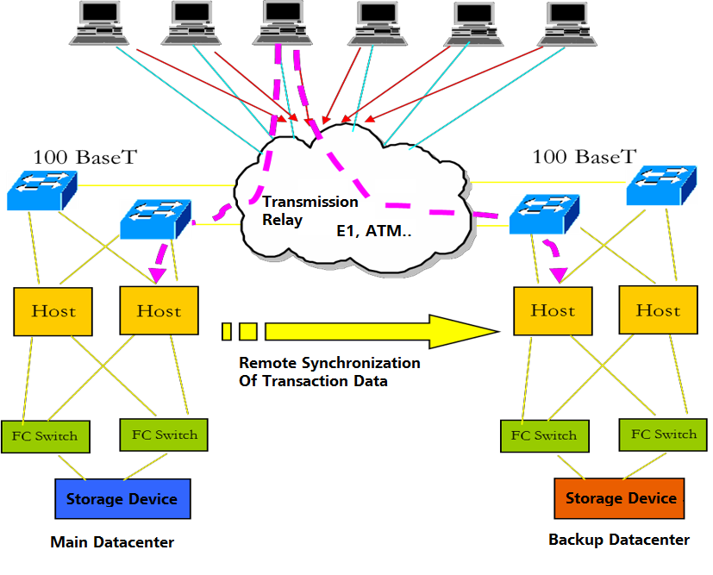
Host Layer DR Technology - Application Level
Application-level DR technology uses application software to implement remote data replication and synchronization. When the production center fails, the application software system in the DR center recovers and takes over services from the production center.
Notes:
Working principle: The application software is connected to two remote databases. The service processing data is stored in the databases of both the active and standby centers.
Advantages and disadvantages:
Supports wide area networks (WANs). No independent hardware or software is required. Data is logically replicated to avoid spreading human errors.
The consistency check needs to be performed periodically. Backup data in the backup center cannot be quickly restored to the active center. Major modifications need to be made to the application program.

Slide 26
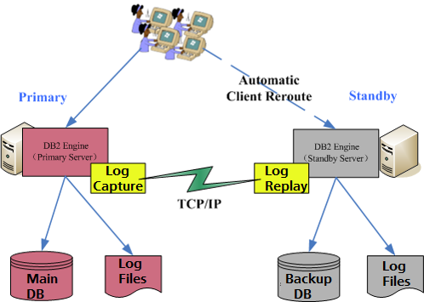
Host Layer DR Technology - Database Level
Database-level DR technology is designed for specific databases. Generally, typical databases have the database-level DR function, like Oracle Data Guard and DB2 HADR. Database-level DR is implemented by transmitting database logs and replaying them at the DR site. The database-level DR technology supports a smooth switchover.
Notes:
Working principles:
Configure the active and standby database servers.
When a transaction operation is performed on the active database, the log file is simultaneously sent to the standby database. The standby database then replays the received log file to ensure data consistency with the active database.
When the active database is faulty, the standby database server takes over the transaction processing from the active database server.
Advantages and disadvantages:
Supports wide area networks (WANs). No independent hardware is required. Implements logical replication to reduce the risk of human errors. No application needs to be modified. Data in the active and standby centers can be accessed at the same time.
Backup data in the backup center cannot be quickly restored to the active center. Remote replication of non-database data cannot be implemented. In synchronous mode, the production system is greatly affected. In asynchronous mode, a large amount of data is lost, the switchback process is complex, and the production reconstruction is complex.

Slide 27



Host Layer DR Technology - Logical Volume Level
Remote data replication based on logical disk volumes refers to remote synchronous (or asynchronous) replication of one or more volumes as required. This solution is usually implemented by using software.
WAN
Volume Replication System/Software
Servers
Servers
Fiber Connection/DWDM
FC Switch
FC Switch
Storage
Device
Storage
Device
Notes:
Working principle: In remote replication control management, the software copies operation data from each I/O on active nodes in real time (or in time or at a latency) to (almost) synchronize data between two remote volumes.
Advantages and disadvantages:
Ensure data integrity and consistency. The structure is simple.
The write performance of the host is greatly affected by the distance. Data-level DR cannot be implemented if no host exists in the DR center. Logical disasters cannot be prevented.

Slide 28



Network-layer DR Technology
A smart switch is added to the storage area network (SAN) between the front-end application servers and back-end storage systems.
Production center
DR center
③Writing data is completed.
Write new data.①
④Write a request to the DR center.
⑤The DR center returns the confirmation signal.
⑦The DR center returns the completion signal.
Write data into a log volume.②
④Write data into production volume.
⑥Write data into a replication volume.
Production
volume
Log
Replication volume
Log
Notes:
Working principles:
The host in the production center writes data to the local virtualization gateway.
The virtualization gateway in the production center writes data to the local log volume.
After data is successfully written to the log volume, the virtualization gateway in the production center returns a confirmation message to the local host.
The virtualization gateway at the production end writes data to the production volume at the local end and sends a data write request to the virtualization gateway at the DR end.
After receiving the write request, the virtualization gateway at the DR end returns a confirmation message to the virtualization gateway at the production end.
The virtualization gateway at the DR end writes data to the replication volume at the DR end.
After data is successfully written to the replication volume, the DR center sends a completion response to the virtualization gateway in the production center.
Advantages and disadvantages: Supports heterogeneous storage devices. Implements virtualization consolidation and unified management, which improves storage utilization. The SAN network must be reconstructed.

Slide 29

Array-layer DR Technology
Array-level DR is implemented using the inter-array replication technology. The replication of the array does not pass through the host. The impact on the host performance is therefore limited.
Application
LAN
Application
hosts
FC/IP
switch
FC/IP
FC/IP
switch
SAN
Local storage system
Remote storage system

Slide 30






SAN Synchronous Replication
Production center
DR center
DR management server
DR management network
DR management network
WAN
Service plane
Application
server
Data replication network
(Optional) DR servers
FC switch
FC switch
DWDM
DWDM
Synchronous replication
IP management network
IP service network
FC network
Data flow
Server
Agent
Huawei OceanStor Hybrid Flash Storage
Huawei OceanStor Hybrid Flash Storage
Notes:
The figure shows the deployment setup. The target RPO is 0, and the RTO is within minutes.
Only SAN-based DR replication supports synchronous replication. It is recommended that the distance be less than 100 km.
RD provides DR management functions, including topology, DR test, drill, and DR.
To manage applications and recover DR applications, you need to install the Agent on the server.
The RD management network needs to communicate with hosts and storage devices.
FC/iSCSI links are supported. FC links are recommended for synchronous replication.

Slide 31
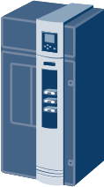


SAN Synchronous Replication Principles
①
Synchronous replication
②
③
②
Cache
Cache
③
④
Primary LUN
Secondary LUN
Host
Production storage
DR storage
DB Server
Cache
Synchronization
Cache
Data Change Log (DCL)
LUN A
LUN B
Primary site
Secondary site
Notes:
The synchronization procedure is as follows:
The production storage receives a write request from the host. HyperReplication logs only the address information. It does not record data content.
The data from the write request is written to both the active and standby LUNs. If a LUN is in the write-back state, data will be written to the cache.
HyperReplication waits for the data write results from the active and standby LUNs. If writing to both LUNs is successful, the system deletes the log. If writing to either LUN fails, the system retains the log and replicates the data again in the next synchronization.
The system returns the write result of the source LUN to the host.
Splitting:
In split mode, write requests from production hosts go only to the active LUN, and the difference between the active and standby LUNs is recorded by the differential log. If users want to achieve data consistency between the active and standby LUNs again, they can start a manual synchronization process, during which data blocks marked as differential in the log are copied from the active LUN to the standby LUN. The I/O processing operation is similar to the initial synchronization process.

Slide 32
SAN Asynchronous Replication DR
Production center
DR center
DR management
server
DR management network
WAN
DR management network
Service plane
Application
server
(Optional) DR servers
FC switch
FC switch
WAN
IP management network
IP service network
FC network
Data flow
Server
Agent
Huawei OceanStor Hybrid Flash Storage
Huawei OceanStor Hybrid Flash Storage
Notes:
The figure shows the deployment setup. The target RPO is > 3s, and the RTO is within minutes.
Asynchronous replication is different from synchronous replication in that it has a replication policy with a time interval. Theoretically, there is no distance limit.
RD provides DR management functions, including replication policy, topology, DR testing, drills, and DR.
To manage applications and recover DR applications, you need to install the agent on the server.
The RD management network needs to communicate with hosts and storage devices.
Second-level replication is triggered on storage devices. Replication that takes more than 15 minutes can be triggered on RD.

Slide 33
SAN Asynchronous Replication Principles
4
Cache
Cache
2
N+1
x+1
1
1
N
x
3
5
Asynchronous remote replication
DB Server
5
LUN A
Primary site
Secondary site
LUN B
Production host
Standby production host
Primary
LUN
Secondary
LUN
Switchover
Switchover
Secondary
LUN
Primary
LUN
Primary site
Secondary site
Notes:
Time segment: logical space in a cache that manages new data received during a specific time period (data size is not restricted).
In scenarios of a low RPO and short replication period, the caches of the active and standby LUNs can store all data in multiple time segments. However, if the host bandwidth or disaster recovery bandwidth is abnormal and the replication period is prolonged or interrupted, data in the caches is flushed onto disks in the active and standby storage systems for consistency protection. Upon replication, the data is read from the disks.

Slide 34
Notes:
1. Incremental data is automatically synchronized from the primary site to the secondary site based on the user-defined synchronization period, which ranges from three seconds to 1,440 minutes. (If the synchronization type is manual, a user needs to trigger the synchronization.) When a replication period starts, new time segments (TPN+1 and TPX+1) are generated in the caches of the active LUN (LUN A) and the standby LUN (LUN B), respectively.
2. The primary site receives a write request from a production host.
3. The primary site writes data from the write request to cache time segment TPN+1 and sends a write success response to the host immediately.
4. During data synchronization, the storage system reads data in cache time segment TPN of the active LUN from the previous synchronization period, transmits this data to the secondary site, and then writes it to cache time segment TPX+1 of the standby LUN. When the write cache of the primary site reaches the high watermark, data in the cache is automatically flushed to disks. In this case, a snapshot is generated for the data from time segment TPN. During synchronization, this data is read from the snapshot and copied to the secondary LUN.
5. When the synchronization is complete, the storage system flushes data from time segments TPN and TPX+1 in the caches of the active and standby LUNs (the corresponding snapshots are deleted automatically) and waits for the next synchronization period.
Switchover:
When the pair is in the normal state, an active/standby switchover can be performed.
In the split state, an active/standby switchover can be performed only when the standby LUN is set to writable.
Asynchronous remote replication can be performed in the split state.
In split mode, the secondary LUN is set to writable.

Slide 35
NAS Asynchronous Replication DR
Production center
DR center
DR
management
server
DRM network
WAN
DRM network
Service
network
(Optional) DR servers
Application servers
FC switches
FC switches
IP management
network
WAN
IP service
network
FC network
Huawei OceanStor Hybrid Flash Storage
Asynchronous replication
Data flow
Server
Huawei OceanStor Hybrid Flash Storage
Agent
DRM: Disaster recovery management
Notes:
Currently, only V3R2C10 supports NAS file system replication using ROW.
The RD agents are not deployed on Linux or Windows for NAS. RD only manages the replication policies and DR for OceanStor V3 storage.
Currently, file systems support NFS and CIFS and DR management manages only file system replication and permission controls of file systems, which need to be configured during system creation.
Like SAN, file system replication supports FC/iSCSI links.

Slide 36
NAS Asynchronous Replication Principles
Replicate incremental data.
①
④
Primary FS
Secondary FS
③
⑤
②
Host
Primary FS
snapshot
Secondary FS snapshot
Production storage
DR storage
Notes:
At the beginning of each period, a snapshot is created for the primary file system. The system reads the incremental data from the end of the last period to the present and replicates it to the secondary file system. After the incremental replication is complete, the data in the secondary file system is consistent with that in the primary file system.
Supports remote replication between file systems. Does not support replication between directories or files.
One file system can support only one replication task at a time. One replication task can contain multiple file systems.
File systems support only one-to-one replication. A file system cannot serve as the replication source and destination at the same time. Cascading replication and 3DC are not supported.
The minimum unit of incremental replication is the file system block size (4 KB to 64 KB). The minimum synchronization period of asynchronous replication is 5 minutes.
Supports resumable data transfer.

Slide 37

Multi-Point-in-Time Asynchronous Remote Replication Technology – Second-Level RPO
DB Server
3
2
Time segment T2
Time segment T2
Time segment T1
4
Time segment T1
Cache
1
Cache
1
Asynchronous remote replication
5
5
Active LUN
Standby LUN
Production center
DR center
Notes:
At least 3 seconds for a consistency point:
When a replication period starts, new time segments (T2 and P2) are generated in the caches of the active LUN and standby LUN, respectively.
New data from the host is written into time segment T2 in the cache of the primary LUN.
The host receives a write success acknowledgement.
Data in time segment T1 is replicated to time segment P2.
The active and standby LUNs flush their data to disks.
Data is directly read from cache. The latency is short.
The snapshot does not require real-time data updates based on COW. The synchronization has minor impact on performance. The replication period is shortened to 3 seconds.

Slide 38
Remote Replication - Application Consistency
Host
Consistency Agent
Application engine
Triggered periodically
Requests archiving
Host status recovered.
Writes the data in the memory to the disk.
Memory
1
2
3
4
5
6
7
8
9
A
B
C
Storage array
Completed
Host channel
Snapshot
Mirroring
Replication
Notes:
Application consistency:
Install the consistency agent on a host to associate the array snapshot with the database.
When a snapshot task is executed:
Set the database to backup mode, create checkpoints, and write all dirty data in the memory to the storage system.
Inform the storage array a snapshot has been taken.
Take the database out of backup mode.
Advantages:
Direct use of data at the DR site without the need to perform a rollforward or rollback.

Slide 39
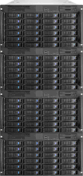
Remote Replication - Consistency Group
A consistency group ensures time consistency of mirrored data among multiple LUNs.
All pairs in a consistency group are simultaneously synchronized, split, interrupted, or switched over.
Active LUN 1
Standby LUN 1
Active LUN 2
Standby LUN 2
Active LUN 8
Standby LUN 8
Notes:
In medium- and large-sized database applications, data, logs, and modification information are stored on different LUNs (typically, these associated LUNs are called dependent LUNs). If data on one of the LUNs is unavailable, data on the other LUNs will also be invalid.
If you want to synchronize or split data for these LUNs, you can perform operations on them in a batch. This way, the data relationship between these LUNs remains unchanged, and the backup data stays integral and available. This technology is called remote replication consistency group technology.
The maximum number of remote replication pairs in a remote replication consistency group in Huawei storage arrays is 8. Cross-array consistency groups are not supported.
Note: The remote replication pairs of associated LUNs must be added to the same consistency group. Do not add the remote replications of unassociated LUNs to the same consistency group. In addition, synchronous remote replication pairs and asynchronous remote replication pairs cannot be added to the same consistency group. The standby LUNs of all remote replication pairs must reside in the same remote storage system.

Slide 40
Comparison of DR Technologies
Advantages
This function is implemented on hosts, and the compatibility between underlying devices does not need to be considered.
During database replication, the DR center can take over part of the work of the production center.
Host layer (typical replication software such as Symantec VVR, Oracle DataGuard, DSG and Quest)
Disadvantages
Database replication can be implemented only for the corresponding database.
Host-layer replication occupies certain host resources and affects the application system.
Implemented on hosts, which is complex and usually requires system reconstruction.
Advantages
Broad compatibility with different back-end heterogeneous SAN storage resources.
Simultaneous disaster recovery for multiple SAN arrays without a one-to-one relationship.
Extendable disaster recovery platform.
No extra investment required as the number of hosts and arrays increases.
Network layer (typically IBM SVC, EMC VPLEX, and Huawei VIS)
Disadvantages
High initial investment because few vendors can provide such a solution.
Advantages
Data replication does not affect the host application system.
When the production array is faulty, applications can be switched to the DR array in a short time.
Data replication is implemented based on lower-layer arrays, and users are not charged based on host licenses.
Array layer (arrays that support mirroring or replication, such as Huawei OceanStor series)
Disadvantages
Does not support heterogeneous storage arrays. Storage arrays at the production center and the disaster recovery center must be from the same vendor.
The data at the remote site cannot be accessed in real time. The data can be viewed only after the data volume can be read and written or the snapshot mode is used.

Slide 41
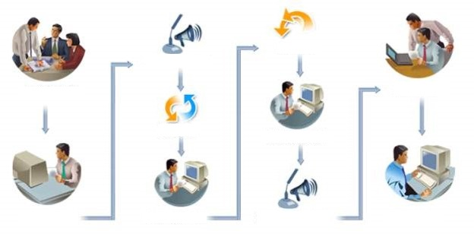
Typical DR Drill Solution
Drill switchback
Publishing the drill start message
Making a drill plan
Analysis and assessment
Drill switchover
Verification after the drill switchback
Approving the drill plan
Verification after the drill switchover
Publishing the drill finish message
Drill summary
Notes:
Functions of the DR drill:
Simulates the DR response.
Helps engineers understand the DR process and improve service recovery capabilities.
Checks service integrity.

Slide 42
DR Solution Overview
DR Solution Architecture
Common DR Technologies
DR Application Cases

Slide 43



Case 1: XX Virtualization DR Project
2. The standby end requests the replication task information from the active end, and then creates a recovery task at the backup end based on a replication task.
1. The active end creates a remote replication task (task 1). The active LUN is LUN 1, and the standby LUN is LUN 1'.
Windows Server
Windows Server
HA
HA
Linux Server
Linux Server
Linux Server
Linux Server
Linux Server
Linux Server
A disaster
occurs at the
active end.
3. The active end starts task1 to copy data from LUN1 to LUN1'.
4. The replication task is complete.
5. The standby end chooses snapshots to recover VMs based on the specified recovery task.
Notes:
Challenges
The customer has a vSphere virtual data center and wants to build a new data center for DR.
Low TCO and high return on investment (ROI)
Huawei's solution
Deploy an IT system, including storage devices, services, networks, and virtualization platforms, in the DR center.
Install Huawei UltraVR DR component in the production center and DR center.
Install ConsistentAgent on host machines of VMs to implement application-level protection for VMs.
Customer benefits
The live network architecture does not need to be reconstructed.
Flexible configuration of DR policies and one-click recovery.
DR drills and switchbacks are supported.

Slide 44




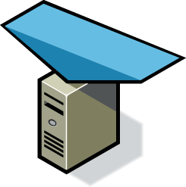
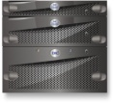


Case 2: Application-Level DR Solution
MSTP
Internet
Production center
DR center
Data replication
GSLB
2 Mbit/s private line
GSLB
Core switch
Core switch
CDP aggregation
switch
CDP aggregation
switch
Application server
Application server
IP SAN
switch
IP SAN
switch
Data replication
CDP device
CDP device
Data replication
Production storage
CDP storage
CDP storage
Production storage
Notes:
Challenges
The current IT system cannot meet the service development requirements and ensure the continuity of online services.
Complex IT O&M, high power consumption, and low resource utilization.
Huawei's solution
Migrate the service system to the Huawei cloud platform.
Deploy CDP storage devices and CDP software in the two data centers. The CDP technology is used to implement application-level DR for the two data centers in the same city.
Customer benefits
Elastic resources are implemented and resources are reused, improving resource usage and reducing O&M costs.
The RTO and RPO of key services are zero. When the production center encounters a problem, services and data are automatically switched to the DR center, ensuring service continuity.

Slide 45
(Multiple-answer question) Data replication is the core of a DR technology. On which three layers are replication devices distributed?
  Application layer
  Host layer
  Network layer
  Storage layer
(True or False) When designing a DR solution, you should set RTO to 0 to ensure that services are not interrupted.
Notes:
Answers:
BCD
False

Slide 46
DR Solution Overview
DR Solution Architecture
DR Solution Introduction
Common DR Technologies
DR Application Cases

Slide 47




Enterprise Technical Support App
Huawei Enterprise Service App
Notes:
Huawei training app
Contains a huge library of Huawei certified learning videos.
Enterprise technical support app
Covers all popular product documents, cases, and bulletins from Huawei. Users can quickly query commands, alarms, and spare parts. They can also use it to scan and view the device information. Simple and intuitive video guides provide 24/7 enterprise technical support.
Huawei enterprise business app
Provides one-stop mobile ICT portals for customers and partners to learn about Huawei's comprehensive products and solutions for enterprise ICT anytime and anywhere.

Slide 48
Huawei official websites
  Enterprise business: https://e.huawei.com/en/
  Technical support: https://support.huawei.com/enterprise/en/index.html
  Online learning: https://www.huawei.com/en/learning
Popular tools
  HedEx Lite
  Network Document Tool Center
  Information Query Assistant
Notes:
Popular tools
HedEx Lite is the Huawei tool for product document management. It allows users to browse, search, update, and manage product documentation.
eStor is a graphic storage simulation platform. The platform simulates Huawei OceanStor all-flash storage devices to help ICT practitioners and customers get familiar with Huawei storage products and quickly master their operations.
The Network Documentation Tool Center is the documentation tool for network products. It assists in bidding, network planning, project delivery, upgrades, and maintenance.
The Information Query Assistant provides command and alarm information querying for Huawei products.

