Slide 1
Jiang Binbin (employee ID: WX341670)
2017.08.25
Liu Lican (employee ID: 00180730)
New
Zhang Yue (employee ID: zwx635169)
2019.3.21
Liu Lican (employee ID: 00180730)

Slide 2
Introduction to eSight

Slide 3
eSight is an integrated convergent O&M management solution oriented to enterprise data centers, campuses, branch networks, unified communications, videoconferencing, and video surveillance.
eSight centrally manages servers, storage devices, virtualization, switches, routers, WLANs, firewalls, eLTE devices, eNodeBs, service engines, equipment room facilities, UC, telepresence, video surveillance, and application systems. eSight enables automatic deployment, visualized fault diagnosis, and intelligent capacity analysis for enterprise ICT devices. With these functions, eSight effectively helps enterprises improve O&M efficiency and resource usage at lower O&M costs, ensuring reliable operations of ICT systems.

Slide 4
Upon completion of this course, you will understand:
eSight overview
eSight architecture
eSight functions
eSight deployment

Slide 5
eSight Overview
eSight Architecture
eSight Functions
eSight Deployment

Slide 6
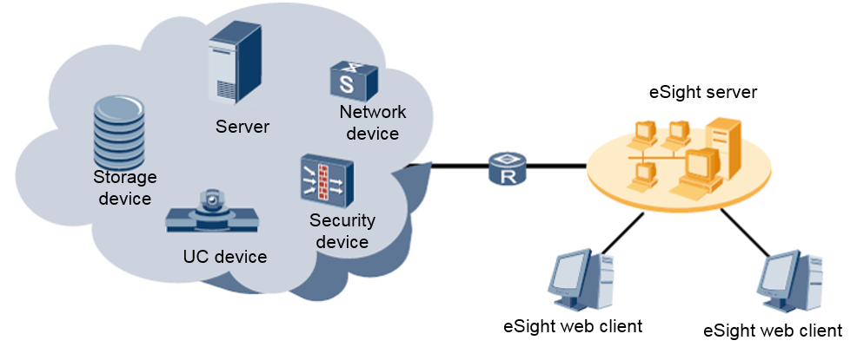
Product Positioning
eSight is a new-generation comprehensive operation and maintenance solution developed by Huawei for network infrastructure management, unified communications, telepresence conferencing, video surveillance, and data centers of enterprises. eSight supports unified monitoring and configuration management over devices of various types and from various vendors, monitors and analyzes network and service quality, and implements unified management and intelligent association for enterprise resources, services, and users.

Slide 7
Product Positioning
Traditional O&M
eSight
Independent device management with multiple maintenance systems used
Associated troubleshooting failure caused by multi-person maintenance and management
Unified management of devices by one maintenance system
Reduced maintenance costs and associated troubleshooting
Manpower
Time
Capital
Time-consuming and costly site deployment
Time-consuming and labor-intensive troubleshooting
Automatic deployment with higher efficiency
Visualized diagnosis with reduced downtime
Full lifecycle management of installation, deployment, maintenance, optimization, and upgrade
Intelligent capacity analysis with increased resource value
Losses caused by device faults and service interruption
Repeated capital investment caused by lack of planning basis

Slide 8
Product Features
Lightweight and web-based clients
eSight uses the B/S architecture and requires no other plug-ins.
With the distributed feature, eSight allows users to perform operations like querying and browsing anywhere anytime.
Large-scale management capability
A maximum of 20,000 NEs can be managed.
A maximum of 100 clients can be online at the same time.

Slide 9
Product Features
Support for multiple types of operating systems
Windows
SUSE Linux
Support for multiple types of databases
Oracle
MySQL
SQL Server

Slide 10
Product Features
Capability of managing devices from multiple vendors
Huawei devices: switches, routers, UC devices, telepresence devices, video surveillance devices, servers, and storage devices
Non-Huawei devices: devices from H3C, Cisco, and ZTE, and IT devices from IBM, HP, and SUN
Multiple service management components
eSight uses a component-based architecture and provides various components. Customers can select the required components based on the site requirements.
Notes:
eSight can manage mainstream devices from H3C, Cisco, and ZTE by default. For other non-Huawei devices, eSight allows users to customize the management method.
Users can use eSight to manage non-Huawei devices that support standard management information bases (MIBs) (including RFC1213-MIB, Entity-MIB, SNMPv2-MIB, and IF-MIB) through user-defined settings.
Users can use eSight to manage non-Huawei devices that do not support standard MIBs through NE adaptation packages.

Slide 11
Product Features
Differentiated editions
Edition | Management Scale | Positioning
Compact edition (network device) | 40 network devices | This edition provides only simple functions for managing network devices. Capacity expansion is not supported and no other components can be installed.
Compact edition (server) | 100 rack servers + 40 blade servers | This edition can manage only Huawei servers and provides functions of device management, configuration deployment management, and stateless computing management. Capacity expansion is not supported and no other components can be installed.
Standard edition | 5,000 NEs | This edition can manage multiple types of devices and applications, and provides differentiated service components based on the site requirements.
Professional edition | 20,000 NEs | In addition to functions in the standard edition, this edition provides the large-scale management capability and the hot standby function for Linux two-node clusters.
Notes:
Number of managed NEs = Number of network devices (including APs managed by the WLAN) + Number of ONUs + Number of UC/CC devices + Number of video surveillance devices + Number of telepresence devices + Number of IP phones/4 + Number of eLTE terminals/5 + Number of eLTE eNodeBs x 2 + Number of eLTE core networks x 20 +Number of high-end storage devices x 160 + Number of big data storage nodes x 160/288 + Number of mid-range storage devices x 40 + Number of entry-level storage devices x 10 + Number of heterogeneous storage devices x 10 + Number of rack servers x 2 + Number of blade servers x 40 + Number of managed equipment room devices + Number of objects monitored by the application management function x 2

Slide 12
Product Features
Support for multiple types of southbound interfaces, including:
SNMP
Telnet/STelnet
FTP/SFTP/FTPS
TR069
Huawei Man-Machine Language (MML)
SMI-S
Modbus
HTTPS
System reliability
Architecture scalability
Ability to be integrated

Slide 13
eSight Overview
eSight Architecture
eSight Functions
eSight Deployment

Slide 14











Overall eSight Solution
O&M personnel
OSS
3rd Party
Value-added O&M
Network SLA Management
WLAN Management
MPLS Tunnel Management
Server Configuration Deployment
Customized Report (UniBI)
eSight Open SDKs
Network Traffic Analysis
PON Service Management
MPLS VPN Management
Server Stateless Computing
Network Report
iPCA Management
Log Management
IPsec VPN Management
Storage Capacity Management
Storage Report
Business Service Management
Security Policy Management
Asset Management
Storage Network Analysis Management
Device Management
Server Management
UC Device Management
Application Management
Network Device Management
Storage Device Management
Virtual Resource Management
Telepresence and Videoconferencing Management
Host Management
eLTE Device Management
Customized Device Management
Region Monitoring
Video Surveillance Management
Equipment Room Facility Management
Management Platform
eSight Platform
1. Application container (component management and component hot swapping) 2. Public basic management functions (resource, alarm, performance, physical topology, security, NMS logs, and maintenance tool) 3. Hierarchical management
Managed Object
Network power infrastructure
Host
Database
Application log
Mail server
New components
Switch/ Router
Security
PON
eLTE
UC/Telepresence/ Video surveillance
Server
Storage
Fusion
vCenter
Third-party device
Middleware
Enhanced functions

Slide 15




eSight Architecture
Open interfaces, supporting integration with third-party systems
Web-based centralized maintenance page, allowing users to access the system anytime without installing the client
OSS
3rd Party
O&M Personnel
SNMP/HTTP
Open
SDK
Intelligent Report
MPLS VPN Management
MPLS Tunnel
Management
WLAN
Management
SLA
Management
Network Traffic Analysis
IPSec
VPN
Management
Security Policy Management
Server Stateless Computing Management
Server Configuration Deployment
LogCenter (Log Management)
...
Component-based architecture, allowing customers to establish a management system as needed
Network Device Management
eLTE Device Management
Server Management
Storage Device Management
Host Management
Virtualization Management
MicroDC Device Management
UC/CC Device Management
Telepresence Device Management
Video Surveillance Device Management
Infrastructure Management
...
eSight Platform
SNMP
Centralized management of devices from multiple domains and vendors
FTP/SFTP
TR069
Netflow
SMI-S
Telnet/STelnet
Netconf
Switch/Router
Security
Server
Storage
UC
Telepresence
Video surveillance
Third-party device

Slide 16
Dependencies Between eSight Components
Components that require independently-deployed MySQL databases
PON Management Component
IPsec VPN Management Component
WLAN Management Component
Open
SDK
Intelligent Report Management Component
Security Policy Analysis Component
MPLS Tunnel Management Component
Storage Network Analysis Management
Telepresence Device Management
Security Policy Management Component
MPLS VPN Management Component
Storage Capacity Management
MicroDC
Expanded Log Management Component
Network Traffic Management Component
Video Surveillance Device Management
Log Management Component
Network SLA Management Component
Host Management
Server Stateless Computing
UC/CC Device Management
Virtualization Management
Server Configuration Deployment
eLTE Device Management
Network Power Infrastructure Management
Network Device Management
Storage Management
Server Management
Application Management
eSight Platform

Slide 17
eSight Overview
eSight Architecture
eSight Functions
eSight Deployment

Slide 18
eSight Functions
Basic management functions
Log management
Resource management
Alarm management
Performance management
License management
Server management
MicroDC management
Storage management
Equipment room facility management
Network device and service management
Host management
eLTE management
Unified communications and collaboration management
Computing virtualization management
Application management

Slide 19
eSight Overview
eSight Architecture
eSight Functions
Basic Management Functions
Server Management
Storage Management
Network and Security Management
eSight Deployment

Slide 20
Basic Management Functions: Resource Management
Resource management includes adding and managing devices and subnets.
Devices can be added to eSight in any of the following ways: automatic discovery, manual creation, and batch import.
Multiple protocols are supported, including SNMP, SNMP+Telnet/STelnet, HTTPS, IPMI, MML, REST, SMI-S, SOAP, SSH, TLV, TR069, and WMI.
The SNMPv1 and SNMPv2c protocols have security risks. SNMPv3 is recommended. The Telnet protocol has security risks. STelnet is recommended.

Slide 21
Basic Management Functions: Alarm Management
eSight needs to promptly notify maintenance personnel of network exceptions so that the maintenance personnel can take proper measures to recover the network.
Alarm management includes the following functions:
Monitors network-wide alarms and remotely sends alarm notifications to notify maintenance engineers in a timely manner, ensuring troubleshooting efficiency.
Blocks alarms and provides maintenance experience library to improve the efficiency and accuracy of alarm handling.
Synchronizes alarms to ensure alarm reliability.
Provides customized functions such as alarm filtering and alarm severity redefinition to meet requirements in various scenarios.

Slide 22
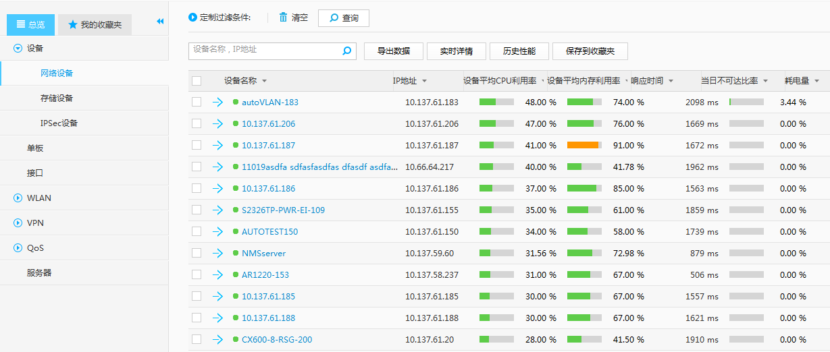
Basic Management Functions: Performance Management
The network performance may deteriorate due to internal or external factors, causing network faults. To ensure that the current network runs properly at a low cost and prepare for future network performance requirements, the network efficiency, such as the disconnection rate and usage, needs to be monitored. Performance management allows users to detect the deterioration trend in advance and eliminate these risks before faults occur.

Slide 23
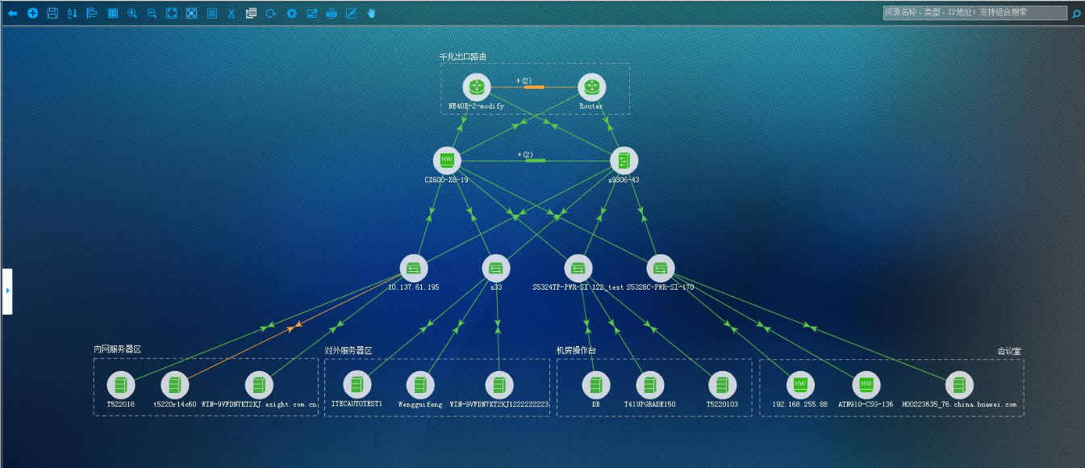
Basic Management Functions: Topology Management
Topology management displays the managed NEs and their connections and status in the topology view. Users can check the topology view to better understand the hierarchy and running status of devices on the entire network.

Slide 24
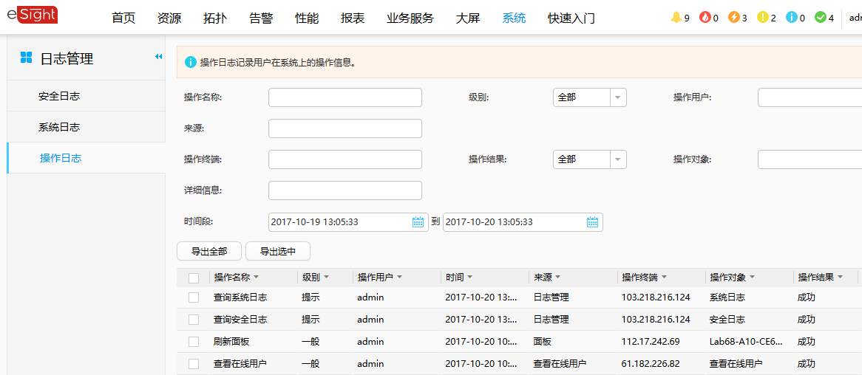
Basic Management Functions: Log Management
Log management records important user operations and allows users to query the log list, view detailed log information, and export operation, system, and security logs to a CSV file.
eSight logs mainly include security logs, system logs, operation logs, and background run logs.

Slide 25
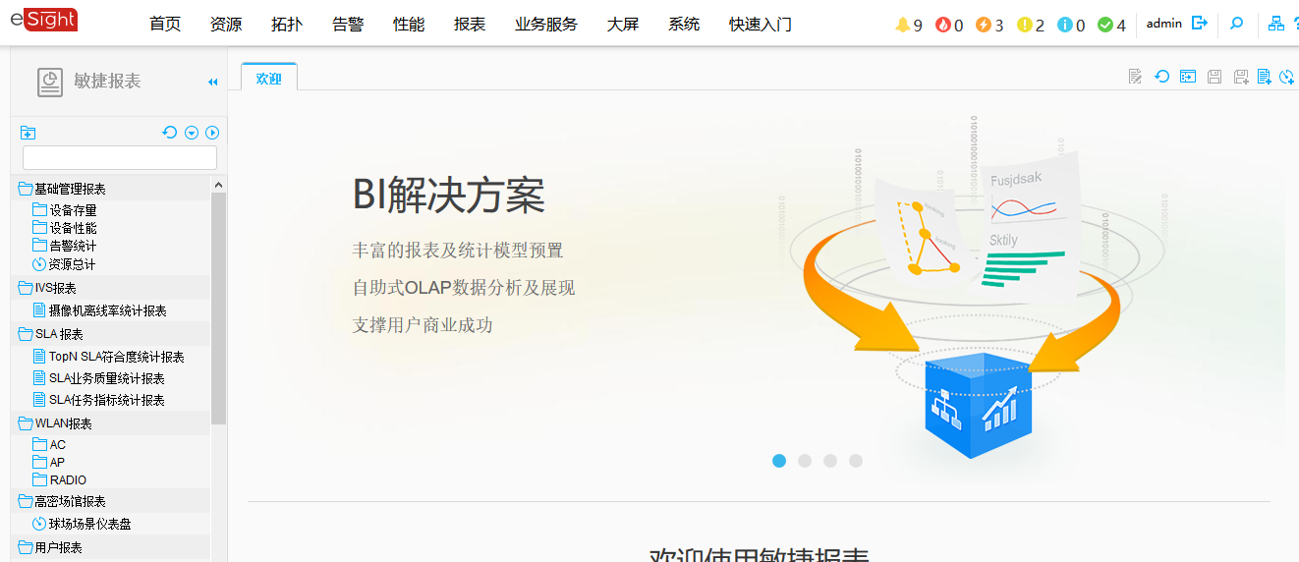
Basic Management Functions: Report Management
Network report: eSight displays performance and alarm reports of network devices from multiple dimensions, helping users with analysis, optimization, and decision-making.
Storage report: eSight displays performance and capacity analysis reports of storage devices, hosts, and virtualization servers from multiple dimensions, helping users analyze performance bottlenecks and plan capacity usage.
Resource statistics report: Resource statistics reports collect statistics on the number of new resources managed by eSight and the total number of resources managed by eSight from dimensions such as time, region, category, type, and vendor. In addition, the report can display the trend and status of resource quantity.

Slide 26
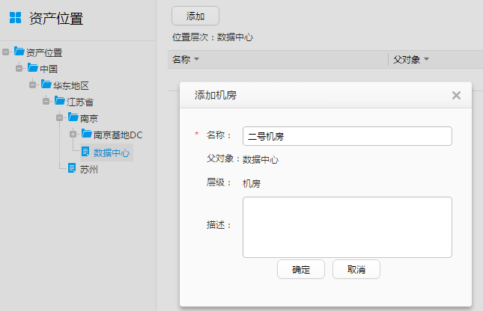
Basic Management Functions: Asset Management
eSight manages networks, servers, and storage assets throughout their life cycles from asset stock-in to online running to returning.
Bench sheet management
The bench sheet management function allows users to import, modify, and view assets such as devices and accessories, and provides asset modification functions such as deploying, removing, transferring, repairing, and returning assets.
Returned assets
Users can view the returned device and accessory assets and export them to an Excel file.
Location and rack management
Before recording an asset to eSight, you need to define the location model, location instance, and cabinet information of the asset in the location and rack management component. In this way, the asset can be specified to a specific geographical location and cabinet when it is imported into the database.
Model management
An asset management model is preconfigured in the asset management component. If the model cannot meet the management requirements, you can add asset attribute fields based on the built-in model to meet the asset management requirements.

Slide 27
Basic Management Functions: Asset Management
By managing devices, accessories, locations, changes, and models, eSight can manage data center assets such as networks, servers, and storage devices throughout their life cycles from stock-in, deployment, maintenance, to returning. This helps enterprises comprehensively understand asset distribution and running status and make correct investment decisions to lower the cost and enhance O&M efficiency.
Stock-in
Asset stock-in
Device and accessory management
Batch import and export
Asset model management
Returning
Deployment
Asset deployment
Asset removing
Asset location management
Life cycle management of ICT assets
Asset returning
Maintenance
Asset repairing
Asset transferring
Asset maintenance
Asset querying and historical auditing

Slide 28
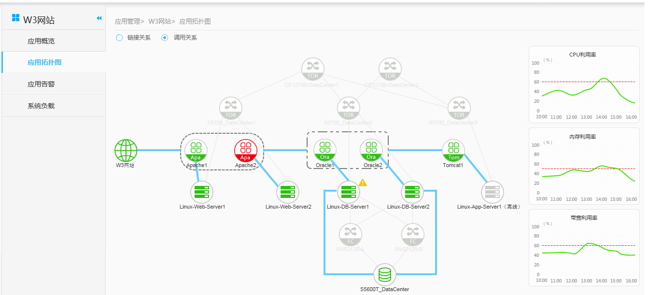
Basic Management Functions: Service Management
The core value of service management lies in the ability to connect service processes to IT services and underlying applications and infrastructure components, providing insight into service quality from the service user perspective. The key to establishing service management is to connect service impacts with service models of IT assets and resources, including service definition, dependency discovery and mapping, service availability indicator definition for end users, and service model maintenance throughout the service life cycle.
Based on the comprehensive infrastructure management capability, eSight can create a visualized model between services and IT infrastructure and application components (web service, application service, middleware, database, operating system, FC switch, storage device, switch, and router). In addition, eSight provides a 360-degree view for each service and displays service running status from various aspects including external service status, service application logical topology, application alarm, and system load.
IT personnel only need to focus on specific IT infrastructure resources of the business service and solve related problems, greatly decreasing the time required for troubleshooting, quickly recovering services, and reducing the service interruption time.

Slide 29
Basic Management Functions: Infrastructure Management
Simple O&M
Unified management of the data center and site power supply
Integration of devices and subsystems and joint positioning
Comparison and analysis of the power supply component reliability to quickly identify outdated devices
Visualization and WYSIWYG
O&M
Unified view
Device monitoring
Energy efficiency analysis
Health report
Linkage control
Battery management
Capacity management
...
Data center domain
Communications energy domain (safe city)
Power supply reliability assurance
Subsystem
Linkage control and fault isolation
Device health check and report
Dynamic configuration and evaluation
Device reliability management (battery management, capacitor life evaluation, bus temperature monitoring, and fan blocking)
Power and environment monitoring
Power transformation and distribution system
Chiller teamwork control
Security monitoring
Energy saving scheduling
Device management
UPS/Battery
HVDC
PDU
Cabinet
Air conditioner
High-voltage cabinet
Power generation cabinet
Transformer
Switchover control
Chiller
Cooling level
Cooling chilled pump
Fresh air handling unit
Video
Access control
...
Data collection, analysis, and processing
Maximizing resource utilization
Power system
Batteries
Hybrid power supply...
Recommendation of resource maximization policies and actions
Power grid quality management: load matching
Identification of cold and hot islands and cooling optimization
Visualization of KPI (PUE and SPUE) power consumption
Energy consumption statistics and analysis by domain
Electricity cost analysis

Slide 30
eSight Overview
eSight Architecture
eSight Functions
Basic Management Functions
Server Management
Storage Management
Network and Security Management
eSight Deployment

Slide 31
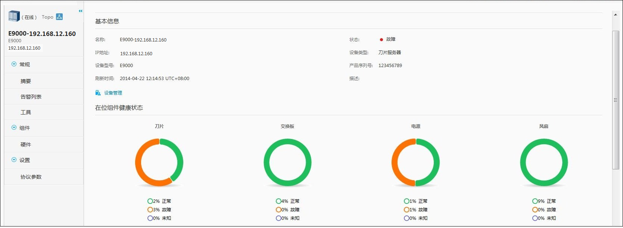
Server Management: Device Management
Server management: eSight provides centralized server fault monitoring, performance analysis, and virtual media integration tool, which greatly improve O&M efficiency and reduce the O&M cost.

Slide 32



Server Management: Stateless Computing Management
Stateless computing management: eSight extracts hardware attribute information, such as server attributes, network attributes, and storage attributes for unified management and dynamic configuration to minimize the impact of hardware differences on the system. eSight can quickly recover the system when a fault occurs, reducing the hardware replacement time and system downtime. You can also configure the Ethernet switch board and FC switch board on an E9000 server. For details, see the specifications list.
Service resource pool creation
Faulty device detection
Fast migration of hardware configurations and active/standby switchover
MAC address 1, WWN 1, and IP address 1
MAC address 1, WWN 1, and IP address 1
MAC address 1, WWN 1, and IP address 1
Service device
Service device
Service device
Switch
Switch
Switch
MAC address n, WWN n, and IP address n
MAC address n, WWN n, and IP address n
MAC address 1, WWN 1, and IP address 1
FC storage
FC storage
FC storage
Standby device
FC switch
Standby device
FC switch
Service device
FC switch
Notes:
Stateless computing management: eSight extracts hardware attribute information, such as server attributes, network attributes, and storage attributes for unified management and dynamic configuration to minimize the impact of hardware differences on the system. eSight can quickly recover the system when a fault occurs, reducing the hardware replacement time and system downtime. You can also configure the Ethernet switch board and FC switch board on an E9000 server. For details, see the specifications list.

Slide 33


Server Management: Configuration Deployment
Batch deployment on eSight
Supports batch power-on, power-off, and restart of servers.
Supports batch configuration of management network ports.
Supports the function of configuring iBMC (iMana).
Supports batch configuration of BIOSs.
Supports batch configuration of RAID groups.
Supports batch configuration of HBAs.
Supports batch configuration of CNAs.
Supports partition configuration when an operating system is installed.
Supports batch operating system installation and deployment.
Supports software distribution and automatic installation.
Supports the function of configuring switch boards.
Batch delivery
Record query
Batch restart
Task management
User
eSight
Three
steps
Configure
a template
Select devices
Assign tasks
1. Batch delivery of same configurations
2. Unified task management
Import and export of configuration templates, and template sharing among multiple NMSs
Batch configuration and automatic deployment

Slide 34
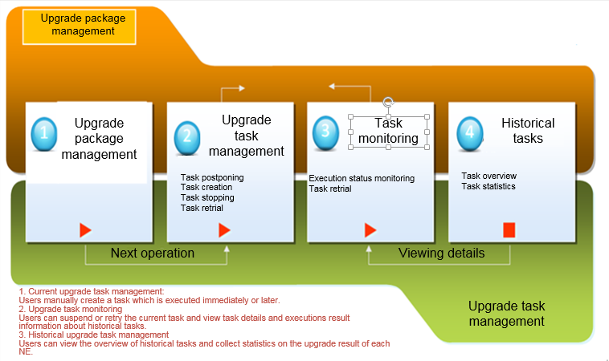
Server Management: Firmware Upgrade
Remote firmware upgrade greatly reduces manpower, travel expenses, and service costs, improves maintenance efficiency, and shortens the upgrade duration, quickly providing new service experience for customers and enhancing product competitiveness.
Prepare the upgrade package:
Manually download the firmware package from Huawei support website.
Firmware upgrade package management automatically downloads an upgrade package with a version later than that of the connected device from Huawei support website.

Slide 35
eSight Overview
eSight Architecture
eSight Functions
Basic Management Functions
Server Management
Storage Management
Network and Security Management
eSight Deployment

Slide 36
Storage Management: Storage Device Discovery and Batch Import
Huawei-developed storage devices:
Unified storage devices
Massive storage devices
Data protection devices
Third-party storage devices and FC switches
The discovery modes are as follows:
Single addition
Automatic discovery
Batch import
Notes:
1. Single addition indicates that one device is added to eSight at a time. The device can be a unified storage device, massive storage device, data protection device, third-party storage device, or FC switch.
2. Automatic discovery indicates discovery of devices through an IP address segment and related discovery parameters. This mode can easily add devices with the same user name and password to eSight.
3. Batch import means that users enter device IP addresses and discovery parameters in an Excel template and import the devices to eSight at a time. This mode can easily add devices whose IP addresses and discovery parameter information are known.

Slide 37
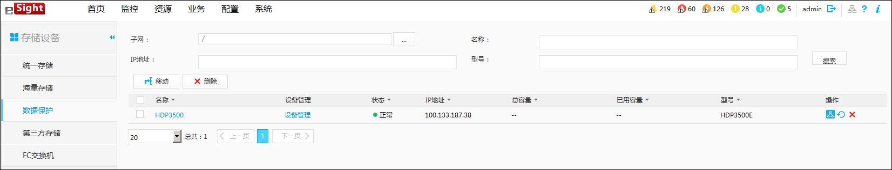
Storage Management: Storage Device Management
Storage device management includes:
Displaying the status and attribute of devices and their components.
Managing device alarms.
Maintaining discovery parameters
Entering device information query criteria
Clicking the link to go to the device management page
Clicking the device name to go to the device details page
Moving and deleting the device
Moving, refreshing, and deleting the device
Device directory

Slide 38
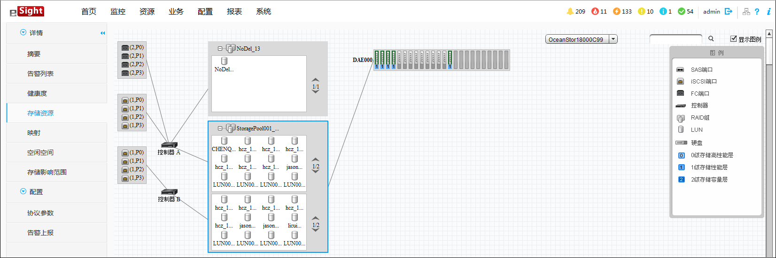
Storage Management: Storage Visualization
Monitors the whole storage process from the front-end host port, controller, LUN, storage pool, to the hard disk.
FC port
Hard disk
RAID group
iSCSI port

Slide 39
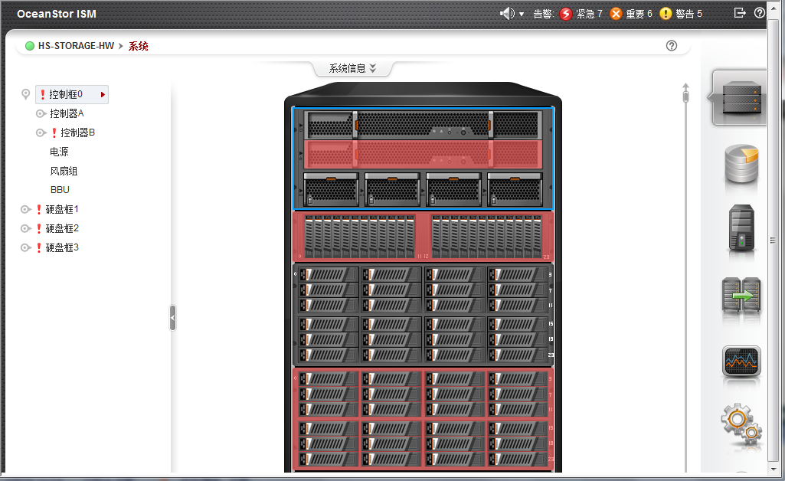
Storage Management: Storage Visualization
The integrated Storage Device Manager displays the device rack diagram.

Slide 40
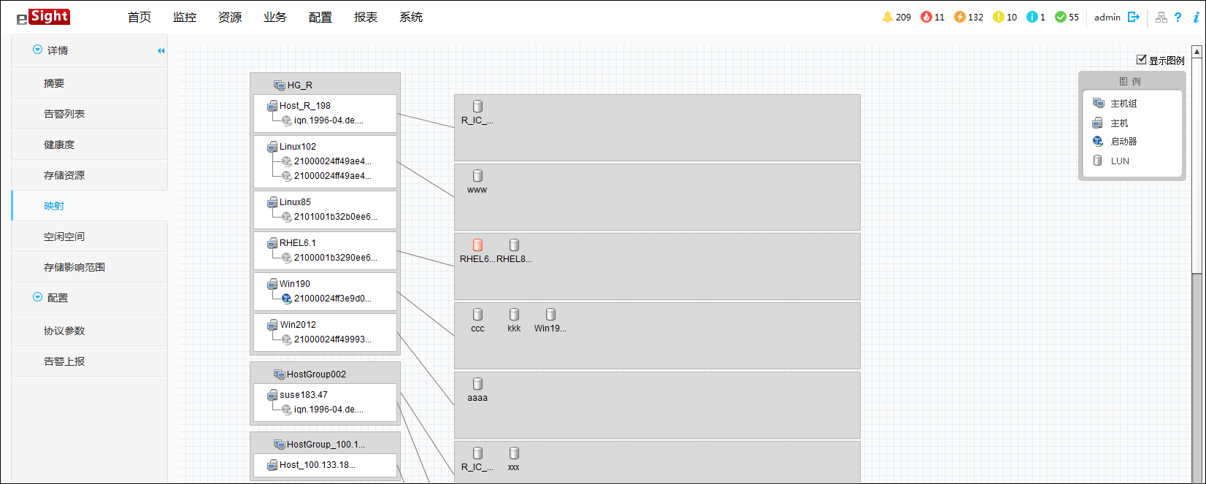
Storage Management: Storage Device Mapping View
Displays the mappings between arrays and unified storage devices.
LUNs can be mapped to host groups or hosts. One host group can contain multiple hosts, and one host can be configured with multiple initiators.
Host group
(2) The LUN is mapped to a host group.
Host
(1) The LUNs are mapped to a host in a host group.
Initiator

Slide 41
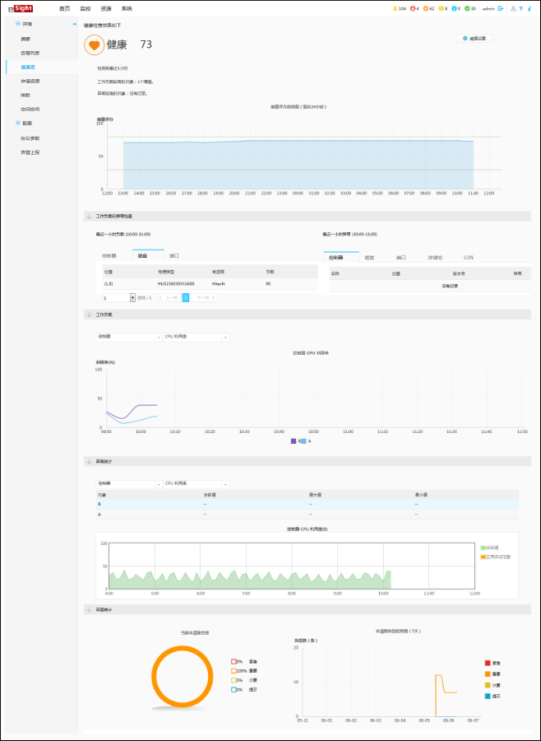
Storage Management: Storage System Health Evaluation
eSight can assess the overall health of a device from the workload, exception, and alarm statistics dimensions.
Health score
Health trend in the last 24 hours
Load and exceptions in the last hour
Workload of each component
Exception statistics of each component
Alarm statistics

Slide 42
Storage Management: Cloud Service
Cloud Service automatically sends device or eSight information to the O&M center through emails.
The O&M center analyzes the running status of eSight and devices, detects faults in a timely manner, and reminds users of handling the faults.
The backhaul information includes the health check report and event log package of the storage device, which can reflect the hardware and software configurations and fault status of the device.
Notes:
Cloud Service refers to the built-in function of eSight Storage Manager. The function provides an independent Cloud Service software for remote notification of alarms reported by Huawei storage devices.

Slide 43
eSight Overview
eSight Architecture
eSight Functions
Basic Management Functions
Server Management
Storage Management
Network and Security Management
eSight Deployment

Slide 44
Network Management
eSight network management provides the following functions:
IP topology management
Link management
Single-NE feature management
Terminal resource
VLAN management
Smart configuration tool
Configuration file management
MIB management
Device software management
SLA management
iPCA management
QoS management
Network traffic analysis
IPsec VPN management
Secure Center (security policy management)
SVF management
Zero touch provisioning (ZTP)
eSight Mobile

Slide 45
Security Management
Protection Mechanism | Mechanism Description | Security Policy
System security | System security ensures that the operating system, database, and middleware run properly. | Patch policy, hardening policy, password policy, authentication, data encryption, security log, minimum permission principle, and file permission management
Network security | Network security includes the normal running of network devices such as switches, routers, and firewalls. | Network isolation: The LAN is isolated from the external network through routers to enhance data communication security. Network firewalls are set up in the system to ensure system network security. Permission on services that can be accessed externally is controlled and managed.
Data security | Data security includes the storage, transmission, and management security of user identity information, configuration information for normal system running, system run logs, and database data. | Encryption policy: Sensitive data is encrypted for storage and transmission. User management policy: minimum authorization Backup/Restoration policy: Key data is periodically backed up. Data storage security: The HA two-node cluster switchover mechanism is supported to restore the system in a timely manner.
Operation and maintenance security | eSight provides security mechanisms for users, applications, and auditing to ensure O&M security. | Group- and permission-based access mechanism Login access control policy: password policy, login lock and unlock, and authentication policy Audit logs: security logs, operation logs, and system logs Automatic client logout mechanism Application software security mechanism: Provides password and identity authentication, and uses high-strength data encryption algorithms to encrypt sensitive user information for storage. The system allocates a password to each user and verifies the password when providing services for the user, securing user information.

Slide 46
eSight Overview
eSight Architecture
eSight Functions
eSight Deployment

Slide 47
Deployment Modes
Single-Server Deployment
Distributed Server Deployment
HA System Deployment

Slide 48
Single-Server Deployment
eSight is deployed in a local single-node system. This mode applies to scenarios with low security requirements.

Slide 49
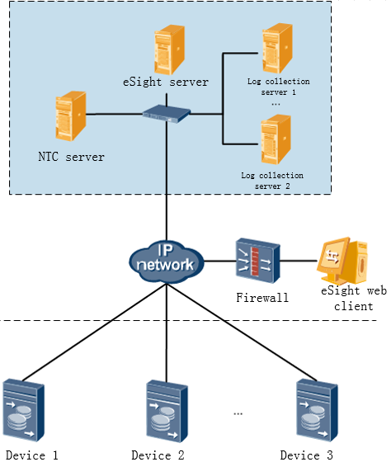
Distributed Server Deployment
One eSight server and one or more distributed collector servers are required.
This mode applies to large-scale network management.

Slide 50
Local HA System Deployment
eSight is deployed in a local two-node cluster and uses local disaster recovery (DR).
Notes:
The eSight local HA system consists of one active server and one standby server.
The eSight software is installed on both the active and standby servers. Data on the active and standby servers are synchronized through a dedicated replication line. When the active server is faulty, services are automatically switched to the standby server to ensure that the eSight system runs properly.
You can set a floating IP address between the active and standby servers. In this case, devices do not need to reconnect to eSight after the active-standby switchover.

Slide 51
Remote HA System Deployment
eSight is deployed in a remote two-node cluster and uses remote DR.
Notes:
The eSight remote HA system consists of one active server and one standby server. The eSight software is installed on both the active and standby servers. The two servers can be deployed in geographically-dispersed places. In case of a fault on the active server, services are automatically switched to the standby server. Data between the active and standby servers is synchronized through a dedicated replication line, which ensures normal running of the eSight system.
The two eSight servers in the remote HA system use different IP addresses. After the remote HA system is deployed, the IP addresses of both the active and standby servers must be set on the managed devices. After the active-standby switchover, information such as the alarm information on the devices is automatically sent to the standby server to ensure normal device monitoring and management.

Slide 52
Networking Modes
Integration Networking
Hierarchical Management Networking

Slide 53
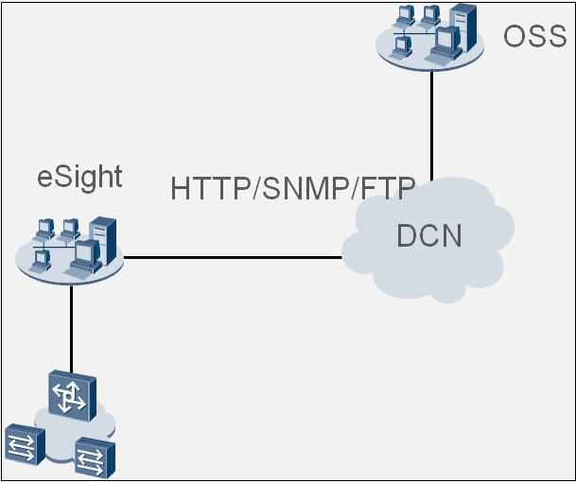
Networking Mode: Integration Networking
eSight can be integrated into third-party systems such as upper-layer OSSs. Third-party systems can obtain network resources and alarms managed by eSight through SNMP or HTTP interfaces.

Slide 54
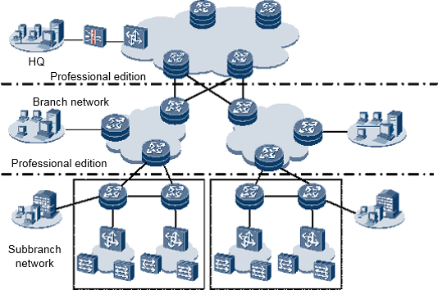
Networking Mode: Hierarchical Management Networking
eSight supports hierarchical management, allowing enterprise HQs to monitor and manage networks in different regions.
Notes:
In the hierarchical management networking mode, upper-layer NMSs can add lower-layer NMSs to the system and provide links for accessing the lower-layer NMSs. When a user clicks a link for accessing a lower-layer NMS, a new browser window is displayed and the login page of the lower-layer NMS is displayed in the new browser window.

Slide 55
Standards and Protocols
SNMP and MIB-II standards for interfaces between eSight and devices
RFC1155: structure and identification of management information for TCP/IP-based Internet
RFC1157: simple network management protocol
RFC1213: management information base for network management of TCP/IP-based internet (MIB-II) •XML 1.0
ITU-T X.733: fault management specification
JSR-286 Portlets specifications: Java Portlet specification v2.0
HTTP/1.0|HTTP/1.1: Hypertext Transfer Protocol
HTTPS: Hypertext Transfer Protocol Secure
Session Initiation Protocol (SIP) RFC3261
Transfer Control Protocol (TCP) RFC0872
TCP and User Datagram Protocol (UDP) RFC1356
Storage Management Initiative – Specification (SMI-S)
Modbus Protocol

Slide 56
eSight Overview
eSight Architecture
eSight Functions
eSight Deployment

Slide 57
eSight product:
http://e.huawei.com/cn/products/software/mgmt-sys/esight
eSight Demo:
https://122.112.233.209:31943/

Slide 58
Huawei e-Learning website:
http://support.huawei.com/learning/Index!toTrainIndex
Huawei support case library:
http://support.huawei.com/enterprise/servicecenter?lang=zh

