Slide 1
USG6000
V500R001C50
1.0
V1.5
Yuan Weihua/WX462781
2019.4.10
Liu Lican/00180730
HCDCA106

Slide 2
USG6000 Series Product Introduction
Huawei Data Center Series of Courses

Slide 3
Upon completion of this course, you will be able to:
  Understand the USG6000 series products
  Be familiar with the interface cards of the USG6000 series products
  Understand the hard disk of the USG6000 series products
  Understand the power supply of the USG6000 series products

Slide 4
USG6000 Series Product Appearance and Panel Views
  USG6000 Series Portfolio and Product Appearance
  USG6000 Series Hardware Architecture
Expansion Cards for USG6000 Series
Hard Disks for USG6000 Series
Power Supply for USG6000 Series

Slide 5
USG6000 Features
New 10-Gigabit Multi-Core Hardware Platform
Professional Content Security Defense
Integration of Security, Routing, and VPN Services
Refined Management by Application and User
Visualized Management and Diversified Logs and Reports
Carrier-Class Reliability
Flexible Scalability

Slide 6


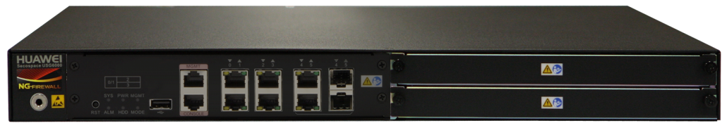

USG6000 Series Portfolio
USG6300/6500/6600 series has 17 models
Delivers 1G to 40G application-layer performance and 20G full-featured threat prevention performance
Provides a minimum of 6*GE interfaces and a maximum of 64*GE+14*10GE
USG6680, 40Gbps FW + application identification,20G full-featured threat prevention 3U, 4*10GE+16GE+8SFP
USG6670, 35Gbps FW + application identification,18G full-featured threat prevention , 3U, 4*10GE+16GE+8SFP
USG6570, 9Gbps FW + application identification, 4G full-featured threat prevention, 1U,8GE+4SFP
USG6660, 25Gbps FW + application identification,
13G full-featured threat prevention 3U, 2*10GE+8GE+8SFP
USG6390, 8Gbps FW + application identification, 4G full-featured threat prevention, 1U,8GE+4SFP
USG6650, 20Gbps FW + application identification, 10G full-featured threat prevention 3U, 2*10GE+8GE+8SFP
USG6380, 6Gbps FW + application identification, 3G full-featured threat prevention, 1U,8GE+4SFP
USG6550, 5Gbps FW + application identification, 3G full-featured threat prevention, 1U,8GE+4SFP
USG6630, 16Gbps FW + application identification, 8G full-featured threat prevention, 1U, 8GE+4SFP
USG6620, 12Gbps FW + application identification, 6G full-featured threat prevention, 1U, 8GE+4SFP
USG6370, 4Gbps FW + application identification, 2G full-featured threat prevention, 1U,8GE+4SFP
Expansion cards
USG6530, 3Gbps FW + application identification, 1.5G full-featured threat prevention, 1U, 4GE+2Combo
USG6360, 3Gbps FW + application identification, 1.5G full-featured threat prevention, 1U, 4GE+2Combo
WSIC-2SFP+&8GE
WSIC-8GE
USG6350, 2Gbps FW + application identification, 1G full-featured threat prevention, 1U, 4GE+2Combo
SAS-300GB
USG6330, 1Gbps FW + application identification, 500M full-featured threat prevention, 1U,4GE+2Combo
WSIC-8SFP
WSIC-4GE-BYPASS

Slide 7
USG6000 Series Product Appearance and Panel Views
  USG6000 Series Portfolio and Product Appearance
  USG6000 Series Hardware Architecture
Expansion Cards for USG6000 Series
Hard Disks for USG6000 Series
Power Supply for USG6000 Series

Slide 8
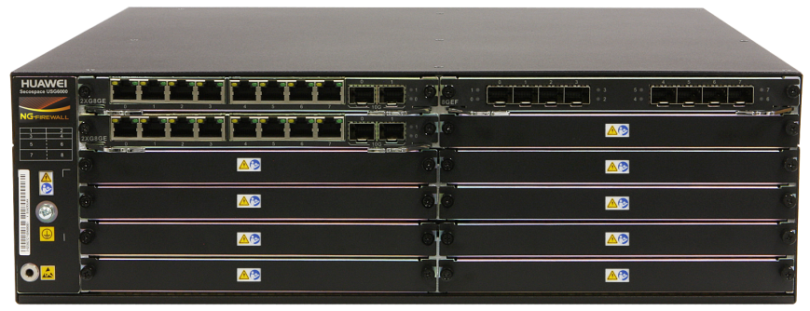
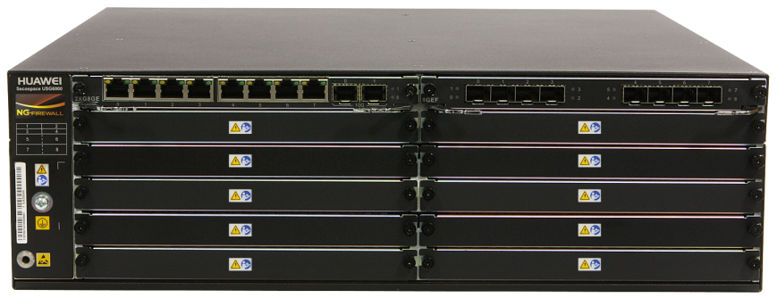
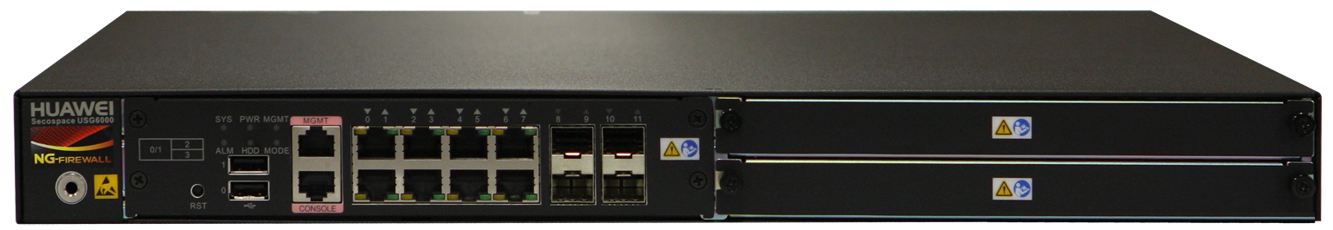
Product Appearance of the USG6600 Series (1)
USG6600 series products are NGFW products designed for large and medium-sized enterprises and data centers.
USG6600 series uses industry-leading hardware and software architecture and is able to provide security and bandwidth management based on the awareness of network environment information, such as application, user, content, threat, time, and location. USG6600 series also provides IPS, antivirus, and data loss prevention (DLP) functions based on application identification to comprehensively protect the information security of enterprises.

Slide 9
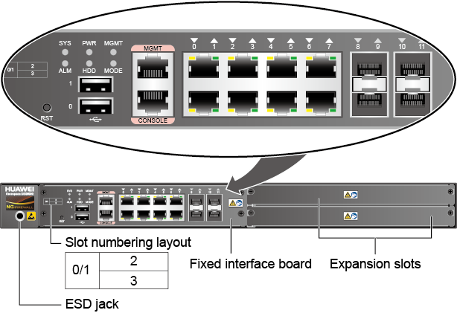
Product Appearance of the USG6600 Series (2)
USG6620/6630 Front Panel

Slide 10
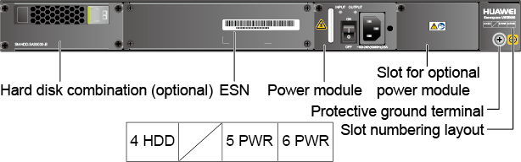
Product Appearance of the USG6600 Series (3)
USG6620/6630 Rear Panel
If no hard disk is installed, a filler panel must be installed on slot HDD4 to ensure normal air flow and keep out dust.

Slide 11
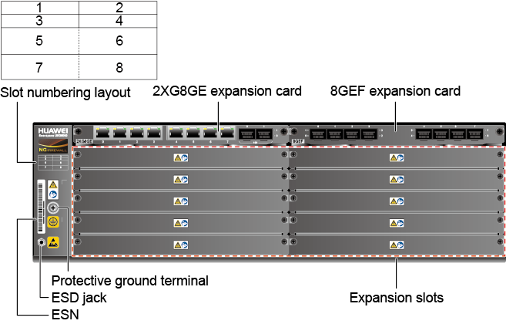
Product Appearance of the USG6600 Series (4)
USG6650/6660 Front Panel
Slot 3
Slot 4
Slot 5
Slot 6
Slot 7
Slot 8

Slide 12
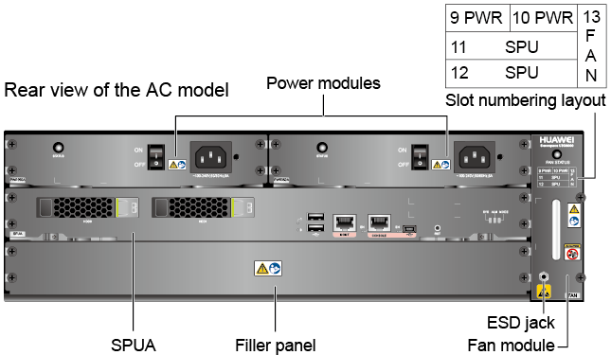
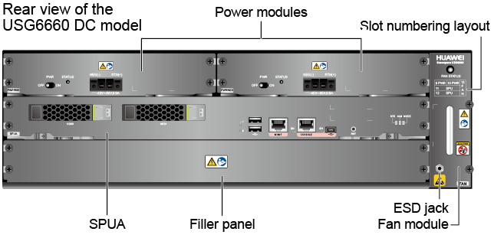
Product Appearance of the USG6600 Series (5)
USG6650/6660 Rear Panel
The USG6650/6660 supports two 350W power modules for 1+1 redundancy. USG6650 supports only AC power modules, and USG6660 supports both AC and DC power modules for 1+1 power redundancy so that if one power module is faulty, it can be hot-swapped.
The USG6650/6660 provides a dedicated fan module for heat dissipation. The fan module supports hot-swapping. However, to prevent overheating, do not operate the device without a functioning fan module for more than one minute.
The USG6650/6660 provides Hard disk slots, support 2.5-inch SAS hard disks. You can install two hard disks to form a RAID-1 array and store log and report data.

Slide 13
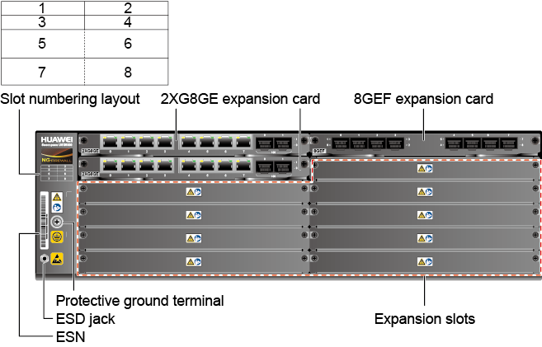
Product Appearance of the USG6600 Series (6)
USG6670 Front Panel
Slot 4
Slot 5
Slot 6
Slot 7
Slot 8

Slide 14
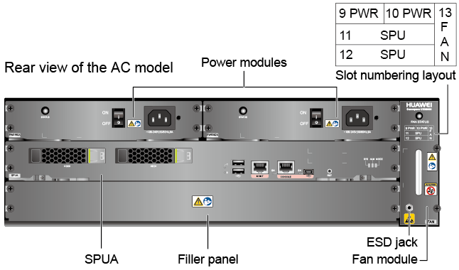
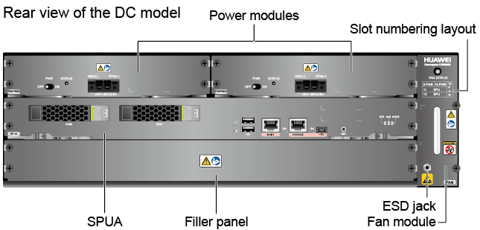
Product Appearance of the USG6600 Series (7)
USG6670 Rear Panel
The USG6670 supports two AC or DC 350W power modules for 1+1 redundancy so that if one power module is faulty, it can be hot-swapped.
The USG6670 provides a dedicated fan module for heat dissipation. The fan module supports hot-swapping. However, to prevent overheating, do not operate the device without a functioning fan module for more than one minute.
The USG6670 provides Hard disk slots, support 2.5-inch SAS hard disks. You can install two hard disks to form a RAID-1 array and store log and report data.

Slide 15
Product Appearance of the USG6600 Series (8)
USG6680 Front Panel
Slot 4
Slot 5
Slot 6
Slot 7
Slot 8

Slide 16
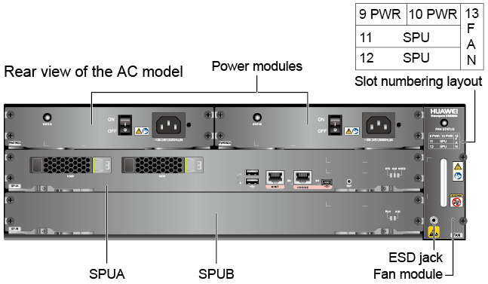
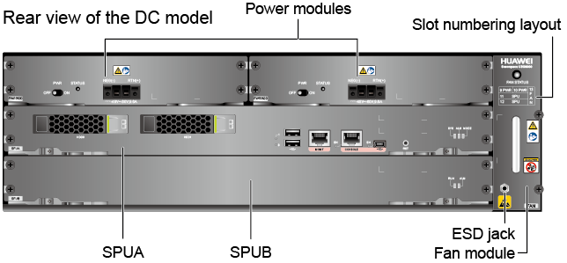
Product Appearance of the USG6600 Series (9)
USG6680 Rear Panel
The USG6680 supports two AC or DC 350W power modules for 1+1 redundancy so that if one power module is faulty, it can be hot-swapped.
The USG6680 provides a dedicated fan module for heat dissipation. The fan module supports hot-swapping. However, to prevent overheating, do not operate the device without a functioning fan module for more than one minute.
USG6680 provides an SPUB board to share the service processing workload with the MPU.
The USG6680 provides Hard disk slots, support 2.5-inch SAS hard disks. You can install two hard disks to form a RAID-1 array and store log and report data.

Slide 17
USG6000 Series Product Appearance and Panel Views
  USG6000 Series Portfolio and Product Appearance
  USG6000 Series Hardware Architecture
Expansion Cards for USG6000 Series
Hard Disks for USG6000 Series
Power Supply for USG6000 Series

Slide 18
USG6000 Series Hardware Architecture
Out-of-band management port
Ethernet switching 480G
20G
Fixed port
20G
20G
Expansion port
Multi-core processor
20G
…….
20G
SPUB
PCI
HDD
Multi-core CPU+Switch architecture
The CPU and switching chip both provide two 20G high-speed service ports.
The switching capacity is high, so the upstream bandwidth in the expansion slot does not have any bottleneck.
Provides various cards for flexible configuration.
The USG6680 supports expansion of SPUB, providing 1+1 CPU processing capability.
Notes:
The USG6000 employs the multi-core CPU+Switch architecture. The traffic from all interfaces must go through the switching chip to be processed by the CPU. After CPU processing, the traffic is forwarded from the switching chip. On the USG6680, some traffic will be forwarded to SPUB for processing.

Slide 19
USG6000 Series Product Appearance and Panel Views
Expansion Cards for USG6000 Series
Hard Disks for USG6000 Series
Power Supply for USG6000 Series

Slide 20
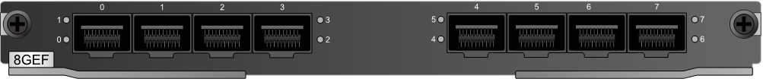
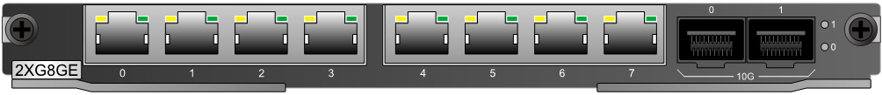
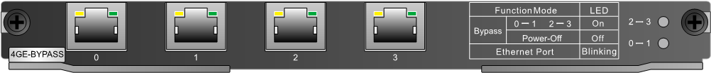


Expansion Card Appearance
8GEF
WSIC interface card
2XG8GE WSIC interface card
4GE-BYPASS WSIC card
The expansion cards do not support hot swap.
You are advised to replace expansion cards during off-peak hours.
8GE
WSIC interface card
Notes:
The USG6680 supports a limited number of expansion cards. The number of supported expansion cards is determined by the power. On the USG6680 V1R1C20, the power is updated to 700W, and the number of supported expansion cards is not limited.
Capacity expansion of the USG6680 is as follows:
2XG8GE : 1
4GE-BYPASS: 2
2XG: 1
8GE: 2
8GEF: 1
The USG6600 provides both Wide Service Interface Card (WSIC) and Extended Service Interface Card (XSIC, 2 times higher than WSIC cards) slots. The lower half of the XSIC slot houses a WSIC card. The upper half does not house any card and is reserved for an XSIC card in the future.
8GE WSIC interface card: provides eight RJ45 GE ports.
2XG8GE WSIC interface card: provides eight Gigabit RJ45 and two 10G SPF+ ports.
8GEF WSIC interface card: provides eight Gigabit SFP ports.
4GE-BYPASS WSIC card: provides two electrical bypass links.
Do not replace the expansion card during power-on, because the expansion card does not support hot swap; otherwise, the expansion card may be damaged.
Replacing expansion cards will interrupt services. Please replace expansion cards during off-peak hours.
Wear the ESD wrist strap while working on the USG to avoid possible damages to the USG and expansion cards.

Slide 21

WSIC-8GEF Interface Card Panel and Indicators
Indicator | Color | Description
Indicators 0 through 7 | Green | Steady on: The link of the port is connected. Blink: Data is being sent or received through the port. Off: The link of the port is disconnected.

Slide 22
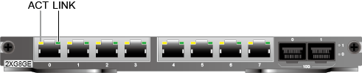
WSIC-2XG8GE Interface Card Panel and Indicators
Indicator | Color | Description
LINK indicator | Green | Off: The link is disconnected. Steady on: The link is connected.
ACT indicator | Yellow | Blink: Data is being sent or received. Off: No data is being sent or received.
Indicator 0 | Green | Steady on: The link of SFP+ port 0 is connected. Blink: Data is being sent or received through SFP+ port 0. Off: The link of SFP+ port 0 is disconnected.
Indicator 1 | Green | Steady on: The link of SFP+ port 1 is connected. Blink: Data is being sent or received through SFP+ port 1. Off: The link of SFP+ port 1 is disconnected.

Slide 23

WSIC-8GE Interface Card Panel and Indicators
Indicator | Color | Description
LINK indicator | Green | Off: The link is disconnected. Steady on: The link is connected.
ACT indicator | Yellow | Blink: Data is being sent or received. Off: No data is being sent or received.

Slide 24
WSIC-4GE-BYPASS Introduction
Failover
Bypass card
GE0
Relay device
GE1
CPU
GE2
Switching
GE3
The 4GE-BYPASS card provides two pairs of interfaces to allow traffic to bypass the device in case of a failure, such as power failure and unexpected restart.
The interfaces of the 4GE-BYPASS card can serve as the service interfaces of the NGFW.
  When the NGFW is working normally, traffic from Router_up goes to the NGFW through GE0. After the traffic is processed by the NGFW, the traffic is sent to Router_down out of interface GE1.
  When the NGFW fails or is powered off, traffic from Router_up goes to GE0, and then to GE1, and then to Router_down. It is equivalent that Router_up is directly connected to Router_down.
Notes:
Normally, bypass GE0/GE1 is one pair interfaces and GE2/GE3 is other pair. Bypass card detect heart information between CPU and itself, to estimate whether normal status. When CPU happened exception occurs, Bypass card change to bypass status, relay device connect GE0 and GE1, or GE2 and GE2. Upstream and Downstream pass through the device in bypass, until CPU have recovered normal status.

Slide 25

WSIC-4GE-BYPASS Panel and Indicators
Indicator | Color | Description
LINK indicator | Green | Off: The link is disconnected. Steady on: The link is connected.
ACT indicator | Yellow | Blink: Data is being sent or received. Off: No data is being sent or received.
Indicator 0-1 | Green | Status indicator of the Layer 2 bypass link formed by GE0 and GE1 Steady on: The card is powered on. The bypass formed by GE0 and GE1 is in protection state. Blink: The card is powered on. The bypass formed by GE0 and GE1 is in working state. Off: The card is powered off. The bypass formed by GE0 and GE1 is in protection state.
Indicator 2-3 | Green | Status indicator of the Layer 2 bypass link formed by GE2 and GE3 Steady on: The card is powered on. The bypass formed by GE2 and GE3 is in protection state. Blink: The card is powered on. The bypass formed by GE2 and GE3 is in working state. Off: The card is powered off. The bypass formed by GE2 and GE3 is in protection state.

Slide 26
USG6000 Series Product Appearance and Panel Views
Expansion Cards for USG6000 Series
Hard Disks for USG6000 Series
Power Supply for USG6000 Series

Slide 27
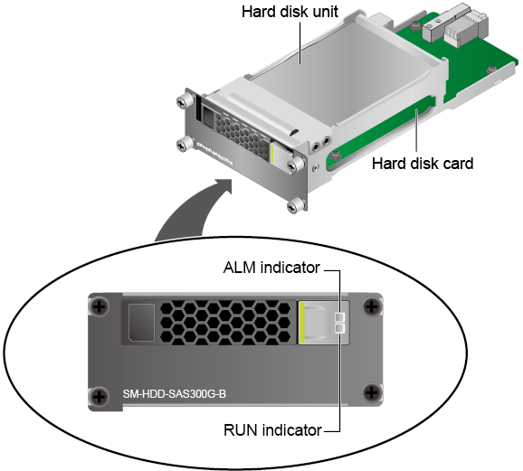
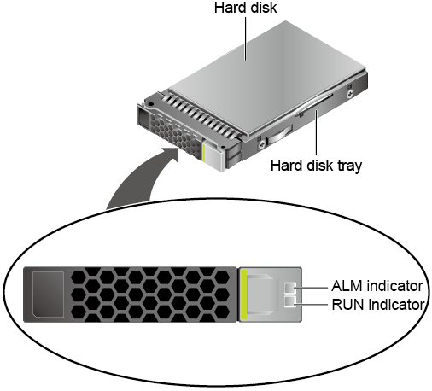
Hard Disk Appearance
SM-HDD-SAS300G-B
SM-HDD-SAS300G-A
USG6300/6500(1U)
USG6600(3U)
Notes:
The SM-HDD-SAS300G-A hard disk has the following functions:
Stores log and report data.
Can function with another hard disk to form RAID1 and provide reliable backup for user data. Once the working hard disk is faulty, the system automatically reads data from the mirroring hard disk, ensuring user services.
Supports "hot replacement", that is, replacing the faulty hard disk without powering it off. After the replacement, you only need to restore data from the mirroring hard disk.
The SM-HDD-SAS300G-B hard disk group has the following functions:
Stores log and report data.
Hard disk SM-HDD-SAS300G-A is hot swappable, but the hard disk card is not hot swappable.

Slide 28
Notes:
Replacing a hard disk:
When dual hard disks are used, the new disk can replace only the faulty disk but cannot exchange slots with the other hard disk. Otherwise, the two disks may fail to be identified.
After you replace the hard disks, run the disk online command in the system view for the new disks to start working. When dual hard disks are used and you run the disk online command, the active and standby disks automatically synchronize data. The synchronization process make take several hours. Do not remove or insert the hard disks. Otherwise, data loss may occur.
When dual hard disks are used and you run the disk online command, it takes several hours to change the Filesystem Status to Mounted. Please wait. Other services are available during this process, but the hard disks do not log these services. After data is synchronized, the hard disks automatically start working. You can run the display disk information command in the user view on the other day to check whether the Filesystem Status is Mounted. If not, contact Huawei technical support personnel.Explain that it takes a long time for data synchronization when dual hard disks are used. Please wait.
Expanding the capacity of hard disks:
Run the disk offline command in the system view and wait for about 30 seconds. After the system displays a message indicating that the hard disk has stopped working, remove the filler panel from the slot to expand the capacity and then install the new hard disk.
Run the reset raid primary-disk disk-id command in the system view to construct RAID with disk-id as the active disk and synchronize data. In the example, the command should be reset raid primary-disk 0. After a few hours, run the display disk information command. If Filesystem Status is Mounted and DiskRaidMode is ACTIVE, the hard disks after capacity expansion are working properly. The synchronization process may take a very long time, which depends on the service data volume.

Slide 29
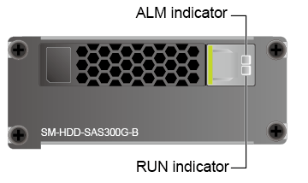
SM-HDD-SAS300G-B Panel and Indicators
Indicator | Color | Description
ALM indicator | Red | Steady on: The hard disk fails. Off: The hard disk is running properly.
RUN indicator | Green | Steady on: The hard disk is running. Blink twice every second (2 Hz): Data is being read from or written to the hard disk. Off: The hard disk is not detected.
  Hard disk unit SM-HDD-SAS300G-A is hot-swappable, but the hard disk card is not.

Slide 30

SM-HDD-SAS300G-A Panel and Indicators
Indicator | Color | Description
ALM indicator | Red | Steady on: The hard disk fails. Off: The hard disk is running properly.
RUN indicator | Green | Steady on: The hard disk is running. Blink twice every second (2 Hz): Data is being read from or written to the hard disk. Off: The hard disk is not detected.
  Works with another hard disk unit to form a RAID1 for reliable user data backup. Once the working hard disk fails, the system automatically reads data from the mirror hard disk, ensuring non-stop services.
  Supports hot swap. If a hard disk fails, you can replace it without powering off the NGFW. After the replacement, you can restore data from the mirror hard disk.

Slide 31
USG6000 Series Product Appearance and Panel Views
Expansion Cards for USG6000 Series
Hard Disks for USG6000 Series
Power Supply for USG6000 Series

Slide 32
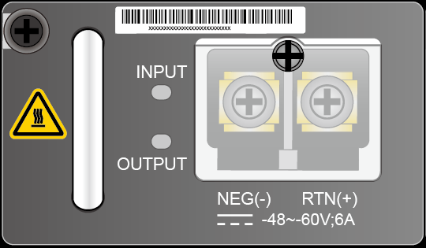
DC Power Module
Item | Description
Dimensions (H^{b} x Wª x D) | 40mm×69mm×195mm
Weight | 0.82kg
Maximum input voltage | -40V DC ～ -72V DC
Rated input voltage | -48V/-60V
Maximum output voltage | 12V DC
Maximum output current | 14.2A
Maximum output power | 170W
Item | Description
Dimensions (H^{b} x Wª x D) | 38.5mm×201mm×260.5mm
Weight | 1.28kg
Maximum input voltage | -40V DC ～ -72V DC
Rated input voltage | -48V/-60V
Maximum output voltage | 12V DC
Maximum output current | 29.2A
Maximum output power | 350W

Slide 33
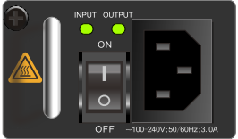
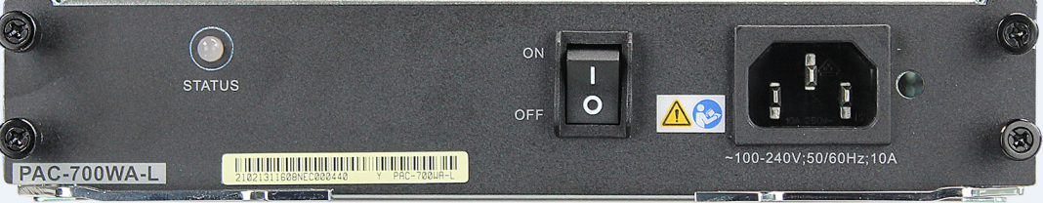
AC Power Module
Item | Description
Dimensions (H^{b} x Wª x D) | 40mm×69mm×195mm
Weight | 0.82kg
Maximum input voltage | 90V ～ 264V
Rated input voltage | 100V ~ 240V
Maximum output voltage | 12V DC
Maximum output current | 14.2A
Maximum output power | 170W
Item | Description
Dimensions (H^{b} x Wª x D) | 38.5mm×201mm×260.5mm
Weight | 1.45kg
Maximum input voltage | 90V ～ 264V
Rated input voltage | 100V ~ 240V
Maximum output voltage | 12V DC
Maximum output current | 29.2A
Maximum output power | 350W
Item | Description
Dimensions (H^{b} x Wª x D) | 38.5mm×201mm×260.5mm
Weight | 1.28kg
Maximum input voltage | 90V ～ 264V
Rated input voltage | 100V ~ 240V
Maximum output voltage | 12V DC
Maximum output current | 58.4A
Maximum output power | 700W

Slide 34
What are the features of the USG6000 series?
What is the role of the WSIC-4GE-BYPASS card?
Notes:
What are the features of the USG6000 series?
New 10-Gigabit Multi-Core Hardware Platform
Professional Content Security Defense
Integration of Security, Routing, and VPN Services
Refined Management by Application and User
Visualized Management and Diversified Logs and Reports
Carrier-Class Reliability
Flexible Scalability
What is the role of the WSIC-4GE-BYPASS card?
Normally, bypass GE0/GE1 is one pair interfaces and GE2/GE3 is other pair. Bypass card detect heart information between CPU and itself, to estimate whether normal status.When CPU happened exception occurs, Bypass card change to bypass status, relay device connect GE0 and GE1, or GE2 and GE2. Upstream and Downstream pass through the device in bypass, until CPU have recovered normal status.

Slide 35
USG6000 series products
The interface cards of the USG6000 series products
The hard disk of the USG6000 series products
The power supply of the USG6000 series products

Slide 36
Huawei Learning Website
  http://support.huawei.com/learning/Index!toTrainIndex
Huawei Support Case Library
  http://support.huawei.com/enterprise/servicecenter?lang=zh

Slide 37
Cloud DC solution
  http://e.huawei.com/cn/solutions/business-needs/data-center

