Slide 1
Jiang Bingbing (employee ID: zwx201803)
2017.7.20
Liu Lican
(employee ID: 00180730)
New
Zhang Yue
(employee ID: zwx635169)
2019.3.18
Liu Lican
(employee ID: 00180730)

Slide 2
Introduction to the Agile Controller-DCN

Slide 3
This course describes the positioning, functions, application scenarios, standards, and protocols of the Agile Controller-DCN.
Notes:
Traditional Network:
CLI configuration
Scattered platform
Device management one by one
Independent scheduling of physical and virtual networks
Global invisibility
SDN network
Automatic management:
GUI-based configuration
Open architecture
Application-based management and control
Global visibility

Slide 4
Upon completion of this course, you will be able to:
  Understand basic information about the Agile Controller-DCN.
  Understand functions of the Agile Controller-DCN.
  Be familiar with application scenarios of the Agile Controller-DCN.
  Be familiar with standards and protocols with which the Agile Controller-DCN complies.

Slide 5
Introduction to the Agile Controller-DCN
Functions of the Agile Controller-DCN
Application Scenarios of the Agile Controller-DCN
Standards and Protocols of the Agile Controller-DCN

Slide 6
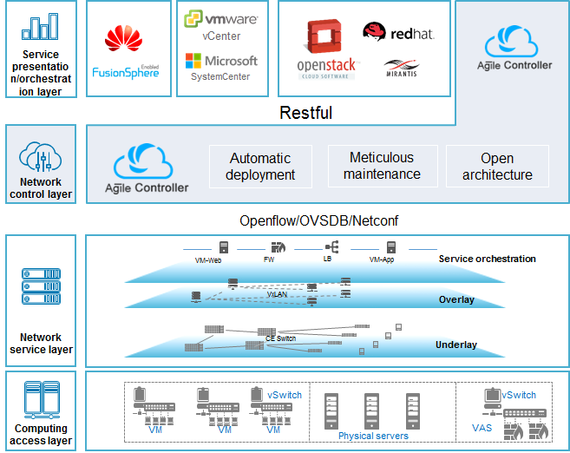
Positioning : Super Brain
The Agile Controller-DCN is a new-generation SDN controller oriented to the data center network (DCN).
The Agile Controller-DCN has a new open and reliable architecture and is a core component in the data center SDN solution.
The Agile Controller-DCN provides application-based network automation to simply network deployment.
The Agile Controller-DCN can seamlessly interconnect with mainstream cloud platforms and computing management platforms. It also supports reliable distributed clustering and multi-DC disaster recovery mechanisms.
Notes:
The service presentation and orchestration layer implements network orchestration, service provisioning, and collaborative scheduling of computing or storage resources and network resources. Collaborative service provisioning is implemented through interconnection with a cloud platform, the customer portal, or the Agile Controller-DCN GUI.
The network control layer implements centralized control of physical and virtual networks. The Agile Controller-DCN interconnects with the standard cloud platform through northbound interfaces. It also supports service orchestration, network modeling, and automatic network service deployment. The Agile Controller-DCN manages and controls physical and virtual networks through standard southbound interfaces such as the OpenFlow, OVSDB, and NETCONF interfaces.
The network service layer supports fabrics based on the network, hybrid, or host overlay VXLAN, network device stacking, M-LAG networking, active-active VXLAN gateways, and service automation from Layer 4 to Layer 7.
The computing access layer is responsible for computing and the storage resource pool. It also supports mainstream virtualization platforms and automatic bare metal server network provisioning.

Slide 7
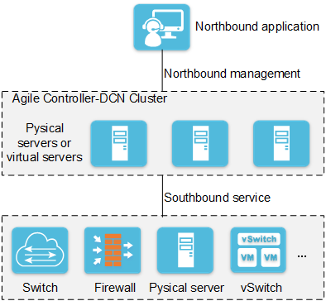
Physical Deployment Architecture
Module Type | Function Description | Deployment
Northbound proxy | Provides unified northbound access through a floating IP address, and forwards northbound requests to different service cluster nodes for load balancing. | In a cluster, only two nodes provide the northbound proxy function. To improve the system reliability, Northbound proxy is deployed on two cluster nodes in active/standby mode.
Cluster management | Uses the floating IP address for management of all Agile Controller-DCN cluster nodes, such as the internal cluster configuration and maintenance, cluster configuration, startup, stop, and process protection. | In a cluster, only two nodes provide the cluster management function. Cluster management is deployed in active/standby mode on the cluster nodes where northbound proxy is deployed.
Service processing | Indicates service management nodes that are used to process the Agile Controller-DCN services, such as NE management, topology management, and service provisioning, and send processing results to southbound forwarding devices. | The cluster deployment mode is used and at least 3 service processing nodes are required. If the cluster performance reaches the bottleneck, you can add nodes to improve the cluster performance.
Distributed lock | Provides capabilities of locking global resources for services. | The components use the cluster deployment mode and can be deployed independently or on the cluster nodes where service processing is deployed.
Distributed queue | A message sender sends the message to a message queue. Multiple receivers obtain the data and process their services in parallel, accelerating service processing.
Database | Saves all service settings for real-time service query and configuration restoration after restart. | The component uses the cluster deployment mode and can be deployed independently or on the cluster nodes where service processing is deployed.
Notes:
To ensure system performance and reliability, the Agile Controller-DCN must be deployed in cluster mode. Cluster technology has the following advantages:
Load balances service processing across multiple servers to ensure performance.
Ensures normal running of the entire cluster even if a single node fails, improving reliability.
Supports flexible expansion to enhance the performance of the entire cluster and features good scalability.

Slide 8
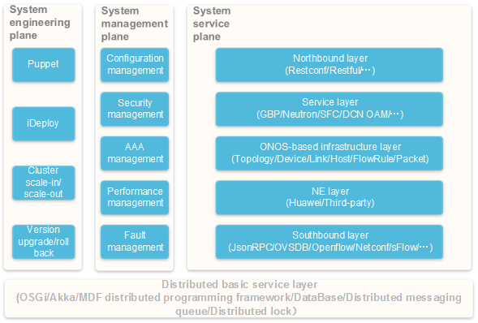
Logical Architecture
Basic service layer of the distributed system: This plane provides the basic middleware service and Model Driven Framework (MDF) programming framework for SDN distributed programming.
System engineering plane: This plane provides functions such as the Agile Controller-DCN cluster installation, deployment, scale-in, scale-out, and upgrade.
System management plane: This plane provides system management capabilities for SDN services, including configuration management, security management, Authentication, Authorization, and Accounting (AAA) management, service performance monitoring, and fault management.
System service plane: This plane is the key for Agile Controller-DCN service implementation. It collects network resources in the southbound and abstracts them for unified display and provides open northbound interfaces to provision SDN network services.
Notes:
Basic service layer of the distributed system:
It provides basic middleware services for distributed SDN programming, including the Open Services Gateway Initiative (OSGi) container, Akka cluster management, distributed caching, distributed database storage, and distributed locking services. The OSGi container is provided by the ONOS platform, and the Akka cluster management service is provided by the ODL platform. Commercial functions of other distributed basic services are enhanced based on mainstream open source components in the industry, and fully meet the reliability, performance, and security requirements.
The distributed model driven framework (MDF) provides a modular service architecture based on ODL MD-SAL to ensure separated running and scheduling of processes and threads of various service protocols. This framework is compatible with MD-SAL interfaces to support enhanced functions, such as synchronous/asynchronous RPC encapsulation, routed RPC performance optimization, and high-performance DOM storage. The MDF framework integrates Kafka-based distributed messaging service bus and distributed event management capability, providing the reliability and performance.

Slide 9
Notes:
System service plane:
Northbound interface layer: This layer provides processing of access protocols, open security management of northbound interfaces, and processing of services that are automatically deployed on the GUIs of the Agile Controller-DCN in the background.
Network service layer: Various service applications required in the SDN solution are deployed in this layer to provide network-level service capabilities, such as DCN service provisioning, Neutron, service function chain (SFC), and DCN operation, administration, and maintenance (OAM).
Network infrastructure resource management and control layer: This layer is built based on the distributed core layer of the ONOS platform. It provides management and control on standard and abstracted core SDN resources for upper-layer applications, including device, link, topology, host, and packet receiving and sending services.
NE management and control layer: This layer provides the device abstraction level (DAL) capability to the upper layer and uses the NE driver and device driver plug-in to realize adaptation and conversion of driver models from multiple vendors.
Southbound interface layer: This layer supports the standard SDN southbound protocols including configuration management protocols such as NETCONF, OVSDB, JSON-RPC, and SNMP, device control protocol OpenFlow, and traffic collection protocol sFlow.

Slide 10
Introduction to Agile Controller-DCN
Functions of Agile Controller-DCN
  Basic Concepts of Underlay
  Basic Concepts of Overlay
  Other Functions and Features
Application Scenarios of Agile Controller-DCN
Standards and Protocols of Agile Controller-DCN

Slide 11




Basic Concepts of Underlay
An underlay network is a bearer network consisting of physical devices, such as TOR switches, aggregation switches, core switches, LBs, and firewalls. In Huawei CloudFabric Solution, the underlay network mainly refers to the basic network layer.
AC Orchestration
Service presentation/
orchestration layer
Third-party cloud platform
Network control layer
Spine
Basic network layer
Firewall
L3 Network
LB
Leaf
Underlay network
vSwitch
vSwitch
vSwitch
vSwitch
Virtual network layer
VM
VM
VM
VFW

Slide 12
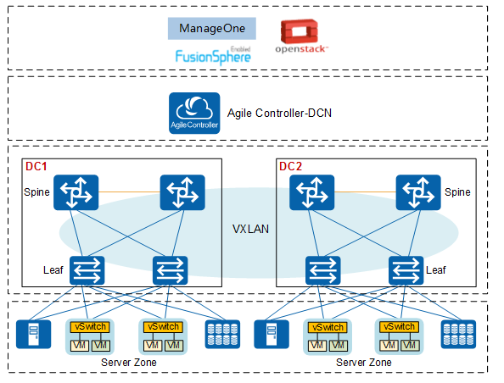
Underlay Network Features of Huawei
CloudFabric Solution
High bandwidth:
  High-density 10GE
  Evolution from 10GE to 25GE/40GE/100GE
Large Layer 2 network:
  Spine-leaf high scalability architecture
  VXLAN
High reliability:
  CSS/iStack
  M-LAG

Slide 13
Introduction to Agile Controller-DCN
Functions of Agile Controller-DCN
  Basic Concepts of Underlay
  Basic Concepts of Overlay
  Other Functions and Features
Application Scenarios of Agile Controller-DCN
Standards and Protocols of Agile Controller-DCN

Slide 14
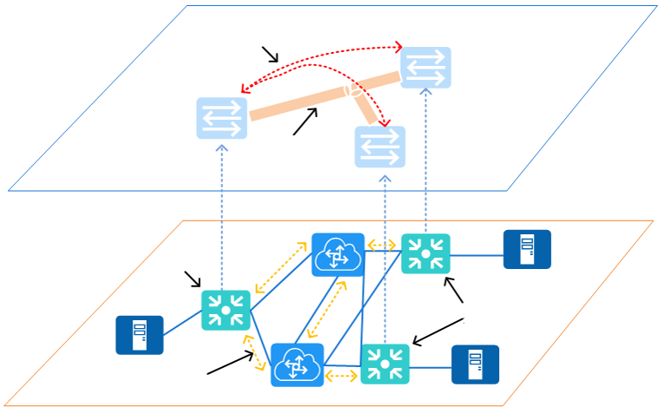
Basic Concepts of Overlay
An overlay network (large Layer 2 network) is constructed at Layer 3 or Layer 4 on a traditional network and encapsulates data into Layer 3 or Layer 4 packets for transmission.
Overlay technology is a tunnel encapsulation technology, including VXLAN and Network Virtualization Using Generic Routing Encapsulation (NVGRE). It encapsulates Layer 2 packets over tunnels, transparently transmits the encapsulated packets, and finally decapsulates the packets to obtain the raw packets after the packets arrive at the destination. That is, a large Layer 2 network is built on the existing network.
Overlay
control plane
Data plane
payload encapsulation
Overlay network
Overlay
edge device
Host
Overlay
edge device
Host
Physical bearer network
Bearer network
Control plane

Slide 15
Basic Concepts of Overlay
In Huawei CloudFabric Solution, an overlay is built using VXLAN technology. Service packets are transmitted on the VXLAN overlay that is decoupled from the physical bearer network.
Based on the VXLAN NVEs, VXLAN-based overlays are classified into:
  Network Overlay
  Host Overlay
  Hybrid Overlay

Slide 16
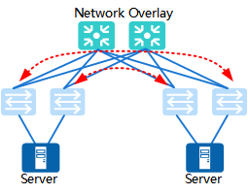
Overlay Networking - Network Overlay
Centralized Network Overlay
VXLAN Gateway Deployment
Network Overlay
Distributed Network Overlay
Notes:
KVM can convert a standard Linux kernel into a VMM. The Linux standard kernel embedded with the KVM module can load guest OSs through KVM tools. Therefore, in such an OS platform, the VMM virtualization layer resides directly on the physical hardware layer of the host, and no independent host OS layer is provided. In this case, the VMM functions as the host OS. CPU instructions of the guest OS are executed directly, rather than through QEMU. This greatly improves the speed. KVM exposes the necessary APIs through /dev/kvm. User-mode programs can access these APIs by calling the ioctl function.
The KVM kernel module provides only CPU and memory virtualization. Therefore, it must be combined with QEMU to form a complete virtualization solution, that is, qemu-kvm.
As a hypervisor, KVM focuses on VM scheduling and memory management. I/O peripheral tasks are handled by the Linux kernel and QEMU. With I/O virtualization, storage and network resources are virtualized by the Linux kernel and QEMU.
By integrating KVM, QEMU uses its kernel module to process CPU instructions by invoking the /dev/kvm interface through ioctl. KVM is responsible only for CPU and memory virtualization. QEMU emulates I/O devices (such as NICs and disks). Server virtualization is jointly implemented with KVM and QEMU, so QEMU is called qemu-kvm. QEMU is an emulator that emulates the CPU and other hardware needed by the guest OS. The guest OS believes that it communicates with the hardware directly. In fact, it interacts with the hardware simulated by QEMU. QEMU translates and sends these instructions to the real hardware. The performance is compromised because all the instructions need to be translated by QEMU.
QEMU also emulates other hardware, such as NICs and disks, which also affects the performance of these devices. To address this, pass-through and paravirtualization techniques, such as virtio_blk and virtio_net, are used to improve device performance.
15

Slide 17
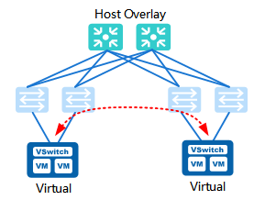
Overlay Networking - Host Overlay
On a host overlay network, all VXLAN overlay tunnel end points are deployed on software switches (installed on servers). That is, both the ingress and egress of a VXLAN tunnel are software switches.
Notes:
Host Overlay is based on CE1800V

Slide 18
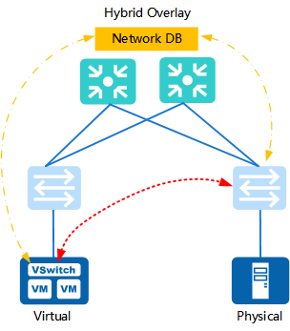
Overlay Networking - Hybrid Overlay
Differences
In a network overlay scenario, all overlay devices are physical devices and a VXLAN tunnel is encapsulated on a physical switch.
In a hybrid overlay scenario, overlay devices include physical network devices and virtual network devices. A VXLAN tunnel is encapsulated on a physical switch or a virtual switch where the host server is located.
Advantages
Uses the high performance of physical network devices for forwarding.
Uses the existing physical network devices and overlay of physical servers to improve performance.
Provides more flexible networking.

Slide 19
Introduction to Agile Controller-DCN
Functions of Agile Controller-DCN
  Basic Concepts of Underlay
  Basic Concepts of Overlay
  Other Functions and Features
Application Scenarios of Agile Controller-DCN
Standards and Protocols of Agile Controller-DCN

Slide 20
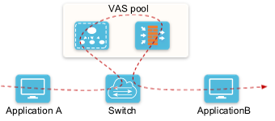
Flexible Service Orchestration
SFC makes service orchestration more flexible. It has the following features:
  Supports decoupling of service functions from fabric network devices, implementing flexible deployment and on-demand expansion and breaking the restrictions of the physical topology.
  Provides GUIs to simplify operations and improve the orchestration efficiency, and provides personalized services for each tenant on demand without affecting other tenants.
  Supports VAS pooling, flexible scalability, and on-demand allocation, realizing sharing and expansion of VAS capabilities in multiple services.

Slide 21
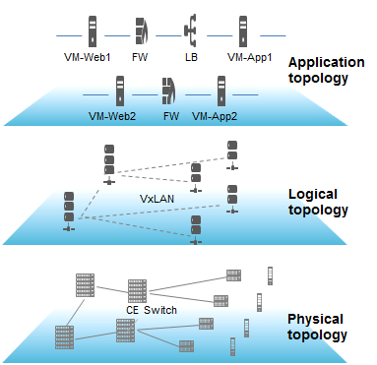
Refined O&M
Network resource visualization
Visibility of the physical network, logical network, and application network
Network path detection
Single-path detection
Multi-path detection
Connectivity detection
Loop detection
Notes:
Entire network resource visibility
The Agile Controller-DCN obtains network information from the dimension of physical or virtual device resources and tenants, and supports resource visibility, solving the problem of mixed devices and poor resource management.
The Agile Controller-DCN uniformly manages physical and virtual resources, and monitors the resource status of physical and virtual network devices on the entire network as well as the NE running status.
The Agile Controller-DCN monitors the network running status from the tenant dimension and displays the tenants, tenant quotas, and tenant traffic.
Visibility of the physical network, logical network, and application network
The Agile Controller-DCN supports the visibility of the physical network, logical network, and application network.
Supports mapping of the logical network topology and the physical network topology.
Displays logical network resources used by application networks and physical network resources used by logical networks (that is, mapping from the top to the bottom).

Slide 22
Notes:
When a physical network resource on the underlay network changes (device restart or link disconnection), the Agile Controller-DCN synchronizes the changes to the logical and application networks.
Service path visibility: The Agile Controller-DCN can display the real physical paths of services based on the application and logical networks. When the physical network decouples from the logical network, users can rapidly locate the network fault, discover, and fix service flow interruptions.
Single path detection: Views the actual physical path of a service flow between VMs and checks whether the service flow is interrupted.
Multi-path detection: Traces multiple physical paths between NVE devices and checks whether the service flows are interrupted.
Connectivity detection: Detects connectivity between VMs, VMs and BMs, as well as VMs or BMs and the Internet.
The Agile Controller-DCN uses the service path visibility function to filter the path information based on 5-tuple information and displays the path information by hops. As a result, users can view the service path information as required.
Loopback detection
The Agile Controller-DCN can automatically detect whether VXLAN and VLAN loops that may occur in the fabric network exist through traffic collection and event association, locate the loops, and repair the loop, avoiding impacts on traffic services caused by improper networking or network attacks.
Network path detection
Network path detection detects actual physical paths between VMs or devices and check whether the service flows are interrupted.
Single path detection: Views the actual physical path of a service flow between VMs and checks whether the service flow is interrupted.
Multi-path detection: Traces multiple physical paths between NVE devices and checks whether the service flows are interrupted.
Connectivity detection
Detects connectivity between VMs, VMs and BMs, as well as VMs or BMs and the Internet. By using the connectivity detection function, you can effectively check and locate faults on the network and quickly rectify faults.
Loopback detection
The Agile Controller-DCN can automatically detect whether VXLAN and VLAN loops that may occur in the fabric network exist, locate the loops, and repair the loop, avoiding impacts on traffic services caused by improper networking or network attacks.

Slide 23
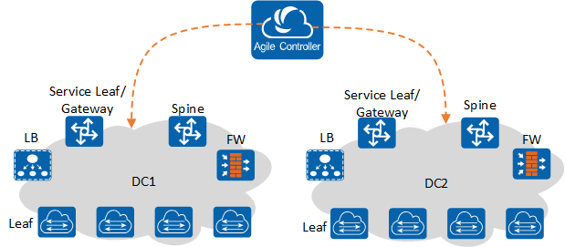
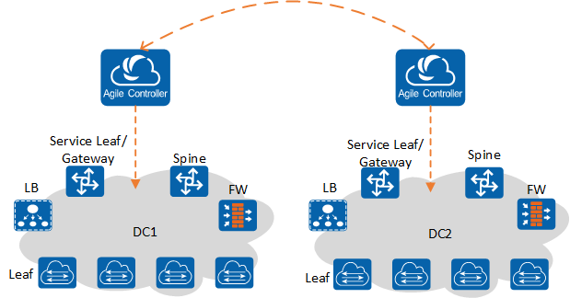
Multi-DC Pooling
Remote management of the Agile Controller-DCN: An Agile Controller-DCN cluster manages multiple DCs and centrally delivers the DC configuration on the overlay network.
Cluster federation: The Agile Controller-DCN clusters are deployed independently for different DCs. The DCs exchange service routing information on the overlay network through BGP-EVPN to implement service communication at Layer 3.
Notes:
The Agile Controller-DCN can manage both a single data center (DC) and multiple DCs in different regions, expanding the size and scope of DC services and breaks the physical distance limitations of traditional DCs. In this case, customers can share DC network resources in different regions, implementing flexible resource scheduling and improving resource utilization. The Agile Controller-DCN also supports geographic redundancy deployment of active and standby clusters. When the active cluster fails, a geographic redundancy switchover is triggered automatically or manually, ensuring smooth running of services and improving the DC reliability.
The Agile Controller-DCN manages DCs in the following modes: remote management of multiple DCs using a single Agile Controller-DCN cluster, active/standby Agile Controller-DCN management, independent deployment of multiple sets of the Agile Controller-DCN.
Remote management of multiple DCs using a single Agile Controller-DCN cluster: A set of the Agile Controller-DCN manages multiple DCs and uniformly delivers the DC configuration on the overlay. This scenario supports inter-DC cluster and elastic resource scaling.
Independent deployment of multiple sets of the Agile Controller-DCN: An independent Agile Controller-DCN cluster is deployed for each DC. DCs exchange the service routing on the overlay through BGP-EVPN and streamline services through upper-layer applications, implementing service communication at Layer 3 and elastic scalability.

Slide 24
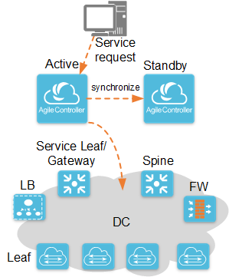
Geographic Redundancy Deployment
Notes:
The Agile Controller-DCN can manage both a single data center (DC) and multiple DCs in different regions, expanding the size and scope of DC services and breaks the physical distance limitations of traditional DCs. In this case, customers can share DC network resources in different regions, implementing flexible resource scheduling and improving resource utilization. The Agile Controller-DCN also supports geographic redundancy deployment of active and standby clusters. When the active cluster fails, a geographic redundancy switchover is triggered automatically or manually, ensuring smooth running of services and improving the DC reliability.
The Agile Controller-DCN manages DCs in the following modes: remote management of multiple DCs using a single Agile Controller-DCN cluster, active/standby Agile Controller-DCN management, independent deployment of multiple sets of the Agile Controller-DCN.
Remote management of multiple DCs using a single Agile Controller-DCN cluster: A set of the Agile Controller-DCN manages multiple DCs and uniformly delivers the DC configuration on the overlay. This scenario supports inter-DC cluster and elastic resource scaling.
Independent deployment of multiple sets of the Agile Controller-DCN: An independent Agile Controller-DCN cluster is deployed for each DC. DCs exchange the service routing on the overlay through BGP-EVPN and streamline services through upper-layer applications, implementing service communication at Layer 3 and elastic scalability.

Slide 25
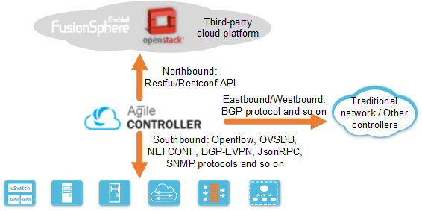
Southbound and Northbound Openness
The Agile Controller-DCN is based on an open software platform and has an architecture with loosely coupled components. The Agile Controller-DCN can provide extensive northbound API capabilities and southbound interface capabilities to control network devices and computing resources.
Notes:
The Agile Controller-DCN interconnects with the open-source OpenStack cloud platform, Huawei FusionSphere cloud platform, and applications seamlessly using the northbound standard RESTful interface.
The Agile Controller-DCN manages the physical and virtual devices using the southbound standard OpenFlow, OVSDB, NETCONF, BGP-EVPN, JsonRPC, and SNMP protocols.
The Agile Controller-DCN communicates with traditional networks or other controllers through the eastbound and westbound protocols such as BGP.

Slide 26
Multi-tenant Control
Support multi-tenant management and control. Each tenant can independently plan and provision services. Resources of tenants are isolated without affecting each other.
Supports communication between tenants, providing more flexibility for tenants and meeting various application requirements of users.
Notes:
The Agile Controller-DCN supports multi-tenant management and control during service provisioning or collaboration with other cloud platforms to provision services. Each tenant can independently plan and provision services. Resources of tenants are isolated without affecting each other.
Supports communication between tenants under certain control, providing more flexibility for tenants and meeting various application requirements of users.

Slide 27
Introduction to the Agile Controller-DCN
Functions of the Agile Controller-DCN
Application Scenarios of the Agile Controller-DCN
Standards and Protocols of the Agile Controller-DCN

Slide 28
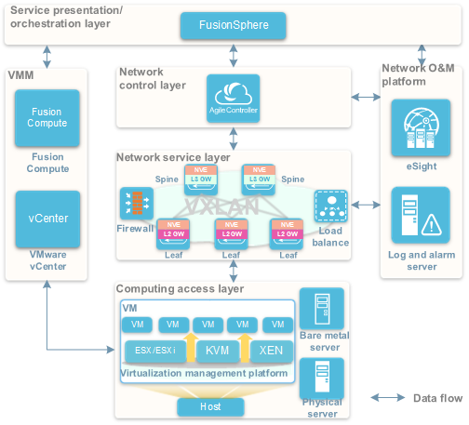
Cloud-Network Integration - FusionSphere
Notes:
Traditional data centers have low service provisioning efficiency, low resource usage, and O&M difficulties. Therefore, the traditional data center architecture needs to be evolved to the cloud computing architecture. In the cloud-network integration-FusionSphere scenario, computing and network services are uniformly provisioned based on FusionSphere. FusionSphere provides the unified page to manage computing and network resources. The Agile Controller-DCN interconnects with FusionSphere to implement flexible and convenient resource management, service provisioning, and migration.
Service presentation/orchestration layer
The service presentation layer is oriented to data center users. The cloud platform at this layer provides GUIs for service, network, and tenant administrators, implementing service management, automatic service provisioning, as well as resource and service guarantee.
The service orchestration layer consists of Nova, Neutron, and Cinder components of the cloud platform. This layer controls and manages resources through the components to implement virtualization and pooling of computing, storage, and network resources. The components interoperate to realize collaboration of resources.

Slide 29
Notes:
The network control layer is the core of the cloud-network integration-FusionSphere scenario. The Agile Controller-DCN implements network modeling and instantiation, collaborates virtual and physical networks, and provides network resource pooling and automation. Meanwhile, the Agile Controller-DCN also constructs a view of the entire network and implements centralized control and delivery of service flow tables. The Agile Controller-DCN is a key component to isolate SDN network control and forwarding.
The network service layer is the infrastructure of a data center network, providing high-speed channels for carrying services, including L2-L3 basic network services and L4-L7 value-added network services.
The computing access layer supports access from virtualization servers, physical servers, and bare metal servers.

Slide 30
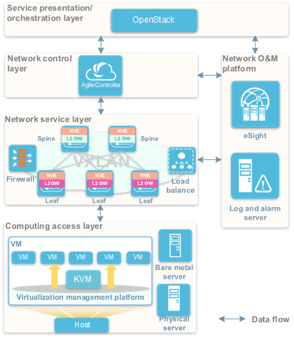
Cloud-Network Integration - OpenStack
Notes:
Traditional data centers have low service provisioning efficiency, low resource usage, and O&M difficulties. Therefore, the traditional data center architecture needs to be evolved to the cloud computing architecture. In the cloud-network integration-FusionSphere scenario, computing and network services are uniformly provisioned based on FusionSphere. FusionSphere provides the unified page to manage computing and network resources. The Agile Controller-DCN interconnects with FusionSphere to implement flexible and convenient resource management, service provisioning, and migration.
Service presentation/orchestration layer
The service presentation layer is oriented to data center users. The cloud platform at this layer provides GUIs for service, network, and tenant administrators, implementing service management, automatic service provisioning, as well as resource and service guarantee.
The service orchestration layer consists of Nova, Neutron, and Cinder components of the cloud platform. This layer controls and manages resources through the components to implement virtualization and pooling of computing, storage, and network resources. The components interoperate to realize collaboration of resources.

Slide 31
Notes:
The network control layer is the core of the cloud-network integration - OpenStack scenario. The Agile Controller-DCN implements network modeling and instantiation, collaborates virtual and physical networks, and provides network resource pooling and automation. Meanwhile, the Agile Controller-DCN also constructs a view of the entire network and implements centralized control and delivery of service flow tables. The Agile Controller-DCN is a key component to isolate SDN network control and forwarding.
The network service layer is the infrastructure of a data center network, providing high-speed channels for carrying services, including L2-L3 basic network services and L4-L7 value-added network services.
The computing access layer supports access from virtualization servers, physical servers, and bare metal servers.

Slide 32
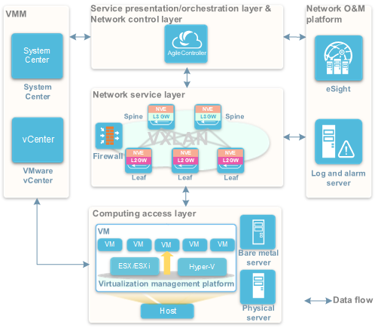
Network Virtualization - Computing
Notes:
Different from cloud-network integration scenarios, the network virtualization – computing scenario realizes service provisioning without a cloud platform. The Agile Controller-DCN directly provides a separate management page to manage network resources. The computing system can be associated with network system. If a unified cloud platform cannot be built due to the complexity of the computing service management system or inadequate convergence between computing management and network management, the network virtualization – computing scenario is recommended. In this scenario, the Agile Controller-DCN interconnects with a computing virtualization platform to implement automatic network configuration and collaborative provisioning of computing and network resources and provide flexible and convenient resource management. This scenario is applicable to data center construction without a cloud platform.
The service presentation layer is oriented to data center users. The Agile Controller-DCN provides GUIs for service, network, and tenant administrators, implementing service orchestration, policy provisioning, automatic service provisioning, as well as O&M.

Slide 33
Notes:
The network control layer is the core of the cloud-network integration - computing scenario. The Agile Controller-DCN implements network modeling and instantiation, collaborates virtual and physical networks, and provides network resource pooling and automation. Meanwhile, the Agile Controller-DCN also constructs a view of the entire network and implements centralized control and delivery of service flow tables. The Agile Controller-DCN is a key component to isolate SDN network control and forwarding.
The network service layer is the infrastructure of a data center network, providing high-speed channels for carrying services, including L2-L3 basic network services and L4-L7 value-added network services.
The computing access layer supports access from virtualized servers and physical servers.

Slide 34
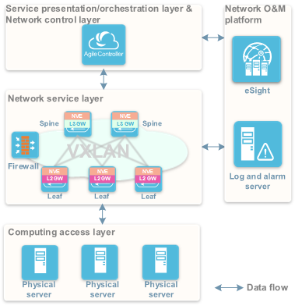
Network Virtualization - Hosting
Notes:
In a network virtualization - hosting, the Agile Controller-DCN but not the cloud platform is used to provision services. However, the Agile Controller-DCN does not interconnect with a virtualization platform. The network administrator provisions the network resource services. This scenario is applicable to independent network service provisioning. In this case, the Agile Controller-DCN provides an independent GUI to uniformly manage physical and virtual network resources. In the network virtualization - hosting scenario, a lessor leases equipment rooms and cabinet space to tenants and provides the following types of services to tenants:
Basic services: including leasing of equipment space and racks, and network access services such as access bandwidth and outbound bandwidths.
VASs: including Layer 4 to Layer 7 VASs such as the security, load balancing, VPN, and NAT services.
The network virtualization - rack leasing scenario includes the following two scenarios according to whether tenants have gateways:
Gateways provided by tenants: Devices hosted by tenants include servers, Layer 2 switches, gateways, and firewalls. Tenant devices access the network of the lessor at Layer 3.

Slide 35
Notes:
Gateways provided by lessors: Devices hosted by tenants include servers and Layer 2 switches only. Tenant devices access the network of the lessor at Layer 2. Gateways and VASs are provided by the lessor.
In the network virtualization – hosting scenario, the functions of each layer are as follows:
The service presentation layer is oriented to data center users. The Agile Controller-DCN provides GUIs for service, network, and tenant administrators, implementing service orchestration, policy provisioning, automatic service provisioning, as well as O&M.
The network control layer is the core of the cloud-network integration - hosting scenario. The Agile Controller-DCN implements network modeling and instantiation, collaborates virtual and physical networks, and provides network resource pooling and automation. Meanwhile, the Agile Controller-DCN also constructs a view of the entire network and implements centralized control and delivery of service flow tables. The Agile Controller-DCN is a key component to isolate SDN network control and forwarding.
The network service layer is the infrastructure of a data center network, providing high-speed channels for carrying services, including L2-L3 basic network services and L4-L7 value-added network services.
The computing access layer supports Layer 3 access from tenant switches and Layer 2 access from tenant servers or switches.

Slide 36
Introduction to the Agile Controller-DCN
Functions of the Agile Controller-DCN
Application Scenarios of the Agile Controller-DCN
Standards and Protocols of the Agile Controller-DCN

Slide 37
Standards Compliance
Southbound interface protocol
  Southbound interface protocols include the NETCONF, OpenFlow, and SNMPv3
Northbound interface protocol
  Northbound interface protocols include HTTPS and HTTP 1.1
Standard No. | Description
RFC6241 | Network configuration protocol (NETCONF)
RFC3414 | Simple network management protocol v3 (SNMPv3), based on a user authentication model
OpenFlow Switch Specification Version 1.3.4 | OpenFlow
Standard No. | Description
RFC2818 | HTTP, based on TLS
RFC2616 | Hypertext Transfer Protocol 1.1

Slide 38
Single-Answer Question
  Which of the following is not a southbound interface protocol of Agile Controller-DCN?
  NETCONF
  SNMP
  OpenFlow
  OSPF
Multiple-Answer Question
  Which of the following are overlay networking modes in Huawei CloudFabric Solution?
  Host overlay
  Physical overlay
  Network overlay
  Hybrid overlay
Notes:
Answer:
D
ACD

Slide 39
Introduction to the Agile Controller-DCN
Functions of the Agile Controller-DCN
Application scenarios of the Agile Controller-DCN
Standards and protocols of the Agile Controller-DCN

Slide 40
Agile Controller-DCN
  http://support.huawei.com/enterprise/zh/sdn-controller/agile-controller-dcn-pid-21481886

Slide 41
Huawei e-Learning website:
  http://support.huawei.com/learning/Index!toTrainIndex
Huawei support case library:
  http://support.huawei.com/enterprise/servicecenter?lang=zh

