Slide 1
HCDCA107
HCNA-DC
V1R1
1.0
Yuan Weihua/WX462781
2017.9.27
Liu Lican/00180730
New

Slide 2
Routine Maintenance of DC Network Devices
Huawei Data Center Series of Courses

Slide 3
Upon completion of this course, you will be able to:
Display objective of routine maintenance
Describe the usage scenarios of maintenance methods.
Describe tasks and methods of the routine maintenance of Sx7 series switches.
Execute periodic routine maintenance in the network made of NE and AR routers.
Use maintenance methods to locate USG normal faults.

Slide 4
Routine Maintenance Items Introduction
Maintain Commonly Used Methods and Equipment Environmental Checks
Methods for Handling Sx7 Switch Password Loss
CE Switches Parts Replacement
AR and NE Routers Common Maintenance Commands
USG Common Troubleshooting

Slide 5
Objectives of Routine Maintenance
Routine maintenance is a preventive measure.
It is carried out regularly during the normal running of a device. Routine maintenance is to detect and remove the defects or potential hazards in time. Therefore it is essential for secure, stable, and reliable running of the device in a long period.
Notes:
Stable running of devices depends on proper network planning, routine maintenance, and monitoring on the devices.

Slide 6
Routine Maintenance Principles
Equipment room environment requirements
The environment in an equipment room must comply with national or industrial standards and regulations. An equipment room must be clean and tidy, and prevent dust, moist, rats, and insects.
Personnel requirements
Before maintaining devices, maintenance personnel must receive training on maintenance principles and procedures, learn necessary maintenance knowledge about devices, and master basic operation skills about devices and emergency handling procedures. In addition, they must strictly abide by operating regulations and security rules when maintaining devices.
Device maintenance regulations
The regulations involve maintenance rules, periodic check, password management regulations, operation regulations, data modification regulations, and electrostatic discharge (ESD) standards.
Notes:
Device maintenance regulations
Maintenance rules
Maintenance personnel must attach importance to routine maintenance for fault prevention, and establish regulations to ensure proper management and maintenance of the equipment.
Periodic check
Maintenance personnel should perform the routine checks or tests and record the results periodically based on the suggestions in this document.
Password management regulations
System administrators must keep administrative-level passwords well and change the passwords periodically. The passwords need to be classified into different levels and be allocated based on the operation rights of the maintenance personnel and workstations. This is to ensure secure functioning of local maintenance terminals (LMTs).
Operation regulations
Maintenance personnel must record all the major operations, such as swapping cards, restarting the system, and loading software. Before performing a major operation, maintenance personnel must verify that the operation is feasible, back up related configurations or data, and work out emergency and security measures.

Slide 7
Notes:
Data modification regulations
Data modification must be authorized and controlled. The maintenance personnel must back up data before modifying the data and record the modified contents.
ESD regulations
Maintenance personnel must wear electrostatic discharge (ESD) wrist straps before touching any hardware component. To prevent other faults, a faulty card must be removed from a cabinet and placed into an antistatic bag for safekeeping.
LMT maintenance regulations
Maintenance personnel can install and run valid firewall and antivirus software on LMTs as required.
Others
Users shall maintain sufficient spare parts for key cards, power modules, and fans in the warehouse.
Faulty cards, power modules, or fans must be returned for repair in time.
If an emergency occurs, the system maintenance personnel must keep calm, record the original information in detail, and contact Huawei technical support center or the regional office of Huawei immediately.

Slide 8
Classification - Daily Routine Maintenance
Daily routine maintenance is carried out by the ordinary maintenance personnel.
Alarm system
Operation status of the device
Daily routine maintenance is performed to:
Locate alarms or other problems and solve them promptly. This helps in the stable functioning of the device and lowers the failure rate.
Find out the faults on the links or connections quickly and solve them to ensure normal provision of services.
Have real-time information about the operation of the device and the network. This helps to improve the efficiency of troubleshooting.

Slide 9
Classification - Periodic Routine Maintenance
Periodic routine maintenance is relatively complex. It must be carried out by the maintenance personnel who have undergone professional trainings.
Power supply
Grounding resistance
Dust on the device
Periodic maintenance is done to:
Ensure the secure and stable operation of the device for a long period.
Check for problems such as device aging, function failures, and performance degradation. You can do this by regularly checking, testing and cleaning the devices and creating a backup of the data.

Slide 10
Routine Maintenance Items
Maintenance Cycle | Maintenance Item
Daily | Logs and alarms
 | Temperature and voltage
 | Fan and power supply
 | CPU usage and memory usage
Monthly | Configuration files
 | Available space on the CF card
 | License information
 | System time
 | Interface traffic
 | Board running status
 | OSPF/IS-IS/BGP neighbor status
 | Routing information
 | Management-level user control
 | Telnet control
 | Anti-attack detect
 | FTP password control
 | Change of the login password
 | Backup of configuration files and log files
 | Temperature and humidity in the equipment room
Quarterly | Cleaning of air filters
Yearly | Cleaning of fan frames, and boards
NOTE:
The installation tools, meters, and related devices are not delivered with the equipment.
Meters must be calibrated before use.
Notes:
The routine maintenance items are the references and suggestions for maintenance of the running environment, software and hardware of the CE switch
In routine maintenance, you can maintain the CE switch according to the maintenance items. In addition, you can add or delete the routine maintenance items according to the actual networking and environment of the equipment room.
Routine maintenance and operations please refer to the CE switch product manual.

Slide 11
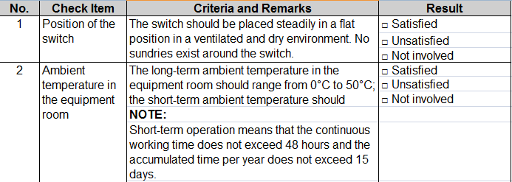
Routine Maintenance Suggestions
Stable operation of equipment on the one hand depends on the perfect network planning, on the other hand, through routine maintenance and monitoring equipment to found run risks is also very necessary.
Network maintenance staff can organize a inspects Checklist used for regular equipment inspection. Inspection need to focus on:
Equipment running environment
Device basic information
Device running status
Interfaces information
Services
Notes:
inspects Checklist in the product manual "Maintenance and Fault Management" section.
Equipment running environment
normal operating environment is the precondition to ensure the normal operation of equipment.
Device basic information check
The basic device information includes software version, patch information, and system time.
Checking the Device Running Status
The running status of a switch includes the running status of subcards, resetting information, and device temperature.
Checking the Interface Information
The interface information includes the negotiation mode, configurations, and status of the interface.
Checking Services
All the services on the switch must run normally.

Slide 12
Routine Maintenance Items Introduction
Maintain Commonly Used Methods and Equipment Environmental Checks
Methods for Handling Sx7 Switch Password Loss
CE Switches Parts Replacement
AR and NE Routers Common Maintenance Commands
USG Common Troubleshooting

Slide 13
Common Maintenance Methods (1)
Analyzing the indicator status
This method is used to check the running status of each card and user-side device and determine whether a card or user-side device is damaged.
Analyzing alarm logs
This method is to check the current and historical alarms on a network management system (NMS) terminal to determine whether the system runs properly. If faults occur, the alarm logs help to locate the faults. After a fault is rectified, the corresponding alarm will be cleared.
Replacing a component or device
When a fault cannot be located using the preceding methods, you can replace a card, line, or user-side device that is possibly faulty with a proper card, line, or user-side device to locate the fault.

Slide 14
Common Maintenance Methods (2)
Ping
If a fault occurs on the service network or management network, you can ping IP address of each node to locate the fault.
Observing
Some faults can be determined based on observation, which is the first method that maintenance personnel use when a fault occurs. Correctly determining the fault is the key to analyze and rectify the fault.
Removing and reinserting connectors
When a circuit board is faulty, you can remove and reinsert the connector to check whether the fault is caused by improper connection or a processor exception.

Slide 15
Common Maintenance Methods (3)
Isolating a faulty part
When the system is partially faulty, you can isolate the faulty part from related devices to check whether the fault is caused by effects of other devices.
Self-check
After the system or a circuit board is powered on again, it performs self-check. When a device is performing self-check after powered on again, the indicators on the panel blink regularly. You can check the indicator status to determine whether the circuit board is faulty.
Tightly reconnecting a chip or connector
You can tightly reconnect a chip or cable connector to check whether a fault is caused by improper connection.

Slide 16
Checking the Device Environment (1)
Recommended Maintenance Period | Check Item | Evaluation Criteria and Description | Result
Day | Air conditioners in the equipment room | Air conditioners keep running steadily so that the temperature in the equipment room is within an acceptable range. | □ Pass □ Fail □ N/A
 | Connection to the power supply | The power cable is correctly and securely connected to the specified position of the device. The power supply indicator on the device should be steady green. | □ Pass □ Fail □ N/A
Week | Ambient temperature in the equipment room | The long-term ambient temperature in the equipment room should range from 0°C to 50°C. The short-term ambient temperature should range from –5°C to 55°C. Note: Short-term operation means that the continuous working time does not exceed 48 hours and the accumulated time per year does not exceed 15 days. | □ Pass □ Fail □ N/A
 | Ambient humidity in the equipment room | The ambient humidity in the equipment room should range from 10% RH to 90% RH. | □ Pass □ Fail □ N/A

Slide 17
Checking the Device Environment (2)
Recommended Maintenance Period | Check Item | Evaluation Criteria and Description | Result
Month | Device position | The device is placed stably in a flat position in a ventilated and dry environment. No sundries exist around the device. | □ Pass □ Fail □ N/A
 | Grounding and the ground resistance | The working grounding, protection grounding, and surge protection grounding should be arranged separately in the equipment room. Joint grounding can be used if the equipment room is under limited conditions. Grounding is important especially for outdoor devices because outdoor devices are possibly damaged by lightning. | □ Pass □ Fail □ N/A
 | Power supply system | The power supply system should run stably. The DC rated voltage ranges from –48 V DC to –60 V DC. The AC rated voltage ranges from 100 V AC to 240 V AC. | □ Pass □ Fail □ N/A

Slide 18
Routine Maintenance Items Introduction
Maintain Commonly Used Methods and Equipment Environmental Checks
Methods for Handling Sx7 Switch Password Loss
CE Switches Parts Replacement
AR and NE Routers Common Maintenance Commands
USG Common Troubleshooting

Slide 19
Restoring the Console Port Password - STelnet/Telnet (1)
Method 1: Log in to the switch using STelnet or Telnet and change the console port password.
Log in to the switch using STelnet. Ensure that your user right is level 3 or higher.
Run the display users command to display all the users that have logged into the switch. The item marked with a plus (+) indicates your user account, which corresponds to VTY1.
Run the display user-interface command to display user rights of all users. VTY1 corresponds to the user right level 15; therefore, you have the rights to change the console port password.
<HUAWEI> display users
User-Intf Delay Type Network Address AuthenStatus AuthorcmdFlag
129 VTY 0 00:23:36 TEL 10.135.18.67 pass no
+ 130 VTY 1 01:20:36 TEL 10.135.18.91 pass no
131 VTY 2 00:00:00 TEL 10.135.18.54 pass no
<HUAWEI> display user-interface
Idx Type Tx/Rx Modem Privi ActualPrivi Auth Int
0 CON 0 9600 - 15 - P -
+ 129 VTY 0 - 15 15 P -
+ 130 VTY 1 - 15 15 P -
+ 131 VTY 2 - 15 - P -
132 VTY 3 - 15 15 P -
......

Slide 20
Restoring the Console Port Password - STelnet/Telnet (2)
Change the console password. The following example changes the authentication mode to password authentication and the password to huawei@123.
Save the configuration to prevent configuration loss after a restart.
<HUAWEI> system-view
[HUAWEI] user-interface console 0
[HUAWEI-ui-console0] authentication-mode password
[HUAWEI-ui-console0] set authentication password cipher huawei@123
[HUAWEI-ui-console0] return
<HUAWEI> save
The current configuration will be written to the device.
Are you sure to continue?[Y/N]y
Now saving the current configuration to the slot 0.
Save the configuration successfully.

Slide 21
Deleting Password Through the BootROM Menu (1)
Use a serial cable to connect a PC to the switch and restart the switch. Press Ctrl+B or Ctrl+E and enter the password (admin@huawei.com by default) to display the BootROM menu.
Delete the password for login through the console port.
BootROM MENU
1. Boot with default mode
2. Enter serial submenu
3. Enter startup submenu
4. Enter ethernet submenu
5. Enter filesystem submenu
6. Modify BootROM password //Modify BootROM password is displayed if the version is V200R006 or earlier. Enter password submenu is displayed if the version is V200R007 or later.
7. Clear password for console user
8. Reboot
(Press Ctrl+E to enter diag menu)
Enter your choice(1-8): 7
Note: Clear password for console user? Yes or No(Y/N): y
Clear password for console user successfully. Choose "1" to boot, then set a new password.
Note: Do not choose "8. Reboot" or power off the device, otherwise this operation will not take effect.
Notes:
When the message "Press Ctrl+B to enter BootROM menu..." (if the version is V200R002 or V200R003) or "Press Ctrl+B or Ctrl+E to enter BootROM menu..." (if the version is V200R005 or later) is displayed, press Ctrl+B or Ctrl+E and enter the password to enter the BootROM menu. The default password is Admin@huawei.com; however, if the version is V100R006C03 or earlier, the default password may be huawei.
You can use the BootROM menu of a switch to clear the lost password for console port login. Then the system can start and load all configurations normally, except that it does not prompt you to enter the console password. After the switch starts, change the console port password and save the configuration.

Slide 22
Deleting Password Through the BootROM Menu (2)
Select 1 on the BootROM menu to start the switch.
After the switch starts, you can log in to the switch through the console port without entering the password only this time. After logging in to the switch, configure a new console port login password immediately. The following example changes the authentication mode to password authentication and the password to huawei@123.
Save the configuration to prevent configuration loss after a restart.
<HUAWEI> system-view
[HUAWEI] user-interface console 0
[HUAWEI-ui-console0] authentication-mode password
[HUAWEI-ui-console0] set authentication password cipher huawei@123
[HUAWEI-ui-console0] return
<HUAWEI> save
The current configuration will be written to the device.
Are you sure to continue?[Y/N]y
Now saving the current configuration to the slot 0.
Save the configuration successfully.

Slide 23
Deleting the Configuration File Through the BootROM Menu (1)
Use a serial cable to connect a PC to the switch, restart the switch, and enter the BootROM menu.
Clear the startup configuration file. The switch will start with no configuration.
BootROM MENU
1. Boot with default mode
2. Enter serial submenu
3. Enter startup submenu
4. Enter ethernet submenu
5. Enter filesystem submenu
6. Modify BootROM password //Modify BootROM password is displayed if the version is V200R006 or earlier. Enter password submenu is displayed if the version is V200R007 or later.
7. Clear password for console user
8. Reboot
(Press Ctrl+E to enter diag menu)
Enter your choice(1-8): 3
Startup Configuration Submenu
1. Display startup configuration
2. Modify startup configuration
3. Return to main menu
Enter your choice(1-3): 2

Slide 24
Deleting the Configuration File Through the BootROM Menu (2)
Note: startup file field can not be cleared
'.'=clear field; '^D'=quit; Enter=use current configuration
startup type(1: Flash)
current: 1
new :
Flash startup file (can not be cleared)
current: HUAWEI-v200r002c00.cc
new :
saved-configuration file
current: vrpcfg.zip
new : . //Clear the current value.
patch package
current:
new :
Startup Configuration Submenu
1. Display startup configuration
2. Modify startup configuration
3. Return to main menu
Enter your choice(1-3): 3

Slide 25
Deleting the Configuration File Through the BootROM Menu (3)
On the BootROM menu, select 1 to restart the switch.
After the switch starts, factory settings are restored. When you log in to the switch through the console port, the system asks you to set the console port login password. The following example uses the password huawei@123.
The factory configuration of the switch is restored. To restore the original configuration without saving the console port password, download the original configuration file to the PC and delete the console port configuration. Then upload the file to the switch, specify the file for next startup, and restart the switch.
An initial password is required for the first login via the console.
Continue to set it? [Y/N]:y
Set a password and keep it safe. Otherwise you will not be able to login via the console.
Please configure the login password (8-16)
Enter Password: //Enter huawei@123.
Confirm Password: //Enter huawei@123 again.

Slide 26
Restoring the Telnet Login Password - AAA Mode
You can reconfigure a password for your old login account. For example, if your old login user name is huawei, you can reset the password to huawei@123 and the user privilege level to 2 as follows:
After completing the configuration, you can enter the user name huawei and password huawei@123 to log in to the switch. If you do not remember your old user name, you can create an account and set the user name to huawei and password to huawei@123 using the same method.
<HUAWEI> system-view
[HUAWEI] user-interface vty 0 4
[HUAWEI-ui-vty0-4] protocol inbound telnet
[HUAWEI-ui-vty0-4] authentication-mode aaa
[HUAWEI-ui-vty0-4] quit
[HUAWEI] aaa
[HUAWEI-aaa] local-user huawei password irreversible-cipher huawei@123
[HUAWEI-aaa] local-user huawei service-type telnet
[HUAWEI-aaa] local-user huawei privilege level 2
Notes:
Telnet can be used to manage and maintain a device remotely. If the password of a Telnet account is lost, use another method to log in to the device (for example, log in to the device through the console port) and configure a new password.
AAA mode: Enter a user name and password to log in.
Password mode: Enter only the password to log in.
The preceding example configures the same password for VTY user interfaces 0 to 4.

Slide 27
Restoring the BootROM Password (1)
In any view, restore the default BootROM password.
The default password has a low security level. Change the default password to a password that is easy for you to remember.
In the system view, run the bootrom password change command to change the BootROM password.
<HUAWEI> reset boot password
The password used to enter the boot menu by clicking Ctrl+B or Ctrl+E will be restored to the default password, continue? [Y/N]y
Info: Succeeded in setting password of boot to "Admin@huawei.com".
<HUAWEI> system-view
[HUAWEI] bootrom password change
Old Password: //Enter the old password of the account.
New Password(6 to 79 chars): //Enter a new password.
Confirm Password(6 to 79 chars): //Enter the new password again.

Slide 28
Restoring the BootROM Password (2)
Change the BootROM password in the BootROM menu.
Run the reboot command to restart the switch and then enter the BootROM menu.
BOOTROM MENU
1. Boot with default mode
2. Enter serial submenu
3. Enter startup submenu
4. Enter ethernet submenu
5. Enter filesystem submenu
6. Modify BOOTROM password
7. Clear password for console user
8. Reboot
Enter your choice(1-8):6 //Select 6 to change the BootROM password.
Old password: //Enter the old BootROM password (Admin@huawei.com by default).
New password: //Enter a new BootROM password.
Verify: //Enter the new BootROM password again.
Save password to Flash...OK!
Save backup password to Flash...OK!
Notes:
If the version is V200R007 or later, select 1. Modify BOOTROM password on the BootROM menu to change the BootROM password. The output is displayed as follows:
BootROM MENU
1. Boot with default mode
2. Enter serial submenu
3. Enter startup submenu
4. Enter ethernet submenu
5. Enter filesystem submenu
6. Enter password submenu
7. Clear password for console user
8. Reboot
(Press Ctrl+E to enter diag menu)
Enter your choice(1-8): 6 //Select 6 to enter the password submenu.
PASSWORD SUBMENU
1. Modify BootROM password
2. Reset BootROM password
3. Return to main menu

Slide 29
Notes:
Enter your choice(1-3): 1 //Select 1 to change the BootROM password.
Old password: //Enter the old BootROM passwor (Admin@huawei.com by default).
New password: //Enter a new BootROM password.
Verify: //Enter the new BootROM password again.
Save password to Flash...OK!
Save backup password to Flash...OK!

Slide 30
Routine Maintenance Items Introduction
Maintain Commonly Used Methods and Equipment Environmental Checks
Methods for Handling Sx7 Switch Password Loss
CE Switches Parts Replacement
AR and NE Routers Common Maintenance Commands
USG Common Troubleshooting

Slide 31
Parts Replacement Overview
The following two scenarios require parts replacement:
Device Maintenance
Routine maintenance
Device components need to be maintained periodically. For example, an air filter sponge needs to be cleaned periodically.
Troubleshooting
When alarms or indicators show that components (such as cards or cables) have faults that affect services, the components must be replaced immediately.
Components Upgrade
A component needs to be upgraded when new functions become available.
Notes:
To ensure a successful card upgrade, follow all steps described in this document when you remove, reinstall, and restore configuration of a card.

Slide 32
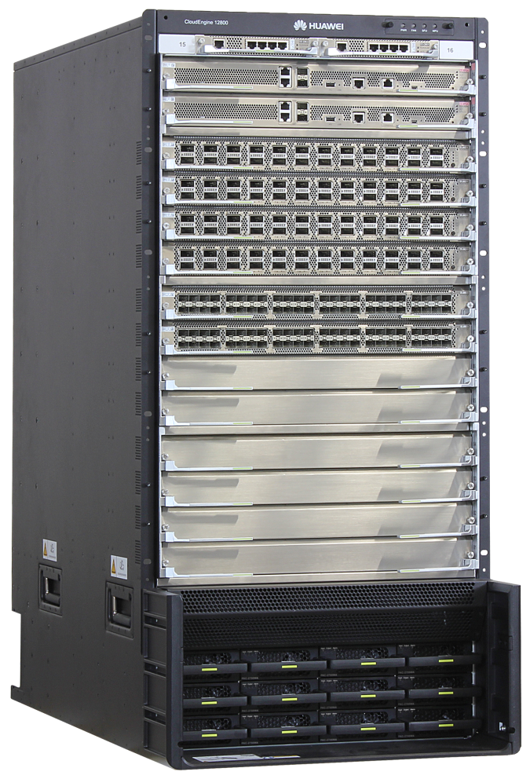
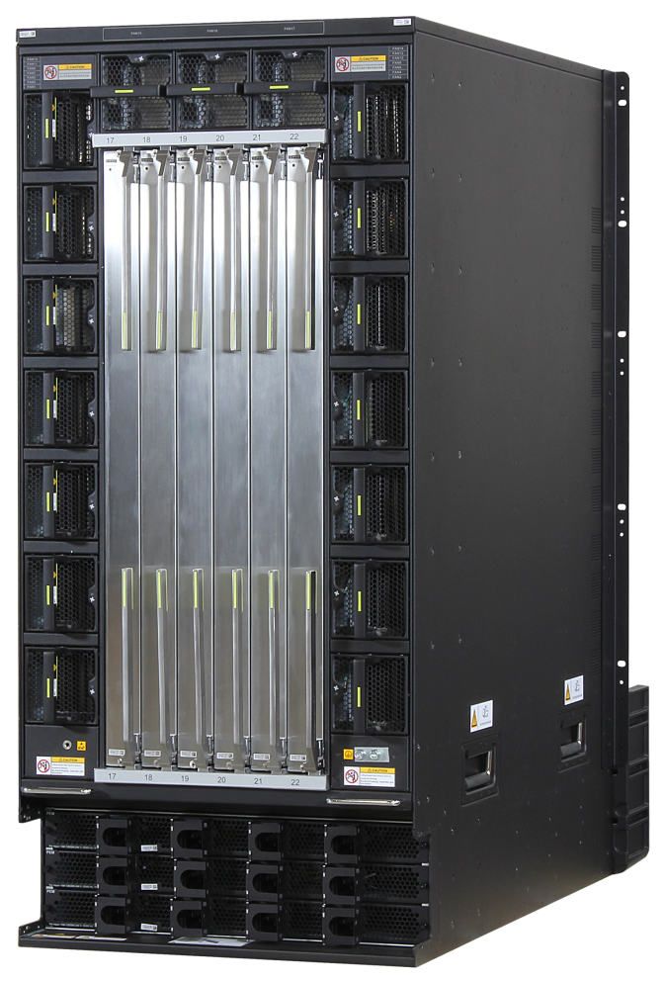
CE12812 Core Switch
CMU: 1+1 backup mode
MPU: 1+1 backup mode
Fan modules: total of 17, 1+1 backup mode
LPU: total of 12
SFU: 5+1 backup mode
Air intake frame
Power modules: 6+6 backup mode
Power frame: total of 3, 12-way AC power
Front view
Rear view
Notes:
CMU: Centralized Monitoring Unit
MPU: Main Processing Unit
LPU: Line Process Unit
SFU: Switch Fabric Unit

Slide 33
Replaceable Parts
Parts | Impact on Services
Card | If no backup card is available, services will be interrupted.
 | If cards such as SRUs work in backup mode, replacing one card may interrupt services.
Power supply | If no backup power supply is available, services will be interrupted.
 | If a backup power supply is available, replacing one power supply will not interrupt services.
Fan module | If no backup fan module is available, replacing the existing fan within 2 minutes will not interrupt services.
 | If a backup fan module is available, replacing one fan module will not interrupt services.
Optical module | Services will be interrupted.
Cable | Replacing an internal power cable (single-cable) in a cabinet will interrupt services on the device.
 | Replacing an optical fiber or a cable will interrupt services over that fiber or cable.

Slide 34
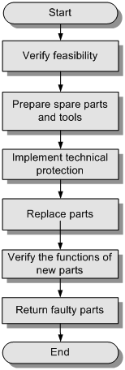
Parts Replacement Process
Notes:
Determine the feasibility of parts replacement.
Before replacing a part for equipment troubleshooting or maintenance, determine the following aspects of operation feasibility:
Ensure that the spare part is available in the storehouse. If the spare part is not available, contact Huawei for technical support.
Ensure that the maintenance personnel have the following qualifications:
Be trained or certified in accordance with local safety regulations.
Know the functions of each part on the CE series switches.
Understand the operations of parts replacement.
Have skills relevant to parts replacement.
Ensure that the risks associated with parts replacement are controllable. Before replacing a part, conduct a thorough risk assessment. You should assess whether the risks can be controlled by taking protective measures without powering off the device. Parts replacement must be performed only when the risks are controllable. If the risks cannot be controlled, contact Huawei for technical support.

Slide 35
Notes:
Prepare spare parts and tools.
Place the spare part in an ESD bag or ESD tote box during transportation.
Sort and register the spare parts, especially important parts such as cards, so that you can find the required spare parts quickly.
Take system protective measures.
Parts replacement may have risks. You can reduce the risks and minimize impact on services by taking the proper protective measures. For example, before replacing the active MPU, back up data files and configuration files on the active MPU, and then switch the services of the active MPU to the standby MPU. Replace the original active MPU after the original standby MPU becomes the new active MPU. This avoids the risks that may be caused by card replacement.
Replace the parts.
After checking that protective measures are available, maintenance personnel can carry out parts replacement according to corresponding precautions.
Verify the functions of the new parts.
Verify the functions of the new parts after replacement. The replacement task is complete only when all the new parts function properly. If a part does not function properly, contact Huawei for technical support.
Verification methods include viewing LED status, querying card status, and querying port status.
Return the faulty parts to Huawei for repair.
Fill in the Fault Tag. Send the Fault Tag together with the faulty parts to Huawei for repair.
When returning the equipment for repair, package and transport it properly.
Properly keep the faulty parts that do not need repair, such as cables.

Slide 36
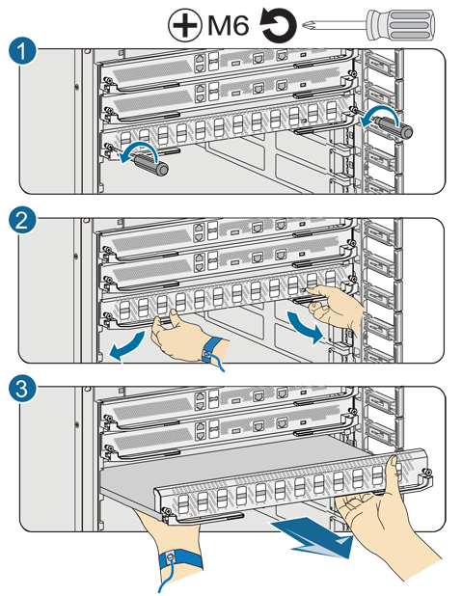
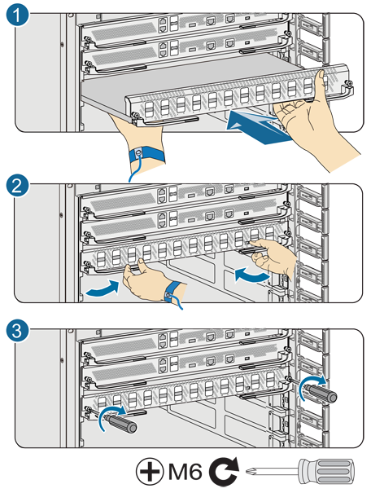
Common Card Replacement Methods
Removing a card
Installing a card
Notes:
Wear an ESD wrist strap and insert the ground terminal into the ESD jack on the cabinet, or wear ESD gloves.
Select a spare card. The new card must be of the same type as the old card. If their types are different, ensure that the cards are compatible. Make sure that the components on the new card are not damaged or missing and record the bar code on the new card.
Record the location of the cables and check whether the labels on the cables are correct and clear. If the labels are hard to identify, attach new labels to the cables.
Remove cables from the card to be replaced.
Remove the card.
Loose the captive screws at both ends of the card with a screwdriver, as shown in (1) in left figure.
Raise the ejector levers to separate the card from the backplane, as shown in (2) in left figure.
Grasp the ejector levers and pull out the card smoothly and slowly along with the guide rail of the slot, as shown in (3) in left figure.
CAUTION: When removing the card, do not touch the components on other cards.

Slide 37
Notes:
Install a new card.
Raise the ejector levers of the new card and insert the card into the slot smoothly and slowly along with the guide rail, as shown in (1) in the right figure.
When the ejector levers touch the chassis, lower the ejector levers to completely install the card into the chassis, as shown in (2) in the right figure.
Fasten the captive screws at both ends of the card with a screwdriver, as shown in (3) in the right figure.
Connect cables or optical modules to the new card in sequence.
View the RUN/ALM indicator status of the new card.
NOTE: The card automatically starts and registers within 7 minutes.
When the RUN/ALM indicator blinks green four times every second (4 Hz), the card is starting.
When the RUN/ALM indicator blinks green once every two seconds (0.5 Hz), the card is running.
Precautions for Replacing Cards
Card storage and transportation:
Handle a card carefully when it is outside the cabinet (chassis). Take ESD protection measures. Place the card horizontally. Keep the printed circuit board (PCB) side facing down. Do not place any objects on the card.
Do not place a card in a humid environment or direct sunlight. Ensure that the environment where the card is temporarily stored is suitable for storage.
If only the ESD bag is used as the protection material, do not stack multiple cards together for transportation.
Card installation and removal:
Take ESD protection measures before replacement, and do not touch the surface of the PCB.
Before installing or removing a card, ensure that the card is not connected to any cables. If the card is connected to cables, attach labels to the cables. The labels record relationships between the cables and their connected ports to the cables. When inserting or removing an optical fiber, do not look directly at the optical port or connector without eye protection. The laser emitted from the optical port can injure your eyes.
Install and remove a card smoothly along the guide rail,

Slide 38
Notes:
properly place the tools, and prevent short circuits caused by metallic objects.
Connect optical modules and cables to ports on a new card according to the labels attached to the cables.
Other Precautions
LPU
Removing an LPU that is loading a program can damage the program. Therefore, before replacing an LPU, make sure that the LPU is not loading any program. When a card is loading a program, the RUN/ALM indicator of this card blinks green four times every second (4 Hz).
MPU
If the system can be operated using the CLI, perform Saving Data before replacing the MPU.

Slide 39
Querying Card Information
Log in to the switch.
Run the display device command to view the type and status of the new card. View the Type field to check whether the card type is correct. If the Register field is displayed as Registered, the card is registered successfully. If the Alarm field is displayed as Normal, the card is running properly.
Run the display version command to view the card software version, hardware type, and information about the MPU and LPUs.
<HUAWEI> display device
CE12804's Device status:
------------------------------------------------------------------------
Slot Sub Type Online Power Register Alarm Primary
------------------------------------------------------------------------
3 _ CE-L24XS-EA Offline - Unregistered - NA
4 _ CE-L24XS-EA Present On Registered Normal NA
5 _ CE-MPUA Present On Registered Normal Master

Slide 40
Replacing the MPU (Single MPU)
The MPU faults are classified into two types:
Complete fault: Services are interrupted and the CLI operation cannot be performed.
Remove the MPU and install the new one. For details about card installation, see Common Card Replacement Methods.
Incomplete fault: Services are still available and the CLI operation can be performed.
Install the new MPU into the standby MPU slot.
Run the slave switchover command to perform an active/standby switchover.
After removing cables from the MPU to be replaced, remove the MPU.
Notes:
Fault Type 1: Services Are Interrupted
CAUTION: Install the component slowly and horizontally to prevent it from colliding with other cards, and do not touch the components.
Log in to the BIOS menu of the MPU through the serial port and copy the configuration and license files from the MPU.
The operation procedure is as follows:
Wear an ESD wrist strap and insert the ground terminal into the ESD jack on the cabinet, or wear ESD gloves.
Take out the new MPU from the package box, and make sure that the components on the new MPU are not damaged or missing.
Record the cable locations on the MPU and check whether the labels on the cables are correct and clear. If the labels are hard to identify, attach new labels to the cables.
Remove cables from the MPU to be replaced.
Remove the MPU and install the new one. For details about card installation, see Replacing Cards. NOTE: The system software version on the new MPU must be the same as that on the MPU to be replaced.
View the RUN/ALM indicator status of the new MPU. NOTE: The new MPU automatically starts and registers. This process lasts 5 minutes.

Slide 41
Notes:
When the RUN/ALM indicator blinks green four times every second (4 Hz), the MPU is starting.
When the RUN/ALM indicator blinks green once every two seconds (0.5 Hz), the MPU is running.
Connect the cables to the new MPU in sequence.
Fault Type 2: Services Are Still Available
CAUTION: Install the component slowly and horizontally to prevent it from colliding with other cards, and do not touch the components.
Data has been loaded to the flash of the new MPUs when they leave the factory.
The system software version on the new MPU must be the same as that on the old MPU.
The operation procedure is as follows:
Wear an ESD wrist strap and insert the ground terminal into the ESD jack on the cabinet, or wear ESD gloves.
Take out the new MPU from the package box, and make sure that the components on the new MPU are not damaged or missing.

Slide 42
Notes:
Install the new MPU into the standby MPU slot. For details about card installation, see Replacing Cards. View the RUN/ALM indicator status of the new MPU. NOTE: The new MPU automatically starts and registers. This process lasts 5 minutes.
When the RUN/ALM indicator blinks green four times every second (4 Hz), the MPU is starting.
When the RUN/ALM indicator blinks green once every two seconds (0.5 Hz), the MPU is running.
Run the dir command to check whether the configuration file name is the same as the replaced one. If so, synchronization succeeds. If not, synchronize the configuration file to the new MPU. For details, see Saving Data.
Run the slave switchover command to perform an active/standby switchover.
Run the display switchover state command to check the switch. Wait until the Switchover State field displays Ready and remove the MPU you want to replace.
Record the cable locations on the MPU and check whether the labels on the cables are correct and clear. If the labels are hard to identify, attach new labels to the cables.
After removing cables from the MPU to be replaced, remove the MPU. For details about how to remove an MPU, see Replacing Cards.
Connect the cables to the new MPU in sequence.
Follow-up Procedure
Verify the functions of the new MPU.
Run the display device command to view the running status of the new MPU.
Run the display startup command to view the system software and configuration file for next startup. The data on the new MPU must be the same as the data on the old MPU.
Run the display current-configuration command to view the configured parameters. The data on the new MPU must be the same as the data on the old MPU.

Slide 43
Replacing the MPU (Dual MPUs)
Before replacing an active MPU, perform an active/standby switchover. Before replacing a standby MPU, you do not need to back up service data.
Run the slave switchover command to perform an active/standby switchover if the active MPU needs to be replaced.
Run the display switchover state command to check the switch status. Continue your operations until the Switchover State field displays as Ready.
Notes:
CAUTION:
Before replacing an active MPU, perform an active/standby switchover. Before replacing a standby MPU, you do not need to back up service data.
Install the component slowly and horizontally to prevent it from colliding with other cards, and do not touch the components.
Data has been loaded to the flash of the new MPUs when they leave the factory. After being installed into the chassis, the new MPU automatically synchronizes the system software from the active MPU.
Procedure
Wear an ESD wrist strap and insert the ground terminal into the ESD jack on the cabinet, or wear ESD gloves.
Take out the new MPU from the package box, and make sure that the components on the new MPU are not damaged or missing.
Run the slave switchover command to perform an active/standby switchover if the active MPU needs to be replaced.
Run the display switchover state command to check the switch status. Continue your operations until the Switchover State field displays as Ready.

Slide 44
Notes:
Record the cable locations on the MPU and check whether the labels on the cables are correct and clear. If the labels are hard to identify, attach new labels to the cables.
After removing the cables of the MPU to be replaced, remove the MPU from the chassis and install a new one. For details about card installation, see Replacing Cards.
View the RUN/ALM indicator status of the new MPU.
NOTE: The new MPU automatically starts and registers. This process lasts 5 minutes.
When the RUN/ALM indicator blinks green four times every second (4 Hz), the MPU is starting.
When the RUN/ALM indicator blinks green once every two seconds (0.5 Hz), the MPU is running.
Connect the removed cables to the new MPU in the sequence specified by labels and synchronize the configuration file to the new MPU. For details, see Saving Data.
Follow-up Procedure
Verify the functions of the new MPU.
Run the display device command to view the running status of the new MPU.
Run the display startup command to view the system software and configuration file for next startup. The data on the standby MPU must be the same as the data on the active MPU.
Run the display current-configuration command to view the configured parameters. The data on the new MPU must be the same as the data on the old MPU.
NOTE: The network monitoring engineer or system maintenance engineer can configure the software using the CLI.

Slide 45
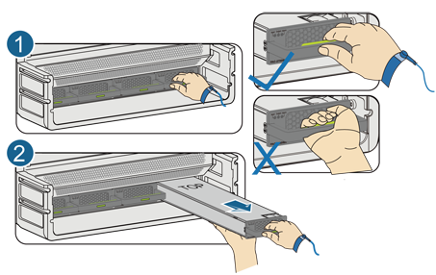
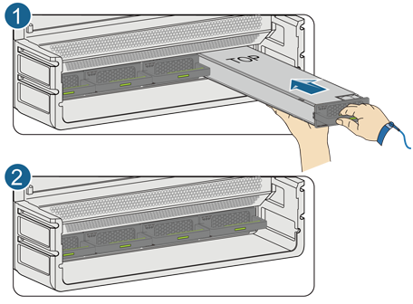
Replacing Power Modules
Before replacing a power module, switch off the corresponding circuit breaker on the power distribution frame to power off the power module.
Exercise caution when replacing a power module to prevent scald.
Removing a power module
Installing a power module
Notes:
Procedure
Check the position of the power module to be replaced.
Before removing a power module, find the cabinet and chassis where the power module resides. Then attach a label to the panel of the power module to identify it.
Wear an ESD wrist strap and connect the ground terminal to the ESD jack on the chassis.
Switch off the corresponding circuit breaker on the power distribution frame to power off the power module.
Remove the power module from the chassis.
Remove the cables from the power module.
Unlock the power module. Use three fingers to press the release button at the interior of the handle, as shown in (1) of the left figure.
Remove the power module. Slowly pull out the power module with one hand and hold the power module with the other hand, as shown in (2) of the right figure.
Insert the spare power module into the chassis.
Identify the top and bottom of the power module. Keep the top of the power module (marked with TOP) facing up, as shown in (1) of the right figure.

Slide 46
Notes:
When the fan module installed in an upper fan slot, its top faces up.
When the fan module installed in a fan slot at the left of the chassis, its top faces right.
When the fan module installed in a fan slot at the right of the chassis, its top faces left.
Insert the fan module into the fan slot. Hold the handle of the fan module with one hand and support the bottom with the other hand to slowly push the fan module along the guide rails, until the power module is locked into the chassis, as shown in (2) of the right figure.
Insert the power module into the power slot. Hold the handle of the power module with one hand and support the bottom with the other hand to slowly push the power module along the guide rails, until the power module is locked into the chassis, as shown in the right figure.
Connect the cables to the power module in sequence.
Switch on the corresponding circuit breaker on the power distribution frame to power on the power module.
Verify the functions of the new power module.
After installing the power module, check whether the power module functions normally:
If the Alarm indicator on the panel of the power module is green, the power module runs normally. If the indicator is red, the power module is abnormal.
Run the display device command to check the running status of the new power module.

Slide 47
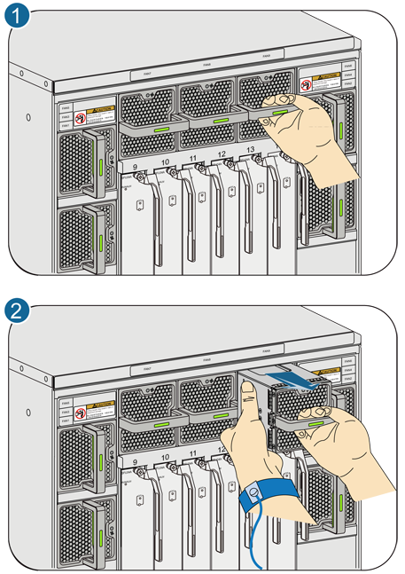
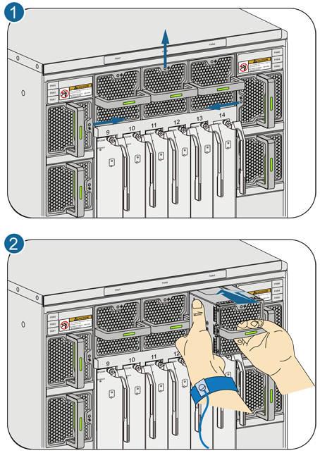
Replacing a Fan Module
Do not remove the active and standby fan modules simultaneously; otherwise, the device temperature will increase quickly, severely affecting the safety and stability of the device.
Exercise caution when replacing a fan module to prevent scald.
Removing a fan module
Installing a fan module
Notes:
Procedure
Check the location of the fan module to be replaced.
Before removing a fan module, find the cabinet and chassis where the fan module is located. Then attach a label to the panel of the fan module to identify it.
Wear an ESD wrist strap and connect the ground terminal to the ESD jack on the chassis.
Remove the fan module from the chassis.
Unlock the fan module. Use three fingers to press the release button at the interior of the handle, as shown in (1) of the left figure.
Remove the fan module. Slowly pull out the fan module with one hand and hold the power module with the other hand, as shown in (2) of the left figure.
Install the spare fan module into the chassis.
Identify the top and bottom of the fan module. The plane closest to the status indicator of the fan module is the top, and the opposite plane is the bottom. (1) of the right figure shows the installation position of a fan module in different fan slots. The top of a fan module faces different directions when the fan module installed in different fan slots of a chassis:

Slide 48
Installing a fan module
Notes:
Verify the functions of the new fan module.
After a new fan module is inserted into the chassis, the fan operates at 40% of the maximum speed for about 10 seconds, and then the fan module intelligently adjusts the fan speed. You can use the following ways to check whether the fan module functions properly:
If the status indicator on the panel of the fan module blinks green once every two seconds (0.5 Hz), the fan module runs normally. If the indicator is red, the fan module is not working properly.
Run the display device fan command to view the running status of the new fan module.

Slide 49
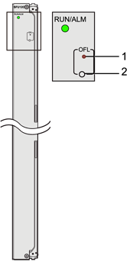
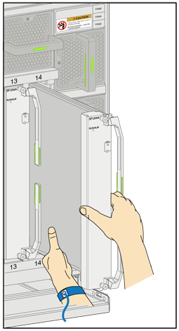
Replacing an SFU
The CE-SFUs of different series cannot be used in the same chassis.
1、OFL indicator | 2、OFL button
Notes:
Before replacing an SFU, read the following requirements:
The CE-SFUs of different series cannot be used in the same chassis. For example, CE-SFU04As, CE-SFU04Bs, and CE-SFU04Cs cannot be installed on the same CE12804 chassis. A CE12804 chassis can have only one type of these CE-SFUs installed. NOTE: You can determine which series an SFU belongs to according to the name of the SFU.
To install or remove an SFU, hold the bottom of the SFU with one hand and hold the front panel with the other hand. Gently push or pull the SFU, as shown in the left Figure.
Install the component slowly and horizontally to prevent it from colliding with other cards, and do not touch the components.
CAUTION: To ensure that services are not affected when an SFU is replaced, hold down the OFL button before removing a running SFU. Remove the SFU when the SFU is isolated from the system (its OFL indicator turns red). You can directly replace an unregistered SFU and do not need to press the OFL button. When an SFU is running properly, its RUN/ALM indicator blinks green once every 2s (0.5 Hz) and its OFL indicator is off. the right figure shows the OFL indicator and OFL button.

Slide 50
Notes:
Procedure
Check the location of the SFU to be replaced.
Before replacing an SFU, find the cabinet and chassis where the SFU is located. Then attach a label on the panel of the SFU to avoid misoperation.
Take out a new SFU from the package. Check that no component on the SFU is damaged or missing.
Wear an ESD wrist strap and connect the ground terminal to the ESD jack on the chassis.
If the SFU is running, hold down the OFL button on the SFU for more than 6 seconds, until the OFL indicator turns red.
Remove the old SFU from the chassis and install a new one. For details on how to remove and install a card, see Replacing Cards.
View the RUN/ALM indicator status of the new SFU.
The new SFU automatically starts and registers after it is installed in the chassis. This process lasts less than 5 minutes.
When the RUN/ALM indicator blinks green four times every second (4 Hz), the SFU is starting or resetting.
When the RUN/ALM indicator blinks green once every two seconds (0.5 Hz), the SFU is running.
Verify the functions of the new SFU.
After installing a new SFU, check whether the SFU functions normally:
If the RUN/ALM indicator is steady red, the SFU functions abnormally.
Run the display device command to check the running status of the new SFU.

Slide 51
Precautions for Replacing Optical Modules
When replacing an optical module, do not look directly at optical port without eye protection. The laser emitted from the optical port can injure your eyes.
WARNING:
Be careful when you remove or insert an optical fiber to prevent damage to the fiber connector.
An optical module is an electrostatic sensitive device. Always take ESD protection measures when replacing an optical module to prevent the optical module from being damaged.
An optical module cannot be inserted inversely. If you cannot completely insert an optical module into the port, do not force it. Instead, reverse it and insert it into the port again.
Notes:
Follow the rules to replace an optical module:
Ensure that the new optical module and the optical module to be replaced have the same center wavelength and support the same standards.
Install dust-proof caps on ports when removing optical fibers from optical modules.
Before replacing an optical module, remove all fibers from it. Exercise caution when removing the optical module to prevent damage.

Slide 52
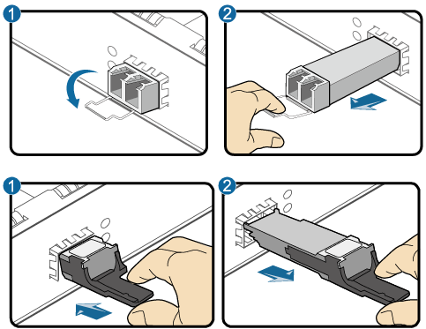
Replacing Optical Modules
Hold the handle to pull out the optical module, as shown in the figure.
On a two-fiber bidirectional optical port, if the LINK indicator is off, swap the two fibers.
Notes:
Configuration Limitations
The copper module, high speed cable, and optical module have different configuration limitations. After you replace a module with a module of a different type, the interface configuration may be modified. Therefore, you need to confirm the interface configuration after installing a new module.
Note the following when an electrical module, a high speed cable, or an optical module is installed on a 10G card. When a 1000 Mbit/s copper module is installed on the 10G optical port, the port supports 1000 Mbit/s auto-negotiation and full duplex mode. The port cannot be set to work in non-auto negotiation mode.
When a 1000 Mbit/s optical module is installed on the 10G optical port, the port supports 1000 Mbit/s auto-negotiation and full duplex mode. The port can also be set to work in non-auto negotiation mode.
When a 10 Gbit/s optical module or a high speed cable is installed on the 10G optical port, the port works at a rate of 10 Gbit/s and supports non-auto negotiation and full duplex mode. The port cannot be set to work in auto-negotiation mode.

Slide 53
Notes:
Note the following when a high speed cable or an optical module is installed on a 40G card.
When a high speed cable is installed on the 40G optical port, the port supports 40 Gbit/s auto-negotiation and full duplex mode. The port cannot be set to work in non-auto negotiation mode.
When a 40 Gbit/s optical module is installed on the 40G optical port, the port works at a rate of 40 Gbit/s and supports non-auto negotiation and full duplex mode. The port cannot be set to work in auto-negotiation mode.

Slide 54
Precautions for Replacing Cables
Take ESD protection measures before replacement.
When replacing the ground cable, be sure to take electrical and mechanical safety precautions.
When removing a cable, do not pull other cables. Prevent the cables from being twisted.
When installing or maintaining an optical interface card or optical fiber, do not look at the optical interface or fiber connector without eye protection.
Notes:
Power cables
Precautions
Back up service data before replacing the cable.
Cut off the input power before replacing the cable.
Insulate the power cable terminals and other exposed electrical parts.
Ensure correct polarity when connecting power cables.
Operation Suggestions
Before the replacement, attach labels to the switches that need to be operated.
Attach labels to the power switches that are not allowed to be operated.
Check the labels on power cables and ensure that the new power cables are connected in the same sequence as the replaced ones.
Cable
NOTE: The cables include Ethernet cables and high speed cables.
Precautions
During replacement of a cable, the services transmitted over the cable are interrupted.

Slide 55
Notes:
If you need to replace more than one cable, attach temporary labels to the new cable for identification. The new cable must be numbered consistently with the cable to be replaced.
NOTE: For details about limitations on high-speed cable configurations, see Configuration Limitations in replacing optical modules.
Operation Suggestions
To remove a cable, gently push the cable connector and pull the handle on the connector.
Optical Fibers
Precautions
Select the optical fiber based on the mode (single-mode or multimode) of the optical module, the type of the fiber connector, and the required optical fiber length.
Be careful when you remove or insert an optical fiber to prevent damage to the fiber connector.
The curvature radius of an optical fiber should be 20 times greater than its diameter. Generally, the curvature radius is not less than 40 mm.
If the fiber connector is not clean, use alcohol cotton or dust-free tissue to wipe it in only one directions.

Slide 56
Precautions for Replacing an Air Filter Sponge
To ensure good heat dissipation and prevent dust accumulation on an air filter sponge, periodically clean and replace the air filter sponge on the air filter door. It is recommended that an air filter sponge be cleaned at least once every three months and be replaced once every year. When an air filter sponge is used in a dusty environment, it needs to be cleaned and replaced more frequently. When an over temperature alarm is generated on a switch, check whether its air filter sponge is blocked. If the air filter sponge is blocked, clean or replace it immediately.

Slide 57
Routine Maintenance Items Introduction
Maintain Commonly Used Methods and Equipment Environmental Checks
Methods for Handling Sx7 Switch Password Loss
CE Switches Parts Replacement
AR and NE Routers Common Maintenance Commands
USG Common Troubleshooting

Slide 58
Common Maintenance Commands (1)
Command | Function
dir | Displays the information on the specified file or directory in the storage device of the S7700.
display alarm { slot-id | all } | Displays alarms.
display bgp peer | Displays the information on BGP peers.
display clock | Displays the current date and time of the S7700.
display cpu-usage | Displays the information on CPU usage.
display current-configuration | Displays the current valid parameters of the S7700.
display fan | Displays the status of the fan.
display fib | Displays the total number of the FIB entries.
display device [ pic-status | slot-id ] | Displays the basic information on the routers.
display ftp-server | Displays the parameters of the current FTP server.
display interface | Displays the operating status and statistics of an interface.

Slide 59
Common Maintenance Commands (2)
Command | Function
display ip interface [ interface-type interface-number ] | Displays the detailed IP-related configurations and statistics of an interface. The packets, bytes, and multicast packets transmitted and received, and broadcast packets received, sent, and discarded are included.
display ip routing-table | Displays the brief information of the IPv4 routing table.
display isis peer | Displays the IS-IS peer relationship.
display logbuffer | Displays the record in the log buffer.
display memory-usage | Displays the CPU usage of the routers.
display ospf [ process-id ] brief | Displays the brief information of OSPF.
display ospf [ process-id ] peer | Displays OSPF neighbors.
display rip process-id neighbor | Displays RIP neighbors.
display patch-information | Displays the status of the patch.
display power | Displays the status of the power supply.

Slide 60
Common Maintenance Commands (3)
Command | Function
display saved-configuration | Displays the configuration files for next startup of the routers.
display startup | Displays the system software and the configuration file names related to the current and next startup.
display switchover state | Displays the backup status of the active and standby boards.
display temperature | Displays the status of the slot temperature sensor.
display trapbuffer | Displays the record in the alarm buffer.
display voltage slot slot-id | Displays the status of voltage sensor in the specified slot.
display version | Displays the version of system software.
ping | Displays IP network connection.
tracert | You can check whether the host is reachable.
 | Tests the gateways the packets pass through from the host to the destination.
 | You can check the network connection to locate the faults.

Slide 61
Routine Maintenance Items Introduction
Maintain Commonly Used Methods and Equipment Environmental Checks
Methods for Handling Sx7 Switch Password Loss
CE Switches Parts Replacement
AR and NE Routers Common Maintenance Commands
USG Common Troubleshooting

Slide 62
Packet Tracing Principle
Packet tracing displays key path information during packet forwarding. Based on this information, the administrator understands how packets are processed and why packets are discarded.
Currently, packet tracing falls into the following situations:
Real packet tracing
Constructed packet tracing

Slide 63
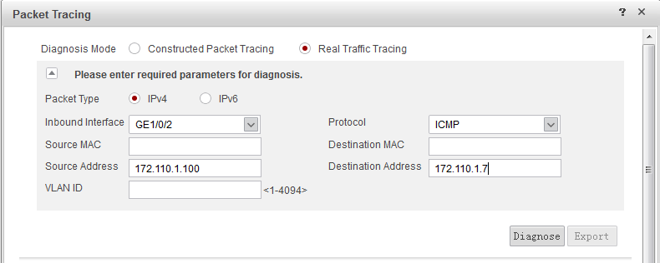
Real Packet Tracing
Key paths of real service traffic are traced based on a configured quintuple.

Slide 64
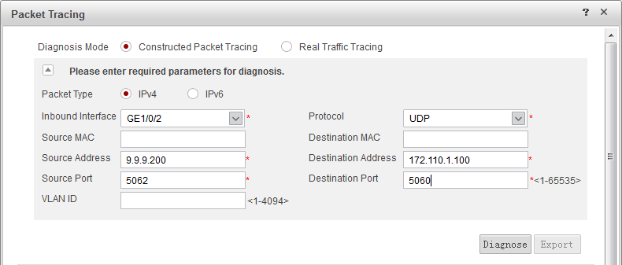
Constructed Packet Tracing
Service packets are constructed as if they were forwarded on the NGFW. Constructed packet tracing helps check whether the current configuration applies to actual service situations. Only simple packets (Layer-2 and Layer-3 headers) are constructed.

Slide 65
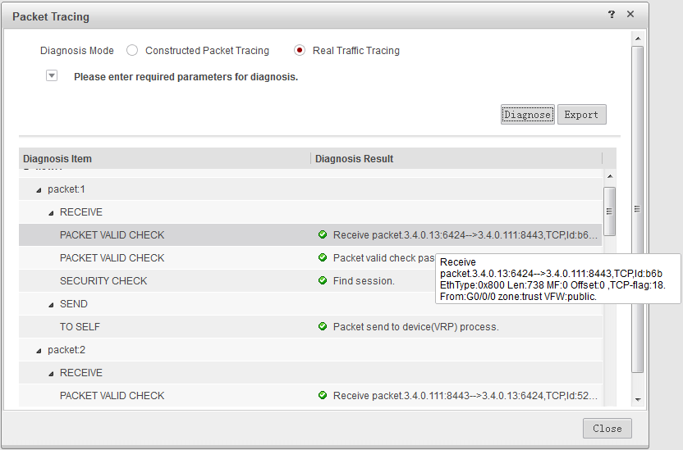
Packet Tracing Result

Slide 66
Quintuple Packet Discarding Statistics
In addition to ACL statistics, quintuple packet discarding statistics can be displayed on the web UI, including statistics on packets that are not received. The statistics displayed on the web UI sum up statistical data of each flow and show fragment statistics. Statistics on packets that are not received can be collected based on a specified quintuple to monitor the continuity of TCP packet sequence numbers.

Slide 67
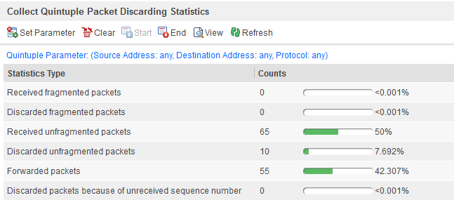
Packet Statistical Dimensions
Notes:
Received fragmented packets: indicates the number of fragments entering the NGFW based on a configured quintuple.
Discarded fragmented packets: indicates the number of fragments discarded due to attack defense, rate limiting, lack of routes, or ARP MISS based on a configured quintuple.
Received unfragmented packets: indicates the number of packets entering the NGFW based on a configured quintuple.
Discarded unfragmented packets: indicates the number of packets discarded due to attack defense, rate limiting, lack of routes, or ARP MISS based on a configured quintuple.
Forwarded packets: indicates the number of forwarded packets (including fragments and non-fragmented packets) based on a configured quintuple.
Discarded packets because of unreceived sequence number: indicates the number of packets discarded before entering the NGFW based on a configured quintuple used to monitor the continuity of TCP packet sequence numbers.

Slide 68
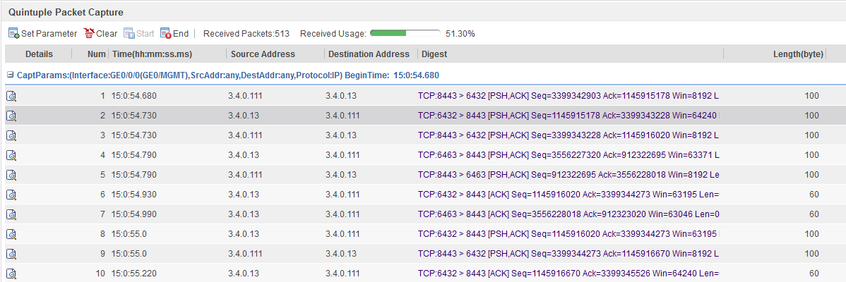
Quintuple Packet Capture
Quintuple packet capture enables an NGFW to copy passing packets and save or display them in a certain format.
Notes:
If the NGFW or service is faulty and the fault cannot be located after you check the configuration and statistics, you can enable quintuple packet capture for the NGFW to capture headers (payloads are not captured or displayed to prevent sensitive information leaks) of a specified flow for fault analysis.

Slide 69
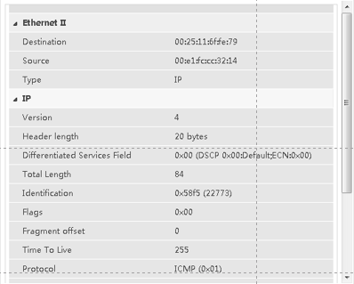
Quintuple Packet Capture

Slide 70
Device Health Check (1)
Notes:
The health score represents the conditions of the network where the NGFW and its server reside. A higher score indicates a healthier condition and a better server performance. If the score is low, service efficiency is reduced or a fault occurs. The health score is calculated based on scores in four dimensions (hardware health, network and service health, resource use, and system health) and weights. Metrics in each dimension are classified based on features, as shown in the above figure.

Slide 71
Device Health Check (2)
If the device health score is low, find the cause and remediation suggestions. The total score is calculated using the following formula: S = (S1 + S2 + S3 + S4)/4 x W. In this formula, S represents the total score; S(i) indicates the score of each dimension; W means the weight of the dimension with the lowest score. The weight of each dimension can be 1 for 100 (score), 0.9 for 90, 0.8 for 70, and 0.7 for 50.
For example:
Example | Formula | Health Score
1 | (100+100+100+90)/4 x 0.9 | 88
2 | (100+100+70+70)/4 x 0.8 | 68
3 | (90+90+90+70)/4 x 0.8 | 68
4 | (90+90+70+70)/4 x 0.8 | 64
5 | (90+70+70+70)/4 x 0.8 | 60
6 | (100+100+100+50)/4 x 0.7 | 61

Slide 72
Hardware Health
 | Dimension | Metric
Hardware health | Hardware resource | None (100): The power and fan modules work properly. The temperature is normal. Warning (90): single power module Minor (70): The ambient temperature exceeds the threshold. Major or higher (50): The fan module is faulty.

Slide 73
Network and Service Health
 | Dimension | Metric
Network and service health | Server | None (100): All servers work properly. Warning (90): N/A Minor (70): One server does not work properly. Major or higher (50): Configured servers become invalid. Note: Servers refers to NAT , DNS, RADIUS, and AD servers.
 | Network use | None (100): All indicators are normal. Warning (90): The uplink direction has error packets. There are packets whose TTL is 0. Minor (70): One uplink interface is Down. Major or higher (50): The bandwidth usage of any uplink interface is higher than 95% or all upstream interfaces are Down.
 | IPSec service | None (100): All indicators are normal. Warning (90): 0 < IPSec service packet discarding rate < 50% Maximum IPSec connection rate < 50% Minor (70): 50% < IPSec service packet discarding rate < 80%； Major or higher (50): 80% < IPSec service packet discarding rate

Slide 74
Resource Use
 | Dimension | Metric
Resource use | Resource usage | None (100): Usage of all resources is within the threshold. Warning (90): The resource usage does not have this grade. Minor (70): The session usage exceeds 95% of the specifications; the memory usage exceeds 90%; the CPU usage exceeds 90%. Major or higher (50): The CPU usage exceeds 98%; the memory usage is 100%; the session usage reaches the specifications. Note: The memory and CPU usage refers to that on the data plane. This data keeps consistent with that on the web UI.

Slide 75
System Health
 | Dimension | Metric
System health | System security | None (100): All metrics are normal. Warning (90): 0 < DDoS attack traffic proportion < 50% 0 < AV/IPS alarm or blocking events Minor (70): 50% <= DDoS attack traffic proportion Note: AV/IPS blocking and alarm events are read from the Engine.
 | System configuration security | None (100): Upgrades are properly performed. Warning (90): No AV/IPS database is loaded. The license is not activated. The license is activated but not loaded. The AV database has been not updated for more than 10 days; The IPS database has not been updated for more than 15 days; the SA database has not been updated for more than 30 days. Attack defense is not configured. The default security policy is in use. Minor (70): The AV database has been not updated for more than 20 days; The IPS database has not been updated for more than 45 days; the SA database has not been updated for more than 60 days.

Slide 76
What is the purpose of routine maintenance?
What are the common methods of maintenance?
Notes:
What is the purpose of routine maintenance?
It is carried out regularly during the normal running of a device. Routine maintenance is to detect and remove the defects or potential hazards in time. Therefore it is essential for secure, stable, and reliable running of the device in a long period.
What are the common methods of maintenance?
Analyzing the indicator status
Analyzing alarm logs
Replacing a component or device
Ping
Observing
Removing and reinserting connectors
Isolating a faulty part
Self-check
Tightly reconnecting a chip or connector

Slide 77
Routine Maintenance Items Introduction
Maintain Commonly Used Methods and Equipment Environmental Checks
Methods for Handling Sx7 Switch Password Loss
CE Switches Parts Replacement
AR and NE Routers Common Maintenance Commands
USG Common Troubleshooting

Slide 78
Huawei Learning Website
http://support.huawei.com/learning/Index!toTrainIndex
Huawei Support Case Library
http://support.huawei.com/enterprise/servicecenter?lang=zh

Slide 79
Cloud DC solution
http://e.huawei.com/cn/solutions/business-needs/data-center

