Slide 1
OHPSW2211
SX7
V2R9
1.50
Wangdong
2017.1.18
Yan Jiangang
New
Yuan Weihua/WX462781
2019.4.10
Liu Lican/00180730
New
Notes:
1.02
Update the note view style, translate P27 note

Slide 2
Introduction to Huawei Data Center S Series Switches
Huawei Data Center Series of Courses

Slide 3
The Quidway S2700/S3700/S5700/S6700 Series Ethernet switches (hereinafter referred to as the SX7 fixed switch) provide the access, aggregation, and data transport functions. They are developed by Huawei to meet the requirements for reliable access and high-quality transmission of multiple services on the enterprise network.
The S-Series modular switch applies to enterprise campus networks, helping enterprises build an Ethernet network.

Slide 4
Upon completion of this course, you will be able to:
  Describe SX7 fixed switch product positioning
  Describe SX7 fixed switch sub-cards and modules
  Describe SX7 fixed switch product characteristics
  Describe SX7 fixed switch typical application scenarios

Slide 5
Overview of S Series Fixed Switches
Overview of S Series Modular Switches
Sub-cards and Modules
Product Features

Slide 6


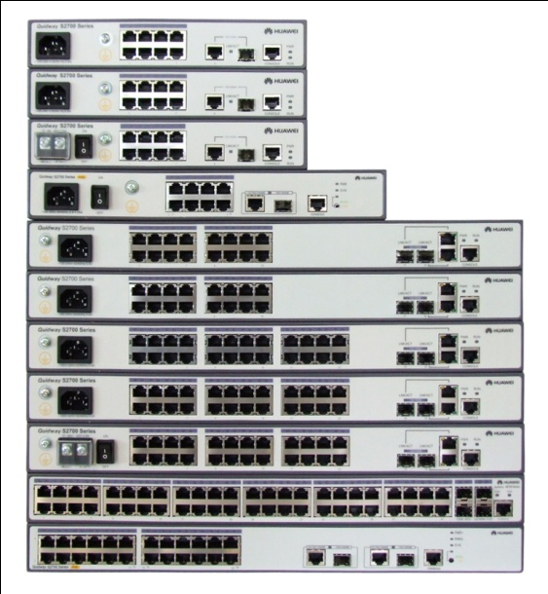


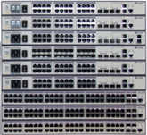







SX7 Series Ethernet Switches Family
10000M
S6700 L3 Switch
100M
1000M
100M
S2700 L2 Switch
S3700 L3 Switch
S5700 L2/L3 Switch
Notes:
In terms of product functions, the S1700, S2700, S5700LI are Layer 2 switches, while the S3700, S5700 (except the S5700LI) and S6700 are Layer 3 switches.
(Compared with Layer 2 switches, Layer 3 switches support Layer 3 features such as dynamic routing protocols in addition to Layer 2 features.
S2700 and S3700 can support to V1R6 software version, S5710LI, S5700SI, S5700EI, S5700HI, S5710HI and S6700 can support to V2R5 software version, and the others can support to higher software version, now is V2R9.

Slide 7

Fixed Switch Naming Conventions
Notes:
A: Switch.
B: Series
6: 10GE downlink ports
5: GE downlink ports
3: Layer 3 switch with 100M downlink ports
2: Layer 2 switch with 100M downlink ports
C: Enterprise series switch
D: Product sub-series (such as 00 or 10)
E: S: resale model
F: Maximum number of ports
NOTE: On an S5710-EI switch (such as S5710-28C-EI), this field indicates the number of fixed ports on the switch.

Slide 8
Notes:
G: Uplink port type:
C: The product supports extended cards and its uplink ports are provided by an extended card or are fixed 10GE ports.
PC: The product supports extended cards and its uplink ports are provided by an extended card or are fixed GE ports.
X: The product has fixed 10GE uplink ports.
TP: The uplink ports of the product include combo ports consisting of electrical and optical ports.
P: The uplink ports of the product are fixed GE optical ports.
NOTE: If the product name does not contain this field, the switch has no uplink port.
H: PoE funtion
PWR: The product supports Power over Ethernet (PoE).
PWH: The product supports PoE++.
NOTE: If the product name does not contain this field, the switch does not support the PoE function.
I: Device type
LI: lightweight version
SI: standard version
EI: enhanced version
HI: high-level version, which supports high-performance operation, administration, and maintenance (OAM) and built-in real-time clock (RTC)
J:Downlink port type
24S: 24 downlink SFP optical ports
48CS: 48 downlink compact SFP (CSFP) optical ports
NOTE: If the product name does not contain this field, all downlink ports of the switch are electrical ports.
K:Power supply type
AC: switch using alternating current power supply
AC1 or ACF: switch using alternating current power supply and sold with high-power PoE power module
DC: switch using direct current power supply
BAT: battery LAN switch

Slide 9
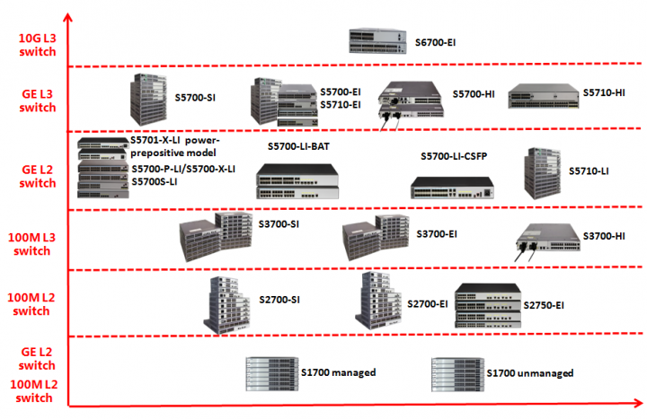
Device Models
Notes:
All the S1700s are Layer 2 switches, some of which provide 100M downstream ports and some provide GE downstream ports. You can distinguish these switches from their product names. The switches with a "G" in their product names have GE downstream ports, for example, S1700-52GFR-4P-AC. The switches without "G" in their product names have 100M downstream ports.
All the S2700s are Layer 2 100M switches.
All the S3700s are Layer 3 100M switches.
The S5700-LI, S5700S-LI and S5710-LI series of the S5700s are Layer 2 GE switches (switches with "LI" in the name are Layer 2 switches), and the rest of the S5700s are Layer 3 GE switches.
The S6700s are Layer 3 10GE switches.

Slide 10
Product Positioning
S2700
For access layer, provides large capacity, high port density, and cost-effective Forwarding performance capabilities.
S3700
For access layer, provides large capacity, high port density, and cost-effective Forwarding performance capabilities.
S5700
For access layer or aggregation layer, provide all 1000M ports.
S6700
For reliable access and high-quality transmission of multiple services on the enterprise network and the data center network. Provide all 10GE ports
Notes:
S2700 positioned for the access layer of enterprise network.
S5700 positioned for the access layer or aggregation layer of enterprise network.
The Quidway S6700 Series series Ethernet switches (hereinafter referred to as the S6700) provide the access, aggregation, and data transport functions. They are developed by Huawei to meet the requirements for reliable access and high-quality transmission of multiple services on the enterprise network and the data center network.
SX7 series switches provide large capacity, high port density, and cost-effective Forwarding performance capabilities. In addition, the SX7 swithes provide multi-service access capabilities, excellent extensibility, quality of service (QoS) guarantee, powerful multicast replication, and carrier-class security, and can be used to build ring topologies of high

Slide 11
Fixed Switches' Network Locations
Recommended deployment locations | S2700 | S3700 | S5700 | S6700
SOHO/Terminal | Access | Access | - | -
Small campus | Access | Access | Aggregation layer/Access layer | -
Medium campus | - | - | Access layer | Aggregation layer
Large campus | - | - | Access layer | Access layer
Data center | - | - | - | Access layer

Slide 12
S2700 Product Positioning
The S2700 series Ethernet switches (S2700 for short) are next-generation energy-saving 100M Ethernet intelligent switches.
The S2700 utilizes cutting-edge switching technologies and Huawei Versatile Routing Platform (VRP) software to meet the demand for multi-service provisioning and access on Ethernet networks. It is easy to install and maintain and supports flexible VLAN deployment, comprehensive security and QoS policies, and energy-saving technologies. These features help enterprise customers build a next-generation IT network.

Slide 13
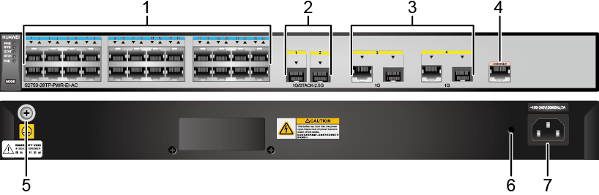
S2750 Appearance and Structure
1 | Twenty-four 10/100BASE-TX electrical ports | 2 | Two 1000BASE-X optical ports
3 | Two combo ports (10/100/1000BASE-T + 100/1000BASE-X) | 4 | One console port
5 | Ground screw NOTE: It is used with a ground cable. | 6 | Jack reserved for AC terminal locking latch.
7 | AC power socket NOTE: It is used with an AC power cable. | - | -
Notes:
Two 1000BASE-X ports Applicable modules:
GE optical module, GE-CWDM optical module, GE-DWDM optical module, GE copper module, Stack optical module, 1 m and 10 m SFP+ copper cables, 3 m and 10 m AOC cables
Two combo ports (10/100/1000BASE-T + 100/1000BASE-X) Modules applicable to combo optical ports:
FE optical module, GE optical module, GE-CWDM optical module, GE-DWDM optical module
In V200R006C10 and later versions, you can hold down this button for 6s and release it to start the web initial login mode: If the switch has no configuration file, the system attempts to enter the web initial login mode. In this mode, the status of mode indicators is as follows:
If the system enters the web initial login mode successfully, all mode indicators turn green and stay on for a maximum of 10 minutes.
If the system fails to enter the initial login mode, all mode indicators fast blink for 10 seconds and then restore to the default status.
If the switch has a configuration file, the system cannot enter the web initial login mode. In this case, all mode indicators fast blink for 10s, and then return to the default states.

Slide 14
S5700 Product Positioning
The S5700 series ethernet switches (S5700 for short) are next-generation energy-saving switches developed by Huawei to meet the demand for high-bandwidth access and Ethernet multi-service aggregation. Based on cutting-edge hardware and Huawei Versatile Routing Platform (VRP) software, the S5700 provides a large switching capacity, high reliability (double power slots and hardware Ethernet OAM), and high-density GE ports to accommodate 10 Gbit/s upstream transmissions. It also supports Energy Efficient Ethernet (EEE) and iStack. The S5700 can be used in various enterprise network scenarios. For example, it can function as an access or aggregation switch on a campus network, a gigabit access switch in an Internet data center (IDC), or a desktop switch to provide 1000 Mbit/s access for terminals.
The S5700 is available in a lite (LI) series, a standard (SI) series, an enhanced (EI) series, and a hyper (HI) series.

Slide 15
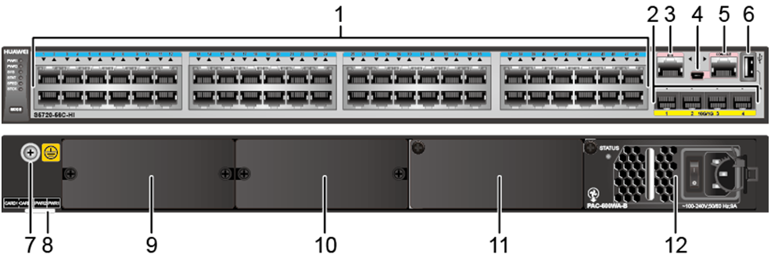
S5720-HI Appearance and Structure
1 | Forty-eight 10/100/1000BASE-T Ethernet electrical ports | 2 | Four 10GE SFP+ Ethernet optical ports
3 | One ETH management port | 4 | One Mini USB port
5 | One console port | 6 | One USB port
7 | Ground screw NOTE: It is used with a ground cable. | 8 | Bar code label
9 | Extended card slot 1 NOTE: This slot is reserved for a stack card. | 10 | Extended card slot 2
11 | Power module slot 2 | 12 | Power module slot 1
Notes:
S5720-HI Series Agile Fixed Switches
Fully programmable, energy-efficient Gbit/s access switches for building high-density, agile Ethernet networks.
Innovative virtualization technology and specialized electronics greatly simplify management of converged, wired and wireless networks, provide more granular quality monitoring and error recovery, and enable rapid provisioning of new services and network features.
Available in 24-port and 48-port models with 10 GE uplink ports enabling comprehensive services processing capabilities.

Slide 16
Performance Differences among S5700 Versions
The richness of functions and features provided by these versions is in the following order: S5700LI < S5700SI < S5700EI < S5700HI.
The following table lists their support for differences features.
Supported Feature | Switch Model
 | S5700LI | S5700SI | S5700EI | S5700HI
RIP/RIPng | N | Y | Y | Y
OSPF/BGP/PIM | N | N | Y | Y
MPLS/Netstream/Hardware-based Ethernet OAM/BFD | N | N | N | Y

Slide 17
S6700 Product Positioning
The S6700 series ethernet switches (S6700 for short) are next-generation 10G box switches. The S6700 can function as an access switch in an Internet data center (IDC) or a core switch on a campus network.
The S6700 has industry-leading performance and provides up to 24 or 48 line-speed 10GE ports. It can be used in a data center to provide 10 Gbit/s access to servers or function as a core switch on a campus network to provide 10 Gbit/s traffic aggregation. In addition, the S6700 provides a wide variety of services, comprehensive security policies, and various QoS features to help customers build scalable, manageable, reliable, and secure data centers.

Slide 18
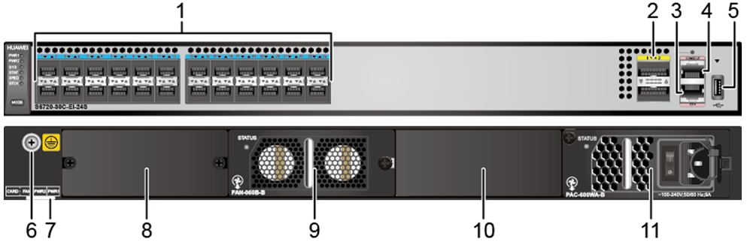
S6720 Series Switches
1 | Twenty-four 10GE SFP+ Ethernet optical ports | 2 | Two 40GE QSFP+ optical ports
3 | One ETH management port | 4 | One console port
5 | One USB port | 6 | Ground screw NOTE: It is used with a ground cable.
7 | Equipment serial number (ESN) label | 8 | Extended card slot
9 | Fan module slot | 10 | Power module slot 2
11 | Power module slot 1 | - | -
Notes:
S6720 Series Next-Generation Enhanced 10 GE Switches
The industry's highest-performing fixed switches, the S6720 series provides 24/48 full line-speed 10 GE ports, which are scalable to 6 x QSFP+ full line-speed ports.
The S6720 supports long-distance stacking with up to 480 Gbit/s bidirectional stack bandwidth. It also supports 1+1 backup of AC and DC power modules that can be installed on the same device.
These switches offer various service features, supports comprehensive security policies and QoS capabilities, and are best suited for data center servers and the core campus network.

Slide 19
Overview of S Series Fixed Switches
Overview of S Series Modular Switches
Sub-cards and Modules
Product Features

Slide 20
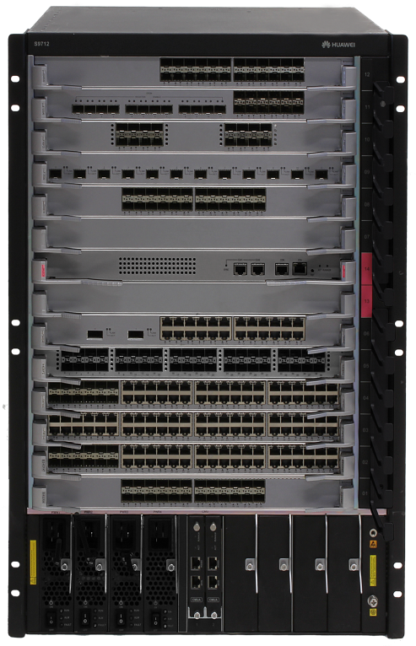
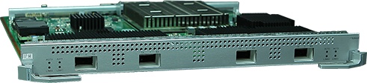
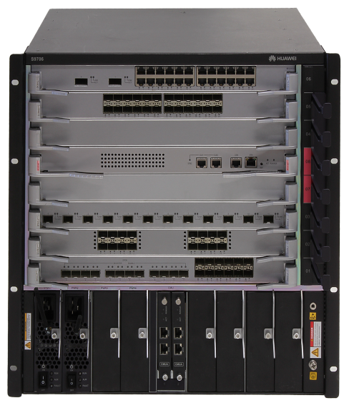
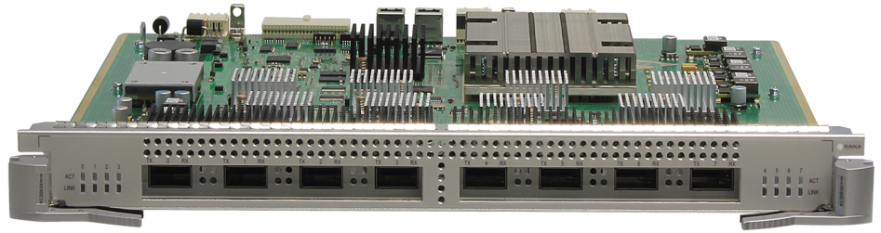
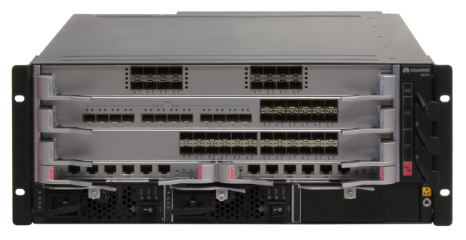
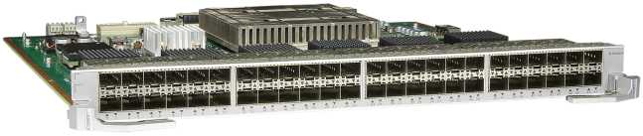
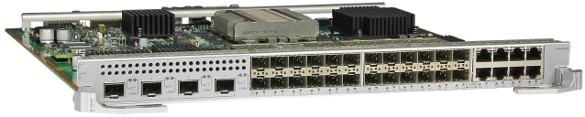

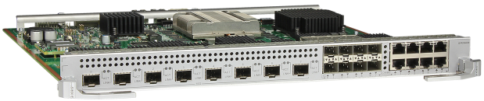
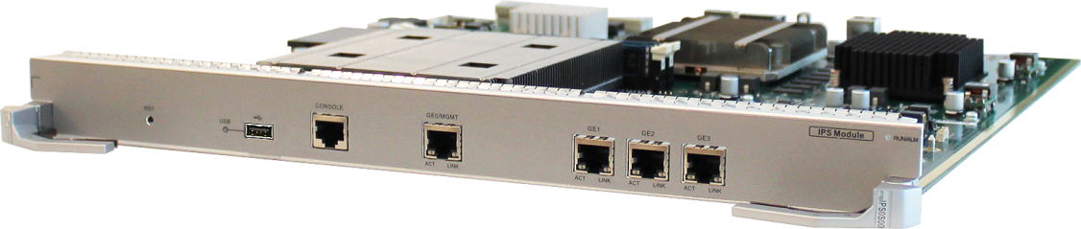
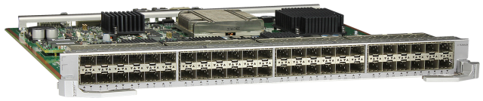
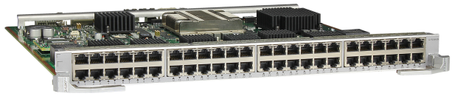
S9700 Series Core Smart Routing switches
S9700 Series Core Smart Routing switches
High-density line-rate cards
4*100GE Card
8*40GE Card
S9703
48*10GE Card
S9712
S9706
VAS Cards
NGFW
IPS
X2H/X2E/X2S/X1E Series Card

Slide 21
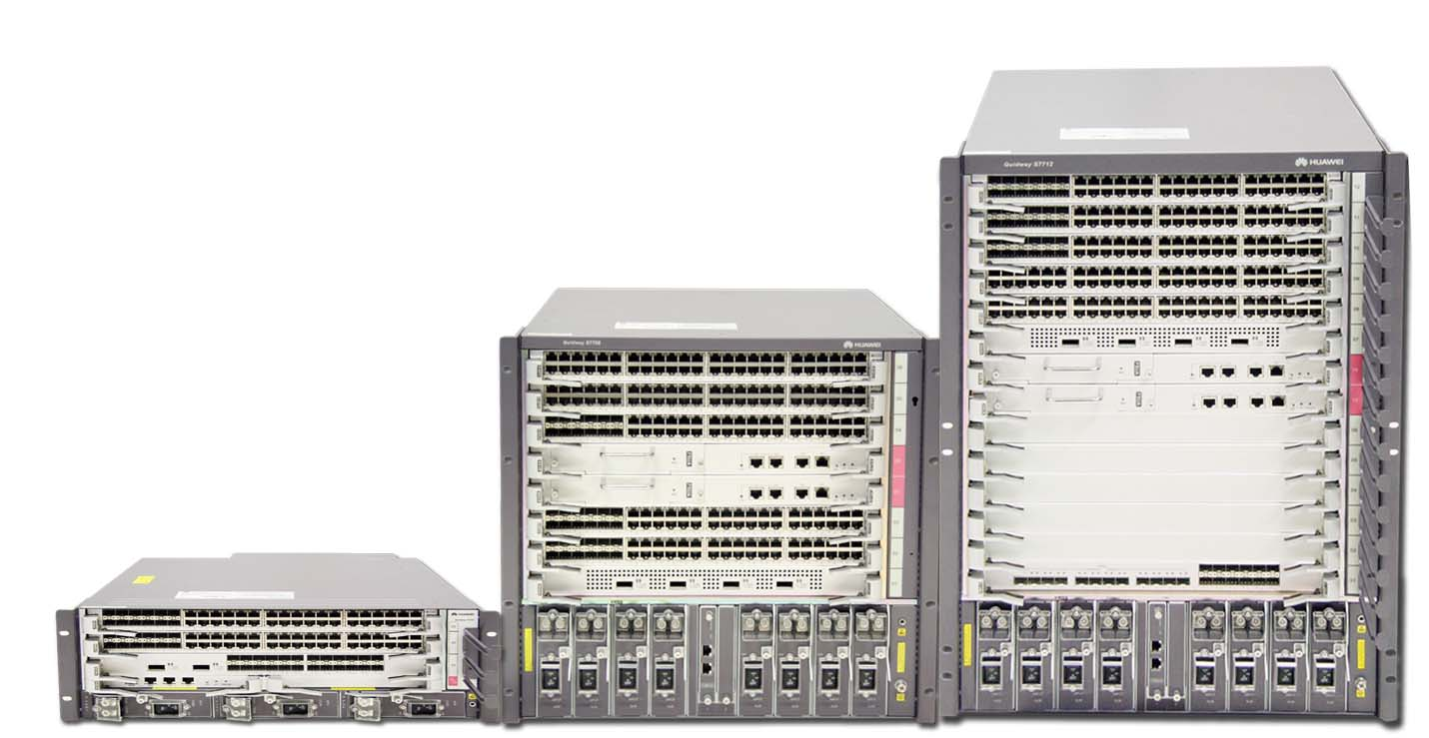
S9700 Series Core Smart Routing switches
Positioning
Core switch for large-sized campus networks
Core switch for large-sized campus networks
Core switch for data centers
Interconnection switch for remote branch offices
Item | S9703 | S9706 | S9712
Height | 4U | 10U | 15U
MPU slots | 2 | 2 | 2
LPU slots | 3 horizontal | 6 horizontal | 12 horizontal
Maximum port density | 144GE/144*10GE/24*40GE/12*100GE | 288GE/288*10GE/48*40GE/24*100GE | 576GE/576*10GE/96*40GE/48*100GE
System power supply | 1+1 | M+N | M+N
Notes:
S9700 Series Switch is design for integrated multi-service network architecture, It is a high-end intelligent terabit routing switch.
S9700 provides 16x10GE ports inter-board wire speed switching, and supports 40GE/100GE standards in the future.

Slide 22


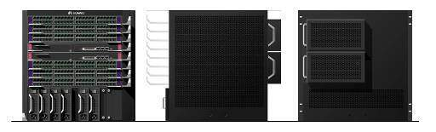
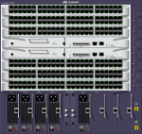
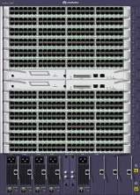
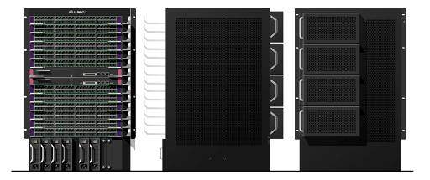
Modular Design
Shared LPUs
Shared fan tray
Shared control boards
Shared monitoring units
Removable and shared handles of the chassis
Shared power modules
Notes:
The fan trays, AC power supplies, DC power supplies, LPUs, cables, and cabinet handles can be used by all types of the switch. The handles can be removed from the cabinet.
The SXX12 and the SXX06 shared the monitoring boards and control boards of the same type.

Slide 23
Overview of S Series Fixed Switches
Overview of S Series Modular Switches
Sub-cards and Modules
Product Features

Slide 24

Port Numbering Conventions
A single switch uses slot ID/subcard ID/port sequence number to identify physical ports.
  Slot ID: indicates the slot where the switch is located. The value is 0.
  Subcard ID: indicates the ID of a subcard.
  Port sequence number: indicates the sequence number of a port on the switch.
A stacked switch uses Stack ID/subcard ID/port sequence number to identify physical ports.
  Stack ID: indicates the ID of a stacked switch. The value ranges from 0 to 8.
  Subcard ID: indicates the ID of a subcard.
  Port sequence number: indicates the sequence number of a port on the switch.
Port Numbering Diagram | Description
 | There are two rows of service ports on the device. These ports are numbered from bottom to top and left to right, starting from 1.For example, the port on the top left is numbered 0/0/2.

Slide 25
Power Modules
Switch Series | Power Supply Configuration
S2700 | It has a built-in power module and does not support pluggable power modules.
S5700 | It uses pluggable power modules: 150/350/650W DC Power Module; 650W DC PoE Power Module；150/600W AC Power Module; 500/580/1150W AC PoE Power Module.
S6700 | It uses pluggable power modules: 170/350W DC Power Module; 170/600W AC Power Module.
All power modules are hot swappable, but it is highly recommended that you power off a switch before removing or installing a power module in the switch to protect personal and equipment safety.
Notes:
Before replacing a power module in a switch, make sure that the switch can be powered by the other power module after the power module is removed. Otherwise, services on the switches will be interrupted by a power failure when the power module is removed.
Before powering off a switch, shut down all of its power supply units.
The S5720-HI models that do not support Power over Ethernet (PoE) can use 350 W DC and 600 W AC power modules together. The S5710-HI series can use 350 W and 1150 W power modules together. The S5720-28X-PWR-SI-AC, S5720-52X-PWR-SI-AC, S5720-28X-PWR-SI-DC, S5720-52X-PWR-SI-DC, S5720-36C-PWR-EI-AC, S5720-36C-PWR-EI-DC, S5720-56C-PWR-EI-DC, and S5720-56C-PWR-EI-AC can use 500 W AC PoE and 650 W DC PoE power modules together. Other models do not allow power modules of different power values to be used in the same chassis.
The S6720-EI can use 350 W DC and 600 W AC power modules together. Other models do not allow power modules of different power values to be used in the same chassis.

Slide 26
PoE Function
Series | Maximum Number of PoE Interfaces (IEEE 802.3af) | Maximum Number of PoE Interfaces (IEEE 802.3at)
S2700 | 8/16/24 | 4/8/12
S5700 | 8/12/16/24/48 | 4/6/8/12/24/26/48
S6700 | Not supporting PoE
Notes:
Switches with PWR in the name support PoE power supply, such as the S5710-52C-PWR-EI.
PoE switches provide power for powered devices (PDs) over Ethernet electrical interfaces. All the PoE switches comply with IEEE 802.3af and 802.3at. IEEE 802.3af supports a maximum of 15.4 W power and the IEEE 802.3at supports a maximum of 30 W power. The PDs connected to a switch determine which standard the switch should comply with, and the switch is auto-sensing.
The number of interfaces that can provide PoE power supply on a switch depends on the power module used, the corresponding standard, and the switch's own limitations. Here, I'm providing the maximum number of interfaces that each series can support theoretically. See the Hardware Description of the corresponding product for details.

Slide 27
Overview of S Series Fixed Switches
Overview of S Series Modular Switches
Sub-cards and Modules
Product Features

Slide 28




iStack Benefits
Traditional network
Virtualization network
Improve bandwidth efficiency and reduce CAPEX
S7700 CSS
  Ring protection protocols such as MSTP are not required, and no link needs to be blocked.
  100% of bandwidth is used. (Only 50% of bandwidth is used on an STP network).
MSTP
MSTP
Build a highly reliable loop-free network
  The convergence time is much shorter than STP.
  The system continues running if a single device fails.
S5700 iStack
Simplify O&M and reduce OPEX
NMS
  Fewer network nodes are deployed, simplifying network management.
  The master switch synchronizes the configuration file to other member switches, simplifying device operation and configuration.
Logical topology
Logical topology

Slide 29

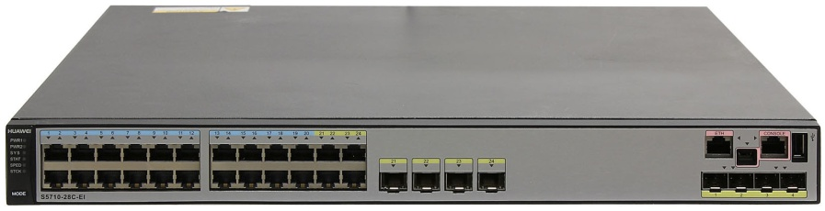
Stack Card Stacking and Service Port Stacking
Stack card stacking
Stack card connection
Two situations exist:
  Member switches are connected using dedicated stack cards and stack cables.
  Stack cards are integrated on the switch’s rear panel. Member switches are connected using stack ports fixed on the rear panel and stack cables.
Service port stacking
Service port connection
Member switches are connected using service ports, which are configured as physical member ports and bound to logical stack ports. This connection mode does not require stack cards.
A logical stack port is bound to physical member ports to connect stack member switches. Each member switch supports two logical stack ports.

Slide 30


SVF Manages a Campus Network as One Device
Virtual MPUs
  Converged campus network
Core/aggregation switch
1
2
3
…
n
Cloud structure, on-demand expansion
Campus network virtualized into one device
Access switches and APs are
virtualized as extended ports on the
virtual switch
Virtual LPUs
Access switch
…
1
2
n
Virtual ports
AP
1
2
…
n
SVF manages a campus network as one device
  Simple management: The devices on the entire network are virtualized into one, and devices are plug-and-play. Only one NE needs to be managed on the network.
  Centralized management: Core devices manage ACL rules, QoS policies, and user security.
  Distributed forwarding: Each device on the wired network can independently perform control and forwarding, avoiding bandwidth bottlenecks.
  Professional capabilities
Virtualize 32 access switches, which triples industrial average
  Unprecedentedly support virtualization of 1K APs, simplifying network maintenance and management

Slide 31

Flexible Ethernet Networking: Stability and Reliability
Key Component Redundancy
Power supplies and fans are hot swappable and work in redundancy mode.
6 kV surge protection
Provides 6 kV patented surge protection technology, 8 times the standard surge protection performance.
OAM
All the S5700 series switches support OAM to implement end-to-end fault detection.
SEP
Supports closed-ring, open-ring, and cascading topologies. SEP can work with STP to provide 50 ms protection switching.
High reliability
99.999%+
G.8032
Supports multiple rings and domains and provides interworking capabilities for devices.
Originates from SDH.
Smart-link
Used in dual-homing networking to ensure nonstop forwarding if a single link fails.

Slide 32
What is the meaning of each section of the switch’s name: S5720-56C-PWR-EI-AC?
Notes:
What is the meaning of each section of the switch’s name: S3728TP-PWR-EI?
S: Switch
57: Series
20: Product sub-series
56:the maximum port quantity
C: The product supports extended cards and its uplink ports are provided by an extended card or are fixed 10GE ports.
PWR: The product supports Power over Ethernet (PoE).
EI: enhanced version
AC: switch using alternating current power supply

Slide 33
SX7 fixed switch product positioning
SX7 fixed switch sub-cards and modules
SX7 fixed switch product characteristics
SX7 fixed switch typical application scenarios

Slide 34
Huawei Learning Website
  http://support.huawei.com/learning/Index!toTrainIndex
Huawei Support Case Library
  http://support.huawei.com/enterprise/servicecenter?lang=zh

Slide 35
Cloud DC solution
  http://e.huawei.com/cn/solutions/business-needs/data-center

