Slide 1
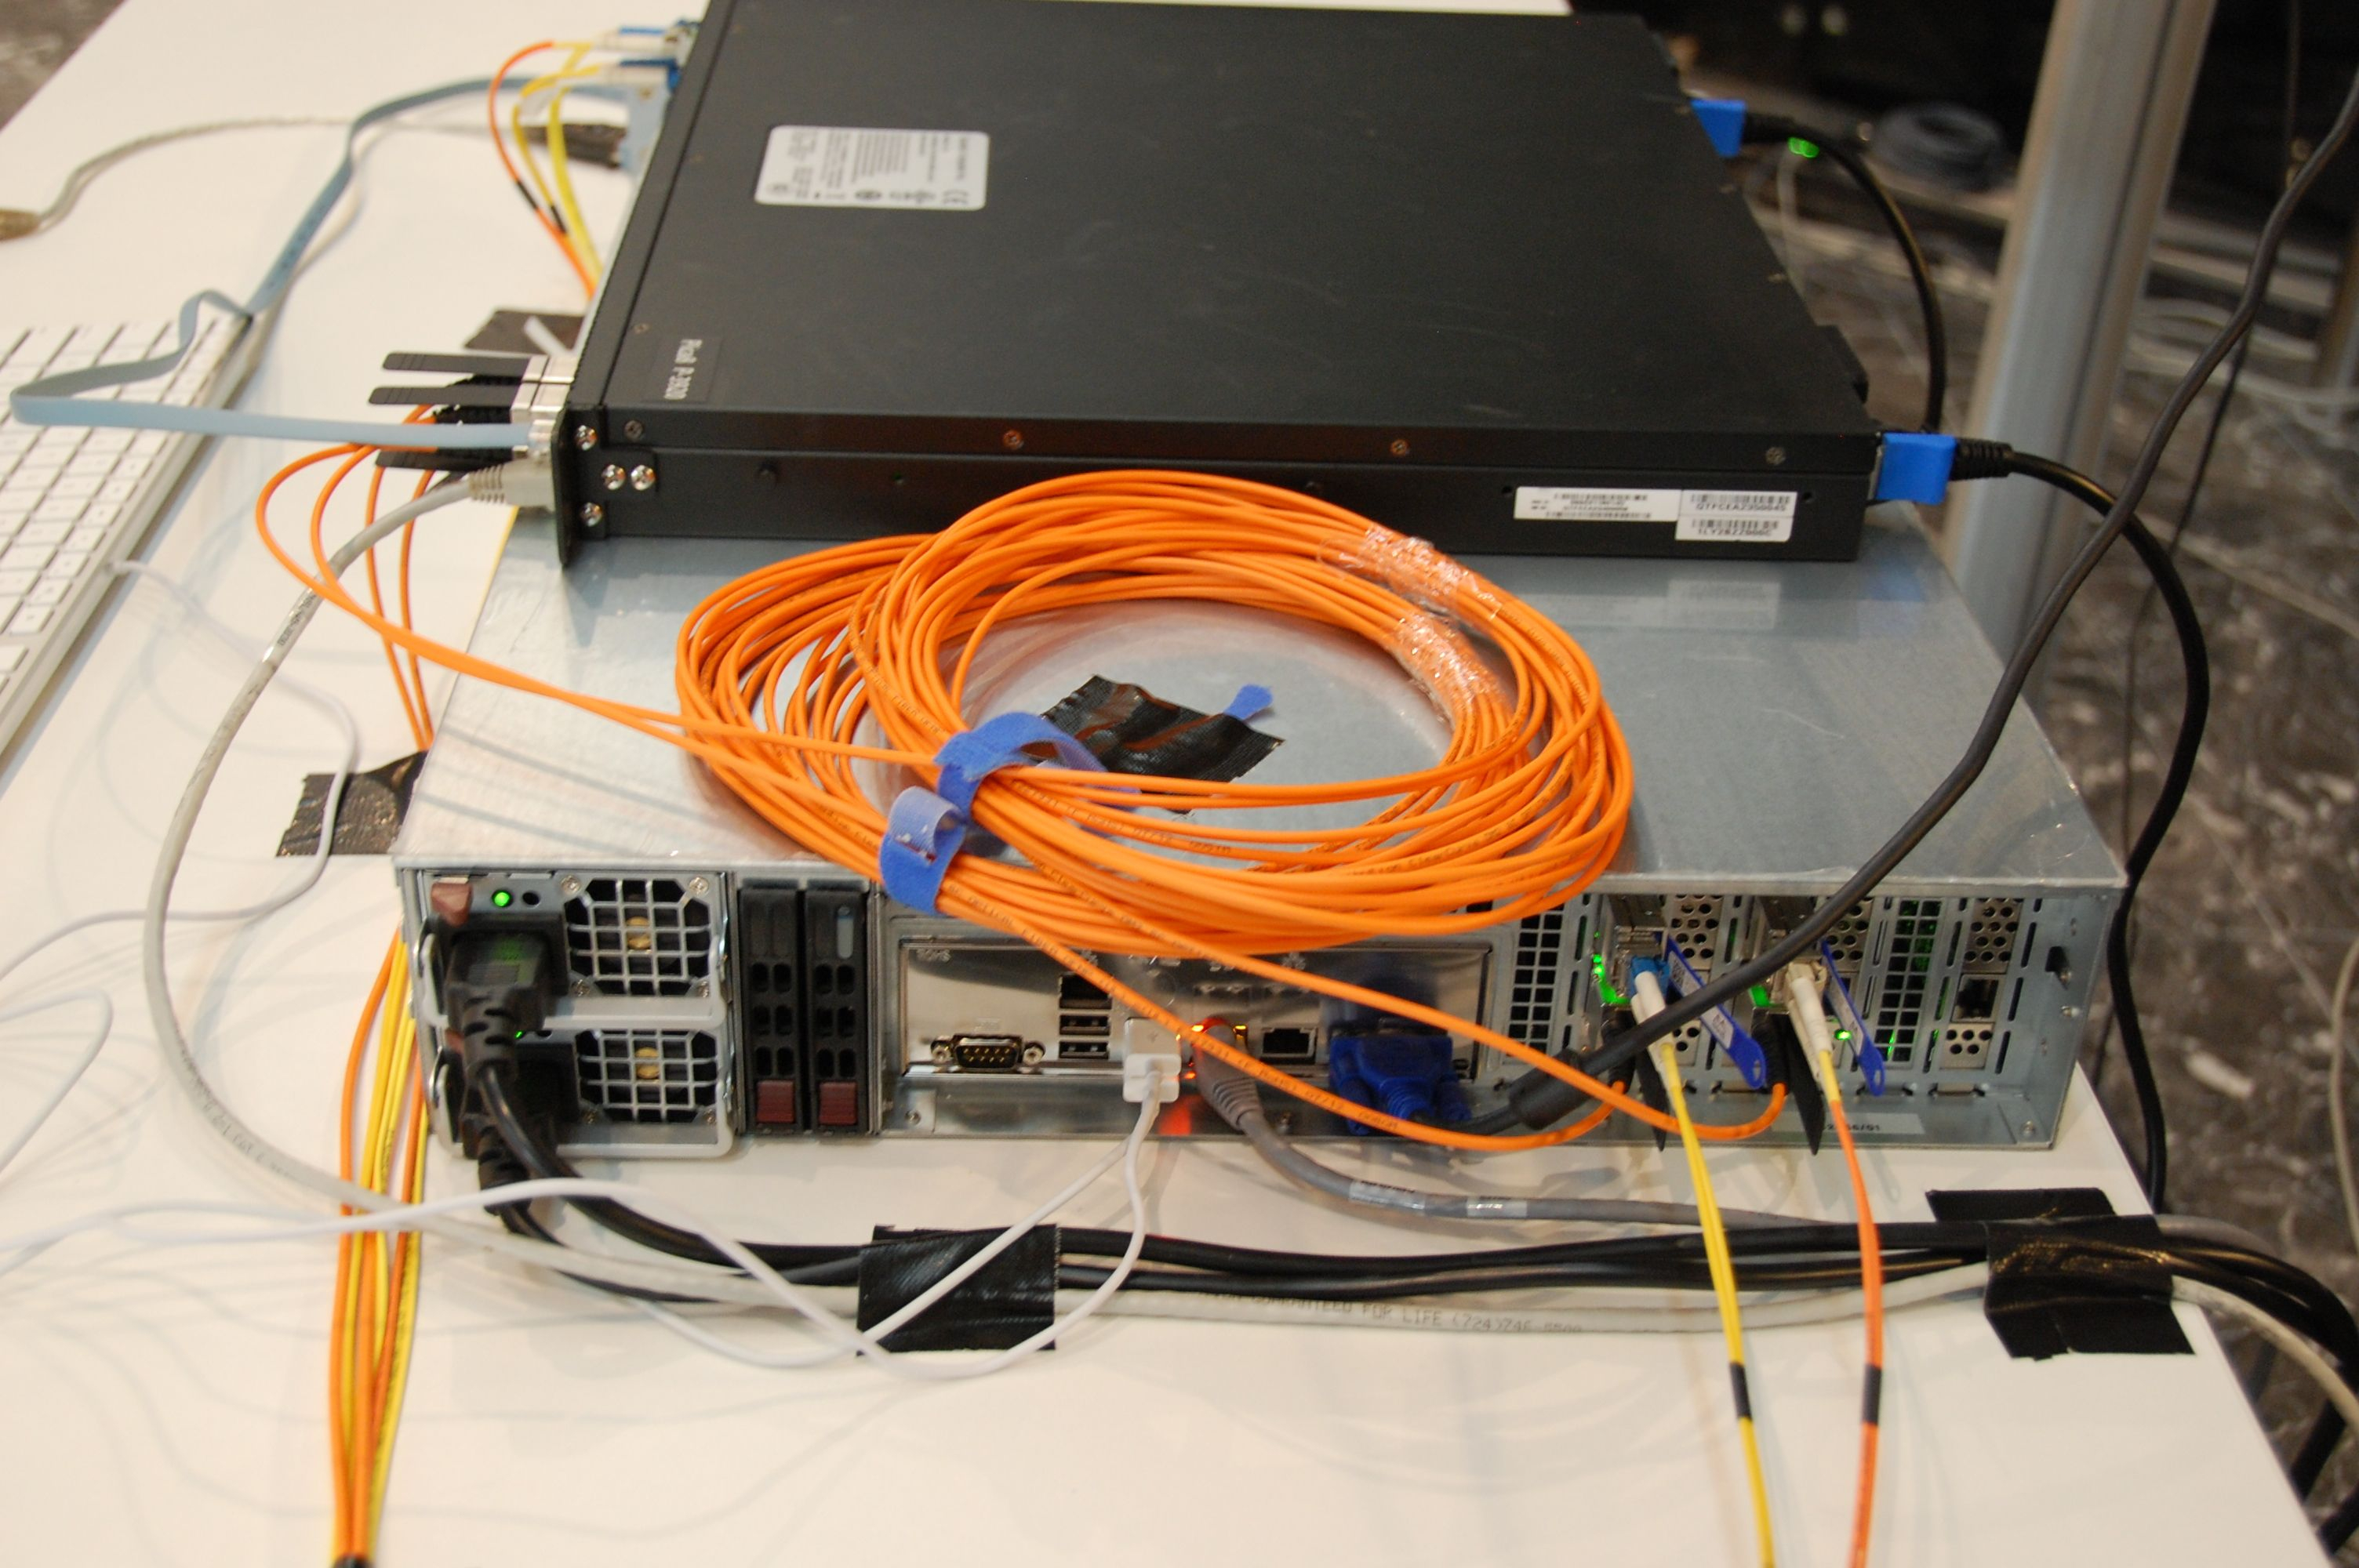
Experiences with MPTCP in a 100G multipathed OpenFlow network
TNC 2013, SDN and openflow applications
Ronald van der Pol
<Ronald.vanderPol@SURFnet.nl>

Slide 2
Partners
Michael Bredel, Caltech, USA
Artur Barczyk, Caltech, USA
Azher Mughal, Caltech, USA
Joe Mambretti, iCAIR, USA
Jim Chen, iCAIR, USA
Fei I Yeh, iCAIR, USA
Benno Overeinder, NLnet Labs, Netherlands
Niels van Adrichem, TU Delft, Netherlands
Fernando Kuipers, TU Delft, Netherlands
Christoph Paasch, UCL, Belgium
TNC 2013, 2-6 June, Maastricht, Netherlands

Slide 3
Outline
Why multipathing?
MPTCP
Demonstration Results
TNC 2013, 2-6 June, Maastricht, Netherlands

Slide 4
Why Multipathing?
Data sets are growing rapidly in size and number
Copying big data sets in reasonable time requires a lot of bandwidth
We are reaching the theoretical limit of fiber throughput
Next step, like RAID (multiple disks) & multi-core
Use all available bandwidth in the network
Use multiple paths simultaneously
TNC 2013, 2-6 June, Maastricht, Netherlands

Slide 5
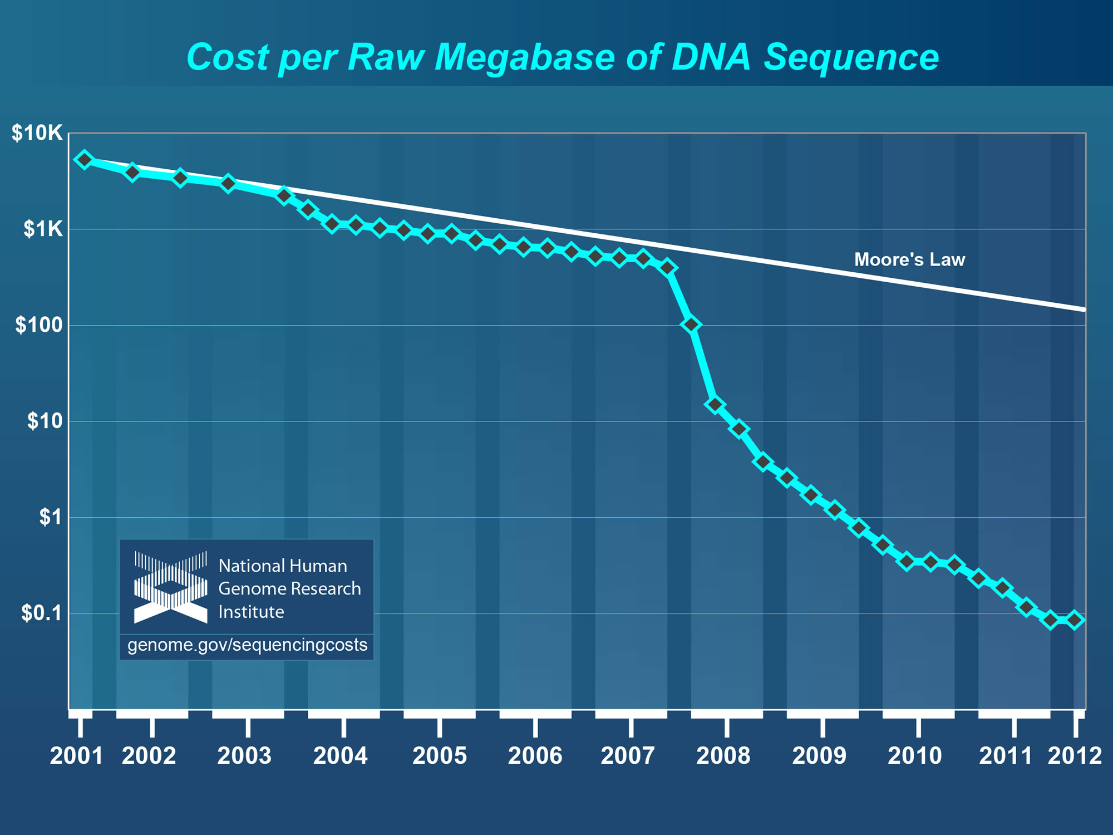
DNA Sequencing Price Drop
TNC 2013, 2-6 June, Maastricht, Netherlands

Slide 6
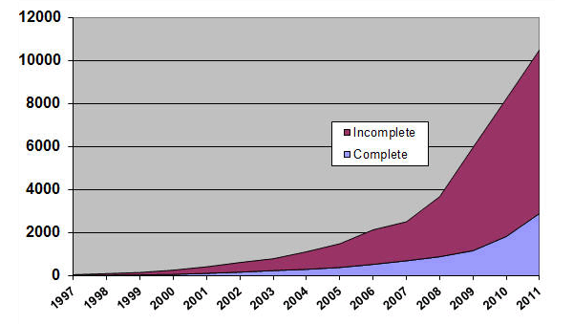
DNA Sequencing Projects on GOLD
TNC 2013, 2-6 June, Maastricht, Netherlands

Slide 7
Shannon Limit on Fiber
Modern modulation technologies and transponders reach the theoretical limit of fiber
Tradeoff between:
  Bandwidth
  Reach
  Cost
Either high bandwidth with short reach or lower bandwidth with longer reach
TNC 2013, 2-6 June, Maastricht, Netherlands

Slide 8
Reaching the Shannin Limit
Source: Ciena
TNC 2013, 2-6 June, Maastricht, Netherlands

Slide 9
Multipath TCP (MPTCP)
Load balancing options:
  Within the network with e.g. Equal Cost Multipath (ECMP) routing
  At the end hosts with e.g. MPTCP
ECMP is hash based, not optimal for small flows
MPTCP also works for 1 or a few flows
  MPTCP can also handle links of different speed
TNC 2013, 2-6 June, Maastricht, Netherlands

Slide 10
Traditional TCP vs Multipath TCP
TNC 2013, 2-6 June, Maastricht, Netherlands

Slide 11
MPTCP Stack
Normal socket API (no need to change applications)
MPTCP splits byte stream from application and sends them across multiple subflows
Each subflow is a normal TCP session to the network
MPTCP does not setup path, it used paths that are available on a multihomed server
TNC 2013, 2-6 June, Maastricht, Netherlands

Slide 12
MPTCP Tasks
Path management
  Detect and use multiple paths
Packet scheduling
  Split byte stream across subflows
Congestion control
  Each subflow uses normal TCP congestion control
  MPTCP automatically moves traffic away from congested subflows to less congested subflows
TNC 2013, 2-6 June, Maastricht, Netherlands

Slide 13
OLiMPS
Floodlight sends & receives LLDP packets on all OpenFlow switch ports → topology
OLiMPS calculates multiple link disjoint paths from source switch to destination switch
Flows are mapped to these paths
  Initially in round robin manner
  Later e.g. based on real time network load
TNC 2013, 2-6 June, Maastricht, Netherlands

Slide 14
Demonstrations
12th Annual Global LambdaGridGrid Workshop
  11-12 October 2012
  Chicago, USA
SC12
  10-16 November 2012
  Salt Lake City, USA
TNC 2013
  3-6 June 2013
  Maastricht, Netherlands
TNC 2013, 2-6 June, Maastricht, Netherlands

Slide 15
GLIF Demonstration Topology
TNC 2013, 2-6 June, Maastricht, Netherlands

Slide 16
GLIF Results
Iperf from Geneva to Chicago over four 10GE links
  ACE, USLHCnet, SURFnet
Large packet loss, limited throughput (~ 1 Gb/s)
  Packet loss on wide area links
  Weird behaviour of OpenFlow switches (packet size problems)
We learned a lot about how to debug large multi-domain OpenFlow networks
TNC 2013, 2-6 June, Maastricht, Netherlands

Slide 17
SC12 Demonstration Topology
TNC 2013, 2-6 June, Maastricht, Netherlands

Slide 18
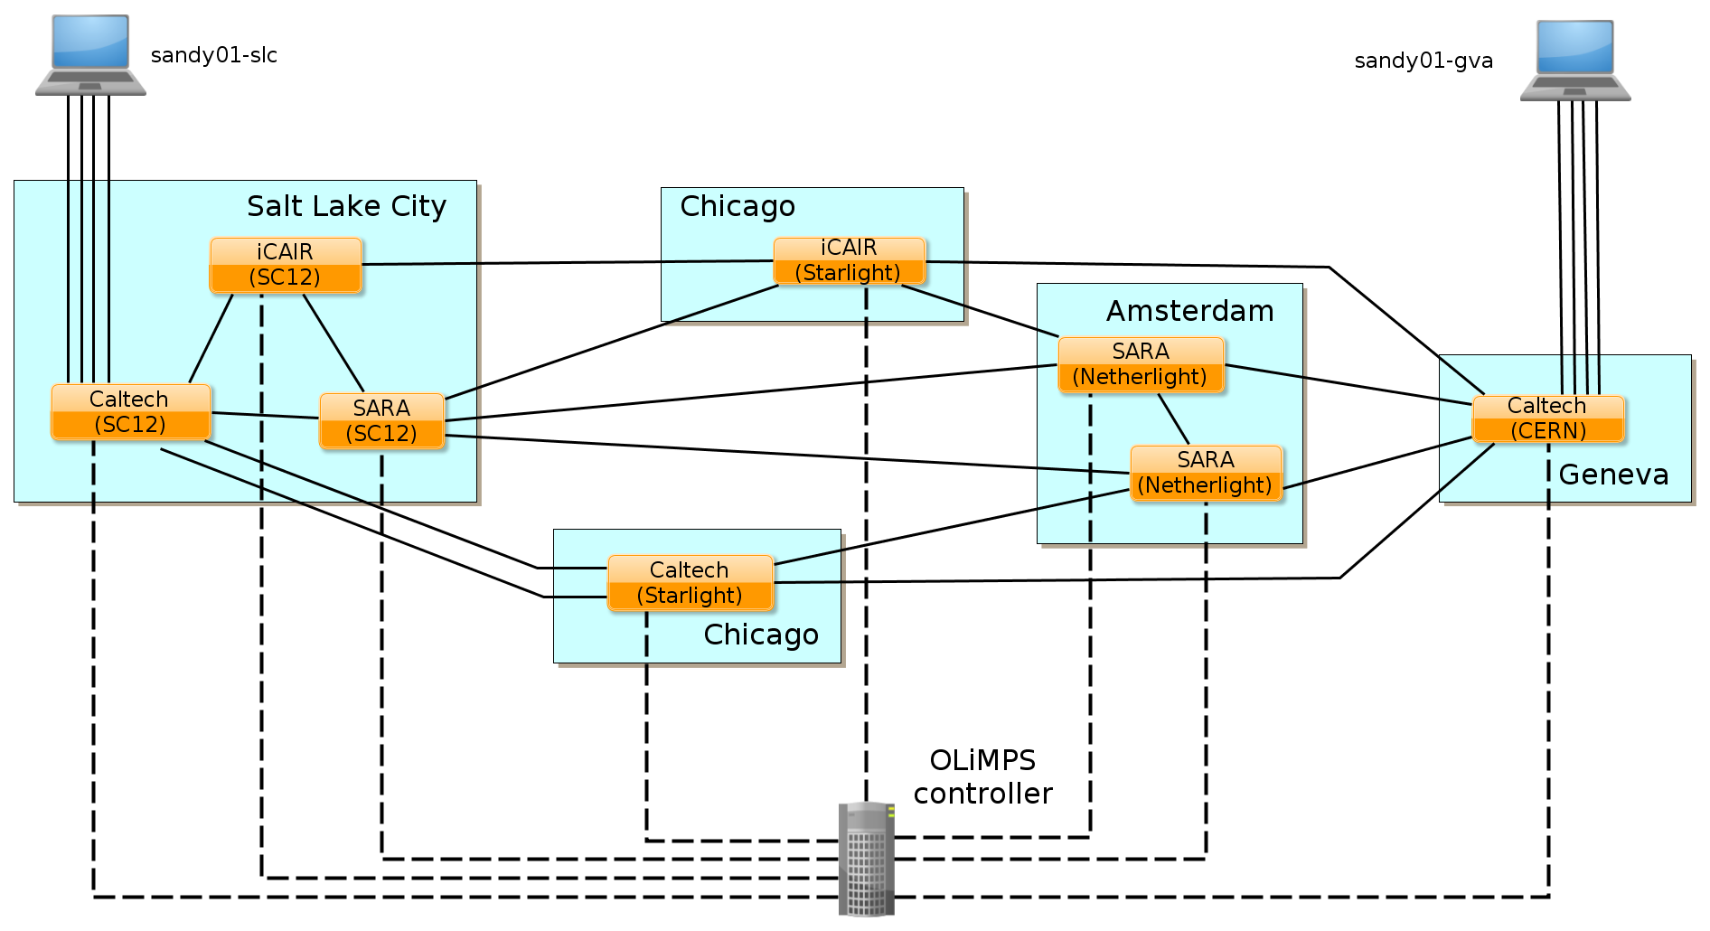
SC12 OpenFlow Topology
TNC 2013, 2-6 June, Maastricht, Netherlands

Slide 19
SC12 Results
3x 10GE + 2x 1GE to show floor
  Two 10G links had packet loss
  Third 10G link did not work at all
2x 10GE between Amsterdam (NetherLight) and Geneva (CERN)
  Two 10GE client interfaces on the 40G wave over the SURFnet dark fiber
  One of the links had packet loss
MPTCP mainly used the lossless link
  Resulting in 9 Gbit/s over this link
TNC 2013, 2-6 June, Maastricht, Netherlands

Slide 20
SC12 Live Monitoring Website
TNC 2013, 2-6 June, Maastricht, Netherlands

Slide 21
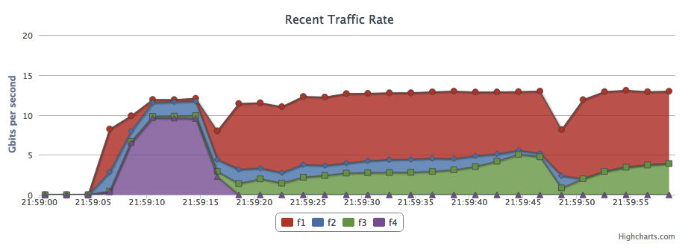
2x10 Amsterdam - Geneva
TNC 2013, 2-6 June, Maastricht, Netherlands

Slide 22
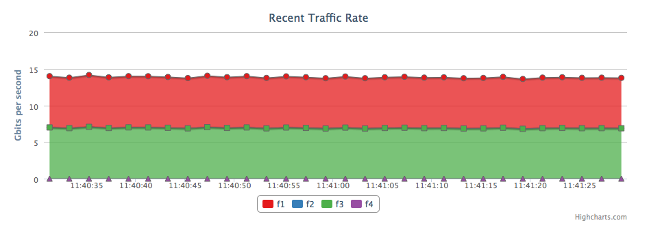
TNC 2013, 2-6 June, Maastricht, Netherlands

Slide 23
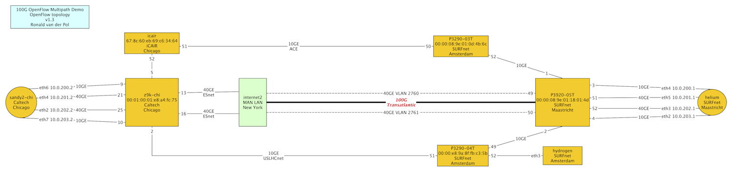
Demonstration Topology
TNC 2013, 2-6 June, Maastricht, Netherlands

Slide 24
TNC 2013 OpenFlow Topology
TNC 2013, 2-6 June, Maastricht, Netherlands

Slide 25
Supermicro Server
TNC 2013, 2-6 June, Maastricht, Netherlands

Slide 26
Supermicro Specs
Supermicro SC216BA-R1K28LP chassis
Supermicro X9DRi-IF Mainboard
2 x Intel Xeon E5-2690 8core
8 x Kingston 8GB DDR3 1600mhz ecc reg
1 x Seagate 1TB SATA III Enterprise 2.5"
3 x Areca 1882i raid controller
24x Intel X25-M 160 GB G2 SSD
3 x Mellanox MCX314A-BCBT 40GB QSFP card
Eur 8835 (without SSD disks)
TNC 2013, 2-6 June, Maastricht, Netherlands

Slide 27
OpenFlow Switches
3x Pica8 P3290
  48x 1GE + 4x 10GE
1x Pica8 P3920
  48x 10GE + 4x 40GE
1x Dell Z9000
  32x 40GE
TNC 2013, 2-6 June, Maastricht, Netherlands

Slide 28
Demonstration
Wednesday 15:30 – 16:00
SURF booth
TNC 2013, 2-6 June, Maastricht, Netherlands

Slide 29
Ronald van der Pol
<Ronald.vanderPol@SURFnet.nl>

