Slide 1
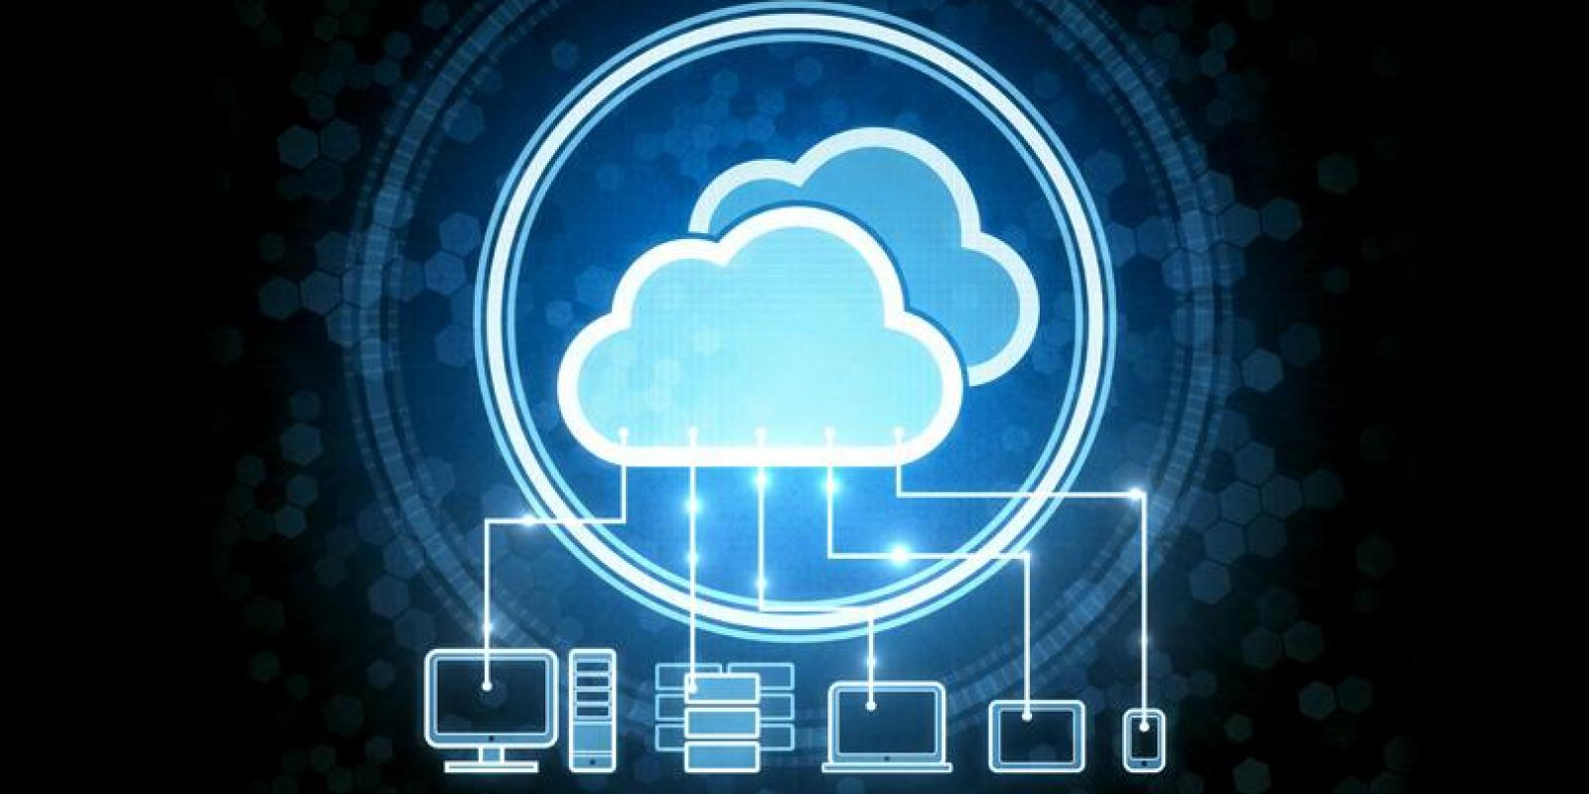
Oracle Cloud
Ahmed Afif Monrat
ahmedmonrat@gmail.com
Course: Cluster, Grid, Cloud
computing systems
Author: Prof. Andrey Shevel
Date: 6th June, 2017
Location: St. Petersburg

Slide 2
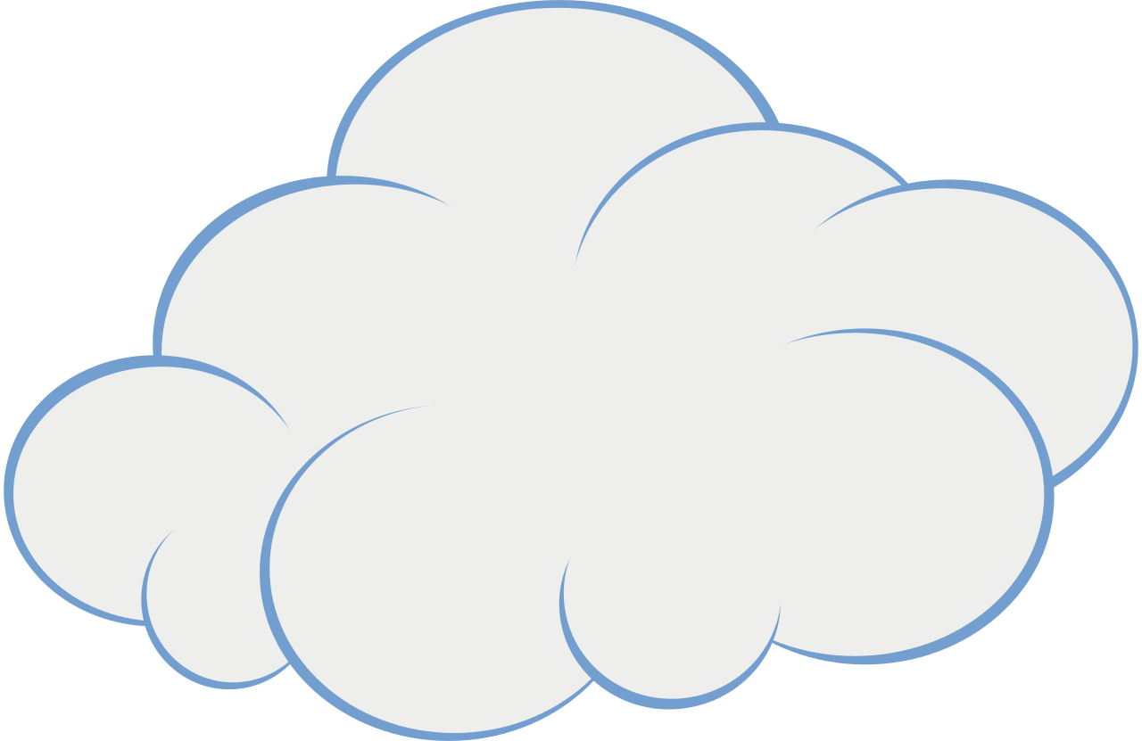
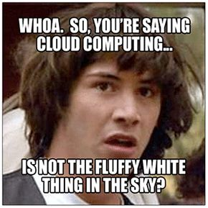
What is Cloud???
I’ve looked at clouds from both sides now
From up and down, and still somehow
It’s cloud illusions I recall
I really don’t know clouds at all.
Cloud computing refers to the practice of using a network of remote servers hosted on the Internet to store, manage, and process data, rather than a local server or a personal computer.

Slide 3
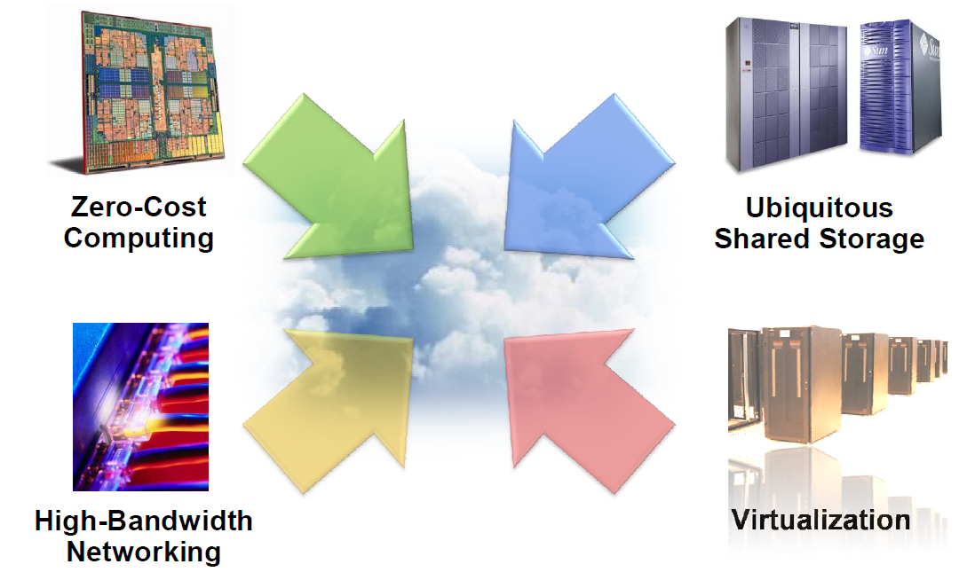
What makes Cloud Computing possible?

Slide 4
Oracle Cloud Services
Oracle Cloud is an enterprise cloud for business. Oracle Cloud offers self-service business applications delivered on an integrated development and deployment platform with tools to extend and create new services rapidly.
SAAS
PAAS
IAAS

Slide 5





Software as a Service (SAAS)
SaaS applications in Oracle Cloud are integrated with social, mobile, and analytic capabilities to deliver the experiences customers expect and the performance which is required by the market.
CX (Customer Experience)
HCM (Human Capital Management)
ERP (Enterprise Resource Planning)
SPM (Supply Chain Management)
EPM (Enterprise Performance Management)
IoT (Internet of Things)
Social Relationship Management
SAAS Analytics (Industry Solution, Deployment Options, Business Intelligence)
Examples:

Slide 6
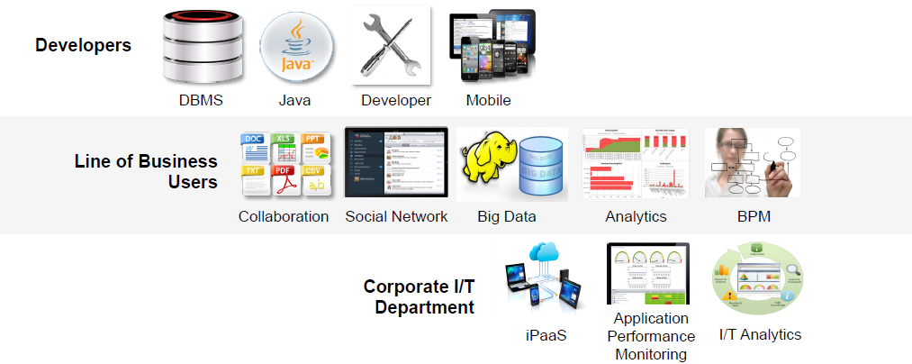
Platform as a Service (PAAS)
Oracle Cloud Platform as a Service (PaaS) helps enterprise IT and independent software vendor (ISV) developers rapidly build and deploy rich applications - or extend Oracle Cloud SaaS apps.
Data Management
Application Development
Integration
Content and Experience
Business Analytics
Security
Developer Portal

Slide 7
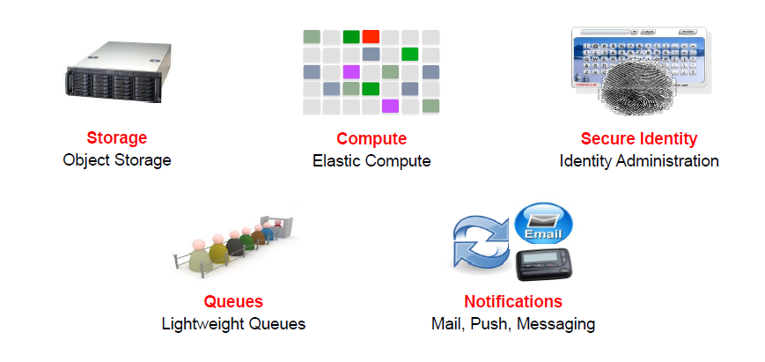
Infrastructure as a Service (IaaS)
A comprehensive set of integrated, subscription-based infrastructure services that enable businesses to run any workload in an enterprise-grade cloud managed, hosted, and supported by Oracle.
Compute
Storage
Network
Container
Ravello
Cloud Machine

Slide 8
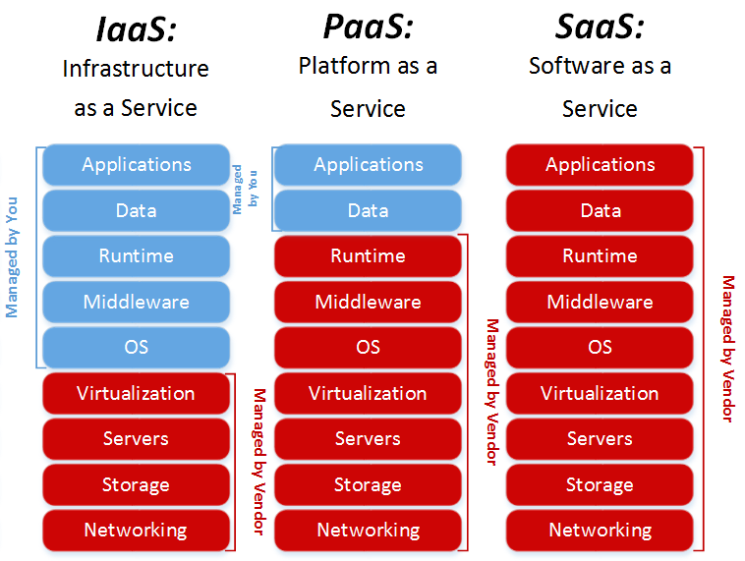
Cloud Service Models

Slide 9
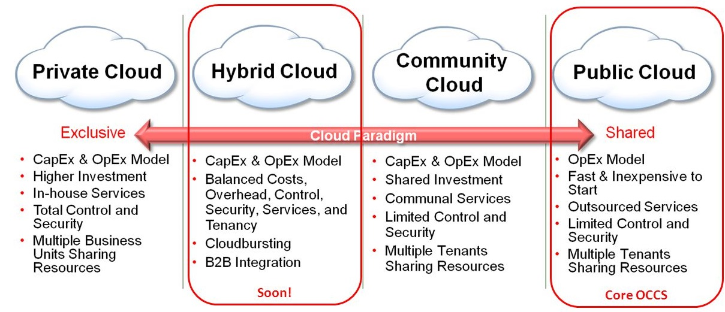
Cloud Deployment Models

Slide 10
Competitive Differentiators
Only Cloud with broadest, standards-based Oracle Software
– Which are widely used & accepted standards within companies
Broad & integrated PaaS for Developers, LOB, IT Audiences
– LOB: Only Public Cloud integrating Documents, Analytics, Social Network, Big Data
– Developers: Only Cloud integrating Source Control, App Server, DBMS, Mobile, SOA, BPM
Highly Differentiated PaaS & IaaS Services
– Only Cloud offering Real Application Clusters, Data Guard, Exadata, Exalogic
Seamless Integration across PaaS & SaaS Applications
– Use Oracle PaaS to extend Oracle’s SaaS Applications
– Enables Oracle’s PaaS to be rapidly sold into Oracle’s SaaS installed base
Seamless Integration from On-Premise to Oracle’s Cloud
– Customer’s have flexibility to transparently move workloads between environments
– Enables companies to rapidly adopt PaaS for Test-Dev, Backup & other patterns

Slide 11
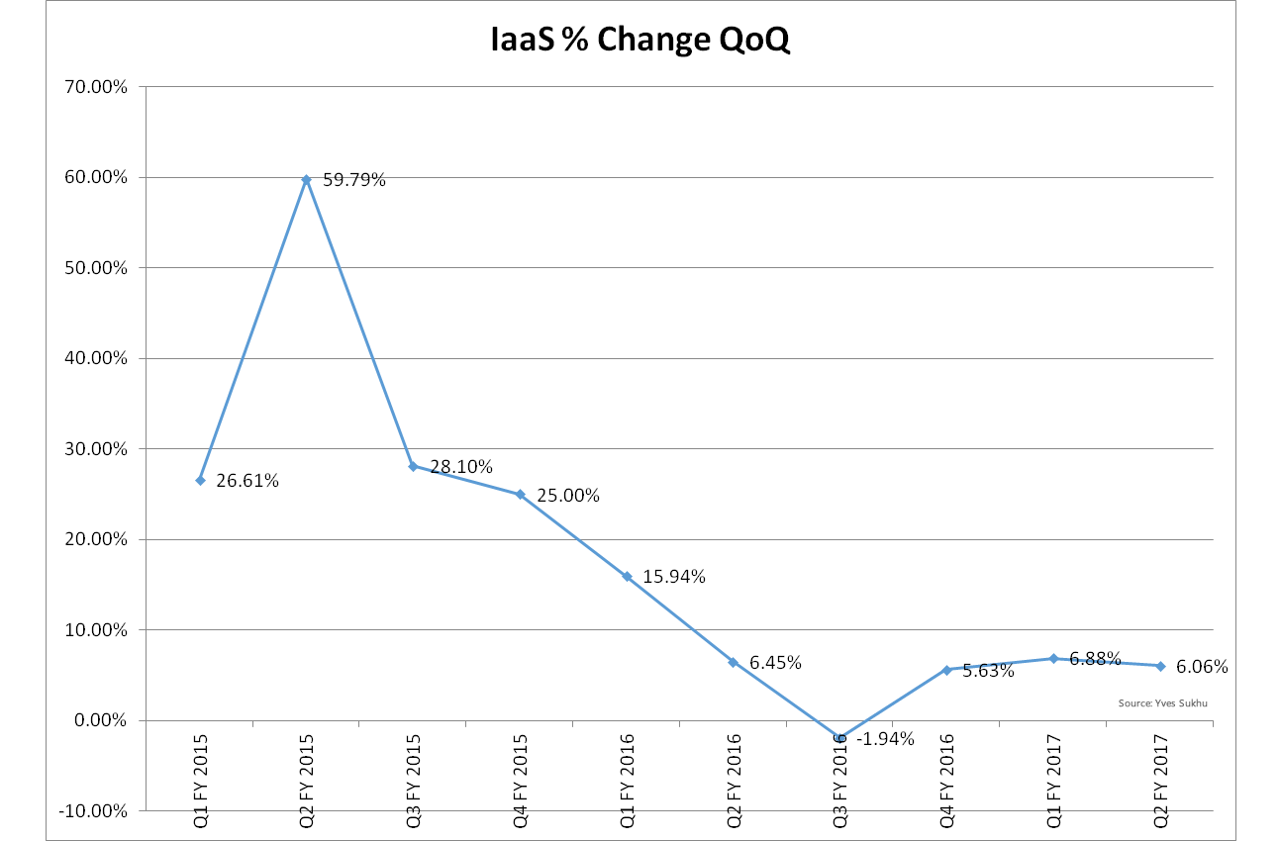
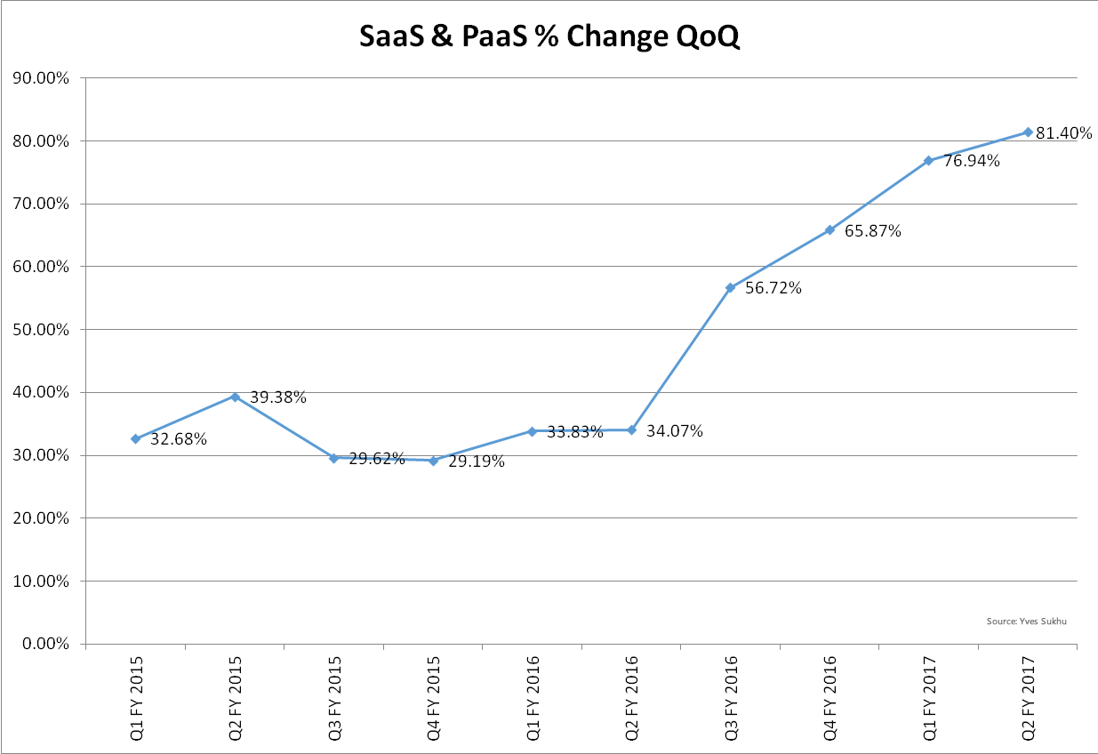
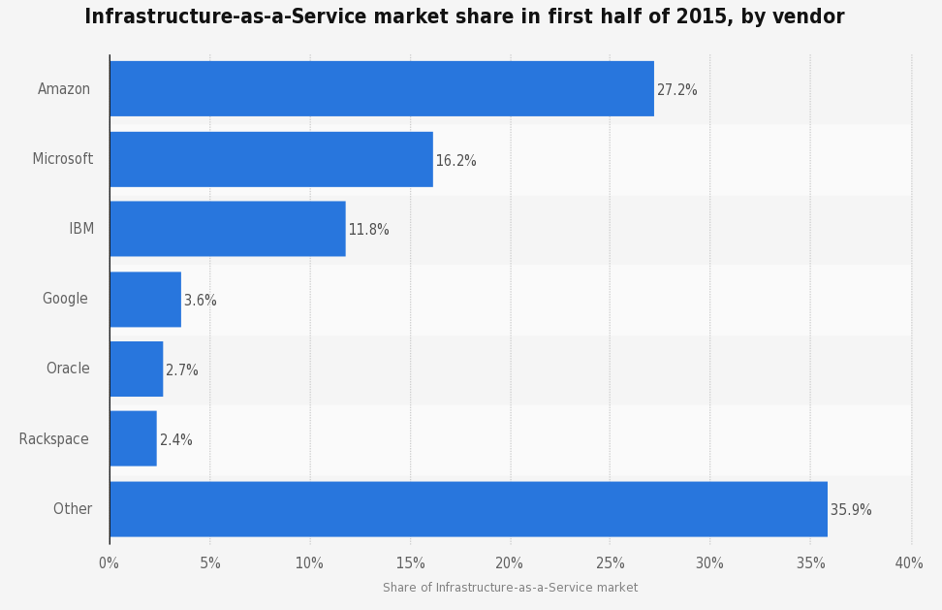
Comparison with other Cloud Service Providers

Slide 12
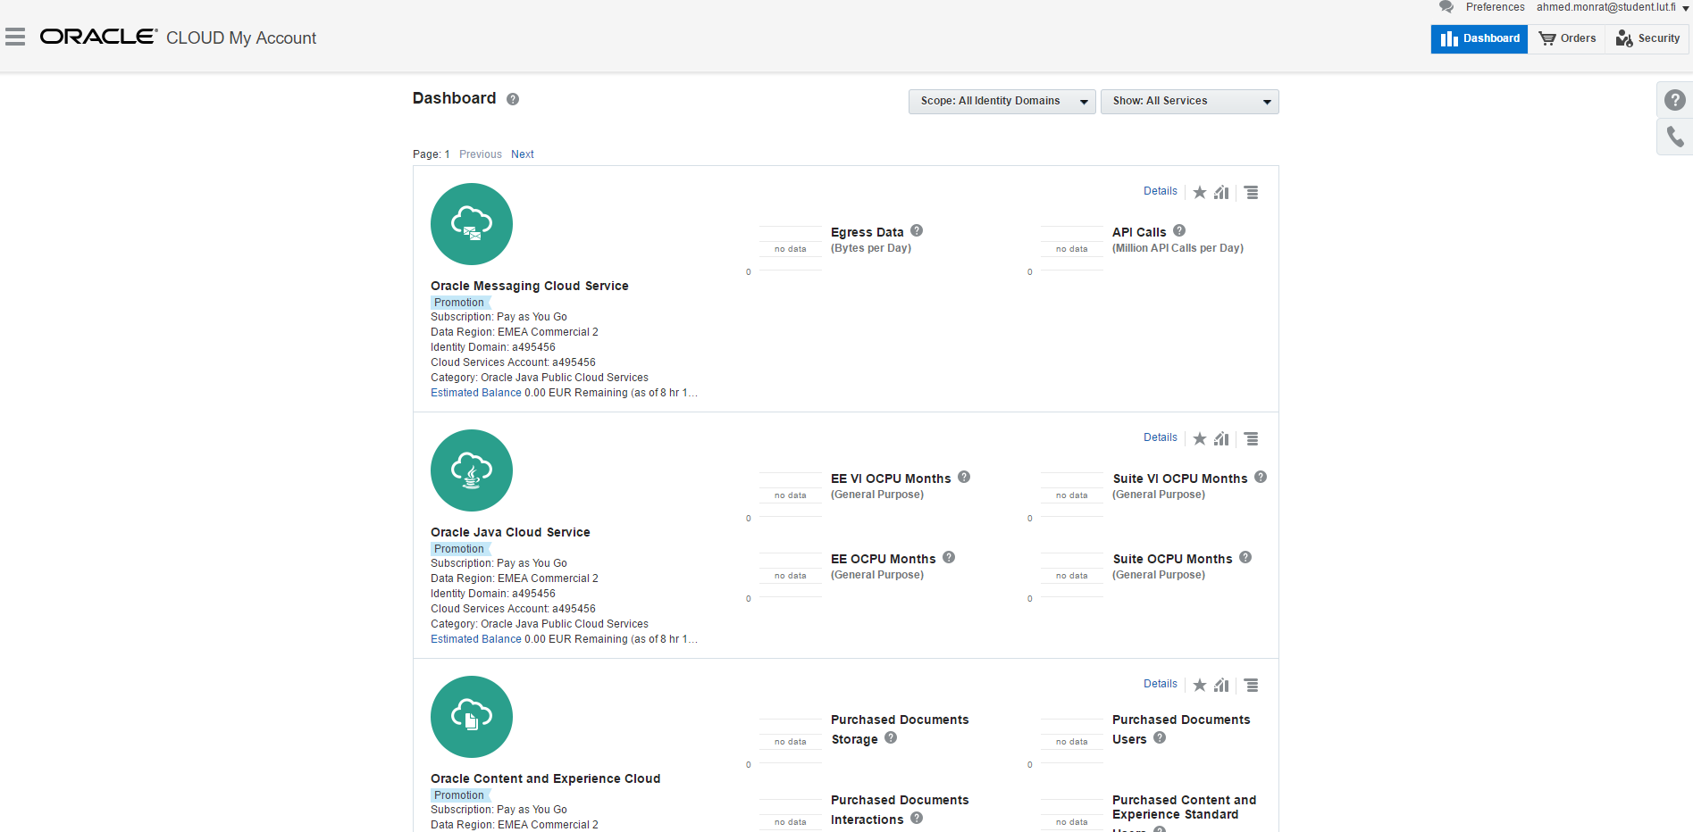
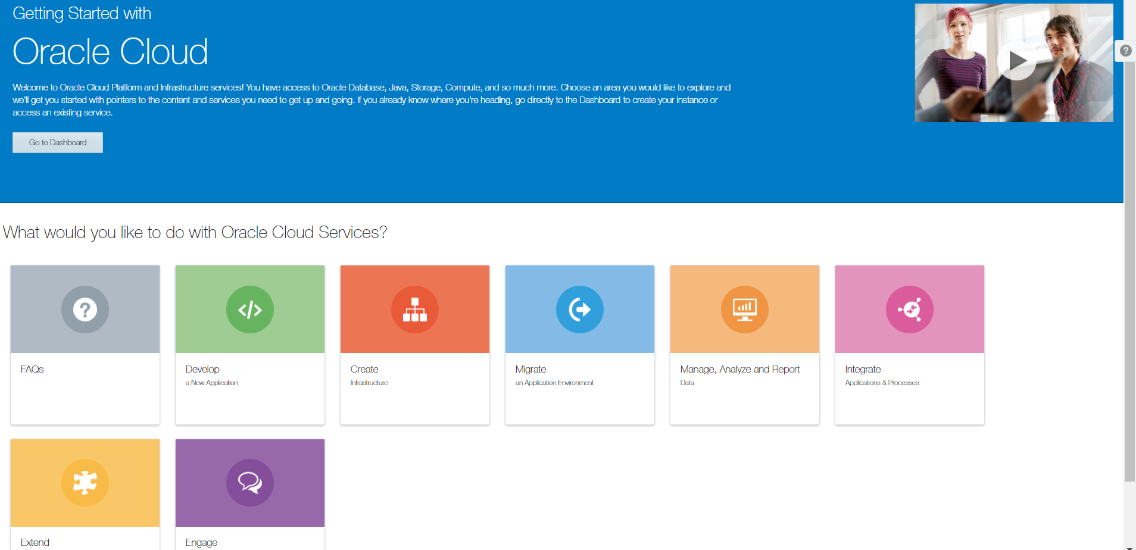
Demo

Slide 13
Thank You

