Slide 1

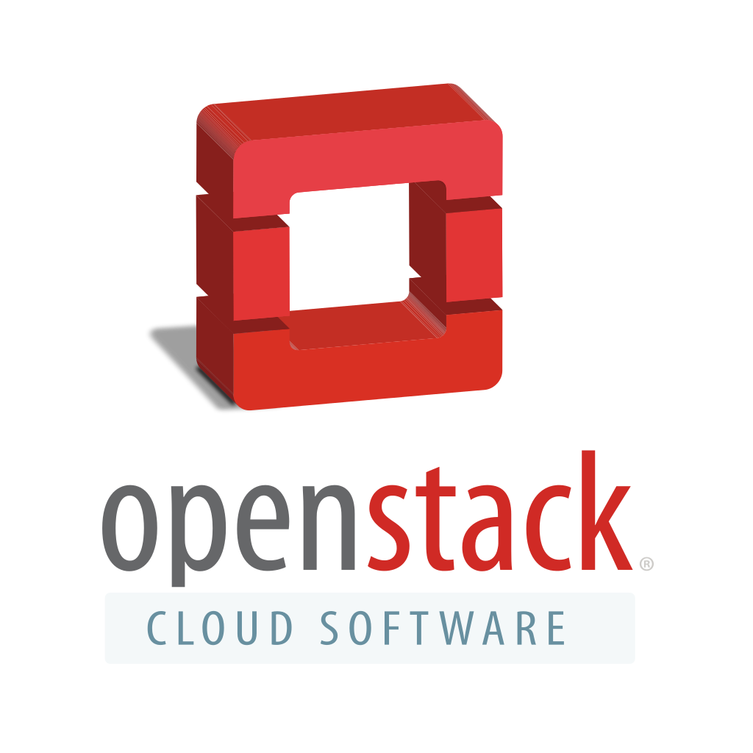
“Cloud, Clusters and Grids” Prof. Andrey Shevel
St.Petersburg
6th June 2017
MADHUBALA GANESAN
madhubala.ganesan25@gmail.com

Slide 2
What is Openstack?
Free and Open Source
Set of software tools
Building and managing cloud computing platforms
Public and Private clouds
2nd largest community after Linux
Written in
Python
Definitions from :
https://en.wikipedia.org/wiki/OpenStack
https://opensource.com/resources/what-is-openstack

Slide 3


An Email started it all!
https://www.rackspace.com/openstack

Slide 4

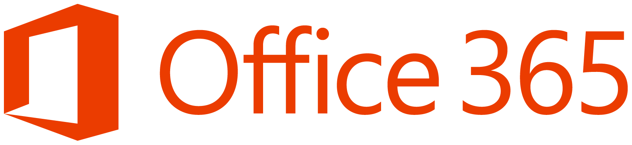
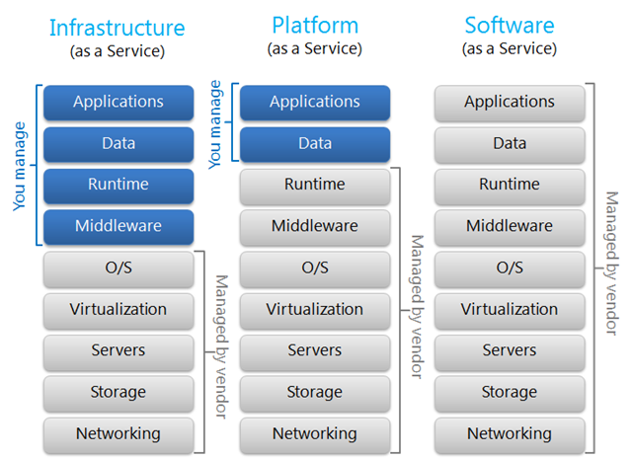
Cloud Service Models

Slide 5
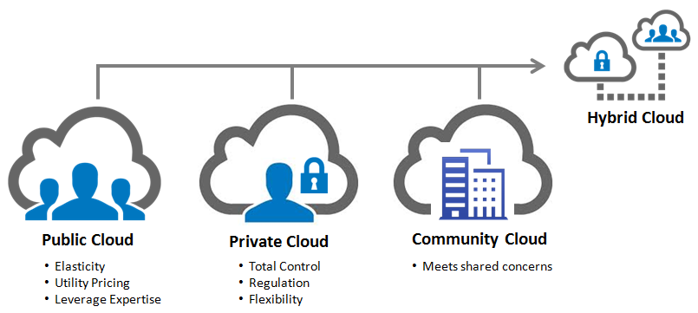
Cloud Deployment Models

Slide 6
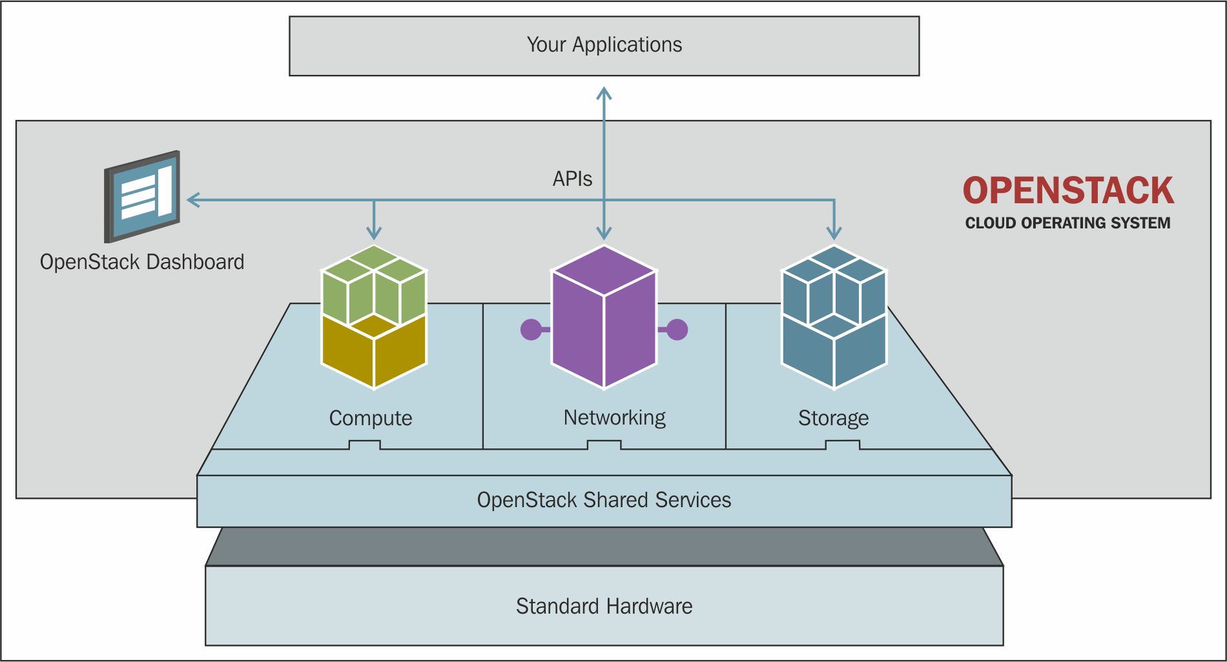
Cloud operating system controls large pools of compute, storage, and networking resources throughout a datacenter, all managed through a dashboard that gives administrators control while empowering the users to provision resources through a web interface.

Slide 7
Stable Releases
Name | Released on | Name | Released on
Austin | 21 Oct 2010 | Icehouse | 17 Apr 2014
Bexar | 3 Feb 2011 | Juno | 16 Oct 2014
Cactus | 15 Apr 2011 | Kilo | 30 Apr 2015
Diablo | 22 Sept 2011 | Liberty | 16 Oct 2015
Essex | 5 Apr 2012 | Mitaka | 7 Apr 2016
Folsom | 27 Sept 2012 | Newton | 6 Oct 2016
Grizzly | 4 Apr 2013 | Ocata | 22 Feb 2017
Havana | 17 Oct 2013 | Pike | 6 Oct 2017
Control & Flexibility: not locked to a proprietary vendor
Industry Standard: > 200 companies are contributing
Proven Software: power some of the largest public & private clouds
Compatible & Connected: easy to migrate data and applications to public clouds

Slide 8


Illusion of Infinite Capacity
Access and Management
APIs
Web Dashboard

Slide 9
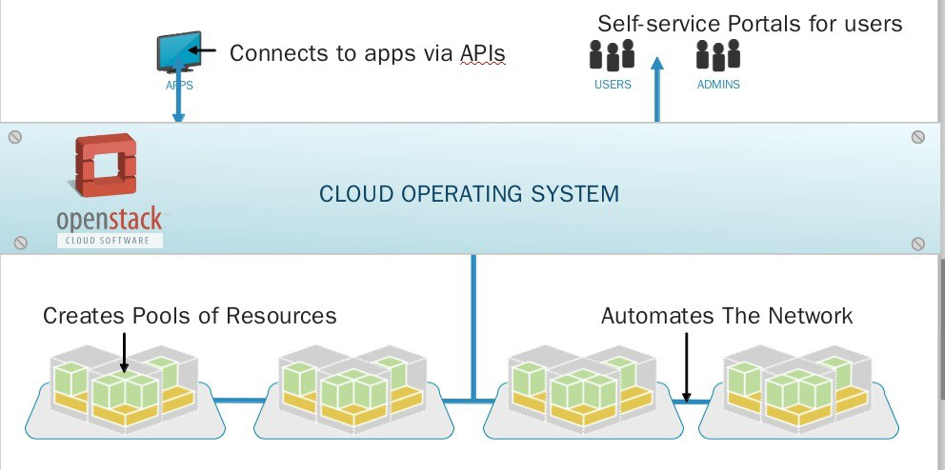
How does it work?

Slide 10
Openstack Architecture

Slide 11
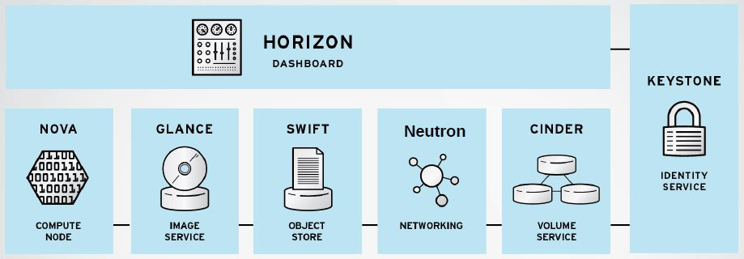
Modular architecture
Designed to easily scale out
Based on (growing) set of core services

Slide 12
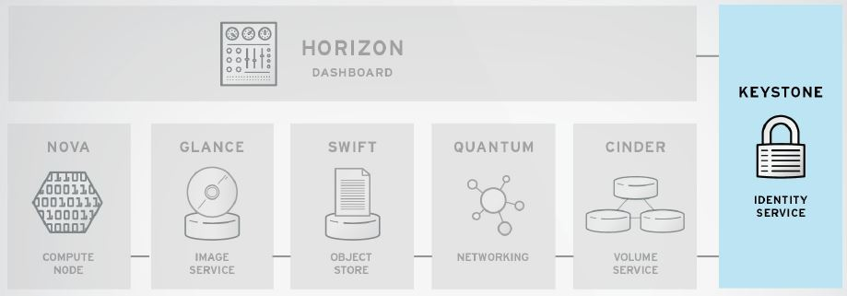
Identity Service
Common authorization framework
Manages users, tenants and roles

Slide 13
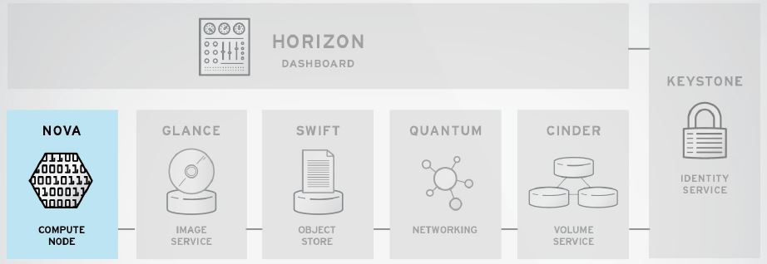
Core compute service comprised of
Compute Nodes – hypervisors that run virtual machines
– Supports multiple hypervisors KVM, Xen, LXC, Hyper-V and ESX
Distributed controllers that handle scheduling, API calls, etc
– Native OpenStack API and Amazon EC2 compatible API

Slide 14
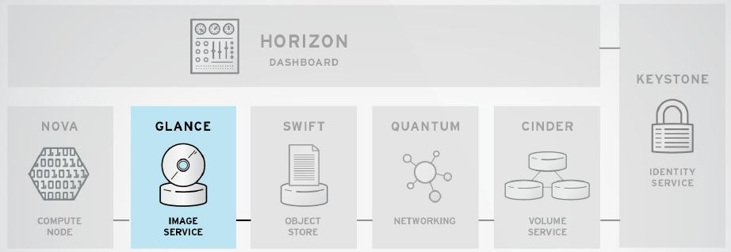
Image service
Stores and retrieves disk images (virtual machine templates)
Supports Raw, QCOW, VMDK, VHD, ISO, OVF & AMI/AKI
Backend storage : Filesystem, Swift, Amazon S3

Slide 15
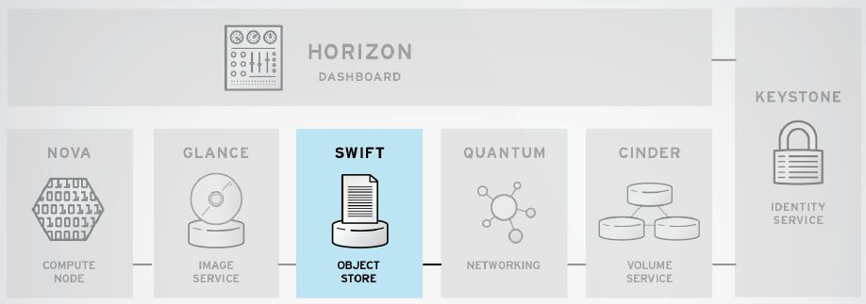
Object Storage service
Modeled after Amazon's S3 service
Provides simple service for storing and retrieving arbitrary data
Native API and S3 compatible API

Slide 16
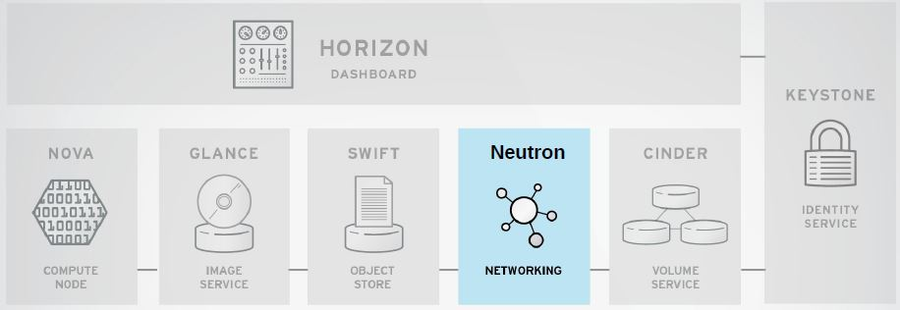
Network Service
Provides framework for Software Defined Network (SDN)
Allows integration of hardware and software based network solutions

Slide 17
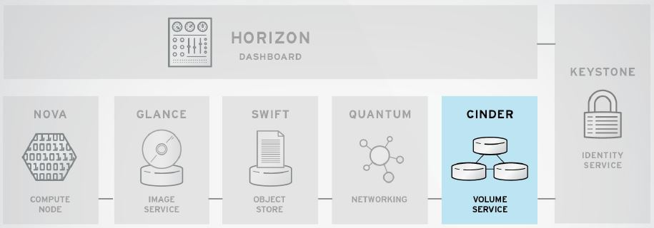
Block Storage (Volume) Service
Provides block storage for virtual machines (persistent disks)
Similar to Amazon EBS service

Slide 18
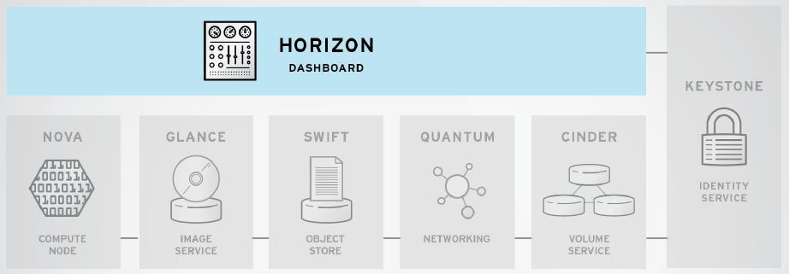
Dashboard
Provides simple self service UI for end-users
Basic cloud administrator functions
Define users, tenants and quotas

Slide 19
Other modules in Openstack
Orchestration (Heat)
Workflow (Mistral)
Telemetry (Ceilometer)
Database (Trove)
Elastic map reduce (Sahara)
Bare metal (Ironic)
Messaging (Zaqar)
Shared file system (Manila)
DNS (Designate)
Key manager (Barbican)

Slide 20
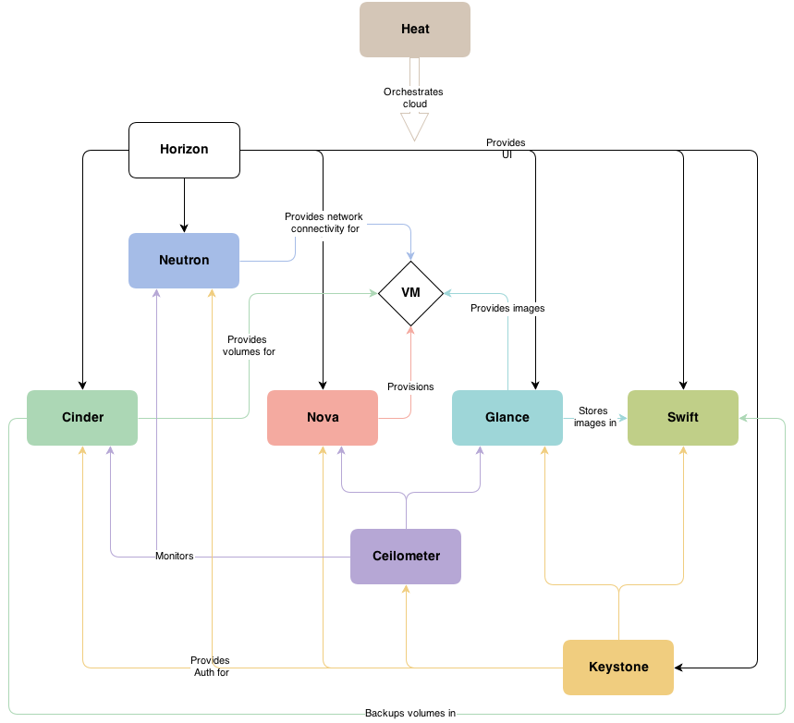
A loosely coupled Architecture

Slide 21
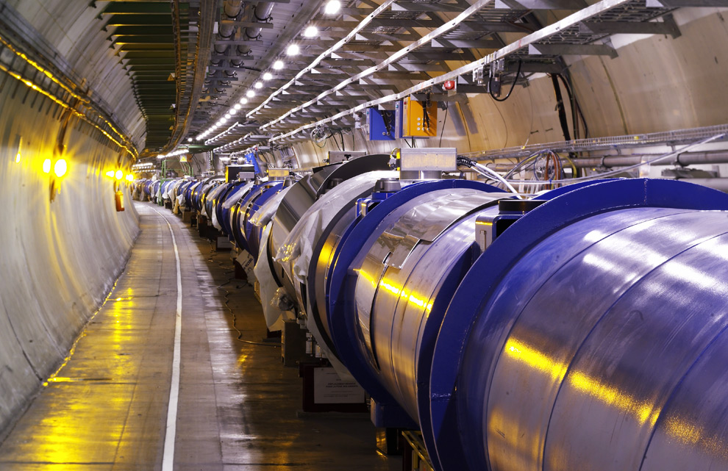
CERN’s INFRASTRUCTURE
~1300 compute nodes
Run ~1000 VMs simultaneously
Deployed ~250VMs in ~5min

Slide 22
Demo Time!

Slide 23
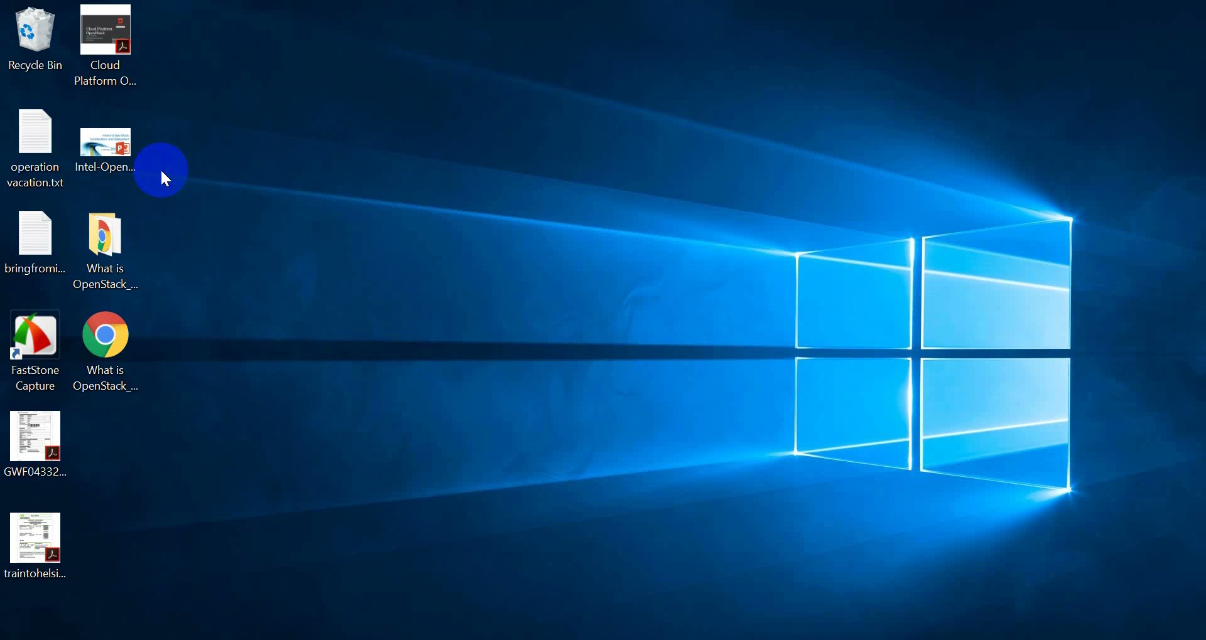

Slide 24
Distributions
HPE
IBM
Mirantis
Oracle OpenStack for Oracle Linux / Solaris
Red Hat
Stratoscale
SUSE
VMware Integrated OpenStack (VIO)

Slide 25
Want to learn Openstack?
The OpenStack Foundation - http://www.openstack.org/
Official OpenStack Documentation - http://docs.openstack.org/
The OpenStack Cloud Computing Cookbook (Second Edition) - http://www.amazon.com/OpenStack-Cloud-Computing-Cookbook-Jackson/dp/1782167587/ref=sr_1_1?s=books&ie=UTF8&qid=1382033707&sr=1-1
TryStack (OpenStack Sandbox) - http://trystack.org/
Rackspace Public Cloud - http://www.rackspace.com/cloud/
Devstack - https://docs.openstack.org/developer/devstack/guides/single-machine.html
Join The OpenStack Community - http://www.openstack.org/community
Open Source - https://github.com/openstack

Slide 26
Thank You!

