Slide 1
Computing Clusters, Grids and Clouds Globus data service
Mukhammadjon Jalolov
Globus.org

Slide 2
Background
Globus is a project of the Computation Institute, which is a partnership between The University of Chicago and Argonne National Laboratory, founded in 2000 to advance science through innovative computational approaches.
Globus is supported by funding from the Department of Energy, the National Science Foundation, and the National Institutes of Health. Globus actively pursues ways to become sustainable such as offering Globus Provider plans to institutions.

Slide 3
Globus system and Globus data transfer
Globus is a fast, reliable file transfer service that makes it easy for users to move data between two GridFTP servers or between a GridFTP server and a user’s machine (Windows, Mac or Linux).
Globus automates the activity of managing file transfers: monitoring performance, retrying failed transfers, recovering from faults automatically whenever possible, and reporting status. For example, the number of parallel streams initiated is dependent on the size of the files being transfered. 2 streams for files less than 50MB, 4 streams for files between 50Mb and 250MB and 8 streams for files >250MB. There is no custom infrastructure required for operation – Globus is Software-As-A-Service that can be used today without building any features oneself.

Slide 4
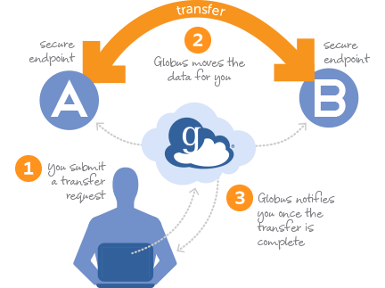
Globus file transfer

Slide 5
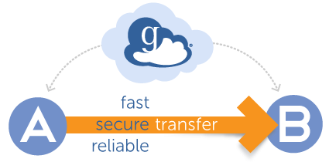
Globus Data Service Advantages
Globus Data Service provides easy, fast, secure, and reliable transfer. Laboratories and universities around the world use Globus to get their big data where they need it quickly, and let their researchers focus on science, not IT issues.
Globus is software as a service (SaaS), which is enabled by the cloud. However, Globus is not a cloud storage service, which means that one does not have to pay to store data. It enables to transfer and share data to and from the storage options: a campus computing cluster, a lab server, a supercomputer, or individual laptop.

Slide 6
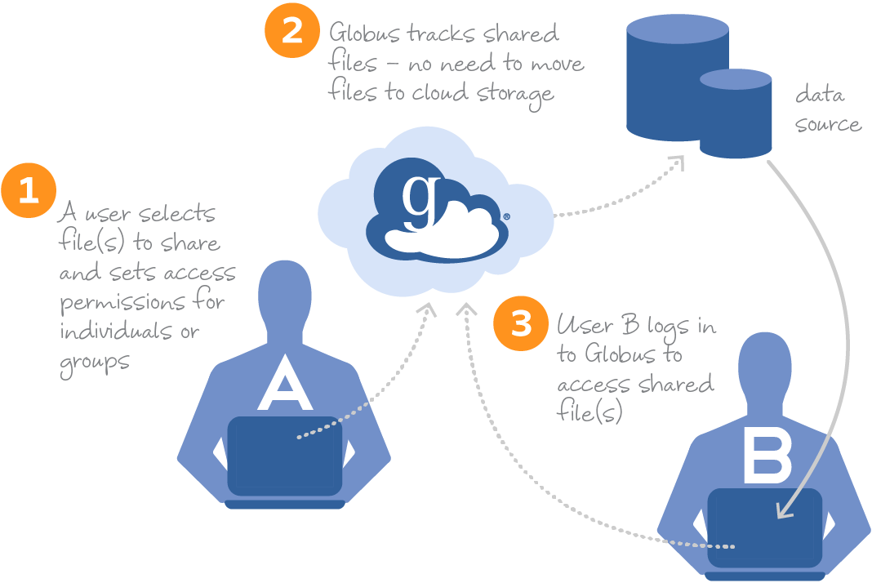
Globus data sharing

Slide 7
Globus Endpoint
A Globus endpoint is a data transfer location. Different types of resources (campus storage systems, HPC clusters, laptops, Amazon S3 buckets, scientific instruments, etc.) can be set up as Globus endpoints and made accessible to authorized users via Globus. An endpoint allows users with accounts on the underlying resource to transfer files, and it can also be configured to allow data sharing, publication, and discovery capabilities for other Globus users, including those who do not have local accounts on that resource.
There are two primary classes of endpoints: server endpoints and personal endpoints. Multi-user resources such as campus storage systems and HPC clusters are set up as server endpoints, typically by system administrators. Laptops or other personal computers are set up as personal endpoints, typically by individuals.
Globus Connect is used to set up server and personal endpoints.

Slide 8
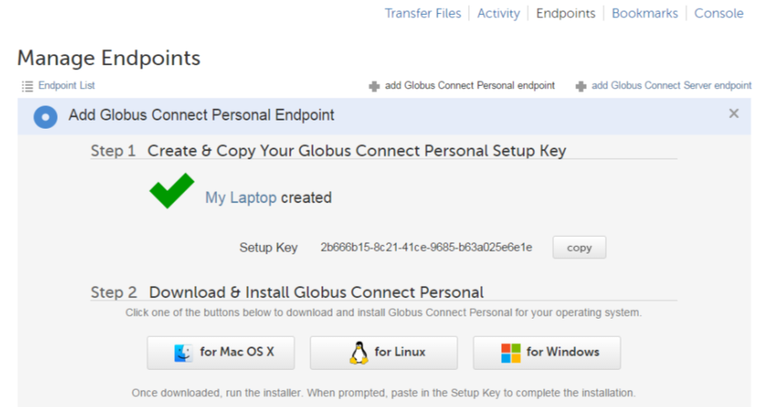
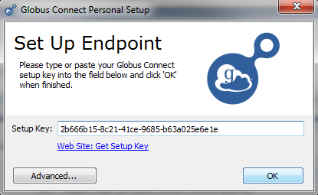
Globus Connect Personal
Creates a Globus endpoint on a laptop or other personal computer and allows to transfer and share files, even without administrative privileges of a user on the machine. Globus Connect Personal is available for Mac OS X, Windows, and Linux operating systems.

Slide 9
Globus Connect Server
Creates a Globus endpoint on multi-user systems such as a lab servers, campus research computing clusters, and other high-performance computing or storage resources. Globus Connect Server is available for all major Linux distributions and integrates with your existing IT infrastructure.

Slide 10
Globus Server requirements
Globus Connect Server is supported on the following Linux distributions:
CentOS 5, 6, and 7
Debian 7 and 8
Fedora 23 and 24
Red Hat Enterprise Linux 5, 6, and 7
Scientific Linux 5, 6, and 7
SuSE Linux Enterprise Server 11sp3
Ubuntu 12.04 LTS, 14.04 LTS, 15.10, and 16.04 LTS
Globus account for the organization is needed
One must have administrator (root) privileges on the system to install Globus Connect Server

Slide 11
Globus Server requirements
The TCP ports that must be open for the default Globus Connect Server installation
Port 2811 inbound from 184.73.189.163 and 174.129.226.69
Ports 50000—51000 inbound and outbound to/from Any
Data channel traffic is sent directly between endpoints—it is not relayed by the Globus service.
Port 2223 outbound to 184.73.255.160
Used to pull certificate information from the Globus service.
Port 443 outbound to 174.129.226.69 and nexus.api.globusonline.org
Used to communicate with the Globus service via its REST API.
Port 80 outbound to 192.5.186.47
Used to pull Globus Connect Server install packages from the Globus repository.
Port 7512 inbound from 174.129.226.69
Port 443 inbound from Any

Slide 12
How does it work
The Globus service manages transfers to and from a Globus Connect Personal endpoint. Globus Connect Personal uses GSI SSH to maintain a control connection to the Globus service and receive commands. Data are always transferred directly between the Globus Connect Personal endpoint and the destination endpoint – data does not "flow through" Globus in any way.

Slide 13
Testing
One must be a Globus Plus user to transfer files between two Globus Connect Personal endpoints. If the two endpoints are owned by different Globus users, both users must be Globus Plus users. An account may be upgraded to Globus Plus if a users institution subscribes to a Globus subscription.
However, it is not required to be a Plus user to transfer files between a Globus Connect Personal endpoint (e.g. from a laptop) and a Globus Connect Server endpoint (e.g. on a lab server or campus cluster). Globus Connect Personal can execute a transfer as long as either the source or destination endpoint has a routable IP address (which is the case for almost all Globus Connect Server endpoints).

Slide 14
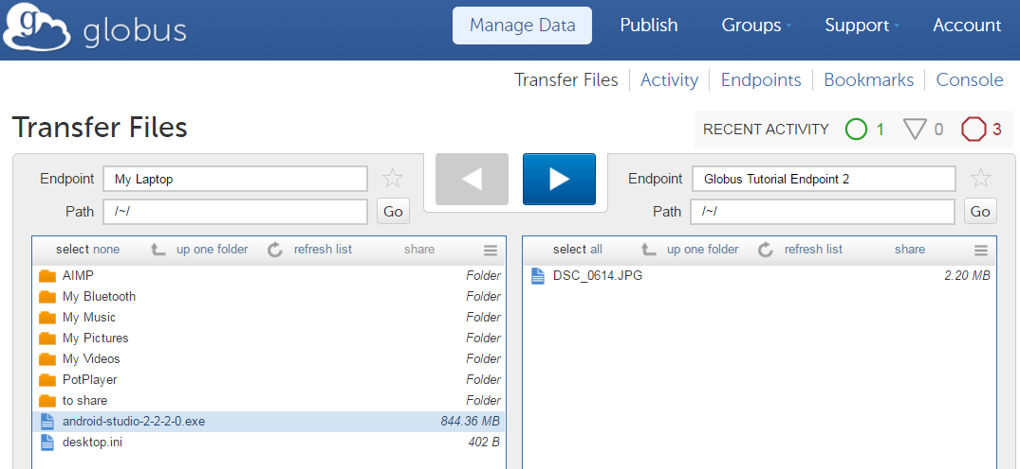
The endpoints Globus Tutorial Endpoint 1 and 2 are server endpoints administered by the Globus team for demonstration purposes and are accessible to all Globus users without further authentication.

Slide 15
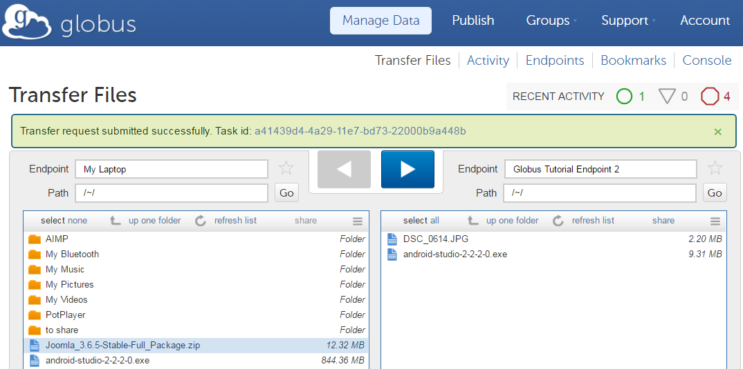
Transferring two files from my local endpoint to server endpoint

Slide 16
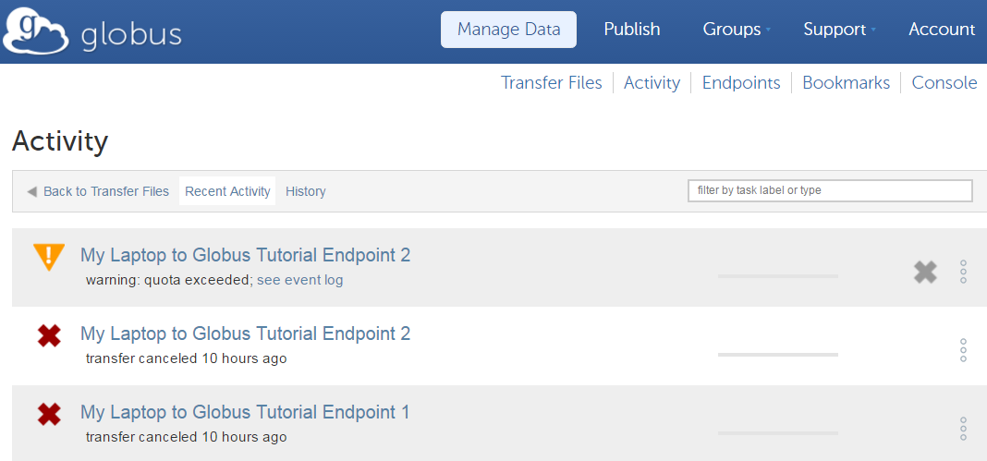

Slide 17
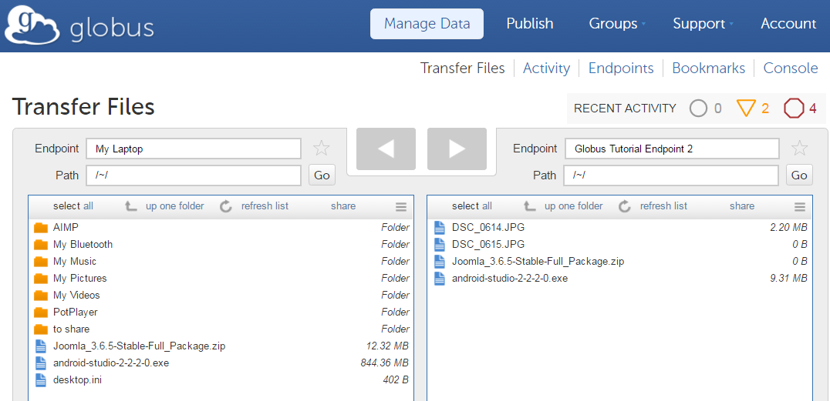

Slide 18
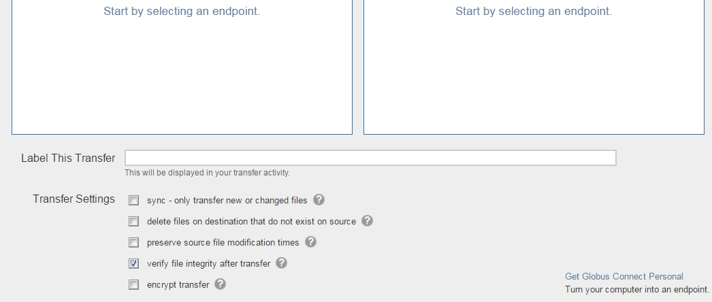
Transfer Settings panel

Slide 19
References:
https://www.globus.org/
https://fasterdata.es.net/data-transfer-tools/globus/
https://docs.globus.org/how-to/share-files/

