Slide 1
A free and open-source distributed NoSQL database
Computer Clusters and Grids
Prof. Andrey Shevel
Carl Kugblenu
ITMO University – St. Petersbury

Slide 2
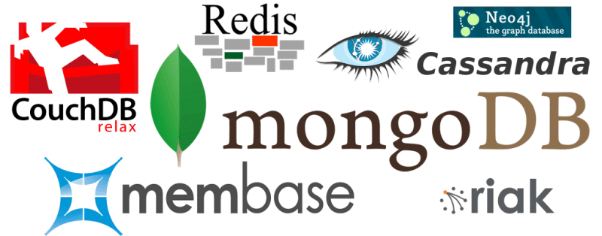
What is NoSQL?
Stands for Not Only SQL
Class of non-relational data storage systems
Usually do not require a fixed table schema nor do they use the concept of joins
Notes:
-> NoSQL was a term coined by Eric Evans. He states that ‘… but the whole point of seeking alternatives is that you need to solve a problem that relational databases are a bad fit for. …
-> This is why people are continually interpreting nosql to be anti-RDBMS, it's the only rational conclusion when the only thing some of these projects share in common is that they are not relational databases.’
-> Emil Elfrem stated it is not a ‘NO’ SQL but more of a ‘Not Only” SQL.

Slide 3
Distributed Database

Slide 4
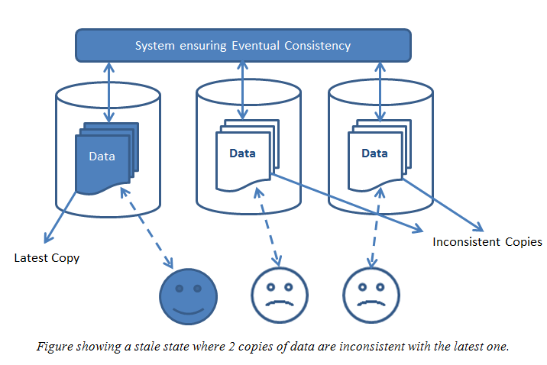
Eventual Consistency
When no updates occur for a long period of time, eventually all updates will propagate through the system and all the nodes will be consistent
Known as BASE (Basically Available, Soft state, Eventual consistency), as opposed to ACID
Notes:
-> http://en.wikipedia.org/wiki/Eventual_consistency
-> http://www.allthingsdistributed.com/2008/12/eventually_consistent.html
The types of large systems based on CAP aren't ACID they are BASE (http://queue.acm.org/detail.cfm?id=1394128): * Basically Available - system seems to work all the time * Soft State - it doesn't have to be consistent all the time * Eventually Consistent - becomes consistent at some later time
Everyone who builds big applications builds them on CAP and BASE: Google, Yahoo, Facebook, Amazon, eBay, etc

Slide 5
Cassandra
Originally developed at Facebook
Follows the BigTable data model: column-oriented
Uses the Dynamo Eventual Consistency model
Written in Java
Open-sourced and exists within the Apache family

Slide 6
Why Use Cassandra

Slide 7
Features
Fault Tolerant Architecture: Cassandra has no single point of failure. Every node in the cluster is identical and can run on commodity hardware.
Performant: Cassandra supports very high throughput. In particular the Cassandra write path allows for high performance, robust writes.
Resilience: Data is automatically replicated to multiple nodes
Scalable: Cassandra is horizontally scalable.
Flexible data storage: Cassandra accommodates all possible data formats including: structured, semi-structured, and unstructured.

Slide 8
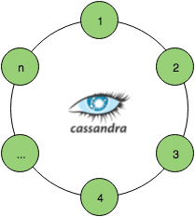
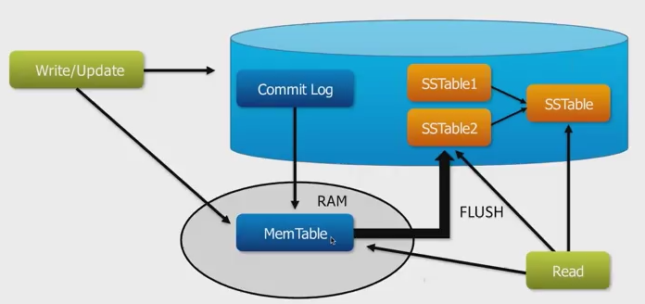
Architecture

Slide 9
Cassandra: Requests Flow

Slide 10
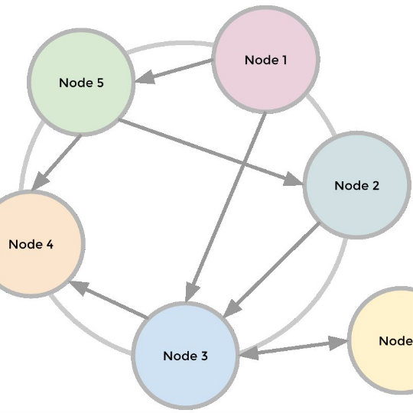
Internode Communication
Cassandra uses Gossip communication protocol in which nodes periodically exchange state information about themselves and other nodes they know about
Gossip messages are versioned
During a gossip exchange, older information is overwritten with the most current state for a particular node

Slide 11
Data Model

Slide 12
Advantages
Write Speeds
Multi-DC Replication
Tunable Consistency

Slide 13
Drawbacks
No Ad-Hoc Queries
No Aggregations
Unpredictable Performance
JVM Based

Slide 14
Use Cases
Immutable data where updates and deletions are the exception rather than the rule.
High-throughput firehoses of immutable events such as personalization, fraud detection, time series and IOT/sensors.

Slide 15
Demo Deployment

Slide 16
References
http://cassandra.apache.org/
http://www.datastax.com/dev/blog/multi-datacenter-replication
http://www.datastax.com/dev/blog/multi-datacenter-replication
https://www.edureka.co/blog/apache-cassandra-advantages/
https://en.wikipedia.org/wiki/Apache_Cassandra
https://www.digitalocean.com/community/tutorials/how-to-install-cassandra-and-run-a-single-node-cluster-on-ubuntu-14-04
https://opencredo.com/fulfilling-promise-apache-cassandra/
https://www.quora.com/What-are-the-pros-and-cons-of-using-the-Cassandra-database

