Slide 1
Openstack Disk Storage vs Amazon Disk Storage
Computing Clusters, Grids and Cloud
Erasmus Mundus Master Program in PERCCOM
Author: Nhi VO
vtynhi2001@gmail.com
Course by: Andrey Shevel
shevel.andrey@gmail.com
St. Petersburg, 2016

Slide 2
Outlines
Storage at glance
Overview about OpenStack Storage
Overview about Amazon Storage
OpenStack Storage versus Amazon Storage
Conclusions

Slide 3
Storage at glance
Block storage
Assign virtual drives/volumes to virtual servers to grow their storage capacity, beyond the boot volume.
Snapshots and backups of virtual servers.
necessary for expandable file systems, maximum performance, and integration with enterprise storage services as well as applications that require access to raw block-level storage.
Object storage
Housing objects (any kinds such as files, media, images…)
Suitable for storing large files

Slide 4
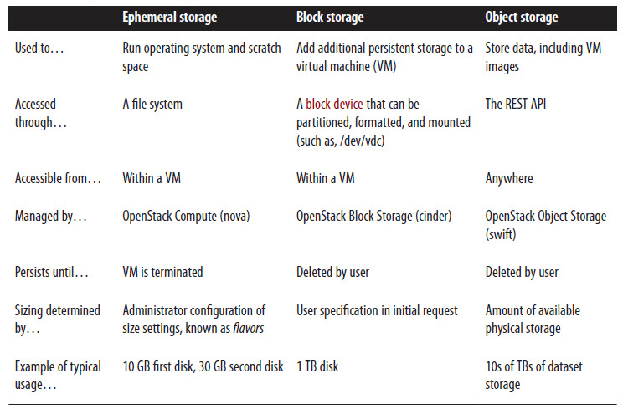
Overview about OpenStack Storage

Slide 5
Overview about Amazon Storage

Slide 6
OpenStack Storage versus Amazon Storage
 | OpenStack | AWS
Object storage | Swift | S3 – Simple Storage Service
Block storage | Cinder | EBS – Elastic Block Storage

Slide 7
Openstack Storage
Open source, rich ecosystem of tools and libraries
Focus on app development, not infrastructure plumbing
Highly available and durable architecture
No single point of failure
No vendor lock-in
Ensuring the integrity of data

Slide 8
OpenStack Swift
A distributed, API-accessible storage platform
Can be integrated directly into applications or used to store VM images, backups, and archives
Comes up short in both transfer speed and latency because the traffic to and from the Swift cluster flows through the proxy servers.
Due to latency when object replicas aren’t necessarily updated at the same time, which can cause requesters to receive an old version of an object after the first write of the new version.

Slide 9
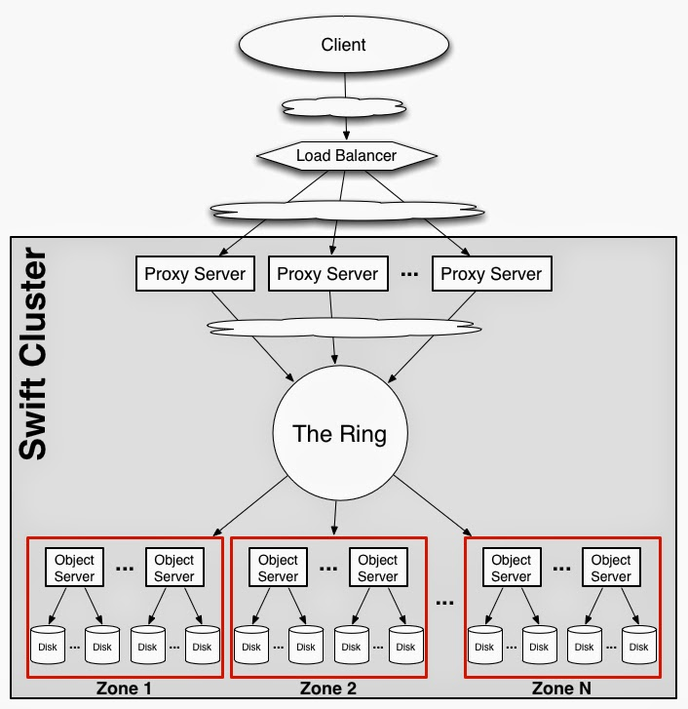
OpenStack Swift Architecture

Slide 10
OpenStack Cinder
Provides persistent block storage to guest virtual machines (VMs)
Cinder is an abstraction layer to manipulate multiple types of backend storages as volumes by the same interfaces

Slide 11
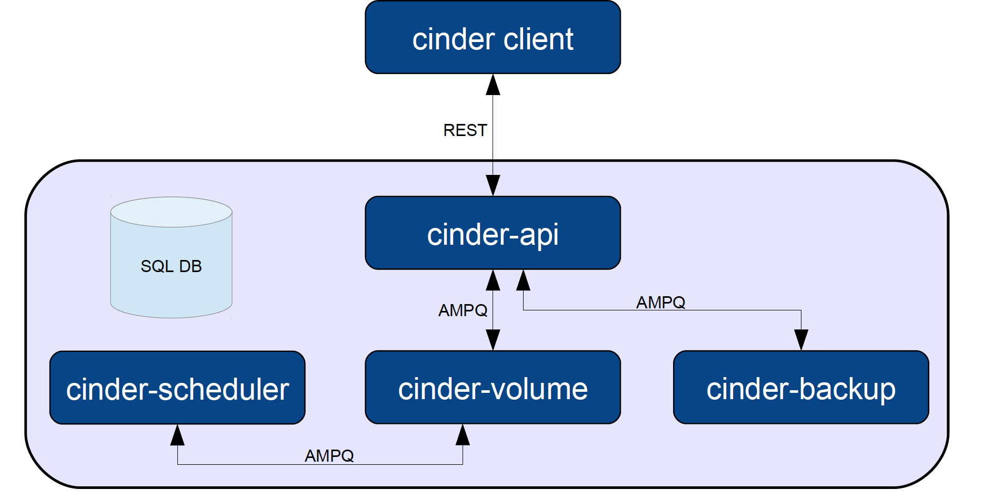
OpenStack Cinder Architecture

Slide 12
Amazon Storage
Provides a simple web services interface that you can use to store and retrieve any amount of data, at any time, from anywhere on the web.
Focus on simplicity and robustness
Fast, highly scalable, available and durable
Can be used alone or together with other AWS services
Programmatic Access Using the AWS SDKs

Slide 13
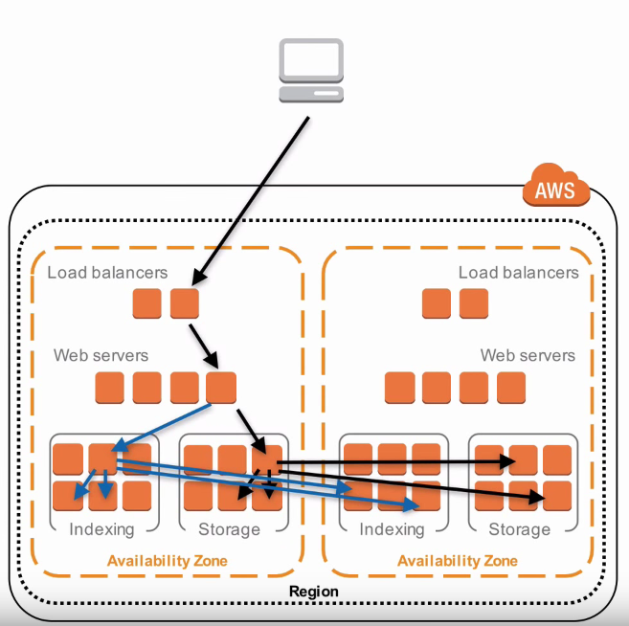
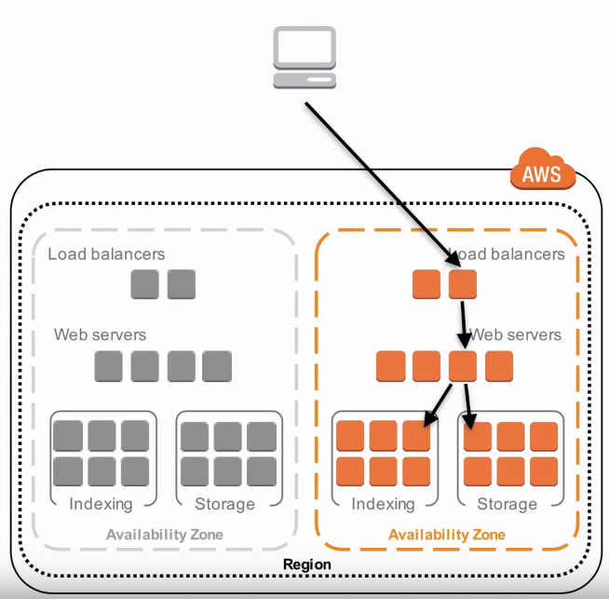
Amazon architecture

Slide 14
Thank you!
Nhi VO
vtynhi2001@gmail.com
Saint-Petersburg, 2016

Slide 15
AWS S3: Key features
Scale. Costs grow and shrink on demand, and global deployments can be done in minutes.
Durability. Amazon S3 is in 12 regions around the world and includes a geographic redundancy option to replicate across regions. In addition, multiple versions of an object may be preserved for point-in-time recovery.
Broad integration with other AWS services: Security (IAM and KMS), alerting (CloudWatch, CloudTrail and Event Notifications), computing (Lambda), and database (EMR, Redshift)...
Cloud Data Migration services. AWS storage includes multiple specialized methods to help you get data into and out of the cloud.
Lifecycle Management Policies. Objects may be moved between storage classes via customizable, automated rules.

Slide 16
AWS EBS: Key features
Reliable, secure storage
Consistent and low-latency performance
Backup, restore, innovate
Quickly scale up, easily scale down

Slide 17
References
http://docs.aws.amazon.com/
https://swiftstack.com/blog/2015/02/23/3825/
http://zenoss.com/blog/2011/12/06/grocery-vs-restaurant-openstack-vs-amazon/

