Slide 1
Globus project
Study course: “Computing clusters, grids and clouds”
Andrey Y. Shevel
PERCCOM Master student
Rybnytska Olga

Slide 2
Outline
Background
Products
Globus Toolkit
Globus GridFTP
Conclusions

Slide 3
Background
Globus is a connected set of services for research data management;
The project was started in 1997 by the University of Chicago and Argonne National Laboratory;
The main goal of Globus project is to make big data portable;
Globus allows to transfer file from Endpoint to Endpoint via Web interface. Examples of Endpoints: PC, HPC cluster, campus storage system etc.

Slide 4
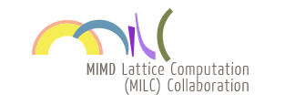
Background
The technology underlying this service is GridFTP. GridFTP is an extension of the standard File Transfer Protocol (FTP) for high-speed, reliable, and secure data transfer. GridFTP also addresses the problem of incompatibility between storage and access systems.
Case studies:

Slide 5
Products
Globus Connect
Globus Connect Personal (a client for communicating with other GridFTP servers, via your local computer using Globus).
Globus Connect Server (a Linux package that sets up a GridFTP server for use with Globus. Once installed on a server, those with access to the server can move data to and from this location).
Globus Genomics (an end-to-end solution for genomics sequencing analysis, bringing together Globus transfer technology, Galaxy workflow tools, and cloud computing power from Amazon Web Services).
Globus Toolkit

Slide 6
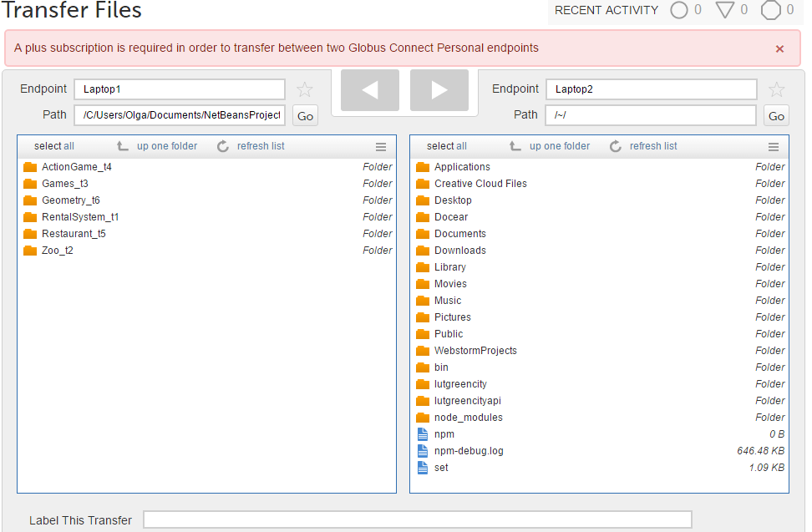
Products
Globus Connect

Slide 7
Globus Toolkit
An open-source software for Grid Computing;
The toolkit includes software for security, information infrastructure, resource management, data management, communication, fault detection, portability.
Core components allow to access remote resources;
In 2003, Globus Toolkit won the Federal Laboratory Consortium award, in recognition of its widespread adoption by industry.

Slide 8
Globus
Toolkit

Slide 9
Globus Toolkit

Slide 10
GridFTP protocol
Key features:
Performance (usage of parallel TCP streams and multi-node transfers);
Checkpointing (the server sends restart markers to the client);
Third-party transfers (FTP protocol separates control and data channels, enabling third-party transfers, that is, the transfer of data between two end hosts, mediated by a third host);
Security (strong security on both control and data channels. Control channel is encrypted by default. Data channel is authenticated by default with optional integrity protection and encryption.)

Slide 11
Globus Implementation of GridFTP
Globus GridFTP framework implements all key features of GridFTP protocol.
Supports both Grid Security Infrastructure (GSI) and SSH for securing the data transfer. Unlike sftp, SSH based GridFTP supports multiple security options on the data channel - authentication only, authentication and integrity protection, fully encrypted.
Globus implementation of GridFTP is modular and extensible. XIO based Globus GridFTP framework makes it easy to plugin alternate transport protocols.
The Data Storage Interface (DSI) allows easier integration with various storage systems. Globus GridFTP has been deployed at thousands of sites with more than 10 million data transfers per day.

Slide 12
Conclusions
Globus transfer is easy, fast, secure, and reliable.
Globus is software as a service (SaaS), enabled by the cloud. But it is not a cloud storage service, so you won’t have to pay for storing your data.
The Globus services are purpose-built to meet the needs and requirements of the research community. Thus the project is committed to sustainably supporting science, not making a profit.

Slide 13
References
Globus: How It Works. Available on: https://www.globus.org/how-it-works
GT 6.0 GridFTP Key Concepts. Available on http://toolkit.globus.org/toolkit/docs/latest-stable/gridftp/key/gridftpKeyConcepts.pdf

Slide 14
QUESTIONS?

