Slide 1
File system: Ceph
Felipe León
Felipe.leon.coello@student.lut.fi
31.05.2016
Computing, Clusters, Grids & Clouds
Professor Andrey Y. Shevel
ITMO University - Russia

Slide 2
INTRODUCTION
CEPH was created in UCL by a PHD student, initially written in 40k lines of C++ Code and made open source under Lesser GNU public License,
Ceph has no enterprise-only model, it means that anyone can implemented.
Inktank was founded to support, and spread the adoption of CEPH, and Red Hat in 2013 acquire Inktank.
Cisco, CERN and Deutsche telekom are Inktank Customers, and partners like dell and alcatel/lucent
CEPH comes from the word Cephalopod which is an octopus, and represents the parallel behavior of CEPH, and related to the company Inkfish name as well.
Openstack and Ceph communities have been working together to fully support CEPH in the openstack cloud,Openstack uses the most important feature of CEPH the RADOS service.
Dell, SUSE and Canonical, offer support and tools for easy deployment of ceph storage for their openstack solutions.

Slide 3
What is CEPH
Is an object storage file system design under the license GPI as free software, is highly distributable, escalable,, reliable and aims to be a file system with less failure in storage.
It includes the following Features:
Every component must be scalable
The solution has to be software based, open source and adaptable
Software should run on commodity hardware, meaning affordable an easy to obtain
Everything should be self-manageable
It provides good performance and one of the most important features it has limitless scalability

Slide 4
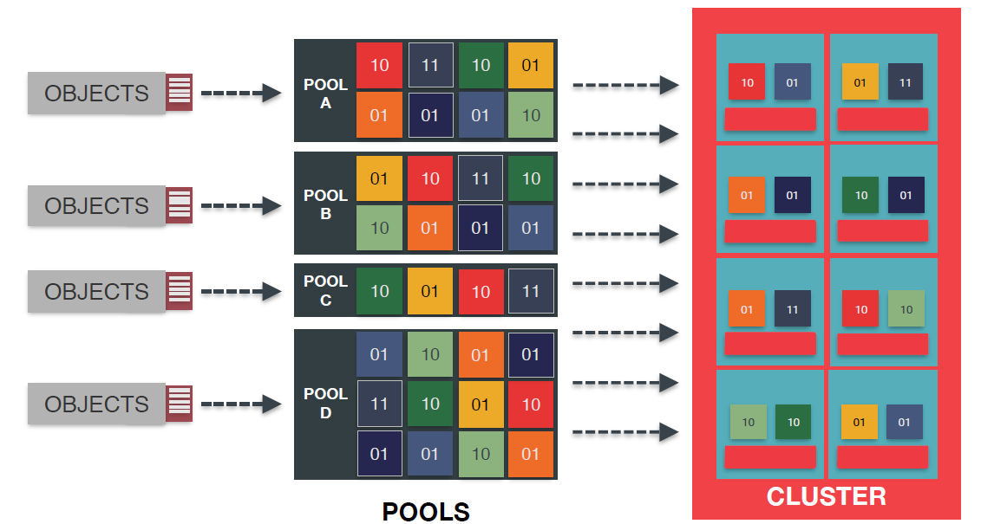
Key Components in Ceph
CEPH uses CRUSH algorithm (Control Replication Under Scalable Hashing)
CRUSH features:
Quick calculation,
Avoid going through centralized server
Deterministic
Uniform Distribution
Stable Mapping
Rule Based Configuration

Slide 5
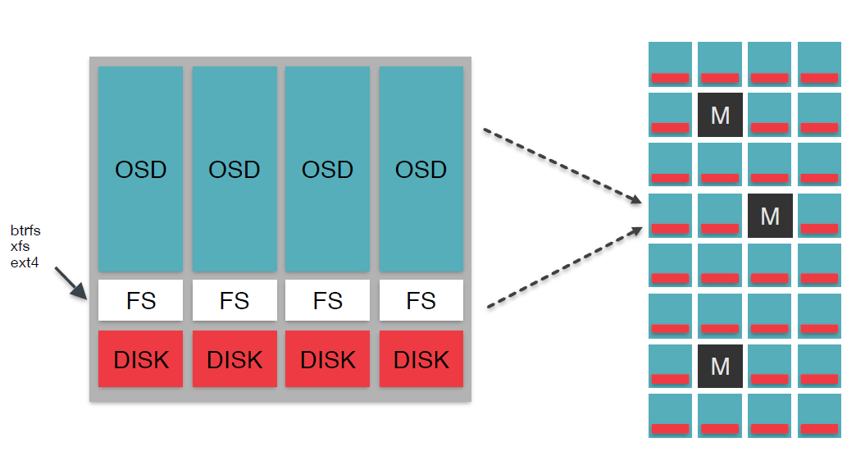
Key Components with CEPH
RADOS (Reliable, Automatic, Distributed Object Stores), is the key element for Ceph
OSD (Object Storage Daemon), is fundamental for the distributed file system
MON, is the monitor for CEPH, it is the brain of the cluster for adding OSDs, detect failure and reconstructs data

Slide 6
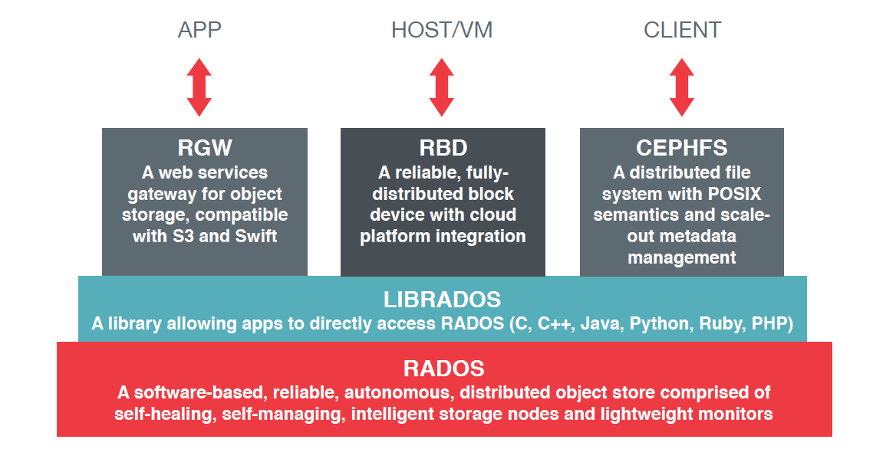
CEPH Architecture

Slide 7
RADOS
A RADOS system is a large collection of OSDs and small groups of monitors in charge of managing OSDs, Each OSD includes a CPU, RAM, network and a local drive. It has a :
Cluster Map.- specifies distribution of data
Data Placement.- maintains balanced distribution on devices
Device State.- state of devices over which data is distributed
Map Propagation.- distribute map updates and combines them
Intelligent storage devices:, RADOS implements data redundancy, failure detection and failure discovery
Replication- implement 3 replication schemes, primary copy, Chain, and splay
Strong Consistency.- all messages in both ways are tagged with the senders map
Failure detection- asynchronous communication from point to point, if there is failure, they are marked down
Data Migration and Failure Recovery.- is driven by map updates and changes, uses peering algorithm to identify data and start recovering
Notes:
Primary-copy replication updates all replicas in parallel, and processes both reads and writes at the primary OSD. Chain replication instead updates replicas in series: writes are sent to the primary (head), and reads to the tail, ensuring that reads always reflect fully replicated updates. Splay replication simply combines the parallel updates of primary-copy replication with the read/write role separation of chain replication. The primary advantage is a lower number of message hops for 2-way mirroring.

Slide 8
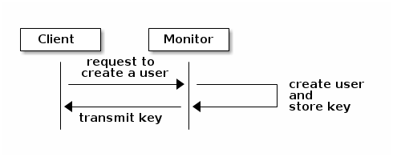
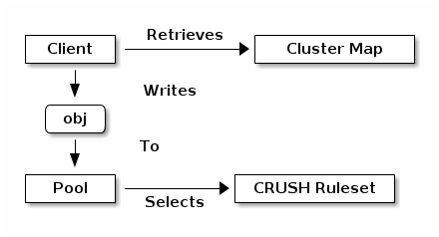
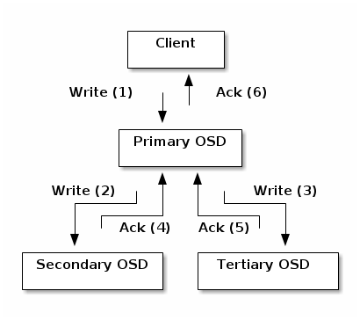
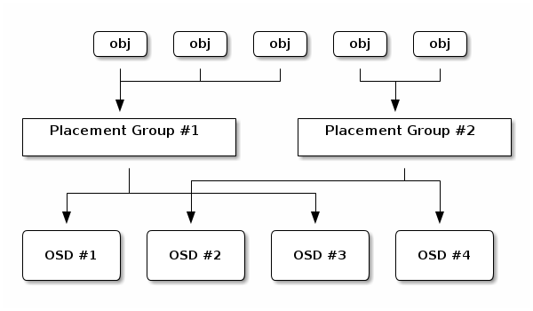
How Does it Work
https://www.youtube.com/watch?v=QBkH1g4DuKEto

Slide 9
REFERENCES
http://ceph.com/docs/master/cephfs/
S. A. Weil, S. A. Brandt, E. L. Miller, and C. Maltzahn. CRUSH: Controlled, scalable, decentralized placement of replicated data. In Proceedings of the 2006 ACM/IEEE Conference on Supercomputing (SC ’06), Tampa, FL, Nov. 2006. ACM.
S. A. Weil, S. A. Brandt, E. L. Miller, and C. Maltzahn.RADOS: A scalable, Reliable Storage Service for Petabyte-scale Storage Cluseters.White Paper

Slide 10
Thank you!
Q&A
Notes:
In Slide Show mode, click the arrows to visit links.

