Slide 1
Cluster, Grid, Clouds – Julien Dhallenne
Large data storage (examples, volumes, challenges)

Slide 2
Introduction
More and more data generated
Social content
Scientific projects
IoT
Current data storage > 10^24 bytes (Yottabyte)
How to store this data?

Slide 3
Outline
Examples
Social Media
Scientific measurements
IoT – sensors data
Volumes
Challenges

Slide 4
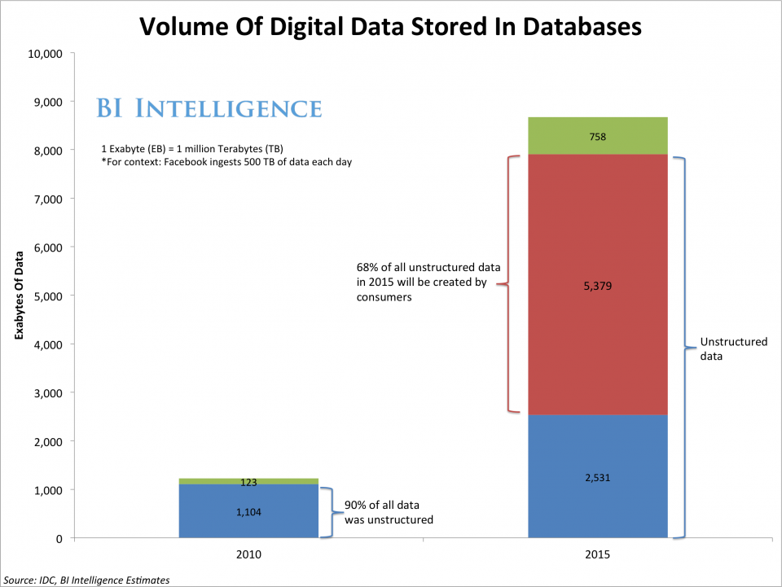
Examples 1/3 – Social Medias

Slide 5
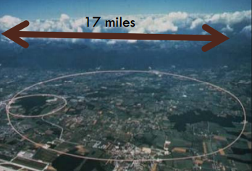
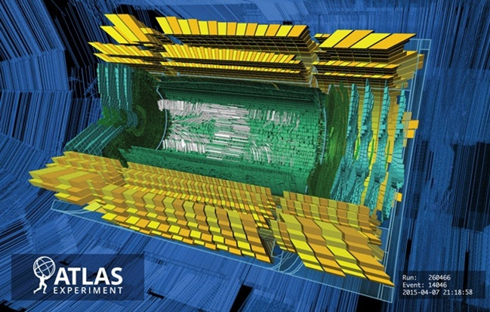
Examples 2/3 – Scientific measurements
The Hadron Collider at CERN (~27km) produces so much data that scientists must discard most of it, hoping they haven’t thrown away anything useful

Slide 6
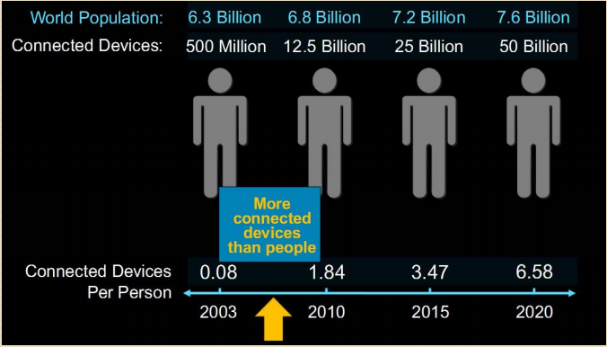
Examples 3/3 – IoT sensors data

Slide 7
Outline
Examples
Social Media
Scientific measurements
IoT – sensor data
Volumes
Challenges

Slide 8
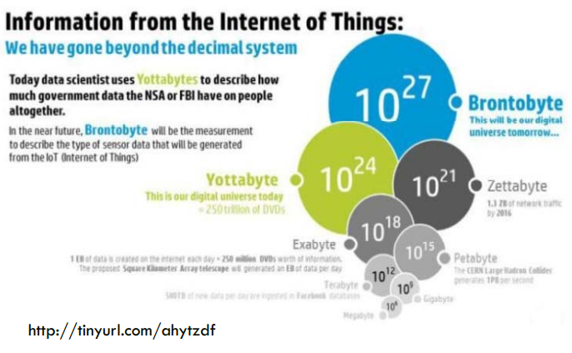
Volumes - IoT

Slide 9
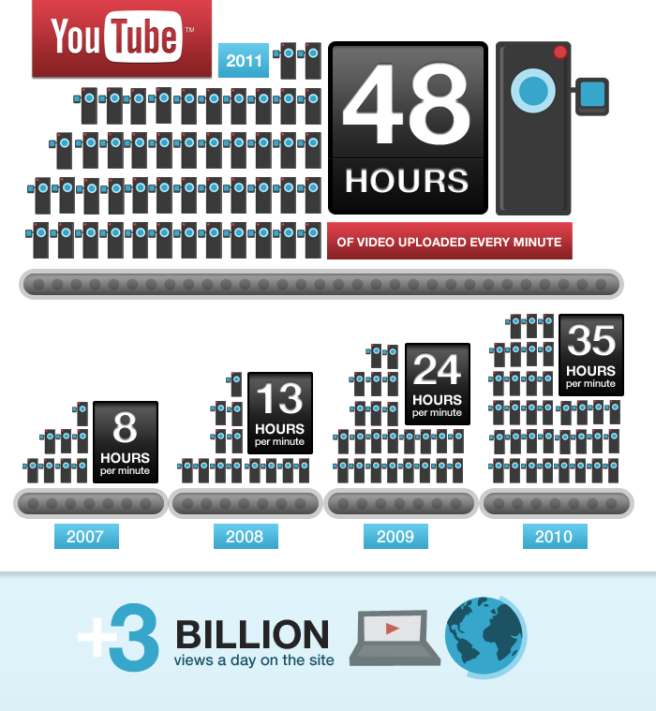
Volumes – Youtube data volume
Consequences :
Huge data storage
Numerous I/O operations
Notes:
Next : challenges

Slide 10
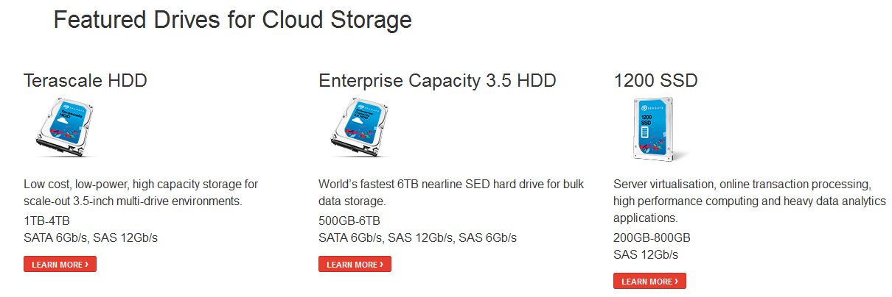
Challenges – current technologies
Notes:
Where do we store this data?
…..
How does that work?

Slide 11
Challenges – adapted file systems
Quantcast File System . High-performance, fault- tolerant, distributed file system
HDFS . Distributed file system providing high-throughput access
Ceph . Unified, distributed storage system
Lustre . File system for computer clusters
GlusterFS . Scale-out NAS file system
PVFS . Designed to scale to petabytes of storage
Notes:
Where do we store this data?

Slide 12
Thank you
Questions?

