Slide 1




ITMO UNIVERSITY
MODERN NETWORK TECHNOLOGIES IN DATA STORAGE SYSTEMS
NVME-OVER-TCP
THE FUTURE OF HIGH-PERFORMANCE STORAGE NETWORKING
BY. GHAITH ABU HUSSAIN
gaes.abu2016@gmail.com
K4110
1

Slide 2

ITMO UNIVERSITY
INTRODUCTION
  Traditional storage protocols (like iSCSI or Fibre Channel) were designed decades ago for HDDs.
  But now, data centers use NVMe SSDs which is ultra-fast, low-latency drives.
  These older protocols become bottlenecks for modern SSD performance.
  NVMe-over-TCP (abbreviated NVMe/TCP) lets organizations use NVMe’s speed across a standard IP network (Ethernet).
  It merges the performance of NVMe with the ubiquity of TCP/IP.
HDD (HARD DISK DRIVE)
1950S–2000S
NVMe (Non-Volatile Memory Express)
2011–2015
NVME/TCP
2019–2021
Flash-based drives replacing HDDs for speed and durability.
Extends NVMe over network fabrics like RDMA and Fibre Channel
Magnetic spinning disks dominant for decades in servers and PCs.
Protocol designed for SSDs over PCIe.
Removes SATA bottleneck.
Enables NVMe over standard TCP/IP networks — no special hardware needed.
SSD (SOLID STATE DRIVE)
2000S–2010S
NVME-OF (NVME OVER FABRICS)
2016–2018
2

Slide 3
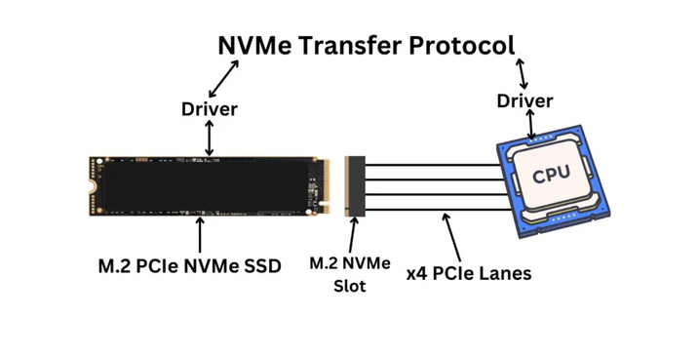
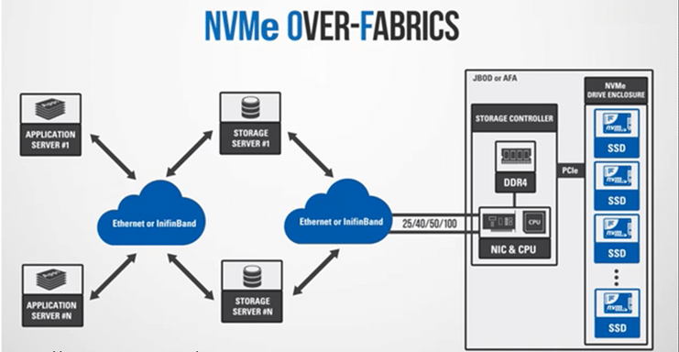
ITMO UNIVERSITY
BACKGROUND
FROM NVME TO NVME-OVER-FABRICS
NVME (NON-VOLATILE MEMORY EXPRESS)
NVME-OVER-FABRICS (NVME-OF)
  IT IS A STORAGE PROTOCOL DESIGNED FOR SSDS CONNECTED DIRECTLY VIA PCIE.
  IT REPLACES OLDER PROTOCOLS (AHCI, SATA) TO REDUCE LATENCY AND MAXIMIZE PARALLEL I/O (UP TO 64,000 QUEUES).
  EXTENDS NVME COMMANDS BEYOND A LOCAL PCIE BUS TO A NETWORK (“FABRIC”).
  DIFFERENT “FABRICS” CAN BE USED: RDMA (ROCE/IWARP), FIBRE CHANNEL (FC-NVME), OR TCP.
  MAKE REMOTE NVME DRIVES FEEL LOCAL TO THE HOST.
3

Slide 4
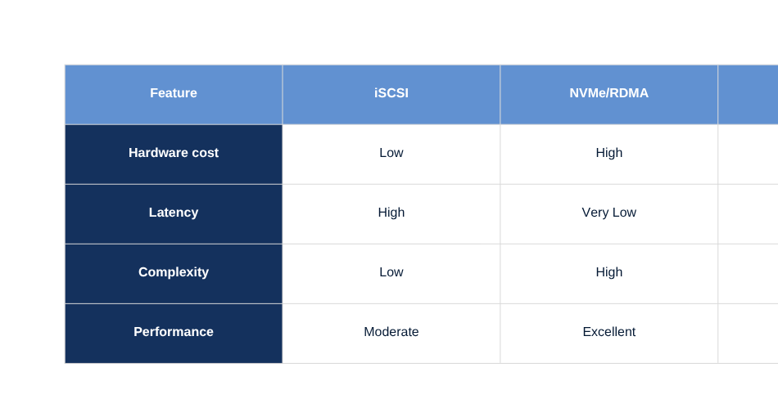
ITMO UNIVERSITY
WHY NVME-OVER-TCP?
  RDMA and Fibre Channel are fast but require specialized hardware (HBA cards, lossless fabrics).
  TCP, on the other hand, runs everywhere and on any Ethernet network.
  NVMe/TCP doesn’t need special switches, drivers, or network types.
  It’s simple, flexible, and cost-effective while still delivering high performance.
4

Slide 5
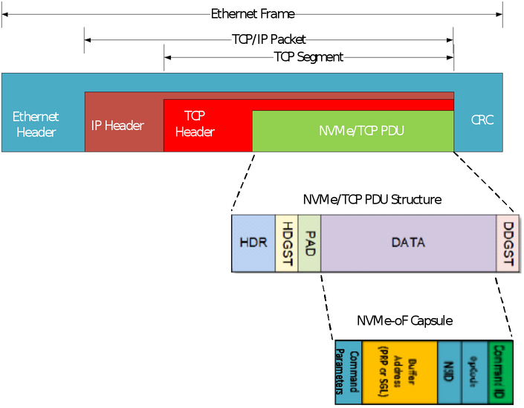
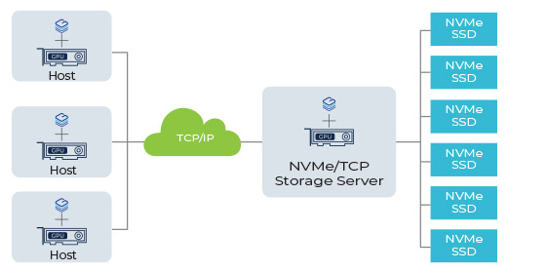
ITMO UNIVERSITY
NVME-OVER-TCP ARCHITECTURE
  Initiator: The host or client that sends NVMe commands (like a compute node).
  Target: The remote storage system exposing NVMe namespaces (logical drives).
  NVMe commands and responses are encapsulated in TCP segments.
  It uses standard Ethernet switches and routers with no changes to network hardware.
  Can optionally use TLS for secure transmission.
  From the host’s perspective, it looks like local NVMe storage.
5

Slide 6
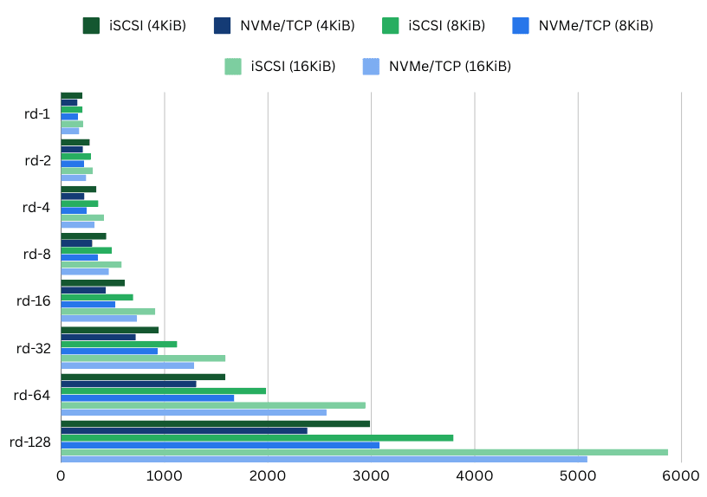
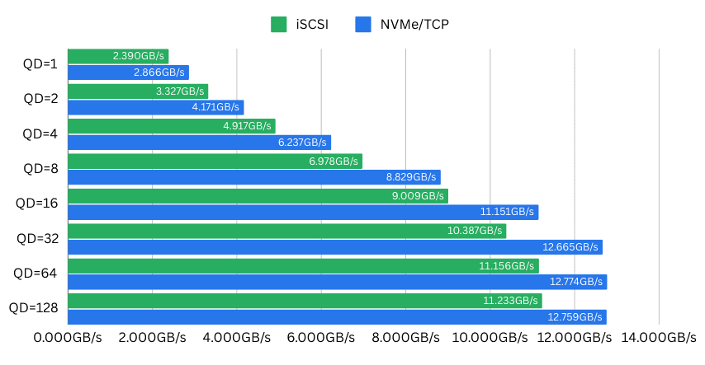
6
ITMO UNIVERSITY
PERFORMANCE CHARACTERISTICS
  NVMe/TCP adds a small latency overhead (a few microseconds) compared to RDMA, but it’s far faster than iSCSI.
  With 25/40/100 Gb Ethernet, throughput can reach millions of IOPS.
  It scales efficiently with CPU cores because it supports multi-queue parallelism (like native NVMe).
  Modern NICs can offload TCP processing, further reducing CPU overhead.
Average access latency comparison, NVMe over TCP vs iSCSI, for 4, 8, 16 KiB (Source: SimplyBlock)
Average throughput of NVMe over TCP vs iSCSI for different queue depths of 1, 2, 4, 8, 16, 32, 64, 128 (Source: SimplyBlock)

Slide 7

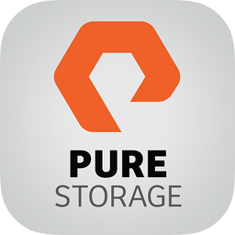
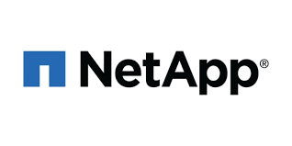
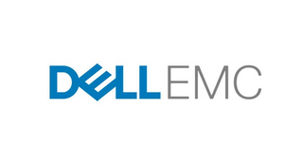

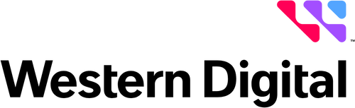
ITMO UNIVERSITY
IMPLEMENTATION AND ECOSYSTEM
LINUX KERNEL
SUPPORTED BY MAJOR VENDORS
CLOUD ENVIRONMENTS
Cloud environments (AWS, GCP, Azure) are exploring NVMe/TCP for disaggregated block storage separating compute and storage physically but connecting them via TCP.
Supports NVMe/TCP since version 5.0.
Dell EMC PowerStore, Pure Storage, NetApp ONTAP, Lightbits Labs, Kioxia, Western Digital.
7

Slide 8
ITMO UNIVERSITY
USE CASES
DISAGGREGATED DATA CENTERS
CLOUD AND VIRTUALIZED STORAGE
AI/ML WORKLOADS
Compute nodes access shared NVMe pools over Ethernet, improving resource utilization.
High-bandwidth access to large NVMe datasets.
Storage presented as a service (like block devices) via TCP.
EDGE COMPUTING
HYBRID CLOUD ENVIRONMENTS
Uses existing TCP/IP infrastructure without special hardware.
Seamless integration between on-prem NVMe and cloud storage.
8

Slide 9
ITMO UNIVERSITY
CHALLENGES AND FUTURE TRENDS
CHALLENGES
FUTURE TRENDS
  Slightly higher CPU utilization due to TCP stack overhead.
  Network tuning (MTU, buffers, congestion control) may be required for optimal performance.
  Management tools (monitoring, provisioning) still developing.
  Hardware offload via SmartNICs or DPUs (e.g., NVIDIA BlueField, Intel IPU).
  Integration with Composable Infrastructure and CXL (Compute Express Link).
  Greater cloud adoption for serverless and AI storage architectures.
9

Slide 10
ITMO UNIVERSITY
CONCLUSION
  NVME-OVER-TCP OFFERS HIGH PERFORMANCE OVER STANDARD NETWORKS.
  IT SIMPLIFIES DEPLOYMENT — NO NEED FOR SPECIALIZED HARDWARE.
  IT’S FLEXIBLE, SCALABLE, AND READY FOR MODERN, CLOUD-NATIVE STORAGE SYSTEMS.
  REPRESENTS A SIGNIFICANT STEP FORWARD IN DATA STORAGE NETWORKING EVOLUTION.
10

Slide 11
ITMO UNIVERSITY
THANK YOU

