Slide 1
RAID Techniques and Data Recovery
Anthony ( Gao Andong)
ISU: 372805
К4113c

Slide 2
Notes:
Today’s data centers house hundreds of disk drives in their storage infrastructure. Which means the greater the number of disk drives in a storage array, the greater the probability of a disk failure in the array. (Mean Time Between Failure (MTBF) is a measure of the reliability of a system or component. )
For example, consider a storage array of 100 disk drives, each with an average life expectancy of 750,000 hours. The average life expectancy of this collection in the array, therefore, is 750,000/100 or 7,500 hours. This means that a disk drive in this array is likely to fail at least once in 7,500 hours. RAID is an enabling technology that leverages multiple drives as part of a set that provides data protection against drive failures.

Slide 3
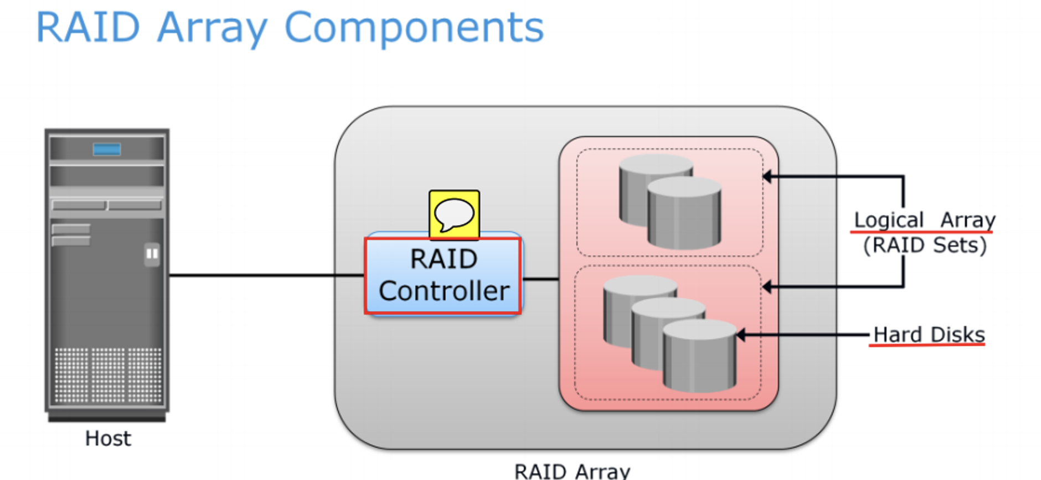
Notes:
A RAID array is an enclosure that contains a number of disk drives and supporting hardware to implement RAID. A subset of disks within a RAID array can be grouped to form logical associations called logical arrays, also known as a RAID set or a RAID group.

Slide 4
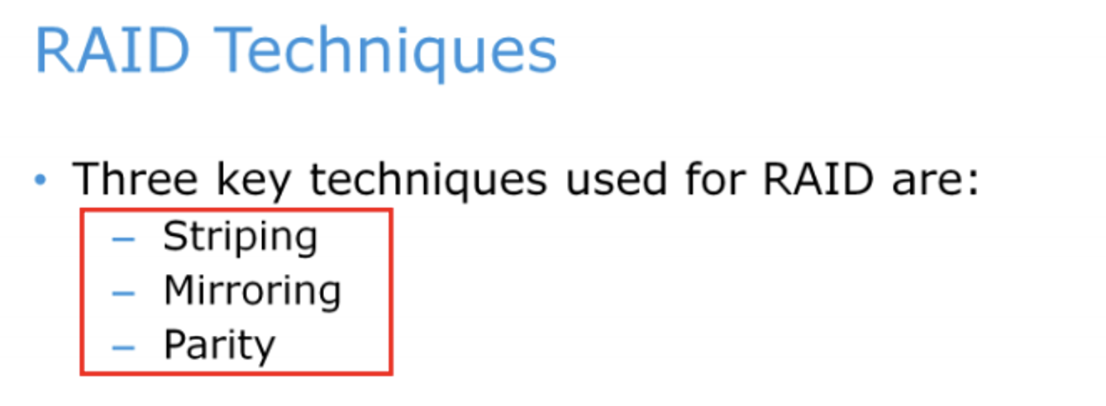
Notes:
RAID techniques – striping, mirroring, and parity – form the basis for defining various RAID levels. These techniques determine the data availability and performance characteristics of a RAID set.

Slide 5
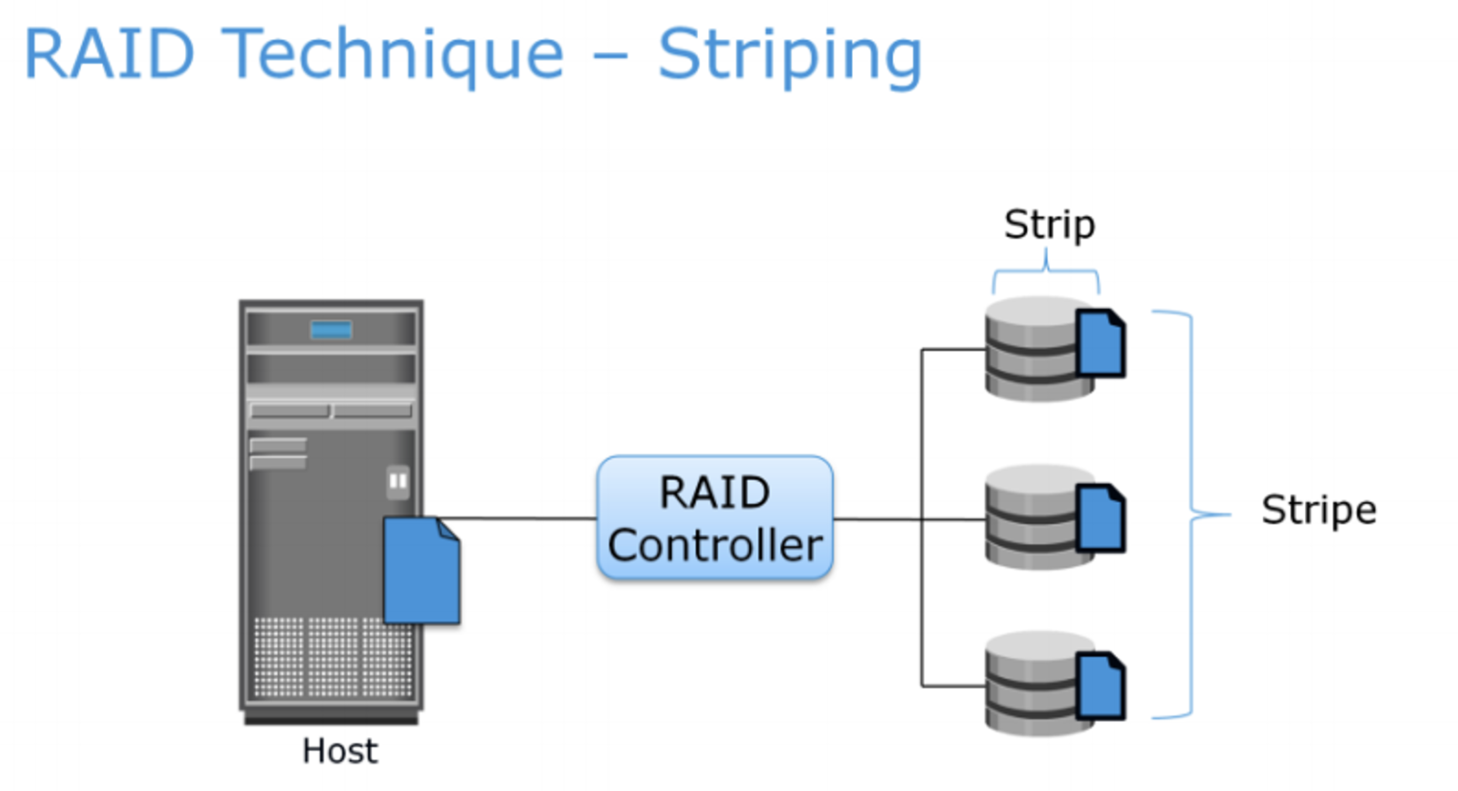
Notes:
Striping is a technique of spreading data across multiple drives (more than one) in order to use the drives in parallel. All the read-write heads work simultaneously, allowing more data to be processed in a shorter time and increasing performance, compared to reading and writing from a single disk. Within each disk in a RAID set, a predefined number of contiguously addressable disk blocks are defined as strip. For example, in a five disk striped RAID set with a strip size of 64KB, the stripe size is 320 KB (64KB x 5). Stripe width refers to the number of data strips in a stripe. Striped RAID does not provide any data protection unless parity or mirroring is used.

Slide 6
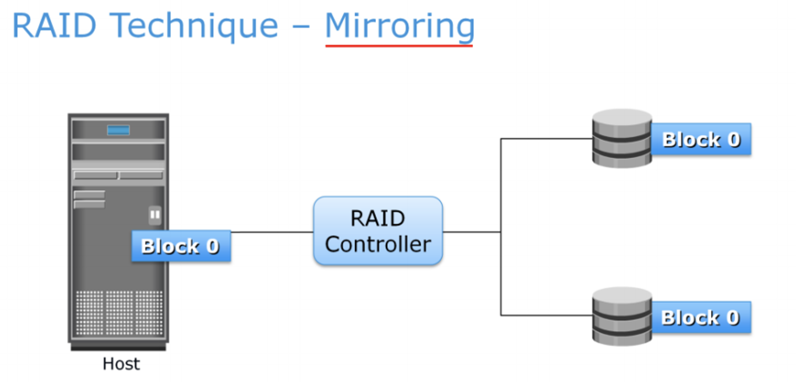
Notes:
Mirroring is a technique whereby the same data is stored on two different disk drives, yielding two copies of the data. If one disk drive failure occurs, the data is intact on the surviving disk drive and the controller continues to service the host’s data requests from the surviving disk of a mirrored pair. When the failed disk is replaced with a new disk, the controller copies the data from the surviving disk of the mirrored pair. Mirroring involves duplication of data—the amount of storage capacity needed is twice the amount of data being stored. Therefore, mirroring is considered expensive and is preferred for mission-critical applications that cannot afford the risk of any data loss.

Slide 7
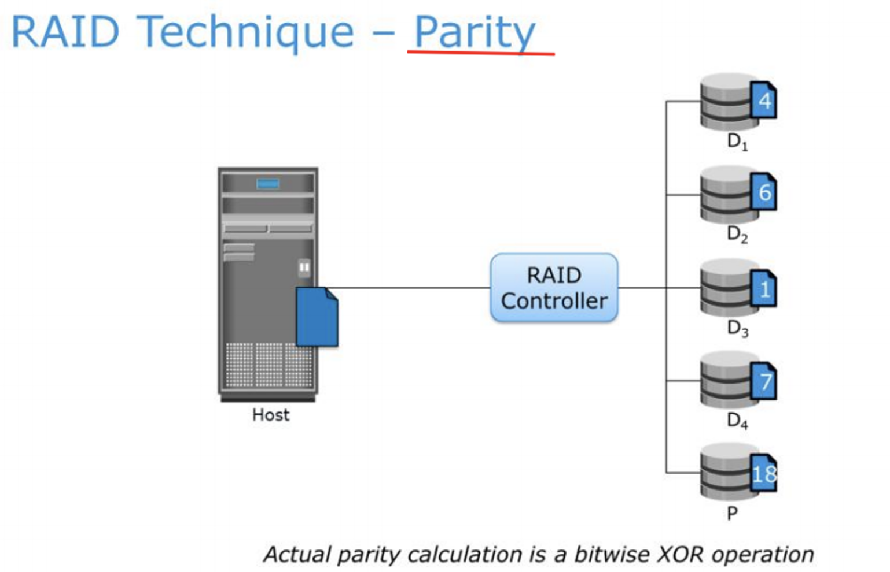
Notes:
Parity is a method to protect striped data from disk drive failure without the cost of mirroring. An additional disk drive is added to hold parity, a mathematical construct that allows re-creation of the missing data. Parity is a redundancy technique that ensures protection of data without maintaining a full set of duplicate data. Calculation of parity is a function of the RAID controller. Parity information can be stored on separate, dedicated disk drives or distributed across all the drives in a RAID set. The first four disks in the figure, labeled D1 to D4 , contain the data. The fifth disk, labeled P, stores the parity information, which, in this case, is the sum of the elements in each row.

Slide 8
bitwise XOR operation
Youtube: https://www.youtube.com/watch?app=desktop&v=O9VELMn3jIY
Microsoft learn:
https://learn.microsoft.com/en-us/cpp/cpp/bitwise-exclusive-or-operator-hat?view=msvc-170
Notes:
Now, if one of the data disks fails, the missing value can be calculated by subtracting the sum of the rest of the elements from the parity value. Here, you can see, the computation of parity is represented as an arithmetic sum of the data. However, parity calculation is a bitwise XOR operation. Compared to mirroring, parity implementation considerably reduces the cost associated with data protection. Consider an example of a parity RAID configuration with five disks where four disks hold data, and the fifth holds the parity information. In this example, parity requires only 25 percent extra disk space compared to mirroring, which requires 100 percent extra disk space. However, there are some disadvantages of using parity. Parity information is generated from data on the data disk. Therefore, parity is recalculated every time there is a change in data.

Slide 9
Thanks for your attention!

