Slide 1
BaiDu cloud
Чэнь Гуаньюань
K4112C

Slide 2
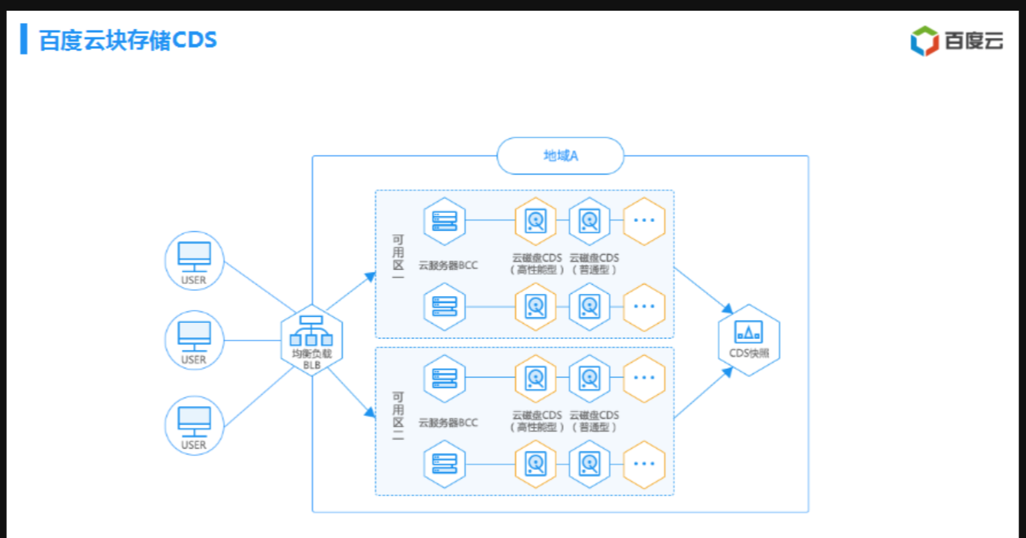
Baidu Cloud Block Storage
Block storage is actually bound to the cloud host, and the cloud host and the cloud disk actually provide an availability zone level, one deployment and one service.A system is deployed within each availability zone to provide services.Then, at the same time, it is to put the snapshot within a regional scope, and the whole will take effect within this scope.There are two computer rooms in Beijing. You are the host. Sometimes when the disk is placed in that computer room, it is during the migration. First put it in Beijing through a snapshot, share a snapshot pool, and then move the host to another computer room.
regional A
block 1
snapshot
block 2

Slide 3
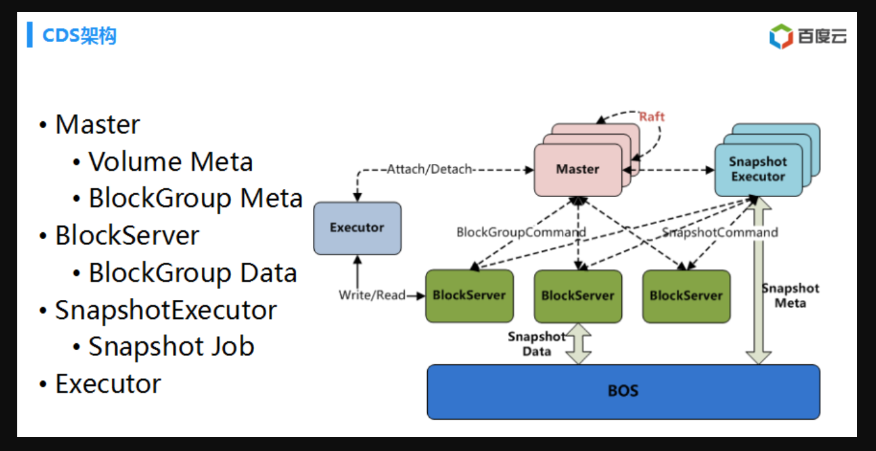
SnapshotExecutor
It includes the execution of creating a snapshot and rolling back a snapshot. The whole is equivalent to a distributed task scheduling system. The Master dispatches tasks, which correspond to different blockservers, take a snapshot of the corresponding BlockServer, and then write the data to the object storage.

Slide 4
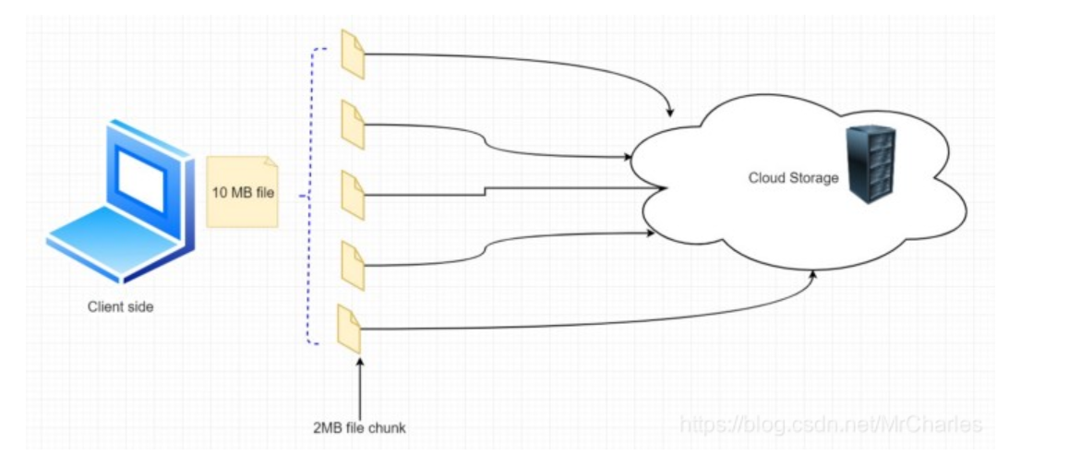
Efficient handling of file transfers：
We can divide each file into smaller pieces.Then, we can only change small fragments of data, not the entire file.In case the data upload fails, this strategy will also help.We need to divide each file into a fixed size, such as 2 MB.
Our block size needs to be smaller.This will help optimize space utilization, and network bandwidth is another consideration when making a decision.The metadata should include a record of the block information of each file.
We can assume that the file needs to be stored in a small block of 2 MB.If the process fails, we will also benefit if the operation is retried in a smaller part of the file. If the file is not uploaded, only the failed block is retried.

Slide 5
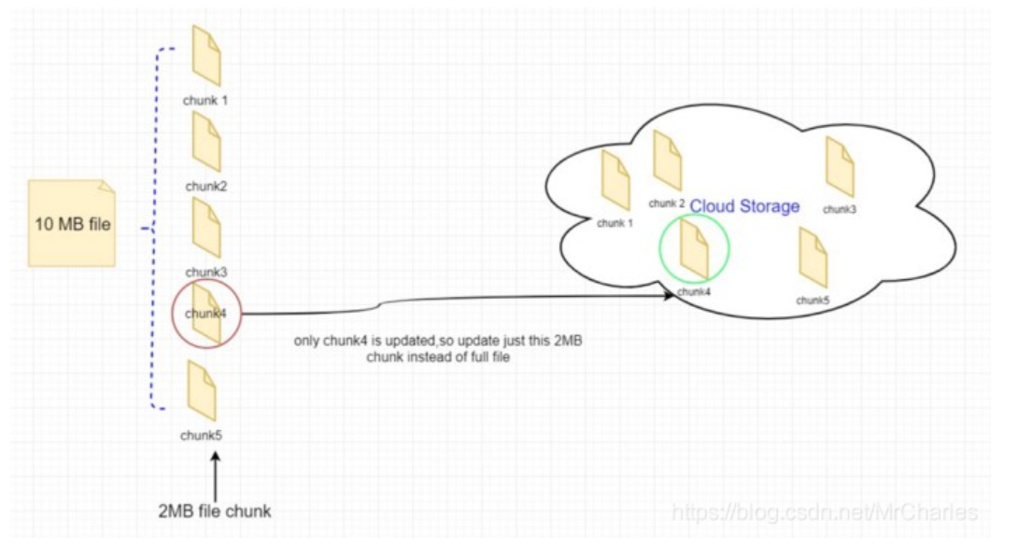
Less data transmission between the client and the cloud storage will help us get a better response time.Instead of sending the entire file, we only need to send the modified block of the file.
In this case, the updated part of the file will be transferred.We will divide the file into 2MB blocks and transfer only the modified part of the file.
We did not update the entire 10 MB file, but the modified 2MB part of the file.It will reduce bandwidth consumption and cloud storage for users.Most importantly, the response time will be faster.

Slide 6
thank you

