Slide 1
Course code
Product
6.0
V5.0
Wang Peng/wwx690470
2020.06.04
Shui Shaolan/00329529
New
Zhong Qi /zwx308124
2020.06.18
Shui Shaolan/00329529
Update
Liu Chao/lwx769666
2020.07.01
Shui Shaolan/00329529
Update
Xu Ningyang/xwx1146004
2022.06.28
Liang Shuai/00569373
Update
Author/ID
2019.01.25
Author/ID
Update

Slide 2
Storage System O&M Management

Slide 3
As the cost of storage devices decreases, large-capacity storage devices have been used by more and more enterprises to store data generated by enterprise service application systems and IT systems, such as emails, documents, service data, and data backup. Therefore, effective management of storage devices is critical to the continuity and stability of enterprise services.

Slide 4
Upon completion of this course, you will understand:
General O&M management process
Common storage system O&M management tools
Process and methods of typical storage system O&M scenarios

Slide 5
O&M Overview
O&M Tools
O&M Scenarios

Slide 6
What Is O&M?
O&M is essentially the operation and maintenance of networks, servers, and services in each phase of their life cycles to achieve a consistent and acceptable status in terms of cost, stability, and efficiency.
Asset management
Event management
Energy efficiency management
…
Organizational structure
Skill
Personnel allocation
…
Maintenance management
Personnel organization
Device maintenance
Device repair
Risk identification
…
Management
Resource
Maintenance tool
Knowledge base
Maintenance platform
…
Technical assurance
Platform configuration
Standard
Standard system
Service process
ITIL
Uptime O&M
ISO 2000
…
Standard operation procedure
Emergency response process
Troubleshooting process
…
Notes:
O&M provides technical assurance for products to deliver quality services. Its definition varies with companies and business stages.

Slide 7
How to Perform O&M
Technical layer: Streamline the O&M lifecycle of each product and identify the key measures of each task.
Process layer (ITIL process management framework): Change, event, and problem management.
Before the device goes online
O&M/Operation period
Process management
Requirement
Model selection
Design
Implementation
Online
O&M/ Operation
Offline
Event management
Operation
Problem management
Requirement analysis
Configuration selection and architecture design
Offline specifications
Service rollout and transfer-to-maintenance criteria
Change management
Rollout and deployment specifications
Configuration management
Monitoring and security compliance
Release management
Capacity management and expansion
Performance and experience optimization
Emergency and DR drill
Cost and efficiency optimization
PRR management (performance, reliability, and recoverability)

Slide 8
Event Management
A
Objective
Restore services as soon as possible.
Minimize the impact of emergencies on service running.
Ensure that the service quality and availability meet the SLA requirements.
B
Definition
Emergency
Any event that causes or may cause service interruption or service quality deterioration
Hardware faults, software faults, and service request interruption
C
Task
Detection and recording
Classification and online support
Priority determining based on the impact and urgency
Investigation and diagnosis
Solution and recovery
End
Responsibilities, monitoring, tracking, and communication
Notes:
Service Level Agreement (SLA)

Slide 9
Event Management Process
Transfer and supervision
Service request
Accident management process:
Identification and recording
Classification and initial support
Investigation and analysis
Solution and recovery
Accident termination
Accident data
Problem management
Service desk
Temporary measure
Computer operation
Change requirement
Change management
Solution
Input: accident
Report
Network
Service level management
Output:
solution&
temporary measures
SLA parameter
Procedure
Report
Capability management
Other sources of accidents
Report
Availability management
Configuration information
Configuration management database (CMDB)
Notes:
Configuration management database (CMDB)

Slide 10
Problem Management
A
Objective
Locate the root cause of the problem and take measures to eliminate known errors.
Minimize the number of emergencies caused by IT infrastructure errors and minimize the negative impact of problems. Prevent the recurrence of emergencies related to errors.
B
Definition
Problem: obtained from multiple emergencies with the same symptom or a major incident and indicates that an error with unknown causes exists.
Known errors: The root cause of a problem has been successfully located and a solution has been found.
C
Task
Problem control
Known error control
Proactive problem management
Trend analysis
Review of major issues

Slide 11
Problem Management Process
Accident management
Configuration management
Service level management
Capability management
Availability management
Information
Matching information, emergency measures, and quick recovery solution
Record
Problem database
Problem management
Information
Change request (RFC)
Post implementation review (PIR)
Change management
Notes:
Request for Change (RFC)
Post implementation review (PIR)

Slide 12
Change Management
A
Objective
Ensure that all changes are effectively controlled and handled through standardized means and processes, and that approved changes are implemented with minimum risks, high efficiency, and high cost-effectiveness.
B
Definition
Change: An action that causes the status of one or more IT infrastructure CIs to change.
Standard change (approved in advance)
Request for Change (RFC)
Forward Schedule of Changes (FSC)
Change Advisory Board (CAB)
C
Task
Receive, record, approve, plan, test, implement, and review change requests.
Provide the IT infrastructure change report.
Propel CMDB modification.
Notes:
Configuration item (CI)
Forward Schedule of Changes (FSC)
Change Advisory Board (CAB)

Slide 13
Change Management Process
The input information includes:
Change request
Data information provided by the CMDB, especially information about the impact of changes
Change implementation schedule
Capability database provided by capability management and budget information provided by the financial management process
Change management
The output information includes:
Updated change implementation schedule
Signals that trigger the start of configuration management and release management
Agenda, minutes, and action items of CAB
Change management report
Problem management
Configuration
management
Release management
Accident management

Slide 14
Configuration Management
A
Objective
Measure the value of all IT assets and configuration items used in organizations and services.
Provide accurate information about IT infrastructure configuration for other service management processes.
Support the operation of accident management, problem management, change management and release management.
Verify the correctness of the configuration records related to the IT infrastructure and correct the detected errors.
B
Definition
Identify and define configuration items.
Plan, define, and manage the CMDB.
Periodically verify the accuracy and integrity of the CMDB.
Detailed report of IT assets
C
Task
Receive, record, approve, plan, test, implement, and review change requests.
Provide the IT infrastructure change report.
Propel CMDB modification.
Notes:
In configuration management, the most basic information unit is configuration items (CIs). All software, hardware, and documents, such as change requests, services, servers, environments, devices, network facilities, desktop computers, mobile devices, application systems, protocols, and telecom services, can be called configuration items.
The CMDB stores not only the configuration information of specific components in the IT infrastructure, but also the relationship between CIs.
Configuration management is different from IT asset management. The latter is a measurement process used to control and manage the depreciation process of assets that exceed a certain value. It records the acquisition time, purchase price, depreciation period, depreciation method, and status and location of assets. Apart from the information about CIs, configuration management also records the relationships between CIs, standards and authorization of CIs, and the current status and changes of CIs.

Slide 15
Configuration Management Process
Change management
Release management
Configuration management
Change request
Report and audit configuration information.
Configuration management database
Definitive software library
Categorization and plan
Report
Release
Update information.
Release and distribute the hardware and software of the new version.
Implementation
Update the CMDB and DSL.
(CMDB)
(DSL)
Comment
End
Check whether the CMDB is updated.

Slide 16
Publication Management
A
Objective
Comprehensively assess changes to IT services and ensure that all aspects (including technical and non-technical factors) of a release are considered.
B
Definition
Release
Delta release
Full release
Package release
Emergency release
Release policy
C
Task
Release planning
Design, development, and configuration release
Release review
Rollout plan
Communication, preparation, and training
Distribution and installation

Slide 17
Release Management Process
Design and development environment
Controlled test environment
Production environment
Release management
Release policy
Release planning
Release design, building, and configuration
Building
and configuration release
Release test and acceptance
First-time running planning
Communication and training
Distribution
installation
Configuration management database (CMDB)
Definitive software library (DSL)

Slide 18
O&M Overview
O&M Tools
O&M Scenarios

Slide 19
Components of Huawei Enterprise Storage O&M Systems
Customer data center
Huawei technical support
Trouble ticket generation and remote troubleshooting
DME
Storage resource control
O&M administrator
Resource pooling and service orchestration
Server
eSight
Multi-device management
O&M administrator
Fault monitoring and performance report
eService cloud platform
Fabric
Remote command center
eService
Remote maintenance
O&M administrator
Fault monitoring and fault upload
Storage
DeviceManager
DeviceManager
DeviceManager
Huawei OceanStor Dorado 18000
Huawei OceanStor hybrid flash storage
Huawei OceanStor scale-out storage
Authentication system
SmartKit
Storage service tool
Service personnel
Delivery, upgrade, and troubleshooting
Equipment archive system
DeviceManager
Single-device management
O&M administrator
Configuration and alarm
Trouble ticket handling system
Fault diagnosis expert system
Notes:
DeviceManager: single-device O&M software.
SmartKit: a professional tool for Huawei technical support engineers, involving compatibility evaluation, planning and design, one-click fault information collection, inspection, upgrade, and FRU replacement.
eSight: a customer-oriented multi-device maintenance suite that features fault monitoring and visualized O&M.
DME: customer-oriented software that manages storage resources in a unified manner, orchestrates service catalogs, and provides storage services and data application services on demand.
eService client: deployed in the customer's equipment room. It detects storage device exceptions in real time and notifies the Huawei maintenance center of the exceptions.
eService cloud platform: deployed in the Huawei maintenance center to monitor devices on the entire network in real time, changing passive maintenance to proactive maintenance and even achieving agent maintenance.

Slide 20
Introduction to DeviceManager
DeviceManager is the single-device management software designed by Huawei for easy configuration, management, and maintenance of storage devices.
Main software functions include storage resource allocation, user management, data protection feature management, device performance monitoring, and alarm management.

Slide 21
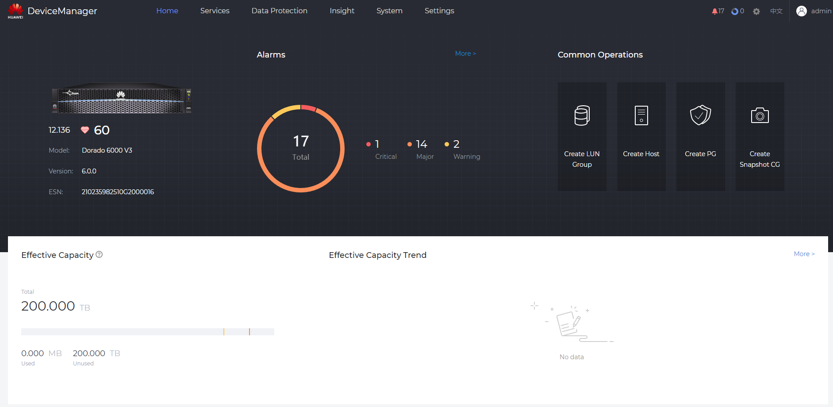
DeviceManager GUI

Slide 22
Introduction to SmartKit
1. Unified platform
The desktop tool management platform integrates O&M tools for storage systems, servers, and cloud computing.
2. Scenario-based guidance
Tools specific to each O&M scenario can be downloaded on demand.
3. Standardized operations
The wizard guides you through operations based on scenarios in an easy and intelligent manner.
Notes:
SmartKit is a unified desktop management platform for all IT tools. It integrates various tools required for deploying, maintaining, and upgrading IT devices, helping product users, and service and maintenance engineers perform precise operations on these devices, improving work efficiency.

Slide 23
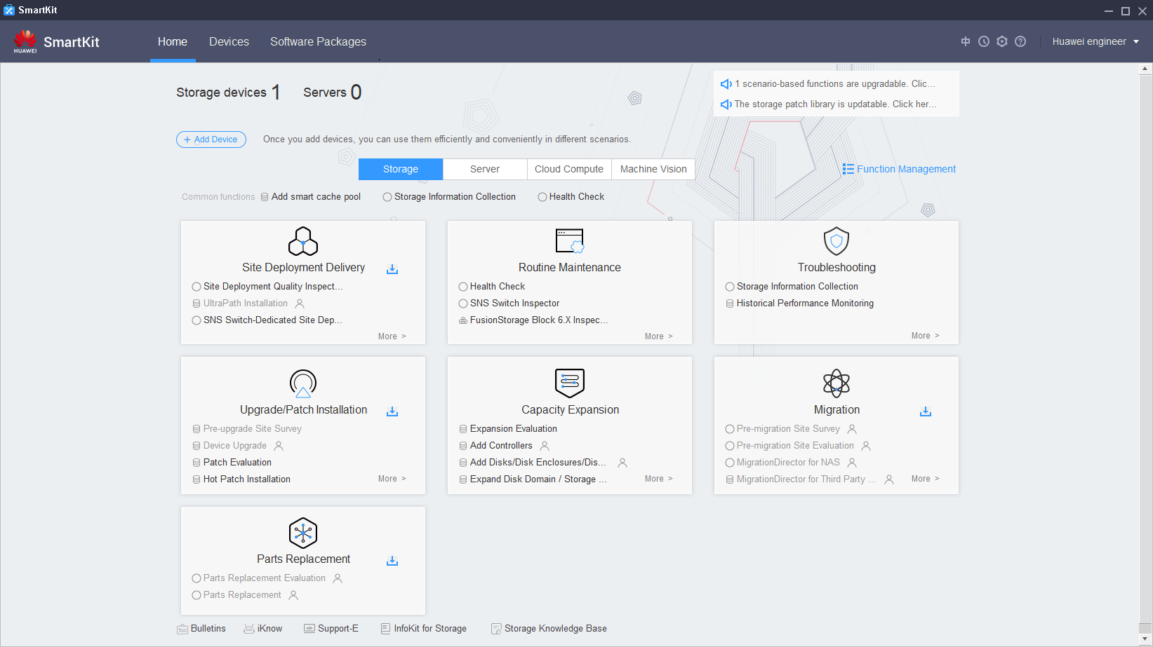
SmartKit GUI
Standardized and process-based operations in various service scenarios, improving operation efficiency
Function navigation bar
Function management
Field
Device
Scenario-based entry
Notes:
Device: indicates the management entry where you can add the IT device you want to maintain.
Devices are added at a time and shared by multiple tools and scenarios.
Devices are imported/exported in a batch. You do not need to manually input information each time.
Typical application scenarios of SmartKit are as follows:
Site Deployment Delivery (installation and deployment): performs deployment checks in a standard manner to ensure the normal running of equipment after the deployment.
Routine Maintenance: You can perform routine inspection and maintenance on devices based on the process guide.
Upgrade/Patch Installation: You can upgrade devices and install patches based on the process guide to improve upgrade efficiency.
Capacity Expansion: improves device performance or expands system capacity.
Parts Replacement: replaces faulty FRUs by following the wizard.
Troubleshooting: enables you to quickly locate and solve common problems and faults of Huawei storage devices.

Slide 24
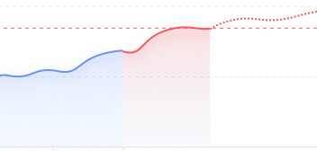
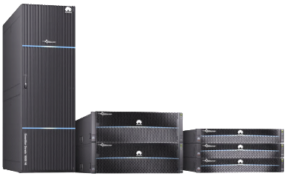
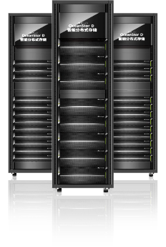
Introduction to DME Storage
ITSM
Automation platform
Monitoring platform
Report platform
Open northbound API
Planning
Construction
O&M
Optimization
SLA-based pooling and integration
Intelligent planning and automatic pooling
Flexible automation modes
Orchestratable scheduled tasks
Automatic identification and proactive prevention
Automatic analysis and quick locating
Multi-dimensional analysis and optimization suggestions
One-click change and autonomous driving
Gold
Silver
Gold
Silver
Bronze
Open southbound API
Huawei OceanStor all-flash storage
Huawei OceanStor scale-out storage
FC switch
Third-party storage

Slide 25
DME Storage Functions and Features
Planning
Construction
O&M
Optimization
SLA-based pooling and integration
Automatic provisioning
Proactive problem identification
Automatic problem resolution
Full-process automation
Configuration compliance/ Data protection
SLA change
Workload evaluation
Auxiliary automation
Data flow (reclamation/migration)
Best practice implementation
Capacity/Performance threshold
QoS policy
Orchestratable scheduled tasks
Capacity/Performance prediction
Multi-dimensional analysis
Threshold Policy
Application template
Disk service life prediction
Scheduling policy
Disk health/Abnormal workload
SLA/Cost/Capacity/Performance
Automatic protection
Application/Device/Project/Label
Quota policy
Copy creation
Automatic problem analysis
Customized report/dashboard
Protection policy
Copy visualization
Automatic masking/aggregation/association
Autonomous driving
Copy enabling
Policy-based autonomy
Fast fault locating
End-to-end performance analysis
AI-based inference autonomy
End-to-end topology
Infrastructure management
User role management
Multi-DC management
Open API

Slide 26
Introduction to eSight
eSight provides multi-vendor device adaptation for unified network-wide device management, component-based architecture for on-demand construction of enterprise O&M platforms, and lightweight design and web client for lower system maintenance and upgrade costs.
Switch/Router/WLAN management
PON management
…
Architecture
Platform + components
UC/Telepresence and intelligent vision management
eLTE management
Transport device management
eSight
Storage management
Server/Virtual resource management
Equipment room facility management
eSight basic management platform
Notes:
Multi-vendor device adaptation for unified network-wide device management
eSight provides unified management of Huawei servers, storage devices, virtualization devices, switches, routers, WLAN devices, firewalls, PON devices, eLTE devices, unified communications devices, telepresence devices, intelligent vision devices, application systems, and equipment room facilities, and pre-integrates capabilities to manage mainstream devices from third parties such as HP, Cisco, and H3C.
Component-based architecture for on-demand construction of enterprise O&M platforms
Using a component-based architecture, eSight provides various components on the unified eSight management platform. Customers can select required components based on the site requirements.
Lightweight design and web client for lower system maintenance and upgrade costs
eSight uses the browser/server (B/S) architecture, which allows users to access the eSight client anytime anywhere without installing any plug-in. When the system is upgraded or maintained, the software needs to be upgraded only on the server, reducing the system maintenance and upgrade cost.

Slide 27
Logical Architecture of eSight
Administrator
WLAN management
Storage capacity management
Server stateless computing
Value-added O&M
Network SLA and QoS management
Storage network analysis
Server configuration and deployment
Network traffic analysis and management
Service management
Report management
…
…
…
Unified communications device
Network device
eLTE device
Device management
Telepresence and videoconferencing
Virtual resource
PON device
Terminal
Server device
Transport device
Intelligent vision
Storage device
Equipment room facility
…
…
…
Management platform
eSight management platform
Managed objects: servers, storage devices, VMs, switches, routers, firewalls...

Slide 28
Introduction to eService
Based on Cloud-Native, Huawei eService cloud intelligent management platform uses big data analysis and AI technologies to provide services such as automatic fault reporting, capacity and performance prediction, and disk risk prediction, preventing potential risks and providing a basis for capacity planning.
O&M challenges
Reactive response
Service rollout delay
Complex management for multiple devices
Technical capabilities
Rapid response
Real-time analysis
Intelligent prediction
Asset platform
Cloud platform capability building
Proactive problem handling
Intelligent prediction and analysis
Asset management
Provides 24/7 remote monitoring for all IT devices, and automatic fault reporting and SR creation.
Provides proactive problem handling to reduce the troubleshooting duration and improve the operation efficiency.
Intelligently identifies risky disks, ensuring data security.
Predicts the capacity trend in the next 12 months to facilitate procurement planning.
Predicts performance bottlenecks according to performance fluctuation rules.
Collects device asset information for future reference.
Provides product EOX information and device maintenance and warranty information.
eService
Notes:
As a large number of Huawei IT products such as storage devices, servers, and cloud computing products are put into use, users have increasingly high requirements on the troubleshooting efficiency. In traditional service support mode, technical support personnel provide local services manually. Faults may not be detected in a timely manner and information may not be delivered correctly. The eService cloud intelligent management system (eService for short) integrates the cloud-based management, remote maintenance, automatic service request (SR) creation, and prediction and prevention functions to improve user O&M capabilities and takes planned maintenance actions to prevent potential risks.
eService provides a self-service intelligent O&M system for customers, aiming for precise customized information services.
Based on HUAWEI CLOUD, the eService cloud system drives IT O&M activities through big data analysis and AI technologies to identify faults in advance, simplify O&M, and improve O&M efficiency.
Data is encrypted for secure transmission. eService can access the customer's system only after being authorized by the customer.
eService provides 24/7 secure, reliable, and proactive O&M services. SRs can be automatically created.
Customers can use any PC to access eService at any time and place to view device information.

Slide 29
System Architecture of eService
Customer network
Huawei network
FusionCloud
Intranet
DMZ
ManageOne
OC/SC
Email (optional channel)
Only fault monitoring supported
DC 1
Customer
email server
Huawei
email server
DC 2
Cloud OS
FusionManager/FusionCompute/FusionAccess/FusionSphere OpenStack OM
Internet
eSight
eService
cloud system
Storage/
Server/
Network
eService client
& FusoinCare
Hardware layer
Network
HTTPS
Storage
Fault monitoring
Remote inspection
Remote log collection
Capacity prediction
Performance exception analysis
Disk prediction
Proxy server
(optional)
HTTPS
service
Server
Customer maintenance host
Notes:
eService enables the client to work with the cloud system.
eService client: It is deployed on the customer side.
It collects customer device alarms and sends them to the eService cloud system in a timely manner to implement remote maintenance functions, such as remote inspection and remote log collection.
eService cloud system: It is deployed in the Huawei technical support center.
The eService cloud system receives device alarms from the eService client in 24/7 mode, automatically notifies Huawei technical support personnel to handle the alarms in a timely manner, and supports automatic inspection and log collection for devices on the customer side.

Slide 30
O&M Overview
O&M Tools
O&M Scenarios

Slide 31
Maintenance Item Overview
03
02
01
Weekly maintenance items
Daily maintenance items
Inspecting storage devices
Checking the equipment room environment
Checking the internal environment of racks
Initial maintenance items
Checking and handling alarms
Checking the SmartKit installation
Checking the installation and configuration of eService
Checking the alarm policy configuration
Notes:
Based on the list of maintenance items and periods, the system administrator can learn the device environment and device status. If an exception occurs, the system administrator can handle the exception and maintain devices in a timely manner to ensure the continuous and healthy running of the storage system.
Based on the maintenance frequency and maintenance items, maintenance items are classified into the following types: initial maintenance items, daily maintenance items, and weekly maintenance items.

Slide 32
Quick Maintenance Process
Start
Check the indicator status
and handle related exceptions.
The indicators on the front and rear panels of the storage devices indicate the device running status and help you discover and rectify common hardware faults.
Check the service status
and handle related exceptions.
By checking the system information and service status, you can learn about the basic information, alarms, capacity trend, and performance of the storage system, as well as the status of storage resource allocation and value-added features.
Check the system performance
and handle related exceptions.
You can query the real-time and historical performance statistics on DeviceManager.
Check and clear alarms.
If a fault occurs in the storage system, DeviceManager automatically determines the severity of the fault and reports an alarm. Maintenance personnel should rectify the fault in a timely manner to prevent service interruption or data loss.
Can the preceding exceptions be handled?
Yes
No
Collect information and report faults.
End

Slide 33
O&M Scenario 1: Inspection
01
Background
After the storage devices purchased by company E are deployed, services are deployed and running properly. To ensure the storage security of core devices in the service system, engineer A in the IT department is responsible for the inspection of storage devices. Help engineer A make an inspection plan.

Slide 34
Inspection Method
Checking the storage system operating environment
Manual
inspection
Inspection using tools:
SmartKit inspection
DeviceManager inspection
Checking the service running status
Checking indicators
Checking the device running status
Notes:
Inspection using tools:
You can use SmartKit or DeviceManager to inspect storage devices.
If no inspection tool is installed, you can use the CLI to check the health status and operating status of a switch.
Manual inspection:
Maintenance engineers perform routine maintenance on site to check the environment room condition, cabinet condition, and device running indicators. In this way, they can proactively understand the device running status and discover exceptions.

Slide 35
O&M Scenario 2: Performance Monitoring
02
Background
Company E's business has gone online. To learn about the performance usage of storage devices, engineer B in the IT department is responsible for monitoring the performance of the storage devices. Help engineer B monitor the performance of the storage devices.

Slide 36
Performance Monitoring Process
Start
Different service scenarios have special requirements on performance monitoring parameters. You can set performance monitoring parameters based on service requirements. Ensure that the performance monitoring function is enabled.
Configure performance monitoring parameters.
Configure the threshold. When the threshold is exceeded, check the alarm information.
Configure thresholds.
Create a service-related indicator template so that you can view the indicators in a timely manner.
Create a metric chart.
After the dump function is enabled, newly-generated performance monitoring files are automatically dumped to the specified application server through the SFTP or FTP protocol.
Configure performance monitoring file dumping.
View the performance monitoring data.
View the storage device performance information, including real-time performance monitoring data, alarms, events, and power consumption.
View the storage system performance information.
View the storage system alarm information.
View the storage system event information.
View the storage system power consumption information.
End

Slide 37
Performance Monitoring Metrics
IOPS
For applications with an I/O size smaller than 64 KB, mainly focus on the IOPS.
For applications with an I/O size greater than or equal to 64 KB, mainly focus on the bandwidth.
Monitoring
metrics
Bandwidth
Latency
Notes:
The following indicators are used to measure the performance of a storage system:
IOPS indicates the number of processed I/Os per second. It measures the I/O processing capability of a storage system. It is a major performance indicator for online transaction processing (OLTP) services.
Bandwidth indicates the amount of data that can be processed per second, and the basic unit is MB/s or GB/s. It measures the storage system throughput. It is a major performance indicator for online analytical processing (OLAP), media asset, and intelligent vision services.
Latency indicates the time duration from the initiation of an I/O request to the completion of I/O request processing. The basic unit is ms. Common indicators include the average response time and maximum response time. For example, the latency must be less than 10 ms for OLTP services and less than 30 ms for the virtual desktop infrastructure (VDI) scenario. The latency requirements for video on demand (VOD) and intelligent vision services vary with bit rates.

Slide 38
Performance Metrics
1
Snapshot
1
Logical port
1
Heterogeneous iSCSI link
2
Front-end Ethernet port
2
Host
2
Heterogeneous FC link
3
LUN priority
3
Controller
3
Remote replication consistency group
4
Back-end SAS port
4
LUN
4
FC replication link
5
Front-end FC port
5
Storage pool
5
Remote replication
6
Front-end bond port
6
SmartQoS policy
6
System
7
Disk
7
LUN group
7
Host group

Slide 39
O&M Scenario 3: Parts Replacement
03
Background
After the storage system of enterprise E has been running for a period, it reports a disk failure and disk replacement is needed. After receiving the disk replacement request, Huawei technical support engineer C is going to the customer site to perform the replacement.

Slide 40
Parts Replacement Process
Start
Log in to SmartKit.
Remove cables from the component.
Use the tool to perform a post-replacement check.
Select the component to be replaced and start the replacement.
Remove the component.
Successful check
No
Rectify the fault as prompted.
Use the tool to perform the pre-replacement check.
Yes
Insert a new component.
Use the tool to perform the inspection.
Rectify the fault as prompted.
No
Successful check
Connect cables.
Successful check
No
Rectify the fault as prompted.
Yes
Use the tool to power off the component.
Confirm that the replacement is complete on the tool.
Yes
End

Slide 41
Replaceable Parts
FRU | CRU
Controller | Power module
Interface module | BBU module
System subrack | Fan module
Management module | Disk module
Cable | Expansion module
Assistant cooling module | Optical module
Quorum server | -
Data switch | -
Notes:
Field Replaceable Units (FRUs) are components that engineers can replace at the deployment site by referring to the operation guide.
Customer Replaceable Units (CRUs) are components that customers can replace at the deployment site by referring to the operation guides of CRUs.

Slide 42
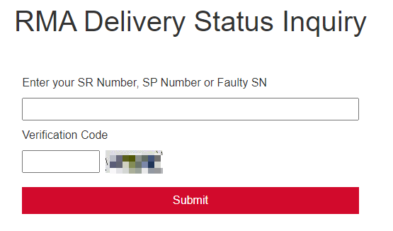
Spare Parts Query
Huawei Spare Parts Query allows users to export the spare part manual and quickly obtain spare part information based on the storage product model, part number, and SN.
You can log in to https://support.huawei.com/enterprise/en/index.html to use the Spare Parts Query tool.

Slide 43
Key Points for Disk Replacement
When handling a disk module, hold only its edge to prevent damage.
Remove and insert a disk module with even force. Excessive force may damage the appearance of the disk module or cause faults.
To avoid damaging disk modules, wait at least 1 minute between removal and insertion.
To prevent data loss, replace only a disk module of which the alarm/location indicator is steady yellow.
Complete the replacement within five minutes after removing a disk module. Otherwise, the system heat dissipation is compromised.
Use SmartKit to replace a risky disk (not faulty).
Ensure that the new disk is inserted into the same slot as the replaced disk. Otherwise, the system may work abnormally.

Slide 44
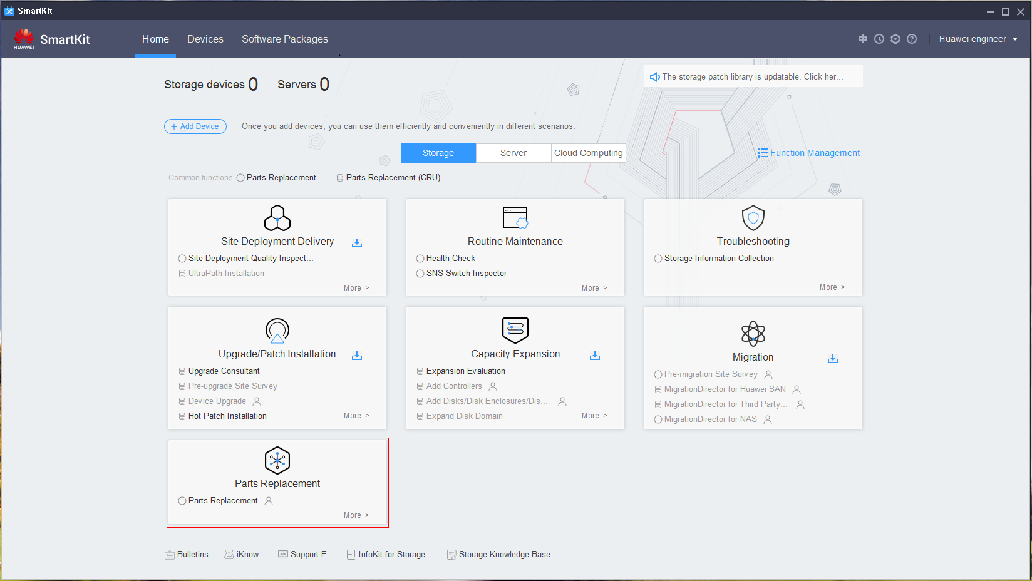
Disk Replacement Using SmartKit
Start SmartKit and select the parts replacement tool.

Slide 45
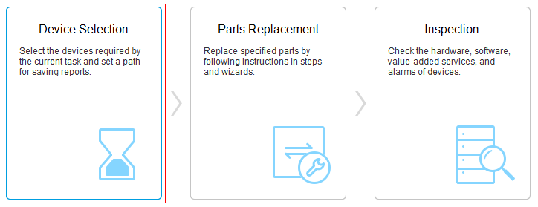
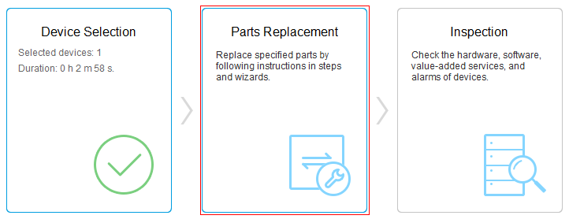
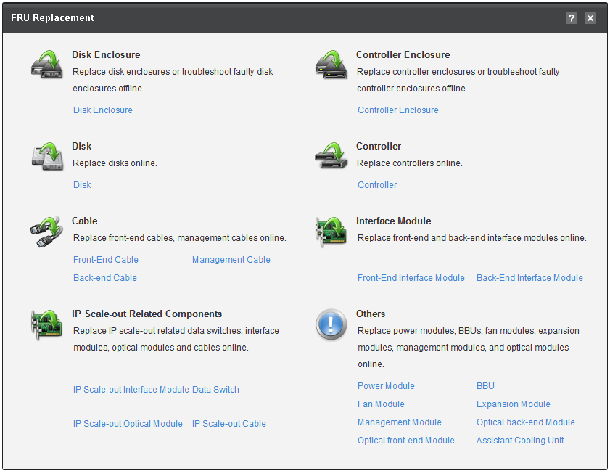
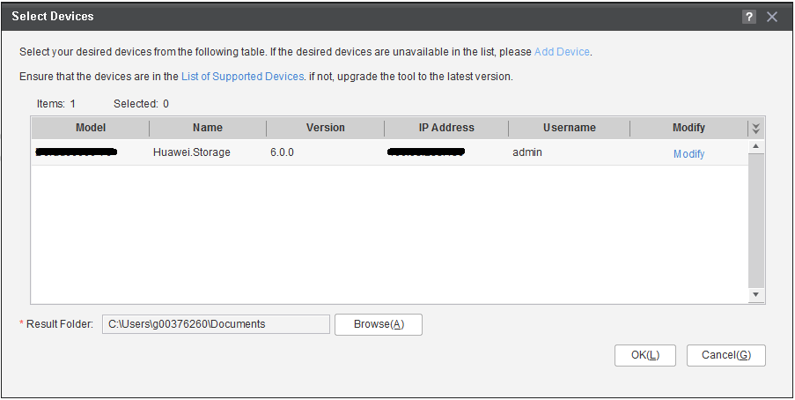
Disk Replacement Wizard

Slide 46
(Choosing multiple options) Which of the following are common management software? ( )
DeviceManager
eSight
SmartKit
eService
(True or false) SmartKit integrates various tools required for deploying, maintaining, and upgrading IT devices, helping product users, and service and maintenance engineers perform precise operations on these devices, simplifying operations and improving work efficiency. ( )
Notes:
Answer:
ABCD
T

Slide 47
Common O&M tools
DeviceManager
Common O&M scenarios
SmartKit
eSight
DME Storage
eService
Storage system O&M management
O&M overview
O&M concepts
O&M handling process

Slide 48
Huawei official websites:
Enterprise business: http://enterprise.huawei.com/en/
Technical support: https://support.huawei.com/enterprise/en/index.html
Online learning: https://www.huawei.com/en/learning
Popular tools
HedEx Lite
Network documentation tool center
Information query assistant
Notes:
Popular tools:
HedEx Lite: Huawei product document management tool, which allows users to browse, search for, update, and manage product documentation.
eStor: A graphical storage simulation platform. It simulates Huawei OceanStor all-flash storage systems to help ICT practitioners and users quickly get familiar with Huawei storage products and master the operations and configuration for related products.
Network documentation tool center: The documentation tool for network products is a good assistant for bidding support, network planning, project delivery, and upgrade and maintenance.
Information query assistant: Provides command and alarm information query for Huawei products.

