Slide 1
Storage System Operation Management

Slide 2
This course introduces two methods of managing storage systems: OceanStor DeviceManager and CLI. It also covers management content and related operations.

Slide 3
On completion of this course, you will understand:
DeviceManager and CLI storage system management tools.
Basic management operations of the storage system.

Slide 4
Storage Management Overview
Storage Management Tools
Basic Management Operations

Slide 5
Storage Management Definition
Storage management allows users to use management tools to query, set, manage, and maintain storage systems.
Storage resource allocation
Management content
User management
Data protection feature management
Device performance monitoring
Alarm management
......

Slide 6
Common Storage System Access Mode
In what ways can I log in to a storage system?
Log in to DeviceManager.
Log in to the CLI.
Notes:
The storage system can be operated and maintained using the DeviceManager and the command-line interface (CLI), adapting to different environments and user habits.
After logging in to the CLI of a storage system, you can query, set, manage, and maintain the storage system.

Slide 7
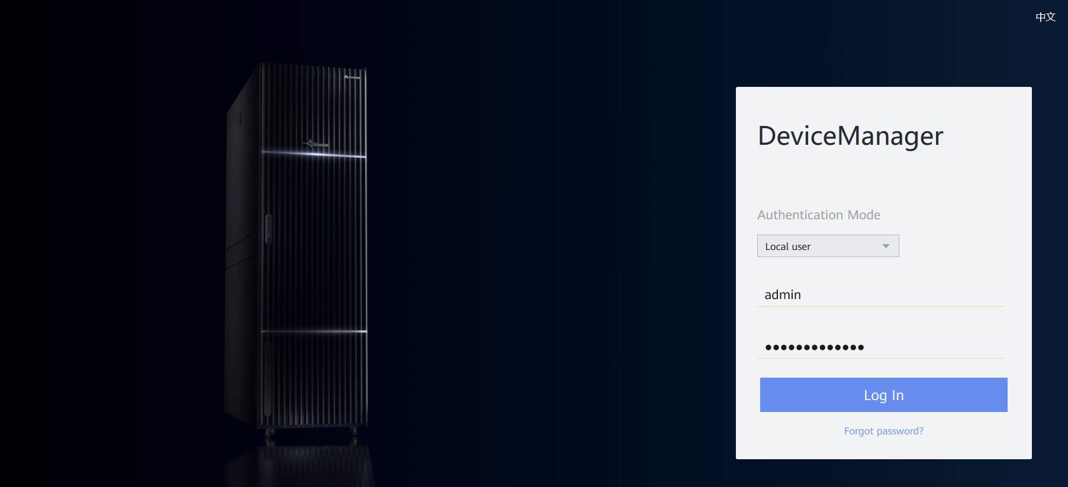
Main Functions of DeviceManager
DeviceManager is storage management software designed by Huawei for a single storage system. It can help you easily configure, manage, and maintain storage devices.
Main software functions include storage resource allocation, user management, data protection feature management, device performance monitoring, and alarm management.
Notes:
DeviceManager is a device management program developed by Huawei. DeviceManager comes pre-installed on Huawei storage systems.

Slide 8
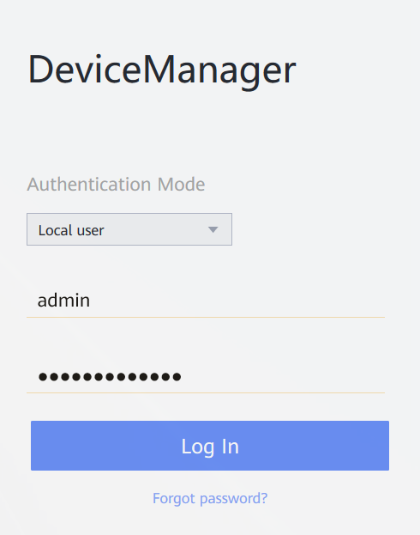
Logging In Using DeviceManager
You must add port number 8088 after the IP address of the management network port. Otherwise, the login fails.
Format: https://xxx.xxx.xxx.xxx:8088
Enter an IP address.
Enter port number 8088.
Enter the user name.
Enter the password.
Notes:
You can log in to DeviceManager on any maintenance terminal connected to the storage system by visiting the system's management network port IP address in a web browser and logging in as a local or domain user.

Slide 9
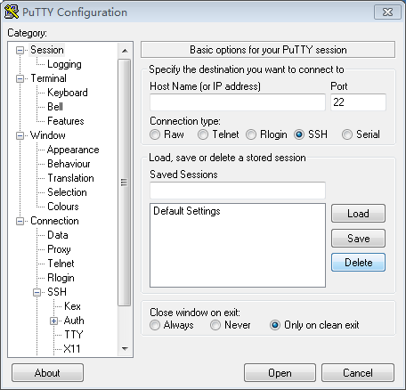
Introduction to the CLI
The CLI allows you to manage and maintain the storage system. Configuration commands are entered using the keyboard and compiled and executed by programs. The command output is displayed in text or graphics on the CLI.
Terminal software is required to log in to the CLI. PuTTY is used as an example below.
Enter the IP address of the management network port.
Set Connection type to SSH.
Click Open. The CLI window is displayed asking you to log in.
Notes:
You can log in to the CLI using ether the following methods:
Use the storage system's serial port. This method is applicable when the storage system is nearby. You can use this approach when you do not know the storage system management IP address or the storage system is abnormal.
Use the storage system's management network port. When the address is reachable, on any maintenance terminal connected to a storage system, you can log in to the CLI by using the SSH protocol in PuTTY to access the management network port IP address on the controller of a storage system. This method is applicable even when the storage system is far away and is the most common CLI login method.

Slide 10
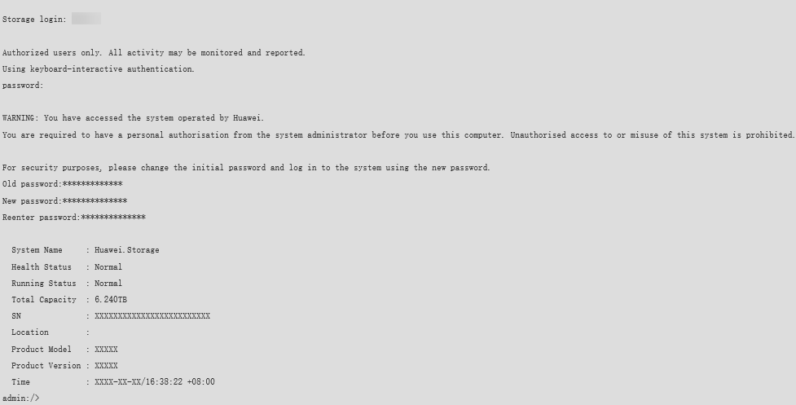
Logging In Using the CLI
Enter the user name and password as prompted. The system asks you to change the password upon the first login. Change the password immediately to ensure system security. The following information is displayed when the login is successful:
1. Enter the user name.
2. Enter the password.
3. Change the password.

Slide 11
Storage Management Overview
Storage Management Tools
DeviceManager
CLI
Basic Management Operations

Slide 12
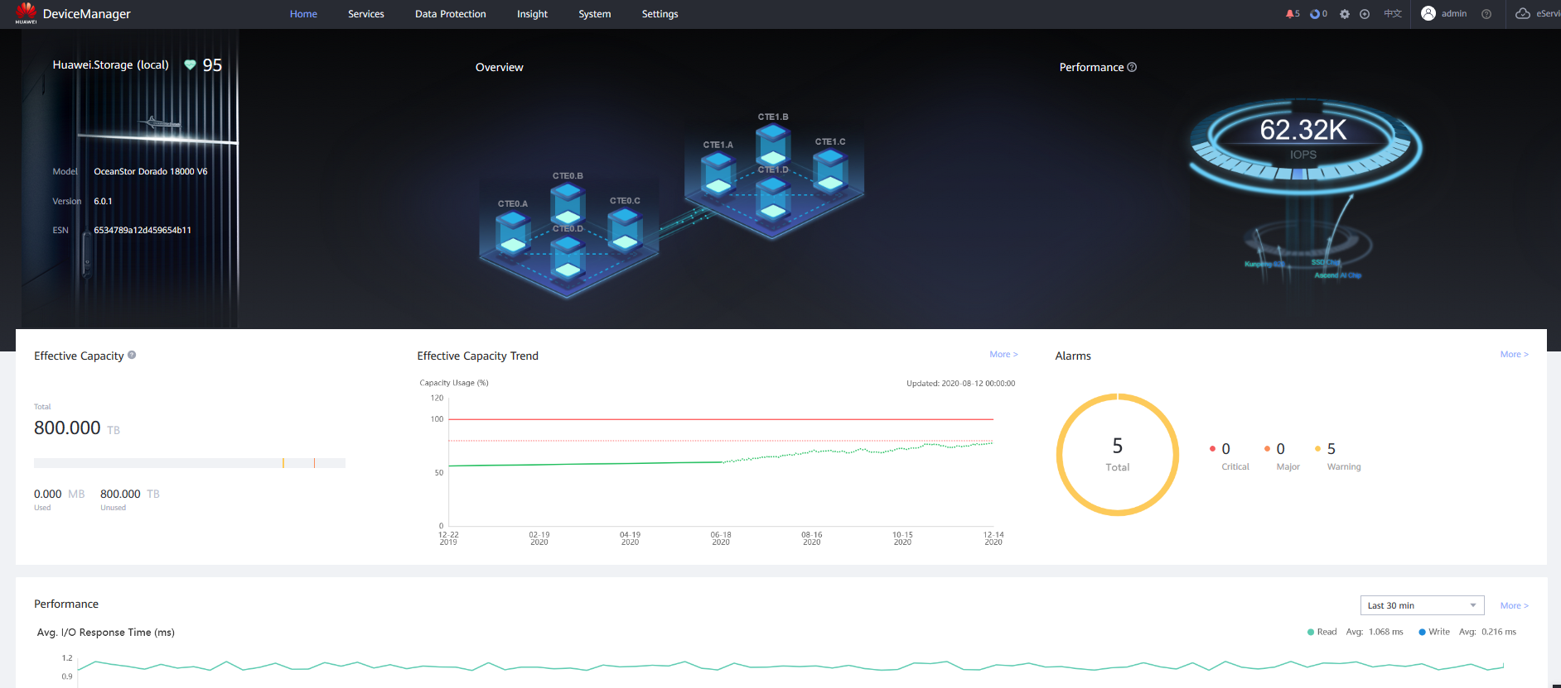
DeviceManager GUI (1)
Navigation bar
Alarm and task statistics area
Function pane
Note: The GUI may vary slightly depending on the product version and model.
Notes:
DeviceManager is storage management software designed by Huawei for a single storage system. It can help you easily configure, manage, and maintain storage devices.

Slide 13
DeviceManager GUI (2)
No. | Name | Description
1 | Function pane | Displays available functions related to the current operation.
2 | Navigation bar | Lists all functional modules of the storage system.
3 | Alarm and task statistics area | The alarm statistics area displays the number of alarms by severity and helps users see the running status of the storage system. The task statistics area displays all the tasks executed by users. You can check whether the tasks are executed successfully.
4 | Device management area | In the device management area, you can view and modify device information and power off or restart devices.
5 | Logout and language area | The logout and language area provides buttons to logout and change language. DeviceManager supports two languages: English and simplified Chinese.

Slide 14
Managing the Access Permission of a Storage System
Account policy
Login policy
Access control
Account audit
Security policy adjustment
Ensuring system security
IP address or address segment list
Operation permissions held by super administrator
Administrator--role
Role--operation permissions
User management
Access IP address control

Slide 15
Storage System User Management
To prevent errors from compromising storage system stability and service data security, the storage system defines user levels and roles to determine user permissions.
Operation permission
Level: super administrator
Role: super administrator
All functional modules of the system
User A
Creating a user and specifying the user level and role
Operation permission
Access permission
Level: administrator
Level: read-only user
Role: built-in role B
Role: customized role C
Disk domain
Storage pool
......
LUN
Host
......
User B
User C
Notes:
Super administrator
Has all permissions on storage devices.
Creates users of different levels.
Administrator
Has limited permissions on storage devices.
Cannot perform operations like user management, system upgrades, system time changes, and turning off or restarting a device.
Read-only user
Has only access permissions on storage devices.
Can perform only the query operation.

Slide 16
Roles and Permissions of a User
Full control permissions
Creates users of different levels.
Data protection administrator
Local data protection
Remote data protection management
HyperMetro management
5
Super administrator
1
4
SAN resource administrator
Storage pool management
LUN management
Mapping view management
Host management
Port management
2
Security administrator
3
Network administrator
Security rule management
Certificate management
KMC management
Antivirus management
Data destruction management
Regulatory clock management
Physical port management
Logical port management
VLAN management
Failover group management

Slide 17
Downloading a DeviceManager Demo
Visit Huawei technical support website:
support.huawei.com
Go to Tools.
Click Storage Simulator Demo and select the simulator for the desired version to be installed.
Search for Storage Simulator.
Notes:
You can find the desired product version on the Huawei technical support website, and download the DeviceManager demo for the target version.

Slide 18
Storage Management Overview
Storage Management Tools
DeviceManager
CLI
Basic Management Operations

Slide 19
CLI Format Conventions (1)
You are required to follow the format conventions when you use the CLI commands. Typical command formats are:
First field: operation that you want to perform, for example, change (modify) and show (query)
Second field: object of an operation, for example, storage_pool (storage pool) and host (host)
Third field (available only in some commands): object attribute, for example, relocation_speed (migration rate)
Other fields: other parameters required.
change storage_pool relocation_speed relocation_speed=?
show host
1
2
3

Slide 20
CLI Format Conventions (2)
For example,
change user keeps unchanged.
user_name=?, mandatory; For level=? and action=?, one of them can be selected.
For parameter level=?, level= remains unchanged. The value of ? must be an optional value, for example, level=admin.
Correct command example:
change user user_name=? { level=? | action=? }
admin:/>change user user_name=newuser level=admin
Format | Description
Boldface | The keywords of a command are in boldface.
Italic | The arguments of a command line, which will be replaced by actual values, are in italics.
[ ] | Items in square brackets [ ] are optional.
{ x | y | ... } | Indicates that one option is selected from two or more options.
[ x | y | ... ] | Indicates that one or no option is selected from two or more options.
{ x | y | ... } * | Indicates that multiple options are selected from two or more options. At least one option must be selected, and at most all options can be selected.
[ x | y | ... ] * | Indicates that multiple options are selected or none is selected from two or more options.

Slide 21
CLI Command Completion
On the CLI, you can press Tab or the space bar to use the command completion function.
The difference between using each key is as follows: The space key is used to supplement only the current field, whereas the Tab key is used to supplement all possible values.
Press Tab once to display the available starting segments of a command line.
After the starting segment is determined and completed, press Tab once to display the available adjacent segments of the starting segment.
admin:/>//Press Tab.
^
add change create
delete exit export
help import poweroff
poweron reboot remove
scan show swap
admin:/>add//Press Tab.
cache_partition clone consistency_group
disk_domain host host_group
lun_copy lun_group mapping_view
notification port port_group
remote_device security_rule smartqos_policy
snmp storage_pool
When all the fields required by the command are entered and the conditions for running the command are met, the system prompts that the command can be run after you press Tab. In this case, you can press Enter to run the command.
admin:/>add port ipv4_route eth_port_id=0 type=net target_ip=192.168.3.0 mask=255.255.255.0 gateway=10.0.0.1//Press Tab.
Command is executable now.
Notes:
When part of a segment has been typed and its intact form can be determined by the CLI, pressing Tab once completes the segment while displaying available adjacent segments.

Slide 22
Context-Sensitive Help
Enter a question mark (?) to query the basic instruction of CLI operations and detailed description of command parameters.
Press Ctrl+A to view the optional values of certain parameters in certain commands. Generally, these values need to be obtained from the system.
Ctrl+A
?
Context-sensitive help
After entering the first field of the command and a space, enter a question mark (?). You can query all available next fields and the detailed description of each field.
PageDown
You can turn pages on the context-sensitive help page.
PageUp
q
Exit the context-sensitive help page.
Notes:
You can obtain real-time help and guides for using the CLI.

Slide 23
CLI Command Filtering
Purpose
Redundant information is deleted, and valid content is displayed as required.
How to use
After entering the complete query command, enter | and press Tab or the space bar.
Filtering
Related commands
filterColumn column filtering command
filterRow row filtering command

Slide 24
CLI Column Filtering Command - filterColumn
show xxx|filterColumn { exclude | include } columnList=?
}
Choose either.
Columns available
for filtering
exclude: Filter out information that does not need to be displayed.
Include: Only the columns to be displayed are reserved.
If multiple columns are involved, they are separated by commas (,).
admin:/>show bbu general|filterColumn exclude//Press Tab.
<columnList=?> column list separated by comma, select one or more
separated by comma, the spaces are replaced with \s in the
parameter list.
columnList=Inter\sID columnList=ID
columnList=Health\sStatus columnList=Running\sStatus
columnList=Current\sVoltage(V) columnList=Number\sOf\sDischarges
columnList=Firmware\sVersion columnList=Delivered\sOn
columnList=Owning\sController columnList=Electronic\sLabel
admin:/>show bbu general |filterColumn include columnList=Inter\sID,ID
Inter ID ID
-------- ------
0.0A.0 CTE0.0
0.0A.1 CTE0.1

Slide 25
CLI Row Filtering Command - filterRow
show xxx|filterRow column=? predict=? [ predict2=? ] value=? [ logicOp=? ]
Columns required for filtering
Filtering condition
Filtering condition 2
Value
Logical relationship between columns
predict=?
logicOp=?
and: Multiple columns that meet the condition are displayed.
or: Any column that meets the condition is displayed.
not: The logicOp is not.
equal_to: a value equal to value=?
greater_than: a value greater than value=?
greater_equal: a value equal to or greater than value=?
less_than: a value less than value=?
less_equal: a value less than or equal to value=?
match: regular expression matching value=?
Notes:
xxx indicates the last several fields of the query command.
Multiple columns can be selected at the same time and logicOp=? can be used to establish the logical relationship between multiple columns.
If the selected column name contains spaces, use \s to replace them. For example, to query the value of Write Policy of a LUN, run the admin:/>show lun general|filterRow column=Write\sPolicy command.

Slide 26
Error Prompt Function
Purpose
Specify the position of the input error in the command and provide the correct field for reference.
Error prompt function
How to use
When the format of the entered command is incorrect, the system displays the error location with symbol ^.
Note
When multiple errors occur in the command, the system displays only the first error.
admin:/>add part
^
port port_group
admin:/>add part

Slide 27
Storage Management Overview
Storage Management Tools
Basic Management Operations

Slide 28
Basic Management Operations
Version information and ESN
Managing a storage system license
3
Managing alarms and events
2
4
1
5
Managing basic information about a storage system
Collecting storage system information
6
Configuring basic storage services

Slide 29
Managing Basic Information About a Storage System - Setting the Device Time (1)
A protocol used to synchronize the system time of a computer to Coordinated Universal Time (UTC). A server that supports the NTP protocol is called an NTP server.
Introduction
NTP
Function
When an alarm is generated, users can accurately determine when it was generated using alarm logs.
Set the time manually.
Synchronize the client time.
Set automatic NTP synchronization.
Setting mode
Notes:
You must configure the NTP server before setting NTP automatic synchronization.
If a firewall is configured, port 123 should be enabled.
To synchronize the time with a client is to change the storage system time to be the same as the client time.
Automatic NTP synchronization uses an NTP server as an external time source to automatically and periodically synchronize the time to a device.

Slide 30
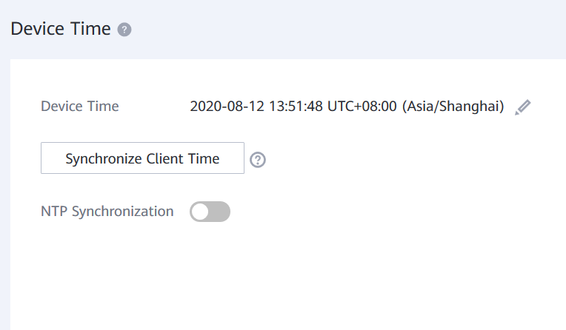
Managing Basic Information About a Storage System - Setting the Device Time (2)
Managing the device time on DeviceManager
Managing the device time on the CLI
The change ntp_server config command is used to automatically synchronize the storage system time with the NTP server time.
The show system ntp command is used to query NTP settings.
The show ntp status command is used to query the NTP status.
The show ntp_server general command is used to query the settings of the time synchronization function.
Notes:
Note: Set the correct time zone and time. Otherwise, the time recorded in alarms or logs may be different from the actual time, making it harder to locate faults.

Slide 31
Managing Device Licenses (1)
Permission credentials to use various value-added features (such as snapshot, remote replication, clone, and SmartQoS)
Introduction
License
file
Precautions
During routine device management, you need to check whether the license file is available.
Using DeviceManager to manage licenses
Based on the status of the imported or activated license, different license operations are displayed on the License Management page: Import License, Activate License, and Update License.
For an activated license file, DeviceManager provides two control modes:
Running time-based control: displays the expiration time of the license.
Capacity-based control: displays the used/total capacity of the license.

Slide 32
Viewing Device Licenses (2)
Using CLI to manage licenses
The export license command is used to export a license file.
Example: export license ip=? user=? password=? license_path=? [ port=? ] [ protocol=? ]
The import license command is used to import a license file.
Example: import license ip=? user=? password=? license_path=? [ port=? ] [ protocol=? ]
The show license command is used to query the function configuration of the imported license file in the system.
Example: show license
The show license_active command is used to query information about active licenses.
Example: show license_active

Slide 33
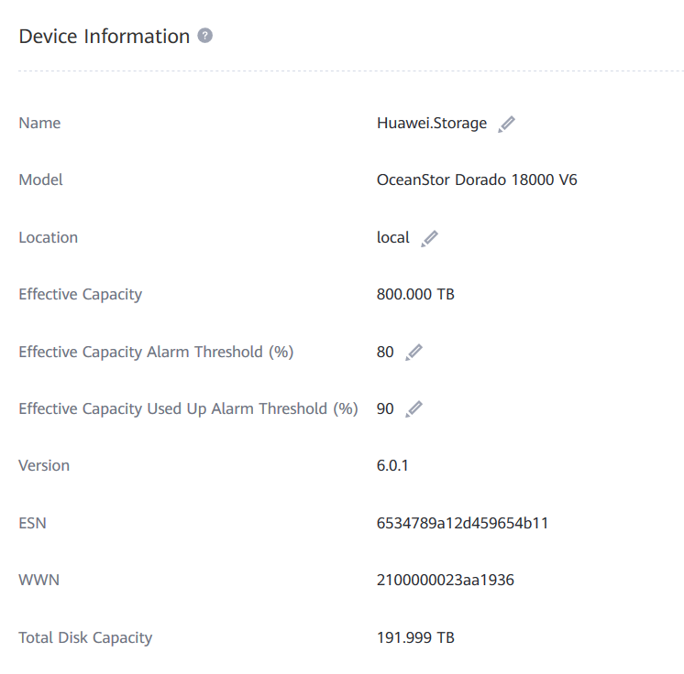
Obtaining the Device's Current Version Information
Version information
Function
The matching software version can be determined based on the system version.
Obtaining the current system version information on DeviceManager
The following shows the device information:
Log in to the CLI as a super administrator.
Run the show system general command.
Product Version indicates the version of the current storage system.
admin:/>show system general
System Name : XXX.Storage
Health Status : Normal
Running Status : Normal
Total Capacity : 3.186 TB
SN : 210235G6EHZ0CX0000XX
Location :
Product Model : XXXX
Product Version : VX00R00XCXX
High Water Level(%) : 80
Low Water Level(%) : 20
WWN : XXXX
Time : 2020-07-07/15:34:05 UTC+08:00
Patch Version : SPCXXX SPHXXX
Description :

Slide 34
Obtaining the Device ESN
Introduction
An ESN is a character string that uniquely identifies a device.
ESN
Application scenarios
Scenarios such as license application, device repair, and eService service configuration
Obtaining the ESN using DeviceManager
Obtaining the ESN using the CLI
>> Run the show system general command.
admin:/>show system general
System Name : XXX.Storage
Health Status : Normal
Running Status : Normal
Total Capacity : 3.186 TB
SN : 210235G6EHZ0CX0000XX
Location :
Product Model : XXXX
Product Version : VX00R00XCXX
High Water Level(%) : 80
Low Water Level(%) : 20
WWN : XXXX
Time : 2020-07-07/15:34:05 UTC+08:00
Patch Version : SPCXXX SPHXXX
Description :

Slide 35
Managing Alarms and Events
Email notification
Email notification
SMS notification
SMS notification
Syslog notification
Trap notification
Trap notification
Configuring the event notification method
Configuring the alarm notification mode
Managing alarms and events
Configuring alarm masking
Configuring alarm dump
Alarm masking determines whether the system does or does not report alarms to the network management system.
When the number of alarms exceeds the threshold, the alarms will be dumped automatically to a specific FTP or SFTP server.

Slide 36
Collecting Storage System Information
Prevent storage system faults and other unpredictable disasters from damaging the storage system.
Check the storage system’s operating status.
Purpose
Collecting information
How
Regularly export and securely save the system data to locate and analyze faults.
System data
Configuration information, system logs, disk logs, and diagnosis files

Slide 37
Collecting Storage System Information (2)
Collecting storage system configuration data using DeviceManager
On DeviceManager:
You can export the configuration information to collect information about the system's current running status.
You can download Recent logs or All logs to collect configuration information, event information, and debugging logs on the storage device.
You can download DHA Runtime Log List or HSSD Log List to collect disk run logs, I/O statistics and service life, and S.M.A.R.T. logs.
You can export the diagnosis file to collect fault information.
Log in to the storage system CLI as the super administrator and run the following command to export the configuration file to an FTP or SFTP server:
Collecting storage system configuration data using the CLI
export configuration_data ip=? user=? password=? db_file=? [ port=? ] [ protocol=? ] [ clean_device_file=? ]
Notes:
System logs record information about the configuration, events, and debugging operations on a storage system and can be used to analyze the status of the storage system. System log files are saved as *.tgz files.
Configuration information is the real-time configuration and status of a storage system, such as, user or configuration information from LUNs. The exported information is saved as a *.txt file.
A DHA runtime log is the daily runtime log of a disk. Key information includes daily disk health status, I/O information, and disk life span. The exported DHA runtime log is saved as a *.tgz file.
An HSSD log is the working log for HSSD, such as the S.M.A.R.T information of a disk. The exported HSSD log is saved as a *.tgz file.
A disk data erasure report includes information about the disk on which data erasure is performed, erasure mode, execution time, and verification result. The exported data erasure report is saved as a *.csv file.
The diagnosis file includes device fault information. The exported diagnosis file is saved as a *.tgz file.

Slide 38
Configuring Basic Storage Services
The storage space provided by the storage system is divided into multiple LUNs.
LUNs are mapped to an application server.
The application server can use the storage space provided by the storage system.
Configuring basic
services
Function
Using DeviceManager to configure basic storage services
Creating a storage pool: DeviceManager allows you to create a storage pool in either recommended or custom mode.
Allocate storage resources by creating LUN groups or file systems.

Slide 39
Configuring Basic Storage Services Using the CLI
3. Using the storage space on an application server
2. Setting up connection
Use the storage space on an application server.
Create a host.
Create a host group.
Configure initiators.
Create a mapping view.
Configure connectivity between a host and a storage system.
1. Creating storage space
Create a disk domain.
Create a storage pool.
Create a LUN.
Create a LUN group.

Slide 40
(Single-answer question) The management IP address of a storage device is 192.168.5.12. Engineer A needs to enter ( ) in the address box of the browser to log in to the storage device.
192.168.5.12
http://192.168.5.12
https://192.168.5.12
https://192.168.5.12:8088
(True or False) DeviceManager can monitor the performance of controllers, front-end ports, and back-end ports.
Notes:
Answers:
D
T

Slide 41
Storage System Operation Management
Storage Management Overview
Storage Management Overview
DeviceManager
Storage Management Login Mode
Introduction to Storage Management Tools
CLI
Basic Management Operations of the Storage System

Slide 42
Enterprise Technical Support App
Huawei Enterprise Service App
Notes:
Huawei training app
Contains a huge library of Huawei certified learning videos.
Enterprise technical support app
Covers all popular product documents, cases, and bulletins from Huawei. Users can quickly query commands, alarms, and spare parts. They can also use it to scan and view the device information. Simple and intuitive video guides provide 24/7 enterprise technical support.
Huawei enterprise business app
Provides one-stop mobile ICT portals for customers and partners to learn about Huawei's comprehensive products and solutions for enterprise ICT anytime and anywhere.

Slide 43
Huawei official websites
Enterprise business: https://e.huawei.com/en/
Technical support: https://support.huawei.com/enterprise/en/index.html
Online learning: https://www.huawei.com/en/learning
Popular tools
HedEx Lite
Network Document Tool Center
Information Query Assistant
Notes:
Popular tools
HedEx Lite is the Huawei tool for product document management. It allows users to browse, search, update, and manage product documentation.
eStor is a graphic storage simulation platform. The platform simulates Huawei OceanStor all-flash storage devices to help ICT practitioners and customers get familiar with Huawei storage products and quickly master their operations.
The Network Documentation Tool Center is the documentation tool for network products. It assists in bidding, network planning, project delivery, upgrades, and maintenance.
The Information Query Assistant provides command and alarm information querying for Huawei products.

