Slide 1
Tang Jiaojiao/wx498299
2020.5.25
Shui Shaolan/00329529
New
Meng Xianyang/wx896519
2020.7.3
Shui Shaolan/00329529
Update
Ma Yuqing/wx408409
2020.7.5
Shui Shaolan/00329529
Update
Ma Deliang/wx1031102
2022.7.1
Liang Shuai/00569373
Update

Slide 2
Storage System Operation Management

Slide 3
This course describes three methods of managing storage systems: OceanStor DeviceManager, common line interface (CLI), and UltraPath, as well as management content and related operations.

Slide 4
Upon completion of this course, you will be able to know:
DeviceManager, CLI, and UltraPath storage system management tools
Basic management operations of the storage system

Slide 5
Storage Management Overview
Storage Management Tools
Basic Management Operations

Slide 6
Storage Management Definition
Storage management allows users to use management tools to query, set, manage, and maintain storage systems.
Storage resource allocation
Management content
User management
Data protection feature management
Device performance monitoring
Alarm management
......

Slide 7
Common Storage System Access Mode
In what ways can I log in to a storage system?
Log in to DeviceManager.
Log in to the CLI.
Notes:
The storage system can be operated and maintained by using the DeviceManager and the command-line interface (CLI), adapting to different environments and user habits.
After logging in to the CLI of a storage system, you can query, set, manage, and maintain the storage system.

Slide 8
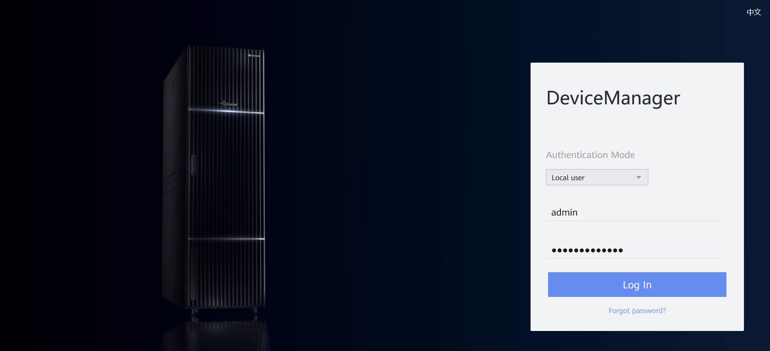
Introduction to DeviceManager
DeviceManager is storage management software designed by Huawei for a single storage system. It can help you easily configure, manage, and maintain storage devices.
Main software functions include storage resource allocation, user management, data protection feature management, device performance monitoring, and alarm management.
Notes:
DeviceManager is a device management program developed by Huawei. DeviceManager has been loaded to storage systems before factory delivery.

Slide 9
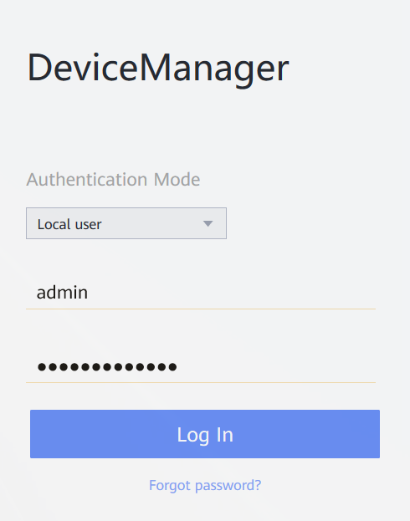
Logging In Using DeviceManager
You must add port number 8088 after the IP address of the management network port. Otherwise, the login fails.
Format: https://xxx.xxx.xxx.xxx:8088
Enter an IP address.
Enter port number 8088.
Enter the user name.
Enter the password.
Notes:
You can log in to DeviceManager on any maintenance terminal connected to the storage system by entering the management network port IP address of the storage system and the local or domain user name in a browser.

Slide 10
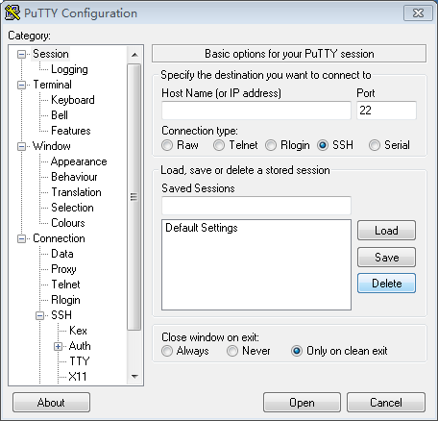
Introduction to the CLI
CLI allows you to manage and maintain the storage system. Configuration commands are entered on the keyboard and compiled and executed by programs. The command output is displayed in text or graphic format on the CLI.
Terminal software is required for logging in to the CLI. PuTTY is used as an example.
Enter the IP address of the management network port.
Set Connection type to SSH.
Click Open. The CLI window is displayed asking you to log in.
Notes:
You can log in to the CLI using either of the following methods:
Use the serial port of the storage system. This method is applicable when the storage system is nearby. You can use this method when you do not know the storage system management IP address or the storage system is abnormal.
Use the management network port of the storage system. When the route is reachable, on any maintenance terminal connected to a storage system, you can log in to the CLI by using PuTTY to access the IP address of the management network port on the controller of a storage system through the SSH protocol. This method is applicable even when the storage system is far away and is the most common CLI login method.

Slide 11
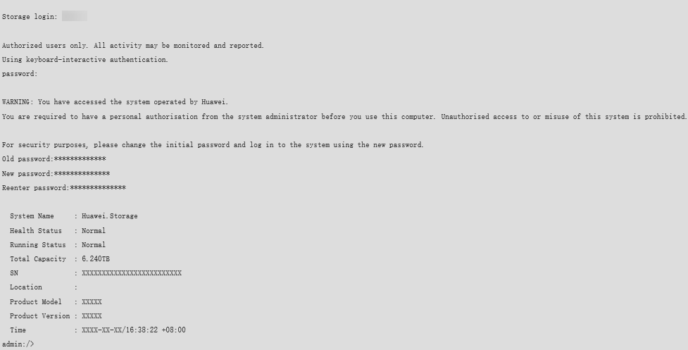
Logging In Using the CLI
Enter the user name and password as prompted. The system asks you to change the password upon the first login. Change the password immediately to ensure system security. The following information is displayed when the login is successful:
1. Enter the user name.
2. Enter the password.
3. Change the password.

Slide 12
Introduction to UltraPath
OceanStor UltraPath is the multipathing software developed by Huawei. Its functions include masking of redundant LUNs, optimum path selection, I/O load balancing, and failover and failback. These functions enable your storage network to be intelligent, stable, and fast.
A piece of multipathing software installed on hosts to improve performance and availability
Overview
Controls access to storage devices.
UltraPath
Runs in kernel mode of the operating system as a driver of the operating system.
Selects paths between hosts and storage devices.
Supports querying and setting the operating parameters of driver software in user mode of the operating system.
Improves the reliability of the paths between hosts and storage devices.
Functions
Environment
Has different installation programs or scripts in different operating systems.

Slide 13
Storage Management Overview
Storage Management Tools
Basic Management Operations

Slide 14
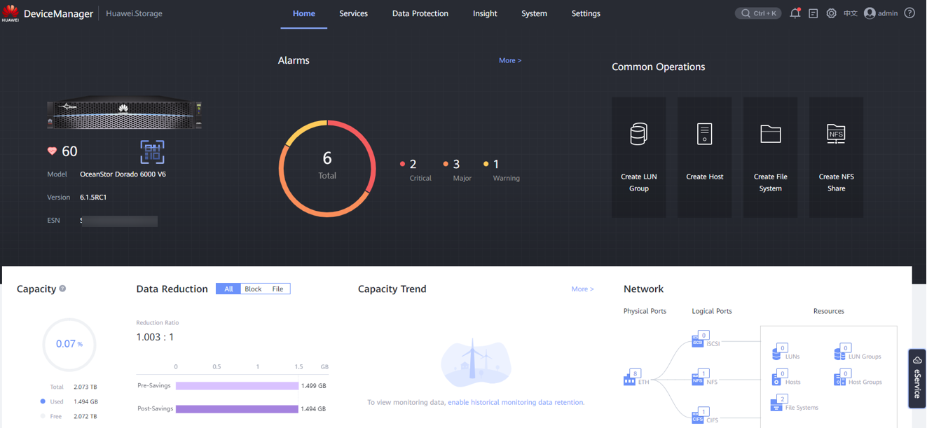
DeviceManager GUI (1)
Note: The GUI may vary slightly depending on the product version and model. The actual GUI prevails.
Notes:
DeviceManager is storage management software designed by Huawei for a single storage system. It can help you easily configure, manage, and maintain storage devices.

Slide 15
DeviceManager GUI (2)
No. | Name | Description
1 | Function pane | Displays available functions related to the current operation.
2 | Navigation bar | Lists all functional modules of the storage system.
3 | Alarm and task statistics area | The alarm statistics area displays the number of alarms by severity and helps you learn about the running status of the system. The task statistics area displays all the tasks executed by users. You can check whether the tasks are executed successfully.
4 | Device management area | In the device management area, you can view and modify device information, and power off or restart devices.
5 | Logout and language area | The logout and language area provide buttons of logout and language. DeviceManager supports two languages: English and simplified Chinese.

Slide 16
Managing the Access Permission of a Storage System
Account policy
Login policy
Access control
Account audit
Security policy adjustment
Ensuring system security
IP address or address segment list
Operation rights of the super administrator
Administrator-----role
Role--operation rights
User management
Access IP address control

Slide 17
Storage System User Management
To prevent misoperations from compromising the storage system stability and service data security, the storage system defines user levels and roles to determine user permission and scope of permission.
Operation permission
Level: super administrator
Role: super administrator
All functional modules of the system
User A
Creating a user and specifying the user level and role
Operation permission
Access permission
Level: administrator
Level: read-only user
Role: built-in role B
Role: customized role C
Disk domain
Storage pool
......
LUN
Host
......
User B
User C
Notes:
Super administrator
Has full control permission on storage devices.
Creates users of different levels.
Administrator
Has certain control permission on storage devices.
Cannot perform operations such as user management, system upgrade, system time modification, device power-off, and device restart.
Read-only User
Has only access permissions on the storage device.
After logging in to the device, you can perform only the query operation.

Slide 18
Roles and Permissions of a User
Full control permissions
Creates users of different levels.
Data protection administrator
Local data protection
Remote data protection management
HyperMetro management
5
Super administrator
1
4
SAN resource administrator
Storage pool management
LUN management
Mapping view management
Host management
Port management
2
Security administrator
3
Network administrator
Security rule management
Certificate management
KMC management
Antivirus management
Data destruction management
Regulatory clock management
Physical port management
Logical port management
VLAN management
Failover group management

Slide 19
Downloading a DeviceManager Demo
Visit Huawei technical support website:
support.huawei.com
Go to Tools.
Click Storage Simulator Demo and select the simulator of the desired version for installation.
Search for Storage Simulator.
Notes:
You can find the desired product version at Huawei technical support website, and download the DeviceManager demo of the target version.

Slide 20
CLI Format Conventions (1)
You are required to follow the format conventions when you use the CLI commands. Typical command formats are:
First field: operation that you want to perform, for example, change (modify) and show (query)
Second field: object of an operation, for example, storage_pool (storage pool) and host (host)
Third field (available only in some commands): object attribute, for example, relocation_speed (migration rate)
Other fields: other parameters required
change storage_pool relocation_speed relocation_speed=?
1
2
3

Slide 21
CLI Format Conventions (2)
For example,
change user keeps unchanged.
user_name=?, mandatory; For level=? and action=?, one of them can be selected.
For parameter level=?, level= remains unchanged. The value of ? must be an optional value, for example, level=admin.
Correct command example:
change user user_name=? { level=? | action=? }
admin:/>change user user_name=newuser level=admin
Format | Description
Boldface | The keywords of a command are in boldface.
Italics | The arguments of a command line, which will be replaced by actual values, are in italics.
[ ] | Items in square brackets ([ ]) are optional.
{ x | y | ... } | Optional items are grouped in braces ({ }) and separated by vertical bars (|). One item must be selected.
[ x | y | ... ] | Optional items are grouped in square brackets ([ ]) and separated by vertical bars (|). Only one item or no item can be selected.
{ x | y | ... } * | Optional items are grouped in braces ({ }) and separated by vertical bars (|). At least one item must be selected, and at most all items can be selected.
[ x | y | ... ] * | Optional items are grouped in square brackets ([ ]) and separated by vertical bars (|). Several items or no item can be selected.

Slide 22
CLI Command Completion
On the CLI, you can press Tab or the space bar to use the command completion function.
The difference between the two keys is as follows: The space key is used to supplement only the current field, whereas the Tab key is used to supplement all possible values.
Press Tab once to display the available starting segments of a command line.
After the starting segment is determined and completed, press Tab once to display the available adjacent segments of the starting segment.
admin:/>//Press "Tab"
^
add change create
delete exit export
help import poweroff
poweron reboot remove
scan show swap
admin:/>add//Press "Tab"
cache_partition clone consistency_group
disk_domain host host_group
lun_copy lun_group mapping_view
notification port port_group
remote_device security_rule smartqos_policy
snmp storage_pool
When all the fields required by the command are entered and the conditions for running the command are met, the system prompts that the command can be run after you press Tab. In this case, you can press Enter to run the command.
admin:/>add port ipv4_route eth_port_id=0 type=net target_ip=192.168.3.0 mask=255.255.255.0 gateway=10.0.0.1//Press Tab
Command is executable now.
Notes:
When part of a segment has been typed and its intact form can be determined by the CLI, pressing Tab once completes the segment while displaying available adjacent segments.

Slide 23
Context-Sensitive Help
Enter a question mark (?) to query the basic instruction of CLI operations and detailed description of command parameters.
Press Ctrl+A to view the optional values of certain parameters in certain commands. Generally, these values need to be obtained from the system.
Ctrl+A
?
Context-sensitive Help
After entering the first field of the command and a space, enter a question mark (?). You can query all available next fields and the detailed description of each field.
PageDown
You can turn pages on the context-sensitive help page.
PageUp
q
Exit the context-sensitive help page.
Notes:
You can obtain real-time help and guides on the CLI.

Slide 24
CLI Command Filtering
Purpose
Redundant information is deleted, and valid content is displayed as required.
Filtering function
After entering the complete query command, enter | and press Tab or the space bar.
How to Use
Related Commands
filterColumn column filtering command
filterRow row filtering command

Slide 25
CLI Column Filtering Command - filterColumn
show xxx|filterColumn { exclude | include } columnList=?
Choose either.
Columns available for filtering
exclude: Filter out information that does not need to be displayed.
Include: Only the columns to be displayed are reserved.
If multiple columns are involved, they are separated by commas (,).
admin:/>show bbu general|filterColumn exclude//Press "Tab"
<columnList=?> column list separated by comma, select one or more
separated by comma, the spaces are replaced with \s in the
parameter list.
columnList=Inter\sID columnList=ID
columnList=Health\sStatus columnList=Running\sStatus
columnList=Current\sVoltage(V) columnList=Number\sOf\sDischarges
columnList=Firmware\sVersion columnList=Delivered\sOn
columnList=Owning\sController columnList=Electronic\sLabel
admin:/>show bbu general |filterColumn include columnList=Inter\sID,ID
Inter ID ID
-------- ------
0.0A.0 CTE0.0
0.0A.1 CTE0.1

Slide 26
CLI Row Filtering Command - filterRow
show xxx|filterRow column=? predict=? [ predict2=? ] value=? [ logicOp=? ]
Columns required for filtering
Filtering condition
Filtering condition 2
Value
Logical relationship between columns
predict=?
logicOp=?
and: Multiple columns that meet the condition are displayed.
or: Any column that meets the condition is displayed.
not: The logicOp is not.
equal_to: a value equal to value=?
greater_than: a value greater than value=?
greater_equal: a value equal to or greater than value=?
less_than: a value less than value=?
less_equal: a value less than or equal to value=?
match: regular expression matching value=?
Notes:
xxx indicates the last several fields of the query command.
Multiple columns can be selected at the same time and logicOp=? can be used to establish the logical relationship between multiple columns.
If the selected column name contains spaces, use \s to replace them. For example, to query the value of Write Policy of a LUN, run the admin:/>show lun general|filterRow column=Write\sPolicy command.

Slide 27
Error Prompt Function
Purpose
Specify the position of the input error in the command and provide the correct field for reference.
Error prompt function
How to Use
When the format of the entered command is incorrect, the system displays the error location with symbol ^.
Note
When multiple errors occur in the command, the system displays only the first error.
admin:/>add part
^
port port_group
admin:/>add part

Slide 28
Major Functions of UltraPath
Virtual LUNs mask physical LUNs and are visible to upper-layer users. Read/Write operations are performed on virtual LUNs.
Mainstream clustering software: MSS MSCS, VCS, HACMP, Oracle RAC, and so on
Mainstream database software: Oracle, DB2, MySQL, Sybase, Informix, and so on
The path to the owning controller of a LUN is used to achieve the best performance.
Virtual LUN generation
Optimum
path selection
Application
software support
UltraPath
Failover
Failback
Failover occurs if a link becomes faulty, preventing service interruption.
I/O
load balancing
After link recovery, failback immediately occurs without manual intervention or service interruption.
Multiple paths are automatically selected to deliver I/Os, improving I/O performance. Paths are selected based on the path workload.

Slide 29
Positioning of Multipathing Software
Without multipathing software
With multipathing software
Basic
function
Eliminating
single points of failure
Server
Multipathing software
Server
+
HBA
HBA
Single point of failure
A single point of failure means that the failure of a component in a network may cause network breakdown. To prevent single points of failure, high-reliability systems implement redundant backup for devices that may suffer single points of failure and adopt a cross cable connection method to achieve optimal reliability. Moreover, redundant paths assist in achieving higher performance.
LUN
LUN
LUN
LUN
LUN
LUN
Storage system
Storage system

Slide 30
Positioning of Multipathing Software
Without multipathing software
With multipathing software
Basic
function
Load balancing
Server
Server
Multipathing software
Load balancing
Link
Load balancing is another critical function of multipathing software. With load balancing, the system uses the bandwidth of multiple links to improve overall throughput.
Common load balancing algorithms include round-robin, minimum queue depth, and minimum task.
I/O
Link
bottleneck
Balanced loads and enhanced performance
LUN
LUN
LUN
LUN
LUN
LUN
Storage system
Storage system

Slide 31
Positioning of Multipathing Software
Positioning
UltraPath is a type of filter driver software running in the host kernel. It can block and process disk creation/deletion and I/O delivery of operating systems. UltraPath implements a reliable use of redundant paths. If a path fails or cannot meet the performance requirement, UltraPath automatically and transparently transfers I/Os to other available paths to ensure that I/Os are transmitted effectively and reliably. As shown in the figure on the right, UltraPath can handle many faults such as HBA faults, link faults, and controller faults.
Server
Application
vdisk
UltraPath
HBA
HBA
SAN
Storage
Controller A
Controller B
Basic Function | Severity | Description
Failover | High | If a path is faulty, I/Os on the path are automatically transferred to another available path.
Failback | High | After the faulty path recovers, I/Os are automatically transferred back to the path.
Load balancing | High | The bandwidths of multiple links are used, improving the overall system throughput.

Slide 32
Active-Active Architecture with Full Load Balancing in OceanStor V6
Even distribution of unhomed LUNs
Data on LUNs is divided into 64 MB slices. The slices are distributed to different virtual nodes based on the hash result (LUN ID + LBA).
Load balancing
UltraPath interacts and negotiates with the storage system, calculates the hash result (LUN ID + LBA) for each delivered I/O, obtains the corresponding virtual node, and selects the physical path corresponding to the virtual node to deliver the I/O. This reduces cross-CPU distribution in a storage system and improves end-to-end performance.

Slide 33
Storage Management Overview
Storage Management Tools
Basic Management Operations

Slide 34
Basic Management Operations
Obtaining the version information and ESN
Managing a storage system license
3
Managing alarms and events
2
4
1
5
Managing basic information about a storage system
Collecting storage system information
6
Configuring basic storage services

Slide 35
Managing Basic Information About a Storage System - Setting the Device Time (1)
A protocol used to synchronize the system time of a computer to the Coordinated Universal Time (UTC). A server that supports the NTP protocol is called an NTP server.
Introduction
NTP
Function
When alarms are generated, users can accurately determine the alarm generation time based on alarm logs.
Set the time manually.
Synchronize with the client time.
Set automatic NTP synchronization.
Setting mode
Notes:
You have configured the NTP server before setting NTP automatic synchronization.
To use automatic NTP synchronization when a firewall is enabled, you must enable port 123.
To synchronize the time with a client is to change the storage system time to be the same as the client time.
Automatic NTP synchronization uses an NTP server as an external time source to automatically and periodically synchronize the time to a device.

Slide 36
Managing Basic Information About a Storage System - Setting the Device Time (2)
Managing the device time on DeviceManager
Managing the device time on the CLI
The change ntp_server config command is used to automatically synchronize the storage system time with the NTP server time.
The show system ntp command is used to query NTP settings.
The show ntp status command is used to query the NTP status.
The show ntp_server general command is used to query the settings of the time synchronization function.
Notes:
Note: Set the correct time zone and time. Otherwise, the time recorded in alarms or logs may be different from the actual time, affecting fault locating.

Slide 37
Managing Device Licenses (1)
Permission credentials for using various value-added features (such as snapshot, remote replication, clone, and SmartQoS)
Introduction
License
file
Precautions
During routine device management, you need to check whether the license file is available.
Using DeviceManager to manage licenses
Depending on whether a license has been imported or activated, the license operation displayed in the License Management area can be Import License, Activate License, or Update License.
For an activated license file, DeviceManager provides two control modes:
Running time-based control: displays the expiration time of the license.
Capacity-based control: displays the used/total capacity of the license.

Slide 38
Managing Device Licenses (2)
Using CLI to manage licenses
The export license command is used to export a license file.
Example:
The import license command is used to import a license file.
Example:
The show license command is used to query the function configuration of the imported license
file in the system.
Example:
The show license_active command is used to query information about active licenses.
Example:
export license ip=? user=? password=? license_path=? [ port=? ] [ protocol=? ]
import license ip=? user=? password=? license_path=? [ port=? ] [ protocol=? ]
show license
show license_active

Slide 39
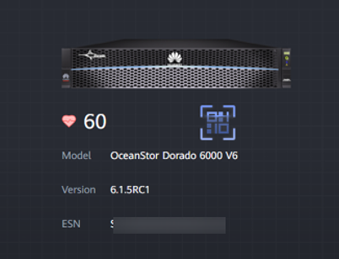
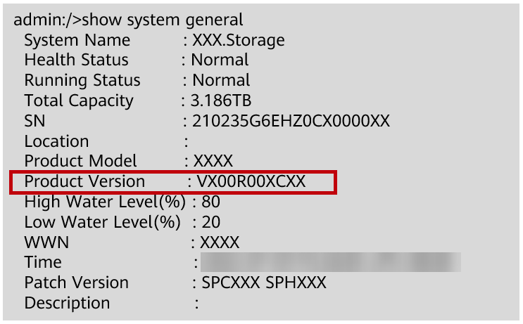
Obtaining the Current Version Information of the Device
Version information
The matching software version can be accurately determined based on the system version.
Function
Obtain the current system version information on DeviceManager.
Log in to the CLI as a super administrator.
Run the show system general command.
Product Version indicates the version of the current storage system.

Slide 40
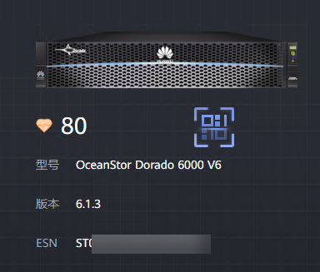
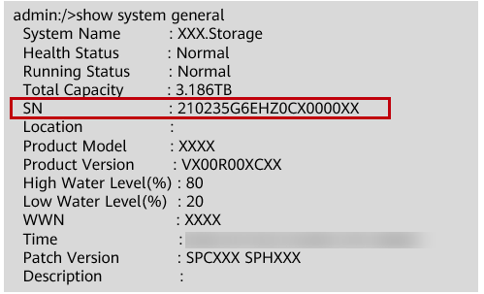
Obtaining the Device ESN
Introduction
Character string that uniquely identifies a device.
ESN
Application scenarios
Scenarios such as license application, device repair, and eService service configuration
Obtain the ESN using DeviceManager.
Obtain the ESN using the CLI.
>> Run the show system general command.

Slide 41
Managing Alarms and Events
Email notification
Email notification
SMS notification
SMS notification
Syslog notification
Trap notification
Trap notification
Configuring the event notification method
Configuring the alarm notification mode
Managing alarms and events
Configuring alarm masking
Configuring alarm dump
Alarm masking needs to be enabled or disabled so that the system does not report or reports alarms to the network management system (NMS).
When the number of alarms exceeds the threshold, the alarms will be dumped automatically to a specific FTP or SFTP server.

Slide 42
Collecting Storage System Information (1)
Prevent storage system faults and other unpredictable disasters from damaging the storage system.
Know the storage system operating status.
Purpose
Collecting information
Regularly export and securely save the system data for fault locating and analysis.
How
System data
Configuration information, system logs, disk logs, and diagnosis files

Slide 43
Collecting Storage System Information (2)
Collecting storage system configuration data using DeviceManager
On DeviceManager:
You can export the configuration information to collect the information about the current running status of
the system.
You can download Recent logs or All logs to collect configuration information, event information, and
debugging logs on the storage device.
You can download DHA Runtime Log List or HSSD Log List to collect disk run logs, I/O statistics and service
life, and S.M.A.R.T. logs.
You can export the diagnosis file to collect fault information of the device.
Collecting storage system configuration data using the CLI
Log in to the CLI of the storage system as the super administrator and run the following command to export
the configuration file to an FTP or SFTP server:
export configuration_data ip=? user=? password=? db_file=? [ port=? ] [ protocol=? ] [ clean_device_file=? ]
Notes:
System logs record information about the configuration information, events, and debugging operations on a storage system and can be used to analyze the status of the storage system. System log files are saved as *.tgz files.
Configuration information indicates the real-time configuration information and status of a storage system, such as, user information or the configuration information of LUNs. The exported configuration information is saved as a *.txt file.
A DHA runtime log is the daily runtime log of a disk. It mainly includes daily disk health status, I/O information, and disk life span. The exported DHA runtime log is saved as a *.tgz file.
An HSSD log is the working log of HSSD, such as the S.M.A.R.T information of a disk. The exported HSSD log is saved as a *.tgz file.
A disk data erasure report includes information about the disk on which data erasure is performed, erasure mode, execution time, and verification result. The exported data erasure report is saved as a *.csv file.
Diagnosis file including device fault information. The exported diagnosis file is saved as a *.tgz file.

Slide 44
Configuring Basic Storage Services
The storage space provided by the storage system is divided into multiple LUNs.
Map LUNs to an application server.
The application server can use the storage space provided by the storage system.
Configuring
basic services
Function
Using DeviceManager to configure basic storage services
Creating a storage pool: DeviceManager allows you to create a storage pool in either recommended or custom mode.
Allocating storage resources by creating LUN groups or file systems.

Slide 45
Configuring Basic Storage Services Using the CLI
3. Using the storage space on an application server
2. Setting up connection
Use the storage space on an application server.
Create a host.
Create a host group.
Configure initiators.
Create a mapping view.
Configure connectivity between a host and a storage system.
1. Creating storage space
Create a disk domain.
Create a storage pool.
Create a LUN.
Create a LUN group.

Slide 46
Basic UltraPath Configuration Guide
Using the CLI to configure UltraPath:
For example, in Windows, choose Start > All Programs > UltraPath > upadm or enter upadm on the CLI of the Windows operating system. Then, run the CLI commands to configure UltraPath.
Note: Windows is used as an example to explain basic configuration commands for Huawei UltraPath. The configuration commands for other operating systems are similar. For details, see the user guide of the corresponding operating system.
Notes:
For details about precautions and steps of UltraPath installation and uninstallation, see the user guide of the UltraPath for the corresponding operating system. For details about precautions and steps of UltraPath upgrade, see the upgrade guide of the UltraPath for the corresponding operating system.
Link to the user guide and upgrade guide:
Enterprise business: https://support.huawei.com/enterprise/en/storage/ultrapath-pid-8576127

Slide 47
UltraPath Parameter Settings in Typical Application Scenarios
In most scenarios, default settings of UltraPath are recommended. In some scenarios, you can configure UltraPath as instructed by the following:
upadm set workingmode={0|1}
It specifies the load balancing mode at the storage controller level. 0 indicates load balancing between controllers. 1 indicates load balancing within a controller.
The default setting is load balancing within a controller. UltraPath selects paths to deliver I/Os based on the owning controller of each LUN.
When the inter-controller load balancing mode is used, UltraPath delivers I/Os to all paths. This increases latency due to I/O forwarding between controllers.
Typical Scenario | Recommended Configuration
The transmission paths between hosts and storage systems become a performance bottleneck. | 0: load balancing between controllers
Other scenarios | 1: default setting, load balancing within a controller

Slide 48
UltraPath Parameter Settings in Typical Application Scenarios
upadm set loadbalancemode={round-robin|min-queue-depth|min-task}
It specifies the load balancing mode at the link level. The value can be round-robin, min-queue-depth, and min-task.
The default algorithm is min-queue-depth. UltraPath selects the path that has the least number of I/Os from all available paths to deliver I/Os.
When round-robin is used, UltraPath selects all available paths between the application server and storage system one by one to deliver I/Os.
When min-task is used, UltraPath selects the path that has the least I/O data volume from all available paths to deliver I/Os.
Typical Scenario | Recommended Configuration
The service I/O models delivered by hosts have small differences and I/Os need to be balanced on each path. | round-robin: round robin algorithm
The service I/Os delivered by hosts are large data blocks. | min-task: minimum task algorithm
Other scenarios | min-queue-depth: default setting, minimum queue depth algorithm

Slide 49
(Single-answer question) The management IP address of a storage device is 192.168.5.12. Engineer A needs to enter ( ) in the address box of the browser to log in to the storage device.
192.168.5.12
http://192.168.5.12
https://192.168.5.12
https://192.168.5.12:8088
(True or false) DeviceManager can monitor the performance of controllers, front-end ports, and back-end ports. ( )
Notes:
Answers:
D
T

Slide 50
Storage System Operation Management
Storage Management Overview
Introduction to Storage Management Tools
DeviceManager
UltraPath
Basic Management Operations of the Storage System
CLI

Slide 51
Huawei official websites:
Enterprise business: https://e.huawei.com/en/
Technical support: https://support.huawei.com/enterprise/en/index.html
Online learning: https://learning.huawei.com/en/
Popular tools
HedEx Lite
Network documentation tool center
Information query assistant
Notes:
Popular tools:
HedEx Lite: Huawei product document management tool, which allows users to browse, search for, update, and manage product documentation.
eStor: A graphical storage simulation platform. It simulates Huawei OceanStor all-flash storage systems to help ICT practitioners and users quickly get familiar with Huawei storage products and master the operations and configuration for related products.
Network Documentation Tool Center: The documentation tool for network products is a good assistant for bidding support, network planning, project delivery, and upgrade and maintenance.
Information query assistant: provides command and alarm information query for Huawei products.

Slide 52
Acronyms and Abbreviations
LUN: Logical Unit Number. It is used to identify a logical unit, which is a device addressed by SCSI.
SAN: Storage Area Network
VLAN: Virtual Local Area Network. It is a group of hosts with a common set of requirements that communicate as if they were attached to the same broadcast domain, regardless of their physical location. VLAN membership can be configured through software instead of physically relocating devices or connections.
NTP: Network Time Protocol. It is an application layer protocol used to synchronize the time between the distributed time server and the client.

