Slide 1
6.0
V5.0
Wang Peng/wwx690470
2020.05.18
Shui Shaolan/00329529
New
Zhu Yuanyuan/zwx640907
2020.07.01
Shui Shaolan/00329529
Update
Tang Jiaojiao/twx498299
2020.08.10
Shui Shaolan/00329529
Update
Xu Ningyang/xwx1146004
2022.06.28
Liang Shuai/00569373

Slide 2
Storage Data Protection Technologies and Applications

Slide 3
Traditional data protection solutions focus on periodic data backup. Therefore, problems such as no backup window, inconsistent data, and impact on the production system always occur.
This course describes storage data protection technologies such as HyperSnap, HyperClone, HyperCDP, and HyperLock.

Slide 4
On completion of this course, you will be able to understand the principles, configuration methods, and application scenarios of the following features:
HyperSnap
HyperClone
HyperCDP
HyperLock

Slide 5
HyperSnap
HyperClone
HyperCDP
HyperLock

Slide 6

Overview
HyperSnap:
It is a snapshot feature. A snapshot generated by HyperSnap is a point-in-time, consistent, and fully usable copy of source data. It is a static image of the source data at the copy point in time.
A snapshot can be implemented using the copy-on-write (COW) or redirect-on-write (ROW) technology.
COW enables data to be copied in the initial data write process. Data copy affects write performance of hosts.
ROW does not copy data. However, after data is overwritten frequently, data distribution on the source LUN will be damaged, adversely affecting sequential read performance of hosts.
Notes:
Purposes of a snapshot:
Backup and archiving: A snapshot can be used to serve as a data source for backup and archiving.
Quick recovery: A snapshot flexibly and frequently generates recovery points in time for data on storage devices, enabling fast data recovery when necessary.
Instant generation: A snapshot is instantaneously generated without interrupting host services. It is a data duplicate of the source LUN at a specific point in time.

Slide 7
ROW Principle
Source file system's
mapping table
Snapshot's
mapping table
L3->P3
(2)
L1->P1
L4->P4
NULL
L2->P2
(3)
L0->P0
L2->P2
L2->P5
(1) Redirect-on-write (ROW)
A B C D E
F
P0 P1 P2 P3 P4 P5 P6 P7

Slide 8
Working Principles of HyperSnap
Definition
A snapshot is a consistent copy of the source data at a certain point in time. After the snapshot is generated, it can be read by hosts and used as a data backup at a certain point in time.
Main features
Instant generation: A storage system can generate a snapshot within a few seconds to obtain the consistent copy of source data.
Small storage space occupation: A snapshot is not a full physical data copy, which does not occupy large storage space. Therefore, a snapshot for a large amount of source data occupies only a small space.
a
b
c
a
b
c
d
e
f
d
e
f
8:00 a.m.
g
h
i
g
h
i
j
k
l
j
k
l
a
b
c
a
b
c
d
m
f
d
e
f
9:00 p.m.
g
h
n
g
h
i
j
k
l
j
k
l
Notes:
Common snapshot terms:
Source volume: A volume that stores the source data of a snapshot. It is presented as a LUN to users.
Snapshot volume: A data copy logically generated after a virtual snapshot is created for a source LUN. It is presented as a LUN to users.
Redirect on write: When data is modified, new space is allocated to new data. After the new data has been written successfully, the original space is released.
Snapshot rollback: Data of a snapshot LUN is copied to the source LUN. In this way, data of the source LUN is recovered to state at the point in time when the snapshot LUN was activated.
Inactive: Status of a snapshot in which the snapshot is unavailable. The opposite status is activated.

Slide 9
LUN Snapshot Principles: Zero Performance Loss
Data requested to be written to L2 of the source LUN is written to P5.
Data requested to be written to L2 of the source LUN is again written to P7.
Data requested to be written to L0 of snapshot 1 is written to P6.
Data requested to be written to L2 of snapshot 2 is written to P8.
Data requested to be written to L2 of the source LUN is written to a new space P5. The original space P2 is referenced by the snapshot.
Data requested to be written to L0 of snapshot 1 is written to the new space P6, bringing no additional read and write overhead.
When data is written to L2 of the source LUN again, the requested data is written to a new space P7. The original space P5 is released because it is not referenced by a snapshot.
A new snapshot 2 is created and activated.
LUN mapping table
Snapshot mapping table
Snapshot mapping table
L0->P6
L0->P0
L1->P1
L2->P2
L3->P3
L4->P4
L2->P5
L2->P7
L2->P8
A B C D E
F
G
H
I
P0 P1 P2 P3 P4 P5 P6 P7 P8
SSD storage space

Slide 10
File System Snapshot Principles: Zero Performance Loss
Write L2->P5
Write L0->P6
File system
Creating snapshot 1
Snapshots do not affect read and write performance of source file systems.
File system mapping table
Snapshot mapping table
File system mapping table
Snapshots are read-only and have the same read performance as the source file systems.
L0->P6
L0->P0
L1->P1
L2->P2
L3->P3
L4->P4
L2->P5
L0->P6
Disk space
A B C D E
F
G
P0 P1 P2 P3 P4 P5 P6 P7 P8
Data requested to be written to L0 and L2 of the source file system is written to new spaces P5 and P6. The original spaces P0 and P2 are referenced by the snapshot.

Slide 11
HyperSnap Principles: Rollback
Data at 10:00 a.m.
Data at 11:00 a.m.
Virus infection
Data at 11:00 a.m.
Restore
10
11
12
Time
Snapshot at 10:00 a.m.
Snapshot at 11:00 a.m.

Slide 12
HyperSnap Principles: Snapshot Cascading and Cross-Level Rollback
Snapshot cascading: It is a child snapshot of a parent snapshot. The difference between snapshot duplicates and snapshot cascading is that the latter includes the data of its parent snapshot. Other functions are the same as common snapshots.
Cross-level rollback: Snapshots sharing the same source volume can roll back each other regardless of their cascading levels.
Source volume
8:00
9:00
snapshot0
snapshot1
10:00
11:00
Snapshot1.snapshot0
Snapshot1.snapshot1

Slide 13
Key Technologies of HyperSnap: Duplicate
How can I obtain multiple duplicates of the same snapshot?
Source volume
Snapshot
8:00
8:00
8:00
8:00
Snapshots are virtual, so they can be duplicated fast.

Slide 14
Key Technologies of HyperSnap: Rollback Before Write
How can I instantly recover data?
Source volume
Snapshot
Snapshot rollback
8:00
During the rollback, when a host writes data to a source LUN, the snapshot copies the data blocks to the source LUN, and then the host continues to write data.
When no host reads or writes data, the snapshot data is rolled back to the source volume in sequence.

Slide 15
Application Scenario
Source LUN
Snapshot LUN
Source LUN
Snapshot LUN
Duplicate
Duplicate
Duplicate
Duplicate
Report generation
Data test
Data analysis
Decision-making support
Continuous data protection
Data backup and restoration

Slide 16
Configuration Process
Required
Start
Optional
1. Checking the availability of the snapshot function
Check the HyperSnap license file.
Performing this operation when a storage system does not have the source LUN or file system of a snapshot.
Create a source LUN (or file system).
2. Creating a snapshot
Create a snapshot.
End
Notes:
Snapshot configuration terms:
Activated: Status of a snapshot. This status indicates that the snapshot is available.
Inactive: Status of a snapshot. This status indicates that the snapshot is unavailable.
Reactivating a snapshot: Combination of the command for deactivating and activating a snapshot.
Snapshot consistency group: To ensure that all snapshots, simultaneously created by multiple LUNs for the same type of services, are consistent in time, you need to add these LUNs to a protection group (PG) and create a snapshot consistency group (CG) for the PG for unified management.
For details, see Huawei Data Storage Infocenter: http://support-it.huawei.com/storage/#/home.

Slide 17
HyperSnap
HyperClone
HyperCDP
HyperLock

Slide 18
Overview
Definition
HyperClone creates a full data copy (a target LUN) of a source LUN at a specified point in time (synchronization start time).
HyperClone is to create a clone for a file system or a snapshot of the file system at a specific point in time. After a clone file system has been created, its data (including the dtree configuration and dtree data) is consistent with that of the parent file system at the corresponding point in time.
Features
A target LUN can be read and written during synchronization.
Full synchronization and incremental synchronization are supported.
Forward synchronization and reverse synchronization are supported.
Consistency groups are supported.

Slide 19
Working Principles of HyperClone
Definition: Clone is a consistent data copy of a source data at a specific point in time. It functions as a complete data copy after data synchronization. It serves as a data backup and is accessible to hosts.
Main features
Quick clone generation: A storage system can generate a clone within several seconds to obtain a consistency copy of a source data. The generated clone can be read and written immediately. Users can configure different deduplication and compression attributes for the generated clone.
Online splitting: A split can be performed to cancel the association between a source LUN and a clone LUN without interrupting services. The split read and write operation on the clone LUN will not affect the I/O process of the source LUN.
Create HyperClone.
Synchronize HyperClone.
a
b
c
a
b
c
a
b
c
d
e
f
d
e
f
d
e
f
g
h
i
g
h
i
g
h
i
j
k
l
j
k
l
j
k
l

Slide 20
HyperClone Principles: Synchronization
Scenario 1: Initial synchronization and full copy are performed.
Scenario 2: Synchronization is performed again after the first synchronization, and differential copy is performed.
a
Stored data
b
a
a
b
2
Snapshot
3
b
1
c
2
a
b
c
Newly copied data
Snapshot
1
c
New data written to the host
a
a
b
b
a
a
Internal signal flow of the storage system
Source LUN
Target LUN
b
b
c
c
HyperClone pair
1
Create a HyperClone pair.
Source LUN
Target LUN
2
Create a snapshot for the source LUN after synchronization is started.
Create a snapshot for the source LUN after a second synchronization.
1
Copy all data a and b to the target LUN.
2
Copy incremental data c to the target LUN.
3

Slide 21
HyperClone Principles: Reverse Synchronization
Scenario 1: Full copy
Scenario 2: Differential copy
a
b
c
Stored data
a
a
Newly copied data
b
b
a
b
c
d
c
c
New data written to the host
d
d
d
2
1
2
1
Internal signal flow of the storage system
Snapshot
Snapshot
HyperClone pair
a
a
a
a
b
b
b
b
c
c
c
c
d
d
d
d
Source LUN
Target LUN
Source LUN
Target LUN
1
Create a snapshot for the target LUN after the reverse synchronization is started.
Create a snapshot for the target LUN after the reverse synchronization is started.
1
Copy all data a, b, c, and d to the source LUN.
2
Copy incremental data d to the source LUN.
2

Slide 22
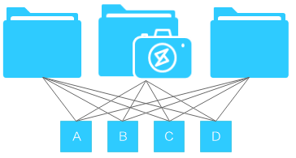
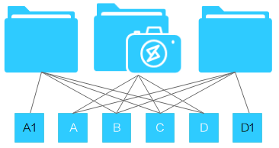
Read/Write Principles of a Clone File System
Parent file system
File system snapshot
Clone file system
Parent file system
File system snapshot
Clone file system
Data status in the clone file system before data change
Data status in the clone file system after data change
Notes:
After a clone file system is created, it shares source data with the parent file system when there is no data change. The snapshot is used to ensure data consistency at the point in time when clone was created. If the clone file system is shared for reads and writes on application servers, the application servers actually read the source data of the parent file system.
When an application server writes new data to an existing data block in the parent or clone file system, the storage system allocates new storage space for the new data instead of overwriting the original data. When the application server attempts to modify data block A in the parent file system, the storage pool allocates a new data block A1 to store the new data and retains data block A; when the application server attempts to modify data block D in the clone file system, the storage pool allocates a new data block D1 to store the new data and retains data block D. Data in the file system snapshot is not changed during this process.

Slide 23
Application Scenarios: Data Backup and Restoration
Source LUN
Target LUN
Time point A
a
Create HyperCopy.
Synchronize data on a source LUN to a target LUN. In this case, the target LUN stores the data on the source LUN at time point B.
Time point B
a
a
Time point C
a
Data on the source LUN is lost.
Reversely synchronize data on the target LUN to the source LUN. In this case, the source LUN is restored to the status at time point B.
Time point D
a
a
Notes:
HyperClone generates one or multiple copies of source data to achieve point-in-time backup, which can be used to restore the source data in the event of data corruption. The figure shows data backup and restoration in a HyperClone pair.

Slide 24
Application Scenarios: Data Analysis and Reproduction
Data analysis
The data analysis service uses data on a target LUN to prevent the data analysis service and production service from contending for resources of a source LUN and affecting performance.
Source LUN
Data analysis host
Reproducing n pieces of data
Only for data analysis
Data reproduction
HyperClone can create multiple copies of the same source LUN for multiple target LUNs.
Target LUN (1)
Target LUN (n-1)
Target LUN (n)
Notes:
Data analysis researches on a great amount of data to extract useful information, draw conclusions, and support decision-making. The analysis services use data on target LUNs to prevent contention of source LUN resources between the analysis and production services, ensuring system performance.
HyperClone can create multiple copies of the same source LUN for multiple target LUNs.

Slide 25
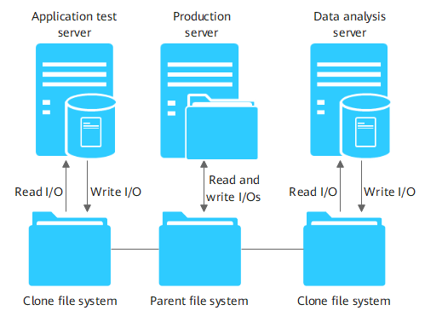
Application Scenarios: Application Test and Data Analysis
Notes:
Application testing is to test the functions, performance, security, and availability of software systems. Data analysis is to extract useful information from a large amount of data to support decision-making. Both application testing and data analysis involve heavy data reads/writes. Reading data from clone file systems ensures data consistency with the parent file systems at the clone point in time and avoids impact on the production system.

Slide 26
Configuration Process
Start
Check the license.
Create a protection group (with LUNs).
Create a clone pair (with LUNs or file systems).
Create a clone consistency group (with LUNs).
End

Slide 27
HyperSnap
HyperClone
HyperCDP
LUN HyperCDP
File System HyperCDP
HyperLock

Slide 28
HyperCDP (for Block)
HyperCDP creates high-density snapshots on a storage system to provide continuous data protection. A HyperCDP object is similar to a common writable snapshot, which is a point-in-time consistent copy of original data to which the user can roll back to, if and when it is needed. It contains a static image of the source data at the data copy time point.
Main features
It provides intensive and persistent data protection. A single LUN supports 60,000 HyperCDP objects. The minimum interval is 3 seconds.
It provides data protection at an interval of seconds, with zero impact on performance and small space occupation.
It supports scheduled tasks. You can specify HyperCDP schedules by day, week, month, or specific interval.
It supports HyperCDP consistency groups.
A HyperCDP object cannot be directly mapped to a host for read and write operations but can be mapped to a host after being converted to a writable snapshot by creating a duplicate.
Notes:
Based on the lossless snapshot technology, HyperCDP has little impact on the performance of source LUNs. Compared with writable snapshots, HyperCDP does not need to build LUNs, greatly reducing memory overhead and providing stronger and continuous protection.
HyperCDP is a value-added feature that requires a license.
In the license file, the HyperCDP feature name is displayed as HyperCDP.
The HyperCDP license also grants the permissions for HyperSnap. If you have imported a valid HyperCDP license to your storage system, you can perform all operations of HyperSnap even though you do not import a HyperSnap license.
HyperCDP has the following advantages:
It provides data protection at an interval of seconds, with zero impact on performance and small space occupation.
It supports scheduled tasks. You can specify HyperCDP schedules by day, week, month, or specific interval to meet different backup requirements.
It provides intensive and persistent data protection. HyperCDP provides more recovery points for data and provides shorter data protection intervals, longer data protection periods, and continuous data protection.
Purposes and benefits
Efficient use of storage space, protecting user investments
HyperCDP objects for various applications
Continuous data protection

Slide 29
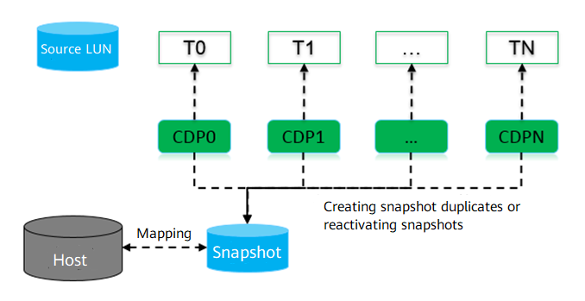
Working Principles of HyperCDP
Based on the lossless snapshot technology, HyperCDP has little impact on the performance of source LUNs. Compared with writable snapshots, HyperCDP does not need to build LUNs, greatly reducing memory overhead and providing stronger and continuous protection.
HyperCDP objects cannot be mapped to hosts directly. To read data from a HyperCDP object, you can create a duplicate for it and map the duplicate to the host.
Notes:
HyperCDP creates high-density snapshots on a storage system to provide continuous data protection. Based on the lossless snapshot technology, HyperCDP has little impact on the performance of source LUNs. Compared with writable snapshots, HyperCDP does not need to build LUNs, greatly reducing memory overhead and providing stronger and continuous protection.
The storage system supports HyperCDP schedules to meet customers' backup requirements. HyperCDP objects cannot be mapped to hosts directly. To read data from a HyperCDP object, you can create a duplicate for it and map the duplicate to the host.

Slide 30
Creating a HyperCDP Object
Creating a HyperCDP object is to save the data status of the source LUN at the activation time.
ROW principle
Host data access
L3->P3
Source LUN
CDP
L1->P1
L4->P4
T1
-
-
F
-
-
-
-
-
T0
A
B
C
D
E
-
-
-
L0->P0
L2->P2
L2->P5
L0
L1
L2
L3
L4
L5
L6
L7
When a host accesses the source LUN data, the mapping table of the source LUN is accessed from the T1 layer. If the T1 layer does not exist, the data at the T0 layer is returned. For example, if the host accesses data of L2, F is returned. If the host accesses data of L0, A is returned.
The HyperCDP mapping table is accessed from the T0 layer. If the host accesses data of L2, C is returned.
A
B
C
D
E
F
-
-
P0
P1
P2
P3
P4
P5
P6
P7
Notes:
Creating a HyperCDP object is to save the data status of the source LUN at the current time point. OceanStor Dorado all-flash storage reads and writes data using the ROW mechanism. Each time the host writes new data, the storage system allocates new space to store the new data and updates the LUN mapping table to point to the new space. In the figure, L0 to L4 are logical addresses, P0 to P7 are physical addresses, and A to F are the data.
ROW
ROW is the core technology to implement HyperCDP. When a storage system receives a write request to modify existing data, it writes the new data to a new location and directs the pointer of the modified data block to the new location.
The figure shows the read/write process after a HyperCDP object is created for the source LUN at T0 based on ROW. In the figure, T0 and T1 are the specific time points, A to F are the data, and L0 to L7 are the logical addresses. F is written to L2 at T1. When the host accesses data from the source LUN, the mapping table of the source LUN at T1 is accessed. If the requested data is not found at T1, the data at T0 is returned. For example, F is returned when the host accesses L2, and A is returned when the host accesses L0. When the host accesses the HyperCDP object, the mapping table at T0 is accessed. For example, C is returned when the host accesses L2.

Slide 31
Reading and Writing a HyperCDP Object
A HyperCDP object cannot be directly mapped to a host for read and write operations but instead, should be mapped to a host after being converted to a writable snapshot.
Source LUN
CDP0
CDP1
Create a snapshot duplicate.
First mapping
Host
Map
SNAP0
Source LUN
CDP0
CDP1
Reactivate the snapshot.
Second mapping
Host
Map
SNAP0
Notes:
Hosts cannot read or write HyperCDP objects directly. To read a HyperCDP object, you can create a duplicate for it and then map the duplicate to the host. The duplicate has the same data as the source HyperCDP object. In the figure, a duplicate SNAP0 is created for CDP0 and mapped to the host. SNAP0 and CDP0 have the same data.
If you want to access the HyperCDP data for the same LUN at another time point, you can reactivate the duplicate using the HyperCDP object generated at that time point to obtain its data immediately. As shown in the figure, you can reactivate SNAP0 based on CDP1 to access its data. Because SNAP0 has been mapped, you do not need to map it again. After the reactivation, the data of SNAP0 is the same as that of CDP1.

Slide 32
Rolling Back a HyperCDP Object (1)
HyperCDP rollback is a process of copying data from a HyperCDP object to the source LUN. The source LUN is available immediately after the rollback is started (data on the source LUN is the data on a HyperCDP object).
Read data from the source LUN during HyperCDP rollback and perform read redirection.
Source LUN
1. The host reads L1.
2. If L1 is not rolled back and the host has not written data to L1 after the rollback is started, the host reads data from CDP1 (T0) instead.
3. Data B is returned to the host.
1
T1
L0
L1
B'
3
2
CDP1
T0
L0
A
L1
B
Notes:
Read redirection is required to read the source LUN. The figure shows the read redirection process. CDP1 is rolled back to the source LUN. When the host reads data from L1 of the source LUN, if L1 has not been rolled back and is not written by the host after the rollback starts, the data corresponding to L1 of CDP1 is returned to the host.

Slide 33
Rolling Back a HyperCDP Object (2)
Write the source LUN during HyperCDP rollback.
Source LUN
1. The host writes data C to L1.
Source LUN
T1
L0
A'
T1
L0
A'
L1
B'
L1
C
2. Roll back L0.
CDP1
CDP1
T0
L0
A
T0
L0
A
L1
B
L1
B
Source LUN
Source LUN
T1
L0
A
4. The rollback is complete.
T1
L0
A
L1
C
L1
C
3. Roll back L1. Skip this step if the host has written data to L1.
CDP1
CDP1
T0
L0
A
T0
L0
A
L1
B
L1
B
Notes:
If the host writes the source LUN during the rollback, the new data is written directly. When the system detects that an address has been written by the host, it will not roll back this address.
Stopping the rollback will not restore the data on the source LUN to the state before the rollback. Therefore, you are advised to create a HyperCDP object for the source LUN before the rollback to protect its data.
Stopping the rollback only stops the data copy process but cannot restore the data on the source LUN to the state before the rollback.

Slide 34
HyperCDP Consistency Group
Medium- and large-size databases' data, logs, and modification information are stored on different LUNs. If data on one of these LUNs is unavailable, data on the other LUNs is also invalid. The HyperCDP consistency group ensures the consistency of application data during restoration.
Similar to individual HyperCDP objects, you can create, delete, roll back, or stop rolling back a HyperCDP consistency group as required. You can also create or rebuild duplicates for HyperCDP consistency groups.
CDP1
CDP2
LUN1
LUN1
Snapshot1
LUN2
LUN2
Snapshot2
Create a protection group.
CDP1-1
CDP2-1
Create a HyperCDP consistency group.
Create a duplicate for a HyperCDP consistency group.

Slide 35
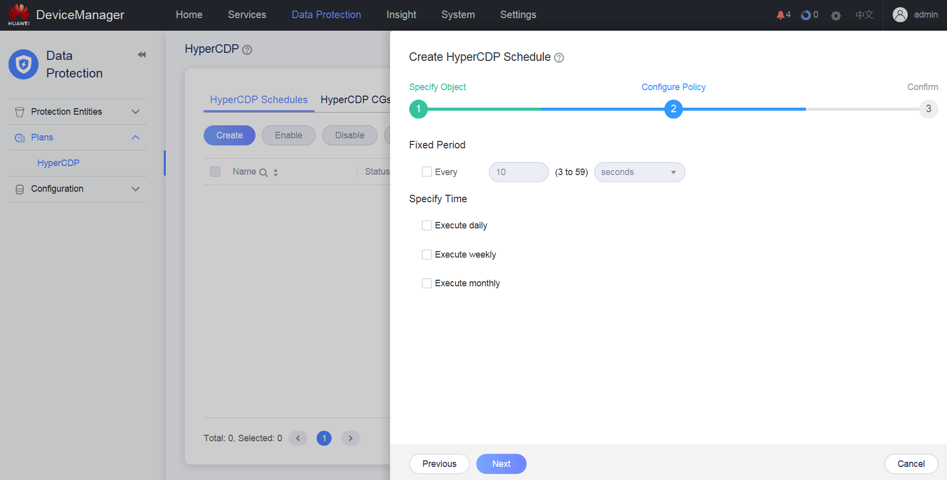
HyperCDP Schedule
You can specify HyperCDP schedules by day, week, month, specific interval, or any combination of them. You can also specify the quantity of HyperCDP objects that can be retained for each schedule.
You can add multiple LUNs and LUN consistency groups to a HyperCDP schedule, but you can add a LUN or a LUN consistency group to only one HyperCDP schedule.
A HyperCDP schedule supports the minimum interval of 3 seconds and retention of up to 60,000 objects.
Notes:
If multiple policies are selected for a schedule, the execution time of the schedule may overlap. In this case, a HyperCDP object will be created for each policy at the overlapped time point. For example, if you specify a schedule that creates HyperCDP objects every 10 seconds and at 00:00 on Sunday, two HyperCDP objects will be created at 00:00 on Sunday.

Slide 36
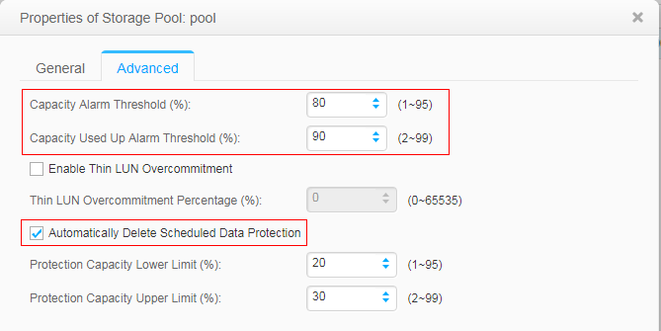
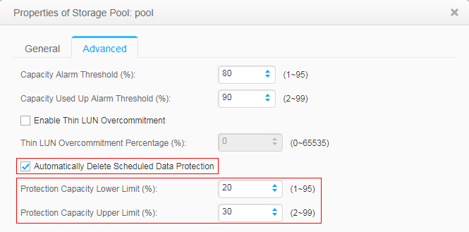
Storage Pool Capacity Threshold
Because HyperCDP supports a minimum interval of 3 seconds, a large amount of data protection capacity may be required if new data is writing to the source LUN constantly. As a result, the space of the storage pool may be used up, affecting host services.
You can set a threshold to the used capacity of the storage pool and the protection capacity, respectively. You can enable or disable it by using automatic deletion of protection data.
Used capacity thresholds
Automatic deletion
Protection capacity thresholds
Notes:
Automatic deletion of protection data is disabled by default. You are advised to enable this function when configuring HyperCDP.
The capacity threshold function only deletes the HyperCDP objects created using HyperCDP schedules and does not delete the HyperCDP objects that are manually created.

Slide 37
Application Scenario: Quick Data Backup and Restoration
HyperCDP backup allows fast data restoration in the following scenarios:
Virus infection
Misoperations
Malicious tampering
Data corruption caused by system breakdown
Data corruption caused by application bugs
Data corruption caused by storage system bugs
If a source LUN covered by continuous data protection is damaged, the source LUN's data can be recovered to any point in time preserved by HyperCDP objects.
Source LUN
HyperCDP
HyperCDP
HyperCDP
HyperCDP
01:00:00
02:00:00
03:00:00
04:00:00
Continuous data protection
Data flow
Time flow
Notes:
In terms of data backup and restoration, HyperCDP has the following advantages:
The RTO is significantly reduced. Even a large amount of data can be restored in a few seconds.
Data can be frequently backed up without service interruption. Applications can run correctly without performance compromise.
The backup window is notably shortened or eliminated.

Slide 38
Configuration Process
Start
1. Check the HyperCDP feature availability.
Check the HyperCDP license.
2. Create a HyperCDP object or HyperCDP consistency group.
Create a protection group.
Create a LUN.
Create a HyperCDP consistency group.
Create a HyperCDP object.
Legend:
Mandatory
Optional
End

Slide 39
HyperSnap
HyperClone
HyperCDP
LUN HyperCDP
File System HyperCDP
HyperLock

Slide 40
HyperCDP (for File)
HyperCDP creates high-density snapshots on a storage system to provide continuous data protection. Based on the lossless snapshot technology, HyperCDP has little impact on the performance of source file systems. Compared with common writable snapshots, HyperCDP does not need to build file system objects, which greatly reduces the memory overhead, delivering more intensive and continuous protection.
OceanStor storage system supports HyperCDP schedules to meet customers' backup requirements. HyperCDP objects cannot be directly mapped to hosts. To read data from a HyperCDP object, you need to share the file system with the host so that the host can read the source file system data at the point in time when the HyperCDP object was created.

Slide 41
Creating HyperCDP Duplicates
After HyperCDP is enabled, the system generates a HyperCDP object for the file system. After the HyperCDP object is created, it shares the mapping table of the source file system. In addition, the creation of the HyperCDP object does not affect the data read or write performance of the source file system. The HyperCDP object is read-only.
HyperCDP object's mapping table
Source file system's mapping table
L0->P0
L1->P1
L2->P2
L3->P3
L4->P4
The original data in the source file system is ABCDE. A HyperCDP object is created and shares the mapping table of the source file system. In the figure, L0 to L4 are logical addresses, P0 to P8 are physical addresses, and A to E are the data.
Storage space
A B C D E
Physical address
P0 P1 P2 P3 P4 P5 P6 P7 P8

Slide 42
Data Writing to the Source File System
After the HyperCDP object is created, the host writes data F and G to L0 and L2 of the source file system. Because the ROW mechanism is used, the host directly applies for new physical addresses P5 and P6 for data writing, and the original addresses P0 and P2 are referenced by the HyperCDP object.
The HyperCDP object does not change the write process of the source file system or cause any extra overhead. This avoids any loss of performance.
HyperCDP object's mapping table
Source file system's mapping table
L0->P0
L1->P1
L2->P2
L3->P3
L4->P4
L2->P5
L0->P6
Storage space
A B C D E
F
G
Physical address
P0 P1 P2 P3 P4 P5 P6 P7 P8

Slide 43
Read Principle of HyperCDP
You can configure the NFS or CIFS sharing service in a storage system to share file systems with clients. A HyperCDP object is a periodic read-only snapshot of the file system. After a HyperCDP object is created, client applications can access the specified share path (.snapshot directory) in the file system to read the source file system data at the point in time when the HyperCDP object was created.
The scheduled snapshot can be accessed in the following three modes:
Enter the .snapshot directory through the shared root directory or dtree directory of the file system to access the data of any snapshot.
You can go to the .snapshot directory from any directory. All scheduled snapshots for the directory are displayed.
You can enter the specific path to go to the .snapshot directory from any directory and access the snapshot. Access to a scheduled snapshot that does not protect the previous directory will fail.
Notes:
Example:
Assume that the root directory of a file system contains directories d1 and d2, and the file system contains scheduled snapshots s1, s2, and s3. s1 and s2 protect d1, and s3 protects d2. A share is created using the root directory.
Enter the .snapshot directory through the root path and access the data of s1, s2, or s3.
Enter the .snapshot directory using the cd .snapshot command from directory /d1 to display s1 and s2.
Run the cd /d2/.snapshot/s1/ command. An error message is reported because s1 does not protect d2. Run the cd /d2/.snapshot/s3/ command. The access is successful because s3 protects d2.
You can restore the data of a file or directory through scheduled snapshot data using the cp command.

Slide 44
Application Scenario - Data Mining and Test Scenario
Duplicates can be created for HyperCDP objects and used for data mining and testing, which will not affect service data.
A HyperCDP object is generated for the data to be tested at 11:00 a.m.
A duplicate is created for the HyperCDP object and is read and written by the test server. During the test, the source data and services accessing the source data are not affected.
1 hour later, the source data and duplicate data are changed based on the data at 11:00.
After the test, users can create another duplicate for the HyperCDP object to obtain the data at 11:00 and use the duplicate for another test.
Applications server
Data at 11:00 a.m.
Data at 12:00 a.m.
Applications
I/Os
Creates a duplicate for the snapshot.
Test I/Os
Test server
Snapshot at 11:00 a.m.
Tested data at 12:00 a.m.
Another snapshot at 11:00 a.m.
11
12
Time

Slide 45
Configuration Process
Start
1. Check the HyperCDP feature availability.
Check the HyperCDP license.
Create a file system.
2. Create a HyperCDP object or HyperCDP schedule.
Create a HyperCDP schedule.
Create a HyperCDP object.
Legend:
Mandatory
Optional
End

Slide 46
HyperSnap
HyperClone
HyperCDP
HyperLock

Slide 47
Overview
Write Once Read Many (WORM), also called HyperLock, protects the integrity, confidentiality, and accessibility of data, meeting secure storage requirements.
A file protected by WORM enters the read-only state immediately after data is written to it. In read-only state, the file can be read but cannot be deleted, modified, or renamed. The WORM feature can prevent data from being tampered with, meeting data security requirements of enterprises and organizations.
A file system with the WORM feature (a WORM file system for short) can be configured only by the administrator. File systems with the WORM feature are classified into regulatory compliance WORM (WORM-C) and enterprise WORM (WORM-E) according to the administrator's permissions.
Mode | Application Scenario
WORM-C | This mode applies to archive scenarios where data protection mechanisms are implemented as required by laws and regulations.
WORM-E | This mode is mainly used by enterprises to implement internal control.

Slide 48
WORM Compliance Clock
To prevent users from changing protection periods of files by changing the system time, storage systems maintain a WORM compliance clock. WORM compliance clocks include the global security compliance clock and WORM file system compliance clock.
Clock Type | Function | Description
Global security compliance clock | The storage system maintains a global security compliance clock that serves as the clock source for all WORM file systems. | When creating a WORM file system for the first time, the system administrator must initialize the global security compliance clock. The time of the global security compliance clock cannot be changed after initialization.
WORM file system compliance clock | Each WORM file system maintains a compliance clock. The protection periods of files are based on the compliance clock. | The system will automatically use the global security compliance clock to initialize the WORM file system compliance clock upon the creation of a WORM file system. You do not need to manually initialize the WORM file system compliance clock.

Slide 49
File Status
There are four file states in a WORM file system, as described in the following table.
Status | Description
Initial | All newly created files are in the initial state. Files in the initial state can be read, written, and modified by all users.
Locked | Files in the locked state cannot be modified, deleted, or renamed by all users. These files can only be read and their properties can be viewed.
Expired | Files in the expired state can be deleted and read and their properties can be viewed. However, these files cannot be modified or renamed.
Appending | Data can be added to the end of files in the appending state and these files cannot be deleted, truncated, or renamed.

Slide 50
WORM Properties
After the WORM feature is configured for a file system, the file system has the WORM properties. The WORM properties apply to files in the WORM file system. You can view the WORM properties to determine the lock time and expiration time of a file. The following table lists the WORM properties of a file system.
Property | Description
Mode | The system supports only the regulatory compliance mode.
Min. Protection Period | Minimum retention period supported by the WORM file system. The retention period of a file in the WORM file system cannot be smaller than the minimum retention period.
Max. Protection Period | Maximum retention period supported by the WORM file system. The retention period of a file in the WORM file system cannot be larger than the maximum retention period.
Default Protection Period | Default retention period supported by the WORM file system. The retention period of a file in the WORM file system is the default value of the parameter if you do not set a retention period for the file.
Automatic Lockout | After the automatic lockout function is enabled, files in the WORM file system automatically enter the locked state a specific period of time after data or metadata in the files is modified.
Lockout Wait Time | Default waiting time for modified files to automatically enter the protection state. This parameter is valid only when Automatic Lockout is enabled.
Automatic Deletion | After this function is enabled, the system automatically deletes files whose protection periods have expired. Note: Before enabling this function, ensure that files do not need protection and can be automatically deleted by the system after they expire.

Slide 51
Working Principles
If a common file system is protected by the WORM feature, files in the file system can be read only within the protection period. After WORM file systems are created, you need to map them to application servers using the NFS or CIFS protocol.
Manually or automatically lock upon expiration.
Extend the protection period.
Reset the protection period.
Initial
Locked
Expired
The protection period expires.
Manually set the appending state.
(Condition: The file size is 0.)
Manually set the locked state.
Appending
Manually set the appending state.
(Condition: The file size is 0.)
Notes:
WORM enables files in the WORM file system to be shifted between initial, locked, appending, and expired states, preventing important data from being incorrectly or maliciously tampered within a specified period.

Slide 52
Configuration Process
A license file grants the permission to use a specific value-added feature. Before configuring a value-added feature, ensure that the license file of the feature is valid.
When creating a WORM file system for the first time, you needs to initialize the global WORM compliance clock of the storage system.
After a WORM file system is created, storage resources can be shared as file directories.
After creating a WORM file system, share it with clients. You can store files that need to be protected in the WORM file system to prevent data tampering.
After a WORM file system is created, if the automatic lockout function is not enabled, you may need to manually set files in the WORM file system to enter the locked state on the client. In addition, you can set the files to enter the appending state from the locked state to add content to the file.
Start
Check the license file.
Create a WORM file system.
Share and access a WORM file system.
Manually set files to enter the protection period.
End

Slide 53
Storage data protection technologies and applications
HyperSnap
HyperClone
HyperCDP
HyperLock
Definitions, principles, and configuration processes

Slide 54
(True or false) A source LUN can form multiple HyperClone pairs with different target LUNs. A target LUN can be added to only one HyperClone pair.
(Short-answer question) When can a host read or write the source LUN after a rollback command is executed?
Notes:
Answers:
T
After the rollback command is successfully executed, the host can read and write data to the source LUN.

Slide 55
(Single-answer question) Which of the following is not a state of a file in a WORM file system?
Initial
Locked
Deleted
Expired
Notes:
Answers:
C

Slide 56
Huawei official websites
Enterprise business: https://e.huawei.com/en/
Technical support: https://support.huawei.com/enterprise/en/index.html
Online learning: https://www.huawei.com/en/learning
Popular tools
HedEx Lite
Network Documentation Tool Center
Information Query Assistant
Notes:
Popular tools:
HedEx Lite: Huawei product document management tool, which allows users to browse, search for, update, and manage product documentation.
eStor: A graphic storage simulation platform. Through simulation of Huawei OceanStor all-flash storage devices, the platform helps ICT practitioners and customers quickly get familiar with Huawei storage products, and understand and master their operations and configurations.
Network Documentation Tool Center: The documentation tool for network products is a good assistant for bidding support, network planning, project delivery, and upgrade and maintenance.
Information Query Assistant: It provides commands and alarm information queries for Huawei products.

