Slide 1
Storage
Storage
5.0
5.0
Wang Peng/wwx690470
2020.05.13
Shui Shaolan/00329529
New
Zhu Yuanyuan/zwx640907
2020.07.01
Shui Shaolan/00329529
Update
Xu Ningyang/xwx1146004
2022.06.27
Liang Shuai/00569373
Update

Slide 2
Storage Resource Tuning Technologies and Applications

Slide 3
This course describes storage resource tuning technologies, including SmartThin, SmartTier, SmartCache, SmartAcceleration, SmartQoS, SmartDedupe, SmartCompression, SmartVirtualization, and SmartMigration, as well as their service characteristics, implementation principles, and application scenarios.

Slide 4
On completion of this course, you will be able to understand the service characteristics, implementation principles, and application scenarios of the following features:
SmartThin
SmartTier&SmartCache
SmartAcceleration
SmartQoS
SmartDedupe&SmartCompression
SmartVirtualization
SmartMigration

Slide 5
SmartThin
SmartTier&SmartCache
SmartAcceleration
SmartQoS
SmartDedupe&SmartCompression
SmartVirtualization
SmartMigration

Slide 6
Overview
The traditional deployment of a storage system has the following problems:
Adverse impact or even interruption on services when expanding the storage space
Uneven storage space utilization
Low storage efficiency
SmartThin
SmartThin uses the on-demand storage space allocation policy to improve storage resource utilization and meet service requirements to a greater extent.
Notes:
If the actual amount of data is larger than expected, LUN space can be adjusted dynamically. As public space, free space can be allocated to any LUN that needs space. In this way, storage space utilization and effectiveness are improved. In addition, LUN space can be adjusted online without affecting services during capacity expansion.
Improvements are as follows using SmartThin:
Improvement 1: Real space is not allocated to LUNs when LUNs are created, but is allocated on demand when LUNs are being used.
Improvement 2: LUN space can be adjusted dynamically.

Slide 7
Thin LUN
Definition: A thin LUN is a logical disk that can be accessed by hosts. It dynamically allocates storage resources from the storage pool according to the actual capacity requirements of users.
Data collection: From the perspective of a storage system, a thin LUN is a LUN that can be mapped to a host.
Full availability: data can be read and written properly.
Dynamic allocation: Resources are allocated while data is being written.
Data in the file system
Host volume
The allocated capacity equals the actual capacity used by the user.
Capacity allocation

Slide 8
Storage Virtualization
Capacity-on-write (COW): Storage space is allocated from engines upon data writes based on load balancing rules.
Direct-on-time (DOT): Data reads from and writes to a thin LUN are redirected.
Space occupied by data
Physical storage space (storage pool)
Thin LUN
RAID 5
Space allocation
Host
Space allocation upon data writes
COW
Redirection to the actual storage location

Slide 9
Working Principles of SmartThin
Server
Logical virtual space
Actual physical space
data
DB
server
disk
RAID
data
DB
server
space
disk
RAID
data
DB
server
disk
RAID
data
DB
server
RAID
Visible storage space
Storage resource pool
Disk resource
Storage array
Notes:
The working principle of SmartThin is to virtualize storage resources.
SmartThin manages storage devices on demand.
SmartThin does not allocate all space in advance, but presents users a virtual storage space larger than the physical storage space. In this way, users see a larger storage space than the actual storage space. SmartThin allocates the space based on users' demands. If the storage space is insufficient, users can add back-end storage units to expand the system capacity. The whole expansion process is transparent to users without system shutdown.
SmartThin creates thin LUNs based on a RAID 2.0+ virtual storage resource pool, that is, thin LUNs coexist with thick LUNs in the same storage resource pool. A thin LUN is a logic unit created in a storage pool, which can be mapped to and then accessed by a host. The capacity of a thin LUN is not an actual physical space but a virtual value. Only when the thin LUN starts to process an I/O request, physical space can be applied from the storage resource pool based on the capacity-on-write policy.
SmartThin allows the capacity detected by a host to be larger than the actual capacity of a thin LUN. The capacity detected by a host is the capacity that a user creates for a thin LUN, namely the volume capacity (virtual space) displayed on a host after a thin LUN is created and mapped to the host. The actual capacity of a thin LUN refers to the physical space actually occupied by the thin LUN. SmartThin hides the actual capacity of the thin LUN from the host and provides only the nominal capacity of the thin LUN.
In addition, SmartThin allows users to create a thin LUN whose capacity is larger than the maximum available space of a storage pool. For example, if the maximum physical capacity of a storage resource pool is 2 TB, SmartThin allows users to create a thin LUN larger than 10 TB.

Slide 10
SmartThin Read Process
1. A thin LUN receives a read request from a host.
2. Queries the mapping table between the thin LUN and the storage pool.
3. Confirms that the space is allocated by the storage pool and returns the data read from the corresponding area in the storage pool to the host.
Data
2
1 | D
2
3 | D
4
5 | D
6
3
1
D
D
D
1
1
3
5
2
0000
2
4
6
3
Thin LUN
Storage pool
Mapping table
1. The thin LUN receives a read request from the host.
2. Queries the mapping table between the thin LUN and the storage pool.
3. Confirms that the space is not allocated by the pool and returns all zeros to the host.
Notes:
The SmartThin read process is as follows:
After receiving a read request from a host, a thin LUN queries the mapping table between the thin LUN and the storage pool to check whether an actual storage space has been allocated to the thin LUN by the storage pool.
If the storage pool allocates an actual storage space to the thin LUN, SmartThin uses direct-on-time to read data from the actual storage space and returns the data to the host.
If the storage pool does not allocate an actual storage space to the thin LUN, no data is written. SmartThin returns all zeros to the host. The figure in the slide shows the specific process.
Direct-on-time
When capacity-on-write is used, the relationship between the actual storage area and logical storage area of data is not calculated using a fixed formula but determined by random mappings based on the capacity-on-write principle. Therefore, when a thin LUN is read or written, the relationship between the actual storage area and logical storage area must be redirected based on a mapping table. A mapping table is used to record the mappings between an actual storage area and a logical storage area. It is dynamically updated during writes and is queried during reads. Therefore, direct-on-time is classified into read direct-on-time and write direct-on-time.

Slide 11
SmartThin Write Process
1. A thin LUN receives a write request from a host.
2. Queries the mapping table between the thin LUN and the storage pool.
3. Confirms that the space is allocated by the pool and performs the write process on the corresponding area in the storage pool. If the write request asks for releasing space, the space is released.
Data
Data
2
1 | D
2
3
4
5
6
3
1
D
D
3
1
1
3
5
2
1. A thin LUN receives a write request from the host.
2
4
6
2. Queries the mapping table between the thin LUN and the storage pool.
Thin LUN
Storage pool
Mapping table
3. If the space is not allocated by the pool, the storage system allocates the space first. And then performs write process on the corresponding area in the storage pool. If the write request asks for releasing space, a message is returned to the host.
Notes:
The SmartThin write process is as follows:
Upon receiving a write request from a host, a thin LUN queries the mapping table between the thin LUN and the storage pool to check whether an actual storage space has been allocated to the thin LUN by the storage pool.
If the storage pool has allocated an actual storage space to the thin LUN, data is written to the corresponding area in the storage pool (based on direct-on-time). If the write request asks for releasing space, the system releases the space and returns a response to the host indicating a successful data write.
If the storage pool does not allocate an actual storage space to the thin LUN, SmartThin uses capacity-on-write to allocate an actual storage space from the pool, uses direct-on-time to build a relationship between the actual storage space and logical storage space, and writes data to the actual storage space. If the write request asks for releasing space, a write success acknowledgement is directly returned to the host.
Capacity-on-write
Upon receiving a write request from a host, a thin LUN uses direct-on-time to check whether a physical storage area is allocated to a logical storage area provided for the request. If a physical storage area is not allocated, a space allocation task is triggered, and the grain size (minimum granularity) is 64 KB (for thin LUNs with deduplication or compression enabled, the granularity can be configured during LUN creation). Then data is written to the newly allocated physical storage area.

Slide 12
Application Scenarios
SmartThin can help core system services that require high service continuity, such as bank transaction systems, expand system capacity online without interrupting ongoing services, such as back transaction systems.
SmartThin can assist with on-demand physical space allocation for services where the growth of application system data is hard to be accurately evaluated, such as email services and web disk services, preventing a space waste.
SmartThin can assist with physical space contention for mixed services that have diverse storage requirements, such as carriers' services, to achieve optimized space configuration.

Slide 13
SmartThin
SmartTier&SmartCache
SmartAcceleration
SmartQoS
SmartDedupe&SmartCompression
SmartVirtualization
SmartMigration

Slide 14
SmartTier
Tiered storage migrates hot data, cold data, and data with different values in use to specific storage media to effectively balance performance.
SmartTier is also called intelligent data tiering. SmartTier provides intelligent data storage management. It automatically matches data of different activity levels with storage media of different characteristics by collecting and analyzing data activity levels.
Performance tier
SCM drives
Capacity tier
SSDs
Hot data
Cold data
Notes:
With the development of disk technologies, storage systems support more types and a growing number of storage media. As a medium with higher performance than solid-state drives (SSDs), storage class memory (SCM) is mainly used as the cache and main storage in storage systems to accelerate key applications. OceanStor Dorado 6.1.0 and later versions use SCM to deliver tiered storage of data, and this practice improves service performance.
Hot data: relatively active data stored on or migrated to disks at the performance tier.
Cold data: "idle" data stored on or migrated to disks at the capacity tier without any performance reduction after migration.

Slide 15
Dividing Storage Tiers
In the same storage pool, a storage tier is a collection of storage media with the same performance. SmartTier divides storage media into performance and capacity tiers. The performance tier that consists of SCM drives delivers higher performance than the capacity tier that consists of SSDs. Each storage tier respectively uses the same type of disks and RAID policy.
Storage Tier | Disk Type | Disk Feature | Data Feature
Performance tier | SCM drive | Very short response time and high cost per gigabyte. | Suitable for storing frequently accessed data.
Capacity tier | SSD | Short response time and moderate cost per gigabyte. | Suitable for storing less frequently accessed data.
Notes:
A storage pool is a logical combination of one or more storage tiers. A maximum of three storage tiers are supported. The types of disks in a storage pool determine the allowed number of storage tiers. A storage pool housing one type of disks can only create a single storage tier and therefore does not support SmartTier for intelligent data storage management.
With the development of disk technologies, storage systems support more types and a growing number of storage media. As a medium with higher performance than solid-state drives (SSDs), storage class memory (SCM) is mainly used as the cache and main storage in storage systems to accelerate key applications. OceanStor Dorado 6.1.0 and later versions use SCM to deliver tiered storage of data.
OceanStor Dorado supports the intermixing of SCM drives and SSDs. SCM drives provide better performance than SSDs. If a storage pool contains these two types of disks, new data written by a host is preferentially stored to the performance tier for better performance of writing data to the storage system. If the data is not accessed for a long time, the storage system migrates the data to the capacity tier. When the capacity of the preferred tier is insufficient, data is written to the other tier.

Slide 16
Managing Member Disks
Hot standby
RAID 6: 5+2
Performance tier (SCM)
Hot standby
RAID 6: 7+2
Capacity tier (SSD)
Storage pool (RAID 6)
Notes:
A storage pool with SmartTier enabled manages SCM drives and SSDs as member disks.
Number of hot spare disks: Each tier reserves its own hot spare disks. For example, in the case of a low hot spare policy for a storage pool, one disk is reserved for the performance tier and the capacity tier, respectively.
Large- and small-capacity disks: The capacity of each tier is calculated independently. Each tier supports a maximum of two disk capacity specifications.
RAID: RAID groups are configured for each tier separately. Chunk groups (CKGs) are not formed across different media.
Capacity: The available capacity of a storage pool is the sum of the available logical capacity of each tier.

Slide 17
Data Migration
SCM drives provide better performance than SSDs. With SmartTier available, new data from hosts is preferentially written to the performance tier for better performance. Cold data that is not accessed for a long time is migrated to the capacity tier in the background.
Data management and migration policies are as follows:
Metadata: Metadata for new writes and garbage collection (GC) is preferentially stored at the performance tier (SCM) to ensure high-performance access in large-capacity scenarios. Space is allocated from the capacity tier only when the space of the performance tier is insufficient.
User data: User data is preferentially stored at the performance tier (SCM). When the size of data in the performance tier reaches a certain level, cold data is migrated to the capacity tier (SSD) in the background. This ensures that the performance tier stores more hot data and metadata, allowing faster data accessibility.
Notes:
If a storage pool contains both SCM drives and SSDs, the data newly written by a host is preferentially saved to the performance tier for better performance. Data that has not been accessed for a long time is migrated to the capacity tier. When the capacity of the preferred tier is insufficient, data is written to the other tier.

Slide 18
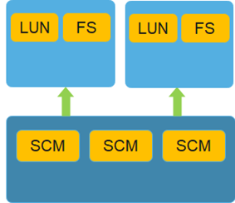
SmartCache
Advantages of SCM:
Lower latency and higher IOPS than SSDs
Larger capacity and lower price than DRAM
Suitable for using as cache
SmartCache partition
SmartCache partition
SmartCache pool
SmartCache:
Based on the short read response time of SCM drives, SmartCache uses SCM drives to compose a SmartCache pool and caches frequently-read data to the SmartCache pool. This shortens the response time for reading hot data, improving system performance.
SmartCache pool:
A SmartCache pool consists of SCM drives and is used as a complement of DRAM cache to store hot data.
SmartCache partition:
The SmartCache partition is a logical concept based on the SmartCache pool. It is used to store LUNs and file system services.

Slide 19
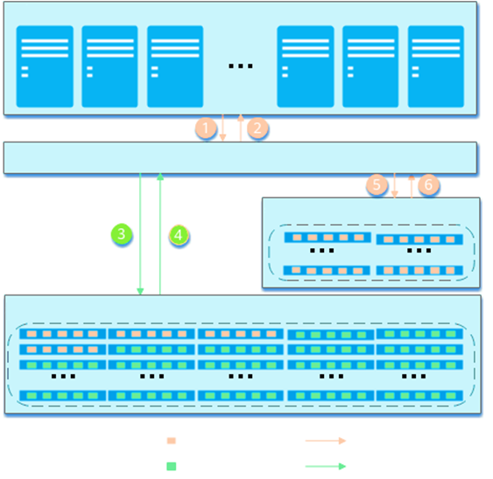
SmartCache Write Process
Servers
After receiving a write I/O request to a LUN or file system from a server, the storage system sends data to the DRAM cache.
After the data is written to the DRAM cache, an I/O response is returned to the server.
The DRAM cache sends the data to the storage pool management module.
Data is stored on SSDs, and an I/O response is returned.
The DRAM cache sends data copies to the SmartCache pool. After the data is filtered by the cold and hot data identification algorithm, the identified hot data is written to the SCM media, and the metadata of the mapping between the data and SCM media is created in the memory.
Data is cached to the SmartCache pool, and an I/O response is returned.
DRAM cache
SmartCache pool
SCM
Storage pool
SSDs
Hot data
Hot data flow
Non-hot data
Non-hot data flow

Slide 20
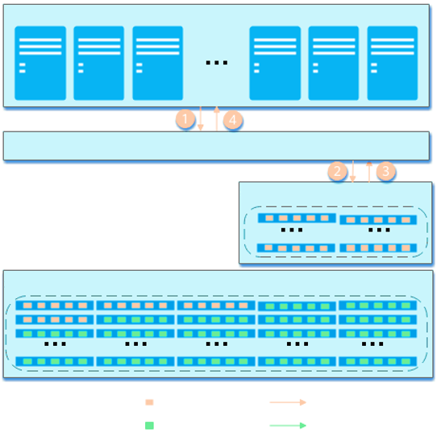
SmartCache Read Hit
Servers
A read I/O request from an application server is first delivered to the DRAM cache before arriving at LUNs or file systems.
If the requested data is not found in the DRAM cache, the read I/O request is further delivered to the SmartCache pool.
If the requested data is found in the SmartCache pool, the read I/O request is delivered to SCM drives. Data is read from the SCM drives and returned to the DRAM cache.
The DRAM cache returns the data to the application server.
DRAM cache
SmartCache pool
SCM
Storage pool
SSDs
Hot data
Hot data flow
Non-hot data
Non-hot data flow

Slide 21
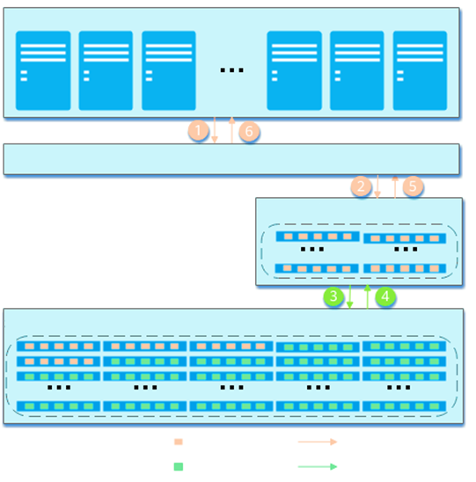
SmartCache Read Miss
Servers
A read I/O request from an application server is first delivered to the DRAM cache before arriving at LUNs or file systems.
If the requested data is not found in the DRAM cache, the DRAM cache forwards the read I/O request to the SmartCache pool.
If the requested data is not found in the SmartCache pool either, the SmartCache module forwards the read I/O request to the storage pool management module to read the data from SSDs.
Data is read from the SSDs and returned to the SmartCache module.
The SmartCache module returns the data to the DRAM cache.
The DRAM cache returns the data to the application server.
DRAM cache
SmartCache pool
SCM
Storage pool
SSDs
Hot data
Hot data flow
Non-hot data
Non-hot data flow

Slide 22
Highlights
Dynamic Capacity Expansion
You can add SCM media to a SmartCache pool for dynamic capacity expansion.
You are advised to configure SCM resources of the same quantity and capacity for controllers in the same controller enclosure. This ensures balanced acceleration performance for LUN or file system services of multiple controllers in the same controller enclosure.
Flexible Policy Configuration
You can enable or disable SmartCache for specific LUNs or file systems without interrupting services.
You can add one or more LUNs or file systems to a specified SmartCache partition to shorten the data read response time.
Adaptive Switch
When detecting that the SmartCache policy is inefficient (for example, when the SmartCache hit ratio is low or the CPU is busy), the system stops allowing I/Os to enter the SmartCache pool to reduce the impact on services. In this case, I/Os are not sent to the SmartCache pool and the requested data will not be found in the SmartCache pool. In addition, to ensure data consistency, data in the SmartCache pool is cleared.
When detecting a scenario suitable for SmartCache, the system automatically restores to the previous state.

Slide 23
SmartThin
SmartTier&SmartCache
SmartAcceleration
SmartQoS
SmartDedupe&SmartCompression
SmartVirtualization
SmartMigration

Slide 24
SmartAcceleration
SSDs at the performance tier are exclusively used and cannot be shared by multiple disk domains.
Performance tier configurations are difficult to adjust, lacking flexibility.
Tiers and caches are independent of each other, and physical disks must be planned separately for both tiers and caches.
The performance layer is shared by multiple disk domains, improving utilization.
The performance layer is distributed by the system to each pool based on the recommended quota by default, and can be flexibly scaled.
The performance layer converges tiers and caches, and is automatically configured for optimal overall efficiency.
Traditional SmartTier
SmartAcceleration
SmartTier storage pool
Hybrid-flash storage pool
Hybrid-flash storage pool
HDD
HDD
...
HDD
HDD
...
Exclusive use of physical disks
All-flash storage pool
Capacity layer
Capacity layer
SSD
SSD
SSD
SSD
...
Performance layer: SSD acceleration quota
Performance layer: SSD acceleration quota
Performance tier
Shared
Shared
Shared
HDD
HDD
HDD
HDD
...
Performance layer
SSD
SSD
SSD
SSD
...
Capacity tier

Slide 25
Storage Layer
Random distribution of hot and cold data cannot maximize the characteristics of disks on various media. SmartAcceleration uses a multi-dimensional adaptive hot and cold data sensing algorithm to implement a unified performance layer, where hot and cold data are automatically identified based on their characteristics and then automatically distributed, achieving optimal distribution of hot and cold data.
Performance layer
SSDs
Capacity layer
NL-SAS disks
Hot data
Cold data

Slide 26
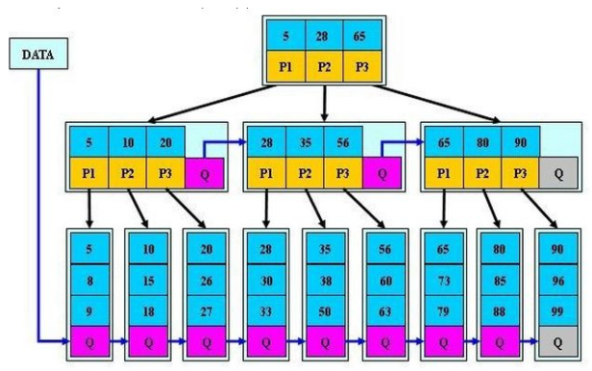
Unified Performance Layer That Flexibly Integrates Caches and Tiers
Unified and converged performance layer
ROW mechanism accelerating write performance
...
Cache
Aggregation
Popularity
Association
Read
Write
Tier
Admission
Traffic distribution
Eviction
Read-after-write acceleration
Read acceleration
Migration
Integration
2) Small I/O overwrite
Hit rate and performance acceleration effect
5) Read-only hot data
3) Hot data write/read
Service scenario 1
6) Associated prefetch
Flexible
Service scenario 2
Scenario-based adaptive cache ratio adjustment
Cache
Tier
Performance layer
Hot
Cold
Cache capacity
4) Cold data migration over time
1) Cold data directly written to HDDs
LSM Tree/AR Tree/Learning Tree
SSD
HDD
Capacity layer
Flow
HDD
B+ Tree
Notes:
Global cold and hot data sensing and data collaboration algorithms, breaking the boundaries of caches and tiers, and providing optimal data layout and simplified configuration:
Converged caches and tiers, preventing repeated data flow and improving efficiency
Global popularity, unifying cache's admission and eviction and tier's traffic distribution and migration
Detecting performance, capacity, and service life of different media to comprehensively determine data placement
Scenario-based adaptive elastic cache adjustment, achieving optimal balance between performance and capacity:
Flexible cache adjustment and dynamic conversion between caches and tiers, going for optimal cost-effectiveness
No need to configure caches and tiers (physical) separately, simplifying configuration
Performance layer and capacity layer using the multiple modes of index technologies to adapt to different data layouts, achieving optimal efficiency in mixed models with variable data:
Performance layer PelagoDB, implementing small- and medium-capacity, and fast data update
Capacity layer KVDB, implementing medium- and large-capacity, and balanced read and write efficiency

Slide 27
ROW-based Large-Block Sequential Write
Object 0
Object 1
Object 2
...
...
4 KB
...
4 KB
3 KB
7 KB
4 KB
3 KB
7 KB
4 KB
16 KB
Logic space
ROW and I/O aggregation
Log structure
A
B
C
D
E
...
Data update
A
B
C
D
E
Full stripe
P
Q
CKG
Traditional Mode |  |  |  |  | OceanStor Mode
Configuration | Read Count | Write Count | Total I/Os |  | Configuration | Read Count | Write Count | Total I/Os
RAID-5 | 2 | 1 | 4 (3) |  | RAID-5 | 0 | 0 | 1
RAID-6 | 3 | 2 | 6 (5) |  | RAID-6 | 0 | 0 | 1
RAID-TP | 4 | 3 | 8 (7) |  | RAID-TP | 0 | 0 | 1
Notes:
Huawei OceanStor storage also supports ROW-based sequential writes of large blocks. This enables controllers to detect SSD data layouts with Huawei-developed SSDs. Consequently, multiple small and scattered blocks are aggregated into a large continuous block and sequentially written to SSDs. RAID 5, RAID 6, and RAID-TP perform just one I/O operation and do not require the usual multiple read and write operations for small scattered write blocks. The write performance of RAID 5 and RAID 6 for OceanStor storage arrays far surpasses that of traditional arrays and is almost the same as that of RAID-TP.

Slide 28
Working Principles of SmartAcceleration
Write
Read
DRAM
1. Find hot read data in the DRAM.
Intelligent access frequency identification algorithm
Write I/O distribution
DRAM
Intelligent access frequency identification algorithm
Small I/Os written to the SSD tier
Modification to hot read data written to the SSD tier
Admission: Check whether the data is hot enough to be distributed to SSDs.
Miss
Admission
SSD performance layer
Cache
Miss
Tier
SSD performance layer
Cache
Tier
Large I/Os aggregated and flushed to disks
2. Find hot read data in the SSD cache.
3. Find hot read data in the SSD tier.
Eviction
Read
(including prefetch)
Regular migration
Miss
Hot data I/O
HDD capacity layer
HDD capacity layer

Slide 29
SmartThin
SmartTier&SmartCache
SmartAcceleration
SmartQoS
SmartDedupe&SmartCompression
SmartVirtualization
SmartMigration

Slide 30
Overview
SmartQoS:
SmartQoS is an intelligent service quality control feature. It dynamically allocates storage system resources to meet the performance requirement of certain applications.
The controlled objects of SmartQoS include LUNs, LUN groups, hosts, and file systems.
By function, SmartQoS can be classified into traffic control management, burst traffic control management, and lower limit guarantee.
Other characteristics of SmartQoS include multi-dimensional traffic control, hierarchical policies, and objective distribution.
Notes:
SmartQoS is an essential value-added feature for a storage system, especially in certain applications that demand high service-level requirements.
When multiple applications are deployed on the same storage device, users can obtain maximized benefits through the proper configuration of SmartQoS.
Performance control reduces adverse impacts of applications on each other to ensure the performance of critical services.
SmartQoS limits the resources allocated to non-critical applications to ensure high performance for critical applications.

Slide 31
Upper Limit Traffic Control Management
Application server 1
Application server 2
1
I/O request
1
I/O request
Number of allocated tokens
(I/O queue processing mechanism of applications in the system)
Storage system
2
...
Process the dequeuing I/O requests.
Application I/O queue 1
3
Application I/O queue n
Disk
Notes:
SmartQoS traffic control is implemented by I/O queue management, token allocation, and dequeue management for controlled objects.
The SmartQoS determines the amount of storage resources to be allocated to an I/O queue of controlled objects by counting the number of tokens owned by the queue. The more tokens owned by an I/O queue, the more resources will be allocated to the queue, and the more preferentially the I/O requests in the queue will be processed.
SmartQoS maintains a token bucket and an I/O queue for a LUN associated with a SmartQoS policy and converts the upper limit of the policy into the bucket generation rate.
If the maximum IOPS is limited in a SmartQoS policy, one I/O consumes one token. If the maximum bandwidth is limited, one sector consumes one token.
A larger maximum IOPS or bandwidth indicates a larger number of tokens in the token bucket and higher performance of the corresponding LUN.
I/O queue processing mechanism of applications in the system:
After application servers send I/O requests, the storage system delivers the requests to corresponding I/O queues of controlled objects.
The storage system adjusts the number of tokens owned by I/O queues based on the priorities of controlled objects. By reducing the number of tokens owned by low-priority queues, the storage system guarantees sufficient resources for high-priority controlled objects so that I/Os to these controlled objects can be preferentially processed.
The storage system processes the I/Os in queues by priority.

Slide 32
Burst Traffic Control Management
When configuring the burst value, you must configure the upper limit. That means the instantaneous performance value can reach the burst value, but the average performance value cannot exceed the upper limit.
The service load in phase 1 is lower than the upper limit, and the burst capabilities are accumulated.
In phase 2, when the service load increases, the performance can exceed the upper limit and reach the burst threshold. The total burst duration is the smaller value between the accumulated burst duration in phase 1 and the burst duration configured in the QoS policy.
In phase 3, once the burst ends, the service performance falls below the upper limit.
Supplement tokens
2
Lend tokens
Burst limit
Token bucket C
Token bucket E
Upper limit
3
Store tokens
1
Consume tokens
Notes:
Working principles:
The burst capability of a LUN comes from the burst credits converted from performance accumulated when the actual performance of the LUN is lower than the upper limit.
SmartQoS uses the dual-token-bucket mode to support the production and consumption of burst credits. As shown in the right figure, Token bucket C is used to implement upper limit control, and Token bucket E is used to implement burst control.
If the LUN's service pressure is lower than the configured performance upper limit, that is, the consumption rate is lower than the production rate of tokens in Token bucket C, the number of tokens in Token bucket C gradually increases and overflows when it exceeds the bucket depth. Excessive tokens are stored in token bucket E until the number of tokens in it also exceeds the bucket depth. At this time, excessive tokens are discarded. Only when token bucket E has remaining tokens, the volume has the burst capability.
If the LUN's service pressure is greater than the configured performance upper limit, tokens in Token bucket C will be exhausted gradually. When token bucket C has no token, it attempts to borrow tokens from token bucket E until tokens in token bucket E is exhausted.

Slide 33
Lower Limit Guarantee
When multiple services preempt resources and a small number of critical services have no advantages in resource preemption, the lower limit guarantee function can automatically suppress non-critical services to reserve resources for critical services.
Users set a lower limit objective for LUNs of a few critical services. But the LUNs fail to reach the objective.
The system sets a minimum performance value for other LUNs—a shared lower limit objective.
System rating is triggered.
LUNs with performance failing to reach the lower limit objective
LUNs with performance lower than the minimum performance
LUNs with performance slightly exceeding the minimum performance
LUNs with performance far beyond the minimum performance
No suppression
No suppression
Burst prevention
Traffic suppression
Disk
Notes:
Working principles:
Set lower limit objectives for all LUNs: Users set a lower limit objective for LUNs of a few critical services. The system sets a shared lower limit objective for other LUNs at 10% (configurable) of the nominal performance value of the system. The latency objective is converted into the IOPS objective.
Rate the loads of all LUNs in the system. If the load of a LUN does not reach the lower limit objective, the system rating and adjustment process are triggered.
Suppress the traffic for LUNs whose performance values are far beyond the lower limit to release resources.

Slide 34
Multi-dimensional Traffic Control
SmartQoS policies provide multi-dimensional processes to simplify user operations:
Traffic control for LUNs
Traffic control for LUN groups
Traffic control for hosts
Traffic control for file systems
Notes:
Only one type of objects can be added to each policy.
Only one LUN group can be added to each policy.
A LUN, LUN group, host, or file system can be added to only one policy.
A LUN can be added to different LUN groups, and different LUN groups can be added to different policies. In this case, the final traffic control value for the LUN is set to the smallest value to ensure that all policies are implemented.
Host policies do not support the lower limit guarantee function.

Slide 35
Hierarchical Management
Hierarchical policy: System capabilities are classified by user, vStore, or subsidiary to prevent interference between different dimensions. Multiple common policies can be added to a hierarchical policy. The total performance of all sub-policies meets the requirements of the hierarchical policy.
Common policy: Traffic control policies are configured for different services of a single user, vStore, or subsidiary.
Notes:
A hierarchical policy has all the features of a common policy, and a common policy can be added as a sub-policy.
Sub-policies with LUNs and LUN groups can be added to the same hierarchical policy.
The policy configuration for a LUN/LUN group, a host, and a file system are mutually exclusive. Therefore, they cannot be added to the same hierarchical or common policy.
A lower limit guarantee policy cannot be added to a hierarchical policy.

Slide 36
Objective Distribution
All objects in a SmartQoS policy share the upper limit objectives. The SmartQoS module periodically collects the performance and requirement statistics of all controlled objects in a traffic control policy, and distributes the traffic control objective to controlled objects.
Currently, the max-min weight allocation algorithm is used. The figure below shows the overall objective distribution process.
Start
Collect information.
Identify valid distribution objects and accumulate weights.
Calculate the intermediate result of the max. and min. values for the objective distribution.
Calculate the final objective distribution result.
End

Slide 37
SmartQoS Application Scenarios
Upper limit traffic control management:
Suitable to scenarios with mixed services to prevent services from affecting each other. It can limit the resource usage of low-priority services that have great impacts on the system.
Suitable for scenarios where performance restriction is required. For example, when an online service and a backup service coexist, SmartQoS restricts the maximum traffic of the backup service to ensure performance of the online service while ensuring the backup window.
Burst traffic control management:
Suitable for latency-sensitive services, such as database services, VM deployment, and VM startup.
Lower limit guarantee:
Ensures service quality (IOPS, BPS, and latency) for services that have a small quantity but are the most critical.

Slide 38
Configuration Process
Start
Check the SmartQoS license.
Monitor service performance.
Configure SmartQoS.
Create a SmartQoS policy.
End
Main steps
Sub-steps
Notes:
If performance is a major consideration for applications in a storage system, it is important to identify the true performance requirement of each application. The storage system provides a service monitoring function to help you identify performance bottlenecks of each application.

Slide 39
SmartThin
SmartTier&SmartCache
SmartAcceleration
SmartQoS
SmartDedupe&SmartCompression
SmartVirtualization
SmartMigration

Slide 40
SmartDedupe
SmartDedupe is a data deduplication technology developed by Huawei for saving storage space. It deletes duplicate data in a storage system by searching for duplicate data blocks (generally greater than 4 KB) and saves only one copy of these blocks in the storage system. This technology is widely used in network disks, emails, and backup media devices.
Type of deduplication
Inline deduplication: Data is deduplicated when being written to storage media.
Post-process deduplication: Data is first written to persistent storage media and then read for deduplication.
Fixed-length deduplication: Data is divided into blocks of a fixed size for deduplication.
Variable-length deduplication: Data is divided into blocks of variable sizes based on its content for deduplication. This is mainly used in data backup.
Similarity-based deduplication: The system divides data into blocks of a fixed size and analyzes the similarity among the blocks. The system deduplicates the identical data blocks and performs combined or delta compression on the similar data blocks.

Slide 41
SmartCompression
SmartCompression is a data compression technology developed by Huawei. It is a process of encoding information using fewer bits than the original representation.
Type of compression
Inline compression: Data is compressed when being written to storage media.
Post-process compression: Data is first written to storage media and then read for compression.
Software compression: Uses the CPU of a system to perform a compression algorithm.
Hardware compression: The compression algorithm logic is fixed to the hardware device, for example, the acceleration engine, FPGA, or ASIC of the Arm CPU. The compression API provided by the hardware device is invoked when the compression algorithm logic is used.
Lossy compression: A compression mode in which original data cannot be completely restored after decompression. This mode is commonly used to process audio, video, and images.
Lossless compression: A compression mode in which original data can be completely restored after decompression.

Slide 42
Working Principles of Inline Deduplication
Data to be deduplicated
5. For existing blocks, increases the reference count (RC) and returns the addresses of the existing blocks. For new blocks, writes them to the storage space.
1. Divides data into blocks.
Block 0
Block 1
Block 2
6. Adds the fingerprints and storage locations of the new blocks to the fingerprint table.
2. Calculates the fingerprints of the data blocks.
FP 0
FP 1
FP 2
Fingerprint (FP) table
3. Checks whether the fingerprints exist in the fingerprint table.
FP | Data Address | RC
FP 0 = FP x | Data address 0 | +1
FP 1 = FP y | Data address 1 | +1
FP 2 | Data address 2 | 1
FP x | Data address x | 1->2
FP y | Data address y | 1->2
Old
block
Old
block
New
block
4. If a fingerprint exists in the fingerprint table, this block already exists in the system. If a fingerprint is not found in the fingerprint table, the block is new.
Increases the RC.
Increases the RC.
Writes data.

Slide 43
Working Principles of Post-processing Similarity-based Deduplication
Data to be deduplicated
Block 1
Block 2
Block 3
SFP 0
FP 0
SFP 1
FP 1
SFP 2
FP 2
Storage
Similarity-based deduplication opportunity table
<LBA> | <FP> | <SFP>
LBA 0 | FP 0 | SFP 0
LBA 1 | FP 1 | SFP 1
LBA 2 | FP 2 | SFP 2
New block
Same block
(same FP)
(byte-by-byte comparison)
Similar block
(same SFP)
Writes data.
Increases the RC.
Performs delta compression.
Fingerprint (FP) table
<FP> | Data Address | RC
FP 0 | Data address 0 | 2,1
Saves data after delta compression
Notes:
The system divides to-be-written data into blocks. The default data block size is 8 KB.
The storage system uses a similar fingerprint algorithm to calculate similar fingerprints of the new data blocks.
The storage system writes the data blocks to disks and records data blocks' fingerprint and location information in the opportunity table.
The storage system periodically checks whether there are similar fingerprints in the opportunity table.
If yes, the storage system performs operations in the next step.
If no, the storage system continues the periodic check.
The storage system performs a byte-by-byte comparison to check whether similar blocks are actually the same.
If yes, the storage system deletes the new data block and points the fingerprint and storage location of the new data block to that of the existing one in the fingerprint table.
If no, the storage system performs delta compression on the new data block, records the new data block's fingerprint in the fingerprint table, updates the fingerprint to the metadata of the new data block, and reclaims the storage space of the new data block.

Slide 44
Working Principles of Similarity-based Deduplication in the Background
Data to be deduplicated
7. Adds the fingerprint, storage location, and reference count of the reference block to the fingerprint table.
1. Divides data into blocks.
2. Calculates the fingerprints and similar fingerprints (SFPs) of the data blocks and adds them to the similarity-based deduplication opportunity table.
Block 0
Block 1
Block 2
8. Updates the mapping of each data block. The LBA points to the fingerprint and storage location of the reference block.
3. Analyzes the similarity-based deduplication opportunity table in the background and performs similarity-based deduplication on data blocks with the same SFP.
SFP 0
FP 0
SFP 1
FP 1
SFP 2
FP 2
Performs data persistence.
Similarity-based deduplication opportunity table
SFP 0 -> FP 0, LBA 0, ...
4. Selects a reference block and compares other blocks with the reference block.
5. If the fingerprint of another block is the same as that of the reference block and the two blocks are consistent byte by byte, the block is duplicate. Increases the reference count of the reference block.
<LBA> | <FP>
LBA 0 | FP 0,0
LBA 1 | FP 0,0
LBA 2 | FP 0,1
Reference block
Same block
FP 1 = FP 0
Similar block SFP 2 = SFP 0
6. If another block is different from the reference block, but they have the same SFP, performs delta compression on this block.
After delta compression, writes the data to persistent storage media.
<FP> | Data Address | RC
FP 0 | Data address 0 | 2,1
Compresses data.
Increases the RC.
Performs delta compression.
Performs data persistence after delta compression.

Slide 45
Working Principles of SmartCompression
(LZ77 example)
abcdbbccaaabaeaaabaee
Assume that a string abcdbbccaaabaeaaabaee is to be compressed, the first 10 characters have been compressed, and the window is 10 characters.
The compression result is (0,2,a)(0,0,e)(4,6,e).
Window | Uncompressed | Identical String | Start Position of the Identical String | Length of the Identical String | Last Character in the Identical String | Compression Code
abcdbbccaa | abaeaaabaee | ab | 0 | 2 | a | (0,2,a)
dbbccaaaba | eaaabaee | null | 0 | 0 | e | (0,0,e)
bbccaaabae | aaabaee | aaabae | 4 | 6 | e | (4,6,e)

Slide 46
SmartDedupe and SmartCompression Process
App
Application
1. Host data is written to the cache of the storage system.
2. A write success is returned to the host.
Device
3. Data is divided into blocks of a fixed length while being written to disks.
4. Fingerprints are calculated using weak hash.
5. The system compares the fingerprints with those in the fingerprint table.
FP | Data Address | RC
FP 0 | Data address 0 | 3
FP 1 | Data address 1 | 2
... | ... | ...
FP
6. If a fingerprint is the same as that in the fingerprint table, the system reads the existing data corresponding to the fingerprint and compares it with the new data byte by byte. If the data is the same, the system increases the reference count.
7. If the fingerprints are different or the data is found different in byte-by-byte comparison, the system compresses the new data.
Compression
8. Compressed data is written to SSDs. The mapping between the fingerprint and storage location is saved in the fingerprint table, and the reference count is set to 1.

Slide 47
Scenarios Where SmartDedupe and SmartCompression Are Used Together
Using both SmartDedupe and SmartCompression can achieve the best space saving effect.
The scenarios include:
VDI and VSI scenarios
Data testing or development systems
Storage systems with the file service enabled
Engineering data systems

Slide 48
Configuration Process
Start
Check the license file.
Enable SmartDedupe and SmartCompression.
End

Slide 49
SmartThin
SmartTier&SmartCache
SmartAcceleration
SmartQoS
SmartDedupe&SmartCompression
SmartVirtualization
SmartMigration

Slide 50
Concepts Related to SmartVirtualization
Question: SmartVirtualization allows external LUNs to provide physical storage space for OceanStor Dorado series storage systems. How can it be implemented?
What do "local storage system", "heterogeneous storage system", "external LUN", "eDevLUN", "online takeover", "offline takeover", and "hosting" mean?
Notes:
Local storage system: refers to the OceanStor Dorado series storage system.
Heterogeneous storage system: can be either a storage system manufactured by another mainstream vendor or a Huawei storage system of a specific model.
External LUN: a LUN in a heterogeneous storage system, which is displayed as a remote LUN in DeviceManager.
In the storage pool of a local storage system, the mapped external LUNs are reorganized as raw storage devices based on a certain data organization form. A raw device is called an eDevLUN. The physical space occupied by an eDevLUN in the local storage system is merely the storage space needed by the metadata. The service data is still stored on the heterogeneous storage system. Application servers can use eDevLUNs to access data on external LUNs in the heterogeneous storage system, and the SmartMigration feature can be configured for the eDevLUNs.
Online takeover: During the online takeover process, services are not interrupted, ensuring service continuity and data integrity. In this mode, the critical identity information about heterogeneous LUNs is masqueraded so that multipathing software can automatically identify new storage systems and switch I/Os to the new storage systems. This remarkably simplifies data migration and minimizes time consumption.
Offline takeover: During the offline takeover process, connections between heterogeneous storage systems and application servers are down and services are interrupted temporarily. This mode is applicable to all compatible Huawei and third-party heterogeneous storage systems.
Hosting: LUNs in a heterogeneous storage system are mapped to a local storage system for use and management.

Slide 51
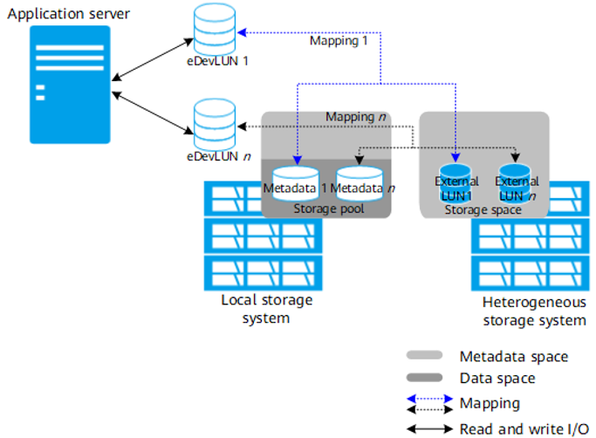
Relationship Between an eDevLUN and an External LUN
An eDevLUN consists of data and metadata. A mapping is established between data and metadata.
Notes:
The physical space needed by data is provided by the external LUN from the heterogeneous storage system. Data does not occupy the capacity of the local storage system.
Metadata is used to manage storage locations of data on an eDevLUN. The space used to store metadata comes from the metadata space in the storage pool created in the local storage system. Metadata occupies merely a small amount of space. Therefore, eDevLUNs occupy a small amount of space in the local storage system. (If no value-added feature is configured for eDevLUNs, each eDevLUN occupies only dozens of KBs in the storage pool created in the local storage system.)
If value-added features are configured for eDevLUNs, each eDevLUN, like any other local LUNs, occupies local storage system space to store the metadata of value-added features. Properly plan storage space before creating eDevLUNs to ensure that value-added features can work properly.

Slide 52
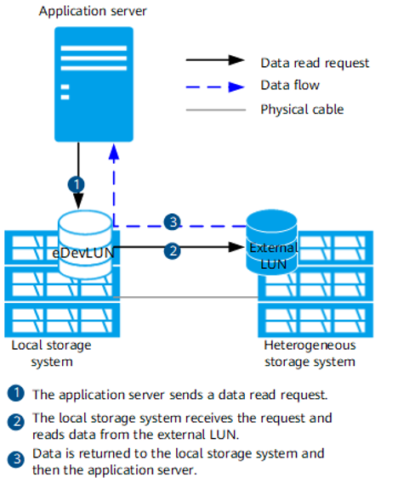
Data Read Process
After an external LUN in a heterogeneous storage system is hosted using SmartVirtualization, when an application server sends a request to read data from the external LUN, the eDevLUN in the local storage system receives the request and reads data from the external LUN
Notes:
With the use of SmartVirtualization, an application server can read data from and write data to an external LUN in a heterogeneous storage system through the local storage system. The entire process is similar to the process of reading and writing data to a LUN in the local storage system.

Slide 53
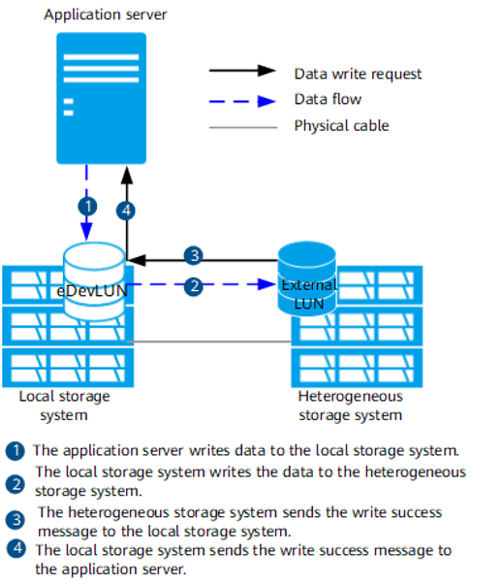
Data Write Process
After an external LUN in a heterogeneous storage system is hosted using SmartVirtualization, the data write process is as follows:
Notes:
With the use of SmartVirtualization, an application server can read data from and write data to an external LUN in a heterogeneous storage system through the local storage system. The entire process is similar to the process of reading and writing data to a LUN in the local storage system.

Slide 54
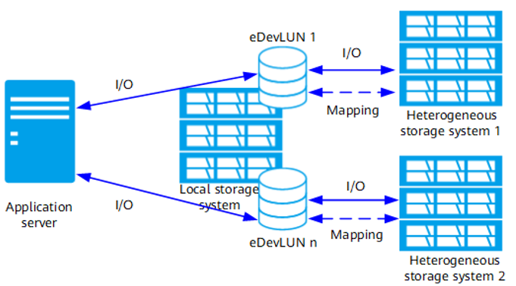
Centralized Management of Storage Resources
If multiple heterogeneous storage systems have been deployed onsite, the following two challenges may occur:
Due to incompatibility issues, the multipathing software on an application server may not be compatible with all heterogeneous storage systems.
In a certain network environment (such as a Fibre Channel direct-connection network), one application server can only be connected to one storage system. However, in actual applications, one application server needs to distribute services to multiple storage systems.
Notes:
SmartVirtualization functions similarly to virtual gateways. SmartVirtualization allows you to discover storage resources in multiple heterogeneous storage systems from the local storage system, and deliver read and write commands to the storage resources for centralized management.

Slide 55
Offline Takeover and Online Takeover
eDevLUNs without masquerading properties
eDevLUNs with masquerading properties
Read and write I/Os
Step 2: Disconnect the application server from the heterogeneous storage system to stop data transfer and services.
Step 3: Connect the application server to the local storage system and enable the local storage system to take over services.
Step 2: Disconnect the application server from the heterogeneous storage system. Data transfer interruption does not affect service.
Step 3: Connect the application server to the local storage system and then the application server can identify the masqueraded eDevLUNs.
Mapping
SmartVirtualization
Mapping
SmartVirtualization
Heterogeneous storage system
Local storage system
Heterogeneous storage system
Local storage system
Step 1: Connect the local storage system to the heterogeneous storage system.
Step 1: Connect the local storage system to the heterogeneous storage system to enable the local storage system to take over services from the heterogeneous storage system.
Notes:
SmartVirtualization functions similarly to virtual gateways. SmartVirtualization allows you to discover storage resources in multiple heterogeneous storage systems from the local storage system, and deliver read and write commands to the storage resources for centralized management.

Slide 56
Service Data Migration from a Legacy Storage System to a New Storage System
As services grow continuously, more storage is required for storing increasing data. The legacy storage system cannot provide satisfactory data storage capacity and performance. In this case, you can purchase a storage system that provides a larger capacity and better performance to replace the legacy storage system. As software and hardware of the legacy and new storage systems are different, the services may be interrupted and data may be lost during data migration. SmartVirtualization can mask the differences between storage systems to map an external LUN of the legacy storage system to the new storage system (presented as an eDevLUN on the new storage system). Then SmartMigration can be used to reliably migrate all service data from the legacy storage system to the new storage system while keeping services running.
New storage system
Legacy storage system
Notes:
In this application scenario, a new storage system and a legacy storage system serve as a local storage system and a heterogeneous storage system, respectively.
Play the animation.

Slide 57
Cold Data Migration from a New Storage System to a Legacy Storage System
After a legacy storage system is replaced with a new storage system, some data in the new storage system is rarely accessed, which is called cold data. If massive cold data is stored in the new storage system, the storage resource utilization of the storage system lowers down, causing a waste of storage space. To reduce operation expenditure (OPEX), SmartVirtualization can work with SmartMigration to migrate the cold data to the legacy heterogeneous storage system.
New storage system
Legacy storage system
Notes:
In this application scenario, a new storage system and a legacy storage system serve as a local storage system and a heterogeneous storage system, respectively.
Play the animation.

Slide 58
Takeover Mode Selection
SmartVirtualization provides online and offline modes to take over heterogeneous storage systems. There are three masquerading types for online takeover, which are basic masquerading, extended masquerading, and third-party masquerading. The takeover mode depends on the vendors and versions of the heterogeneous storage systems and multipathing software.
Takeover Mode | Masquerading | Description
Offline takeover | No masquerading | The offline takeover mode is applicable to all compatible Huawei and third-party heterogeneous storage systems. In this mode, services running on the related application servers are stopped temporarily.
Online takeover | Basic masquerading or extended masquerading | The selection of basic masquerading or extended masquerading depends on the vendor and version of the multipathing software and the versions of Huawei heterogeneous storage systems.
Notes:
The offline takeover mode is applicable to all compatible Huawei and third-party heterogeneous storage systems. In this mode, services running on the related application servers are stopped temporarily and the masquerading property for eDevLUNs is No masquerading.
When a Huawei heterogeneous storage system is taken over in online mode, the masquerading property for eDevLUNs is Basic masquerading or Extended masquerading. The selection of basic masquerading or extended masquerading depends on the vendor and version of the multipathing software and the versions of Huawei heterogeneous storage systems. For details, see the product documentation of the corresponding version.
For details about versions and compatibility, see related documents or compatibility lists before deployment. This chapter only describes theories regarding SmartVirtualization.

Slide 59
Configuration Process
Start
Check the license file.
Complete the installation and deployment.
Configure and use eDevLUNs.
End

Slide 60
SmartThin
SmartTier&SmartCache
SmartAcceleration
SmartQoS
SmartDedupe&SmartCompression
SmartVirtualization
SmartMigration

Slide 61
Overview
SmartMigration is a key technology for service migration. Services on a source LUN can be completely migrated to a target LUN without interrupting host services. The target LUN can totally replace the source LUN to carry services after the replication is complete.
What does "completely" mean?
Notes:
"Completely" means that all application-related data is copied from the source LUN to the target LUN.
Benefits of SmartMigration:
Reliable service continuity: Service data is migrated non-disruptively, preventing any loss caused by service interruption during service migration.
Stable data consistency: During service data migration, data changes made by hosts will be sent to both the source LUN and target LUN, ensuring data consistency after migration and preventing data loss.
Convenient performance adjustment: To flexibly adjust service performance levels, SmartMigration migrates service data between different storage media and RAID levels based on service requirements.
Data migration between heterogeneous storage systems: In addition to service data migration within a storage system, SmartMigration also supports service data migration between a Huawei storage system and a compatible heterogeneous storage system.

Slide 62
Working Principles of SmartMigration
SmartMigration is leveraged to adjust service performance or upgrade storage systems by migrating services between LUNs.
SmartMigration is implemented in two phases:
Service data synchronization
LUN information exchange
Start
Finish
Notes:
Storage systems use virtual storage technology. Virtual data in a storage pool consists of metadata volumes and data volumes.
Metadata volumes: record the data storage locations, including LUN IDs and data volume IDs. LUN IDs are used to identify LUNs, and data volume IDs are used to identify physical space of data volumes.
Data volumes: store actual user data.

Slide 63
SmartMigration Service Data Synchronization
After creating a SmartMigration task, create the pair relationship between a source LUN and a target LUN.
Service data synchronization between the source and target LUNs involves initial synchronization and change synchronization.
A
B
C
Host
D
E
F
1
5
A
B
C
G
H
I
A
B
C
DCL
LOG
Copies full data.
4
2
LM
Storage
D
E
F
D
E
F
G
H
I
G
H
I
4
Source LUN
Target LUN
2
3
2
3
Source LUN
Target LUN
Initial synchronization
Data change synchronization
Notes:
Pair: In SmartMigration, a pair indicates the data migration relationship between a source LUN and a target LUN. A pair can have only one source LUN and one target LUN.
The two synchronization modes of service data are independent and can be performed at the same time to ensure that service data changes on the host can be synchronized to the source LUN and the target LUN.
Data change synchronization:
1. A host delivers an I/O write request to the LM module of a storage system.
2. The LM module writes the data to the source LUN and target LUN and records write operations to the log.
3. The source LUN and target LUN return the data write result to the LM module.
4. The LM module determines to clear LOG or not based on the write I/O result.
5. A write success acknowledgment is returned to the host.

Slide 64
SmartMigration LUN Information Exchange
LUN information exchange is used for mappings between LUNs and data volumes, namely, the exchange between both data volume IDs when the IDs of source LUNs and target LUNs remain unchanged.
Source LUN
Target LUN
The host reads the source LUN ID.
Before LUN information exchange
LUN ID | Source data volume ID
0 | 0
LUN ID | Target data volume ID
1 | 1
1
Mapping
During LUN information exchange
LUN ID | Target data volume ID
0 | 1
LUN ID | Source data volume ID
1 | 0
2
Exchanges data volume IDs.
After LUN information exchange
LUN ID | Target data volume ID
0 | 1
LUN ID | Source data volume ID
1 | 0
3
Mapping
Notes:
LUN information exchange is the prerequisite for a target LUN to take over services from a source LUN after service information synchronization.
In a storage system, each LUN and its corresponding data volume have a unique identifier, namely, the ID of a LUN and data volume ID. A source LUN corresponds to a data volume. The former is a logical concept whereas the latter is a physical concept.
Before LUN information exchange: A host identifies a source LUN by the ID of the source LUN. The ID of a LUN corresponds to a data volume ID.
During LUN information exchange: A source data volume and a target data volume ID are exchanged. The physical storage space to which the source LUN points becomes the target data volume.
After LUN information exchange: The ID of the source LUN is unchanged, and users sense no fault because services are not affected. The ID of the source LUN and target data volume ID form a new mapping relationship. The host actually read and writes physical space of the target LUN.

Slide 65
SmartMigration Pair Splitting
Splitting is performed on a single pair. The splitting process includes stopping service data synchronization between the source LUN and target LUN in a pair to exchange LUN information, and removing the data migration relationship after the exchange.
After service data synchronization is stopped
How to split multiple pairs?
1. Exchanges information
Source LUN
Pair
Target LUN
Splitting
2. Splits the pair.
Notes:
In splitting, host services are suspended. After information is exchanged, services are delivered to the target LUN. In this way, service migration is transparent to users.
Pair splitting: Data migration relationship between a source LUN and a target LUN is removed after LUN information is exchanged.
After the pair is split, if the host delivers an I/O request to the storage system, data is only written to the source LUN.
The target LUN stores all data of the source LUN at the pair splitting point in time.
After the pair is split, no connections can be established between the source LUN and target LUN.
The consistency splitting of SmartMigration means that multiple pairs exchange LUN information at the same time and concurrently remove pair relationships after the information exchange is complete, ensuring that data consistency at any point in time before and after the pairs are split.
In scenarios where multiple pairs are used, such as in medium- and large-size database applications, data, logs, records, and other files are stored on LUNs that are associated with one another in a storage system. Splitting cannot ensure that information in one LUN is always associated with that in another. If data in a LUN is unavailable, data in the other LUNs may become invalid. Consistency splitting is used to ensure data consistency.

Slide 66
SmartMigration Status Transition
Migrating: Data is being synchronized from the source LUN to the target LUN.
Normal: Data is successfully synchronized between the source LUN and the target LUN.
Paused: The pair is in the waiting queue.
Interrupted: The replication relationship between the source LUN and target LUN is interrupted due to an I/O error in SmartMigration.
Migrated: Data is successfully synchronized between the source LUN and the target LUN, and the splitting is complete.
Initial creation
Migrating
Sync restoration
Sync suspension
Paused
Sync interruption
Synchronized
Fault rectification
Normal
Interrupted
Splitting
Migrated

Slide 67
Configuration Process
Start
Check the license file.
Create a SmartMigration task.
(Consistently) Split a SmartMigration pair.
End
Notes:
The preceding figure shows the configuration process of SmartMigration in a storage system. To perform a SmartMigration task between storage systems, the LUN takeover function of SmartVirtualization is required. In this case, after checking the license file, take over LUNs on a heterogeneous storage system before creating a SmartMigration task and splitting SmartMigration pairs or performing consistency splitting on SmartMigration pairs.

Slide 68
Storage Resource Tuning Technologies and Applications
SmartThin
SmartTier&SmartCache
SmartAcceleration
SmartQoS
SmartDedupe&SmartCompression
SmartVirtualization
SmartMigration
Definition, Principle, and Application

Slide 69
(True or false) SmartTier cannot be enabled for a storage pool whose member disks are of the same type. ( )
(Multiple-choice) Which of the following migration policies can be set for LUNs? ( )
Automatic migration
Migration to the higher-performance tier
Migration to the lower-performance tier
No migration
Notes:
Answers:
T
ABCD

Slide 70
(Single-answer question) Which status must a pair be before consistency splitting during LUN migration? ( )
Migrating
Paused
Normal
Migrated
Notes:
Answer:
D

Slide 71
Huawei official websites
Enterprise business: https://enterprise.huawei.com/en/
Technical support: https://support.huawei.com/enterprise/
Online learning: https://learning.huawei.com/en/
Popular tools
HedEx Lite
Network Documentation Tool Center
Information Query Assistant
Notes:
Popular tools:
HedEx Lite: a Huawei product document management tool, which allows users to browse, search for, update, and manage product documentation.
eStor: A graphical storage simulation platform. It simulates Huawei OceanStor all-flash storage systems to help ICT practitioners and users quickly get familiar with Huawei storage products and master the operations and configuration for related products.
Network Documentation Tool Center: The documentation tool for network products is a good assistant for bidding support, network planning, project delivery, and upgrade and maintenance.
Information query assistant: provides command and alarm information query for Huawei products.

