Slide 1
Storage
5.0
Tang Jiaojiao/twx498299
2020.05.14
Shui Shaolan/s00329529
New
Tang Jiaojiao/twx498299
2020.07.06
Shui Shaolan/s00329529
Update
Xu Ningyang/xwx1146004
2020.07.23
Shui Shaolan/s00329529
Update
Wang Xing/wwx921123
2020.08.10
Shui Shaolan/s00329529
Update
Liu Dayong/lwx696245
2022.06.30
Liang Shuai/l00569373
Update

Slide 2
Intelligent Data Storage System

Slide 3
This course describes the components of the storage system, including the controller enclosure, disk enclosure, disks, and interface modules, the expansion methods of the storage system, and the working principles of the storage media and the components.

Slide 4
Upon completion of this course, you will understand:
Storage product forms
Functions and components of controller enclosures and disk enclosures
Working principles of HDDs and SSDs
Concepts of scale-up and scale-out, and related cables and interface modules

Slide 5
Intelligent Data Storage System
Intelligent Data Storage Components
Storage System Expansion Methods

Slide 6
Storage in the Intelligent Era
As we move rapidly toward an intelligent world, data is being generated at an unprecedented rate.
More companies have realized that the key to achieving smartization is data infrastructure, with storage at its core.
An intelligent world calls for intelligent storage.
Storage for AI
Support companies to adopt intelligent technologies to accomplish AI training and application.
AI in Storage
Integrate AI technologies into the full-lifecycle management to improve storage management, performance, efficiency, and stability.

Slide 7
Intelligent Data Storage Architecture
Storage
Database
Big data
Edge
Intelligent data reduction
AI-based prediction
CPU and GPU intelligent reduction algorithm
Intelligent data reduction
Intelligent data storage
Deep compression
Intelligent global prediction
CPU/GPU acceleration
Intelligent tiering
Intelligent prefetch
Intelligent prediction
Intelligent data storage
Intelligent prefetch, data tiering, hotspot identification, data caching and other technologies for optimal media combination
Intelligent scheduling
Intelligence
Container
Heterogeneous computing power
Near-data computing
+
Intelligent scheduling
Dynamic management of heterogeneous computing resources, near-data computing scheduling, and quick start of containers
CPU
NPU
GPU
Hardware
DRA
SCM
SSD
Memory Fabric
Network chip
Network chip
Memory Fabric: building a memory-centric and high-performance network
Supporting high-performance networks with nanosecond-level latency
Memory pooling and tiering
All IP
Memory
media
SSD
media
All IP: ultimate cost reduction based on SSD media
In-depth disk-controller collaboration, and SLC, QLC, and OLC evolution
Building a simplified network with all IP
DRAM
SCM
SLC/QLC
QLC/OLC
ns
μs
50 μs
200 μs
Notes:
Huawei has built an innovative architecture for new age data storage. This architecture is built on intelligence + hardware + algorithm. It comprises the following features:
Memory and SCM-centered high performance tier based on Memory Fabric
All IP-based all-flash capacity tier, providing intelligent layered management for storage
10,000-core computing resource pooling and intelligent scheduling for CPUs, NPUs, and GPUs, based on innovative algorithms and high-speed interconnection protocols.
Container-based heterogeneous microservices for services
Intelligent data lifecycle management system to deliver innovative storage products for a fully connected, intelligent world
Octa-Level Cell (OLC): Each cell stores 8 bits.

Slide 8
Intelligent Data Storage Components
Controller enclosure
Disk enclosure
Expansion module
Disk
Interface module

Slide 9
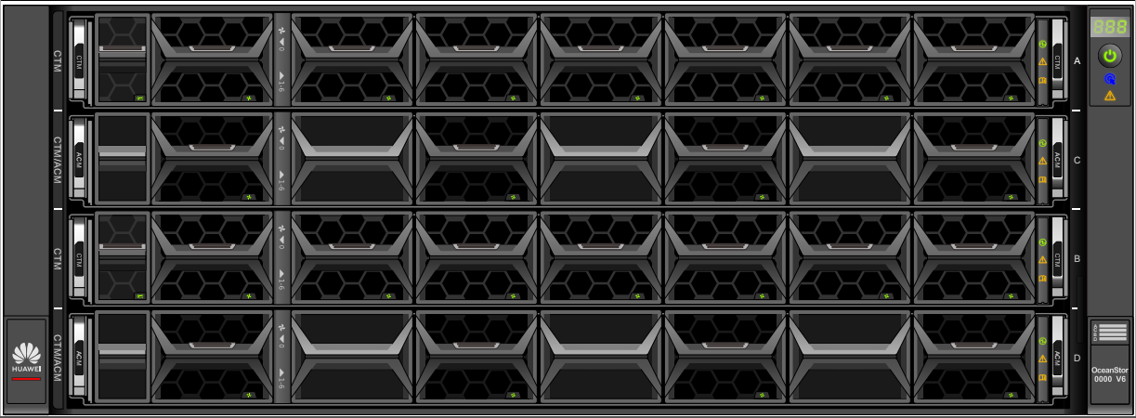
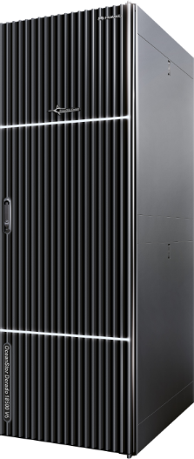
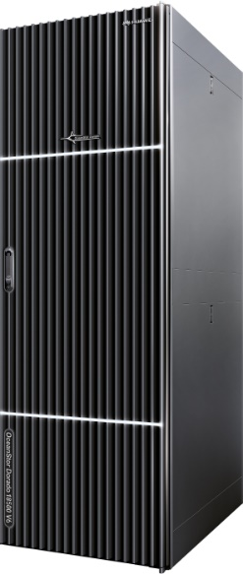
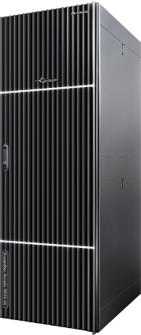
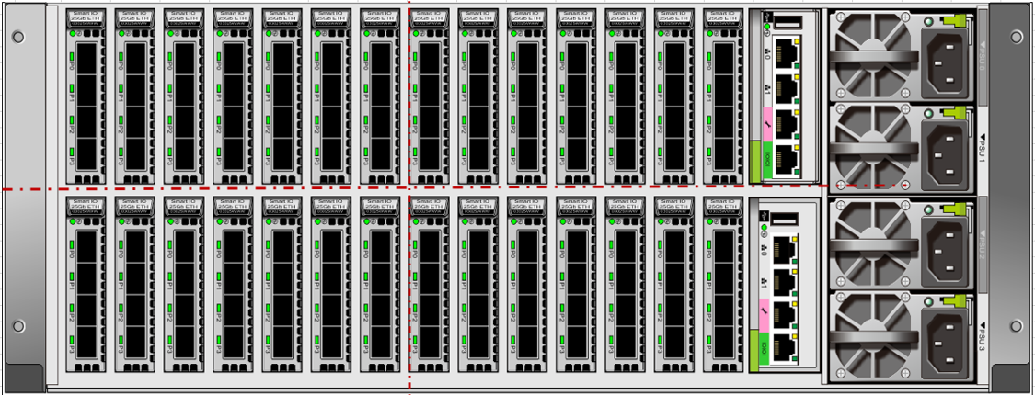
Storage Product Form
2 U, disk and controller integration
4 U, disk and controller separation
Integrated bay
Note: Huawei OceanStor Dorado V6 is used as the example.

Slide 10
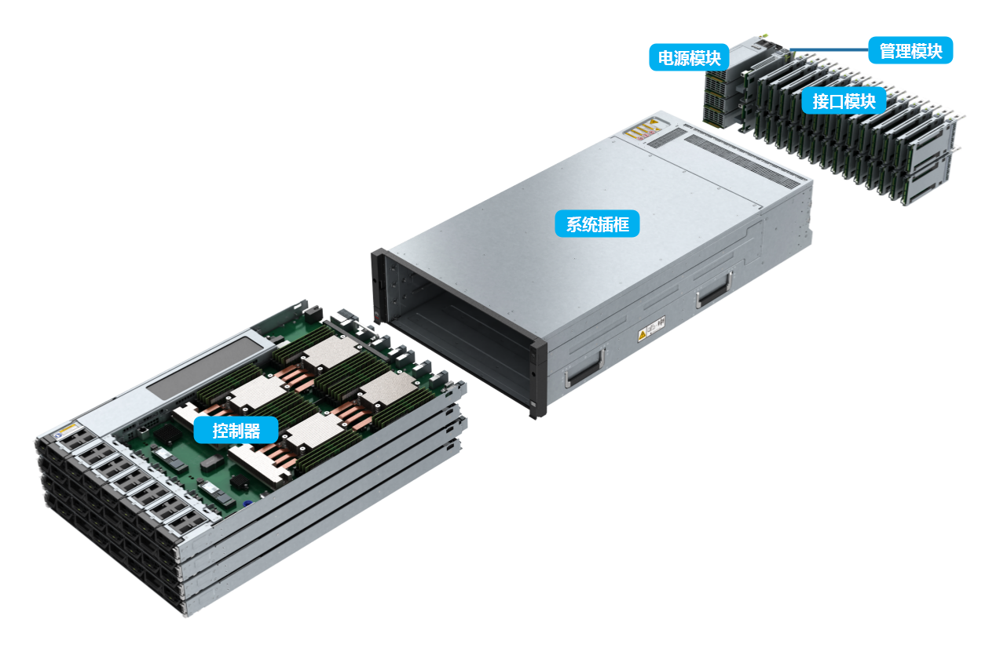
Controller Enclosure
The controller enclosure uses a modular design and consists of a system subrack, controllers (with built-in fan modules), BBUs, power modules, management modules, and interface modules.
Management module
Power module
Interface module
System subrack
Controller
Notes:
A controller enclosure houses controllers and is the core component of a storage system to provide storage services.
The system subrack integrates a backplane to provide signal and power connectivity among modules.
BBUs supply power to the storage system in the event of an external power supply failure to protect data in the storage system.
The management module provides management, maintenance, and serial ports.
The AC power module supplies power to the controller enclosure, allowing the enclosure to operate normally at maximum power.
Interface modules provide service or management ports and are field replaceable units.

Slide 11
Front View of a Controller Enclosure
Icon | Description
 | Enclosure ID indicator
 | Enclosure location indicator Blinking blue: The controller enclosure is being located. Off: The controller enclosure is not located.
 | Enclosure alarm indicator Steady amber: An alarm is reported by the controller enclosure. Off: The controller enclosure is working properly.
 | Power indicator/Power button
2 U controller enclosure (disk and controller integration)
4 U controller enclosure (disk and controller separation)
Note: Huawei OceanStor Dorado V6 is used as the example.
Notes:
Huawei OceanStor Dorado V6 controller enclosures:
2 U enclosure with 25 x 2.5-inch SSDs;
2 U enclosure with 36 x palm-sized NVMe SSDs;
4 U enclosure without SSD.

Slide 12
Rear View of a Controller Enclosure
1
2
3
4
5
No. | Description
1 | Management port
2 | Maintenance port
3 | Serial port
4 | Interface module
5 | Power-BBU module
6 | SAS expansion port
7 | Interface module
8 | Management module
9 | Power module
6
7
8
9

Slide 13
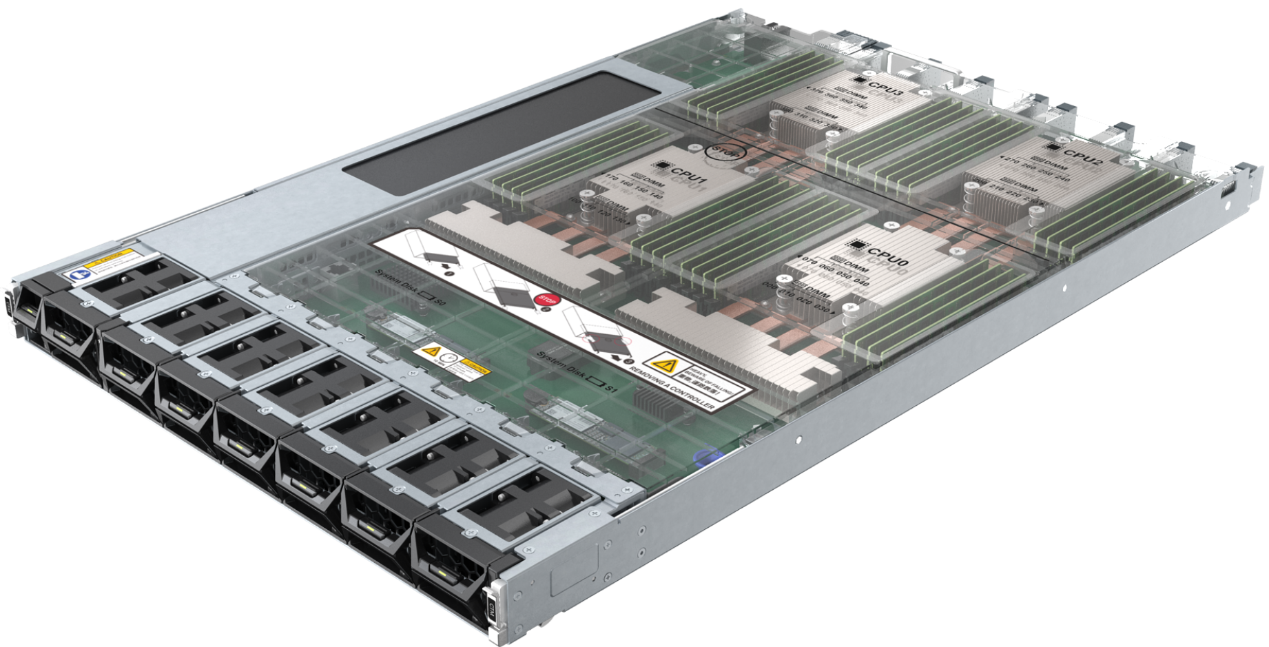
Controller
A controller is the core component of a storage system. It processes storage services, receives configuration management commands, saves configuration data, connects to disks, and saves critical data to coffer disks.
Controller
enclosure
FE
FE
Controller
Controller
Cache
Cache
CPU
CPU
BE
BE
Disk
enclosure
Cache data
Notes:
The controller is a core module that processes services in a storage system.
The CPU and cache on the controller work together to process I/O requests from the host and manage RAID of the storage system.
Each controller has multiple built-in disks to store system data. If a power failure occurs, these disks also store cache data. Disks on different controllers are redundant of each other.
Front-end (FE) ports are used for service communication between application servers and the storage system, that is, for processing host I/Os.
Back-end (BE) ports connect a controller enclosure to a disk enclosure and provide channels for reading/writing data from/to disks.
A cache is a memory chip on a disk controller. It provides fast data access speed and functions as a buffer between the internal storage and external interfaces.
An engine is a core component of a development program or system on an electronic platform. It is usually the support part of a program or a set of systems.

Slide 14
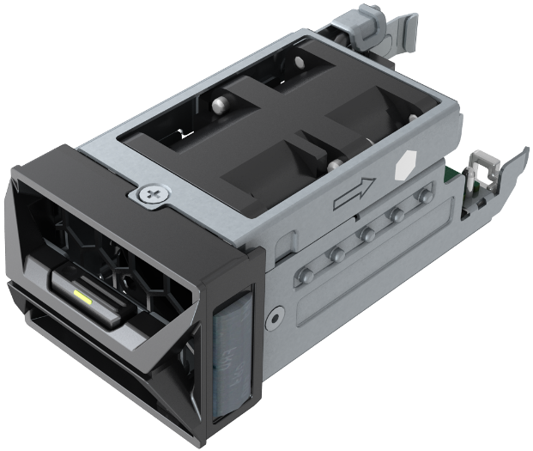
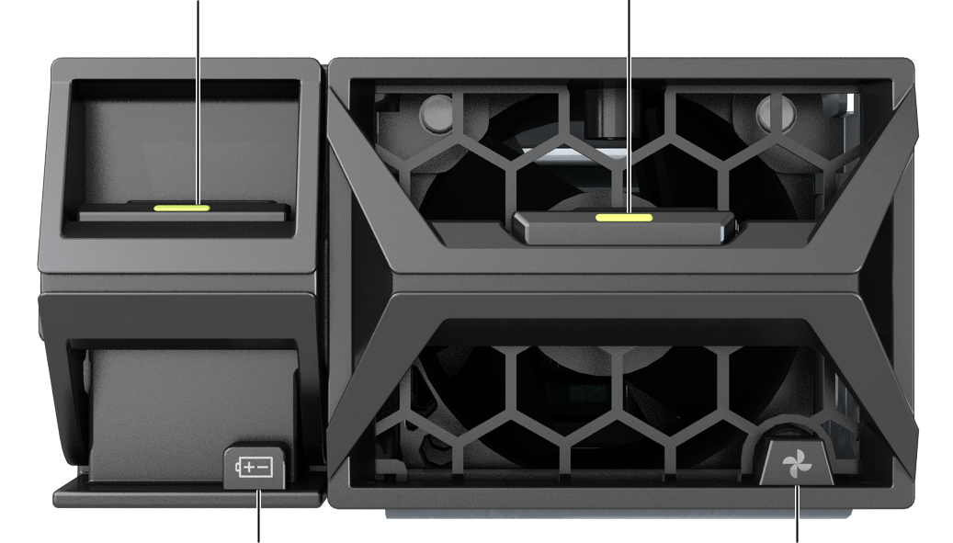
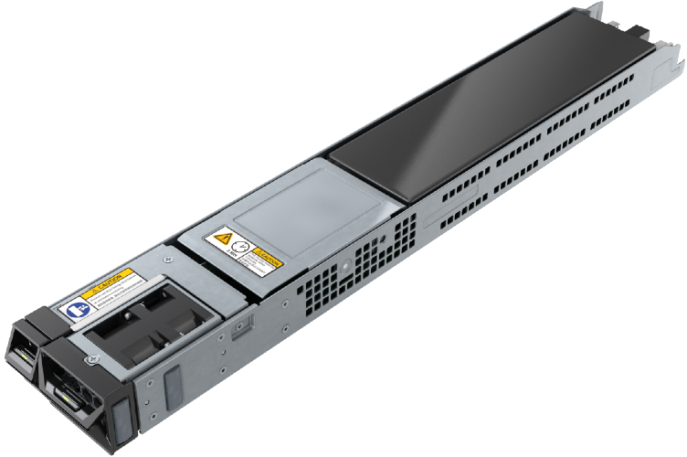
BBU and Fan Module
BBU latch
Fan latch
Fan module
Running/Alarm indicator of the BBU
Running/Alarm indicator of the fan
BBU
Front view
Notes:
Fan modules dissipate heat from the system, allowing the controller enclosure to operate normally at maximum power.
BBUs supply power to the storage system in the event of an external power supply failure to protect data in the storage system.
When the external power supplies are normal, the BBUs are standing by. Faulty BBUs can be isolated without affecting normal running of the storage system. The BBUs allow the system to write cache data to the built-in disks of the controllers upon a power failure to prevent data loss. When the external power supply recovers, storage software recovers data from the built-in disks of the controllers into the cache. In a system using the lithium batteries, the battery capacity is updated and detected by charging and discharging the batteries. In this way, the problems can be detected in advance that the battery capacity attenuates, the batteries fail to meet the power backup requirements of the system, and thus the data backup fails when the batteries are not used for a long time. Then, the reliability of data protection upon the system power failure can be improved.

Slide 15
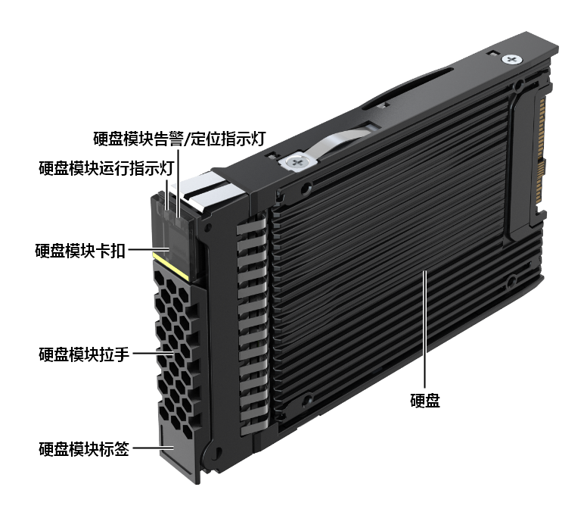
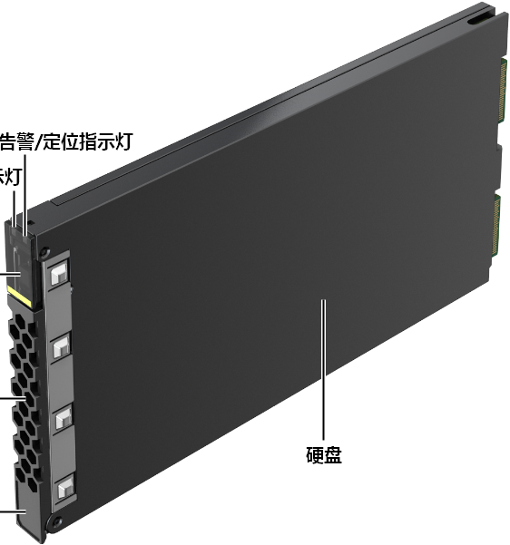
Coffer Disk
2.5-inch coffer disk
Palm-sized NVMe coffer SSD
Alarm/Location indicator
Alarm/Location indicator
Running indicator
Running indicator
Latch
Latch
Handle
Handle
Disk
Disk
Label
Label
Note: Huawei OceanStor Dorado V6 is used as the example.
Notes:
Coffer disks are used to store user data, system configurations, logs, and dirty data in the cache in the event of an unexpected power outage.
There are built-in coffer disks and external coffer disks.
Built-in coffer disk
Each controller of OceanStor Dorado V6 has one or two built-in SSDs as coffer disks. For details, see the product documentation.
External coffer disk
The storage system automatically selects four disks as coffer disks. Each coffer disk provides 2 GB space to form a RAID 1 group. The remaining space of the coffer disks can be used to store service data. If a coffer disk is faulty, the system automatically replaces the faulty coffer disk with a normal disk to ensure redundancy.

Slide 16
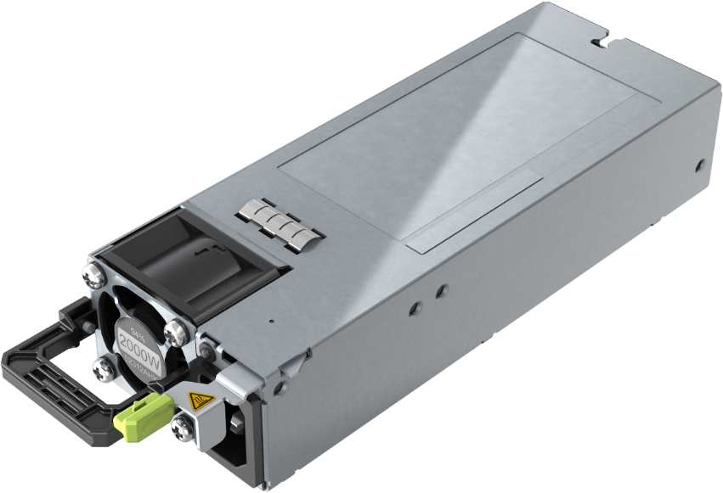
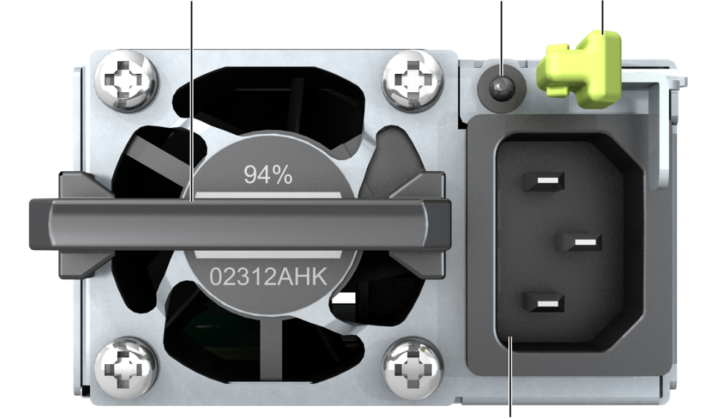
Power Module
The AC power module supplies power to the controller enclosure, allowing the enclosure to operate normally at maximum power.
Running/
Alarm indicator
Handle
Latch
Power socket
Note: Huawei OceanStor Dorado V6 is used as the example.
Notes:
A 4 U controller enclosure has four power modules (PSU 0, PSU 1, PSU 2, and PSU 3). PSU 0 and PSU 1 form a power plane to supply power to controllers A and C, and are redundant of each other. PSU 2 and PSU 3 form the other power plane to supply power to controllers B and D, and are redundant of each other. For reliability purposes, it is recommended that you connect PSU 0 and PSU 2 to one PDU, and PSU 1 and PSU 3 to another PDU.
A 2 U controller enclosure has two power modules (PSU 0 and PSU 1) to supply power to controllers A and B. The two power modules form a power plane and are redundant of each other. For reliability purposes, it is recommended that you connect PSU 0 and PSU 1 to different PDUs.

Slide 17
2. Intelligent Data Storage Components
Controller enclosure
Disk enclosure
Expansion module
Disk
Interface module

Slide 18
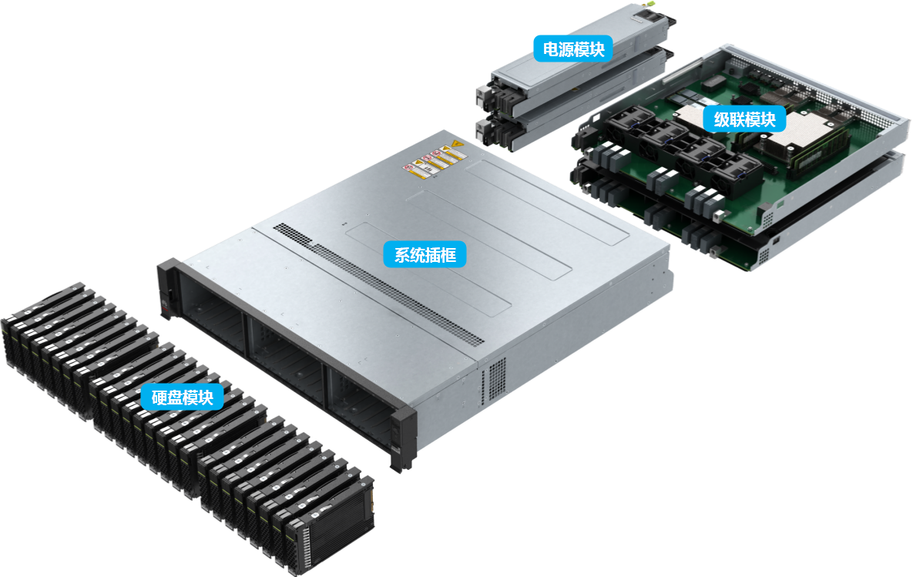
Disk Enclosure
The disk enclosure uses a modular design and consists of a system subrack, expansion modules, power modules, and disks.
Power module
Expansion module
System subrack
Disk drive module
Notes:
The system subrack integrates a backplane to provide signal and power connectivity among modules.
The expansion module provides expansion ports to connect to a controller enclosure or another disk enclosure for data transmission.
The power module supplies power to the disk enclosure, allowing the enclosure to operate normally at maximum power.
Disks provide storage space for the storage system to save service data, system data, and cache data. Specific disks are used as coffer disks.

Slide 19
Front View of a Disk Enclosure
Icon | Description
 | ID indicator of the disk enclosure
 | Location indicator of the disk enclosure Blinking blue: The disk enclosure is being located. Off: The disk enclosure is not located.
 | Alarm indicator of the disk enclosure Steady yellow: An alarm is reported by the disk enclosure. Off: The disk enclosure is working properly.
 | Power indicator of the disk enclosure Steady green: The disk enclosure is powered on. Off: The disk enclosure is powered off.
 | Power indicator/Power button The disk enclosure is powered on and off with the controller enclosure. The power button on the disk enclosure is invalid and cannot be used to power on or off the disk enclosure separately.
2 U 25-slot smart SAS disk enclosure
2 U 36-slot smart NVMe disk enclosure
Note: This slide shows the front views of a 2 U SAS disk enclosure and a 2 U smart NVMe disk enclosure of Huawei OceanStor Dorado V6.
Notes:
Huawei OceanStor Dorado V6 all-flash storage systems support SAS, smart SAS, and smart NVMe disk enclosures.
After a disk enclosure is powered on, check its indicators to determine its operating status.

Slide 20
Rear View of a Disk Enclosure
4
No. | Description
1 | Serial port
2 | Mini SAS HD expansion port
3 | ID display
4 | Expansion module
5 | Power module
6 | Onboard expansion port
7 | Onboard management port
8 | Power module
1
2
3
5
2 U smart SAS disk enclosure
Note: This slide shows the rear views of the 2 U smart SAS and smart NVMe disk enclosures of Huawei OceanStor Dorado V6.
6
7
8
2 U smart NVMe disk enclosure
Notes:
Smart disk enclosures use RDMA over Converged Ethernet (RoCE) ports to connect to controller enclosures, and are equipped with Kunpeng CPUs and DDR memory to provide computing capability.
Smart disk enclosures are 2 U high. A smart SAS disk enclosure can house 25 SAS SSDs, and a smart NVMe disk enclosure can house 36 palm-sized NVMe SSDs.

Slide 21
2. Intelligent Data Storage Components
Controller enclosure
Disk enclosure
Expansion module
Disk
Interface module

Slide 22
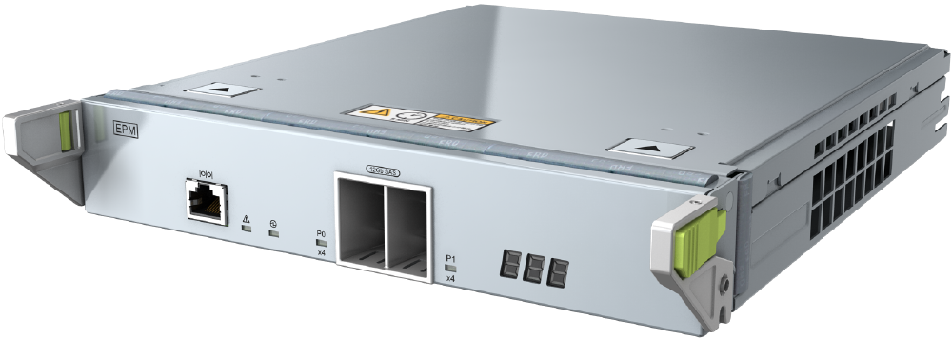
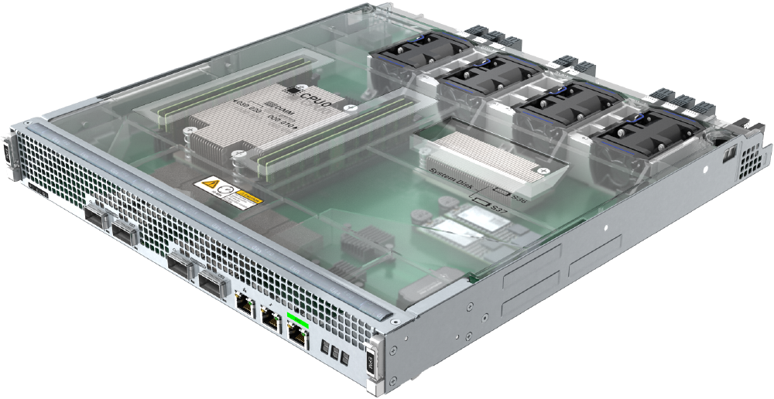
Expansion Module
Expansion module of a 2 U SAS disk enclosure
Connects to a controller enclosure through expansion ports
Expansion module of a 2 U smart NVMe disk enclosure
Connects to a controller enclosure through expansion ports
Notes:
Each expansion module provides one P0 and one P1 expansion port. The expansion module provides expansion ports to connect to a controller enclosure or another disk enclosure for data transmission.

Slide 23
CE Switch
Rear view
48 x 10GE electrical ports
4 x 60 Gbit/s optical ports
Console
Front view
USB port
FAN1
FAN2
PWR1
PWR2
Two Ethernet management ports (combo)
Note: Huawei CE6800 series switches are used as an example.
Notes:
Huawei CloudEngine series fixed switches are next-generation Ethernet switches designed for data centers and provide high performance, high port density, and low latency. The switches use flexible front-to-rear or rear-to-front airflow design and can be used in IP SANs and scale-out storage networks.

Slide 24
Fibre Channel Switch
Management ports (serial port and Ethernet port)
USB port
24 Fibre Channel ports
Power socket
Three link aggregation groups
Note: Huawei SNS2124 is used as an example.
Notes:
Fibre Channel switches are high-speed network transmission relay devices that transmit data over optical fibers. They provide fast transmission speed and strong anti-interference capability.
Fibre Channel switches are used on FC SANs.

Slide 25
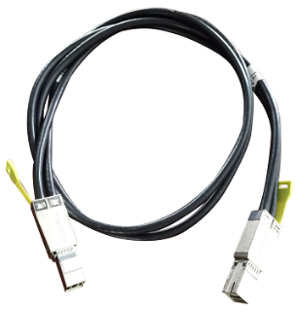
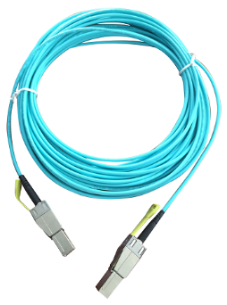
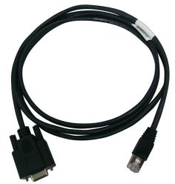
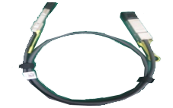
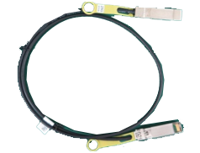
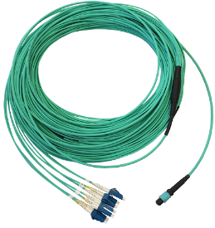
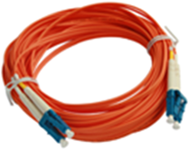
Device Cables
1. Serial cable
2. Mini SAS HD electrical cable
3. Mini SAS HD optical cable
4. 100G QSFP28 cable
6. MPO-4*DLC optical fiber
7. Optical fiber
5. 25G SFP28 cable
Notes:
A serial cable connects the serial port of the storage system to the maintenance terminal.
Mini SAS HD cables connect to expansion ports on controller and disk enclosures. There are mini SAS HD electrical cables and mini SAS HD optical cables.
100G QSFP28 cables are used for direct connection between controllers or for connection to smart disk enclosures.
25G SFP28 cables are used for front-end networking.
Optical fibers connect the storage system to Fibre Channel switches. One end of the optical fiber connects to a Fibre Channel host bus adapter (HBA), and the other end connects to the Fibre Channel switch or the storage system. An optical fiber uses LC connectors at both ends. MPO-4*DLC optical fibers, which are dedicated for 8 Gbit/s Fibre Channel interface modules (8 ports) and 16 Gbit/s Fibre Channel interface modules (8 ports), can be used to connect the storage system to Fibre Channel switches.

Slide 26
2. Intelligent Data Storage Components
Controller enclosure
Disk enclosure
Expansion module
Disk
HDD
SSD
Interface module

Slide 27
Disk Type
IDE
SCSI
SATA
SAS
FC
NVMe
...
Interface type
1.8-inch
2.5-inch
3.5-inch
5.25-inch
...
Dimensions
Application
scenario
Enterprise-class
Desktop-class
...
What are the types of disks?
Structure
HDD
SSD
...
Notes:
There are multiple types of disks, which can be classified by interface type, dimensions, application scenario, and structure.

Slide 28
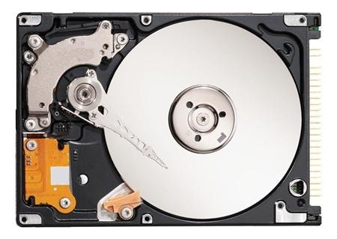
HDD Structure
An HDD consists of platters, an actuator arm, read/write heads, a spindle, a port, and control circuits.
Platter
Actuator arm
Spindle
Control circuit
Port
Read/write head
Notes:
Disk components:
A platter is coated with magnetic materials on both surfaces. The magnetic grains on the platter are polarized to represent a binary information unit (or bit).
A read/write head reads data from and writes data to a platter. It changes the N and S polarities of magnetic grains on the surface of the platter to save data.
The actuator arm moves the read/write head to the specified position.
The spindle has a motor and bearing underneath. It rotates the platter to move the specified position on the platter to the read/write head.
The control circuit controls the speed of the platter and movement of the actuator arm, and delivers commands to the head.

Slide 29
HDD Working Principles
Basic operation
The platter is driven by a motor.
Platter
Landing zone
Spindle
Magnetic data
R/W Head
The distance between the head and the disk is small.
The head flies over the platter.
Notes:
Each platter of a disk has two read/write heads, which respectively read and write data on two surfaces of the platter.
The head floats on the platter by air flow and does not touch the platter. Therefore, the head can move back and forth between tracks at a high speed. If the distance between the head and the platter is too long, the signal read by the head is weak; if the distance is too short, the head may rub against the platter surface. Therefore, the platter surface must be smooth and flat. Any foreign matter or dust will cause the head to rub against the magnetic surface, causing permanent data corruption.
Working principles:
At the beginning, the read/write head is in the landing zone near the spindle of the platters.
The spindle connects to all platters and a motor. The spindle motor rotates at a constant speed to drive the platters.
When the spindle rotates, there is a small gap between the head and the platter, which is called the flying height of the head.
The head is attached to the end of the actuator arm, which drives the head to the specified position above the platter where data needs to be written or read.
The head reads and writes data in binary format on the platter surface. The read data is stored in the flash chip of the disk and then transmitted to the program.

Slide 30
Data Organization on a Disk
Sector
Track
Head
A
B
C
Cylinder
D
Actuator arm
Platter
Motor
Motor
Notes:
Platter surface: Each platter of a disk has two surfaces, both of which can store data and are valid. All valid surfaces are numbered in sequence, starting from 0 for the top surface. In a disk system, a surface number is also referred to as a head number, because each valid surface has a read/write head.
Track: Tracks are concentric circles around the spindle on a platter. Data is recorded on the tracks. Tracks are numbered from the outermost circle to the innermost one, starting from 0. Each platter surface has 300 to 1024 tracks. New types of large-capacity disks have even more tracks on each surface. Generally, the tracks per inch (TPI) on a platter are used to measure the track density. Tracks are only magnetized areas on the platter surfaces and are invisible to human eyes.
Cylinder: A cylinder is formed by tracks with the same number on all platter surfaces of a disk. The heads of each cylinder are numbered from top to bottom, starting from 0. Data is read and written based on cylinders. That is, head 0 in a cylinder reads and writes data first, and then the other heads in the same cylinder read and write data in sequence. After all heads have completed reads and writes in a cylinder, the heads move to the next cylinder. Selection of cylinders is a mechanical switching process called seek. Generally, the position of heads in a disk is indicated by the cylinder number instead of the track number.
Sector: Each track is divided into smaller units called sectors to arrange data orderly. A sector is the smallest storage unit that can be independently addressed in a disk. Tracks may have different number of sectors. Generally, a sector can store 512 bytes of user data, but some disks can be formatted into larger sectors, such as 4 KB sectors.

Slide 31
Disk Capacity and Cache
Disk capacity
Disk capacity = Number of cylinders x Number of heads x Number of sectors x 512 bytes. The unit is MB or GB. The disk capacity is determined by the capacity of a single platter and the number of platters.
Cache
Because the processing speed of a CPU is much faster than that of a disk, the CPU must wait until the disk completes a read/write operation before issuing a new command. To solve this problem, a cache is added to the disk to improve the read/write speed.
Notes:
Disks may have one or multiple platters. However, a disk allows only one head to read and write data at a time. Therefore, increasing the number of platters and heads only improves the disk capacity, but cannot improve the throughput or I/O performance of the disk.

Slide 32
Factors Relevant to Disk Performance
Rotation speed
Primary factor that determines the throughput in the case of sequential I/Os
Seek speed
Primary factor that affects the random I/O performance
Single platter capacity
Indirect factor for disk performance
Port speed
The least important factor for disk performance
Notes:
Factors relevant to disk performance:
Rotation speed: indicates how many circles a platter can rotate per minute. The unit is revolutions per minute (rpm). When data is being read or written, the platter rotates while the head stays still. Therefore, a faster rotation speed of the platter means shorter data transmission time. In the case of sequential I/Os, the actuator arm does not need to seek frequently. Therefore, the rotation speed is the primary factor to determine the throughput and IOPS.
Seek speed: In the case of random I/Os, the actuator arm must change tracks frequently, and the data transmission time is much shorter than the time for track changes. Therefore, a faster seek speed of the actuator arm can improve the IOPS of random I/Os.
Single platter capacity: A larger capacity of a single platter means more data can be stored in a unit space, bringing a higher data density. Under the same rotation speed and seek speed, disks with a higher data density provide better performance.
Port speed: In theory, the current port speed is enough to support the maximum external transmission bandwidth of disks. In the case of random I/Os, the seek speed is the bottleneck and the port speed has little impact on performance.

Slide 33
Average Access Time
The average access time is determined by:
Average seek time
Average latency time
Seek time
Latency
Wait time
Disc
Data Block
Seek
Tracks
Notes:
The average seek time refers to the average time required for a head to move from the initial position to a specified track on a platter. It is an important metric for the internal transfer rate of a disk. The time should be as short as possible.
The average latency time means how long a head needs to wait for a sector to move to the specified position after the head has reached the desired track. The average latency time is generally half of the time required for the platter to rotate a full circle. Therefore, a faster rotation speed leads to a shorter latency time.

Slide 34
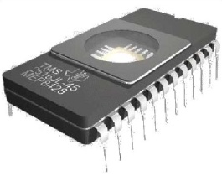
Data Transfer Rate
The date transfer rate is determined by:
Internal transfer rate
External transfer rate/Interface transfer rate
Disk
Disc
Seek
Tracks
External
Internal
Notes:
The data transfer rate of a disk means how fast the disk can read and write data. It includes the internal and external data transfer rates. The unit is MB/s.
Internal transfer rate is also called sustained transfer rate, which is the highest rate at which a head reads and writes data. This does not include the seek time and the time waiting for the sector to move to the head. It is achieved in an ideal situation that the head does not need to change the track or read a specified sector, but reads and writes all sectors sequentially and cyclically on one track. The rate in such a situation is the internal transfer rate.
External transfer rate is also called burst data transfer rate or interface transfer rate. It refers to the data transfer rate between the system bus and the disk buffer, and depends on the disk port type and buffer size.

Slide 35
Disk IOPS and Transmission Bandwidth
IOPS
Input/Output operations per second (IOPS) is a key indicator to measure disk performance.
IOPS is calculated by the seek time, rotation latency, and data transmission time.
Transmission bandwidth (throughput)
Indicates the amount of data that is successfully transmitted in a unit time, that is, the speed at which data streams are transmitted. For example, if it takes 10s to write 10,000 files of 1 KB size, the transmission bandwidth is only 1 MB/s; if it takes 0.1s to write a 10 MB file, the transmission bandwidth is 100 MB/s.
Notes:
IOPS is calculated by the seek time, rotation latency, and data transmission time.
Seek time: The shorter the seek time, the faster the I/O operation. Currently, the average seek time is 3 to 15 ms.
Rotation latency: refers to the time required for the platter to rotate the sector where the requested data is located to the position below the head. The rotation latency depends on the rotation speed. Generally, the latency is half of the time required for the platter to rotate a full circle. For example, the average rotation latency of a 7200 rpm disk is about 4.17 ms (60 x 1000/7200/2), and the average rotation latency of a 15000 rpm disk is about 2 ms.
Data transmission time: indicates the time required for transmitting the requested data. It depends on the data transfer rate. Data transmission time = Data size/Data transfer rate. For example, the data transfer rate of IDE/ATA disks can reach 133 MB/s, and that of SATA II disks can reach 300 MB/s.
In the case of random I/Os, the head must change tracks frequently. The data transmission time is much less than the time for track changes (not in the same order of magnitude). Therefore, the data transmission time can be ignored.
Theoretically, the maximum IOPS of a disk can be calculated using the following formula: IOPS = 1000 ms/(Seek time + Rotation latency). The data transmission time is ignored. For example, if the average seek time is 3 ms, the theoretical maximum IOPS for 7200 rpm, 10k rpm, and 15k rpm disks is 140, 167, and 200, respectively.

Slide 36
Parallel and Serial Transmission
For example, the methods for transmitting numbers 1 to 8 are as follows:
Parallel transmission
Serial transmission
Transmit end
Receive end
Transmit end
Receive end
1
2
3
8
7
6
5
4
3
2
1
4
5
6
7
8
Multiple lines are connected between two ends, and one number is transmitted on each line.
Only one line is connected between two ends. Eight numbers are sent on this line in sequence. The receive end has all numbers after eight transmissions.
Notes:
Parallel transmission:
Parallel transmission features high efficiency, short distance, and low frequency.
In long-distance transmission, using multiple lines is more expensive than using a single line.
Long-distance transmission requires thicker conducting wires to reduce signal attenuation, but it is difficult to bundle them into a single cable.
In long-distance transmission, the time for data on each line to reach the peer end varies due to wire resistance or other factors. The next transmission can be initiated only after data on all lines has reached the peer end.
When the transmission frequency is high, the circuit oscillation is serious and great interference is generated between the lines. Therefore, the frequency of parallel transmission must be set properly.
Serial transmission:
The efficiency of serial transmission is much lower than that of parallel transmission. The transmission speed can be improved by increasing the transmission frequency. In general, the overall speed of serial transmission is higher than that of parallel transmission.
Serial transmission is used for long-distance transmission. Currently, PCI interfaces use serial transmission. The PCIe interface is a typical example of serial transmission. The transmission rate of a single line is up to 2.5 Gbit/s.

Slide 37
HDD Port Technology
A disk must provide a simple port for users to access its data. Generally, disks provide the following physical ports:
IDE port
Used for the ATA instruction system
SATA port
Disk ports
Parallel SCSI port
Used for the SCSI instruction system
Serial SCSI (SAS) port
Fibre Channel port
Notes:
Disks are classified into IDE, SCSI, SATA, SAS, and Fibre Channel disks by port. In addition to ports, these disks also differ in the mechanical base.
IDE and SATA disks use the ATA mechanical base and are suitable for single-task processing.
SCSI, SAS, and Fibre Channel disks use the SCSI mechanical base and are suitable for multi-task processing.
Comparison:
Under high data throughput, SCSI disks provide higher processing speed than ATA disks.
In the case of multi-task processing, the read/write head moves frequently, which causes overheating on ATA disks.
SCSI disks provide higher reliability than ATA disks.

Slide 38
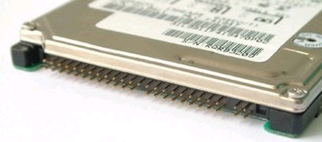
IDE Disk Port
The integrated drive electronics (IDE) port is also called the parallel ATA port.
ATA stands for Advanced Technology Attachment.
The ATA disk is also called the IDE disk.
The ATA port uses the parallel ATA technology.
Notes:
Multiple ATA versions have been released, including ATA-1 (IDE), ATA-2 (Enhanced IDE/Fast ATA), ATA-3 (Fast ATA-2), ATA-4 (ATA33), ATA-5 (ATA66), ATA-6 (ATA100), and ATA-7 (ATA133).
The advantages and disadvantages of the ATA port are as follows:
Advantages: low price and good compatibility
Disadvantages: Low speed; built-in use only; strict restriction on the cable length
The transmission rate of the PATA port does not meet the current user needs.

Slide 39
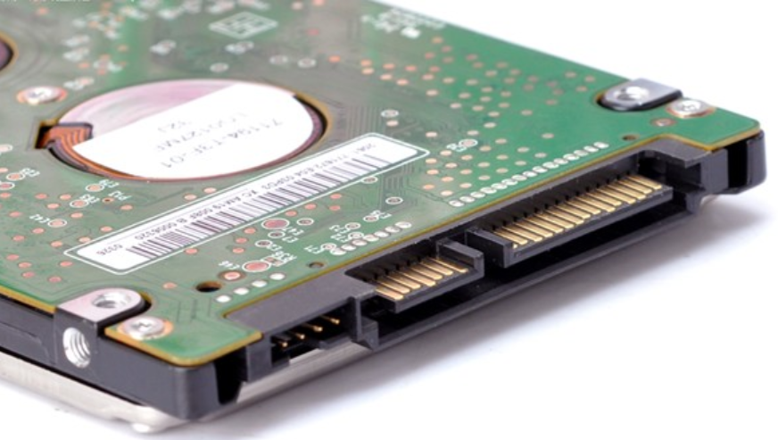
SATA Port
SATA is short for serial ATA.
SATA ports use serial transmission and provide a higher rate than IDE ports.
SATA uses a point-to-point architecture and supports hot swap.
SATA Version | Line Code | Transfer Rate | Throughput
1.0 | 8b/10b | 1.5 Gbit/s | 150 MB/s
2.0 | 8b/10b | 3 Gbit/s | 300 MB/s
3.0 | 8b/10b | 6 Gbit/s | 600 MB/s
Power
SATA port
Notes:
During data transmission, the data line and signal line are separated and use independent transmission clock frequency. The transmission rate of SATA is 30 times that of PATA.
Advantages:
Generally, a SATA port has 7+15 pins and uses a single channel. The transmission rate of SATA is higher than that of ATA.
SATA uses the cyclic redundancy check (CRC) for instructions and data packets to ensure data transmission reliability.
SATA has a better anti-interference capability than ATA.

Slide 40
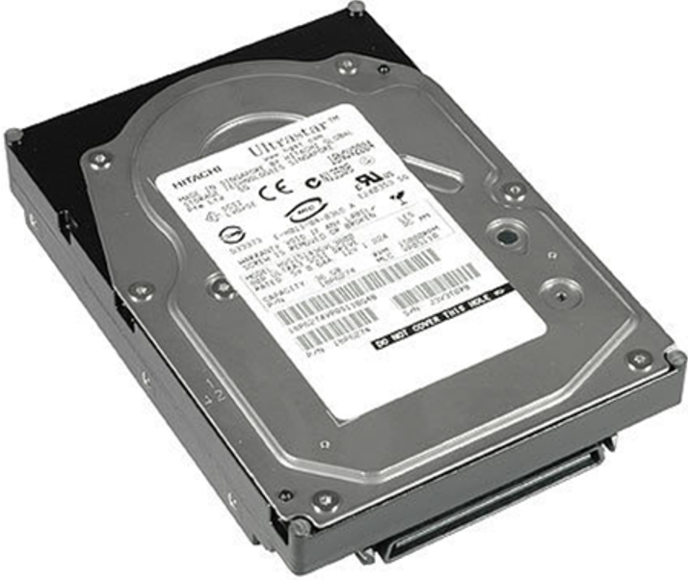
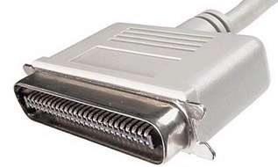
SCSI Port
SCSI is short for Small Computer System Interface.
Notes:
SCSI disks were developed to replace IDE disks to provide higher rotation speed and transmission rate. SCSI is originally a bus-type interface and works independently of the system bus.
Advantages:
Applicable to a wide range of devices. One SCSI controller card can connect to 15 devices simultaneously.
High performance (multi-task processing, low CPU usage, fast rotation speed, and high transmission rate)
SCSI disks can be external or built-in ones, and are hot-swappable.
Disadvantages:
High cost and complex installation and configuration.

Slide 41
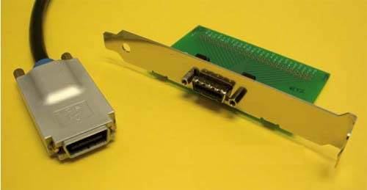
SAS Port
SAS is short for Serial Attached SCSI.
SAS is a point-to-point, full-duplex, and dual-port interface.
SAS is backward compatible with SATA.
Rate: 600 Mbit/s per channel
SAS features high performance, high reliability, and powerful scalability.
Notes:
Similar to SATA, SAS uses a serial architecture for high transmission rate and improves internal space by shortening internal connections.
SAS improves the efficiency, availability, and scalability of the storage system, and is backward compatible with SATA in terms of the physical and protocol layers.
Advantages:
SAS is superior to SCSI in terms of transmission rate and anti-interference, and supports a longer connection distance.
Disadvantages:
SAS disks are more expensive.

Slide 42
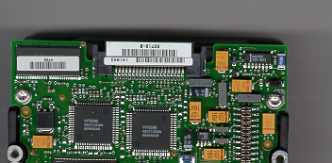
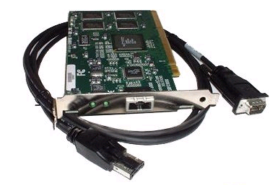
Fibre Channel Port
Fibre Channel disks use the Fibre Channel arbitrated loop (FC-AL).
FC-AL is a dual-port serial storage interface based on the SCSI protocol.
FC-AL supports full-duplex mode.
Fibre Channel provides a universal hardware transmission platform for upper-layer protocols (SCSI and IP). It is a serial data transmission interface that features high speed, high reliability, low latency, and high throughput.
40-pin Male FC-SCA II Connector
Notes:
Fiber Channel (FC) was not originally designed for disk ports, but was for network transmission. It is gradually applied to disk systems in pursuit of higher speed.
Advantages:
Easy to upgrade. Supports optical fiber cables with a length over 10 km.
Large bandwidth.
Strong universality.
Disadvantages:
High cost.
Complex to build.

Slide 43
2. Intelligent Data Storage Components
Controller enclosure
Disk enclosure
Expansion module
Disk
HDD
SSD
Interface module

Slide 44
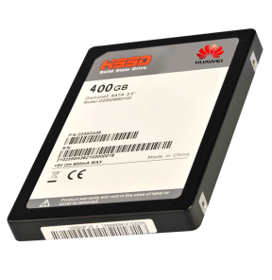
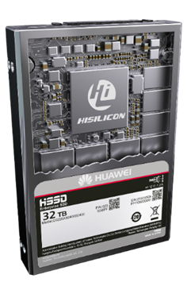
SSD Overview
Compared to HDDs, SSDs have absolute advantages in terms of performance, reliability, power consumption, and portability. SSDs have been widely used in various industries.
SSD characteristics:
Uses NAND flash to save data, providing a faster speed than HDDs.
Has no mechanical structure inside, so it consumes less power, dissipates less heat, and generates less noise.
Its service life is determined by the number of program/erase (P/E) cycles.
Notes:
SSD characteristics:
Unlike traditional disks that use magnetic materials to store data, SSDs use NAND flash (using cells as the storage units) to store data. NAND flash is a non-volatile random access storage medium that can retain stored data after the power is turned off. It can quickly and compactly store digital information.
SSDs do not have high-speed rotational components, and feature high performance, low power consumption, and zero noise.
SSDs do not have mechanical parts, but this does not mean that they have infinite life cycle. Because NAND flash is a non-volatile medium, original data must be erased before new data can be written. However, each cell can only be erased for a limited number of times. When the upper limit is reached, data reads and writes become invalid on this cell.

Slide 45
SSD Architecture
An SSD consists of a control unit and a storage unit (mainly flash memory chips).
Control unit: SSD controller, host interface, and DRAM
Storage unit: NAND flash
RAM
SSD Controller
Flash
Pkg
Flash
Pkg
...
Host
interface
logic
Processor
NAND
flash
interface
Host
Flash
Pkg
Flash
Pkg
...
Interconnect
Buffer
manager
Notes:
The host interface is the protocol and physical interface used by a host to access an SSD. Common interfaces are SATA, SAS, and PCIe.
The SSD controller is the core SSD component responsible for read and write access from a host to the back-end media and for protocol conversion, table entry management, data caching, and data checking.
DRAM is the cache for flash translation layer (FTL) entries and data.
NAND flash is a non-volatile random access storage medium that stores data.
Concurrent multiple channels, allowing time-division multiplexing for flash granules in a channel. Support for TCQ and NCQ, which respond to multiple I/O requests at a time.

Slide 46
NAND Flash
Internal storage units in NAND flash include:
LUNs, planes, blocks, pages, and cells
Operations on the NAND flash include erase, program, and read.
NAND flash is a non-volatile medium. A block must be erased before new data is written to it. A program/erase (P/E) cycle is the process of erasing a block and then writing it again.
Page 0
Page 0
Page 1
Page 1
...
...
Page P
Page P
Block 0
Block 1
Page 0
Page 0
Logical Unit 0
Page 1
Page 1
...
...
Page P
Page P
Block 2
Block 3
...
...
Page 0
Page 0
Page 1
Page 1
...
...
Page P
Page P
Block B
Block B+1
Page Register
Page Register
Plane
Address 0
Plane
Address 1
Notes:
NAND flash working principles:
NAND flash stores data using floating gate transistors. The threshold voltage changes based on the number of electric charges stored in a floating gate. Data is then represented using the read voltage of the transistor threshold.
A LUN is the smallest physical unit that can be independently encapsulated. A LUN typically contains multiple planes.
A plane has an independent page register. It typically contains 1,000 or 2,000 odd or even blocks.
A block is the smallest erasure unit and generally consists of multiple pages.
A page is the smallest programming and read unit. Its size is usually 16 KB.
A cell is the smallest erasable, programmable, and readable unit found in pages. A cell corresponds to a floating gate transistor that stores one or multiple bits.
A page is the basic unit of programming and reading, and a block is the basic unit of erasing.
Each P/E cycle causes some damage to the insulation layer of the floating gate transistor. If erasing or programming a block fails, the block is considered as a bad block. When the number of bad blocks reaches a threshold (4%), the NAND flash reaches the end of its service life.

Slide 47
SLC, MLC, TLC, and QLC
1
11
111
1111
110
1110
1101
10
101
1100
1011
100
1010
1001
0
01
011
1000
010
0111
0110
00
001
0101
0100
000
0011
0010
0001
0000
SLC-1bit
MLC-2bit
TLC-3bit
QLC-4bit
SLC
1. Supports 50,000 to 100,000 P/E cycles, providing the best reliability.
2. The storage capacity is small.
3. The cost is the highest.
MLC
1. Supports about 3,000 P/E cycles.
2. The speed is slower than that of SLC.
3. The storage capacity is relatively large.
4. The price is relatively low.
TLC
1. Provides higher data density and supports only several hundred to 1,000 P/E cycles.
2. The reliability and performance are low.
3. Generally used in personal devices due to the cost advantage, but cannot meet the requirements of enterprise products.
QLC
1. The capacity is further improved by 33%.
2. The performance and life cycle are further reduced.
Notes:
NAND flash chips can be classified into the following types based on the number of bits stored in a cell:
A single level cell (SLC) can store one bit of data: 0 or 1.
A multi level cell (MLC) can store two bits of data: 00, 01, 10, and 11.
A triple level cell (TLC) can store three bits of data: 000, 001, 010, 011, 100, 101, 110, and 111.
A quad level cell (QLC) can store four bits of data: 0000, 0001, 0010, 0011, 0100, 0101, 0110, 0111, 1000, 1001, 1010, 1011, 1100, 1101, 1110, and 1111.
The four types of cells have similar costs but store different amounts of data. Originally, the capacity of an SSD was only 64 GB or smaller. Now, a TLC SSD can store up to 2 TB of data. However, different types of cells have different life cycles, resulting in different SSD reliability. The life cycle of SSDs is also an important factor in selecting SSDs.

Slide 48
Flash Chip Data Relationship
Plane
Die
1478 blocks
2 planes
Cell
Page
Block
...
146688 cells
768 pages
...
...
...
...
...
...
Page is the minimum read/write unit, and block is the minimum program/erase unit.
Notes:
This slide shows the logic diagram of a flash chip.
A page is logically formed by 18336*8=146688 cells. Each page can store 16 KB content and 1952 bytes of ECC data. A page is the minimum I/O unit of the flash chip.
Every 768 pages form a block. Every 1478 blocks form a plane.
A flash chip consists of two planes. One plane stores blocks with odd sequence numbers, and the other stores blocks with even sequence numbers. The two planes can be operated concurrently.
Considering that ECC needs to be performed on the data stored in the NAND flash, the size of the page in the NAND flash is not an integer of 16 KB, but an extra part of bytes. For example, if the actual size of a 16 KB page is 16384 + 1952 bytes, 16384 bytes are used to store data, and 1952 bytes are used to store ECC data check codes.

Slide 49
Address Mapping Management
Logical block address (LBA)
Physical block address (PBA)
No. 26, XX Road, Binjiang District, Hangzhou City, Zhejiang Province, People's Republic of China
120º 12' east longitude, 30º 16' north latitude
HDD: The relationship between LBA and PBA is fixed.
Overwrite
SSD: The relationship between LBA and PBA is not fixed.
Non-overwrite: A block must be erased before new data is written to it. New data and old data are at different locations.
The Flash Translation Layer (FTL) is responsible for the conversion between the LBA and PBA.
Notes:
The logical block address (LBA) may refer to an address of a data block or a data block pointed to by an address.
PBA: physical block address
The host accesses the SSD through the LBA. Each LBA represents a sector (generally 512 bytes). Generally, the host OS accesses the SSD in the unit of 4 KB. The basic unit for the host to access the SSD is called host page.
Inside an SSD, the flash page is the basic unit for the SSD controller to access the flash chip, which is called physical page. Each time the host writes a host page, the SSD controller writes it to a physical page and records their mapping relationship.
When the host reads a host page, the SSD finds the requested data according to the mapping relationship.

Slide 50
FTL
Sector 0
 |  |  | Sector 2
 | Sector 1
 |  | Sector 4
Sector 3 |  |  | Sector 5
Sector 3
Main controller
FTL mapping table: saved in the internal SRAM/DRAM, external DRAM, or NAND flash.
Sector 2
Sector 0
Sector 1
OS sector (512 bytes). File systems read/write data in the unit of 512 bytes.
FTL mapping operation. The main controller maps the addresses based on the mapping table.
Data is stored in the NAND physical addresses based on the mapping table.
Notes:
Flash translation layer (FTL)

Slide 51
Data Write Process on an SSD (1)
The following uses eight channels as an example to demonstrate how the host writes data to the SSD.
Channel 0 block
Channel 1 block
Channel 2 block
Channel 3 block
Writes 4 KB of data
Writes 16 KB of data
4 KB
SSD controller
Channel 4 block
Channel 5 block
Channel 6 block
Channel 7 block
Notes:
The following uses eight channels as an example to demonstrate how the host writes data to the SSD.
The SSD controller connects to eight flash dies through eight channels. For better explanation, the figure shows only one block in each die. Each square in the blocks represents a page (assuming that the size is 4 KB).
The host writes 4 KB data to the block of channel 0 (occupying one page).
The host continues to write 16 KB data. In this case, 4 KB data is written to each block of channels 1 to 4.
The host continues to write data to the blocks until all blocks are full.
When the blocks on all channels are full, the SSD controller selects a new block to write data in the same way.

Slide 52
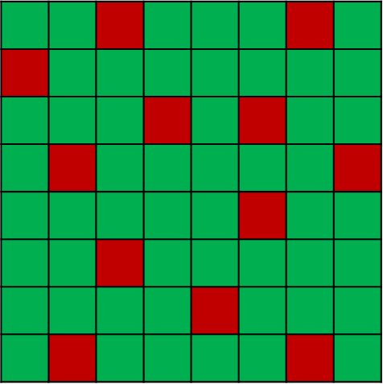
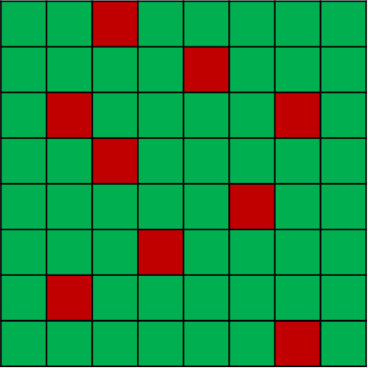
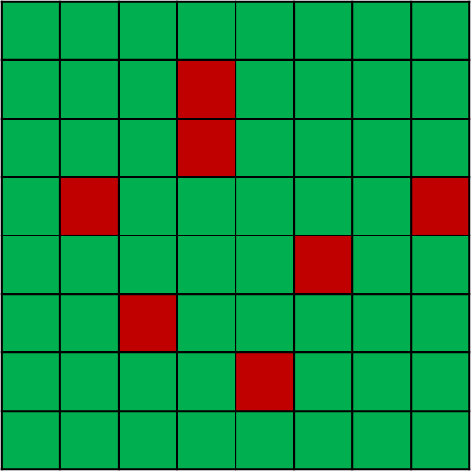
Data Write Process on an SSD (2)
When the SSD is full, old data must be deleted to release space for new data. When a user deletes and writes data, data in some blocks becomes invalid or aged.
Channel 0 block
Channel 1 block
Channel 2 block
Channel 3 block
SSD controller
Channel 4 block
Channel 5 block
Channel 6 block
Channel 7 block
Notes:
Green indicates valid data and red indicates invalid data. When the user no longer needs the data on a flash page, the data on this page becomes aged or invalid and its mapping relationship is replaced by a new mapping.
For example, host page A was originally stored in flash page X, and the mapping relationship was A->X. Later, the host rewrites the host page. Because the flash memory does not overwrite data, the SSD writes the new data to a new page Y. In this case, a new mapping relationship A->Y is established, and the original mapping relationship is canceled. The data in page X becomes aged and invalid, which is called garbage data.
The host continues to write data to the SSD until its space is used up. In this case, the host cannot write more data unless the garbage data is cleared.

Slide 53
Data Read Process on an SSD
Reads 4 KB of data
Channel 0 block
Channel 1 block
Channel 2 block
Channel 3 block
Reads 32 KB of data
4 KB
SSD controller
Channel 4 block
Channel 5 block
Channel 6 block
Channel 7 block
Notes:
Whether the read speed can be improved 8-fold depends on whether the data to be read is evenly distributed in the blocks of each channel. If the 32 KB data is stored in the blocks of channels 1-4, the read speed is improved 4-fold at most. That is why smaller files are transmitted at a lower rate.

Slide 54
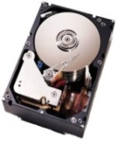
SSD Performance Advantages
SSD Performance Advantages
Power consumption under 100,000 read IOPS
I/O
I/O
IP/FC SAN
Seek time
Mechanical latency
2 SSDs
250 HDDs
Power (W)
4000
About 400-fold
2000
VS
HDD storage system
SSD storage system
SSD
FC HDD
Notes:
Short response time
Traditional HDDs spend most of the time in seeking and mechanical latency, limiting the data transmission efficiency. SSDs use NAND flash as the storage medium, which does not cause any seek time or mechanical latency, delivering quick responses to read and write requests.
High read/write efficiency
When an HDD is performing random read/write operations, the head moves back and forth, resulting in low read/write efficiency. In comparison, an SSD calculates data storage locations using an internal controller, which saves the mechanical operation time and greatly improves read/write efficiency.
When a large number of SSDs are used, they have a prominent advantage in saving power.

Slide 55
Use of SSDs in Storage Systems
Class A applications: high-concurrency applications featuring random reads and writes, such as databases
Class B applications: large files, images, and streaming media featuring sequential reads and writes
Class C applications: data backup or rarely used applications
Access frequency
A
SSD media
FC/SAS disk
SATA/NL-SAS/Tape
B
C
Data distribution
Notes:
80-20 rule
Data that needs to be frequently modified, read, or written accounts for 20% of the total storage capacity. Such data is called hot data and corresponds to class-A applications.
Tiered storage
Hot data is stored on SSDs, and data of class B and class C applications is stored on high-speed HDDs and common HDDs, respectively. This improves performance and reduces investment.

Slide 56
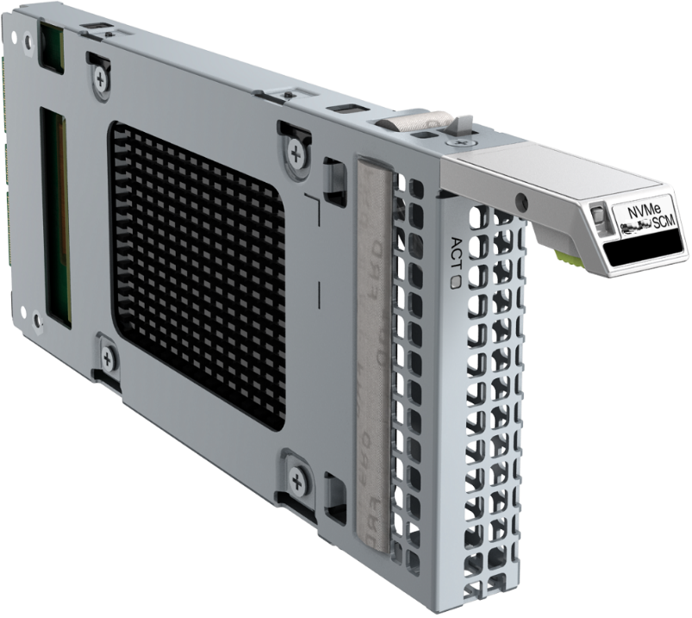
SCM Card
Storage class memory (SCM) is a new class of non-volatile memory. It is slightly slower than memory but much faster than NAND in terms of the access speed.
An SCM card is a cache acceleration card of the SCM media type. To use SmartCache for OceanStor Dorado V6 all-flash storage (6.1.0 and later versions), install an SCM card on the controller enclosure.
Notes:
SCM is the next-generation of storage media that features both persistence and fast access. Its read/write speed is faster than that of flash memory.
There are a wide variety of SCMs:
PCRAM/PCM: phase change memory
MRAM: magnetoresistive random access memory
STT-RAM: spin transfer torque random access memory
FeRAM: ferroelectric memory
RRAM: resistive random access memory
PFRAM: polymer memory

Slide 57
Intelligent Data Storage Components
Controller enclosure
Disk enclosure
Expansion module
Disk
Interface module

Slide 58
Front-End: GE Interface Modules
GE electrical interface module
10GE electrical interface module
40GE interface module
100GE interface module
Notes:
A GE electrical interface module provides four 1 Gbit/s electrical ports and is used for HyperMetro quorum networking.
A 10GE electrical interface module provides four 10 Gbit/s electrical ports for connecting storage devices to application servers, which can be used only after electrical modules are installed.
A 40GE interface module provides two 40 Gbit/s optical ports for connecting storage devices to application servers.
A 100GE interface module provides two 100 Gbit/s optical ports for connecting storage devices to application servers.

Slide 59
Front-End: RoCE Interface Modules
25 Gbit/s RoCE interface module
100 Gbit/s RoCE interface module
Notes:
Both 25 and 100 Gbit/s RoCE interface modules are used for connecting storage devices to application servers.

Slide 60
Front-End: SmartIO Interface Modules
Notes:
SmartIO interface modules support 8, 10, 16, 25, and 32 Gbit/s optical modules, which respectively provide 8 Gbit/s Fibre Channel, 10GE, 16 Gbit/s Fibre Channel, 25GE, and 32 Gbit/s Fibre Channel ports. SmartIO interface modules connect storage devices to application servers.
The optical module rate must match that on the interface module label. Otherwise, the storage system will report an alarm and the port is unavailable.

Slide 61
Back-End: 100 Gbit/s RDMA Interface Module and 12 Gbit/s SAS Expansion Module
100 Gbit/s RDMA interface module
12 Gbit/s SAS expansion module
Notes:
A 100 Gbit/s RDMA interface module provides two 100 Gbit/s optical ports for connecting controller enclosures to scale-out switches or smart disk enclosures. In the labels, SO stands for scale-out and BE stands for back-end.
A 12 Gbit/s SAS expansion module provides four 4 x 12 Gbit/s mini SAS HD expansion ports to connect controller enclosures to 2 U SAS disk enclosures.

Slide 62
Scale-out: 100 Gbit/s RDMA Interface Module and 25 Gbit/s RDMA Interface Module
25 Gbit/s RDMA interface module
100 Gbit/s RDMA interface module
Notes:
A 25 Gbit/s RDMA interface module provides four 25 Gbit/s optical ports for direct connections between two controller enclosures.
A 100 Gbit/s RDMA interface module provides two 100 Gbit/s optical ports for connecting controller enclosures to scale-out switches or smart disk enclosures. In the labels, SO stands for scale-out and BE stands for back-end.

Slide 63
Intelligent Data Storage System
Intelligent Data Storage Components
Storage System Expansion Methods

Slide 64
Scale-up and Scale-out
Developments in enterprise IT systems and service expansion have caused data to skyrocket. The initial configuration of storage systems cannot meet the demands, and now capacity expansion is a top concern for system administrators. There are two capacity expansion methods: scale-up and scale-out. The following uses Huawei storage products as an example to describe the two methods.
Storage controller
Storage controller
Devices (enclosure and disk)
Storage controller
Storage controller
Scale-out
Switch fabric
Storage controller
Scale-up
Storage controller
Scale-up
Scale-out
Notes:
Scale-up:
This traditional vertical expansion architecture continuously adds storage disks into the existing storage systems to supply capacity.
Advantage: simple operation at the initial stage
Disadvantage: As the storage system scale increases, resource increase reaches the bottleneck.
Scale-out:
This horizontal expansion architecture adds controllers to cope with demands.
Advantage: As the scale increases, the unit price decreases and the efficiency improves.
Disadvantage: The complexity of software and management increases.

Slide 65
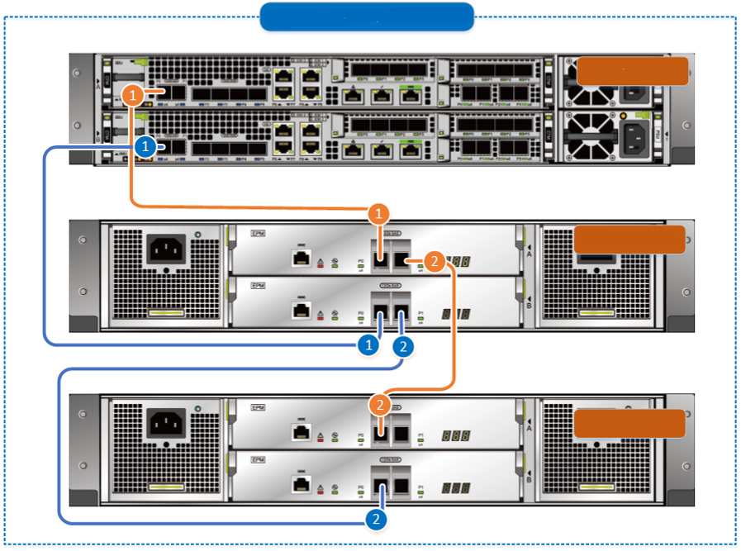
SAS Disk Enclosure Scale-up Networking Principles
Adding a 2 U SAS disk enclosure to an existing loop
Controller enclosure
2 U SAS
disk enclosure 0
2 U SAS
disk enclosure 1
Notes:
Huawei SAS disk enclosure is used as an example.
Port consistency: In a loop, the downlink (EXP) port of an upper-level disk enclosure is connected to the uplink (PRI) port of a lower-level disk enclosure.
Dual-plane networking: Expansion module A is connected to controller A and expansion module B is connected to controller B.
Symmetric networking: On controllers A and B, ports with the same port IDs and slot IDs are connected to one enclosure.
Forward and backward connection networking: Expansion modules A use forward connection and expansion modules B use backward connection. (OceanStor Dorado V6 and new converged storage use forward connection.)
Cascading level: The number of cascading disk enclosures cannot exceed the preset threshold.

Slide 66
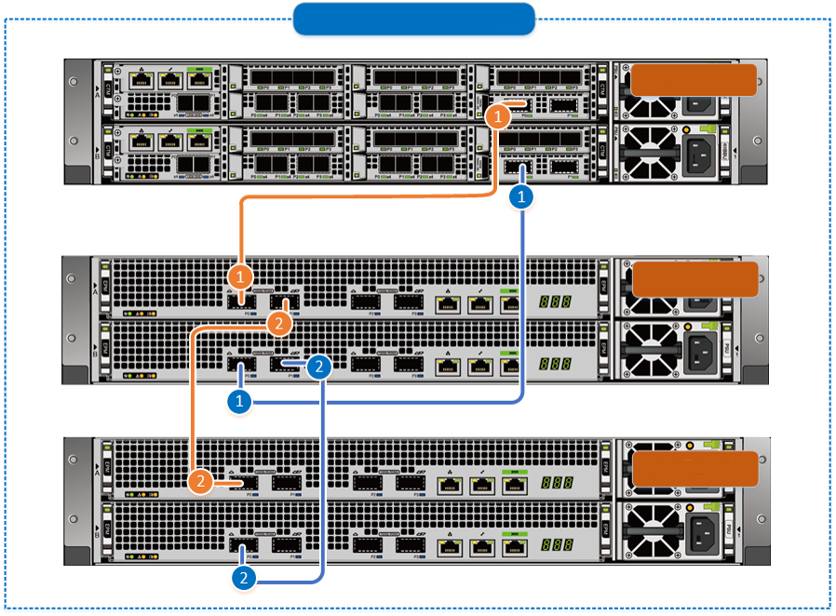
Smart Disk Enclosure Scale-up Networking Principles
Adding a 2 U smart disk enclosure to an existing loop
Controller enclosure
Smart disk enclosure 0
Smart disk enclosure 1
Notes:
Huawei smart disk enclosure is used as an example.
Port consistency: In a loop, the downlink port (P1) of an upper-level disk enclosure is connected to the uplink port (P0) of a lower-level disk enclosure.
Dual-plane networking: Expansion module A is connected to controller A and expansion module B is connected to controller B.
Symmetric networking: On controllers A and B, ports with the same port IDs and slot IDs are connected to one enclosure.
Forward connection networking: Both expansion modules A and B use forward connection.
Cascading level: The number of cascading disk enclosures cannot exceed the preset threshold.

Slide 67
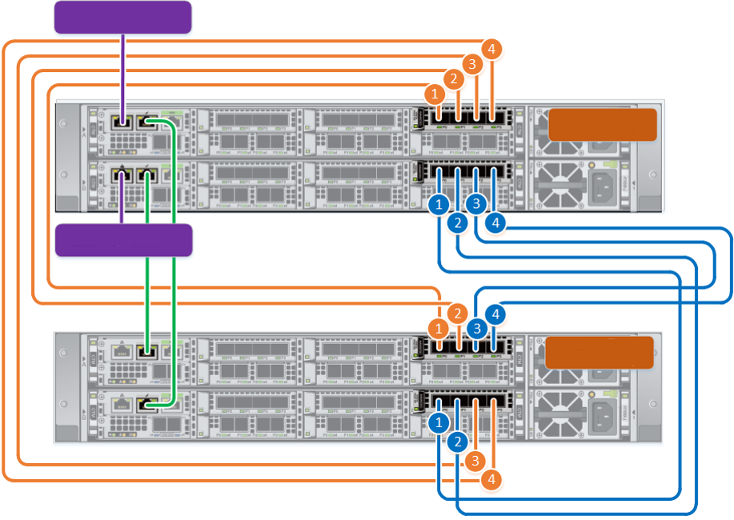
Scale-out Direct-Connection Networking
Connecting to the management network
Controller enclosure 0
(existing)
Connecting to the management network
Controller enclosure 1
(new)
Four-controller direct connection
The above figure shows the scale-out networking of Huawei OceanStor Dorado 5000 V6 and 6000 V6.
Notes:
This networking mode supports a maximum of four controllers. It cannot be expanded to eight-controller switch-based networking.
Eight optical fibers and 16 optical modules

Slide 68
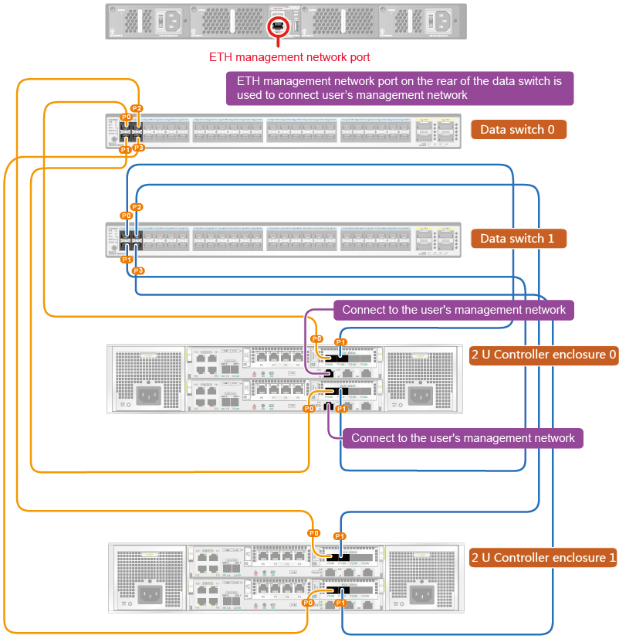
Scale-out Switched Networking
The networking can be switching networking or switch-free networking.
The management networks involve external and internal management networks.
The internal management network and internal data network share the same physical network. For details, see the orange and blue cables in the figure. QoS is used, minimizing the impact on the management channel and data channel.
The external management network only needs to enable the management network of two controllers in the first controller enclosure to connect to the user's management network. There is no need to connect controllers in other controller enclosures to the user's management network.
The ETH management network ports in the rear of a CE6850 switch are used to connect to the user's network.

Slide 69
Local Write Process
1
2
SAN
LUN
1
PCIe switched network
2
4
Engine 0
Engine 1
Engine 2
Engine 3
3
5
Notes:
The LUN to which a host writes data is owned by the engine to which the host delivers write I/Os. The process is as follows:
A host delivers write I/Os to engine 0.
Engine 0 writes the data into the local cache, implements mirror protection, and returns a message indicating that data is written successfully.
Engine 0 flushes dirty data onto a disk. If the target disk is on the local computer, engine 0 directly delivers the write I/Os.
If the target disk is on a remote engine, engine 0 transfers the I/Os to the engine (for example, engine 1) where the disk resides.
Engine 1 writes dirty data onto disks.

Slide 70
Non-local Write Process
1
4
SAN
1
4
LUN
2
PCIe switched network
3
6
5
Engine 0
7
Engine 1
Engine 2
Engine 3
Notes:
The LUN to which a host writes data is not owned by the engine to which the host delivers write I/Os. The process is as follows:
The LUN is owned by engine 0 and the host delivers write I/Os to engine 2.
After detecting that the LUN is owned by engine 0, engine 2 transfers the write I/Os to engine 0.
Engine 0 writes the data into the local cache, implements mirror protection, and returns a message indicating that data is written successfully.
Engine 2 returns the write success message to the host.
Engine 0 flushes dirty data onto a disk. If the target disk is on the local computer, engine 0 directly delivers the write I/Os.
If the target disk is on a remote engine, engine 0 transfers the I/Os to the engine (for example, engine 1) where the disk resides.
Engine 1 writes dirty data onto disks.

Slide 71
Local Read Process
1
2
SAN
1
LUN
2
PCIe switched network
5
8
Engine 1
Engine 2
Engine 3
Engine 0
3
4
6
7
Notes:
The LUN from which a host reads data is owned by the engine to which the host delivers write I/Os. The process is as follows:
A host delivers read I/Os to engine 0.
If the read I/Os are hit in the cache of engine 0, engine 0 returns the data to the host.
If the read I/Os are not hit in the cache of engine 0, engine 0 reads data from the disks. If the target disk to which data is written is on the local computer, engine 0 reads data from the disks.
After the read I/Os are hit locally, engine 0 returns the data to the host.
If the target disk is on a remote engine, engine 0 transfers the I/Os to the engine (for example, engine 1) where the disk resides.
Engine 1 reads data from the disk.
Engine 1 accomplishes the data read.
Engine 1 returns the data to engine 0, which then returns the data to the host.

Slide 72
Non-local Read Process
1
4
SAN
1
4
LUN
2
PCIe switched network
3
7
Engine 0
10
Engine 1
Engine 2
Engine 3
5
6
8
9
Notes:
The LUN from which a host reads data is not owned by the engine to which the host delivers write I/Os. The process is as follows:
The LUN is owned by engine 0 and the host delivers read I/Os to engine 2.
After detecting that the LUN is owned by engine 0, engine 2 transfers the read I/Os to engine 0.
If the read I/Os are hit in the cache of engine 0, engine 0 returns the data to engine 2.
Engine 2 returns the data to the host.
If the read I/Os are not hit in the cache of engine 0, engine 0 reads data from the disks. If the target disk to which data is written is on the local computer, engine 0 reads data from the disks.
After the read I/Os are hit locally, engine 0 returns the data to engine 2 and then engine 2 returns the data to the host.
If the target disk is on a remote engine, engine 0 transfers the I/Os to the engine (for example, engine 1) where the disk resides.
Engine 1 reads data from the disk.
Engine 1 accomplishes the data read.
Engine 1 returns the data to engine 0, and engine 0 returns the data to engine 2, which then returns the data to the host.

Slide 73
(Multiple-answer question) What are the types of SSDs?
SLC
MLC
TLC
QLC
(Multiple-answer question) Which of the following can be used to measure the performance of an HDD?
Disk capacity
Rotation speed
Data transfer rate
Average access time
Notes:
Answers:
ABCD
BCD

Slide 74
Intelligent data storage system
Controller
Controller enclosure
Coffer disk
Intelligent storage components
Intelligent data storage system
Disk enclosure
BBU
Expansion module
Expansion module
Device cables
HDD
Storage system expansion methods
Disk
SSD
Interface module
Scale-up
Scale-out

Slide 75
Huawei official websites
Enterprise business: https://e.huawei.com/en/
Technical support: https://support.huawei.com/enterprise/
Online learning: https://www.huawei.com/en/learning
Popular tools
HedEx Lite
Network Document Tool Center
Information Query Assistant
Notes:
Popular tools
HedEx Lite: Huawei product document management tool, which allows users to browse, search for, update, and manage product documentation.
eStor: A graphic storage simulation platform. Through simulation of Huawei OceanStor all-flash storage devices, the platform helps ICT practitioners and customers quickly get familiar with Huawei storage products, and understand and master their operations and configurations.
Network Documentation Tool Center: The documentation tool for network products is a good assistant for bidding support, network planning, project delivery, and upgrade and maintenance.
Information Query Assistant: provides command and alarm information query for Huawei products.

