Slide 1
Storage System O&M Management

Slide 2
As the cost of storage devices decreases, large-capacity storage devices are being used by more and more enterprises to store data generated by service application and IT systems, such as email, documents, service data, and data backups. Effective management of storage devices is therefore critical to the continuity and stability of enterprise services.

Slide 3
On completion of this course, you will understand:
General O&M management process
Common storage system O&M management tools
Processes and methods to tackle typical storage system O&M scenarios

Slide 4
O&M Overview
O&M Tools
O&M Scenarios

Slide 5
O&M
O&M is essentially the operation and maintenance of networks, servers, and services in each phase of their lifecycles to achieve a consistent and acceptable status in terms of cost, stability, and efficiency.
Asset management
Event management
Energy efficiency management
...
Organizational structure
Skill
Personnel allocation
...
Maintenance management
Personnel organization
Management
Resource
Maintenance tool
Knowledge base
Maintenance platform
...
Device maintenance
Device repair
Risk identification
...
Platform configuration
Technical assurance
Standard
Standard system
Process
ITIL
Uptime O&M
ISO 2000
...
Standard operation procedure
Emergency response process
Troubleshooting process
...
Notes:
O&M provides technical assurance for products to deliver quality services. Its definition varies by company and business stage.

Slide 6
How to Perform O&M
Technical layer: Streamline the O&M lifecycle of each product and identify the key measures of each task.
Process layer (ITIL process management framework): change, event, and problem management.
Before the device goes online
O&M/Operation period
Requirement
Model
selection
Design
Implementation
Online
O&M/
Operation
Offline
Process management
Requirement analysis
Configuration selection and architecture design
Offline specifications
Operation
Event management
Service rollout and maintenance transfer specifications
Problem management
Rollout and deployment specifications
Monitoring and security compliance
Change management
Capacity management and expansion
Configuration management
Performance and experience optimization
Emergency and DR drill
Release management
Cost and efficiency optimization
......
PRR management (performance, reliability, and recoverability)

Slide 7
Event Management
A
Objective
To restore services as soon as possible
To minimize the impact emergencies have on services
To ensure that service quality and availability meet the SLA requirements
B
Definition
Emergency
Any event that causes or may cause service interruption or service quality deterioration
Hardware faults, software faults, and service request interruption
C
Task
Detection and recording
Classification and online support
Priority (based on the impact and urgency)
Investigation and diagnosis
Solution and recovery
End
Responsibilities, monitoring, tracking, and communication
Notes:
Service level agreement (SLA)

Slide 8
Event Management Process
Transfer and supervision
Service request
Accident data
Problem management
Service desk
Incident management process:
Identification and record
Classification and initial support
Investigation and analysis
Solution and recovery
Incident termination
Temporary measures
Change requirement
Change management
Computer operations
Input: accident
Solution
Network
Report
Service level management
Output:
solution&
temporary measures
SLA parameters
Procedure
Report
Capability management
Other sources of accidents
Report
Availability management
Configuration information
Configuration management database (CMDB)
Notes:
Configuration management database (CMDB)

Slide 9
Problem Management
A
Objective
Locate the root cause of the problem and take measures to eliminate known errors.
Minimize the number of incidents caused by IT infrastructure errors and the negative impact of problems. Prevent the recurrence of error-related emergencies.
B
Definition
Problem: obtained from multiple emergencies with the same symptom or a major incident; indicates that an error with unknown causes exists.
Known errors: The root cause of a problem has been successfully located and a solution has been found.
C
Task
Problem control
Known error control
Proactive problem management
Trend analysis
Review of major issues

Slide 10
Problem Management Process
Incident management
Configuration management
Service level management
Capability management
Availability management
Matching information, emergency measures, and quick recovery solution
Information
Problem database
Problem management
Record
Information
Change request (RFC)
Post implementation review (PIR)
Change management
Notes:
Request for Change (RFC)
Post-implementation review (PIR)

Slide 11
Change Management
A
Objective
Ensure that all changes are effectively managed through standardized means and processes, and that approved changes are implemented with minimum risk, high efficiency, and high cost-effectiveness.
B
Definition
Change: An action that causes the status of one or more IT infrastructure CIs to change.
Standard change (approved in advance)
Request for Change (RFC)
Forward Schedule of Changes (FSC)
Change Advisory Board (CAB)
C
Task
Receive, record, approve, plan, test, implement, and review change requests.
Provide the IT infrastructure change report.
Modify CMDB.
Notes:
Configuration item (CI)
Forward Schedule of Changes (FSC)
Change Advisory Board (CAB)

Slide 12
Change Management Process
The input information includes:
Change request
Data provided by the configuration management database, especially information about the impact of changes
Change implementation schedule
Capability database provided by capability management and budget information provided by the financial management process
Change management
The output information includes:
Updated change implementation schedule
Signals that trigger the start of configuration management and release management
Agenda, minutes, and action items for CAB
Change management report
Configuration
management
Problem management
Release management
Incident management

Slide 13
Configuration Management
A
Objective
Measure the value of all IT assets and configuration items used in organizations and services.
Provide accurate information about IT infrastructure configuration for other service management processes.
Support operations conducted to manage incidents, problems, changes, and releases.
Verify the correctness of the configuration records related to the IT infrastructure and correct any detected errors.
B
Definition
Identify and define configuration items.
Plan, define, and manage the configuration management database.
Periodically verify the accuracy and integrity of CMDB.
Detailed report of IT assets
C
Task
Receive, record, approve, plan, test, implement, and review change requests.
Provide the IT infrastructure change report.
Modify CMDB.
Notes:
The infrastructure configuration information provided by the configuration management provides support for other service management processes. For example, the information helps the incident and problem management personnel research and analyze incidents and problems. The capability and availability management personnel analyze and assess the service capability and potential availability of the infrastructure based on the configuration information.
In configuration management, the most basic information unit is configuration items (CIs). All software, hardware, and documents, such as change requests, services, servers, environments, devices, network facilities, desktops, mobile devices, application systems, protocols, and telecom services, can be called configuration items.
The CMDB stores not only the configuration information of specific components in the IT infrastructure, but also the relationship between CIs.
Configuration management is different from IT asset management. The latter is a measurement process used to control and manage the depreciation of assets that exceed a certain value. It records the acquisition time, price, depreciation period, depreciation calculation method, and asset status and location. Configuration management tracks not only the information about configuration items, but also the relationships between configuration items and information about the standards and authorization of configuration items. Configuration management also records the ongoing status and changes in configuration items.

Slide 14
Configuration Management Process
Change management
Release management
Configuration management
Change request
Report and audit configuration information
Configuration management database
Definitive software library
Categorization & Plan
Report
Release
Update information.
Release and distribute the hardware and software for the new version.
(CMDB)
(DSL)
Implementation
Update CMDB & DSL.
Comment
End
Check whether CMDB is updated.

Slide 15
Release Management
A
Objective
Comprehensively assess changes to IT services and ensure that all aspects (technical and non-technical) of a release are considered.
B
Definition
Release
Delta release
Full release
Package release
Emergency release
Release policy
C
Task
Release planning
Design, development, and configuration release
Release review
Rollout plan
Communication, preparation, and training
Distribution and installation

Slide 16
Release Management Process
Design and development environment
Controlled test environment
Production environment
Release management
Release policy
Release planning
Release design, construction, and configuration
Construction and configuration release
Release test and acceptance
Preliminary run planning
Communication and training
Distribution
Installation
Configuration management database (CMDB)
Definitive Software Library (DSL)

Slide 17
O&M Overview
O&M Tools
O&M Scenarios

Slide 18
Components of Huawei Enterprise Storage O&M System
Customer Data Center
Huawei Technical
Support Center
Trouble submission
Remote processing
DME
Storage resource control
O&M administrator
Resource pooling & service orchestration
Server
eSight
Multi-device management
O&M administrator
Fault monitoring & performance report
eService
Cloud Platform
Fabric
Remote control
eService
Remote maintenance
O&M administrator
Fault monitoring & fault feedback
Storage
DeviceManager
DeviceManager
DeviceManager
Authentication system
18000
V3
9000
SmartKit
Storage service tool
Service personnel
Delivery & upgrade & troubleshooting
Device archive system
DeviceManager
Single Device Management
O&M administrator
Configuring & alarming
Trouble order handling system
Fault diagnosis expert system
Notes:
DeviceManager: single-device O&M software
SmartKit: a professional tool for Huawei technical support engineers. Features include compatibility evaluation, planning and design, one-click fault information collection, inspection, upgrades, and FRU replacement.
eSight: multi-device maintenance suite provided for customers. It facilitates fault monitoring and visualized O&M.
DME: intended for customers. It offers unified management of storage resource software, service catalogue orchestration, on-demand supply of storage services and data application services.
eService client: deployed in a customer's equipment room. It can detect exceptions in storage devices in real time and report them to the Huawei maintenance center.
eService on the cloud: deployed in the Huawei maintenance center. It monitors devices on the network in real time and turns passive maintenance into active maintenance. It can even conduct maintenance for customers.

Slide 19
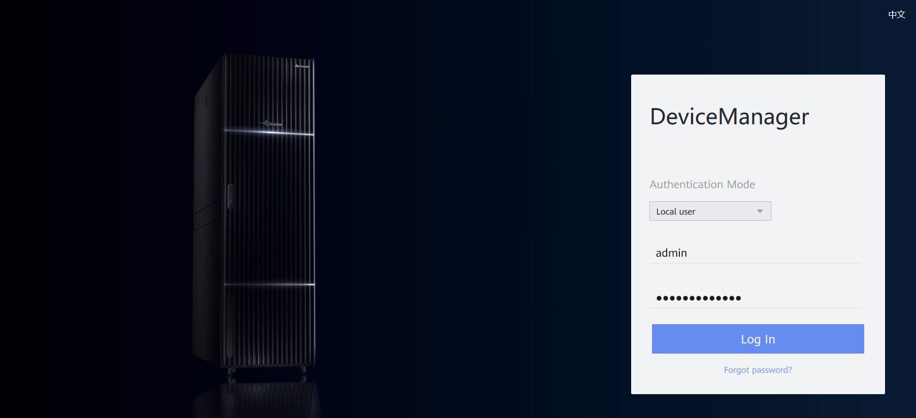
Main Functions of DeviceManager
DeviceManager is storage management software designed by Huawei for a single storage system. It can help you easily configure, manage, and maintain storage devices.
Main software functions include storage resource allocation, user management, data protection feature management, device performance monitoring, and alarm management.

Slide 20
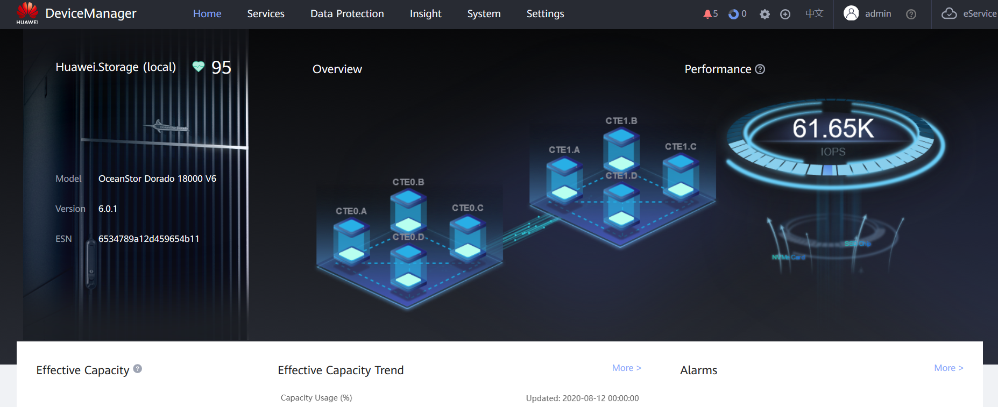
Home Page of DeviceManager

Slide 21
Introduction to SmartKit
1. Unified platform
The desktop tool management platform integrates O&M tools for storage systems, servers, and cloud computing.
2. Scenario-based guidance
Tools specific to each O&M scenario can be downloaded on demand.
3. Standardized operations
The wizard guides you through operations based on different scenarios in an easy and intelligent manner.
Notes:
SmartKit is a unified desktop management platform for all IT tools. It integrates various tools required for deploying, maintaining, and upgrading IT devices, and helping service and maintenance engineers perform precise operations on these devices to improve operating efficiency.

Slide 22
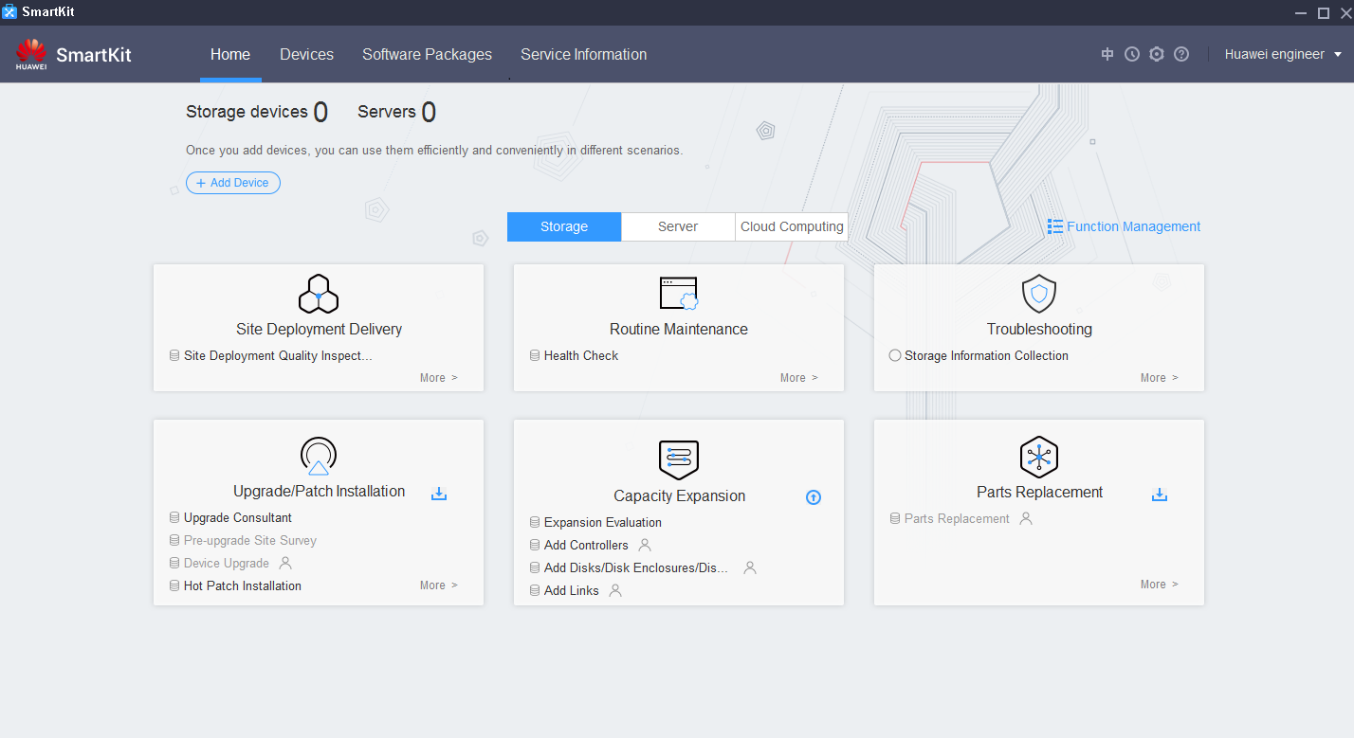
Home Page of SmartKit
Standardized and process-based operations for various service scenarios to improve operating efficiency
Function navigation bar
Domain
Function management
Device
Scenario-based entry
Notes:
Device: Adding the device you want to maintain
Devices are added and shared by multiple tools and scenarios.
Devices are imported/exported in a batch. You do not need to manually input information each time.
Typical application scenarios for SmartKit are as follows:
Site Deployment Delivery (installation and deployment): performs deployment checks in a standard manner to ensure the normal running of equipment post deployment.
Routine Maintenance: You can perform routine inspections and maintenance on devices using the wizard.
Upgrade/Patch Installation: You can upgrade devices and install patches using the process guide to improve efficiency.
Capacity Expansion: improves device performance or expands system capacity.
Parts Replacement: replaces faulty FRUs by following the wizard.
Troubleshooting: enables you to locate and solve common problems and faults with Huawei storage devices.

Slide 23
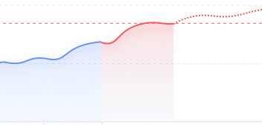
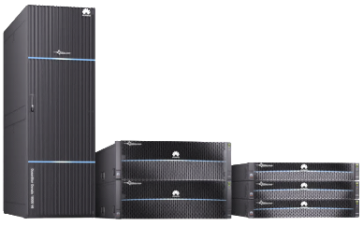
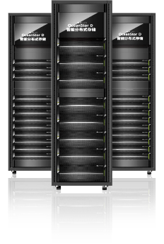
Introduction to DME
ITSM
Automation platform
Monitoring platform
Report platform
Northbound API
Planning
Construction
O&M
Optimization
Service level-based pooling and consolidation
Intelligent planning and automatic pooling
Flexible automation modes
Task scheduling
Automatic identification and proactive prevention
Automatic analysis and quick locating
Multi-dimensional analysis and optimization suggestions
One-click change and automated operations
Gold
Silver
Gold
Silver
Bronze
Southbound API
Huawei OceanStor
all-flash storage
Huawei OceanStor
distributed storage
FC switch
Third-party storage

Slide 24
DME Functions and Features
Planning
Construction
O&M
Optimization
SLA-based pooling and consolidation
Automatic provisioning
Proactive problem identification
Automatic problem resolution
Full-process automation
Configuration compliance/
data protection
SLA change
Workload evaluation
Auxiliary automation
Data flow (reclamation/migration)
Best practice implementation
QoS policy
Capacity threshold/
performance threshold
Task scheduling
Threshold policy
Capacity prediction/
performance prediction
Scheduling policy
Application templates
Disk service life prediction
Multi-dimensional analysis
SLA/cost/capacity/
performance
Quota policy
Automatic protection
Disk health/abnormal load
Automatic problem analysis
Application/device/
project/label
Protection policy
Copy creation
Automatic masking/
aggregation/association
Customized report/
large screen
Copy visualization
Copy enabling
Fast fault locating
Autonomous operation
E2E performance analysis
Policy-based autonomy
AI-based inference autonomy
E2E topology
Infrastructure management
User role management
Multi-DC management
Open API

Slide 25
Introduction to eSight
eSight provides multi-vendor device adaptation for unified network-wide device management, component-based architecture for on-demand construction of enterprise O&M platforms, and lightweight web client for lower system maintenance and upgrade costs.
Switches/Routers/WLAN Management
PON Management
……
Architecture
Platform + Components
UC/Telepresence, Video Surveillance Management
eLTE Management
Transport Device Management
eSight
Storage Management
Servers/Virtual Resources Management
Equipment
Room Facility Management
eSight Basic Management Platform
Notes:
Multi-vendor device adaptation for unified network-wide device management
eSight provides unified management of Huawei servers, storage devices, virtualization devices, switches, routers, WLAN devices, firewalls, PON devices, eLTE devices, unified communications devices, telepresence devices, video surveillance devices, application systems, and equipment room facilities. It also pre-integrates capabilities to manage mainstream devices from third parties like HP, Cisco, and H3C.
Component-based architecture for on-demand construction of enterprise O&M platforms
Using a component-based architecture, eSight provides various components for the unified eSight management platform. Customers can select components based on the site requirements.
Lightweight web client for lower system maintenance and upgrade costs
eSight uses the browser/server (B/S) architecture, which allows users to access the eSight client anytime anywhere without installing any plug-in. To perform a system upgrade or maintenance, the user needs only to update the server software.

Slide 26
Logical Architecture of eSight
Administrator
WLAN Management
Storage Capacity Management
Server Stateless Computing
Value-added
O&M
Network SLA & QoS management
Storage Network Analysis
Server Configuration and Deployment
Network Traffic Analysis Management
Business Service Management
Report Management
……
……
……
Communication Devices
Network Devices
eLTE Devices
Device
Management
Telepresence & Videoconferencing
Virtual Resources
PON Devices
Terminals
Servers
Transport Devices
Intelligent Video Surveillance
Storage Devices
Equipment Room Facilities
……
……
……
Management
Platform
eSight Management Platform
Managed object: server/storage/VM/switch/router firewall/……

Slide 27
Introduction to eService
Based on Cloud-Native, Huawei eService cloud intelligent management platform uses big data analysis and AI technologies to provide such services as automatic fault reporting, capacity and performance prediction, disk risk prediction, potential risk prevention, and providing a basis for capacity planning.
Reactive response
Service rollout delay
Complex management for multiple devices
Efficient O&M
Technical support capabilities
Rapid response
Real-time analysis
Intelligent forecasting
Asset platform
Cloud platform capability building
Proactive problem management
Intelligent forecasting and analysis
Asset management
24/7 remote monitoring for all IT devices, automatic fault reporting, and SR creation
Proactive problem handling reduces the troubleshooting duration and improves operating efficiency.
Intelligently identifies at-risk disks to ensure data security.
Predicts capacity needs for in the next 12 months to facilitate procurement planning.
Predicts performance bottlenecks based on performance fluctuation rules.
Collects device asset information for future reference.
Provides product EOX information and device maintenance data.
eService
Notes:
As many Huawei IT products, like storage devices, servers, and cloud computing products, are put into use, customers are setting higher requirements for troubleshooting efficiency. In traditional service support mode, technical support personnel provide local services manually. Faults may not be detected in a timely manner and information may not be delivered correctly. The eService cloud intelligent management system (eService for short) integrates cloud management, remote maintenance, automatic service request (SR) creation, and prediction and prevention functions to improve user O&M capabilities and takes planned maintenance actions to prevent potential risks.
eService provides a self-service O&M system for customers who demand precise information services.
Based on HUAWEI CLOUD, the eService cloud system conducts O&M activities using big data analytics and artificial intelligence (AI) to identify faults in advance, reduce O&M difficulties, and improve O&M efficiency.
Data is encrypted for secure transmission. eService can access the customer's system only after being authorized by the customer.
eService provides 24/7 secure, reliable, and proactive O&M services. SRs can be created automatically.
Customers can use any PC to access eService at any time or place to check device information.

Slide 28
System Architecture of eService
Customer network
Huawei network
FusionCloud
Intranet
DMZ zone
Email (optional channel)
Supports only fault monitoring.
ManageOne
OC/SC
DC1
DC2
Customer
Email server
Huawei
Email server
Cloud OS
Fusion Manager/Fusion Compute/Fusion Access/FusionSphere OpenStack OM
Internet
eSight
eService
cloud system
Storage
/Server
/Network
Network
eService Client
& FusionCare
HTTPS
Hardware layer
Storage
Fault monitoring
Remote inspection
Remote log collection
Capacity forecasting
Performance exception analysis
Disk prediction
Server
Proxy server
(Optional)
HTTPS
service
Maintenance host
Notes:
eService enables the client to work on a cloud system.
The eService client is deployed on the customer side.
It collects alarms on the customer devices and sends them to the eService cloud system for remote maintenance, such as inspections and log collection.
The eService cloud system is deployed at the Huawei technical support center.
The eService cloud system receives device alarms from the eService client in 24/7 mode, automatically notifies Huawei technical support personnel to handle the alarms in a timely manner, and supports automatic inspections and log collection for devices on the customer side.

Slide 29
O&M Overview
O&M Tools
O&M Scenarios

Slide 30
Routine Maintenance Items
03
02
Weekly maintenance items
01
Daily maintenance item
Inspecting storage device
Checking the equipment room environment
Checking the rack's internal environment
Initial maintenance items
Checking and handling alarms
Checking the SmartKit installation
Checking the eService installation and configuration
Checking the alarm policy configuration
Notes:
Using the maintenance check schedule, the system administrator can better understand the device's environment status. If an exception occurs, the system administrator can handle and maintain devices in a timely manner to ensure the storage system continues to run correctly.
Based on the frequency and required checks, routine maintenance is classified into the following categories: initial maintenance, daily maintenance, and weekly maintenance

Slide 31
Quick Maintenance Process
Start
Check indicator status
and handle related exceptions.
The indicators on the front and rear panels of the storage devices indicate the device running status and help you detect and rectify common hardware faults.
Check service status.
and handle related exceptions.
By checking the system information and service status, you can learn about the storage system's basic information, alarms, capacity trends, and performance. You can also view the status of storage resource allocation and value-added features.
Check system performance
and handle related exceptions.
You can query the real-time and historical performance statistics on DeviceManager.
Check and clear alarms.
If a fault occurs in the storage system, DeviceManager automatically determines the severity of the fault and reports an alarm. Maintenance personnel should rectify the fault in a timely manner to prevent service interruption or data loss.
Can the preceding
exceptions be handled?
Yes
No
Collect information and report faults.
End

Slide 32
O&M Scenario 1: Inspection
01
Background
After the storage devices purchased by Company E are deployed, services are running properly. To ensure the storage security of core devices in the service system, Engineer A in the IT department is in charge of inspecting storage devices. Help Engineer A design an inspection plan.

Slide 33
Inspection Method
Check the storage system
operating environment.
Manual
inspection
Inspection using tools
SmartKit inspection
DeviceManager inspection
Check the service
running status.
Check indicators.
Check the device
running status.
Notes:
Inspection using tools:
You can use SmartKit or DeviceManager to inspect storage devices.
If SmartKit is not installed, you can use the CLI to check the health status and operating status of a switch.
Manual inspection:
Maintenance engineers perform routine maintenance on site to check the condition of the environment and cabinet and the device's operating indicators. This way, they can proactively understand the device running status and discover exceptions.

Slide 34
O&M Scenario 2: Performance Monitoring
02
Background
Company E's business has gone online. To find out about the performance and usage of the storage device, Engineer B in the IT department is responsible for monitoring its performance. Help Engineer B monitor the performance of the storage device.

Slide 35
Performance Monitoring Process
Start
Different service scenarios have varied requirements on performance monitoring parameters. You can set performance monitoring parameters based on service requirements. Ensure that the performance monitoring function is enabled.
Set performance monitoring parameters.
Configure the threshold. If the threshold is exceeded, check the alarm information.
Configure the threshold.
Create a service-related indicator template so that you can view the indicators in a timely manner.
Create a metric chart.
After the dump function is enabled, newly generated performance monitoring files are automatically dumped to the specified application server through the SFTP or FTP protocol.
Configure performance monitoring file dump.
View performance monitoring data.
View storage device performance information, including real-time monitoring data, alarms, events, and power consumption.
View storage system performance information.
Check storage system alarm information.
Check storage system event information.
End
Check storage system power consumption.

Slide 36
Performance Monitoring Metrics
IOPS
For applications with an I/O size smaller than 64 KB, focus mainly on the IOPS.
For applications with an I/O size greater than or equal to 64 KB, focus mainly on the bandwidth.
Monitoring
metrics
Bandwidth
Latency
Notes:
The following indicators are used to measure the performance of a storage system:
IOPS indicates the number of processed I/Os per second. It measures the I/O processing capability of a storage system. It is a major performance indicator for online transaction processing (OLTP) services.
Bandwidth indicates the amount of data that can be processed per second, and the basic unit is MB/s or GB/s. It measures the storage system throughput. It is a major performance indicator for online analytical processing (OLAP), media asset, and video surveillance services.
Latency indicates the time duration from the initiation of an I/O request to the completion of I/O request processing. The basic unit is ms. Common indicators include the average response time and maximum response time. For example, the latency of OLTP services must be less than 10 ms and the latency for a virtual desktop infrastructure (VDI) must be less than 30 ms. The latency requirements for video on demand (VOD) and video surveillance services vary with bit rates.

Slide 37
Performance Metrics
1
Snapshot
1
Logical port
1
Heterogeneous iSCSI link
2
Front-end Ethernet port
2
Host
2
Heterogeneous FC link
3
LUN priority
3
Controller
3
Remote replication consistency group
4
Back-end SAS port
4
LUN
4
FC replication link
5
Front-end FC port
5
Storage pool
5
Remote replication
6
Front-end bound port
6
SmartQoS policy
6
System
7
Disk
7
LUN group
7
Host group

Slide 38
O&M Scenario 3: Parts Replacement
03
Background
After the storage system of Company E has been running for a while, it reports a disk failure and the disk must be replaced. After receiving the disk replacement request, Huawei technical support's Engineer C is going to the customer site to perform the replacement.

Slide 39
Parts Replacement Procedure
Start
Log in to SmartKit.
Remove cables from the component.
Check the system after the replacement.
Select the component to be replaced and start the replacement.
Remove the component.
Successful check
No
Rectify the fault as prompted.
Yes
Use the tool to perform the pre-replacement check.
Insert a new component.
Use the tool to perform the inspection.
Rectify the fault as prompted.
No
No
Successful check
Connect cables.
Successful check
Rectify the fault as prompted.
Yes
Confirm that the replacement is complete on the tool.
Yes
Use the tool to power off the component.
End

Slide 40
Replaceable Parts
FRU | CRU
Controller | Power module
Interface module | BBU module
System subrack | Fan module
Management module | Disk module
Cable | Expansion module
Assistant cooling unit | Optical module
Quorum server | -
Data switch | -
Notes:
Field Replaceable Units (FRUs) are components that engineers can replace at the deployment site by referring to instruction manual.
Customer Replaceable Units (CRUs) are components that customers can replace at the deployment site by referring to the CRU instruction manual.

Slide 41
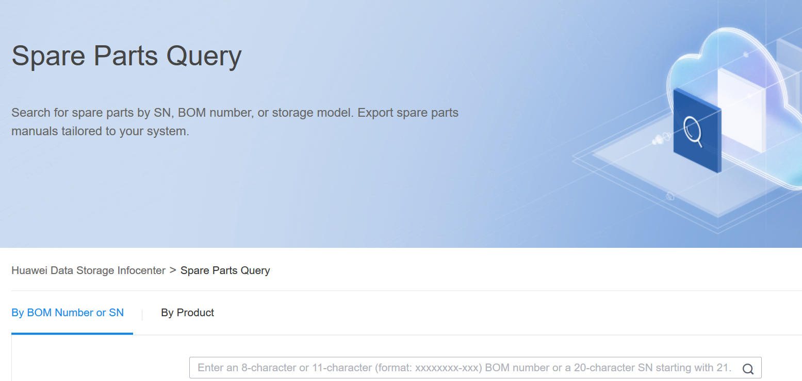
Spare Parts Query Assistant

Slide 42
Key Points for Disk Replacement
When handling a disk module, hold only its edge to prevent damage.
Remove and insert a disk module with even force. Excessive force may damage the appearance of the disk module or cause faults.
To avoid damaging disk modules, wait at least 1 minute between removal and insertion.
To prevent data loss, replace a disk module only when its Alarm/Location indicator is steady yellow.
Complete the replacement within five minutes of removing a disk module. Otherwise, the system heat dissipation is compromised.
Use SmartKit to replace an at-risk disk (not faulty).
Ensure that the replacement disk is inserted into the same slot as the disk being replaced. Otherwise, the system might not run correctly.

Slide 43
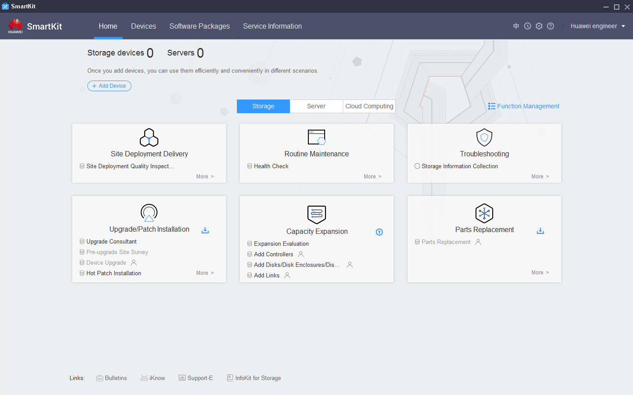
Disk Replacement Using SmartKit
Start SmartKit and select the parts replacement tool.

Slide 44
Disk Replacement Wizard

Slide 45
(Multiple-answer question) Which of the following are common management software?
DeviceManager
eSight
SmartKit
eService
(True or False) SmartKit integrates various tools required for deploying, maintaining, and upgrading IT devices, helping service and maintenance engineers perform precise operations on these devices to improve operating efficiency.
Notes:
Answers:
ABCD
T

Slide 46
Storage system O&M management
O&M overview
O&M concepts
O&M handling process
Common O&M tools
DeviceManager
Common O&M scenarios
SmartKit
eSight
DME
eService

Slide 47
Enterprise Technical Support App
Huawei Enterprise Service App
Notes:
Huawei training app
Contains a huge library of Huawei certified learning videos.
Enterprise technical support app
Covers all popular product documents, cases, and bulletins from Huawei. Users can quickly query commands, alarms, and spare parts. They can also use it to scan and view the device information. Simple and intuitive video guides provide 24/7 enterprise technical support.
Huawei enterprise business app
Provides one-stop mobile ICT portals for customers and partners to learn about Huawei's comprehensive products and solutions for enterprise ICT anytime and anywhere.

Slide 48
Huawei official websites
Enterprise business: https://e.huawei.com/en/
Technical support: https://support.huawei.com/enterprise/en/index.html
Online learning: https://www.huawei.com/en/learning
Popular tools
HedEx Lite
Network Document Tool Center
Information Query Assistant
Notes:
Popular tools
HedEx Lite is the Huawei tool for product document management. It allows users to browse, search, update, and manage product documentation.
eStor is a graphic storage simulation platform. The platform simulates Huawei OceanStor all-flash storage devices to help ICT practitioners and customers get familiar with Huawei storage products and quickly master their operations.
The Network Documentation Tool Center is the documentation tool for network products. It assists in bidding, network planning, project delivery, upgrades, and maintenance.
The Information Query Assistant provides command and alarm information querying for Huawei products.

