Slide 1
Backup Solution Introduction

Slide 2
This course introduces storage backup solutions for data centers broken down into five key segments:
Overview
Architecture
Network
Common technologies
Typical applications

Slide 3
After completing this course, you will be able to understand and master:
Technologies for storage backup solutions for data centers
Technical differences between backup and disaster recovery solutions
Deployment of backup solutions

Slide 4
Overview
Architecture
Network
Common Technologies
Applications

Slide 5
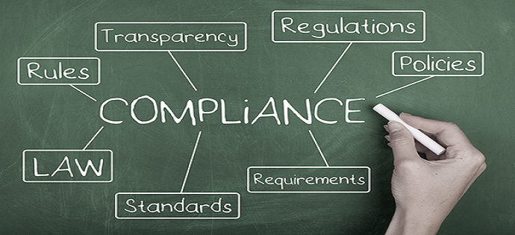
Why Is Backup Important?
Legal requirements on data protection
Risks of data loss
Human errors
Software and hardware failures
Viruses and hacker attacks
Natural disasters
Higher efficiency
Lower costs
Better data utilization
Gartner:
More than 30% of users use backup copies for development and testing, and more than 20% of users have a cloud-based disaster recovery system.
Notes:
Higher efficiency
Backup frequency in seconds
Linear increase in capacity and performance
Lower costs
Fewer non-production facilities
Reduced BC&DR storage capacity
Better data utilization
Use of BC&DR data in multiple scenarios, such as development and testing
Faster recovery of core services

Slide 6
What Is a Backup?
In information technology and data management, a backup refers to a copy of data in a file system or database that can be used to swiftly and promptly recover the valid data and resume normal system operations when a disaster or misoperation occurs.
Application server
Nature: Stores a copy of data elsewhere.
Purpose: Recovers data when an accident occurs.
LAN
Management server
Media server
Backup storage device
Notes:
Definition:
To cope with file or data loss or damage, data in computer storage devices is replicated to large-capacity storage devices, such as tapes.
Backup is a type of replication operation. Generally, backup data is stored in another format.
Backup helps recover data when necessary.
A backup system usually consists of the following components:
Backup server: A backup server is a carrier where the backup software runs. Generally, a backup server can be a PC server or midrange computer.
Backup software: As the core of the backup system, the backup software copies production data to storage media and manages backup data.
Storage device: It is a device that stores backup data. Generally, a storage device is a disk array, physical tape library, or virtual tape library.

Slide 7
Why Is Backup Irreplaceable?
Two servers ≠ Backup
System script ≠ Backup
X ≠ Backup
Availability
Security
× Heterogeneous networks
× Fault tolerance
× Openness
× Complex backup policies
× Large databases
× Special devices, such as tape libraries
A cluster ≠ Backup
A RAID array ≠ Backup
A dual-controller disk array ≠ Backup
System script ≠ Backup
High system availability
Physical fault tolerance
Accidental deletion
Logical damage
✓
×
✓: Supported
×: Not supported

Slide 8


Backup and DR
Backup vs. DR
Backup:
Recovers missing data.
Recovers damaged data.
Recovers historical data.
X Directly takes over services.
DR:
Recovers data from a recent point in time.
Directly takes over services.
X Recovers missing data.
X Recovers damaged data.
✓: Supported
×: Not supported
Backup focuses on data recoverability, while DR is focused on application continuity.
Backup is the basis of DR.

Slide 9
Backup and Archiving
Backup vs. Archiving
Backup:
Recovers data and system.
Meets the SLA (RPO and RTO).
Retains source data at the original location.
Provides control over data retention.
Archiving:
Retains data for a long time period.
Meets legal and efficiency requirements.
Only retains data copies and deletes source data.
Provides control over object retention.
✓: Supported
×: Not supported
Backup is for data recovery and archiving is for legal compliance.
Notes:
SLA: Service-level agreement

Slide 10
Considerations
Effective data recovery must be guaranteed.
Requirements
Objective: data recovery
Backup success rate
Reliable recovery
Multiple data copies
Availability of recovered data
Off-site protection
Compatibility for applications
Fast recovery
Backup mode
Minimal system impact
Backup data identification
Backup granularity
Recovery from a specified point in time
Data retention period

Slide 11
Challenges to Data Backup
A complex application
Challenges
Numerous data copies
Security threats
Notes:
Data backup represents a complex application.
Different machines, operating systems, databases, application software, and storage devices
Different versions
Data backup generates numerous data copies.
Backup policies
Retention period
Offline protection
Data backup also brings security threats.
Highly centralized data

Slide 12
Overview
Architecture
Network
Common Technologies
Applications

Slide 13

Components
Production center
Backup center
LAN
Application server
Backup management system
...
Consists of backup management software and servers.
Automatically initiates and performs a backup task and reads and writes data from the backup client to the backup media.
Application
server
Media
server
Backup management server
Database server
File server
SAN
Production storage
Backup media
Backup client
Backup network
Backup media
A client-side agent of backup software must be installed on service hosts that need to be backed up.
Backup data flows from the backup client to the backup server over the backup network.
TCP or IP network or Fibre Channel network
Devices that store backup data.
E.g. tape library, VTL, disk array, CD-ROM tower, and cloud storage
Notes:
A backup system usually consists of the backup server, backup software, and backup media (storage devices).
Backup software:
Master server (backup management server) manages all modules of a backup system and monitors configurations and processes for backup policies, backup tasks, and recovery.
Media server manages media devices, their communications, and I/Os. It is the middleware between the backup servers and media.
Client (backup client) is the target backup device. The software module client communicates with the master server.
Agent (database agent) is used for database backup.
Management console is a user GUI for managing the backup software operations.

Slide 14
Three Key Elements
Backup Window (BW)
Backup period for the backup system within a working period
Recovery Point Objective (RPO)
Tolerable amount of lost data
Recovery Time Objective (RTO)
Tolerable downtime
Data can be recovered from any point in time during this period.
A recovery task ends.
Recover applications.
A backup task starts.
A backup task ends.
A fault or disaster occurs.
A recovery task starts.
BW
00:00
RPO
06:00
RTO
12:00

Slide 15

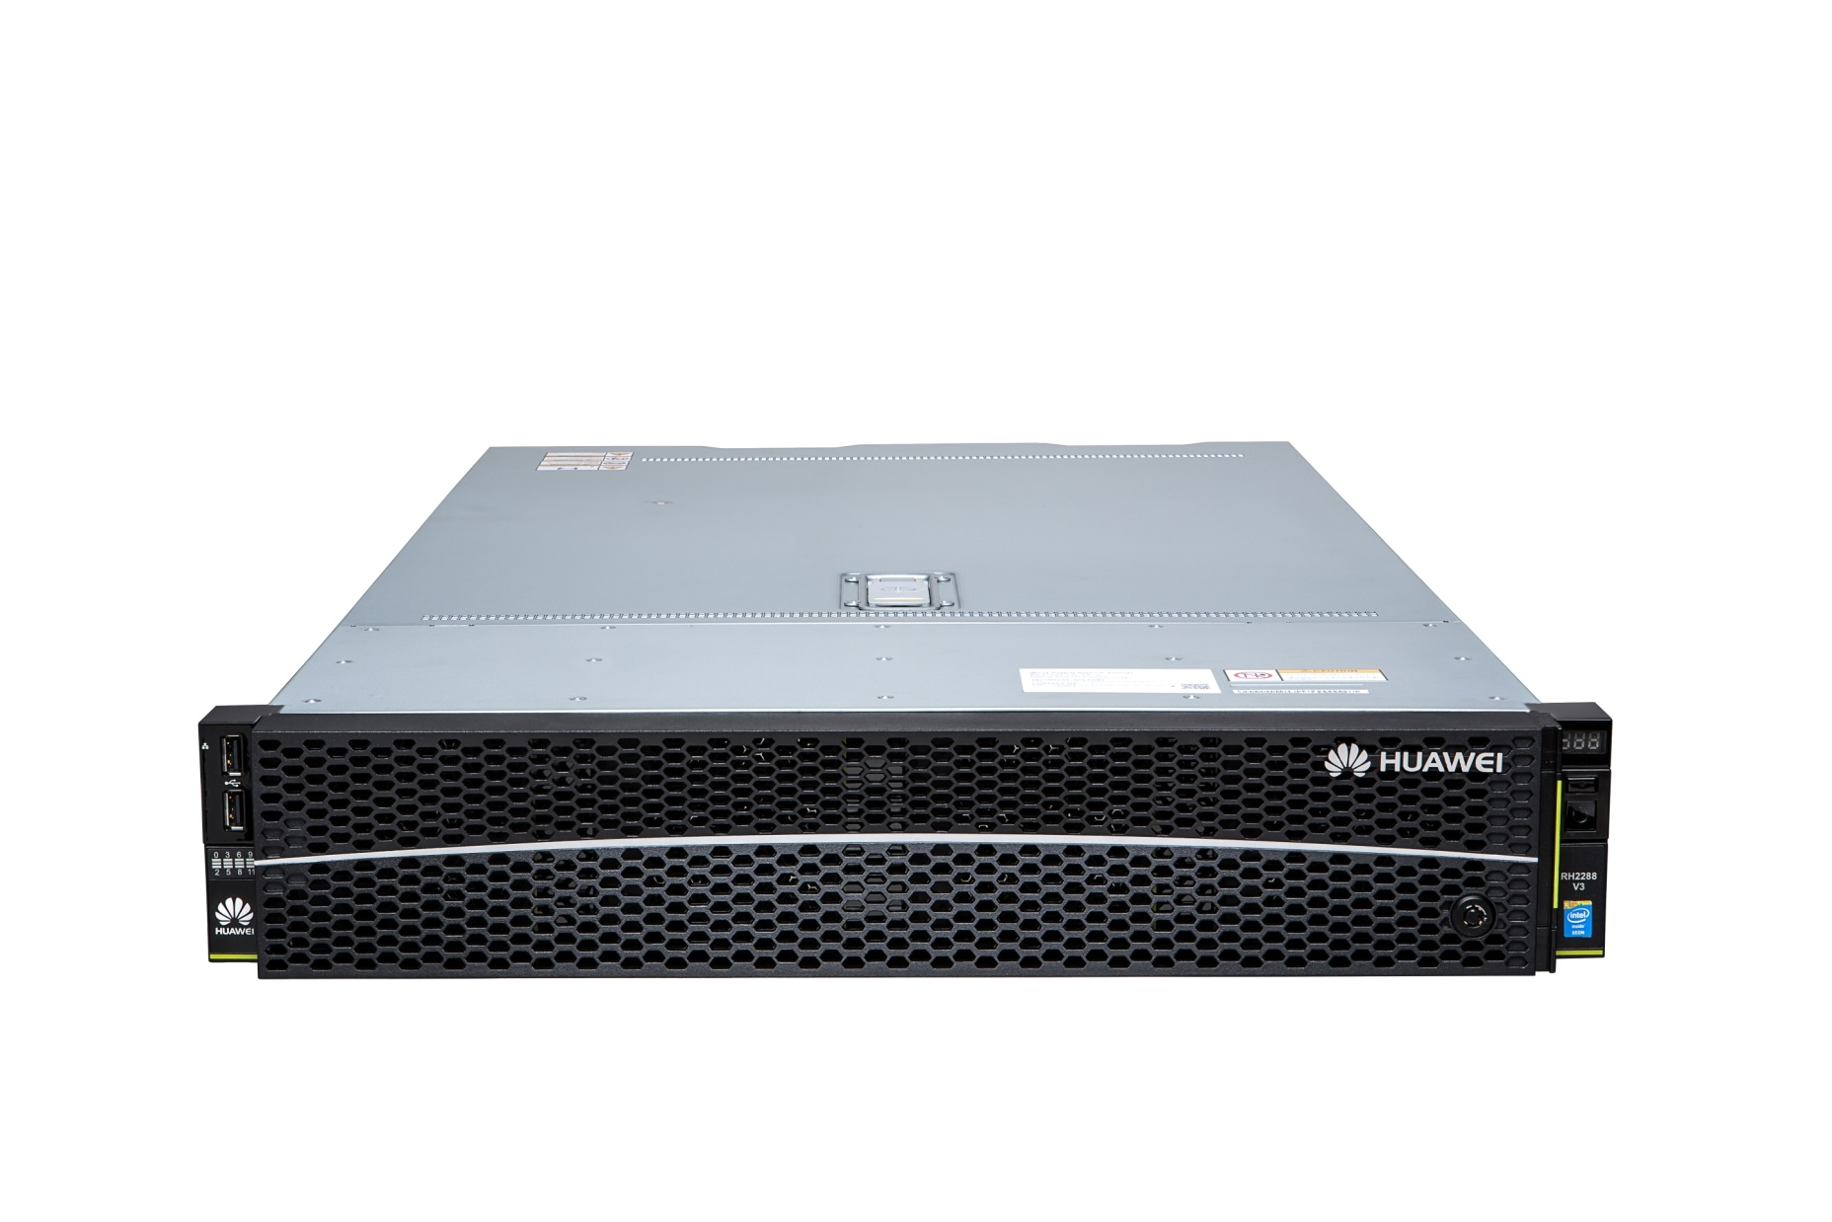
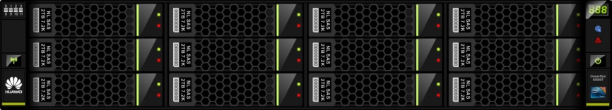
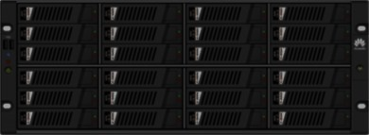
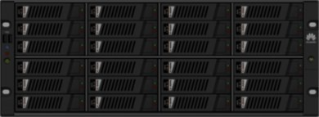

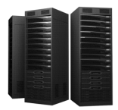



Backup Solutions
All-in-one backup
Enterprise branch and SMB local backup
Hybrid cloud backup
HUAWEI CLOUD
All-in-one backup node
Centralized backup
Centralized backup for data centers
Remote backup center
Backup node
Replication with deduplication
Backup node
Backup storage resource pool
Huawei OceanStor backup storage resource pool
Physical and virtual tape library
Notes:
All-in-one backup supports plug-and-play and is highly integrated and efficient.
Centralized backup provides secure and reliable backup for large-capacity data centers.
Virtual backup applies to virtual environments, such as FusionSphere and VMware.

Slide 16
All-In-One Backup Solution
Item | Description
Application | Local backup for small data centers
Benefits | Integrated backup server and backup storage, greatly reducing device acquisition and maintenance costs Broad compatibility for various operating systems, databases, and virtualization environments Comprehensive protection for virtual, physical, and cloud environments. P2P, P2V, V2V, and V2P migration scenarios Deduplication and compression Web UI for easy management, operation, and maintenance
Production server
...
A
A
Fibre Channel or IP
Data Protection Appliance
Production storage
A
Backup agent

Slide 17

Centralized Backup Solution
Center
Backup management node
(Backup software)
...
A
A
A
A
IP network
Production server
Backup service node
FC/IP
Production storage
Backup storage
(Backup software)
(Backup software)
Branch
Branch
A
Backup agent
Production server
...
Backup service node
Production server
...
A
A
A
A
A
All-in-one backup node
FC/IP
FC/IP
Production storage
Backup storage
Production storage
Notes:
A backup is the minimum requirement for disaster recovery. Currently, almost all service systems are backed up.
All-in-one backup solutions can meet the requirements of small- and medium-sized enterprises or branches. For data centers, centralized backup solutions are required.
Suitable backup solutions can be provided to carriers, large enterprises, and the finance, government, education, and medical sectors for their services that require data backup.

Slide 18

Cloud Backup Solution
Backup service management platform
ManageOne SC
Management flow
Data flow
Data protection service platform
DJ-DPS
HUAWEI CLOUD
Cloud platform
FusionSphere OpenStack
BC&DR management software
Cloud DC 2
Highlights
Huawei's unique two-level cloud backup solution can store backup data in the local data center, in the backup resource pool of the cloud data center, or in the S3 space of the public cloud.
Huawei VBS can back up data to the backup resource pool of the remote cloud data center and or in the S3 space of the public cloud, which can be used to build the two-level e-Government cloud.
Production storage
Backup storage
DC 1
Notes:
Only HUAWEI CLOUD is supported at present.
DJ-DPS, the Huawei data protection service platform, defines and encapsulates OpenStack-based DR capabilities as services and provides standard RESTful APIs of the DR services for upper-layer applications. This allows the cloud management platform to provide BaaS and DRaaS. DJ-DPS receives DR service requests (such as application, modification, cancellation, query, and service execution) from the cloud management platform and converts them into API invoking requests for OpenStack.

Slide 19
Overview
Architecture
Network
Common Technologies
Applications

Slide 20
LAN-Base
LAN
Data flow
Data flow
Agent
Agent
File service
Application service
Backup storage device
Data flow
Command flow
Notes:
For LAN-based backup, both data and control flows are transmitted over a LAN, consuming network resources.
Direction of backup data flows: The backup server sends a control flow to an application server where an agent is installed over a LAN. The application server responds to the request and sends the data to the backup server. The backup server receives and stores the data to a storage device. Backup is complete.
Strengths: The backup system and the application system are separated, conserving the application server's hardware resources during backup.
Weaknesses:
Additional backup servers increase hardware costs.
Backup agents adversely affect the performance of application servers.
Backup data is transmitted over the LAN, which adversely affects network performance.
Backup services must be separately maintained, complicating management and maintenance operations.
Users must be highly proficient at processing backup services.

Slide 21
LAN-Free
LAN
Application server
Application server
Backup server
Media server
SAN
Backup storage device
Storage device
Storage device
Data flow
Command flow
Notes:
Control flows are transmitted over a LAN, but data flows are not.
Direction of backup data flows: The backup server sends a control flow over a LAN to an application server where an agent is installed. The application server responds to the request and reads the production data. The media server reads the data from the application server and transmits the data to the backup media. Backup is complete.
Strengths: Backup data is transmitted without using LAN resources, significantly improving backup performance while maintaining high network performance.
Weaknesses:
Backup agents adversely affect the performance of application servers.
Expensive.
Devices must meet certain requirements.

Slide 22
Server-Free
LAN
Application server
Application server
Backup server
Media server
SAN
Backup storage device
Storage device
Data flow
Storage device
Command flow
Notes:
Control flows are transmitted over a LAN, but data flows are not.
Direction of backup data flows: Backup data is transmitted over an independent network without passing through production servers.
Strengths:
Backup data is transmitted without using LAN resources, so network performance is unaffected.
Host services are largely unaffected.
Backup performance is excellent.
Weaknesses:
Expensive
Devices must meet strict requirements.

Slide 23
Server-Less (NDMP)
LAN
Application server
Application server
Backup server
Media server
Tapes
Storage device
Data flow
Command flow
Notes:
NDMP is a standard network backup protocol. It has supported SAN storage backup since NDMP4.0, but most vendors support only NAS backup. NDMP supports two backup networking modes: (local) 2-way networking and 3-way networking. NDMP is also a server-free backup networking mode.
In the local 2-way backup mode, backup data is transmitted from the NDMP host (primary storage) to directly connected tapes under the control of the Data Management Application (DMA) which is generally the backup software management server, not over the LAN. Tape drives must reside on NDMP backup units, so the backup server must use NDMP to detect tape libraries and load tapes.
The NAS device serves as the primary storage device. The backup server instructs the NAS device to start a backup through the NDMP host on the LAN. The NAS device sends the backup data to the tape device that is directly connected to the NAS device through the fibre channel. An NDMP-based backup creates file snapshots on the primary storage and backs up data based on these snapshots. During the backup process, files and directories are transferred to the backup server through NDMP and then indexed and maintained.
In the 3-way backup mode, backup data is transmitted from the NDMP host (storage device) to the backup server and then written to tapes through the media server. The tape drive must be connected to the media server so that backup data can be transmitted over the LAN.

Slide 24
Architecture Comparison
Architecture | Strength | Weakness
LAN-Base | The backup system and the application system are separated, conserving the application server's hardware resources during backup. | Additional backup servers increase hardware costs. Backup agents adversely affect the performance of application servers. Backup data is transmitted over the LAN, which adversely affects network performance. Backup services must be separately maintained, complicating management and maintenance operations. Users must be highly proficient at processing backup services.
LAN-Free | Backup data is transmitted without using LAN resources, significantly improving backup performance while maintaining high network performance. | Backup agents adversely affect the performance of application servers. Expensive. Devices must meet certain requirements.
Server-Free | Backup data is transmitted using no LAN resources, and network performance remains unaffected. Host services remain nearly unaffected. Backup performance is excellent. | Expensive. Devices must meet strict requirements.
NDMP | Backup and recovery are faster. The throughput depends on the speed of storage devices rather than the processing capability of the server, which significantly improves system performance. | Server workloads are considerably reduced, but the backup software and its host server are still required to control the backup process. Metadata must be recorded in the backup software database, which still consumes CPU resources.

Slide 25
Overview
Architecture
Network
Common Technologies
Applications

Slide 26
Common Backup Types
Full backup
Cumulative incremental backup
Differential incremental backup
Sun.
Sun.
Sun.
Mon.
Mon.
Mon.
Tue.
Tue.
Tue.
Wed.
Wed.
Wed.
Thu.
Thu.
Thu.
Fri.
Fri.
Fri.
Sat.
Sat.
Sat.
Sun.
Sun.
Sun.
All data is fully backed up.
Easy management
A full backup is performed once a week.
During the rest of the week, changes since the last full backup are backed up every day.
A full backup is performed once a week.
During the rest of the week, changes since the last backup are backed up every day.
* The definitions of incremental backup may vary with the backup software.
Notes:
Full backup backs up all data at a point in time.
Strengths: Data can be quickly recovered using the last full backup. Recovery operations are fast.
Weaknesses: Large storage space is required. A backup operation takes a long time.
Cumulative incremental backup, also called incremental backup, is based on the last full backup. If no previous backup has been performed, all files are backed up.
Strengths: It reduces the storage space required for creating a full backup each time. Recovery and backup operations are fast.
Weaknesses: The last full backup and the current incremental backup are both required to fully recover data. The recovery time is shorter than that of a differential backup.
Differential incremental backup, also called differential backup, is based on the last backup, regardless of the type of the last backup. If no previous backup has been performed, all files are backed up.
Strengths: It saves the most storage space and requires a short backup window.
Weaknesses: The last full backup and each differential incremental backup are both required to fully recover data, resulting in a lengthy recovery duration.

Slide 27
Backup Policies
Data to be backed up
Files, operating systems, databases, software, logs...
Backup media
Disk, tape, cloud storage...
Backup type
Full backup, incremental backup, and differential backup
Deduplication policy
Source-side deduplication and target-side deduplication
Data retention period
One month or one year
Backup frequency
Daily or weekly
Backup window
One week or one month
Notes:
Selection of backup policies:
For operating systems and application software, a full backup should be performed when the operating systems are updated or new software is installed.
For critical application data that has a small total data volume but many data updates per day, a full backup should be performed within the backup window daily.
For critical applications that have fewer data updates per day, a full backup should be performed monthly or weekly. Incremental backup operations should also be performed frequently.

Slide 28




Deduplication
3. Maps data blocks to the fingerprint library.
1. Reads fingerprint data.
Storage unit
Processing unit
Fingerprint pool
Memory-level
File-level
Global
Task-level
Production server
Centralized backup solution
2. Transfers data with deduplication (data blocks with deduplication).
Global deduplication: A fingerprint library is shared globally.
Highlights: high deduplication ratio for optimal resource utilization
Memory-level deduplication: Fingerprint query and calculation are performed in the memory.
Highlights: conserved disk I/O resources for higher query efficiency
Task-level deduplication: Backup tasks for different types of applications use independent fingerprint databases.
Highlights: high fingerprint query efficiency and low memory usage
File-level deduplication: One fingerprint is created for each file, eliminating the need for data slicing.
Highlights: higher deduplication ratio
Fingerprint: It is a unique value calculated based on a data block by hashing.
Notes:
Huawei Data Protection Appliance supports global, task-level, memory-level, and file-level deduplication.
Variable-length data segmentation algorithm: intelligent, content-based, variable-length slicing technology.
Shorter backup window: Backup data is transmitted after being deduplicated at the source side, which reduces network pressure and transmission time.

Slide 29
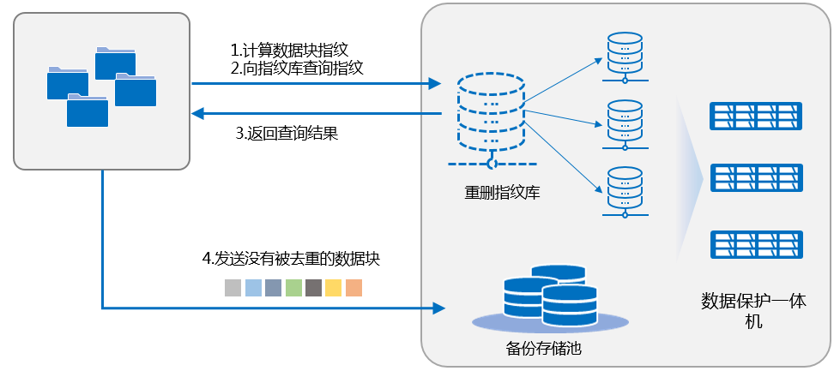
Source-Side Deduplication
Huawei Data Protection Appliance supports deduplication. That is, data is deduplicated before being transferred to the storage media, greatly improving backup performance.
1. Calculates the fingerprints of data blocks.
2. Queries fingerprints in the fingerprint library.
3. Returns the query result.
Deduplication fingerprint library
3. Transfers data blocks without deduplication.
Data Protection Appliance
Backup storage pool
Notes:
Huawei Data Protection Appliance supports source-side and parallel deduplication. Backup data is deduplicated before being transmitted to the storage media, greatly improving backup performance.
Data or files are sliced using an intelligent content-based deduplication algorithm. Then, fingerprints are created for data blocks by hashing, for querying identical fingerprints in fingerprint libraries. If identical fingerprints exist, it indicates that the same blocks are stored on the media servers. Existing blocks will be used to preserve backup capacity and bandwidth resources, and for streamlined data transfer and storage.
Digital transformations of enterprises have intensified the explosive growth of service data. The total amount of backup data that needs to be protected is also increasing sharply. In addition, more and more duplicate data is being generated from backup and archive operations. Mass redundant data consumes a lot of storage and bandwidth resources and leads to issues like long backup windows, which further affect the availability of service systems.

Slide 30
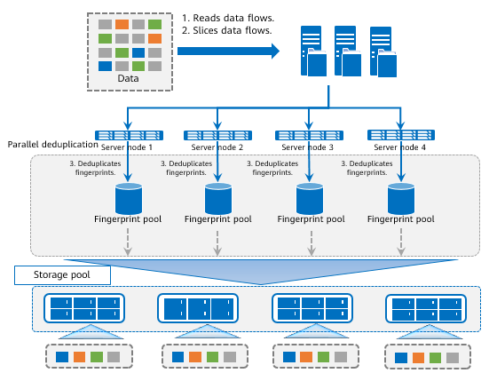
Parallel Deduplication
Parallel deduplication:
Deduplication fingerprint libraries are created on multiple nodes and fingerprints are distributed on these nodes. This effectively addresses the poor performance provided by a single node and saves storage space.
Notes:
Creates a fingerprint pool for deduplication to pool storage and computing resources for deduplication. A fingerprint pool contains a maximum number of 32 nodes.
Then creates fingerprint libraries in a fingerprint pool. All fingerprint libraries can simultaneously use the deduplication resources on each node in the fingerprint pool, for parallel deduplication.

Slide 31





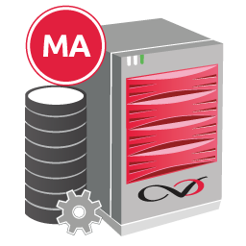

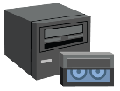
Snapshot Backup
Production LUN or volume
Recovers copies.
Snapshot is taken every two hours.
Storage array
Mount or Index
Retains copies.
Agent (media agent)
Disk
Tape
Notes:
Supports backup using the snapshot function of a storage system.
Supports agent-based backup.
Supports fast recovery.
Browses backup information and quickly recovers the selected object.
Consolidates incremental copies into a full copy in the background to quickly recover data.
Recovers data from hardware snapshots and performs fine-grained recovery using snapshots.
Recovers copies:
Storage array protection: native format, automatic storage detection, full integration (no script), and snapshot support
Storage array recovery: Recovers volumes, clones or mounts volumes, and copies data back.

Slide 32

Standard Backup
File systems
Windows, Linux, and UNIX
NeoKylin, Kylin, and Huawei Euler
Permanent incremental backup
Disk
Huawei Data Protection Appliance
Volumes
Windows and Linux
Parallel deduplication
Tape
Source-side deduplication
Operating systems
Windows, Red Hat, and SUSE
Databases
Oracle: RMAN (Recovery Manager)
SQL Server: Virtual Device Interface (VDI)
DB2: Vendor
MySQL: MySQL Plugin
GBase: GBase API
Informix, Dameng, Kingbase, and Shentong: export and import
Compression
Cloud
Encryption
Multi-channel backup
Virtualization platforms
VMware, H3C CAS, XenServer, Hyper-V,
FusionCompute, and Huawei HCS
Blu-ray optical disc
Agent-free backup
Concurrent backup
Object storage
Production data capture
Copy management
D2D2R or D2C
Notes:
File backup: Invokes the system API to traverse the directory structure in the file system and obtains the metadata information (such as the path, creation time, size, and attribute) of the file or folder through the API.
Volume backup: Allocates bitmaps according to a fixed block size to obtain data changes.
VMware backup: VDDK interface

Slide 33
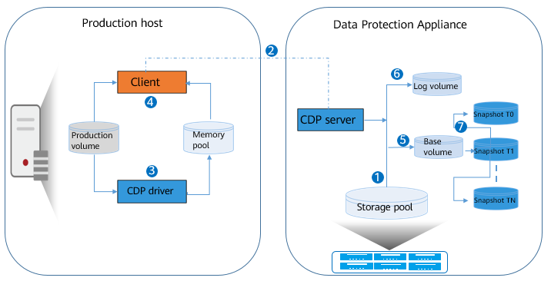
Continuous Backup
Continuous backup:
Data on production hosts is continuously backed up to the backup media.
With block-level continuous data protection, data can be stored in native format and both host-level and volume-level backups are supported.
Notes:
Continuous data protection (CDP) represents a revolutionary breakthrough in data backup technologies and includes continuous backup and continuous replication.
Compared with conventional data protection solutions, the CDP solution continuously records and backs up data changes at a specified frequency. In certain cases, the RPO can be approximately 0. When a disaster occurs, data can be quickly recovered from a specified point in time before the incident.
Continuous backup is a block-level continuous data protection technology. A backup agent host, which is installed on the customer's production host, continuously backs up the data on the customer's production host to the internal storage system of the Data Protection Appliance and stores the data in the native format of the file system. When certain conditions are met, the internal storage system creates snapshots to manage multiple points in time.

Slide 34
Notes:
Continuous backup process:
The snapshot storage pool allocates the base volume.
The agent client for continuous backup connects to the Data Protection Appliance's server.
The bypass monitoring drive in a partition of the production host continuously captures data changes and caches the same data changes to the memory pool.
The agent client for continuous backup continuously transfers data to a storage device in the Data Protection Appliance's snapshot storage pool.
Source data in the partition of the production host is written to the base volume.
Data changes on the production host are written to the log volume first, and then are written to the base volume storing the source data.
Snapshots of the base volume are managed based on the data retention policy for continuous backup.

Slide 35
Advanced Backup
Oracle
Fast recovery
Snapshot copy 1
Copy 1
Oracle RAC
Snapshot copy 1
Development and testing
Copy 2
Data mount and recovery in minutes
SQL Server
Snapshot copy 1
Application data extraction
Copy 3
Snapshot
VMware
Snapshot copy 1
...
Permanent incremental backup
Base volume
Snapshot copy 1
Copy n
Recovery to the
same host
Windows NTFS file system
Clone volume
Recovery to
another host
Recovery
The system periodically creates a snapshot copy for any point in time for the base volume and deletes a snapshot when a copy expires.
Users can access and use virtual copies on demand or instantly and benefit from diverse data services.
Users can obtain application-consistent production data copies in native format.
Production data capture
Copy management
Copy access and use
Notes:
Production data capture
Data is captured in native format.
Format conversion is not required, and data is accessible upon being mounted.
SLA policy can be customized based on applications to intuitively show data retention time, RPO, RTO, and data storage locations.
Copy management
1. Permanent incremental backup: Initial full backup and N incremental backups are performed. A full copy is generated at each incremental backup point in time. Damages to a copy at an incremental backup point in time will not impede recovery from any other point in time.
2. No rollback: Point-in-time copies created through a virtual clone can direct to both source data and current incremental data and can be used directly for recovery.
Copy access and use
No data movement: Data is mounted in minutes, and data volume does not affect recovery efficiency.
A virtual copy can be mounted to multiple hosts.
Data can be recovered from any point in time.
The host automatically takes over the original production applications after the virtual copy is mounted.

Slide 36
Overview
Architecture
Network
Common Technologies
Applications

Slide 37
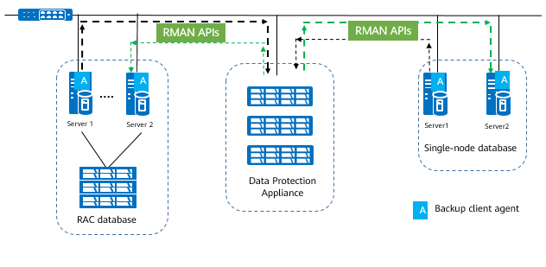
Database
Databases, such as GaussDB, Oracle, SQL Server, MySQL, DB2, and GBase, are supported.
* The preceding figure uses the Oracle database as an example.
Notes:
Backup process:
The backup client agent uses the API interface to invoke the backup API of the database, reads data in the database, and processes deduplication or encryption.
The backup client agent sends data to the Data Protection Appliance to complete the backup.
Data recovery process:
The administration console sends a recovery command to the backup client agent on the production server.
The backup client agent uses the API interface to invoke the database's recovery API.
The backup client agent reads data from the backup server and sends the same data to the recovery API to complete the recovery.
The Data Protection Appliance connects to the database through a dedicated API for backup. The API varies with databases. For example, Oracle’s RMAN interface and SQL Server's VDI interface.

Slide 38
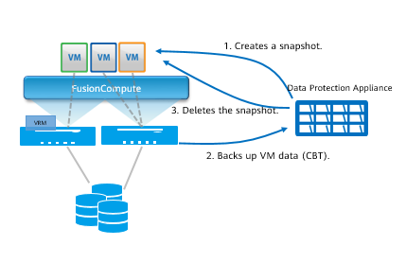
Virtualization Platform
Virtualization platforms, such as VMware, FusionCompute, HCS, CAS, OpenStack, XenServer and Hyper-V, are supported.
Notes:
Backup process:
Create a VM snapshot.
Back up VM data, including VM configuration information and virtual disk data.
Obtain and back up valid blocks (full backup) or incremental blocks (incremental backup) on virtual disks with CBT.
Delete the VM snapshot created in step 1.
Recovery process:
For recovery to a new VM, create a VM based on the original configuration and manual configuration of the VM.
To recover by overwriting a VM, manually configure the VM to be overwritten.
Read the disk block data at the corresponding point in time from the Data Protection Appliance and write the same data to a disk of the VM created in step 1.
The backup and recovery solution for FusionCompute VMs in FusionStorage scenarios is different from the solution for virtual storage scenarios. In FusionStorage scenarios, VM disks correspond to LUN volumes on FusionStorage. Changed data blocks in VM disks are obtained through the bitmap provided by FusionStorage.

Slide 39
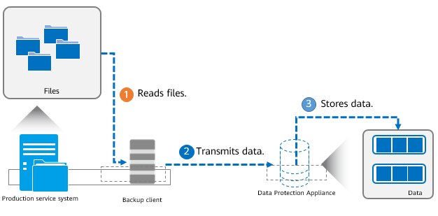
File System
Notes:
Backup process:
The client on the service production system reads files and data to be backed up.
The client transmits data over the network.
The Data Protection Appliance receives and stores the data on physical media. The backup is complete.
Host status check (Windows and Linux)
Windows:
After installing the client, press Windows+R. In the Run dialog box that is displayed, enter services.msc to open the service management window. Then, check whether the client service was started normally. If the client service was started normally, check whether the client is connected to the server. If connected, you can create a standard backup plan for a file system.
Linux:
The process for backing up a Linux file system is similar the process for backing up a Windows file system. Check the host service or process. If the client is connected to the server, you can create a standard backup plan for a file system. The check commands used in CentOS 7 are as follows:
systemctl status HWClientService.service
ps -ef|grep esf

Slide 40
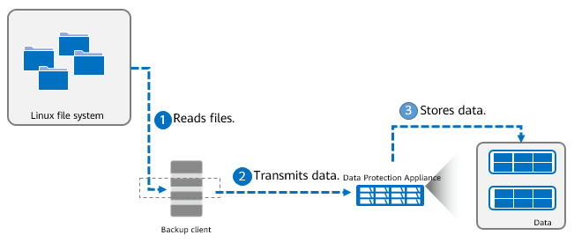
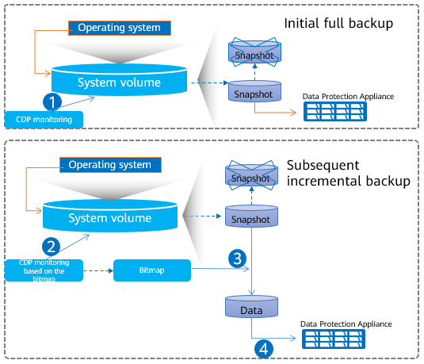
Operating System
Windows
Linux
One of the defining features of Linux operating systems is that everything is a file. Therefore, to back up a Linux operating system, we only need to back up the files in the operating system, modify configuration file, and boot upon recovery.
Notes:
Backup process:
Install the client to acquire information about the operating system.
For Windows, invoke the VSS interface to create a snapshot for the volume where the operating system resides. For Linux, select the data source to be backed up.
Read the data of the volume where the operating system resides and back up the same data to the storage media in the Data Protection Appliance.
The backup is complete (for Windows, delete the snapshot).
Recovery process:
Load the WinPE or LiveCD to boot the recovery environment. For Linux, install the client.
For Windows, manually partition the disk.
Recover the operating system data from the storage media to the specified system volume.
For Windows, use the system API to load the driver, modify the registry, and rectify BSOD. For Linux, modify the configuration file.
Reboot the operating system upon completion of recovery.

Slide 41
(Multiple-answer question) Which are not common backup types?
Full backup
Incremental backup
Extension backup
Elastic backup
(Single-answer question) Which is not a common backup topology?
LAN-Base
LAN-Free
Server-Free
Server-Base
Notes:
Answers:
CD
D

Slide 42
Backup solution
Overview
Architecture
Network
Common technologies
Applications

Slide 43




Enterprise Technical Support App
Huawei Enterprise Service App
Notes:
Huawei training app
Contains a huge library of Huawei certified learning videos.
Enterprise technical support app
Covers all popular product documents, cases, and bulletins from Huawei. Users can quickly query commands, alarms, and spare parts. They can also use it to scan and view the device information. Simple and intuitive video guides provide 24/7 enterprise technical support.
Huawei enterprise business app
Provides one-stop mobile ICT portals for customers and partners to learn about Huawei's comprehensive products and solutions for enterprise ICT anytime and anywhere.

Slide 44
Huawei official websites
Enterprise business: https://e.huawei.com/en/
Technical support: https://support.huawei.com/enterprise/en/index.html
Online learning: https://www.huawei.com/en/learning
Popular tools
HedEx Lite
Network Document Tool Center
Information Query Assistant
Notes:
Popular tools
HedEx Lite is the Huawei tool for product document management. It allows users to browse, search, update, and manage product documentation.
eStor is a graphic storage simulation platform. The platform simulates Huawei OceanStor all-flash storage devices to help ICT practitioners and customers get familiar with Huawei storage products and quickly master their operations.
The Network Documentation Tool Center is the documentation tool for network products. It assists in bidding, network planning, project delivery, upgrades, and maintenance.
The Information Query Assistant provides command and alarm information querying for Huawei products.

