Slide 1
Storage System Architecture Evolution

Slide 2
With the development of cloud computing and big data, the storage architecture is changing from scattered to centralized, and is gradually evolving to network-based, virtualized, and massive data cloud storage. Storage not only needs to provide routine services such as data management, data replication, snapshot, mirroring, and migration, but also needs to enable functions such as data disaster recovery, data consistency, virtualized convergence, elastic computing, and resource expansion. These services and functions depend on a good storage system architecture.

Slide 3
On completion of this course, you will be able to understand:
Storage architecture evolution and expansion methods
Huawei storage product architecture

Slide 4
Storage System Architecture Evolution
Storage System Expansion Methods
Huawei Storage Product Architecture

Slide 5
Storage System Architecture Evolution
Single controller
Dual controllers
Multiple controllers
Distributed architecture
Notes:
The storage system evolved from a single controller to mutual backup of dual controllers that processed their own tasks before processing data concurrently. Later, parallel symmetric processing was implemented for multiple controllers. Distributed storage has become widely used thanks to the development of cloud computing and big data.
Currently, single-controller storage is rare. Most entry-level and mid-range storage systems use dual-controller architecture, while most mission-critical storage systems use multi-controller architecture.

Slide 6
Single-controller Storage
SCSI interface
Logical disks are presented to hosts as LUNs.
Controller
Terminator
SCSI controller
OS
Host
Single-controller storage
Notes:
Just a Bound Of Disks (JBOD) refer to a collection of disks, usually called a disk chassis.
External disk array with RAID controllers: Using a disk chassis, a disk array virtualizes internal disks into logical disks through RAID controllers, and then connects to an SCS interface on a host through an external SCSI interface.
Independent external device: Disks and controllers are independent external devices of a server. These devices have allowed storage technology to become a huge independent subject that continues to grow.
If a storage system has only one controller module, it is a single point of failure (SPOF).

Slide 7
Dual-controller Storage
Services are running on only one controller.
Services are running on both controllers.
Controller A
Controller B
Controller A
Controller B
Active-Standby
Active-Active
Notes:
Active-Standby
This is also called high availability (HA). That is, only one is working at a time, while the other waits, synchronizes data, and monitors services. If the active controller fails, the standby controller takes over its services. In addition, the active controller is powered off or restarted before the takeover to prevent brain split. The bus use of the active controller is released and then back-end and front-end buses are taken over.
Active-Active
Two controllers are working at the same time. Each connects to all back-end buses, but each bus is managed by only one controller. Each controller manages half of all back-end buses. If one controller is faulty, the other takes over all buses. This is more efficient than Active-Standby.
Currently, dual-controller architecture is mainly used in mainstream entry-level and mid-range storage systems.

Slide 8
Mid-range Storage Architecture Evolution
Fixed storage system configuration
Dual-controller active-active redundancy configuration
Flexible hardware component configuration
Flexible software function configuration
Limited Fibre Channel interfaces are provided. Flexibility is poor. Capacity expansion can be implemented only by cascading disk enclosures.
Single-controller and dual-controller active-passive architecture gradually evolve to active-active architecture.
Fast Ethernet (FE) interface modules are supported, greatly improving flexibility and scalability.
The number of ports can be selected as required.
Unified storage that supports both SAN and NAS protocols has become a hotspot. Users can flexibly configure multi-protocol services as required.
Notes:
Mid-range storage systems always use an independent dual-controller architecture. Controllers are usually of modular hardware.
The evolution of mid-range storage mainly focuses on the rate of host interfaces and disk interfaces, and the number of ports.
The common form factor is the convergence of SAN and NAS storage services.

Slide 9
Multi-controller Storage
Controller A
Controller B
Controller C
Controller D
SAS controller
SAS controller
SAS controller
SAS controller
SAS expander
SAS expander
Disk enclosures
Disk enclosures
Notes:
Most mission-critical storage systems use multi-controller architecture.
The main architecture models are as follows:
Bus architecture
Hi-Star architecture
Direct-connection architecture
Virtual matrix architecture

Slide 10
Mission-Critical Storage Architecture Evolution
Bus architecture
Hi-Star architecture
Direct-connection architecture
Virtual matrix architecture
Scale-up multi-controller architecture based on bus interconnection and upgrade using more powerful CPUs, interface modules, memory, and protocols
Switch-based connection of front-end interfaces, back-end disk interfaces, and cache modules, and back-end Fibre Channel connection
Front-end interfaces and back-end disk interfaces directly connected to cache resources to avoid latency caused by bus and switch connection
Scale-out expansion mode, full switching mode, x86 platform, and loose coupling
Notes:
In 1990, EMC launched Symmetrix, a full bus architecture. A parallel bus connected front-end interface modules, cache modules, and back-end disk interface modules for data and signal exchange in time-division multiplexing mode.
In 2000, HDS adopted the switching architecture for Lightning 9900 products. Front-end interface modules, cache modules, and back-end disk interface modules were connected on two redundant switched networks, increasing communication channels to dozens of times more than that of the bus architecture. The internal bus was no longer a performance bottleneck.
In 2003, EMC launched the DMX series based on full mesh architecture. All modules were connected in point-to-point mode, obtaining theoretically larger internal bandwidth but adding system complexity and limiting scalability challenges.
In 2009, to reduce hardware development costs, EMC launched the distributed switching architecture by connecting a separated switch module to the tightly coupled dual-controller of mid-range storage systems. This achieved a balance between costs and scalability.
In 2012, Huawei launched the Huawei OceanStor 18000 series, a mission-critical storage product also based on distributed switching architecture.

Slide 11
Storage Software Technology Evolution
Improved data reliability
Simplified data management
Improved space utilization
Optimized service performance
Emergence of snapshot, clone, and data replication (synchronous and asynchronous) technologies
Storage devices are flexibly managed by centralized management software. Thin provisioning technology resolves conflicts between resource investment and optimal use.
Tiered storage promotes storage space utilization and service efficiency. The data deduplication technology reduces maintenance and capacity expansion costs.
Performance is optimized according to service types. Resources are allocated according to service importance. Storage resources are balanced and shared flexibly and globally.
Notes:
A storage system combines unreliable and low-performance disks to provide high-reliability and high-performance storage through effective management.
Storage systems provide sharing, easy-to-manage, and convenient data protection functions. Storage system software has evolved from basic RAID and cache to data protection features such as snapshot and replication, to dynamic resource management with improved data management efficiency, and deduplication and tiered storage with improved storage efficiency.

Slide 12
Distributed Storage Architecture
VBS
iSCSI initiator
HDFS client
S3/Swift client
Compute node
Compute node
VBS
EDS-F
EDS-F
EDS-F
OBJ service
OBJ service
OBJ service
EDS-B
EDS-B
EDS-B
HDFS service
HDFS service
HDFS service
Block
service
Block
service
Block
service
OBJ index
OBJ index
OBJ index
Storage pool (Block)
Storage pool (HDFS)
Storage pool (Object)
Index
Index
Index
Index
Index
Index
MDC
MDC
MDC
OSD
OSD
OSD
OSD
OSD
OSD
OSD
OSD
OSD
CM
CM
CM
Server node
Server node
Server node
Server node
Server node
Server node
Server node
Server node
Server node
Note: Huawei OceanStor 100D is used as an example to describe distributed storage architecture.
Notes:
A distributed storage system organizes local HDDs and SSDs of general-purpose servers into a large-scale storage resource pool, and then distributes data to multiple data storage servers.
Currently, distributed storage of Huawei learns from Google, building a distributed file system among multiple servers and then implementing storage services on the file system.
Most storage nodes are general-purpose servers. Huawei OceanStor 100D is compatible with multiple general-purpose x86 servers and Arm servers.
Protocol: storage protocol layer. The block, object, HDFS, and file services support local mounting access over iSCSI or VSC, S3/Swift access, HDFS access, and NFS access respectively.
VBS: block access layer of FusionStorage Block. User I/Os are delivered to VBS over iSCSI or SCSI.
EDS-B: provides block services with enterprise features, and receives and processes I/Os from VBS.
EDS-F: provides the HDFS service.
Metadata Controller (MDC): The metadata control device controls distributed cluster node status, data distribution rules, and data rebuilding rules.
Object Storage Device (OSD): a storage device for storing user data in distributed clusters of the object storage device
Cluster Manager (CM): manages cluster information.

Slide 13
Storage Architecture Evolution
Storage System Expansion Methods
Huawei Storage Product Architecture

Slide 14
Scale-up and Scale-out
Service data continues to increase with the continued development of enterprise information systems and the ever-expanding scale of services. The initial configuration of storage systems is often not enough to meet these demands. Storage system capacity expansion has become a major concern of system administrators. There are two capacity expansion methods: scale-up and scale-out. The following uses Huawei storage products as an example to describe the two methods.
Storage controllers
Devices (enclosures and disks)
Storage controllers
Storage controllers
Storage controllers
Scale-out
Switch Fabric
Storage controllers
Scale-up
Storage controllers
Scale-up architecture
Scale-out architecture
Notes:
Scale-up
This traditional vertical expansion architecture continuously adds storage disks into the existing storage systems to meet demands.
Advantage: simple operation at the initial stage
Disadvantage: As the storage system scale increases, resource increase reaches a bottleneck.
Scale-out
This horizontal expansion architecture adds controllers to meet demands.
Advantage: As the scale increases, the unit price decreases and efficiency is improved.
Disadvantage: The complexity of software and management increases.

Slide 15
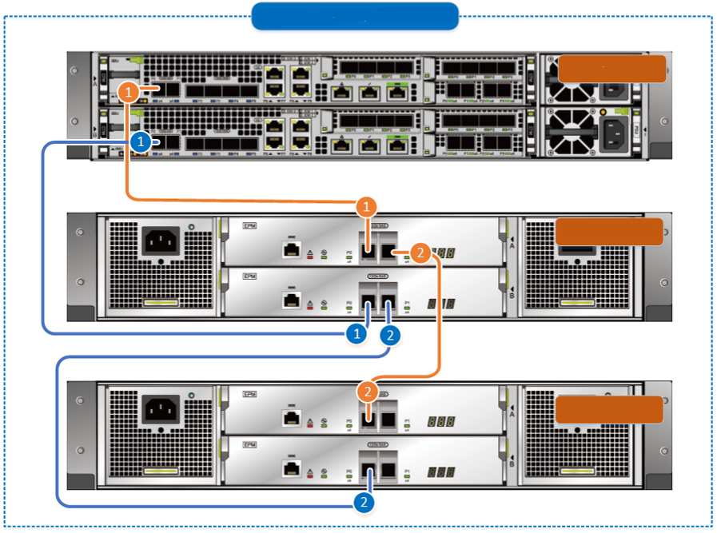
SAS Disk Enclosure Scale-up Networking Principles
Adding a 2 U SAS disk enclosure to an existing loop
Controller enclosure
2 U SAS disk enclosure 0
2 U SAS disk enclosure 1
Notes:
Huawei SAS disk enclosure is used as an example.
Port consistency: In a loop, the EXP port of an upper-level disk enclosure is connected to the PRI port of a lower-level disk enclosure.
Dual-plane networking: Expansion module A connects to controller A, while expansion module B connects to controller B.
Symmetric networking: On controllers A and B, symmetric ports and slots are connected to the same disk enclosure.
Forward and backward connection networking: Expansion module A uses forward connection, while expansion module B uses backward connection.
Cascading depth: The number of cascaded disk enclosures in a loop cannot exceed the upper limit.

Slide 16
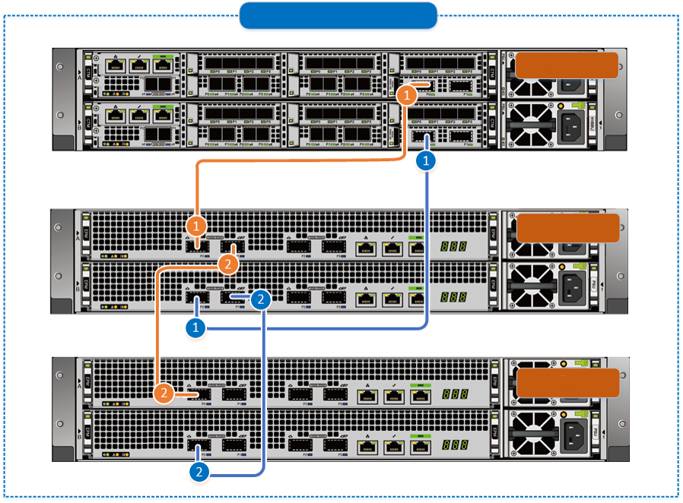
Smart Disk Enclosure Scale-up Networking Principles
Adding a 2 U smart disk enclosure to an existing loop
Controller enclosure
Smart disk enclosure 0
Smart disk enclosure 1
Notes:
Huawei smart disk enclosure is used as an example.
Port consistency: In a loop, the EXP (P1) port of an upper-level disk enclosure is connected to the PRI (P0) port of a lower-level disk enclosure.
Dual-plane networking: Expansion module A connects to controller A, while expansion module B connects to controller B.
Symmetric networking: On controllers A and B, symmetric ports and slots are connected to the same disk enclosure.
Forward connection networking: Both expansion modules A and B use forward connection.
Cascading depth: The number of cascaded disk enclosures in a loop cannot exceed the upper limit.

Slide 17
PCIe Scale-out and IP Scale-out
PCIe scale-out runs on the PCIe protocol while IP scale-out works based on the IP protocol.
Large enterprises
Mission-critical storage
Functions first
PCIe scale-out
Medium enterprises
Mid-range storage
Functions and prices balanced
IP scale-out
Small enterprises
Entry-level storage
Price first
IP scale-out
Notes:
IP scale-out is used for Huawei OceanStor V3 and V5 entry-level and mid-range series, Huawei OceanStor V5 Kunpeng series, and Huawei OceanStor Dorado V6 series. IP scale-out integrates TCP/IP, Remote Direct Memory Access (RDMA), and Internet Wide Area RDMA Protocol (iWARP) to implement service switching between controllers, which complies with the all-IP trend of the data center network.
PCIe scale-out is used for Huawei OceanStor 18000 V3 and V5 series, and Huawei OceanStor Dorado V3 series. PCIe scale-out integrates PCIe channels and the RDMA technology to implement service switching between controllers.

Slide 18
Scale-out Technologies Used by Huawei Storage Systems
OceanStor OS
XNET
XNET-PCIe
XNET RDMA
XNET UDP
PCIE DRV
IB
transport
iWARP
UDP
TCP
IP
PCIe
IB
ETH
Notes:
PCIe scale-out: features high bandwidth and low latency.
IP scale-out: employs standard data center technologies (such as ETH, TCP/IP, and iWARP) and infrastructure, and boosts the development of Huawei's proprietary chips for entry-level and mid-range products.

Slide 19
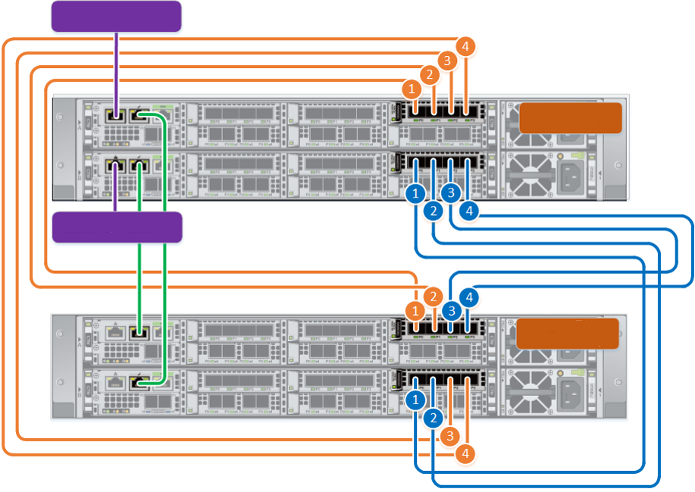
Scale-out Networking
Connects to the user's management network
Controller enclosure
0 (original)
Connects to the user's management network
Controller enclosure
1 (new)
This figure shows the scale-out networking of Huawei solid-state storage Huawei OceanStor Dorado 5000 V6 and 6000 V6.
Four-controller direct connection

Slide 20
Local Write Process
1
2
SAN
LUN
1
PCIe switched network
2
4
Engine 0
Engine 1
Engine 2
Engine 3
3
5
Notes:
The LUN to which a host writes data is owned by the engine to which the host delivers write I/Os. The process is as follows:
A host delivers write I/Os to engine 0.
Engine 0 writes the data into the local cache, implements mirror protection, and returns a message indicating that data is written successfully.
Engine 0 flushes dirty data onto a disk. If the target disk is on the local computer, engine 0 directly delivers the write I/Os.
If the target disk is on a remote device, engine 0 transfers the I/Os to the engine (engine 1 for example) where the disk resides.
Engine 1 writes dirty data onto disks.

Slide 21
Non-local Write Process
1
4
SAN
1
4
LUN
2
PCIe switched network
3
6
Engine 0
Engine 1
Engine 2
Engine 3
5
7
Notes:
The LUN to which a host writes data is not owned by the engine to which the host delivers write I/Os. The process is as follows:
A host delivers write I/Os to engine 2.
After detecting that the LUN is owned by engine 0, engine 2 transfers the write I/Os to engine 0.
Engine 0 writes the data into the local cache, implements mirror protection, and returns a message to engine 2, indicating that data is written successfully.
Engine 2 returns the write success message to the host.
Engine 0 flushes dirty data onto a disk. If the target disk is on the local computer, engine 0 directly delivers the write I/Os.
If the target disk is on a remote device, engine 0 transfers the I/Os to the engine (engine 1 for example) where the disk resides.
Engine 1 writes dirty data onto disks.

Slide 22
Local Read Process
1
2
SAN
1
LUN
2
PCIe switched network
5
Engine 0
8
Engine 1
Engine 2
Engine 3
3
4
6
7
Notes:
The LUN from which a host reads data is owned by the engine to which the host delivers write I/Os. The process is as follows:
A host delivers write I/Os to engine 0.
If the read I/Os are hit in the cache of engine 0, engine 0 returns the data to the host.
If the read I/Os are not hit in the cache of engine 0, engine 0 reads data from the disk. If the target disk is on the local computer, engine 0 reads data from the disk.
After the read I/Os are hit locally, engine 0 returns the data to the host.
If the target disk is on a remote device, engine 0 transfers the I/Os to the engine (engine 1 for example) where the disk resides.
Engine 1 reads data from the disk.
Engine 1 accomplishes the data read.
Engine 1 returns the data to engine 0 and then engine 0 returns the data to the host.

Slide 23
Non-local Read Process
1
4
SAN
1
4
LUN
2
PCIe switched network
3
7
10
5
Engine 0
Engine 1
Engine 2
Engine 3
6
8
9
Notes:
The LUN from which a host reads data is not owned by the engine to which the host delivers write I/Os. The process is as follows:
The LUN is not owned by the engine that delivers read I/Os, and the host delivers the read I/Os to engine 2.
After detecting that the LUN is owned by engine 0, engine 2 transfers the read I/Os to engine 0.
If the read I/Os are hit in the cache of engine 0, engine 0 returns the data to engine 2.
Engine 2 returns the data to the host.
If the read I/Os are not hit in the cache of engine 0, engine 0 reads data from the disk. If the target disk is on the local computer, engine 0 reads data from the disk.
After the read I/Os are hit locally, engine 0 returns the data to engine 2 and then engine 2 returns the data to the host.
If the target disk is on a remote device, engine 0 transfers the I/Os to engine 1 where the disk resides.
Engine 1 reads data from the disk.
Engine 1 completes the data read.
Engine 1 returns the data to engine 0, engine 0 returns the data to engine 2, and then engine 2 returns the data to the host.

Slide 24
Storage Architecture Evolution
Storage System Expansion Methods
Huawei Storage Product Architecture

Slide 25
Hardware Architecture with Two Controllers
Interface
module A0
...
Interface
module A7
Interface
module B7
...
Interface
module B0
Service subsystem
PCIe 3.0 x8
PCIe 3.0 x8
Controller A
PCIe 3.0 x8
Controller B
Fan module 0
Fan module 0
Fan module 1
Fan module 1
Fan module 2
Fan module 2
Management
subsystem
Management
interface module A
Management
interface module B
12 V
12 V
BBU 0
BBU 1
Power
supply 0
Power
supply 1
BBU 2
BBU 3
Electromechanical subsystem
Service channel
Manage channel
Power supply
Notes:
Huawei entry-level and mid-range storage products use dual-controller architecture by default.

Slide 26
Hardware Architecture with Multiple Controllers
Interface
module A0
...
Interface
module A5
Interface
module B5
...
Interface
module B0
PCIe 3.0 x8
PCIe 3.0 x8
Controller C
Controller D
Fan module 0
PCIe 3.0 x8
Fan module 0
Service subsystem
Fan module 1
Fan module 1
Fan module 2
Fan module 2
Interface
module A0
...
Interface
module A5
Interface
module B5
...
Interface
module B0
PCIe 3.0 x8
PCIe 3.0 x8
Controller A
Controller B
Fan module 0
PCIe 3.0 x8
Fan module 0
Fan module 1
Fan module 1
Fan module 2
Fan module 2
Management subsystem
Management
interface module A
Management
interface module B
12 V
12 V
Electromechanical subsystem
BBU 0
BBU 1
Power
supply 0
Power
supply 1
Power
supply 2
Power
supply 3
BBU 2
BBU 3
Notes:
Huawei mission-critical storage products use architecture with multiple controllers.

Slide 27
Full-mesh Architecture
Host I/O
Network adapter
Network adapter
Fully-shared FIMs
Each front-end interconnect I/O module (FIM) connects to all four controllers through PCIe ports in a controller enclosure. This module can simultaneously access the four controllers with multi-channel technology in active-active mode.
FIM
FIM
FIM
FIM
Full interconnection among controllers
192 cores
192 cores
The controllers in a controller enclosure are fully interconnected using a passive backplane.
100 Gbit/s RDMA shared interface modules are used for expansion across controller enclosures, implementing full interconnection between 8/12/16 controllers.
BIM
BIM
BIM
BIM
192 cores
192 cores
Interconnection of disks and enclosures across controller enclosures
A controller enclosure uses the back-end interconnect I/O module (BIM) to connect a disk enclosure, which can be accessed by all controllers in the enclosure.
A smart disk enclosure has two groups of uplink ports and can connect to two controller enclosures, implementing full interconnection between the disk enclosure and eight controllers.
Note: Huawei OceanStor Dorado 8000 and 18000 V6 are used as the example. Dorado 3000, 5000, and 6000 V6 do not support the full-mesh architecture.
Notes:
Front-end full interconnection
Dorado 8000 and 18000 V6 support FIMs, which can be simultaneously accessed by four controllers in a controller enclosure.
Upon reception of host I/Os, the FIM directly distributes the I/Os to appropriate controllers.
Full interconnection among controllers
Controllers in a controller enclosure are connected by 100 Gbit/s (40 Gbit/s for Dorado 3000 V6) RDMA links on the backplane.
For scale-out to multiple controller enclosures, any two controllers can be directly connected to avoid data forwarding.
Back-end full interconnection
Dorado 8000 and 18000 V6 support BIMs, which allow a smart disk enclosure to be connected to two controller enclosures and accessed by eight controllers simultaneously. This technique, together with continuous mirroring, allows the system to tolerate failure of 7 out of 8 controllers.
Dorado 3000, 5000, and 6000 V6 do not support BIMs. Disk enclosures connected to Dorado 3000, 5000, and 6000 V6 can be accessed by only one controller enclosure. Continuous mirroring is not supported.

Slide 28
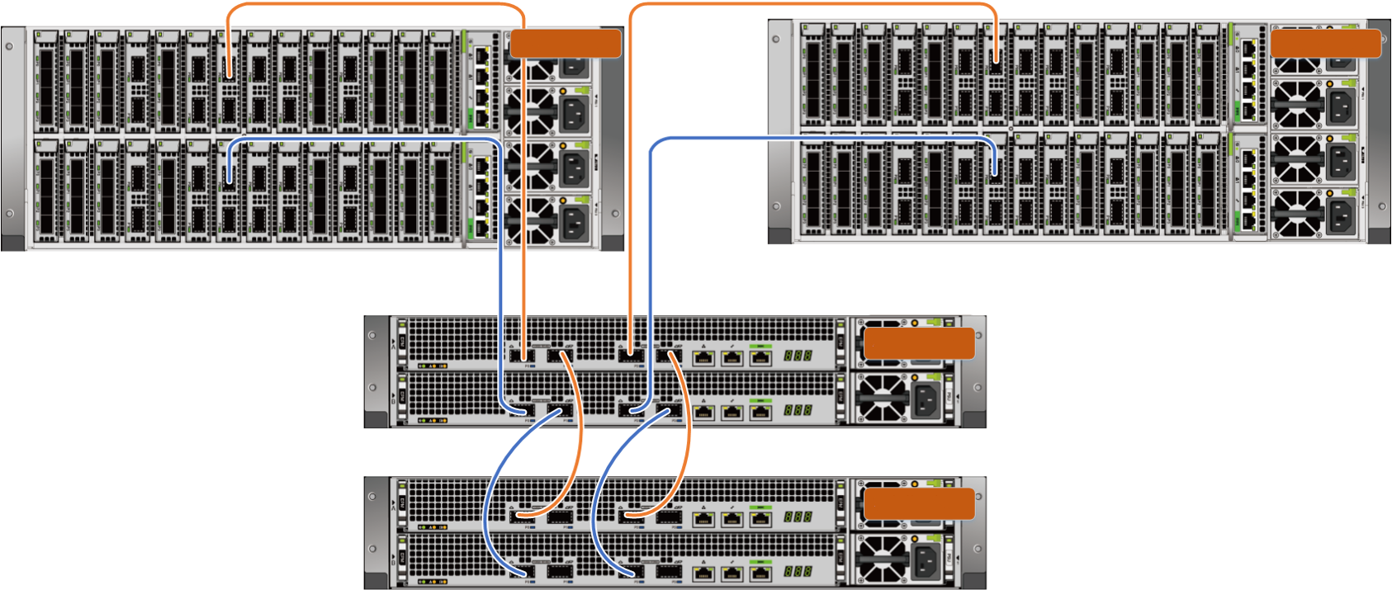
Fully Interconnected Disk Enclosures
Controller enclosure 0
Controller enclosure 1
2 U smart disk enclosure 0
2 U smart disk enclosure 1
Notes:
The storage system supports three types of disk enclosures: SAS, smart SAS, and smart NVMe. Currently, they cannot be used together on one storage system.
Smart SAS and smart NVMe disk enclosures use the same networking mode. In this mode, a controller enclosure uses the shared 2-port 100 Gbit/s RDMA interface module to connect to a disk enclosure. Each interface module connects to the four controllers in the controller enclosure through PCIe 3.0 x16. In this way, each disk enclosure can be simultaneously accessed by all four controllers, achieving full interconnection between the disk enclosure and the four controllers. A smart disk enclosure has two groups of uplink ports and can connect to two controller enclosures at the same time. This allows the two controller enclosures (eight controllers) to simultaneously access a disk enclosure, implementing full interconnection between the disk enclosure and eight controllers. When full interconnection between disk enclosures and eight controllers is implemented, the system can use continuous mirroring to tolerate failure of 7 out of 8 controllers without service interruption.

Slide 29
E2E Global Resource Sharing
Host
SAN
Distribution based on hash results
DHT
Global cache
...
...
Notes:
Symmetric architecture
All products support host access in active-active mode. Requests can be evenly distributed to each front-end link.
They eliminate LUN ownership of controllers, making LUNs easier to use and balancing loads. They accomplish this by dividing a LUN into multiple slices that are then evenly distributed to all controllers using the DHT algorithm
Mission-critical products reduce latency with intelligent FIMs that divide LUNs into slices for hosts I/Os and send the requests to their target controller.
Shared port
A single port is shared by four controllers in a controller enclosure.
Loads are balanced without host multipathing.
Global cache
The system directly writes received I/Os (in one or two slices) to the cache of the corresponding controller and sends an acknowledgement to the host.
The intelligent read cache of all controllers participates in prefetch and cache hit of all LUN data and metadata.
Global pool
Storage pools are evenly distributed on all controllers, and RAID 2.0+ is adopted to manage all SSDs in the storage pool in a fine-grained manner.

Slide 30
Switchover in Seconds: Mission-Critical Storage with FIMs
Host
Hosts are unaware of the switchover, and links are not interrupted.
Fibre Channel switch
Hi1822
I/O process
I/O process
I/O process
I/O process
System mgmt. process
Device mgmt. process
Configuration mgmt. process
Network mgmt. process
User mode
OS kernel mode
Controller 0
Controller 1
Controller 2
Controller 3
Notes:
FIMs of mission-critical storage adopt Huawei-developed Hi1822 chip to connect to all controllers in a controller enclosure via four internal links and each front-end port provides a communication link for the host. If any controller restarts during an upgrade, services are seamlessly switched to the other controller without impacting hosts and interrupting links.
Switchover in seconds
The host is unaware of controller faults. Switchover is completed within 1 second.
FIM
Failure of a controller will not disconnect the front-end link, and the host is unaware of the controller failure.
The PCIe link between the FIM and the controller is disconnected, and the FIM detects the controller failure.
Service switchover is performed between the controllers, and the FIM redistributes host requests to other controllers.
The switchover time is about 1 second, which is much shorter than switchover performed by multipathing software (10-30s).
Dorado 8000 and 18000 V6 support FIMs.

Slide 31
Global Cache
Write latency
LUN 0
LUN 1
LUN 2
95 μs
...
4 KB
...
...
4 KB
4 KB
8 KB
4 KB
8 KB
4 KB
4 KB
8 KB
50 μs
Write Ahead Log (WAL)
Cache linear space
A
B
C
D
E
...
Traditional cache
OceanStor Dorado V6
Data write
A B C
D E
...
Global memory
Virtual address space
RDMA
AddrN1
AddrN2
AddrN3
Memory of controller A
Memory of controller B
Memory of controller C
Memory of controller D
Notes:
The global cache consists of two parts:
Global memory: memory of all controllers (four controllers in the figure). This is managed in a unified memory address, and provides linear address space for the upper layer based on a redundancy configuration policy.
WAL: new write cache of the log type
In global cache mode, host data is directly written into linear space logs, and the logs directly copy the host data to the memory of multiple controllers using RDMA based on a preset copy policy.

Slide 32
Global Pool
A
A1
A2
A3
LUN
B
B1
C
C1
C2
D
D1
D2
LUN mapping and FP mapping
Strip
A
B
C
D
P
Q
Strip
A1
B1
C1
D1
P
Q
Strip
A2
A3
C2
D2
P
Q
...
...
RAID
...
Notes:
RAID 2.0+.
Full-strip write of new data.
Shared RAID groups between multiple strips.

Slide 33
Back-End Sharing
Engine 0
Engine 1
A single port is connected via a single connection in the external system.
A single port is connected to four controllers in the internal system.
Ctrl A
Ctrl A
13
0
13
A
Ctrl B
A
Ctrl B
Ctrl C
Ctrl C
0
13
0
13
B
Ctrl D
B
Ctrl D
100 Gbit/s
100 Gbit/s
Dual physical links are balanced and redundant.
100 Gbit/s
100 Gbit/s
A
0
1
2
3
B
0
1
2
3
A
B
C
D
x4
x4
x4
A single port on the controller cascades two disk enclosures in a loop.
A single expansion module supports dual links, achieving load balancing and redundancy.
x4
A
0
1
2
3
1822
B
0
1
2
3
Notes:
Back-end sharing includes:
Sharing of back-end interface modules within an enclosure.
Cross-controller enclosure sharing of back-end disk enclosures.

Slide 34
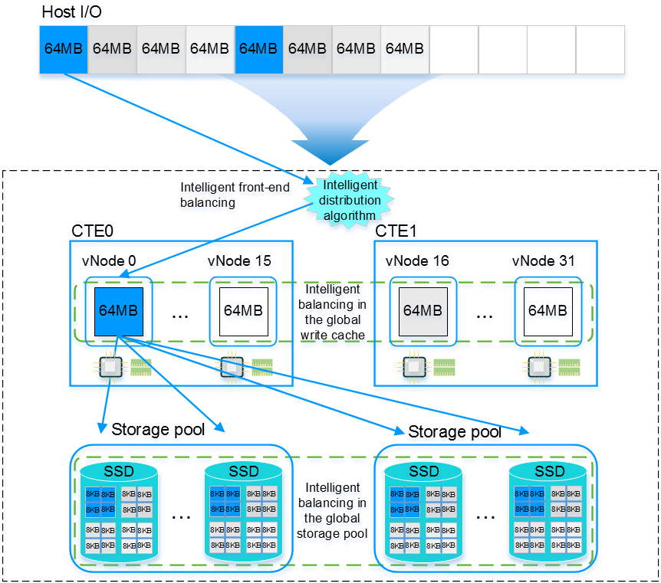
Active-Active Architecture with Full Load Balancing
Notes:
Even distribution of unhomed LUNs
Data on LUNs is divided into 64 MB slices. The slices are distributed to different virtual nodes based on the hash result (LUN ID + LBA).
Front-end load balancing
UltraPath selects appropriate physical links to send each slice to the corresponding virtual node.
The front-end interconnect I/O modules forward the slices to the corresponding virtual nodes.
Front-end: If there is no UltraPath or FIM, the controllers forward I/Os to the corresponding virtual nodes.
Global write cache load balancing
The data volume is balanced.
Data hotspots are balanced.
Global storage pool load balancing
Usage of disks is balanced.
The wear degree and lifecycle of disks are balanced.
Data is evenly distributed.
Hotspot data is balanced.

Slide 35
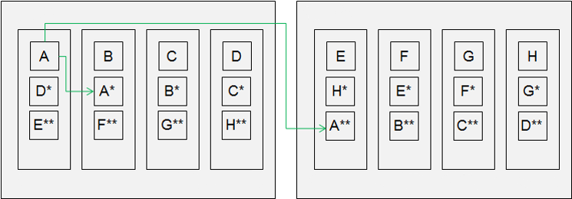
Cache Mirroring Technology
The function is as follows:
Controller enclosure 1
Controller enclosure 2
Controller A
Controller B
Controller C
Controller D
Controller A
Controller B
Controller C
Controller D
Hybrid flash storage
Notes:
Three cache copies
The system supports two or three copies of the write cache.
Three-copy requires an extra license.
Only mission-critical storage systems support three copies.
Three copies tolerate simultaneous failure of two controllers.
Failure of two controllers does not cause data loss or service interruption.
Three copies tolerate failure of one controller enclosure.
With three copies, data is mirrored in a controller enclosure and across controller enclosures.
Failure of a controller enclosure does not cause data loss or service interruption.

Slide 36
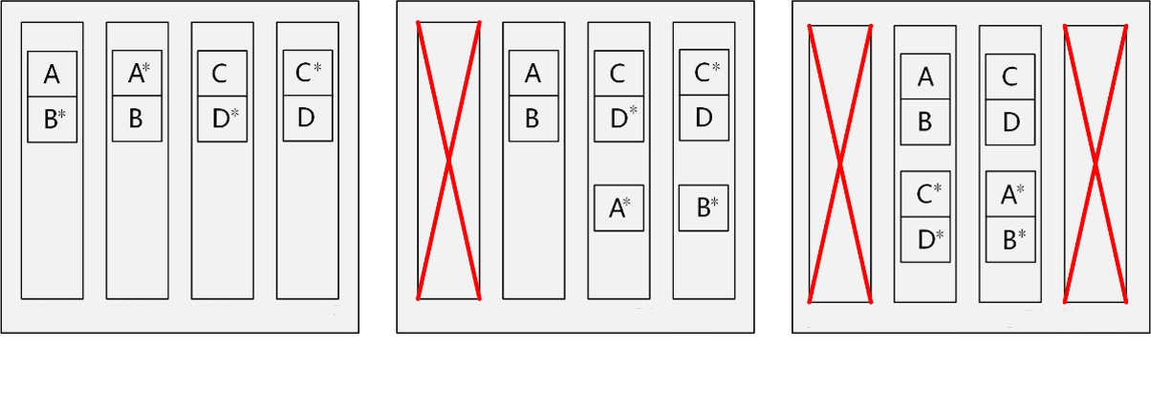
Key Reliability Technology
The function is as follows:
Controller A
Controller B
Controller C
Controller D
Controller A
Controller B
Controller C
Controller D
Controller A
Controller B
Controller C
Controller D
Normal
Failure of a controller (controller A)
Notes:
Continuous mirroring
Dorado V6's mission-critical storage systems support continuous mirroring. In the event of a controller failure, the system automatically selects new controllers for mirroring.
Continuous mirroring includes all devices in back-end full interconnection.
Back-end full interconnection
Controllers are directly connected to disk enclosures.
Dorado V6's mission-critical storage systems support back-end full interconnection.
BIMs + two groups of uplink ports on the disk enclosures achieve full interconnection of the disk enclosures to eight controllers.
Continuous mirroring and back-end full interconnection allow the system to tolerate failure of seven out of eight controllers.

Slide 37
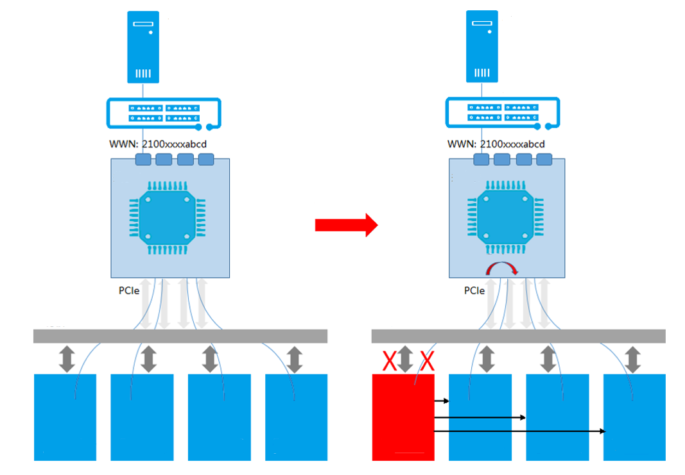
Host Service Switchover upon Failure of a Single Controller
Host
Host
Fibre Channel switch
Fibre Channel switch
Interconnect I/O module
Interconnect I/O module
Automatic switchover
Backplane
Backplane
Controller 1
Controller 2
Controller 3
Controller 4
Controller 1
Controller 2
Controller 3
Controller 4
Notes:
When FIMs are used, failure of a controller will not disconnect front-end ports from hosts, and the hosts are unaware of the controller failure, ensuring high availability. When a controller fails, the FIM port chip detects that the PCIe link between the FIM and the controller is disconnected. Then service switchover is performed between the controllers, and the FIM redistributes host I/Os to other controllers. This process is completed within seconds and does not affect host services. In comparison, when non-shared interface modules are used, a link switchover must be performed by the host's multipathing software in the event of a controller failure, which takes a longer time (10 to 30 seconds) and reduces reliability.
As shown in this figure, if controller 1 is faulty, services on controller 1 are switched over to other controllers within 1 second. At the same time, the FIM detects that the link to controller 1 is disconnected and redistributes host I/Os to other functioning controllers by using the intelligent algorithm. The whole process takes less than a second and the host is unaware of the fault because the Fibre Channel link between the FIM and the host is not disconnected.

Slide 38
(True or False) Scale-up is a method in which disk enclosures are continuously added to existing storage systems to handle increasing data volumes.
(Short Answer Question) What are the differences between scale-up and scale-out?
Notes:
Answers
1. T
2. Scale-up is the traditional vertical expansion architecture. In other words, disks and disk enclosures are continuously added to existing storage systems to meet user requirements on increasing capacity. The advantage of this is that operation is simple at the initial stage. However, as the storage system scale increases, resource increase reaches a bottleneck, leading to high investment and maintenance cost. Scale-out is a horizontal expansion architecture. It adds more controllers to handle ever-increasing data volumes in the unit of nodes. Advantage: As the scale increases, the unit price decreases and efficiency is improved. Disadvantage: The complexity of software and management increases.

Slide 39
Storage Architecture Evolution
Storage System Architecture
Storage System Expansion Methods
Scale-up and Scale-out
Hardware System Architecture
Huawei Storage Product Architecture
Full-mesh Architecture

Slide 40
Enterprise Technical Support App
Huawei Enterprise Service App
Notes:
Huawei training app
Contains a huge library of Huawei certified learning videos.
Enterprise technical support app
Covers all popular product documents, cases, and bulletins from Huawei. Users can quickly query commands, alarms, and spare parts. They can also use it to scan and view the device information. Simple and intuitive video guides provide 24/7 enterprise technical support.
Huawei enterprise business app
Provides one-stop mobile ICT portals for customers and partners to learn about Huawei's comprehensive products and solutions for enterprise ICT anytime and anywhere.

Slide 41
Huawei official websites
Enterprise business: https://e.huawei.com/en/
Technical support: https://support.huawei.com/enterprise/en/index.html
Online learning: https://www.huawei.com/en/learning
Popular tools
HedEx Lite
Network Document Tool Center
Information Query Assistant
Notes:
Popular tools
HedEx Lite is the Huawei tool for product document management. It allows users to browse, search, update, and manage product documentation.
eStor is a graphic storage simulation platform. The platform simulates Huawei OceanStor all-flash storage devices to help ICT practitioners and customers get familiar with Huawei storage products and quickly master their operations.
The Network Documentation Tool Center is the documentation tool for network products. It assists in bidding, network planning, project delivery, upgrades, and maintenance.
The Information Query Assistant provides command and alarm information querying for Huawei products.

