Slide 1
Common Storage Protocols

Slide 2
A protocol is a set of conventions that both communication computers must comply with. For example, how their connection is set up and how they identify each other.
A protocol not only defines the language used for communication, but also specifies the hardware, transmission medium, transmission protocol, and interface technology. This course describes the definitions and principles of different storage protocols.

Slide 3
After completing this course, you are expected to:
Understand common protocols used in storage systems.
Understand the working principles and features of such protocols.

Slide 4
SCSI
iSCSI, Fibre Channel (FC), and FCoE
SAS and SATA
PCIe and NVMe
RDMA and (InfiniBand) IB
CIFS, NFS, and NDMP

Slide 5
SCSI Protocol
Small Computer System Interface (SCSI) is a vast protocol system evolved from SCSI-1 > SCSI-2 > SCSI-3.
The SCSI protocol defines a model and a necessary instruction set for different devices to exchange information using the framework.
Transmission media has no bearing on the SCSI protocol. It can be used across various media types, including virtual media.
SCSI device instruction set
(SBC/SSC)
SCSI system model
(SAM/SPC)
SCSI link implementation
(FCP/SAS/iSCSI)
Notes:
SCSI reference documents cover devices, models, and links.
SCSI architecture documents discuss the basic architecture models SAM and SPC and describe the SCSI architecture in detail, covering topics like the task queue model and basic common instruction model.
SCSI device implementation documents cover the implementation of specific devices, such as the block device (disk) SBC and stream device (tape) SSC instruction systems.
SCSI transmission link implementation documents discuss FCP, SAS, iSCSI, and FCoE, and describe in detail the implementation of the SCSI protocol on media.

Slide 6
SCSI Evolution
SCSI-1
Launched between 1983 and 1985.
Supported synchronous and asynchronous modes.
Supported up to seven 8-bit devices.
Ran at up to 5 Mbit/s.
Used 50-pin cables that span 6 m at most.
Obsolete.
SCSI-1
SCSI-2
Launched between 1988 and 1994.
Compatible with SCSI-1.
Supports 16-bit bandwidth.
Runs at up to 20 Mbit/s.
SCSI-3
SCSI-2
Standardized in 1993.
Compatible with SCSI-1 and SCSI-2.
Is a standard system.
Supports various media such as FCP and IEEE1394.
SCSI-3

Slide 7
SCSI Logical Topology
Initiator 1
Initiator 2
Initiator
SDS
Target 1
Target 2
Target 3
Target
LUN 0
LUN 2
LUN 5
LUN namespace
Target device
Notes:
Initiator: SCSI is essentially a client/server (C/S) architecture in which a client acts as an initiator to send request instructions to a SCSI target. Generally, a host acts as an initiator.
Target: processes SCSI instructions. It receives and parses instructions from a host. For example, a disk array functions as a target.
LUN: a namespace resource described by a SCSI target. A target may include multiple LUNs, and attributes of the LUNs may be different. For example, LUN#0 may be a disk, and LUN#1 may be another device.
The initiator and target of SCSI constitute a typical C/S model. Each instruction is implemented through the request/response mode.
The initiator sends SCSI requests.
The target responds to the SCSI requests, provides services through LUNs, and provides a task management function.

Slide 8
SCSI Initiator Model
A hosts SCSI system typically works in the initiator mode. The SCSI architecture on Windows, Linux, AIX, Solaris, and BSD contains the architecture layer (middle layer), device layer, and transport layer.
SCSI device driver layer
SCSI middle layer
SCSI link layer
Notes:
On Windows, a SCSI initiator includes three logical layers: storage/tape driver, SCSI port, and mini port.
The SCSI port implements the basic framework processing procedures for SCSI, such as device discovery and namespace scanning.
On Linux, a SCSI initiator includes three logical layers: SCSI device driver, scsi_mod middle layer, and SCSI adapter driver (HBA).
The scsi_mod middle layer processes SCSI device-irrelevant and adapter-irrelevant processes, such as exceptions and namespace maintenance.
The HBA driver provides link implementation details, such as SCSI instruction packaging and unpacking. The device driver implements specific SCSI device drivers, such as the famous SCSI disk driver, SCSI tape driver, and SCSI CD-ROM device driver.
The structure of Solaris comprises the SCSI device driver, SSA middle layer, and SCSI adapter driver, which is similar to the structure of Linux/Windows.
The AIX architecture is structured in three layers: SCSI device driver, SCSI middle layer, and SCSI adaptation driver.

Slide 9
SCSI Target Model
Based on the SCSI architecture, a target is divided into three layers: port layer, middle layer, and device layer.
The middle layer is the most important. It manages and maintains LUN namespaces, link ports, target devices, tasks, task sets, and sessions based on SAM/SPC specifications.
Drivers at the port layer are dynamically loaded in via registration. Drivers at the device layer are also dynamically loaded.
Port layer
Middle layer
Device layer
Notes:
A PORT model in a target packages or unpackages SCSI instructions on links. For example, a PORT can package instructions into FPC, iSCSI, or SAS, or unpackage instructions from those formats.
A device model in a target serves as a SCSI instruction analyser. It tells the initiator what device the current LUN is by processing INQUIRT, and processes I/Os through READ/WRITE.
The middle layer of a target maintains models such as LUN space, task set, and task (command). There are two ways to maintain LUN space. One is to maintain a global LUN for all PORTs, and the other is to maintain a LUN space for each PORT.

Slide 10
SCSI Protocol and Storage System
The SCSI protocol is the basic protocol used for communication between hosts and storage devices.
DAS uses the SCSI protocol to achieve interconnection between hosts and storage devices.
SCSI bus
Host adapter
SCSI ID 7
Data/Address bus
SCSI array
ID 0
Control signal
SCSI array
ID 5
LUN 0
LUN 1
LUN 0
LUN 2
LUN 1
Notes:
The controller sends a signal to the bus processor requesting to use the bus. After the request is accepted, the controller's high-speed cache sends data. During this process, the bus is occupied by the controller and other devices connected to the same bus cannot use it. However, the bus processor can interrupt the data transfer at any time and allow other devices to use the bus for operations of a higher priority.
A SCSI controller is like a small CPU with its own command set and cache. The special SCSI bus architecture can dynamically allocate resources to tasks run by multiple devices in a computer. In this way, multiple tasks can be processed at the same time.

Slide 11
SCSI Protocol Addressing
Bus number
Differentiates SCSI buses.
Device ID
Differentiates devices on SCSI buses.
Logical unit number
Differentiates sub-devices in SCSI devices.
Notes:
A traditional SCSI controller is connected to a single bus, therefore only one bus ID is allocated. An enterprise-level server may be configured with multiple SCSI controllers, so there may be multiple SCSI buses. In a storage network, each FC HBA or iSCSI network adapter is connected to a bus. A bus ID must therefore be allocated to each bus to distinguish between them.
To address devices connected to a SCSI bus, SCSI device IDs and LUNs are used. Each device on the SCSI bus must have a unique device ID. The HBA on the server also has its own device ID: 7. Each bus, including the bus adapter, supports a maximum of 8 or 16 device IDs. The device ID is used to address devices and identify the priority of the devices on the bus.
Each storage device may include sub-devices, such as virtual disks and tape drives. So LUN IDs are used to address sub-devices in a storage device.
A ternary description (bus ID, target device ID, and LUN ID) is used to identify a SCSI target.

Slide 12
SCSI
iSCSI, FC, and FCoE
SAS and SATA
PCIe and NVMe
RDMA and IB
CIFS, NFS, and NDMP

Slide 13
Emergence of iSCSI
SCSI allows a small number of devices to be connected.
The distance between devices is limited.
IP-network-based SCSI: iSCSI
Notes:
The iSCSI protocol was first launched by IBM, Cisco and HP. Since 2004, the iSCSI protocol has been used as the formal IETF standard. The existing iSCSI protocol is based on SCSI Architecture Model-2 (AM2).
The iSCSI protocol encapsulates SCSI commands and block data into TCP packets for transmission over IP networks.
As the transport layer protocol of SCSI, iSCSI uses mature IP network technologies to implement and extend SAN.

Slide 14
iSCSI
SCSI applications (file systems and databases)
SCSI block instructions
SCSI flow instructions
Other SCSI instructions
SCSI commands, responses, and data
SCSI instructions, data, and status
Receives SCSI data, generates iSCSI protocol data, and encapsulates the data into iSCSI PDUs.
iSCSI
TCP
Encapsulates iSCSI PDUs into TCP/IP packets for transmission and reception.
IP
Converts bit streams and transmits them over physical links.
Ethernet
iSCSI protocol stack
Notes:
iSCSI is short for Internet Small Computer System Interface. It is an IP-based storage networking standard for linking data storage facilities. It provides block-level access to storage devices by carrying SCSI commands over a TCP/IP network.
The iSCSI protocol encapsulates SCSI commands and block data into TCP packets for transmission over IP networks. As the transport layer protocol of SCSI, iSCSI uses mature IP network technologies to implement and extend SAN.
The SCSI protocol layer generates CDBs and sends the CDBs to the iSCSI protocol layer. The iSCSI protocol layer then encapsulates the CDBs into PDUs and transmits the PDUs over an IP network.

Slide 15
iSCSI Initiator and Target
Initiator
The SCSI layer generates command descriptor blocks (CDBs) and transfers them to the iSCSI layer.
The iSCSI layer generates iSCSI protocol data units (PDUs) and sends them to the target over an IP network.
Target
The iSCSI layer receives PDUs and sends CDBs to the SCSI layer.
The SCSI layer interprets CDBs and gives responses when necessary.
iSCSI
Initiator
Target
SCSI
SCSI
iSCSI
iSCSI
TCP
TCP
IP
IP
Link
Link
Notes:
The iSCSI communication system inherits some of SCSI's features. The iSCSI communication involves an initiator that sends I/O requests and a target that responds to the I/O requests and executes I/O operations. After a connection is set up between the initiator and target, the target controls the entire process as the primary device.
There are three types of iSCSI initiators: software-based initiator driver, hardware-based TCP offload engine (TOE) NIC, and iSCSI HBA. Their performance increases in that order.
An iSCSI target is usually an iSCSI disk array or iSCSI tape library.
The iSCSI protocol defines a set of naming and addressing methods for iSCSI initiators and targets. All iSCSI nodes are identified by their iSCSI names. This method distinguishes iSCSI names from host names.

Slide 16
iSCSI Architecture
iSCSI nodes encapsulate SCSI instructions and data into iSCSI packets and send the packets to the TCP/IP layer, where the packets are encapsulated into IP packets to be transmitted over an IP network.
iSCSI node
iSCSI node
IP address of the network port
IP address of the network port
iSCSI
target
iSCSI
initiator
IP network
IP address of the network port
IP address of the network port
iSCSI
target
Notes:
In an iSCSI system, a user sends a data read or write command on a SCSI storage device. The operating system converts this request into one or multiple SCSI instructions and sends the instructions to the target SCSI controller card. The iSCSI node encapsulates the instructions and data into an iSCSI packet and sends the packet to the TCP/IP layer, where the packet is encapsulated into an IP packet to be transmitted over a network. You can also encrypt the SCSI instructions for transmission over an insecure network.
Data packets can be transmitted over a LAN or the Internet. The receiving storage controller restructures the data packets and sends the SCSI control commands and data in the iSCSI packets to corresponding disks. The disks execute the operation requested by the host or application. For a data request, data will be read from the disks and sent to the host. The process is completely transparent to users. Though SCSI instruction execution and data preparation can be implemented by the network controller software using TCP/IP, the host will spare a lot of CPU resources to process the SCSI instructions and data. If these transactions are processed by dedicated devices, the impact on system performance will be reduced to a minimum. An iSCSI adapter combines the functions of an NIC and an HBA. The iSCSI adapter obtains data by blocks, classifies and processes data using the TCP/IP processing engine, and sends IP data packets over an IP network. In this way, users can create IP SANs without compromising server performance.

Slide 17
Relationships Between iSCSI and SCSI, TCP and IP
Initiator
Function
Target
SCSI application protocol
SCSI commands, responses, and data
SCSI application protocol
Receives SCSI data, generates iSCSI protocol data, and encapsulates the data into iSCSI PDUs.
iSCSI protocol
iSCSI protocol
Encapsulates iSCSI PDUs into TCP/IP packets for transmission and reception.
TCP/IP protocol stack
TCP/IP protocol stack
Performs 8-bit/10-bit encoding, as well as transmits and receives data.
NIC driver
NIC driver
Performs 0/1 code stream transmission.
Physical
Physical
Notes:
PDU is short for protocol data unit.
TCP is short for Transmission Control Protocol, and IP is short for Internet Protocol.
8-bit/10-bit encoding is to divide continuous 8-bit data into 3-bit + 5-bit. The two groups of data are then encoded into 4-bit + 6-bit, respectively, and sent as a group of 10-bit data.

Slide 18
FC in Storage
FC can be referred to as the FC protocol, FC network, or FC interconnection. As FC delivers high performance, it is becoming more commonly used for front-end host access on point-to-point and switch-based networks.
FC brings the following advantages to the storage network:
Improved scalability
Increased transmission distance
Fewer security problems
Host
Initiator
Initiator
FC switch
FC switch
Target
Target
Storage
Disk enclosure
Disk enclosure
Notes:
Like TCP/IP, the FC protocol suite also includes concepts from the TCP/IP protocol suite and the Ethernet, such as FC switching, FC switch, FC routing, FC router, and SPF routing algorithm.

Slide 19
FC Protocol Structure
Upper-layer protocol
SCSI-3
IP
ATM
IPI-3
Command set mapping
SCSI-3
Command set mapping
FC-LE
Link encapsulation
FC-ATM
FC-4
General equipment
FC-3
FC-PH
FC-PH2
FC-PH3
FC-AL
FC-AL2
FC-2
Structure protocol
FC-1
Coding/Decoding
FC-0
Physical conversion
Copper cables and optical cables, 8-bit/10-bit encoding
Notes:
FC-0: defines physical connections and selects different physical media and data rates for protocol operations. This maximizes system flexibility and allows for existing cables and different technologies to be used to meet the requirements of different systems. Copper cables and optical cables are commonly used.
FC-1: records the 8-bit/10-bit transmission code to balance the transmission bit stream. The code can also serve as a mechanism to transfer data and detect errors. Its excellent transfer capability of 8-bit/10-bit encoding helps reduce component design costs and ensures optimum transfer density for better clock recovery. Note: 8-bit/10-bit encoding is also applicable to IBM ESCON.
FC-2: includes the following items for sending data over the network.
- How data should be split into small frames
- How much data should be sent at a time (flow control)
- Where frames should be sent (including defining service levels based on applications)
FC-3: defines advanced functions such as striping (data is transferred through multiple channels), multicast (one message is sent to multiple targets), and group query (multiple ports are mapped to one node). When FC-2 defines functions for a single port, FC-3 can define functions across ports.
FC-4: maps upper-layer protocols. FC performance is mapped to an IP address, a SCSI protocol, or an ATM protocol. SCSI is a subset of the FC protocol.

Slide 20
FC Topology
Point-to-point
FC-AL
FC switching network
A
Most widely used technology
H
Only two devices can be connected.
(Direct connection)
Up to 127 devices can be connected.
Up to 16 million devices can be connected.
Notes:
Like the Ethernet, FC provides the following network topologies:
Point-to-point:
The simplest topology that allows direct communication between two nodes (usually a storage device and a server).
FC-AL:
Similar to the Ethernet shared bus topology but is in arbitrated loop mode rather than bus connection mode. Each device is connected to another device end to end to form a loop.
Data frames are transmitted hop by hop in the arbitrated loop and the data frames can be transmitted only in one direction at any time. As shown in the figure, node A needs to communicate with node H. After node A wins the arbitration, it sends data frames to node H. However, the data frames are transmitted clockwise in the sequence of B-C-D-E-F-G-H, which is inefficient.
Fabric:
Similar to an Ethernet switching topology, a fabric topology is a mesh switching matrix.
The forwarding efficiency is much greater than in FC-AL.
FC devices are connected to fabric switches through optical fibres or copper cables to implement point-to-point communication between nodes.

Slide 21
Seven Types of Ports for the FC Protocol
On an FC network, there are seven types of ports.
FC terminal
N
F
FC switch
F
N
FC terminal
Fabric device
FL
Fabric device
FC terminal
FC terminal
Open ring device
NL
FC-AL device
NL
Open ring device
L
L
L
FC terminal
FC terminal
FC terminal
Private ring device
Private ring device
Private ring device
Notes:
FC frees the workstation from the management of every port. Each port manages its own point-to-point connection to the fabric, and other fabric functions are implemented by FC switches.
Device (node) port:
N_Port: Node port. A fabric device can be directly attached.
NL_Port: Node loop port. A device can be attached to a loop.
Switch port:
E_Port: Expansion port (connecting switches).
F_Port: A port of a fabric device that used to connect to the N_Port.
FL_Port: Fabric loop port.
G_Port: A generic port that can be converted into an E_Port or F_Port.
U_Port: A universal port used to describe automatic port detection.

Slide 22
FC Adapter
The FC host bus adapter (HBA) supports FC network applications and provides high-bandwidth and high-performance storage network solutions.
Notes:
FC HBA: used to connect a server to an FC array

Slide 23
FCoE Protocol
The FCoE protocol is used to transmit FC signals over lossless enhanced Ethernet infrastructure.
FCoE encapsulates FC data frames in Ethernet frames and allows service traffic on a LAN and SAN to be transmitted over the same Ethernet.
Ethernet data link layer frame
Service flow IP address
Block storage FCoE
VoIP call
Video stream VoIP
Notes:
In terms of the FC protocol, FCoE means that FC is carried on a new type of link, that is, Ethernet layer-2 link. Note that an enhanced lossless Ethernet is required to meet the transmission requirements of the FC protocol for the link layer.
FCoE has the following characteristics:
Organization: Submitted to the American National Standards Institute (ANSI) T11 committee for approval in 2008. Cooperation with the IEEE is required.
Objective: To use the scalability of the Ethernet and retain the high reliability and efficiency of FC
Other challenges: When FC and the Ethernet are used together, there can be problems related to packet loss, path redundancy, failover, frame segmentation and reassembly, and non-blocking transmission.
FC delivers poor compatibility and is not applicable for long-distance transmission. FCoE has the same problems.

Slide 24
Comparison Between FC and FCoE
FCoE: defines the mapping from FC to IEEE 802.3 Ethernet. It uses the Ethernet's physical and data link layers and the FC's network, service, and protocol layers.
FCoE retains the protocol stack above FC-2 and replaces FC-0 and FC-1 with the Ethernet's link layer.
FC-4
FC-3
FC-2V
FC-2M
FC-2P
FC-1
FC-0
FC-4
FC-3
FC-2V
FCoE entity
MAC
PHY
FC levels
(No changes)
FC-2
FC_BB_E
Mapping
IEEE
802.3
Layers
FCoE protocol stack
Notes:
The original FC2 is further divided into the following:
FC-2V: FC2 virtual sub-layer
FC-2M: FC2 multiplexer sub-layer
FC-2P: FC2 virtual physical layer
The FC_BB_E mapping protocol requires that FCoE uses lossless Ethernet for transmission at the bottom layer and carries FC frames in full-duplex and lossless mode. The Ethernet protocol is used on the physical line.
Comparison of FC and FCoE:
FC-0 defines the bearer media type, and FC-1 defines the frame encoding and decoding mode. The two layers need to be defined during transmission over the FC SAN network. FCoE runs on the Ethernet. Therefore, the Ethernet link layer replaces the preceding two layers.
Different environments: The FC protocol runs on the traditional FC SAN storage network, while FCoE runs on the Ethernet.
Different channels: The FC protocol runs on the FC network, and all packets are transmitted through FCs. There are various protocol packets, such as IP and ARP packets, on the Ethernet. To transmit FCoE packets, a virtual FC needs to be created on the Ethernet.
Compared with the FC protocol, the FIP initialization protocol is used for FCoE to obtain the VLAN, establish a virtual channel with an FCF, and maintain virtual links.

Slide 25
SCSI
iSCSI, FC, and FCoE
SAS and SATA
PCIe and NVMe
RDMA and IB
CIFS, NFS, and NDMP

Slide 26
Background of SAS
The parallel bus has been developed to the peak and the bandwidth limit is reached.
Serial buses such as FC, IB, and the Ethernet have the following disadvantages for storage applications:
- FC: It is expensive, and applicable to complex networking and long-distance scenarios.
- IB: It is expensive, and the networking is complex.
- iSCSI: The latency is high, and the transmission rate is low.
SCSI in serial mode: SAS
Notes:
SAS is the serial standard of the SCSI bus protocol.

Slide 27
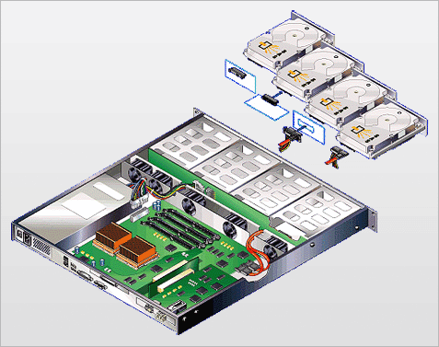
What Is SAS
SAS is the serial standard of the SCSI bus protocol.
SAS uses serial technology to achieve higher transmission rates and greater scalability. It is compatible with SATA disks.
SAS adopts the point-to-point architecture to achieve a transmission rates of up to 3 Gbit/s, 6 Gbit/s, 12 Gbit/s, or higher. It supports full-duplex mode.
Notes:
A serial port has a simple structure, supports hot swap, and boasts a high transmission speed and execution efficiency. Generally, large parallel cables cause electronic interference. The SAS cable structure can solve this problem. The SAS cable structure saves space, thereby improving heat dissipation and ventilation for servers that use SAS disks.
Lower cost:
A SAS backplane supports SAS and SATA disks, which reduces the cost of using different types of disks.
There is no need to design different products based on the SCSI and SATA standards. In addition, the cabling complexity and the number of PCB layers are reduced, further reducing costs.
System integrators do not need to purchase different backplanes and cables for different disks.
More devices can be connected.
The SAS technology introduces the SAS expander, so that a SAS system supports more devices. Each expander can be connected to multiple ports, and each port can be connected to a SAS device, a host, or another SAS expander.
High reliability:
The reliability is the same as that of SCSI and FC disks and is better than that of SATA disks.
The verified SCSI command set is retained.
High performance:
The unidirectional port rate is high.
Compatibility with SATA:
SATA disks can be directly installed in a SAS environment.
SATA and SAS disks can be used in the same system, which meets the requirements of the popular tiered storage strategy.

Slide 28
SAS Protocol Layers
SCSI application layer
ATA application layer
Management application layer
Application layer
SSP transport layer
STP transport layer
SMP transport layer
Transmission layer
SAS port layer
Port layer
SSP link layer
STP link layer
SMP link layer
Link layer
SAS link layer
SAS phy layer
Phy layer
SAS physical layer
Physical layer
Notes:
The SAS architecture includes six layers from the bottom to the top: physical layer, phy layer, link layer, port layer, transport layer, and application layer. Each layer provides certain functions.
Physical layer: defines hardware, such as cables, connectors, and transceivers.
Phy layer: includes the lowest-level protocols, like coding schemes and power supply/reset sequences.
Link layer: describes how to control phy layer connection management, primitives, CRC, scrambling and descrambling, and rate matching.
Port layer: describes the interfaces of the link layer and transport layer, including how to request, interrupt, and set up connections.
Transport layer: defines how the transmitted commands, status, and data are encapsulated into SAS frames and how SAS frames are decomposed.
Application layer: describes how to use SAS in different types of applications.

Slide 29
Highlights of SAS
Provides a serial communication mode so multiple data channels can communicate with devices at full speed.
Binds multiple narrow ports to form a wide port.
Uses expanders to expand interfaces, providing excellent scalability.
Works in full-duplex mode.
Expander
Server
SAS
RAID
Controller
Expander
Expander
Wide
Link
Expander
Expander
SAS
RAID
Controller
Read data
Expander
Commands
Notes:
Compared with SCSI, SAS has the following advantages:
As it uses the serial communication mode, SAS provides higher throughput and may deliver higher performance in the future.
Four narrow ports can be bound as a wide link port to provide higher throughput.
SAS uses the full-duplex (bidirectional) communication mode. The traditional parallel SCSI can communicate only in one direction. When a device receives a data packet from the parallel SCSI and needs to respond, a new SCSI communication link needs to be set up after the previous link is disconnected. However, each SAS cable contains two input cables and two output cables. This way, SAS can read and write data at the same time, improving the data throughput efficiency.

Slide 30
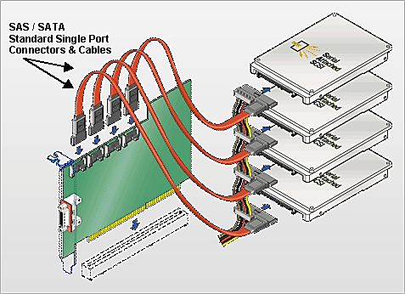
Scalability of SAS
SAS uses expanders to expand interfaces. One SAS domain supports a maximum of 16,384 disk devices.
1
Expander
Expander
Expander
SAS RAID
Controller
Expander
1
Expander
Expander
128
128
Notes:
SAS uses expanders to expand interfaces. One SAS domain supports a maximum of 16,384 disk devices.
A SAS expander is an interconnection device in a SAS domain. Similar to an Ethernet switch, a SAS expander enables an increased number of devices to be connected in a SAS domain, and reduces the cost in HBAs. Each expander can connect to a maximum of 128 terminals or expanders. The main components in a SAS domain are SAS expanders, terminal devices, and connection devices (or SAS connection cables).
A SAS expander is equipped with a routing table that tracks the addresses of all SAS drives.
A terminal device can be an initiator (usually a SAS HBA) or a target (a SAS or SATA disk, or an HBA in target mode).
Loops cannot be formed in a SAS domain. This ensures terminal devices can be detected.
In reality, the number of terminal devices connected to an extender is far fewer than 128 due to bandwidth reasons.

Slide 31
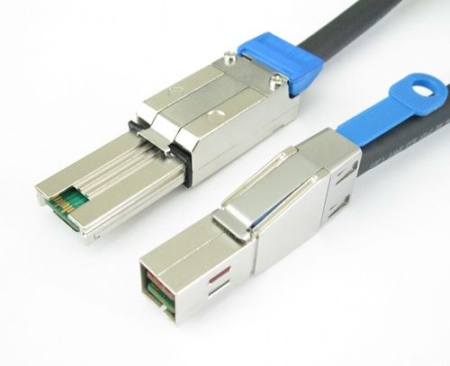
Cable Connection Principles of SAS
Generally, a SAS cable has four channels, each of which supports 12 Gbit/s bandwidth.
SAS devices are connected in the form of a loop (also called a chain).
A cable supports 4 x 12 Gbit/s bandwidth, which limits the number of disks in the loop.
A maximum of 168 disks are supported in a loop. A loop therefore comprises a maximum of seven disk enclosures with 24 disk slots each.
SAS cable connectors:
Mini SAS
High-density mini SAS
Notes:
Most storage device vendors use SAS cables to connect disk enclosures to controller enclosures or connect disk enclosures. A SAS cable bundles four independent channels (narrow ports) into a wide port to provide higher bandwidth. The four independent channels provide 12 Gbit/s each, so a wide port can provide 48 Gbit/s of bandwidth. To ensure that the data volume on a SAS cable does not exceed the maximum bandwidth of the SAS cable, the total number of disks connected to a SAS loop must be limited.
For a Huawei storage device, the maximum number of disks supported is 168. That is, a loop comprising up to a maximum seven disk enclosures each with 24 disk slots. However, all disks in the loop must be traditional SAS disks. As SSDs are becoming more common, one must consider that SSDs deliver much higher transmission speeds than SAS disks. Therefore, for SSDs, a maximum of 96 disks are supported in a loop: four disk enclosures, each with 24 disk slots, form a loop.
A SAS cable is called a mini SAS cable when the speed of a single channel is 6 Gbit/s, and a SAS cable is called a high-density mini SAS cable when the speed is increased to 12 Gbit/s.

Slide 32
SATA
SATA is short for Serial ATA, which is a type of computer bus used for data transmission between the main board and storage devices (disks and CD-ROM drives).
SATA uses a brand new bus structure rather than simply improving that of PATA.
A SATA bus uses embedded clock signals and has better error correction capabilities.
SATA has better anti-interference capabilities than PATA.
SATA is designed for entry-level applications. It is not as powerful as SCSI in terms of big data throughput or multi-thread transmission.
SAS
SATA
Serial transmission
SCSI
Serial transmission
PATA
Notes:
PATA is short for parallel ATA.
At the physical layer, the SAS port is completely compatible with the SATA port. SATA disks can be used in a SAS environment. In terms of port standards, SATA is a sub-standard of SAS. Therefore, a SAS controller can directly control SATA disks. However, SAS cannot be directly used in a SATA environment, because a SATA controller cannot control SAS disks.
At the protocol layer, SAS includes three types of protocols that are used for data transmission of different devices.
The serial SCSI protocol (SSP) is used to transmit SCSI commands.
The SCSI management protocol (SMP) is used to maintain and manage connected devices.
The SATA channel protocol (STP) is used for data transmission between SAS and SATA.
When the three protocols operate cooperatively, SAS can be used with SATA and some SCSI devices.

Slide 33
SCSI
iSCSI, FC, and FCoE
SAS and SATA
PCIe and NVMe
RDMA and IB
CIFS, NFS, and NDMP

Slide 34
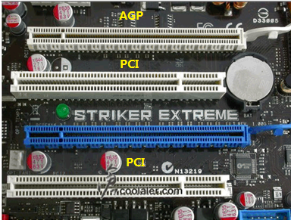
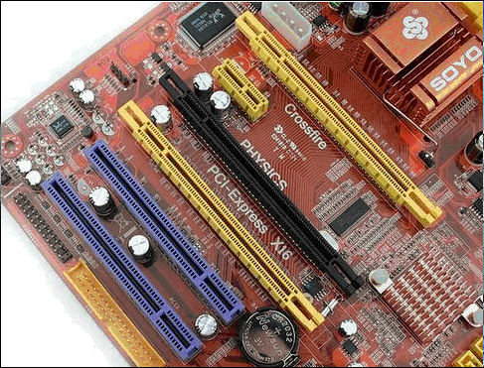
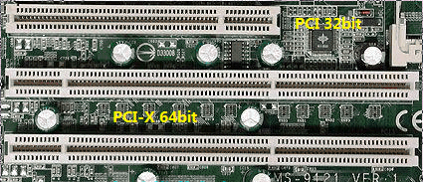
PCIe
PCIe is short for PCI Express, which is a high-performance and high-bandwidth serial communication interconnection standard. It was first proposed by Intel and then developed by the Peripheral Component Interconnect Special Interest Group (PCI-SIG) to replace bus-based communication architectures, such as PCI, PCI Extended (PCI-X), and Accelerated Graphics Port (AGP).
Notes:
Features of PCI:
Simple bus structure, low costs, easy designs.
The parallel bus supports a limited number of devices and the bus scalability is poor.
When multiple devices are connected, the effective bandwidth of the bus is greatly reduced and the transmission rate slows down.
In 1991, Intel first proposed the concept of PCI. With the development of modern processor technologies, it was inevitable engineers would look to replace parallel buses with high-speed differential buses in the interconnectivity field. Compared with single-ended parallel signals, high-speed differential signals are used for higher clock frequencies. In this case, the PCIe bus came to being.
Compared with the traditional PCI bus, PCIe has the following advantages:
Dual channels, high bandwidth, and a fast transmission rate: A transmission mode (RX and TX are separated) similar to the full-duplex mode is implemented. In addition, a higher transmission rate can be provided. The first-generation PCIe X1 provides 2.5 Gbit/s, the second generation provides 5 Gbit/s, the PCIe 3.0 provides 8 Gbit/s, the PCIe 4.0 provides 16 Gbit/s, and the PCIe 5.0 provides up to 32 Gbit/s.
Compatibility: PCIe is compatible with PCI at the software layer but has upgraded software.
Ease-of-use: Hot swap is supported. A PCIe bus interface slot contains the hot swap detection signal, supporting hot swap and heat exchange.
Error processing and reporting: A PCIe bus uses a layered structure, in which the software layer can process and report errors. For details, see the following slides.
Virtual channels of each physical connection: Each physical channel supports multiple virtual channels (in theory, eight virtual channels are supported for independent communication control), thereby supporting QoS of each virtual channel and achieving high-quality traffic control.
Reduced I/Os, board-level space, and crosstalk: A typical PCI bus data line requires at least 50 I/O resources, while PCIe XL requires only four I/O resources. Reduced I/Os saves board-level space, and the direct distance between I/Os can be longer, thereby reducing crosstalk.

Slide 35
Why PCIe
PCIe is used to obtain significantly improved system throughput, scalability, and flexibility at lower production costs, which are almost impossible to achieve using the traditional bus-based interconnection.
High-performance and high-bandwidth serial interconnection standard: PCIe
Notes:
PCIe is future-oriented, and higher throughputs can be achieved in the future. PCIe is providing increasing throughput using the latest technologies, and the transition from PCI to PCIe can be simplified by guaranteeing compatibility with PCI software using layered protocols and drives.
The PCIe protocol has the following features:
Point-to-point connection
High reliability
Tree networking
Full duplex
Frame-structure-based transmission

Slide 36
PCIe Protocol Structure
PCIe device layers include the physical layer, data link layer, transaction layer, and application layer.
Physical layer
Data link layer
Transaction layer
Application layer
PCIe Device
AP
Transaction
Physical
Data link
Logical sub-block
Physical
Electrical sub-block
Tx
Rx
Notes:
The physical layer in a PCIe bus architecture determines the physical features of the bus. In future, the performance of a PCIe bus can be further improved by increasing the speed or changing the encoding or decoding mode. Such changes only affect the physical layer, facilitating upgrades.
Data link layer
The data link layer ensures the correctness and reliability of data packets transmitted over a PCIe bus. It checks whether the data packet encapsulation is complete and correct, adds the sequence number and CRC code to the data, and uses the ack/nack handshake protocol for error detection and correction.
Transaction layer
The processing layer receives read and write requests from the software layer or creates a request encapsulation packet and transmits it to the data link layer. This type of packet is called a transaction layer packet (TLP). The TLP receives data link layer packets (DLLP) from the link layer, associates the DLLP with a related software request, and transmits it to the software layer for processing.

Slide 37
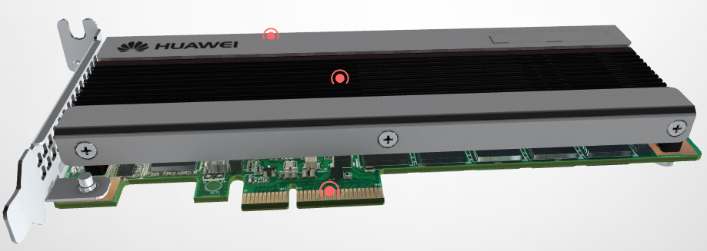
NVMe
NVMe is short for Non-Volatile Memory Express.
The NVMe standard is oriented to PCIe SSDs. Direct connection from the native PCIe channel to the CPU can avoid the latency caused by communication between the external controller (PCH) of the SATA and SAS interface and the CPU.
PCIe is an interface form and a bus standard. NVMe is a standard interface protocol customized for PCIe SSDs.
Notes:
In terms of the entire storage process, NVMe not only serves as a logical protocol port, but also as an instruction standard and a specified protocol.
The low latency and parallelism of PCIe channels and the parallelism of contemporary processors, platforms, and applications can be used to greatly improve the read and write performance of SSDs with controllable costs. They can also reduce the latency caused by the Advanced Host Controller Interface (AHCI) and ensure enhanced performance of SSDs in the SATA era.

Slide 38
NVMe Protocol Stack
App
Reduced interaction: The number of communication interactions is reduced from 4 to 2, reducing the latency.
Block Layer
Controller
SSD
Controller
Initiator
1. Transfer command
SCSI
NVMe
2. Ready to transfer
SAS
3. Transfer data
SAS
4. Response feedback
Target
1. NVMe write command
SAS
NVMe
NVMe
2. NVMe write finished
SCSI
SAS Protocol Stack
NVMe Protocol Stack
NVMe provides a lower average I/O latency than SAS 3.0.
Notes:
In terms of the transmission path, I/Os of a SAS all-flash array are transmitted from the front-end server to the CPU through the FC/IP front-end interface protocol of a storage device. They are then transmitted to a SAS chip, a SAS expander, and finally a SAS SSD through PCIe links and switches.
The Huawei NVMe-based all-flash storage system supports end-to-end NVMe. Data I/Os are transmitted from a front-end server to the CPU through a storage device's FC-NVMe/NVMe Over RDMA front-end interface protocol. Back-end data is transmitted directly to NVMe-based SSDs through 100 Gbit/s RDMA. The CPU of the NVMe-based all-flash storage system appears to communicate directly with NVMe SSDs via a shorter transmission path, providing higher transmission efficiency and a lower transmission latency.
In terms of software protocol parsing, SAS- and NVMe-based all-flash storage systems differ greatly in protocol interaction for data writes. If the SAS back-end SCSI protocol is used, four protocol interactions are required for a complete data write operation. Huawei NVMe-based all-flash storage systems require only two protocol interactions, making them twice as efficient as SAS-based all-flash storage systems in terms of processing write requests.

Slide 39
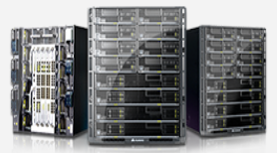
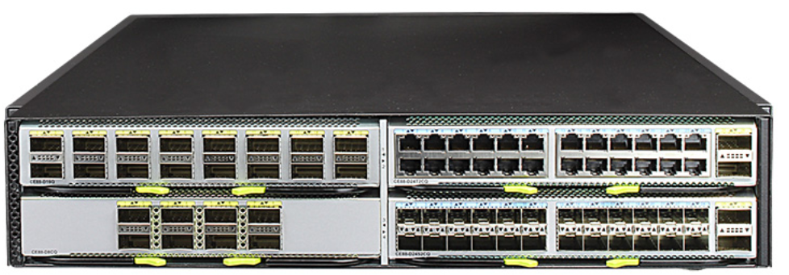
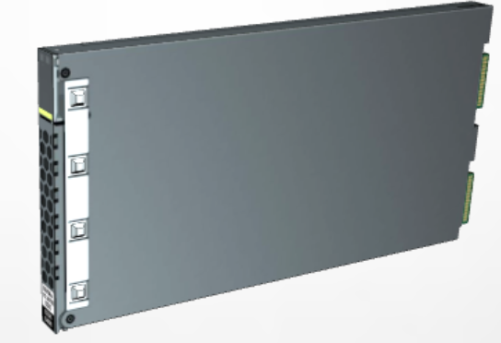
NVMe Advantages and Applications
IOPS
Fusion Server
Over Fabric
End-to-end 100GE
100GE NVMe-oF
FC
NVMe-oF
CloudEngine
CE8800
End-to-end hardware offload
NVMe-oF protocol
Reduced by 50%
Latency
Huawei OceanStor
Dorado
FC
NVMe-oF
Reduced by 66%
TCO
End-to-end DIF
Data integrity protection
NVMe SSD
FC
NVMe-oF
Notes:
Advantages of NVMe:
Low latency: Data is not read from registers when commands are executed, resulting in a low I/O latency.
High bandwidth: PCIe X4 can provide up to 4 Gbit/s throughput for a single drive.
High IOPS: NVMe increases the maximum queue depth from 32 to 64,000. The IOPS of SSDs is also greatly improved.
Low power consumption: The automatic switchover between power consumption modes and dynamic power management greatly reduce power consumption.
Wide driver applicability: The driver applicability problem between different PCIe SSDs is solved.
RDMA uses related hardware and network technologies to enable NICs of servers to directly read memory, achieving high bandwidth, low latency, and low resource consumption. However, the RDMA-dedicated IB network architecture is incompatible with a live network, resulting in high costs. RoCE effectively solves this problem. RoCE is a network protocol that uses the Ethernet to carry RDMA. There are two versions of RoCE. RoCEv1 is a link layer protocol and cannot be used in different broadcast domains. RoCEv2 is a network layer protocol and can implement routing functions.
Huawei OceanStor Dorado all-flash storage systems use NVMe-oF to implement SSD resource sharing, and provide 32 Gbit/s FC-NVMe and NVMe over 100 Gbit/s RDMA networking designs. In this way, the same network protocol is used for front-end network connection, back-end disk enclosure connection, and scale-out controller interconnection.

Slide 40
SCSI
iSCSI, FC, and FCoE
SAS and SATA
PCIe and NVMe
RDMA and IB
CIFS, NFS, and NDMP

Slide 41
RDMA
RDMA is short for Remote Direct Memory Access, a method of transferring data in a buffer between application software on two servers over a network.
Low latency
High throughput
Low CPU and OS resource occupancy
Traditional mode
RDMA mode
APP
App
Buffer
Buffer
OS
OS
TCP/IP
Buffer
TCP/IP
Driver
Buffer
Adapter
Adapter
Buffer
RDMA
Buffer
Notes:
Comparison between traditional mode and RDMA mode:
Compared with the internal bus I/O of traditional DMA, RDMA uses direct buffer transmission between the application software of two endpoints over a network.
Compared with traditional network transmission, RDMA does not require operating systems or protocol stacks.
RDMA can achieve ultra-low latency and ultra-high throughput transmission between endpoints without using an abundance of CPU and OS resources. Few resources are consumed for data processing and migration.

Slide 42
RDMA Bearer Network
Software
RDMA application/ULP
RDMA API (Verbs)
RDMA software stack
Typical hardware
IB transport protocol
IB transport protocol
IB transport protocol
iWARP protocol
IB network layer
IB network layer
UDP
TCP
IP
IP
IB link layer
Ethernet link layer
Ethernet link layer
Ethernet link layer
IB
RoCEv1
RoCEv2
iWARP
IB management
Ethernet/IP management
Ethernet/IP management
Ethernet/IP management
Content defined by IBTA
Content defined by IEEE/IETF
Notes:
Currently, there are three types of RDMA networks: IB, RoCE, and iWARP. IB is designed for RDMA to ensure reliable transmission at the hardware level. RoCE and iWARP are Ethernet-based EDMA technologies and support corresponding verbs interfaces, as shown in the figure.
RoCEv1 is an RDMA protocol implemented based on the Ethernet link layer. Switches must support flow control technologies like PFC to ensure reliable transmission at the physical layer. RoCEv2 is implemented at the UDP layer in the Ethernet TCP/IP protocol.
IB is a new-generation network protocol that supports RDMA from the beginning. NICs and switches that support this technology are required.
RoCE is a network protocol that allows RDMA over the Ethernet. The lower network header is an Ethernet header, and the higher network header (including data) is an IB header. RoCE allows RDMA to be used on a standard Ethernet infrastructure (switch). The NIC should support RoCE.
iWARP: allows RDMA through TCP. The functions supported by IB and RoCE are not supported by iWARP. However, iWARP allows RDMA to be used over a standard Ethernet infrastructure (switch). The NIC should support iWARP (if CPU offload is used). Otherwise, all iWARP stacks can be implemented in the SW, and most RDMA performance advantages are lost.

Slide 43
IB
Overview:
IB technology is specifically designed for server connections and is widely used for communication between servers (for example, replication and distributed working), between a server and a storage device (for example, SAN and DAS), and between a server and a network (for example, LAN, WAN, and the Internet).
Highlights:
Standard-protocol-based
High bandwidth and low latency
RDMA
Transmission uninstallation
Notes:
IB defines a set of devices used for system communication, including channel adapters, switches, and routers used to connect to other devices, such as host channel adapters (HCAs) and target channel adapters (TCAs).
The IB protocol has the following features:
Standard-based protocol: IB was designed by the InfiniBand Trade Association, which was founded in 1999 and comprised 225 companies. Main members of the association include Agilent, Dell, HP, IBM, InfiniSwitch, Intel, Mellanox, Network Appliance, and Sun Microsystems. More than 100 other members help develop and promote the standard.
Speed: IB provides high speeds.
Memory: Servers that support IB use HCAs to convert the IB protocol to the PCI-X or PCI-Xpress bus inside the server. The HCA supports RDMA and is also called kernel bypass. RDMA fits clusters well. It uses a virtual addressing solution to let a server identify and use memory resources from other servers without involving any operating system kernels.
RDMA helps implement transport offload. The transport offload function transfers data packet routing from the OS to the chip level, reducing the service load of the processor. An 80 GHz processor is required to process data at a transmission speed of 10 Gbit/s in the OS.

Slide 44
IB Architecture
IB defines a series of devices for system communication, including channel adapters, switches, and routers.
FCP
TCA
Host interconnect
CPU
Host controller
HCA
Switch
Router
CPU
System main storage
TCA
TCA
SCSI
Gbit
Ethernet
CPU
Notes:
As shown in the figure, the IB system includes CAs, a switch, a router, a repeater, and connected links.
CAs include HCAs and TCAs.
An HCA is used to connect a host processor to the IB structure.
A TCA is used to connect I/O adapters to the IB structure.

Slide 45
IB in Storage
Converged storage
Distributed storage
Server
Initiator
Back-end IB switch
Back-end IB switch
Switch cascading
FCoE
FC
TOE
10GE
IB
Back-end network
Target
Frontend
Node 1
Node 2
Node 3
Node n
Front-end network
Storage controller
...
Initiator
Backend
SAS
SAS
Distributed cluster
Target
Disk
Front-end IB switch
Front-end IB switch
Client
Notes:
IP over IB (IPoIB) is the adaptation layer between the Linux kernel and IB driver. It constructs and destroys IP packet headers and sends and receives IP packets.
The IB front-end network is used to exchange data with customers. Data is transmitted based on the IPoIB protocol.
The IB back-end network is used for data interaction between nodes in a storage device. The RPC module uses RDMA to synchronize data between nodes.

Slide 46
IB Layers
Application layer
Transmission layer
Sends, receives, and reassembles data packet segments.
Network layer
Provides addressing and routing.
Link layer
Provides data packet design and point-to-point connection for local subsystems.
Physical layer
Determines the connection rate.
Notes:
Physical layer: defines connections at three rates: 1X, 4X, and 12X. The signal transmission rates are 2.5 Gbit/s, 10 Gbit/s, and 30 Gbit/s, respectively. IBA therefore allows multiple connections to obtain a speed of up to 30 Gbit/s. Because the full-duplex serial communication mode is used, the single-rate bidirectional connection requires only four cables. When the 12-rate mode is used, only 48 cables are required.
Link layer: provides such functions as packet design, point-to-point connection, and packet switching in the local subsystems. At the packet communication level, two special packet types are specified: data transmission and network management packets. The network management packet provides functions like operation control, subnet indication, and fault tolerance for device enumeration. The data transmission packet is used for data transmission. The maximum size of each packet is 4 KB. In each specific device subnet, the direction and exchange of each packet are implemented by a local subnet manager with a 16-bit identifier address.
Network layer: provides a mechanism for routing packets from one substructure to another. Each routing packet of the source and destination nodes has a global routing header (GRH) and a 128-bit IPv6 address. A standard global 64-bit identifier is also embedded at the network layer and this identifier is unique in all subnets. Through the exchange of such identifier values, data can be transmitted across multiple subnets.
Transport layer: responsible for in-order distribution and segmentation of packets, channel multiplexing, and data transmission. It also sends, receives, and reassembles data packet segments.

Slide 47
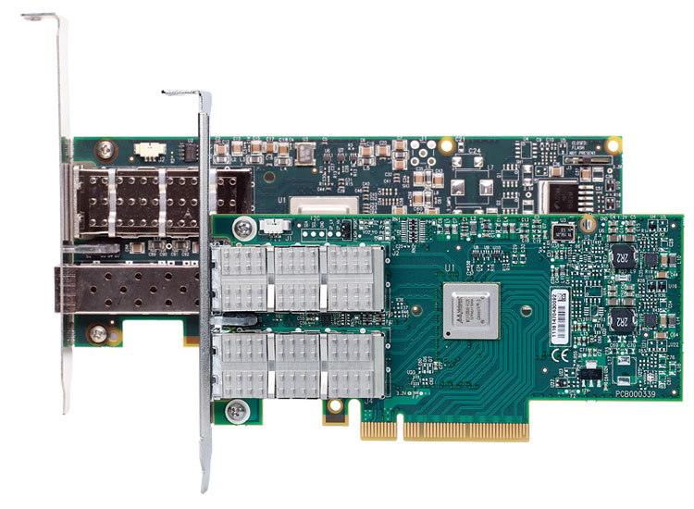
IB Interface
There are two types of channel adapters (CAs):
Host channel adapter (HCA), for example, Mellanox
Target channel adapter (TCA), an I/O interface used for IB switches and storage systems
IB connectors:
CA
10 Gb/s to 40 Gb/s
Notes:
CAs are classified as HCAs or TCAs. HCAs are used to control the master node, and TCAs are used for peripheral nodes to separate I/O devices from the host and place them directly on the network.
CAs provide the functions of the physical layer, link layer, network layer, and transport layer.
CAs are an important part of an IB network interface. They are programmable DMA components with specific protection features and support local and remote DMA operations.

Slide 48
SCSI
iSCSI, FC, and FCoE
SAS and SATA
PCIe and NVMe
RDMA
CIFS, NFS, and NDMP

Slide 49
CIFS Protocol
In 1996, Microsoft renamed SMB to CIFS and added many new functions. Now, CIFS includes SMB1, SMB2, and SMB3.0.
CIFS uses the C/S mode and basic network protocols including TCP/IP and IPX/SPX.
Redefined
Named as SMB
CIFS
Defined SMB2
SMB2.2 -> SMB3.0
1988
1992
1996
2000
2007
2009
2012
2020
IBM
Realized Samba
Added new features
Defined SMB2.1
Notes:
CIFS is a file sharing protocol in the traditional Microsoft environment. It is based on the server message block protocol.
CIFS has high requirements on network transmission reliability, so usually uses TCP/IP.
CIFS is mainly used for the Internet and by Windows hosts to access files or other resources over the Internet. CIFS allows Windows clients to identify and access shared resources. With CIFS, clients can quickly read, write, and create files in storage systems as on local PCs. CIFS helps maintain a high access speed and a fast system response even when many users simultaneously access the same shared file.

Slide 50
NFS Protocol
NFS is short for Network File System. The network file sharing protocol is defined by the IETF and widely used in the Linux/Unix environment.
NFS works using the client/server architecture. The servers provide the clients with access to shared file systems. NFS enables clients using different operating systems to share files over a network.
NFSv1
NFSv2
NFSv3
NFSv4.0
NFSv4.1
NFSv4.2
1990
2000
2010
2020
Notes:
NFS is a traditional file sharing protocol in the UNIX environment.
NFS is a client/server application that uses remote procedure call (RPC) for communication between computers. Users can store and update files on the remote NAS just like on local PCs.
A system requires an NFS client to connect to an NFS server. NFS is used for independent transmission so uses TCP or UDP.
Users or system administrators can use NFS to mount all file systems or a part of a file system (a part of any directory or subdirectory hierarchy). Access to the mounted file system can be controlled using permissions, for example, read-only or read-write permissions.
Differences between NFSv3 and NFSv4:
NFSv4 is a stateful protocol. It implements the file lock function and can obtain the root node of a file system without the help of the NLM and MOUNT protocols. NFSv3 is a stateless protocol. It requires the NLM protocol to implement the file lock function.
NFSv4 has enhanced security and supports and RPCSEC-GSS identity authentication.
NFSv4 provides only two requests: NULL and COMPOUND. All operations are integrated into COMPOUND. A client can encapsulate multiple operations into one COMPOUND request based on actual requests to improve flexibility.
The command space of the NFSv4 file system is changed. A root file system (fsid=0) must be set on the server, and other file systems are mounted to the root file system for export.
Compared with NFSv3, the cross-platform feature of NFSv4 is enhanced.

Slide 51
NDMP Protocol
The NDMP protocol is designed for the data backup system of NAS devices. It enables NAS devices to send data directly to the connected disk devices or the backup servers on the network for backup, without any backup client agent being required.
There are two networking modes for NDMP:
2-way
3-way
2-way networking
Production system A
Production system N
Backup server
NAS storage system
Tape library
3-way networking
Production system A
Production system N
Backup server
NAS storage system A
FC
Ethernet
Tape library
NAS storage system A
Backup data flow
Control flow
Notes:
The backup process of the traditional NAS storage is as follows:
A NAS device is a closed storage system. The Client Agent of the backup software can only be installed on the production system instead of the NAS device. In the traditional network backup process, data is read from a NAS device through the CIFS or NFS sharing protocol, and then transferred to a backup server over a network.
Such a mode occupies network, production system and backup server resources, resulting in poor performance and an inability to meet the requirements for backing up a large amount of data.
On a 2-way network, backup media is connected directly to a NAS storage system instead of to a backup server. In a backup process, the backup server sends a backup command to the NAS storage system through the Ethernet. The system then directly backs up data to the tape library it is connected to.
In the NDMP 2-way backup mode, data flows are transmitted directly to backup media, greatly improving the transmission performance and reducing server resource usage. However, a tape library is connected to a NAS storage device, so the tape library can back up data only for the NAS storage device to which it is connected.
Tape libraries are expensive. To enable different NAS storage devices to share tape devices, NDMP also supports the 3-way backup mode.
In the 3-way backup mode, a NAS storage system can transfer backup data to a NAS storage device connected to a tape library through a dedicated backup network. Then, the storage device backs up the data to the tape library.

Slide 52
Which networks are included in FC topologies?
Arbitrated loop network
Point-to-point network
Switching network
Dual-switching network
Which PCIe versions are currently available?
PCIe 1.0
PCIe 2.0
PCIe 3.0
PCIe 4.0
Notes:
Answers:
ABC
ABCD

Slide 53
Which of the following are file sharing protocols?
HTTP protocol
iSCSI protocol
NFS protocol
CIFS protocol
Which NFS versions are currently available?
NFSv1
NFSv2
NFSv3
NFSv4
Notes:
Answers:
ACD
ABCD

Slide 54
Which processes are involved when the CIFS protocol is used?
Protocol handshake
Security authentication
Connection to the share
File operation
Disconnection
Notes:
Answer:
ABCDE

Slide 55
SCSI
iSCSI, Fibre Channel (FC), and FCoE
SAS and SATA
Common Storage Protocols
PCIe and NVMe
RDMA: RoCE, IB, and iWARP
CIFS, NFS, and NDMP

Slide 56
Enterprise Technical Support App
Huawei Enterprise Business App
Notes:
Huawei training app
Contains a huge library of Huawei certified learning videos.
Enterprise technical support app
Covers all popular product documents, cases, and bulletins from Huawei. Users can quickly query commands, alarms, and spare parts. They can also use it to scan and view the device information. Simple and intuitive video guides provide 24/7 enterprise technical support.
Huawei enterprise business app
Provides one-stop mobile ICT portals for customers and partners to learn about Huawei's comprehensive products and solutions for enterprise ICT anytime and anywhere.

Slide 57
Huawei official websites
Enterprise business: https://e.huawei.com/en/
Technical support: https://support.huawei.com/enterprise/en/index.html
Online learning: https://www.huawei.com/en/learning
Popular tools
HedEx Lite
Network Document Tool Center
Information Query Assistant
Notes:
Popular tools
HedEx Lite is the Huawei tool for product document management. It allows users to browse, search, update, and manage product documentation.
eStor is a graphic storage simulation platform. The platform simulates Huawei OceanStor all-flash storage devices to help ICT practitioners and customers get familiar with Huawei storage products and quickly master their operations.
The Network Documentation Tool Center is the documentation tool for network products. It assists in bidding, network planning, project delivery, upgrades, and maintenance.
The Information Query Assistant provides command and alarm information querying for Huawei products.

