Slide 1
Intelligent Storage Components

Slide 2
This chapter will examine the design and processes of storage system components, including the controller enclosure, disk enclosure, disks, interface modules, and enclosure connections.

Slide 3
Upon completion of this course, you will learn about the:
Storage product forms
Functions and components of controller enclosures and disk enclosures
HDD and SSD designs
Cables and interface modules for connecting storage enclosures and the connection methods

Slide 4
Controller Enclosures
Disk Enclosures
Expansion Modules
Disks
Interface Modules

Slide 5
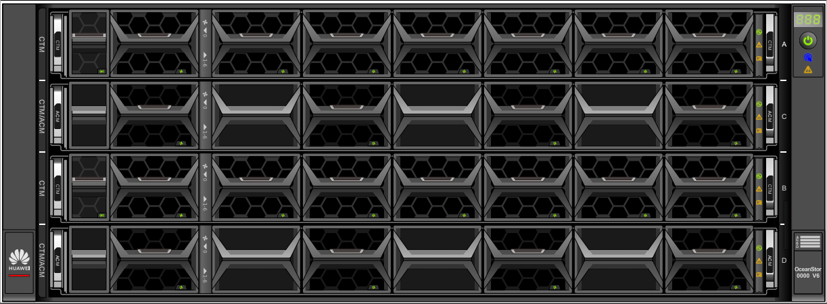
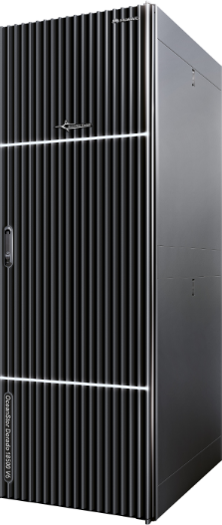
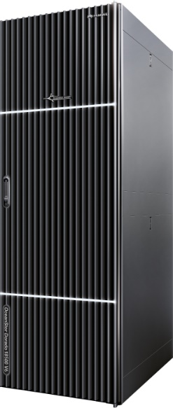
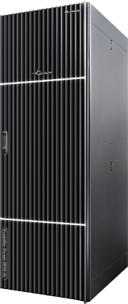
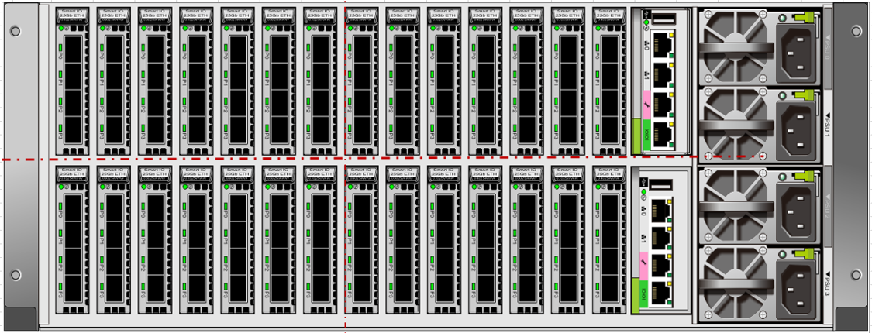
Storage Product Forms
2 U, disk and controller integration
4 U, disk and controller separation
Integrated bay
Note: The slide shows Huawei OceanStor Dorado V6.

Slide 6
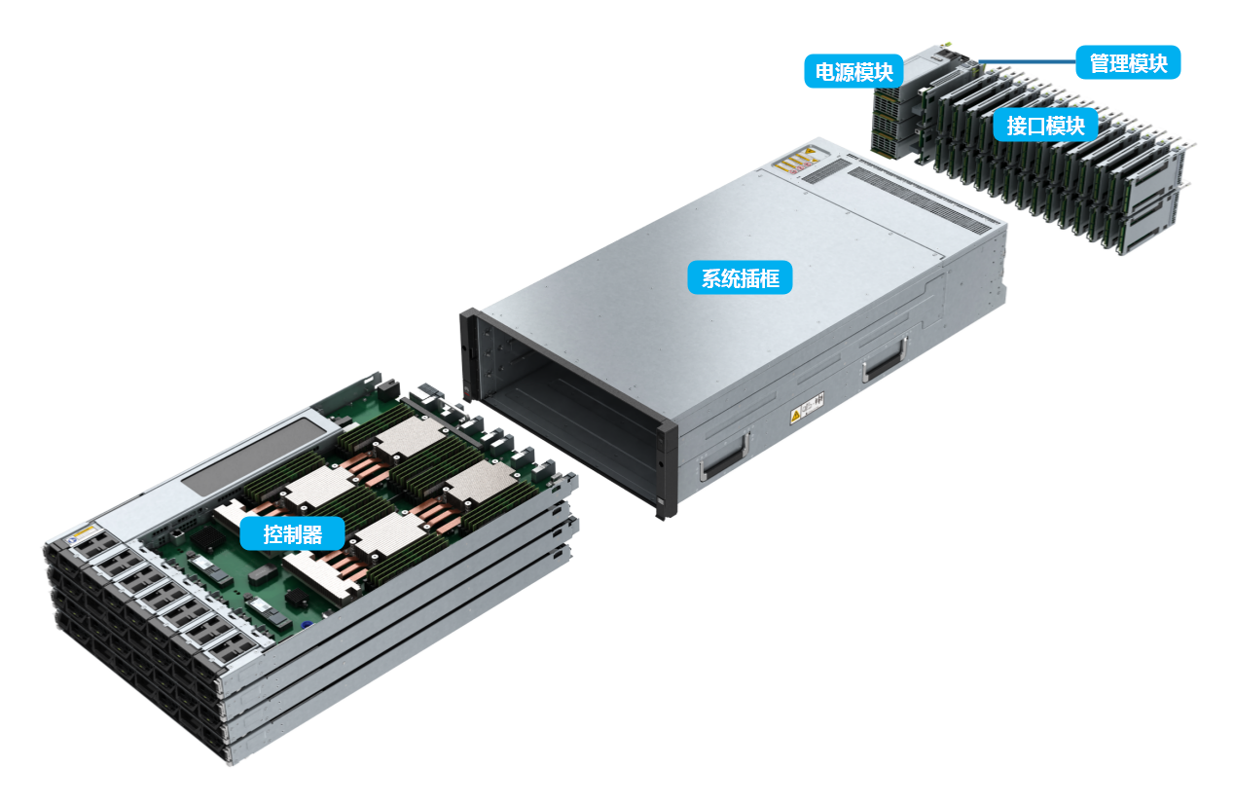
Controller Enclosure
The controller enclosure uses a modular design with a system subrack, controllers (with built-in fan modules), BBUs, power modules, management modules, and interface modules.
Management Module
Power Module
Interface Module
System Subrack
Controller
Notes:
A controller enclosure contains controllers and is the core component of a storage system. It comprises 5 parts.
The system subrack integrates a backplane for signal and power connectivity among modules.
BBUs protect storage system data by providing backup power during failures of the external power supply.
The management module provides management, maintenance, and serial ports.
The AC power module supplies electrical power to the controller enclosure.
Interface modules provide service or management ports and are field replaceable units.

Slide 7
Controller Enclosure: Front View
Icon | Description
 | Enclosure ID indicator
 | Enclosure location indicator Blinking blue: The controller enclosure is being located. Off: The controller enclosure is not located.
 | Enclosure alarm indicator Steady amber: An alarm is reported by the controller enclosure. Off: The controller enclosure is working properly.
 | Power indicator/Power button
2U controller enclosure (disk and controller integration)
4U controller enclosure (disk and controller separation)
Note: The slide shows Huawei OceanStor Dorado V6.
Notes:
This slide shows the controller enclosures of Huawei OceanStor Dorado V6. The top diagram shows a 2 U enclosure with 25 2.5-inch SSDs. It can also support 36 palm-sized NVMe SSDs. The 4 U enclosure on the bottom does not have SSDs.

Slide 8
Controller Enclosure: Rear View
1
2
3
4
5
No. | Description
1 | Management port
2 | Maintenance port
3 | Serial port
4 | Interface module
5 | Power-BBU module
6 | SAS expansion port
7 | Interface module
8 | Management module
9 | Power module
6
7
8
9

Slide 9
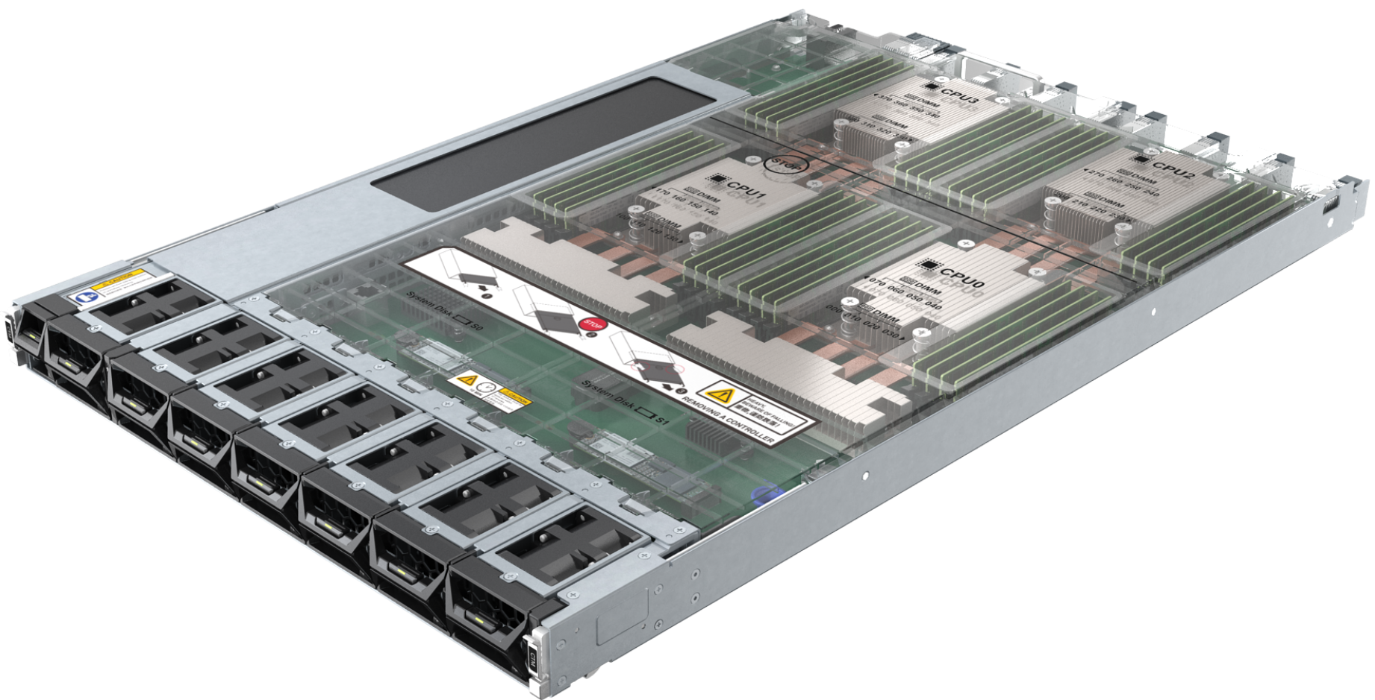
Controller
A controller is the core component of a storage system. It processes storage services, receives configuration management commands, saves configuration data, connects to disks, and saves critical data to coffer disks.
Controller enclosure
FE
FE
Controller
Controller
Cache
Cache
CPU
CPU
BE
BE
Disk
enclosure
Cache data
Notes:
The controller is a core module for processing storage system services. You can see how it works in the diagram on the right.
The controller CPU and cache process I/O requests from the host and manage storage system RAID.
Each controller has built-in disks to store system data. These disks also store cache data during power failures. Disks on different controllers are redundant of each other.
Front-end (FE) ports provide service communication between application servers and the storage system for processing host I/Os.
Back-end (BE) ports connect a controller enclosure to a disk enclosure and provide disks with channels for reading and writing data.
A cache is a memory chip on a disk controller. It provides fast data access and is a buffer between the internal storage and external interfaces.
An engine is a core component of a development program or system on an electronic platform. It usually provides support for programs or a set of systems.

Slide 10
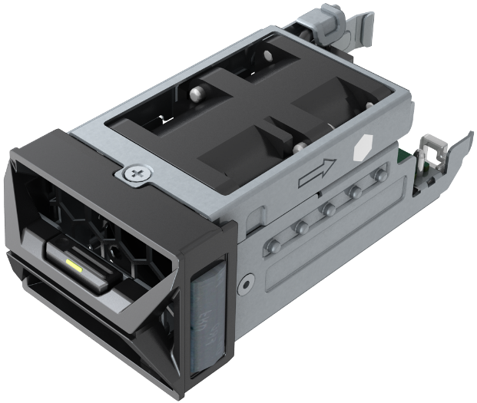
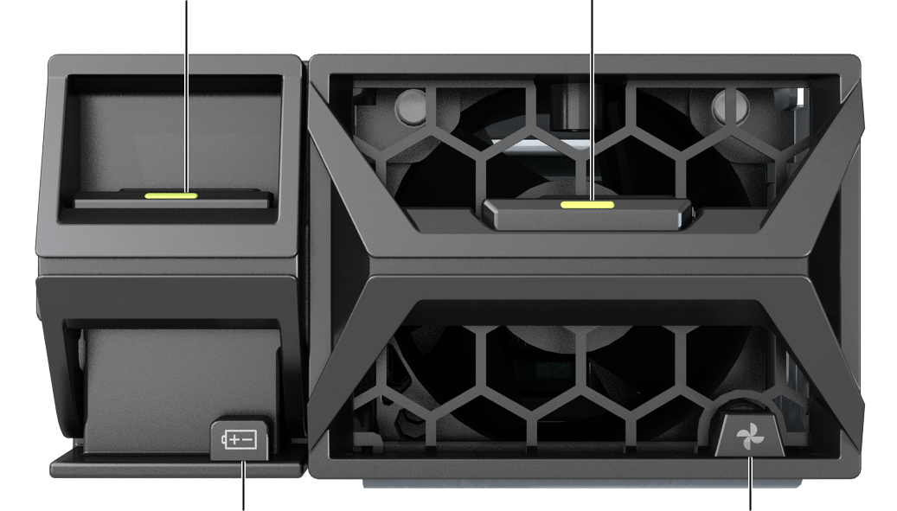
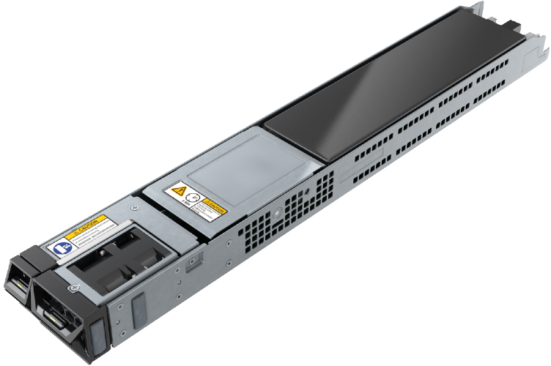
BBU and Fan Module
BBU latch
Fan latch
Fan module
Running/Alarm indicator of the BBU
Running/Alarm indicator of the fan
BBU
Front view
Notes:
Fan modules dissipate heat for the system so that the controller enclosure can operate normally at maximum power.
BBUs operate on standby to supply power to the storage system during failures of the external power supply.
Faulty BBUs can be isolated and removed without disrupting the storage system. The BBUs prevent data loss by allowing the system to write cache data to the built-in controller disks during power failures. After the external power supply is restored, storage software recovers data from the built-in disks of the controllers into the cache.
Systems with lithium batteries detect and update battery capacity by charging and discharging the batteries. In this way, the system detects and then avoids using batteries that fail to meet the power backup requirements of the system for more reliable data protection during power failures.

Slide 11
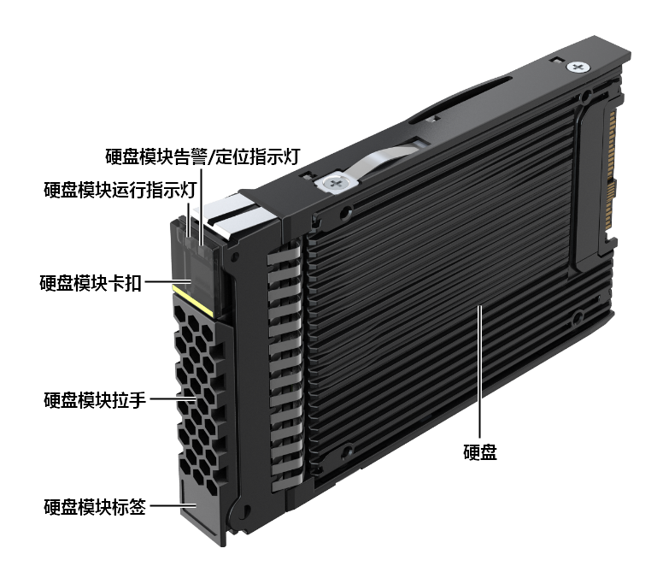
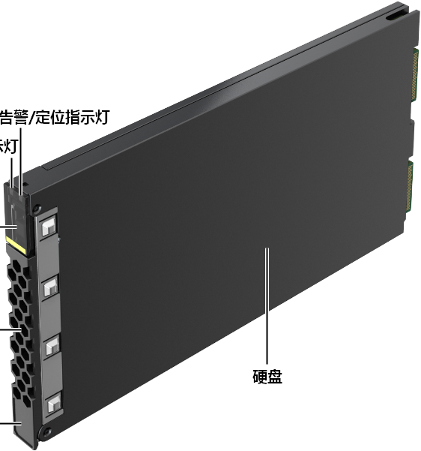
Coffer Disk
2.5-inch coffer disk
Palm-sized NVMe coffer SSD
Alarm/Location indicator
Alarm/Location indicator
Running indicator
Running indicator
Latch
Latch
Handle
Handle
Disk
Disk
Label
Label
Note: The slide shows the disks for Huawei OceanStor Dorado V6.
Notes:
Coffer disks store user data, system configurations, logs, and dirty data in the cache to protect against unexpected power outages.
There are built-in coffer disks and external coffer disks.
Built-in coffer disk
Each controller of OceanStor Dorado V6 has one or two built-in SSDs as coffer disks. See the product documentation for more details.
External coffer disk
The storage system automatically selects four disks as coffer disks. Each coffer disk provides 2 GB space to form a RAID 1 group. The remaining space can store service data. If a coffer disk is faulty, the system automatically replaces the faulty coffer disk with a normal disk for redundancy.

Slide 12
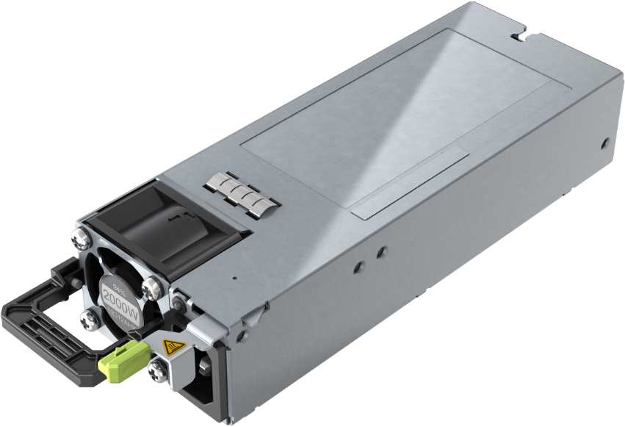
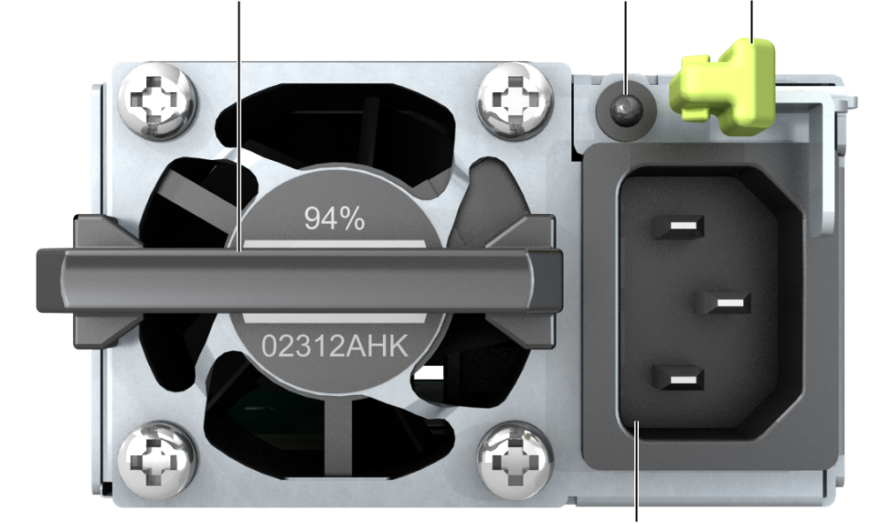
Power Module
The controller enclosure employs an AC power module for its normal operations.
Running/
Alarm indicator
Handle
Latch
Power socket
Note: The slide shows the power module of Huawei OceanStor Dorado V6.
Notes:
A 4 U controller enclosure has four power modules called PSU 0, PSU 1, PSU 2, and PSU 3. PSU 0 and PSU 1 form a power plane to power controllers A and C and provide mutual redundancy. PSU 2 and PSU 3 form the other power plane to power controllers B and D and provide mutual redundancy. It is recommended that you connect PSU 0 and PSU 2 to one PDU and PSU 1 and PSU 3 to another PDU for maximum reliability.
A 2 U controller enclosure has two power modules called PSU 0 and PSU 1 to power controllers A and B. The two modules form a power plane and provide mutual redundancy. Connect PSU 0 and PSU 1 to different PDUs for maximum reliability.

Slide 13
Controller Enclosures
Disk Enclosures
Expansion Modules
Disks
Interface Modules

Slide 14
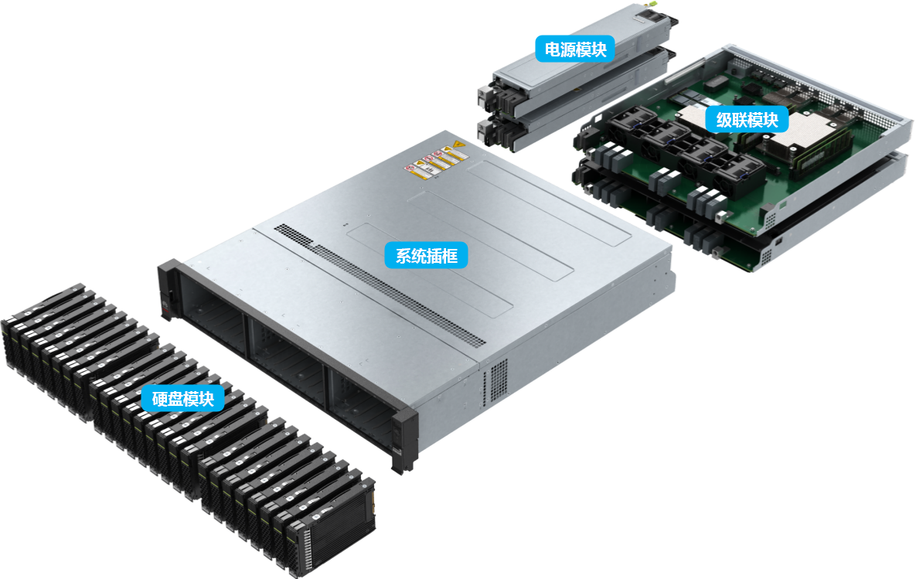
Disk Enclosure
The disk enclosure uses a modular design with a system subrack, expansion modules, power modules, and disks.
Power Module
Expansion Module
System Subrack
Disk Drive Module
Notes:
The system subrack integrates a backplane for signal and power connectivity among modules.
The expansion module provides expansion ports to connect to a controller enclosure or another disk enclosure for data transmission.
The power module supplies power to the disk enclosure, allowing the enclosure to operate normally at maximum power.
Disks provide storage space for the storage system to save service data, system data, and cache data. Specific disks are used as coffer disks.

Slide 15
Disk Enclosure: Front View
Icon | Description
 | Enclosure ID indicator
 | Enclosure location indicator Blinking blue: The disk enclosure is being located. Off: The disk enclosure is not located.
 | Enclosure alarm indicator Steady yellow: An alarm is reported by the disk enclosure. Off: The disk enclosure is working properly.
 | Enclosure power indicator Steady green: The disk enclosure is on. Off: The disk enclosure is powered off.
 | Power indicator/Power button The controller enclosure controls disk enclosure power. The power button on the disk enclosure is invalid and cannot control disk enclosure power separately.
2 U 25-slot SAS disk enclosure
2 U 36-slot smart NVMe disk enclosure
Note: The slide shows the disk enclosures of Huawei OceanStor Dorado V6.
Notes:
Huawei OceanStor Dorado V6 all-flash storage systems support SAS, smart SAS, and smart NVMe disk enclosures.
Check the indicators after a disk enclosure is powered on to determine its operating status.

Slide 16
Disk Enclosure: Rear View
4
No. | Description
1 | Serial port
2 | Mini SAS HD expansion port
3 | ID display
4 | Expansion module
5 | Power module
6 | Onboard expansion port
7 | Onboard management port
8 | Power module
1
2
3
5
2 U SAS disk enclosure
6
7
8
Note: The slide shows the disk enclosures of Huawei OceanStor Dorado V6.
2 U smart NVMe disk enclosure
Notes:
Smart disk enclosures use RDMA over Converged Ethernet (RoCE) ports to connect to controller enclosures. They have Kunpeng CPUs and DDR memory for superior computing capabilities.
Smart disk enclosures are 2 U high. A smart SAS disk enclosure can house 25 SAS SSDs, and a smart NVMe disk enclosure can house 36 palm-sized NVMe SSDs.

Slide 17
Controller Enclosures
Disk Enclosures
Expansion Modules
Disks
Interface Modules

Slide 18
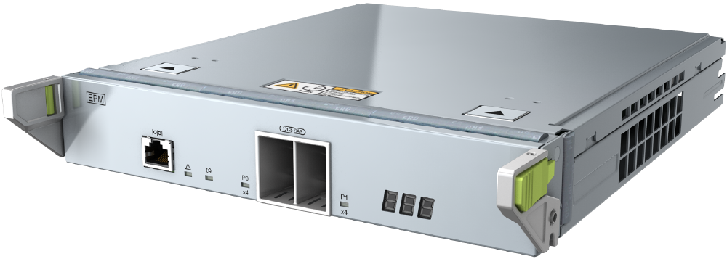
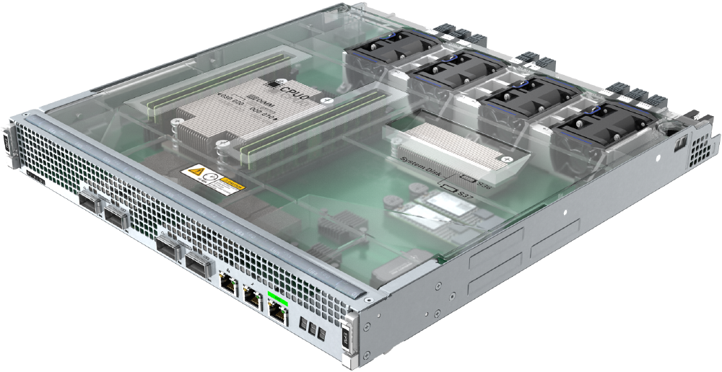
Expansion Module
The expansion module connects to a controller enclosure through expansion ports.
Expansion module of a 2 U SAS disk enclosure
Expansion module of a 2 U smart NVMe disk enclosure
Notes:
Each expansion module provides one P0 and one P1 expansion port to connect to a controller enclosure or another disk enclosure for data transmission.

Slide 19
CE Switch
Rear view
48 x 10GE electrical ports
4 x 60 Gbit/s optical ports
Console
Front view
USB port
FAN1
FAN2
PWR1
PWR2
Two Ethernet management ports (combo)
Note: Huawei CE6800 series switches are used as an example.
Notes:
Huawei CloudEngine series fixed switches are next-generation Ethernet switches for data centers and provide high performance, high port density, and low latency. The switches use a flexible front-to-rear or rear-to-front design for airflow and support IP SANs and distributed storage networks.

Slide 20
Fibre Channel Switch
Management ports (serial port and Ethernet port)
USB port
24 Fibre Channel ports
Power socket
Link aggregation groups
Note: Huawei SNS2124 is used as an example.
Notes:
Fibre Channel switches are high-speed network transmission relay devices that transmit data over optical fibers. They accelerate transmission and protect against interference.
Fibre Channel switches are used on FC SANs.

Slide 21
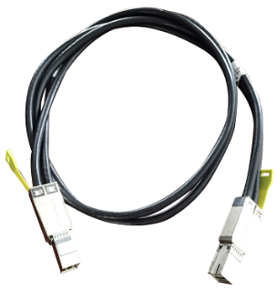
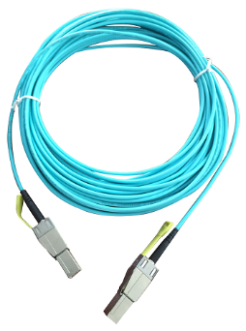
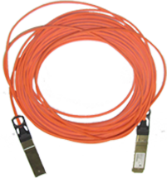
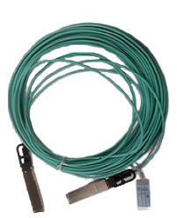
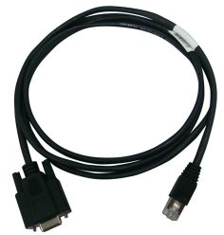
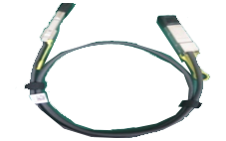
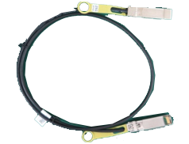
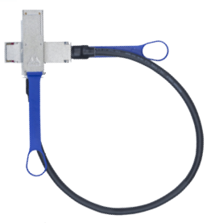
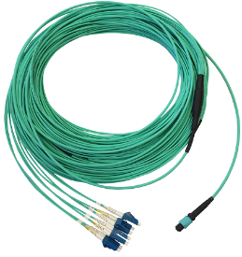
Device Cables
1. Serial cable
2. Mini SAS HD electrical cable
3. Mini SAS HD optical cable
4. AOC cable
5. 100G QSFP28 cable
6. 25G SFP28 cable
7. FDR cable
8. MPO-4*DLC optical fiber
9. Optical fiber
Notes:
A serial cable connects the serial port of the storage system to the maintenance terminal.
Mini SAS HD cables connect to expansion ports on controller and disk enclosures. There are mini SAS HD electrical cables and mini SAS HD optical cables.
An active optical cable (AOC) connects a PCIe port on a controller enclosure to a data switch.
100G QSFP28 cables are for direct connection between controllers or for connection to smart disk enclosures.
25G SFP28 cables are for front-end networking.
Fourteen Data Rate (FDR) cables are dedicated for 56 Gbit/s IB interface modules.
Optical fibers connect the storage system to Fibre Channel switches. One end of the optical fiber connects to a Fibre Channel host bus adapter (HBA), and the other end connects to the Fibre Channel switch or the storage system. An optical fiber uses LC connectors at both ends. MPO-4*DLC optical fibers are dedicated for 8 Gbit/s Fibre Channel interface modules with 8 ports and 16 Gbit/s Fibre Channel interface modules with 8 ports, and are used to connect the storage system to Fibre Channel switches.

Slide 22
Controller Enclosures
Disk Enclosures
Expansion Modules
Disks
HDDs
SSDs
Interface Modules

Slide 23
Disk Types
IDE
SCSI
SATA
SAS
FC
NVMe
...
Interface
1.8-inch
2.5-inch
3.5-inch
5.25-inch
...
Dimensions
Application
scenario
Enterprise-class
Desktop-class
...
How many disk types are there?
Structure
HDD
SSD
...
Notes:
The many types of disks can be classified by structure, dimension, interface, or application scenario.

Slide 24
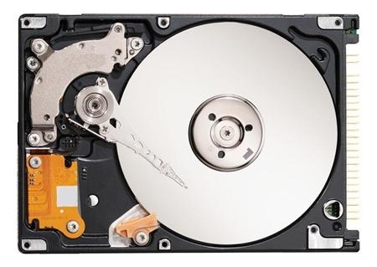
HDD Structure
An HDD has platters, an actuator arm, read/write heads, a spindle, a port, and control circuits.
Platter
Actuator arm
Spindle
Control circuit
Port
Read/write head
Notes:
Disk components:
A platter is coated with magnetic materials on both surfaces with polarized magnetic grains to represent a binary information unit, or bit.
A read/write head reads and writes data for platters. It changes the polarities of magnetic grains on the platter surface to save data.
The actuator arm moves the read/write head to the specified position.
The spindle has a motor and bearing underneath. It rotates the specified position on the platter to the read/write head.
The control circuit controls the speed of the platter and movement of the actuator arm, and delivers commands to the head.

Slide 25
HDD Design
Basic operation
The platter is driven by a motor.
Platter
Landing zone
Spindle
Magnetic data
R/W Head
The distance between the head and the disk is small.
The head hovers over the platter.
Notes:
Each disk platter has two read/write heads to read and write data on the two surfaces of the platter.
Airflow prevents the head from touching the platter, so the head can move between tracks at a high speed. A long distance between the head and the platter results in weak signals, and a short distance may cause the head to rub against the platter surface. The platter surface must therefore be smooth and flat. Any foreign matter or dust will shorten the distance and cause the head to rub against the magnetic surface. This will result in permanent data corruption.
Working principles:
The read/write head starts in the landing zone near the platter spindle.
The spindle connects to all of the platters and a motor. The spindle motor rotates at a constant speed to drive the platters.
When the spindle rotates, there is a small gap between the head and the platter. This is called the flying height of the head.
The head is attached to the end of the actuator arm, which drives the head to the specified position above the platter where data needs to be written or read.
The head reads and writes data in binary format on the platter surface. The read data is stored in the flash chip of the disk and then transmitted to the program.

Slide 26
Data Organization on a Disk
Sector
Track
Head
A
B
C
Cylinder
D
Actuator arm
Platter
Motor
Motor
Notes:
Platter surface: Each platter of a disk has two valid surfaces to store data. All valid surfaces are numbered in sequence, starting from 0 for the top. A surface number in a disk system is also referred to as a head number because each valid surface has a read/write head.
Track: Tracks are the concentric circles for data recording around the spindle on a platter. Tracks are numbered from the outermost circle to the innermost one, starting from 0. Each platter surface has 300 to 1024 tracks. New types of large-capacity disks have even more tracks on each surface. The tracks per inch (TPI) on a platter are generally used to measure the track density. Tracks are only magnetized areas on the platter surfaces and are invisible to human eyes.
Cylinder: A cylinder is formed by tracks with the same number on all platter surfaces of a disk. The heads of each cylinder are numbered from top to bottom, starting from 0. Data is read and written based on cylinders. Head 0 in a cylinder reads and writes data first, and then the other heads in the same cylinder read and write data in sequence. After all heads in a cylinder have completed reads and writes, the heads move to the next cylinder. Selection of cylinders is a mechanical switching process called seek. The position of heads in a disk is generally indicated by the cylinder number instead of the track number.
Sector: Each track is divided into smaller units called sectors to arrange data orderly. A sector is the smallest storage unit that can be independently addressed in a disk. Tracks may vary in the number of sectors. A sector can generally store 512 bytes of user data, but some disks can be formatted into even larger sectors of 4 kilobytes.

Slide 27
Disk Capacity and Cache
Disk capacity
Disk capacity = Number of cylinders x Number of heads x Number of sectors x 512 bytes.
The unit is MB or GB. The disk capacity is determined by the capacity of a single platter and the number of platters.
Cache
The superior processing speed of a CPU over a disk forces the CPU to wait until the disk completes a read/write operation before issuing a new command. Adding a cache to the disk to improve the read/write speed solves this problem.
Notes:
Disks may have one or multiple platters. However, a disk allows only one head to read and write data at a time. As a result, increasing the number of platters and heads can only improve the disk capacity. The throughput or I/O performance of the disk will not change.

Slide 28
Disk Performance Factors
Rotation speed
The primary factor in the throughput of sequential I/Os
Seek speed
The primary factor in random I/O performance
Single platter capacity
An indirect factor for disk performance
Port speed
The least important factor for disk performance
Notes:
Several factors affect disk performance.
Rotation speed: This is the number of platter revolutions per minute (rpm). When data is being read or written, the platter rotates while the head stays still. Fast platter rotations shorten data transmission time. When processing sequential I/Os, the actuator arm avoids frequent seeking, so the rotation speed is the primary factor in determining throughput and IOPS.
Seek speed: The actuator arm must change tracks frequently for random I/Os. Track changes take much longer time than data transmission. An actuator arm with a faster seek speed can therefore improve the IOPS of random I/Os.
Single platter capacity: A larger capacity for a single platter increases data storage within a unit of space for a higher data density. A higher data density with the same rotation and seek speed gives disks better performance.
Port speed: In theory, the current port speed is enough to support the maximum external transmission bandwidth of disks. The seek speed is the bottleneck for random I/Os with port speed having little impact on performance.

Slide 29
Average Access Time
The average access time is determined by:
Average seek time
Average latency time
Seek time
Latency
Wait time
Disc
Data Block
Seek
Tracks
Notes:
The average seek time is the average time required for a head to move from its initial position to a specified platter track. This is an important metric for the internal transfer rate of a disk and should be as short as possible.
The average latency time is how long a head must wait for a sector to move to the specified position after the head has reached the desired track. The average latency is generally half of the time required for the platter to rotate a full circle. Faster rotations therefore decrease latency.

Slide 30
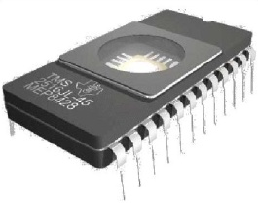
Data Transfer Rate
The date transfer rate is determined by:
Internal transfer rate
External transfer rate/Interface transfer rate
Disk
Disc
Seek
Tracks
External
Internal
Notes:
The data transfer rate of a disk refers to how fast the disk can read and write data. It includes the internal and external data transfer rates and is measured in MB/s.
Internal transfer rate is also called sustained transfer rate. It is the highest rate at which a head reads and writes data. This excludes the seek time and the delay for the sector to move to the head. It is a measurement based on an ideal situation where the head does not need to change the track or read a specified sector, but reads and writes all sectors sequentially and cyclically on one track.
External transfer rate is also called burst data transfer rate or interface transfer rate. It refers to the data transfer rate between the system bus and the disk buffer and depends on the disk port type and buffer size.

Slide 31
Disk IOPS and Transmission Bandwidth
IOPS
Input/Output operations per second (IOPS) is a key indicator to measure disk performance.
IOPS is calculated using the seek time, rotation latency, and data transmission time.
Transmission bandwidth (throughput)
Indicates the amount of data that is successfully transmitted in a unit time, that is, the speed of transmission for data streams. For example, if it takes 10s to write 10,000 files with a size of 1 KB each, the transmission bandwidth is only 1 MB/s. If it takes 0.1s to write a 10 MB file, the transmission bandwidth is 100 MB/s.
Notes:
IOPS is calculated using the seek time, rotation latency, and data transmission time.
The shorter the seek time, the faster the I/O. The current average seek time is 3 to 15 milliseconds.
The rotation latency refers to the time required for the platter to rotate the sector of the target data to the position below the head. The rotation latency depends on the rotation speed. Generally, the latency is half of the time required for the platter to rotate a full circle. For example, the average rotation latency of a 7200 rpm disk is about 4.17 ms (60 x 1000/7200/2), and the average rotation latency of a 15000 rpm disk is about 2 ms.
Data transmission time is the time required for transmitting the requested data and can be calculated by dividing the data size by the data transfer rate. For example, the data transfer rate of IDE/ATA disks can reach 133 MB/s and that of SATA II disks can reach 300 MB/s.
Random I/Os require the head to change tracks frequently. The data transmission time is much shorter than the time for track changes. In this case, data transmission time can be ignored.
Theoretically, the maximum IOPS of a disk can be calculated using the following formula: IOPS = 1000 ms/(Seek time + Rotation latency). The data transmission time is ignored. For example, if the average seek time is 3 ms, the theoretical maximum IOPS for 7200 rpm, 10k rpm, and 15k rpm disks is 140, 167, and 200, respectively.

Slide 32
Parallel and Serial Transmission
For example, the methods for transmitting numbers 1 to 8 are as follows:
Parallel transmission
Serial transmission
Sender
Receiver
Sender
Receiver
1
2
3
8
7
6
5
4
3
2
1
4
5
6
7
8
Multiple lines are connected between two ends, and one number is transmitted on each line.
Only one line is connected between two ends. Eight numbers are sent on this line in sequence. The receiver has all numbers after eight transmissions.
Notes:
Parallel transmission:
Parallel transmission features high efficiency, short distances, and low frequency.
In long-distance transmission, using multiple lines is more expensive than using a single line.
Long-distance transmission requires thicker conducting wires to reduce signal attenuation, but it is difficult to bundle them into a single cable.
In long-distance transmission, the time for data on each line to reach the peer end varies due to wire resistance or other factors. The next transmission can be initiated only after data on all lines has reached the peer end.
High transmission frequency causes serious circuit oscillation and generates interference between the lines. The frequency of parallel transmission must therefore be carefully set.
Serial transmission:
Serial transmission is less efficient than parallel transmission, but is generally faster with potential increases in transmission speed from increasing the transmission frequency.
Serial transmission is used for long-distance transmission. Currently, PCI interfaces use serial transmission. The PCIe interface is a typical example of serial transmission. The transmission rate of a single line is up to 2.5 Gbit/s.

Slide 33
Disk Ports
A disk must provide a simple port for data access. Disks generally provide the following physical ports:
IDE port
Used for the ATA instruction system
SATA port
Disk Ports
Parallel SCSI port
Used for the SCSI instruction system
Serial SCSI (SAS) port
Fibre Channel port
Notes:
Disks are classified into IDE, SCSI, SATA, SAS, and Fibre Channel disks by port. These disks also differ in their mechanical bases.
IDE and SATA disks use the ATA mechanical base and are suitable for single-task processing.
SCSI, SAS, and Fibre Channel disks use the SCSI mechanical base and are suitable for multi-task processing.
Comparison:
SCSI disks provide faster processing than ATA disks under high data throughput.
ATA disks overheat during multi-task processing due to the frequent movement of the read/write head.
SCSI disks provide higher reliability than ATA disks.

Slide 34
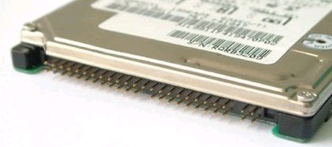
IDE Disk Port
The integrated drive electronics (IDE) port is also called the parallel ATA port.
ATA stands for Advanced Technology Attachment.
The ATA disk is also called the IDE disk.
The ATA port uses the parallel ATA technology.
Notes:
Multiple ATA versions have been released, including ATA-1 (IDE), ATA-2 (Enhanced IDE/Fast ATA), ATA-3 (Fast ATA-2), ATA-4 (ATA33), ATA-5 (ATA66), ATA-6 (ATA100), and ATA-7 (ATA133).
ATA ports have several advantages and disadvantages.
Their strengths are their low price and good compatibility.
Their disadvantages are their low speed, limited applications, and strict restrictions on cable length.
The transmission rate of the PATA port is also inadequate for current user needs.

Slide 35
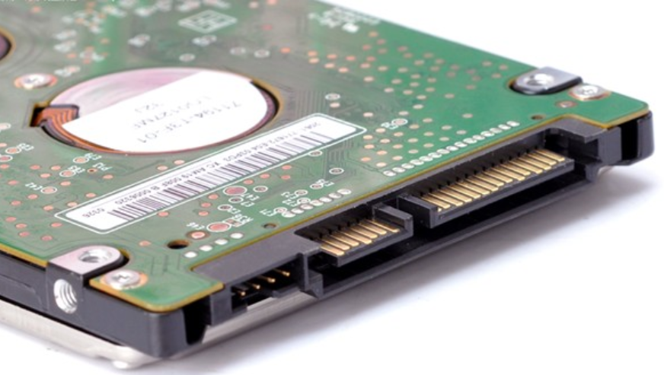
SATA Port
SATA stands for serial ATA.
SATA ports use serial transmission for a higher rate than IDE ports.
SATA uses a point-to-point architecture and supports hot swap.
SATA Version | Line Code | Transfer Rate | Throughput
1.0 | 8b/10b | 1.5 Gbit/s | 150 MB/s
2.0 | 8b/10b | 3 Gbit/s | 300 MB/s
3.0 | 8b/10b | 6 Gbit/s | 600 MB/s
Power port
SATA port
Notes:
During data transmission, the data and signal lines are separated and use independent transmission clock frequency. The transmission rate of SATA is 30 times that of PATA.
SATA ports feature a number of advantages:
A SATA port generally has 7+15 pins, uses a single channel, and transmits data faster than ATA.
SATA uses the cyclic redundancy check for instructions and data packets to ensure data transmission reliability.
SATA surpasses ATA in interference protection.

Slide 36
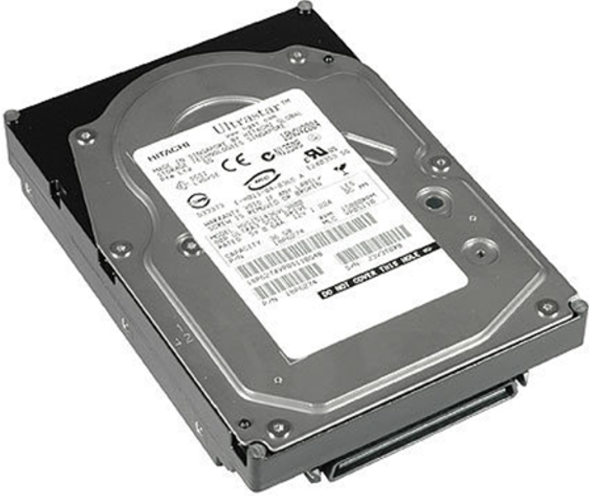
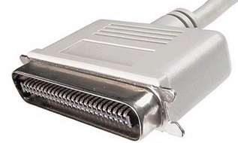
SCSI Port
SCSI stands for Small Computer System Interface.
Notes:
SCSI disks were developed to replace IDE disks to provide higher rotation speed and transmission rate. SCSI was originally a bus-type interface and worked independently of the system bus.
SCSI has the following advantages:
It is applicable to a wide range of devices. One SCSI controller card can connect to 15 devices simultaneously.
It provides high performance with multi-task processing, low CPU usage, fast rotation speed, and a high transmission rate.
SCSI disks support diverse applications as external or built-in components with hot-swappable replacement.
Its main disadvantages are its high cost and complex installation and configuration.

Slide 37
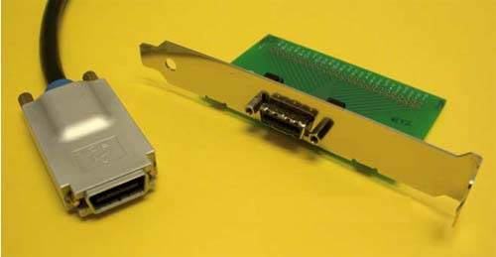
SAS Port
SAS stands for Serial Attached SCSI.
SAS is a point-to-point, full-duplex, and dual-port interface.
It is backward compatible with SATA.
It has a rate of 600 Mbit/s per channel.
It features high performance, reliability, and scalability.
Notes:
SAS is similar to SATA in its use of a serial architecture for a high transmission rate and streamlined internal space with shorter internal connections.
SAS improves the efficiency, availability, and scalability of the storage system. It is backward compatible with SATA for the physical and protocol layers.
Advantages:
SAS is superior to SCSI in its transmission rate, anti-interference, and longer connection distances.
Disadvantages:
SAS disks are more expensive.

Slide 38
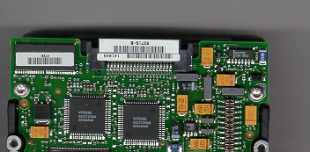
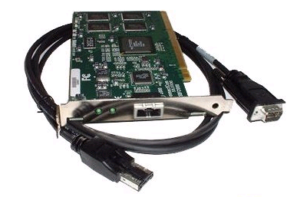
Fibre Channel Port
Fibre Channel disks use the Fibre Channel arbitrated loop (FC-AL).
FC-AL is a dual-port interface for serial storage based on the SCSI protocol.
FC-AL supports full-duplex mode.
Fibre Channel provides a universal hardware transmission platform for upper-layer protocols (SCSI and IP). It is a serial transmission interface with lower latency and higher speed, reliability, and throughput.
40-pin male FC-SCA II connector
Notes:
Fiber Channel was originally designed for network transmission rather than disk ports. It has gradually been applied to disk systems in pursuit of higher speed.
Advantages:
Easy to upgrade. Supports optical fiber cables with a length over 10 km.
Large bandwidth
Strong universality
Disadvantages:
High cost
Complex to build

Slide 39
Controller Enclosures
Disk Enclosures
Expansion Modules
Disks
HDDs
SSDs
Interface Modules

Slide 40
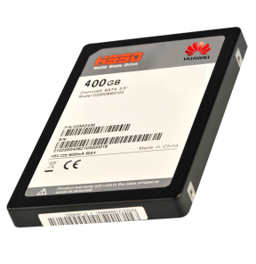
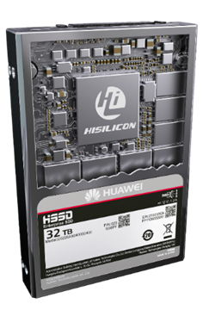
SSD Overview
SSDs exceed HDDs in performance, reliability, power efficiency, and portability. SSDs have been widely used in a variety of industries.
SSD characteristics:
NAND flash saves data faster than HDDs.
Elimination of internal mechanical structure saves power, generates less heat, and produces less noise.
Its service life is determined by the number of program/erase (P/E) cycles.
Notes:
SSD characteristics:
Traditional disks use magnetic materials to store data, but SSDs use NAND flash with cells as storage units. NAND flash is a non-volatile random access storage medium that can retain stored data after the power is turned off. It quickly and compactly stores digital information.
SSDs eliminate high-speed rotational components for higher performance, lower power consumption, and zero noise.
SSDs do not have mechanical parts, but this does not mean that they have an infinite life cycle. Because NAND flash is a non-volatile medium, original data must be erased before new data can be written. However, there is a limit to how many times each cell can be erased. Once the limit is reached, data reads and writes become invalid on that cell.

Slide 41
SSD Architecture
An SSD has a control unit and a storage unit (mainly flash memory chips).
Control unit: SSD controller, host interface, and DRAM
Storage unit: NAND flash
RAM
SSD Controller
Flash
pkg
Flash
pkg
...
Host
interface
logic
Processor
NAND
flash
interface
Host
Flash
pkg
Flash
pkg
...
Interconnect
Buffer
manager
Notes:
The host interface is the protocol and physical interface for the host to access an SSD. Common interfaces are SATA, SAS, and PCIe.
The SSD controller is the core SSD component for read and write access between a host and the back-end media and for protocol conversion, table entry management, data caching, and data checking.
DRAM is the cache for the flash translation layer (FTL) entries and data.
NAND flash is a non-volatile random access storage medium that stores data.
There are concurrent multiple channels with time-division multiplexing for flash granules in a channel. There is also support for TCQ and NCQ for simultaneous responses to multiple I/O requests.

Slide 42
NAND Flash
Internal storage units of NAND flash:
LUNs, planes, blocks, pages, and cells
Operations on the NAND flash include erase, program, and read.
NAND flash is a non-volatile medium. A block must be erased before new data is written to it. A P/E cycle is the process of erasing a block and then writing it again.
Page 0
Page 0
Page 1
Page 1
...
...
Page P
Page P
Block 0
Block 1
Page 0
Page 0
Logical Unit 0
Page 1
Page 1
...
...
Page P
Page P
Block 2
Block 3
...
...
Page 0
Page 0
Page 1
Page 1
...
...
Page P
Page P
Block B
Block B+1
Page Register
Page Register
Plane
Address 0
Plane
Address 1
Notes:
NAND flash stores data using floating gate transistors. The threshold voltage changes based on the number of electric charges stored in a floating gate. Data is then represented using the read voltage of the transistor threshold.
A LUN is the smallest physical unit that can be independently encapsulated and typically contains multiple planes.
A plane has an independent page register. It typically contains 1,000 or 2,000 odd or even blocks.
A block is the smallest erasure unit and generally consists of multiple pages.
A page is the smallest programming and read unit and is usually 16 kilobytes.
A cell is the smallest erasable, programmable, and readable unit found in pages. A cell corresponds to a floating gate transistor that stores one or multiple bits.
A page is the basic unit of programming and reading, and a block is the basic unit of erasing.
Each P/E cycle causes some damage to the insulation layer of the floating gate transistor. If block erasure or programming fails, the block is labeled a bad block. When the number of bad blocks reaches a threshold (4%), the NAND flash reaches the end of its service life.

Slide 43
SLC, MLC, TLC, and QLC
1
11
111
1111
110
1110
1101
10
101
1100
1011
100
1010
1001
0
01
011
1000
010
0111
0110
00
001
0101
0100
000
0011
0010
0001
0000
SLC-1bit
MLC-2bit
TLC-3bit
QLC-4bit
SLC
It supports 50,000 to 100,000 P/E cycles, providing the best reliability.
The storage capacity is small.
The cost is the highest.
MLC
It supports about 3,000 P/E cycles.
It is slower than SLC.
The storage capacity is relatively large.
The price is relatively low.
TLC
It has higher data density and supports only several hundred to 1,000 P/E cycles.
The reliability and performance are low.
It is common in personal devices due to the cost advantage but is inadequate for enterprise products.
QLC
The capacity is 33% higher.
The performance and life cycle are further reduced.
Notes:
NAND flash chips have the following classifications based on the number of bits stored in a cell:
A single level cell (SLC) can store one bit of data: 0 or 1.
A multi level cell (MLC) can store two bits of data: 00, 01, 10, and 11.
A triple level cell (TLC) can store three bits of data: 000, 001, 010, 011, 100, 101, 110, and 111.
A quad level cell (QLC) can store four bits of data: 0000, 0001, 0010, 0011, 0100, 0101, 0110, 0111, 1000, 1001, 1010, 1011, 1100, 1101, 1110, and 1111.
These four types of cells have similar costs but store different amounts of data. Originally, the capacity of an SSD was only 64 GB or smaller. Now, a TLC SSD can store up to 2 TB of data. However, each cell type has a different life cycle, resulting in different SSD reliability. The life cycle is also an important factor in selecting SSDs.

Slide 44
Flash Chip Data Relationship
Plane
Die
1,478 blocks
2 planes
Cell
Page
Block
...
146,688 cells
768 pages
...
...
...
...
...
...
A page is the minimum read/write unit, and a block is the minimum P/E unit.
Notes:
This slide shows the logic diagram of a flash chip.
A page is logically formed by 146,688 cells. Each page can store 16 KB of content and 1952 bytes of ECC data. A page is the minimum I/O unit of the flash chip.
Every 768 pages form a block. Every 1478 blocks form a plane.
A flash chip consists of two planes, with one storing blocks with odd sequence numbers and the other storing even sequence numbers. The two planes can be operated concurrently.
ECC must be performed on the data stored in the NAND flash, so the size of the page in the NAND flash is not an integer of 16 KB, but with an extra group of bytes. For example, if the actual size of a 16 KB page is 16,384 plus 1,952 bytes, then the 16,384 bytes are for data storage, and the 1,952 bytes are for storing data check codes for ECC.

Slide 45
Address Mapping Management
Logical block address (LBA)
Physical block address (PBA)
No. 26, XX Road, Binjiang District, Hangzhou City, Zhejiang Province, People's Republic of China
120º 12' east longitude, 30º 16' north latitude
HDD: The relationship between LBA and PBA is fixed.
Overwrite
SSD: The relationship between LBA and PBA is not fixed.
Non-overwrite: A block must be erased before new data is written to it. New data and old data are at different locations.
The Flash Translation Layer (FTL) is for conversion between the LBA and PBA.
Notes:
The logical block address (LBA) may refer to an address of a data block or the data block that the address indicates.
PBA is the physical block address.
The host accesses the SSD through the LBA. Each LBA generally represents a sector of 512 bytes. The host OS accesses the SSD in units of 4 KB. The basic unit for the host to access the SSD is called host page.
The flash page of an SSD is the basic unit for the SSD controller to access the flash chip, which is also called the physical page. Each time the host writes a host page, the SSD controller writes it to a physical page and records their mapping relationship.
When the host reads a host page, the SSD finds the requested data according to the mapping relationship.

Slide 46
FTL
Sector 0
 |  |  | Sector 2
 | Sector 1
 |  | Sector 4
Sector 3 |  |  | Sector 5
Sector 3
Main controller
FTL mapping table: saved in the internal SRAM/DRAM, external DRAM, or NAND flash.
Sector 2
Sector 0
Sector 1
OS sector (512 bytes). File systems read/write data in units of 512 bytes.
FTL mapping. The main controller maps the addresses with the mapping table.
Data is stored in the NAND physical addresses with the mapping table.
Notes:
This slide demonstrates how the flash translation layer, or FTL, works.

Slide 47
SSD Write Process (1)
The following uses eight channels as an example to demonstrate how the host writes data to the SSD.
Channel 0 block
Channel 1 block
Channel 2 block
Channel 3 block
Writes 4 KB of data
Writes 16 KB of data
4 KB
SSD controller
Channel 4 block
Channel 5 block
Channel 6 block
Channel 7 block
Notes:
These eight channels demonstrate how the host writes data to the SSD.
The SSD controller connects to eight flash dies through eight channels. For better explanation, the figure shows only one block in each die. Each 4 KB square in the blocks represents a page.
The host writes 4 kilobytes to the block of channel 0 to occupy one page.
The host continues to write 16 kilobytes. This example shows 4 kilobytes being written to each block of channels 1 through 4.
The host continues to write data to the blocks until all blocks are full.
When the blocks on all channels are full, the SSD controller selects a new block to write data in the same way.

Slide 48
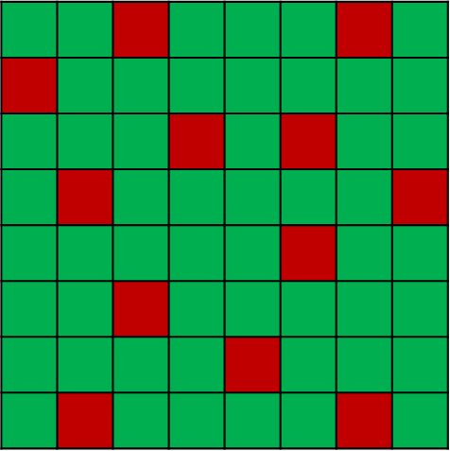
SSD Write Process (2)
When the SSD is full, old data must be deleted to release space for new data. Deletion or writing of data causes the data of some blocks to become invalid or aged.
Channel 0 block
Channel 1 block
Channel 2 block
Channel 3 block
SSD controller
Channel 4 block
Channel 5 block
Channel 6 block
Channel 7 block
Notes:
Green indicates valid data and red indicates invalid data. Unnecessary data in the blocks becomes aged or invalid, and its mapping relationship is replaced.
For example, host page A was originally stored in flash page X, and the mapping relationship was A to X. Later, the host rewrites the host page. Flash memory does not overwrite data, so the SSD writes the new data to a new page Y, establishes the new mapping relationship of A to Y, and cancels the original mapping relationship. The data in page X becomes aged and invalid, which is also known as garbage data.
The host continues to write data to the SSD until it is full. In this case, the host cannot write more data unless the garbage data is cleared.

Slide 49
SSD Read Process
Reads 4 KB of data
Channel 0 block
Channel 1 block
Channel 2 block
Channel 3 block
Reads 32 KB of data
4 KB
SSD controller
Channel 4 block
Channel 5 block
Channel 6 block
Channel 7 block
Notes:
An 8-fold increase in read speed depends on whether the read data is evenly distributed in the blocks of each channel. If the 32 KB data is stored in the blocks of channels 1 through 4, the read speed can only support a 4-fold improvement at most. That is why smaller files are transmitted at a slower rate.

Slide 50
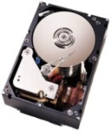
SSD Performance Advantages
SSD Performance Advantages
Power consumption with 100,000 read IOPS
I/O
I/O
IP/FC SAN
Seek time
Mechanical latency
2 SSDs
250 HDDs
Power (W)
4000
≈ 400x
2000
vs
HDD storage system
SSD storage system
SSD
FC HDD
Notes:
Short response time
Traditional HDDs have lower efficiency in data transmission because they waste time with seeking and mechanical latency. SSDs use NAND flash to eliminate seeking and mechanical latency for far faster responses to read and write requests.
High read/write efficiency
HDDs perform random read/write operations by moving the head back and forth, resulting in low read/write efficiency. In contrast, SSDs calculate data storage locations with an internal controller to reduce the mechanical operations and streamline read/write processing.
In addition, deploying a large number of SSDs grants enormous advantages in power efficiency.

Slide 51
Use of SSDs in Storage Systems
Class A applications: high-concurrency applications with random reads and writes, such as databases
Class B applications: large files, images, and streaming media with sequential reads and writes
Class C applications: data backup or rarely used applications
Access frequency
A
SSD media
FC/SAS disk
SATA/NL-SAS/Tape
B
C
Data distribution
Notes:
80-20 rule
Hot data that needs to be frequently modified, read, or written accounts for 20% of the total storage capacity and corresponds to class-A applications.
Tiered storage
Hot data is stored on SSDs, and data of class B and class C applications is stored on high-speed HDDs and common HDDs, respectively. This improves performance and reduces investment.

Slide 52
Controller Enclosures
Disk Enclosures
Expansion Modules
Disks
Interface Modules

Slide 53
GE Interface Modules
GE electrical interface module
40GE interface module
100GE interface module
Notes:
A GE electrical interface module has four electrical ports with 1 Gbit/s and is used for HyperMetro quorum networking.
A 40GE interface module provides two optical ports with 40 Gbit/s for connecting storage devices to application servers.
A 100GE interface module provides two optical ports with 100 Gbit/s for connecting storage devices to application servers.

Slide 54
SAS Expansion Module and RDMA Interface Module
25 Gbit/s RDMA interface module
100 Gbit/s RDMA interface module
12 Gbit/s SAS expansion module
Notes:
A 25 Gbit/s RDMA interface module provides four optical ports with 25 Gbit/s for direct connections between two controller enclosures.
A 100 Gbit/s RDMA interface module provides two optical ports with 100 Gbit/s for connecting controller enclosures to scale-out switches or smart disk enclosures. SO stands for scale-out and BE stands for back-end in the labels.
A 12 Gbit/s SAS expansion module provides four mini SAS HD expansion ports with 4 x 12 Gbit/s to connect controller enclosures to 2 U SAS disk enclosures.

Slide 55
SmartIO Interface Modules
Notes:
SmartIO interface modules support 8, 10, 16, 25, and 32 Gbit/s optical modules, which respectively provide 8 Gbit/s Fibre Channel, 10GE, 16 Gbit/s Fibre Channel, 25GE, and 32 Gbit/s Fibre Channel ports. SmartIO interface modules connect storage devices to application servers.
The optical module rate must match the rate on the interface module label. Otherwise, the storage system will report an alarm and the port will become unavailable.

Slide 56
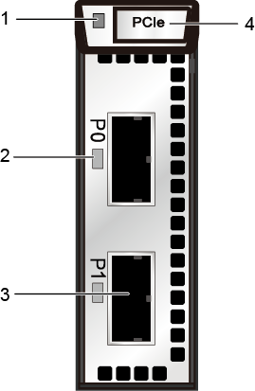
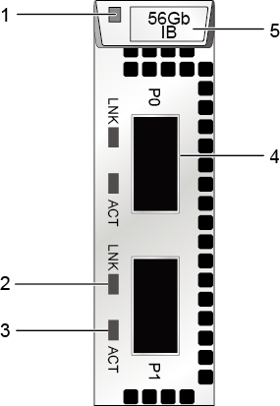
PCIe and 56 Gbit/s IB Interface Modules
PCIe interface module
56 Gbit/s InfiniBand interface module
Notes:
A PCIe interface module provides two PCIe ports for connecting controller enclosures to PCIe switches and exchanging control and data flows between the controller enclosures.
Indicators:
1. Interface module power indicator
2. Link/Speed indicator of a PCIe port
3. PCIe port
4. Handle
The 56 Gbit/s IB interface module provides two IB ports with a transmission rate of 4 x 14 Gbit/s.
Indicators:
1. Power indicator/Hot swap button
2. Link indicator of a 56 Gbit/s IB port
3. Active indicator of a 56 Gbit/s IB port
4. 56 Gbit/s IB port
5. Handle

Slide 57
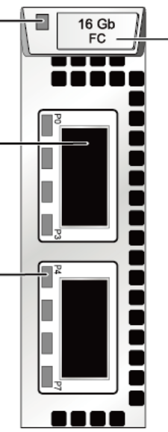
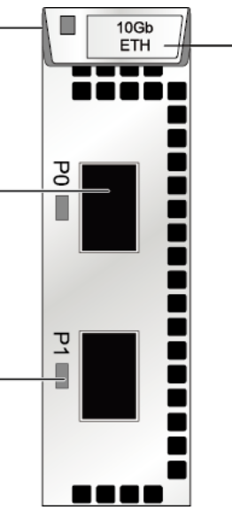
Fibre Channel and FCoE Interface Modules
Power indicator/Hot swap button
Power indicator/Hot swap button
Handle
Handle
16 Gbit/s Fibre Channel port
10 Gbit/s FCoE port
Link/Speed indicator of the port
Link/Speed indicator of a 10 Gbit/s FCoE port
16 Gbit/s Fibre Channel interface module
10 Gbit/s FCoE interface module
Notes:
A 16 Gbit/s Fibre Channel interface module has two physical ports, which are converted into eight 16 Gbit/s Fibre Channel ports by dedicated cables. Each port provides a transmission rate of 16 Gbit/s. They serve as the service ports between the storage system and application server to receive data exchange commands from the application server.
A 10 Gbit/s FCoE interface module provides two FCoE ports with 10 Gbit/s, which connect the storage system to the application server for data transmission.
The 10 Gbit/s FCoE interface module supports only direct connections.

Slide 58
Which of the following are SSD types?
SLC
MLC
TLC
QLC
Which of the following affect HDD performance?
Disk capacity
Rotation speed
Data transfer rate
Average access time
Notes:
Answers:
ABCD
BCD

Slide 59
Controller
Controller enclosure
Coffer disk
Disk enclosure
BBU
Intelligent storage components
Expansion module
Expansion module
Device cable
HDD
Disk
SSD
Interface module

Slide 60
Enterprise Technical Support App
Huawei Enterprise Service App
Notes:
Huawei training app
Contains a huge library of Huawei certified learning videos.
Enterprise technical support app
Covers all popular product documents, cases, and bulletins from Huawei. Users can quickly query commands, alarms, and spare parts. They can also use it to scan and view the device information. Simple and intuitive video guides provide 24/7 enterprise technical support.
Huawei enterprise business app
Provides one-stop mobile ICT portals for customers and partners to learn about Huawei's comprehensive products and solutions for enterprise ICT anytime and anywhere.

Slide 61
Huawei official websites
Enterprise business: https://e.huawei.com/en/
Technical support: https://support.huawei.com/enterprise/en/index.html
Online learning: https://www.huawei.com/en/learning
Popular tools
HedEx Lite
Network Document Tool Center
Information Query Assistant
Notes:
Popular tools
HedEx Lite is the Huawei tool for product document management. It allows users to browse, search, update, and manage product documentation.
eStor is a graphic storage simulation platform. The platform simulates Huawei OceanStor all-flash storage devices to help ICT practitioners and customers get familiar with Huawei storage products and quickly master their operations.
The Network Documentation Tool Center is the documentation tool for network products. It assists in bidding, network planning, project delivery, upgrades, and maintenance.
The Information Query Assistant provides command and alarm information querying for Huawei products.

