Slide 1
DNA Storage
Student: Ali Dayoub
Course: Modern data storage technology
Course moderator: Dr. Alexander Shkrebets Evgenievich
Date : 9/12/2022 Place: ITMO, ICT faculty

Slide 2
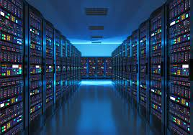
Introduction
The demand for data storage devices is increasing day by day as more and more data is generated every day
The current data storage technology would not be enough to store data in future.

Slide 3
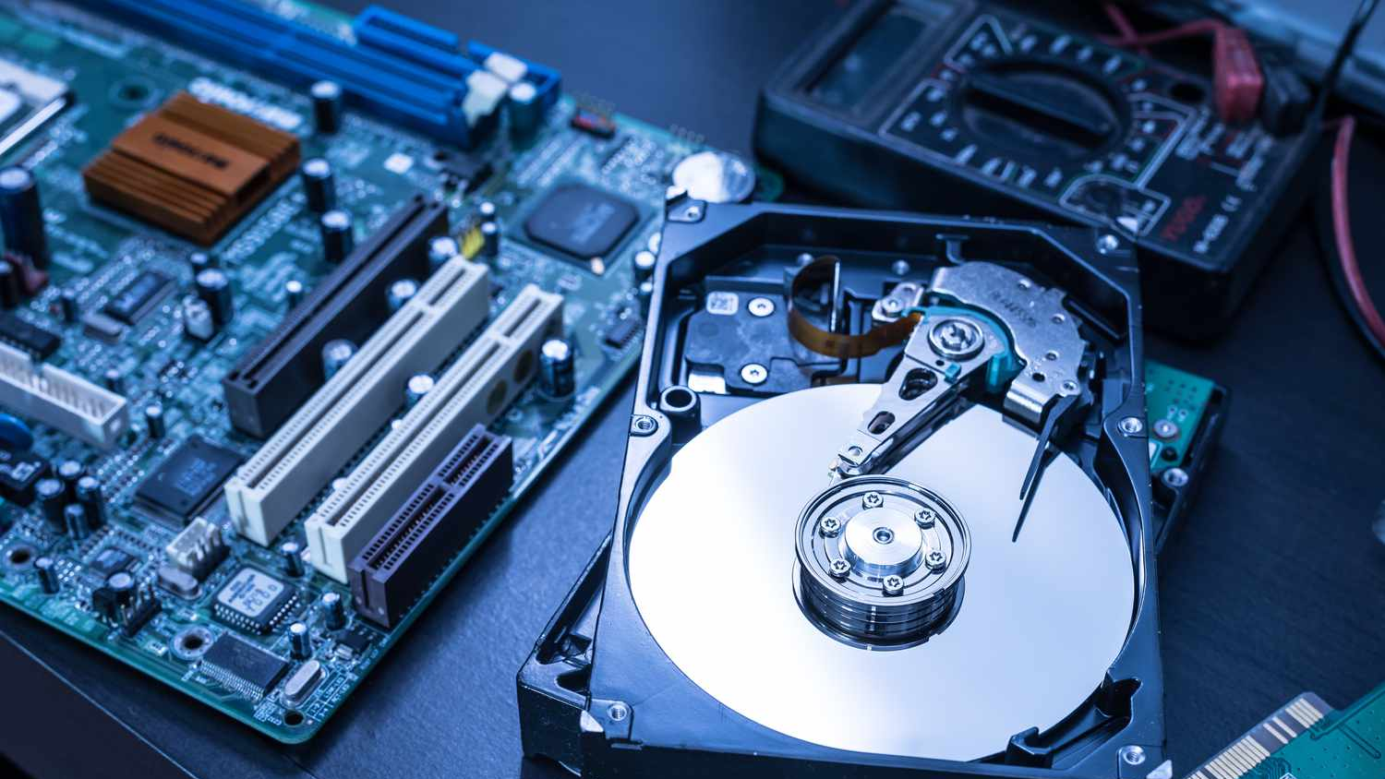
Problems with Current Storage
Low Capacity.
Low Longevity.
Not Robust.
Less Energy Efficient
Not Environment friendly.

Slide 4
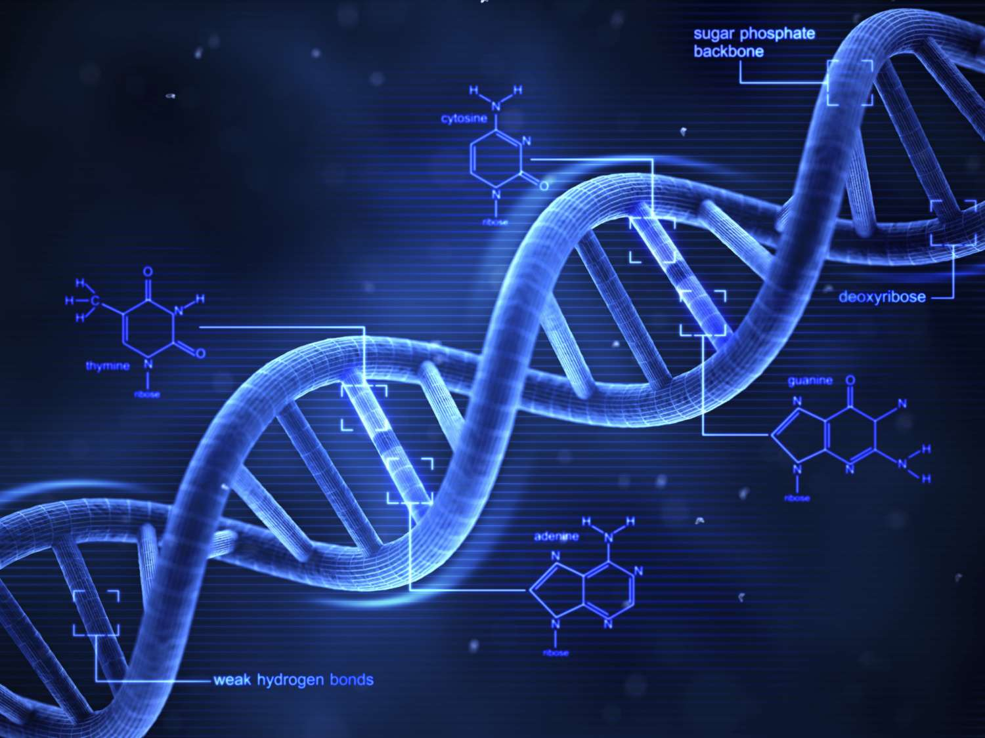
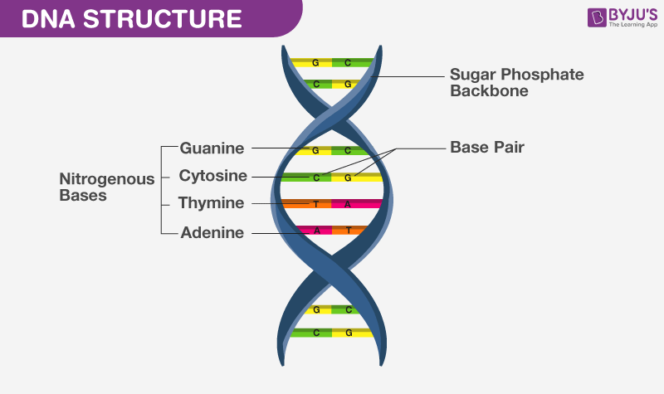
What is DNA?
Deoxyribonucleic acid is a module that carries the genetic instructions.
DNA consists of Adenine(A), Guanine(G), Cytosine(C) and Thymine(T).

Slide 5
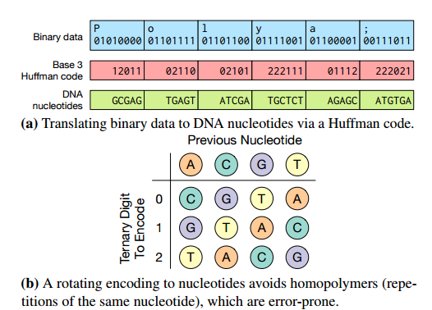
How is data stored in DNA?
In classical computer data is stored in binary form.
In DNA binary data is converted to DNA data using Huffman code.
Every 0 becomes A or C.
Every 1 becomes T or G.

Slide 6
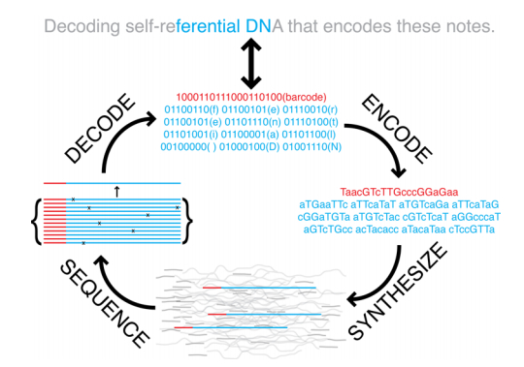
Encoding and Decoding in DNA Storage
The encoding method of DNA storage is to convert 0–1 binary codes to A-T-C-G DNA quaternary codes, while the decoding method is to convert quaternary sequencing data to 0–1 binary files

Slide 7
Advantage of DNA Storage
Density
Capacity
Longevity
Endurance
Efficiency
Notes:
A single gram of DNA can store 5.5 Petabytes of data 10^15 )

Slide 8
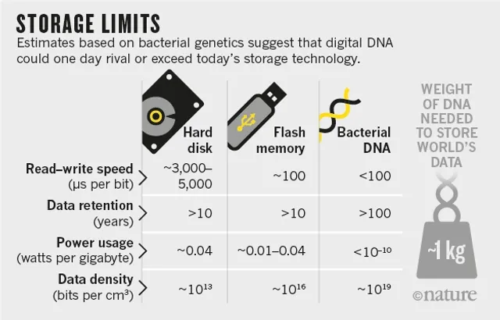
Comparison between DNA storage and current storage

Slide 9
Disadvantage
Speed
Security
User interface
Awareness
Cost

Slide 10
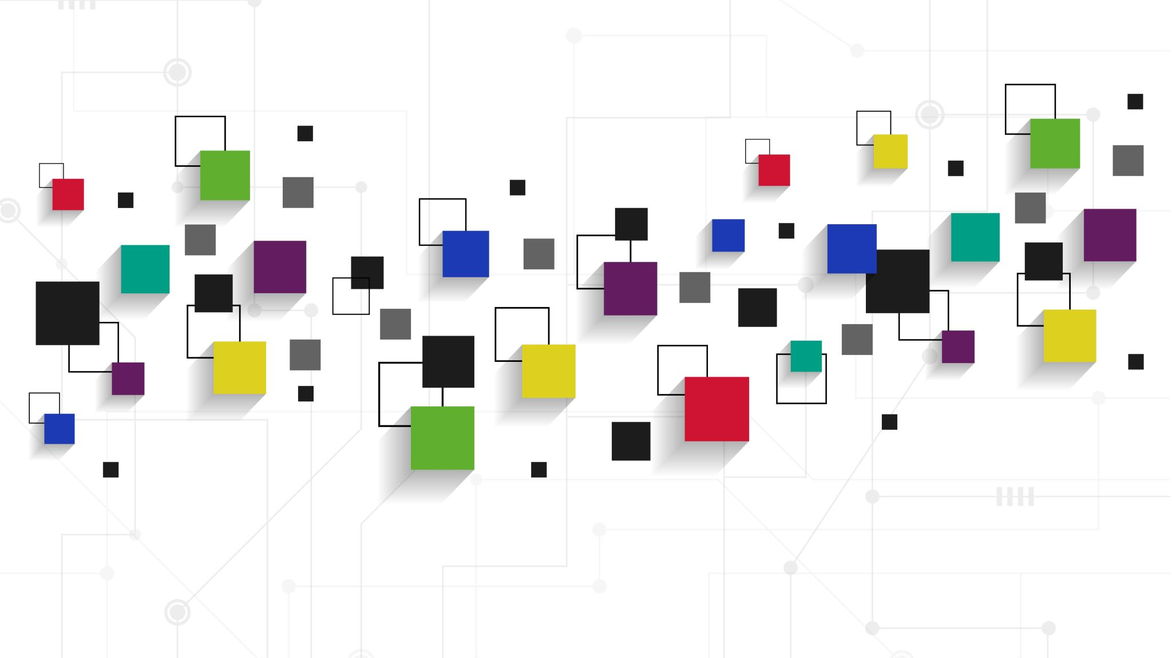
Thank you For your Attention.

