Slide 1
HCDCA108
RH
V5R2
1.0
Cai Wenjun/wx440054
2017.11.11
Liu Lican/00180730
New
Yuan Weihua/wx462781
2019.4.10
Liu Lican/00180730
Update

Slide 2
Huawei Data Center Servers Introduction and Maintenance
Huawei Data Center Series of Courses

Slide 3
Huawei FusionServer V5 series rack servers are new-generation rack servers that can be widely used for the Internet, Internet Data Center (IDC), cloud computing, enterprise market, and telecom service applications.
V5 rack servers combine low power consumption with high scalability and reliability, and easy deployment and management, and are ideal for IT core services, cloud computing virtualization, high-performance computing, distributed storage, big data processing, enterprise or telecom service applications, and other complex workloads.

Slide 4
Upon completion of this course, you will be proficient in:
  RH series servers.
  Installation of key components for RH series servers.
  Know about the routine maintenance and troubleshooting procedures for servers.
  Know about the roadmap for server fault diagnosis.
  Know about collecting logs from servers.

Slide 5
RH Series Server Overview and Positioning
RH Series Server Description
RH Series Server Routine Maintenance

Slide 6





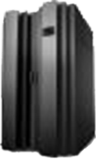






Huawei V5 Server Portfolio
RISC-to-IA migration
SAP HANA appliance
Virtualization/
Cloud
Big data
Solutions
KunLun
FusionCube
Heterogeneous servers
KunLun 9008/9016/9032
FusionCube
9000/6000/
6000C/2000
G5500
G2500
FusionServer
SSD
E9000
4P
2P
X6800
X6000
Blade
servers
High-density
servers
ES3000C
ES3000P
CH242 V5
CH225 V5
CH121 V5
4U 4/8 nodes
2U 4 nodes
1U 2P
2U 2P
4U 2P
2U 4P
4U 4P
8U 8P
Rack
servers
NVMe SSD card
NVMe SSD disk
1288H V5
2288H V5
5288 V5
2488 V5/2488H V5
5885 V5
8100 V5

Slide 7

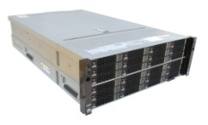
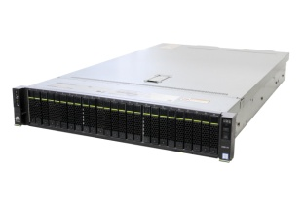
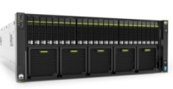
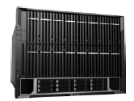


Huawei FusionServer V5 Rack Server Portfolio
2-Socket (1U–4U)
4-Socket (2U–4U)
8-Socket (8U)
Scale-Out
Scale-Up
1288H V5
2288H V5
5288 V5
2488/2488H V5
5885H V5
8100 V5
Value
Positioning
High-Density
Deployment
Flexible
Configuration
Ultra-large
Storage
High Compute
Efficiency
High Reliability & Performance
Notes:
Huawei FusionServer V5 Rack Server Overview
Form factor: 1U-8U, 2S-8S
The servers are categorized as follows to meet different service requirements:
High-density deployment
Flexible configuration
Ultra-large storage
Computing efficiency-focused
High reliability and performance

Slide 8
Server Positioning
RH8100 V5
  The high-end 8-socket rack server is designed for mission-critical business, in-memory databases, virtualization, and HPC.
High
RH5885 V5
  The 4U 4-socket enterprise-level rack server is ideal for databases, virtualization, and in-memory computing.
RH2485 V5
  The mid-range 4-socket rack server integrates computing and storage resources into a compact 2U space, making it a cost-effective solution with less equipment footprint.
RH2288 V5
  The 2U 2-socket rack server features high performance and scalability, and is the most widely used 2U server.
RH2285 V5
  The economical 2U 2-socket rack server meets requirements for IT infrastructure and ultra-large local storage applications.
RH1288 V5
  The compact 1U 2-socket rack server provides high computing density and large memory capacity in 1U space, which is suitable for dense computing applications.
Low

Slide 9
RH Series Server Overview and Positioning
RH Series Server Description
RH Series Server Routine Maintenance

Slide 10
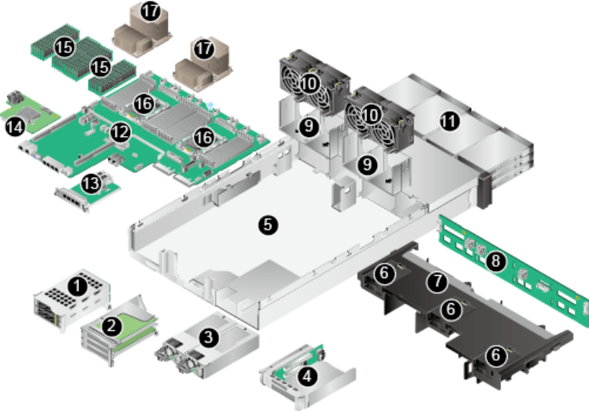
2288H V5 Physical Structure
No. | Name | No. | Name
1 | IO module 1 | 2 | IO module 2
3 | Power supply unit | 4 | IO module 3
5 | Chassis | 6 | Supercapacitor tray
7 | Air duct | 8 | Front drive backplane
9 | Fan module bracket | 10 | Fan module
11 | Front drive | 12 | Mainboard
13 | Flexible NIC | 14 | RAID controller card
15 | DIMM | 16 | CPU
17 | Heat sink | — | —

Slide 11
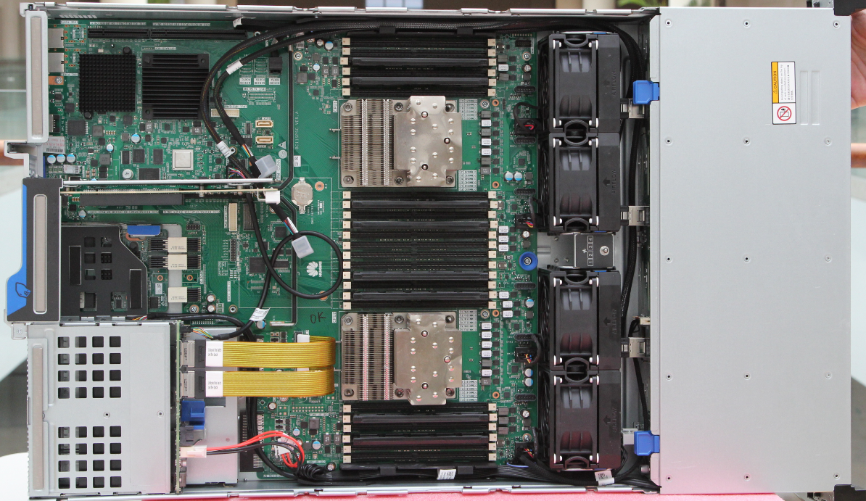
2288H V5 Internal Structure
24 DDR4 DIMMs, with the memory
speed of 2666MT/s
Three full-height PCIe 3.0 x8 slots, or a drive module with 2 x 3.5-inch drives
Two Intel Scalable CPUs,
with the maximum TDP of 205 W
Three full-height PCIe
3.0 x8 slots, or a
drive module with
2 x 3.5-inch drives
Four 80 fan
modules in
N+1 redundancy
mode
Drive tray for
12 x 3.5-inch
or 25 x 2.5-inch
drives
4 x 2.5-inch drive enclosures at the rear, each providing two full-height half-length 8x PCIe 3.0 slots and one full-height half-length 16x PCIe 3.0 slots
RAID controller card
PSU
Flexible NIC

Slide 12
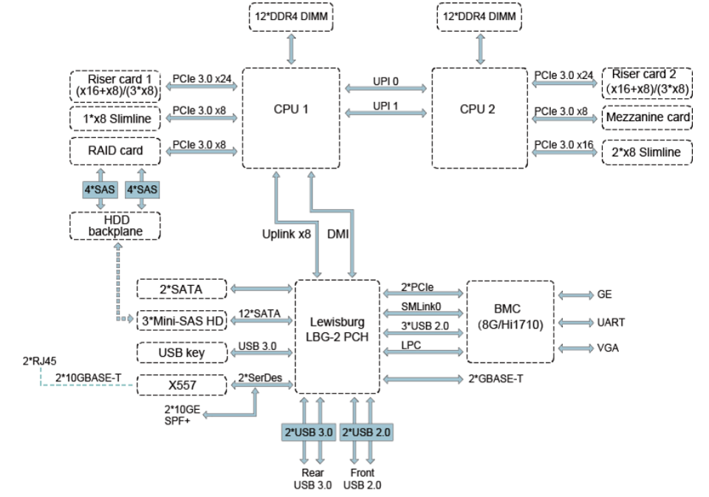
2288H V5 Logical Structure

Slide 13
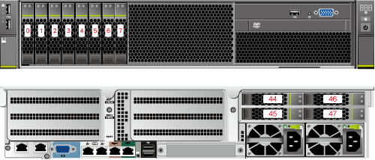
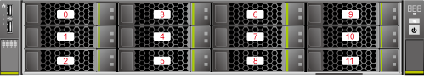
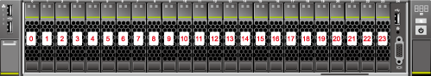
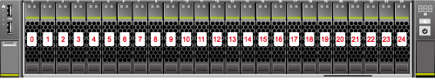
2288H V5 Specifications - Front View
The 2288H V5 supports four types of configuration, 8-drive, 12-drive, 24-drive, and 25-drive.
Components on the front panel of the 4 x 3.5-inch drive configuration
Components on the front panel of the 12 x 3.5-inch drive configuration
Components on the front panel of the 24 x 2.5-inch drive configuration
Components on the front panel of the 25 x 2.5-inch drive configuration

Slide 14
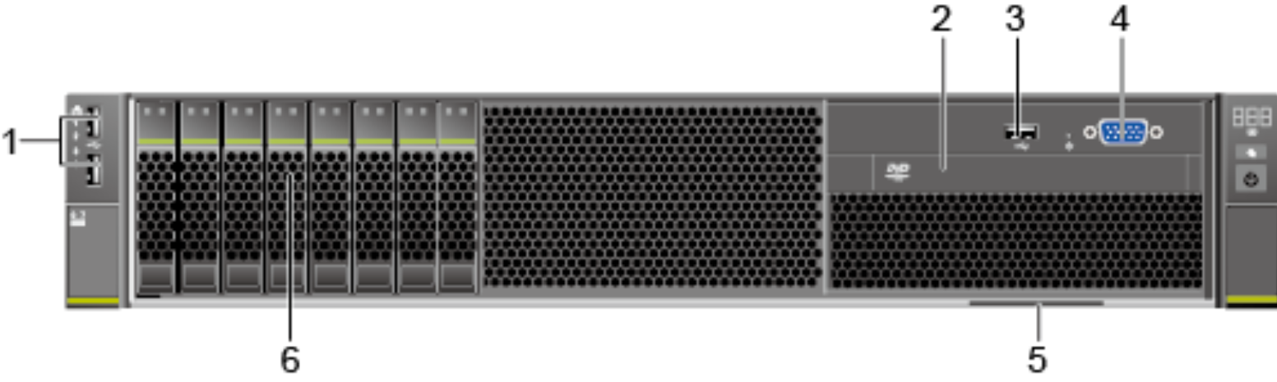
2288H V5 Specifications - Front View (8-drive Configuration)
No. | Name | No. | Name
1 | USB 2.0 ports | 2 | Built-in DVD-RW drive (optional)
3 | USB 3.0 ports | 4 | VGA port
5 | Label (including SN) | 6 | Drive

Slide 15
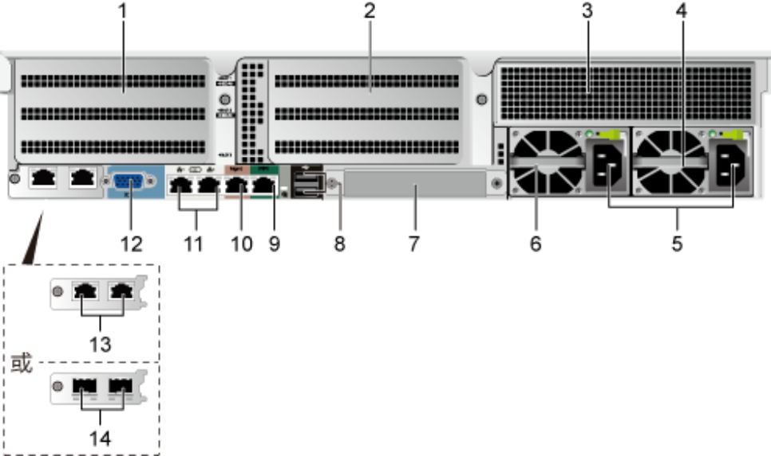
2288H V5 Specifications - Rear View (No Drives)
No. | Name | No. | Name
1 | Three PCIe 3.0 x8 full-height slots | 8 | Two USB 3.0 ports
2 | Three full-height PCIe 3.0 x8 slots | 9 | RJ45 serial port
3 | Two full-height PCIe 3.0 x8 slots | 10 | RJ45 management network port
4 | PSU | 11 | RJ45 GE service network ports
5 | PSU sockets | 12 | VGA port
6 | PSU | 13 | Two 10GE RJ45 electrical ports
7 | PCIe 3.0 x8 flexible NIC | 14 | Two 10GE SFP+ optical ports

Slide 16
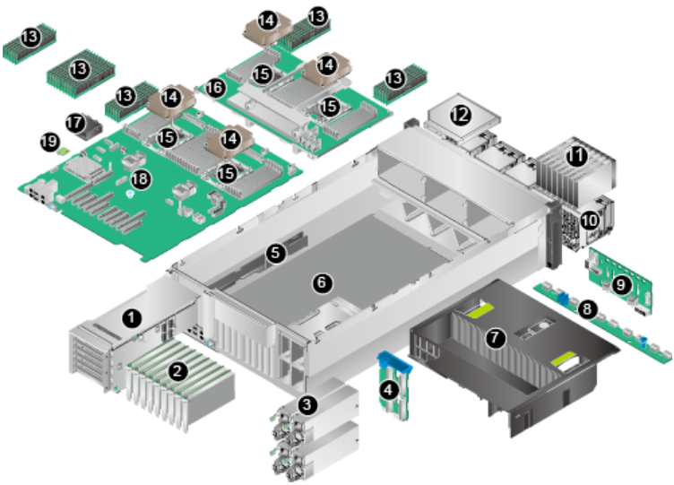
5885H V5 Physical Structure
No | Name | No. | Name
1 | Riser card | 2 | PCIe cards
3 | PSUs | 4 | PSU backplane
5 | Cable guide | 6 | Chassis
7 | Air duct | 8 | Fan adapter board
9 | Drive backplane | 10 | Fan modules
11 | Drives | 12 | DVD drive (or LCD)
13 | DIMMs | 14 | Heat sinks
15 | CPUs | 16 | Daughter board
17 | Supercapacitor | 18 | Mainboard
19 | TPM | — | —

Slide 17
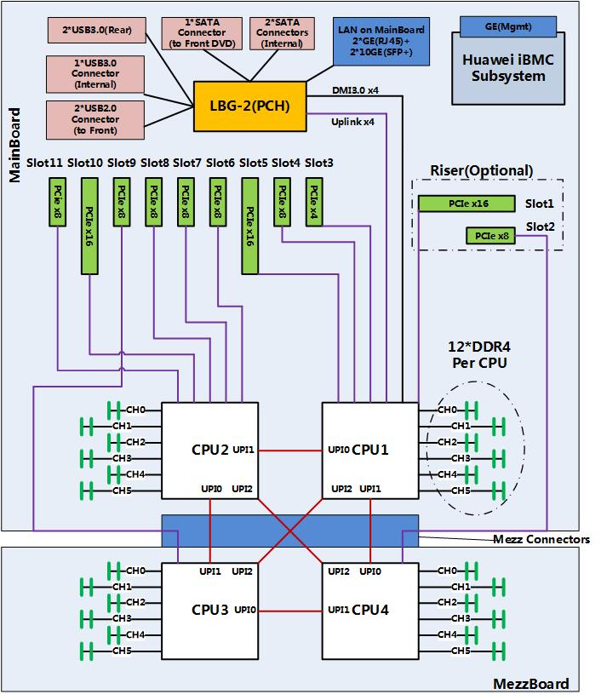
5885H V5 Logical Structure
One mainboard, supporting two CPUs, 24 DIMMs, PCIe riser cards, PCIe slots, and BMC modules
One daughter board, supporting two CPUs and 24 DIMMs
Drive configuration at the front:
  8 x 2.5-inch drives + one DVD drive
  25 x 2.5-inch drives
  16 SAS + 8 NVMe 2.5-inch drives
  24 x 2.5-inch drives
Backplane and front VGA/DVD drive connecting to the RAID controller card and mainboard using cables
Rear I/O module, providing six standard PCIe 3.0 slots, including three x16, seven x8 slots, and one x4 slots (Slots 1 and 3 are on the riser card.)
Two AC PSUs, installed vertically and connected to the mainboard through the PSU backplane
Only a plug-in PCIe RAID controller card is supported. The position of the RAID controller card is restricted in slot 4 for 8-drive, 24-drive, 25-drive, and 16 SAS + 8 NVMe drive configurations and in slot 5 for 8 NVMe configuration.

Slide 18
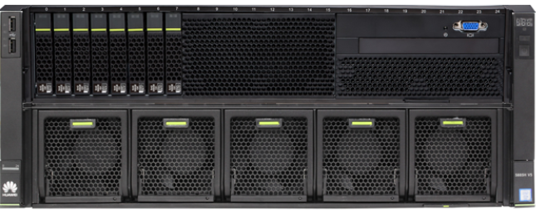
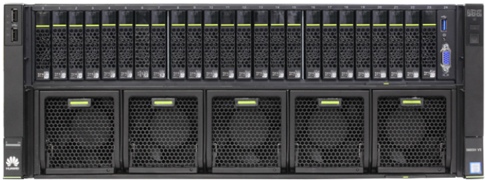
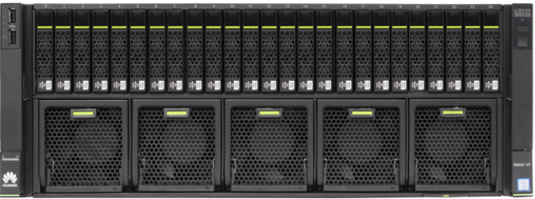
5885H V5 Specifications - Front View
The 5885H V5 supports three types of configuration, 8-drive, 24-drive, or 25-drive.
Components on the front panel of the 8 x 2.5-inch drive configuration
Components on the front panel of the 24 x 2.5-inch drive configuration
Components on the front panel of the 25 x 2.5-inch drive configuration

Slide 19
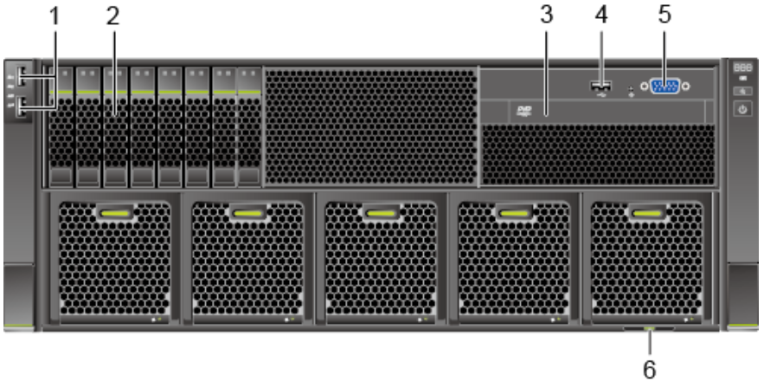
5885H V5 Specifications - Front View (8-drive Configuration)
No. | Name | No. | Name
1 | USB 2.0 ports | 2 | SAS/SATA drives
3 | Built-in DVD drive or LCD | 4 | USB 3.0 prots
5 | VGA port | 6 | Label (with the ESN label)

Slide 20
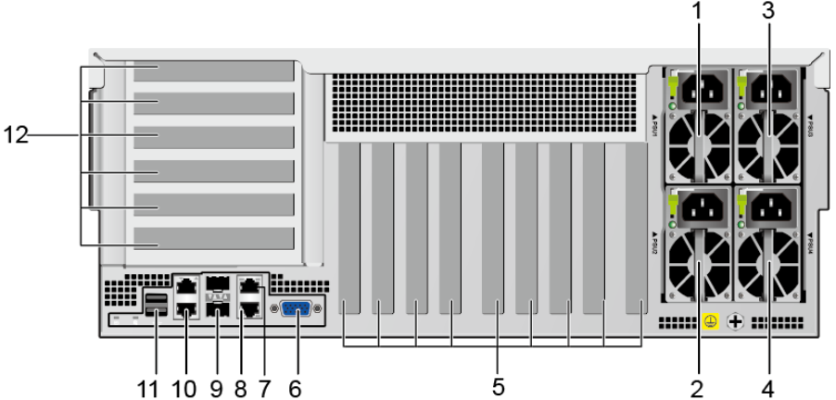
5885H V5 Specifications - Rear View
No. | Name | No. | Name | No. | Name | No. | Name
1 | PSU 1 | 2 | PSU 2 | 3 | PSU 3 | 4 | PSU 4
5 | PCIe slots 7 to 15 (from left to right) | 6 | VGA port | 7 | Serial port | 8 | Management network port
9 | 10GE optical port | 10 | GE electrical port | 11 | USB 3.0 port | 12 | PCIe slots 1 to 6 (from top to bottom)

Slide 21
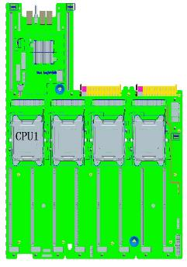
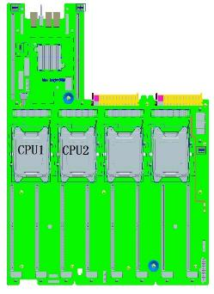
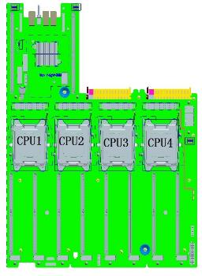
Processor Installation Rules
The RH5885H V5 supports one, two, or four processors.
If only one processor is to be configured, install it in socket CPU1.
If two processors are to be configured, install them in sockets CPU1 and CPU2.
If four processors are to be configured, install them in sockets from CPU1 to CPU4.

Slide 22
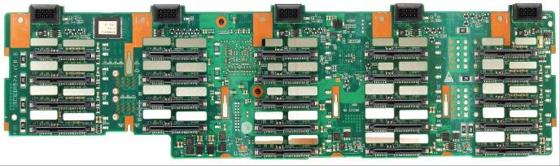
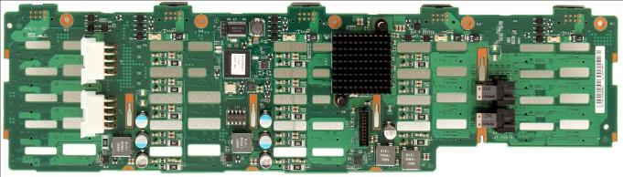
RH5885(H) V5 Hard Disk Backplane
Hard disk connector
Fan connector
SN barcode
The server does not provide the components in the red rectangles.

Slide 23
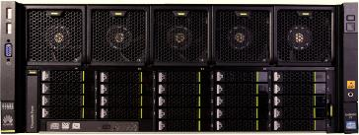
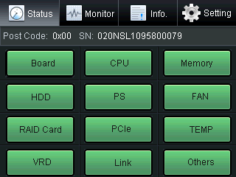
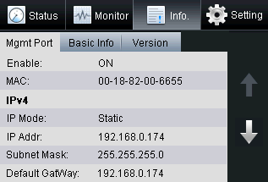
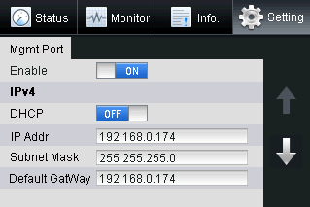
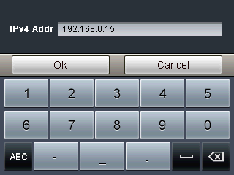
RH5885(H) V5 LCD
The LCD on the front panel provides the following functions:
  Monitors the installation status and running status of server components.
  Queries alarms and fault information to locate faults.
  Sets an IP address for the server.

Slide 24
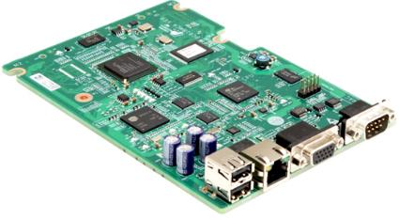
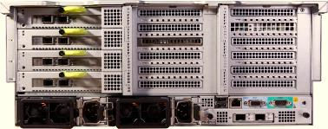
BMC Card
The BMC card is installed on the mainboard and provides the following functions:
  Manages and monitors the server.
  Supports the KVM function.
  Supports the SOL redirection function.
  Supports the online upgrades of the BIOS, FPGA, and CPLD.
  Provides one VGA port, two USB ports, one 10/100Base-T management network port, and one serial port (system serial port by default).
SN barcode

Slide 25
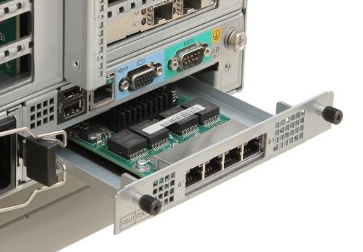
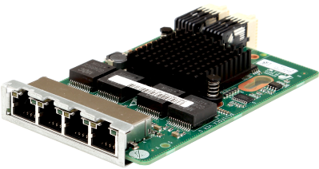
LOM
MAC address
SN barcode

Slide 26
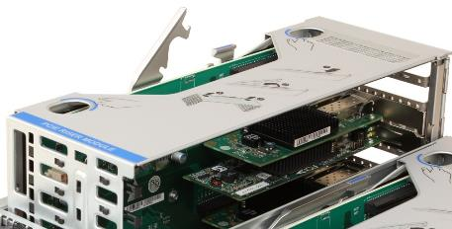
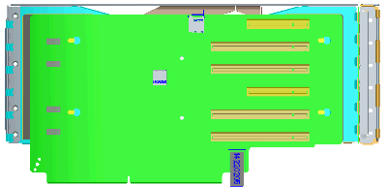
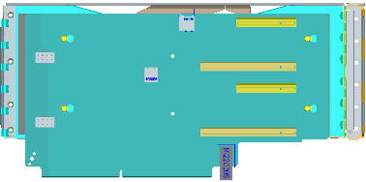
Riser Card
PCIe x8 riser card
PCIe x16 riser card
Notes:
A PCIe x8 riser card provides two PCIe x4 slots (x8 connectors), four PCIe x8 slots (x16 connectors), and one USB 2.0 port.
A PCIe x16 riser card provides two PCIe x16 PCIe slots (x16 connectors), two PCIe x4 slots (x8 connectors), and one USB 2.0 port.

Slide 27
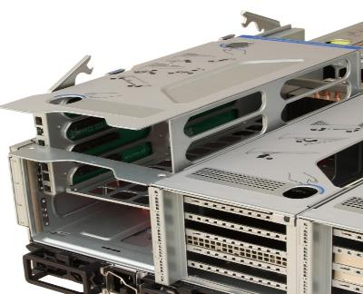
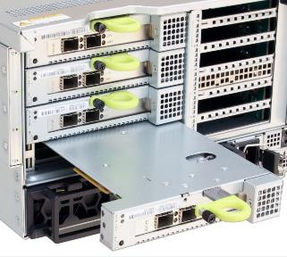
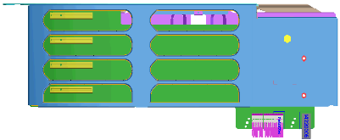
Hot-Swappable Riser Card
2
1
2
1
3
2
1
Notes:
A hot-swappable riser card is used for I/O expansion. It provides four hot-swappable 8x PCIe slots. The riser card supports maintenance without opening the chassis, which improves maintenance efficiency.

Slide 28
RH Series Server Overview and Positioning
RH Series Server Description
RH Series Server Routine Maintenance

Slide 29
Routine Inspection - Basic Principle
Use unique IDs or names to identify devices.
Keep records of the rectification of identified issues.
  Make one change at a time and record the change result.
Use the tools, resources, and software provided by Huawei
  Be familiar with the updates to operating systems and application software
Make reliable backup plan.
Keep spare parts on site for replacements in case of anomalies.
Save the latest network topology for later troubleshooting.
Notes:
Basic principles for routine maintenance are as follows:
Use unique ID or names to identify devices.
Maintain a device name list to avoid name or ID conflicts.
Keep records of the rectification of resolved issues.
Make one change at a time and record the change result, including error messages and other extra information.
Use the tools, resources, and software provided by Huawei to avoid possible faults or issues.
Be familiar with the updates to operating systems and application software and update operating system and application software as required.
Make reliable backup plan.
Back server data at a regular basis based on server operations.
Implement in-time data backup if the data changes frequently.
Save backed up libraries based on information storage requirements.
Implement regular checks to ensure the correctness of saved data.
Keep spare parts on site for replacements in case of anomalies.
Replenish spare parts in time.
Check for potential conflicts before adding new devices.
Save the latest network topology for later troubleshooting.

Slide 30



On-site Inspection (1)
On-site inspection covers equipment room environment and device running status.
The following table lists the safety indicators that are commonly used in the inspections on equipment room environment:
Indicator | Description
 | Indicates that the marked device is a dangerous power device. To avoid electric shocks, Do not open the cover of the device. Warning: All devices with this label may cause electric shocks, and no maintainable components are inside.
 | Indicates that the marked device is a dangerous power device. Such a device may cause electric shocks. Do not uncover the device. No maintainable components are inside. Warning: To prevent an electric shock, do not remove the cover of the device!
 | Indicates that the temperature of the surface of the marked device is high. Warning: To avoid burns, do not touch the surface until it cools down!
 | Indicates that the marked device is a dangerous power device. Any operations on the marked device may cause damages to the device or operator.
 | Indicates the external ground point of a device. The two ends of each power cable are connected to different devices. To ensure device operation and safety of operators, connected devices must be safely grounded using the ground point.
 | Indicates the internal ground point of a device. The two ends of each power cable are connected to different devices. To ensure device operation and safety of operators, connected devices must be safely grounded using the ground point.
 | It indicates an electrostatic sensitive area. Do not touch the device with bare hands. When you operate the device in this area, take antistatic measures, such as wearing an ESD wrist strap or ESD gloves.

Slide 31
On-site Inspection (2)
The equipment room environment checks involve the checks over the temperature, humidity, and power supplies within the room.
No. | Technical Indicator | Reference Value | Check Result
1 | Operating temperature | 10℃ to 35℃ (41℉ to 95℉)
2 | Storage temperature | -40℃ to +65℃ (-40℉ to 149℉)
3 | Temperature change rate | 15℃/h (59℉/h)
4 | Operating humidity | 8% RH to 90% RH (non-condensing)
5 | Storage humidity | 5% RH to 95% RH (non-condensing)
6 | Altitude | ≤3000m
7 | PSU | AC input voltage: 100V AC to 240V AC, 50/60Hz DC power supply: -48V DC, nominal voltage fluctuation range-38.4V to 38.4V DC

Slide 32
On-site Inspection (3)
To connect or remove cables, obtain the permissions from the client. The following table lists the inspections about the cable layout for servers:
No. | Item | Remarks | Result
1 | General cable layout | The strong current cables and weak current cables must be respectively routed from the two sides of cabinets. That is, service cables are separated from power cables. Check whether any optical fiber is bent strongly or extended forcedly.
2 | Power cable layout | The cable layout is neat and in order, with the cabling style being the same as that in other racks in the equipment room. Do not bend power cables or wrap the power cables in a loop.
3 | Service cable layout | The cable layout is tidy and in order, with the cabling style being the same as that in other racks in the equipment room. Do not bend power cables or wrap the power cables in a loop.
4 | PGND | Servers must be properly grounded.
5 | Cable labels | The characters on the label are clear, marks are clear and correct, and labels are firmly attached to cables.
6 | Power plugs | Power cables are securely plugged into the power socket.
7 | Signaling plugs | Check the signals between server devices and switches, and check whether the data link in between is firmly connected.

Slide 33
On-site Inspection (4)
To inspect server running status, see to items lists in the following table:
No. | Inspection | Remarks
1 | Indicators | On the front and rear panels of the servers, there are UID buttons/indicators, HEALTHY indicators, network port indicators, and power buttons/indicators. You can know the current status of the server based on the status of these indicators. For details on indicator status, refer to the server product documentation.
2 | iBMC health inspection | Use the on-site management network to perform the inspection. If no management network is available on site, use a network cable to connect the portable computer to the iBMC. Then, log in to the iBMC web UI to perform the health inspection. For details on alarms, see the iBMC Alarm Reference.

Slide 34
Fault Information Collection (1)
If a server becomes faulty, collect the following information for fault diagnosis:
  Basic fault information (including the basic information about the customer, Equipment model and configuration, fault symptom).
  Server hardware logs (using the iBMC to collect information about the server hardware) for system fault identification.
  Service plane logs (operating system logs and service software logs) for the analysis of software-level issues.

Slide 35
Fault Information Collection (2)
Collect the basic fault information using the following table:
Basic Server Fault Information
Trouble Ticket Number | For example, 123456 | Ticket Submission Time | YYYY-MM-DD HH:MM:SS
Customer | Xxx | Address | Xx county/town/street, xx city, xx province
Name | Jack | Contact | Telephone number / Email address
Server Model | For example, RH2285 V5 | ESN | 2102310XXXXX
Hardware Configuration | Such as CPU, memory, RAID, and NIC model | OS and Service Software Version | For example, SUSE11 SP1 64 bits, Oracle 10u2
Fault Occurs on | YYYY-MM-DD HH:MM:SS
Symptom | For example, the system automatically restarts during the installation.
Operation Before the Fault Occurs | For example, changed the BIOS hardware watchdog.
Operations After the Fault Occurs and Consequences | For example, powered off the server and then powered on the server, and the fault still persisted. Used another CD-ROM, and the fault still persisted. …

Slide 36
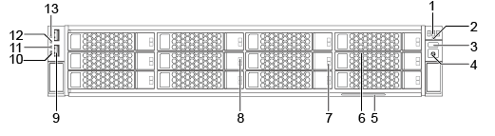
Colleting Indicator Status
The indicators on the server panel shows the server’s status.
1 | Fault diagnosis digital tube | 2 | Health indicator
3 | UID button/indicator | 4 | Power button/indicator
5 | Label (including ESN label) | 6 | Hard disk (numbered 0 to 11 from top to bottom and from left to right)
7 | Hard disk active indicator | 8 | Hard disk fault indicator
9 | USB 2.0 port | 10 | Ethernet port indicator 4
11 | Ethernet port indicator 3 | 12 | Ethernet port indicator 2
13 | Ethernet port indicator 1

Slide 37

Indicators and Buttons
You can observe the indicators to determine the current status of the server.
Silk Screen | Meaning | Color | State Description
 | Fault diagnosis digital tube | - | ---: The server is operating properly. Error Code: A fault occurs in server hardware.
 | Power button/indicator | Yellow and green | Off: The server is not powered on. Blinking yellow: The iBMC is being started. Steady yellow: The system is in the standby state. Steady green: The system is properly powered on. NOTE: You can hold down the power button for 6 seconds to power off the server.
 | UID button/indicator | Blue | Identify and locate a server in a rack. Manually pressing the UID button or remotely running a command on the iBMC CLI to turn on or off the UID indicator. You can hold down the UID button for 4 to 6 seconds to reset iBMC.
 | Health indicator | Red and green | Steady green: The server is operating properly. Blinking red at 1 Hz: A major alarm is generated. Blinking red at 5 Hz: A critical alarm is generated.
 | NMI button | None | The NMI button triggers a server to generate a non-maskable interrupt. You can press this buttton or control it remotely through the iBMC WebUI. NOTICE: Click the NMI button only when the OS is abnormal. Do not click this button when the server is operating properly. Click the NMI button only for internal commissioning. Before clicking this button, ensure that the OS has the handler for NMI interrupt. Otherwise, the OS may crash. Exercise caution when clicking this button.
- | Hard disk active indicator | Green | Off: The hard disk is not detected or is faulty. Blinking green: Data is being read from, written to the hard disk, or synchronized between hard disks. Steady green: The hard disk is inactive.
- | Hard disk fault indicator | Yellow | Off: The hard disk is operating properly or hard disks cannot be detected in the RAID group. Blinking yellow: The hard disk is being located, or the RAID is being reconstructed. Steady yellow: The hard disk is not detected or is faulty.
 | Network port link status indicator | Green | Steady green: The port is properly connected. Off: The port is not in use. NOTE: If the NIC provides two network ports, they correspond to network port indicators 1 and 2 on the front panel.

Slide 38
Alarm Syntax
A standard alarm consists of five fields separated by commas. The content of each field is the string after each colon. The alarm attributes are described as follows:
  Time
    Time when an alarm is generated, for example, Time:Wed Sep 19 09:28:11 2012.
  Sensor
    Name of the sensor where an alarm is generated, for example, Sensor:CPU 1 Status.
  Event
    Details of an alarm, for example, Description:Configuration error.
  Assertion
    Severity of an alarm, for example, Severity:Assertion Critical.
  Event code
    Event code that corresponds to an alarm, for example, Code:0x0705ffff.

Slide 39
Rules for Fault Locating
Rules for Fault Locating
  Ensure that all your operation will not cause any data losing.
  Check the equipment running environment first then check the equipment.
  Do the easy checking first.
  For example, both HDD and HDD back plane can cause data can not be accessed. But checking HDD status is much easier than checking a HDD back plane.

Slide 40
Method for Fault Locating
Analyse all the information you have collected
Using fault diagnosis tools
Referring to cases
Some usefull method
  Minimum system
  Switch the component and Compare
  Add or Remove the Component one by one
Contact Huawei TAC

Slide 41
Component Replacement Procedures and Precautions (1)
The server parts to be replaced in route maintenance are as follows:
  CPU/memory/Hard drive
  Main board
  Power supply backplane/power module
  RAID card (storage controller)
  RAID card battery (capacitor)
  Fan module
  Riser card
  PCI-E card
  Hard drive disk backplane
  SAS cable
  IO rack
  Switching module
Notes:
Note: For detailed replacement operations, see the server maintenance guide
Enter the following address into the address box of a browser: http://support.huawei.com/enterprise/productsupport?lang=zh&pid=9856522&idAbsPath=7919749|9856522, and access the directory of a desired server model and search for the maintenance guide.

Slide 42
Component Replacement Procedures and Precautions (2)
Notes:
  Prevent static electricity.
  Ground the rack properly.
  Follow the operation procedure in replacing server parts.
  Carefully hold server parts during the replacement.
Locate the fault.
Prepare spare parts.
Verify that the impact
Determine the workaround.
Replace the faulty parts.
Verify the replacement

Slide 43
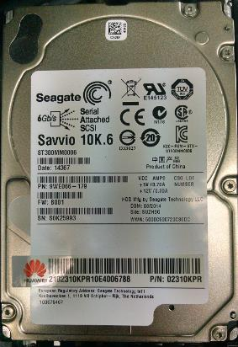
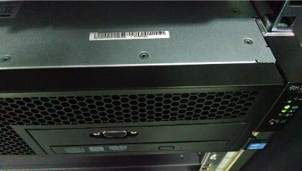
Component Replacement Procedures and Precautions (3)
Check the warranty
  Server SN
Apply the Component
  Part SN
Server SN
Part SN

Slide 44
Component Replacement Procedures and Precautions (4)
When replacing server components, pay attention to the following items:
  Service interruption occurs during the replacement of non-hot-swappable components. Ask for the permission before the replacement.
  Wear ESD gloves for the replacement of PCB boards and cards.
  Wear ESD wrists for the replacement of CPUs. Do not wear ESD gloves.
  Carefully handle the CPU. Install or remove the CPU by nudging it down or lifting it up vertically. Do not move the CPU horizontally, preventing CPU pins from bending over.
  Before the replacement of main board, verify related software versions (especially, iBMC/BIOS versions) .
Notes:
For details on the replacement procedure, refer to the maintenance manual of the desired server model. To obtain the maintenance manual, enter http://support.huawei.com/enterprise in the address box of a browser, choose server product and access the directory of a desired server model, and search for the maintenance manual.

Slide 45
Huawei RH2285 V5 and RH2288 V5 series servers are 2U 2-Socket servers.(Ture or False)
The rear panel of Huawei RH2285 V5 series servers are equipped with two 2.5-inch hard disks for system area, reducing the capacity of the occupied data area and improving data security and reliability.(Ture or False)
Notes:
T
T

Slide 46
RH series server overview and positioning
RH series server description, including the structures, and components
Typical applications of RH series servers
RH V5 series server routine maintenance
RH V5 series server fault information collection
RH V5 series server fault diagnosis and alarm handling

Slide 47
Huawei Learning Website
  http://support.huawei.com/learning/Index!toTrainIndex
Huawei Support Case Library
  http://support.huawei.com/enterprise/servicecenter?lang=zh

Slide 48
Cloud DC solution
  http://e.huawei.com/cn/solutions/business-needs/data-center

