Slide 1
HCDCA105
CE switch
V200R002
1.0
Yuan Weihua/WX462781
2019.4.10
Liu Lican/00493763
New

Slide 2
Introduction to Huawei Data Center CE Series Switches
Huawei Data Center Series of Courses

Slide 3
The CloudEngine 12800 series modular switches are next-generation high-performance core switches designed for data center networks and high-end campus networks, which provide high-density 40GE/100GE line cards and support various data center features such as VXLAN, EVPN, and M-LAG.
The CloudEngine 5800, 6800, 7800, and 8800 series fixed switches are next-generation high-performance, high-density, and low-latency Ethernet switches designed for data center networks, which use flexible front-to-rear/rear-to-front airflow design.

Slide 4
Upon completion of this course, you will be able to:
  Understand the current development of data center switches.
  Distinguish hardware types of Huawei CE series switches.
  Understand networking applications of Huawei CE series switches.

Slide 5
Product Positioning
Product Structure
Cards and Modules
Product Features and Application Scenarios

Slide 6





Challenges to Cloud Data Center Networks
Big Data requires large pipes.
Service innovation requires network agility.
Diversity requires open networks.
Cloud platform
SDN controller
Every minute
Network
1.6 million Google search requests
260 million emails are sent.
47,000 apps are downloaded.
220,000 photos are uploaded to Facebook.
660 million IP packets are transmitted.
Microsoft
320 apps/day
VMware
Huawei
ISP
OpenFlow
IBM
OpenStack
Brocade
ca
ASG
500+ servers/week
......
IP traffic on data center networks
Increased by 5 times each year
Data center applications
Increased by 200% every four years
Diversified ecosystem
50+ mainstream SDN vendors

Slide 7




Requirements for Massive Data Channels in the Cloud Era
Of all the data obtained by human civilization, 90% is generated in the past two years.
By 2020...
Big Data Era
Data volume growth
x 50
In a traditional data center, 80% of traffic is north-to-south traffic.
Number of servers
x 10
Server
port rate
x 100
Evolution of servers on data center networks:
GE -> 10G -> 25G/40G -> 50G -> 100G
In a cloud computing data center, 70% of traffic is east-to-west traffic.

Slide 8



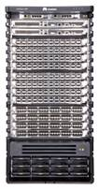

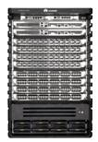

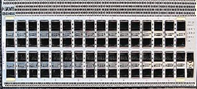


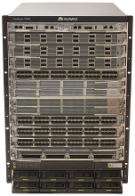

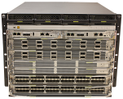






CE Data Center Switch Portfolio (1)
Core Switch
Access Switch
CE12800
ToR switch with flexible cards
10GE ToR switch
10GE large-buffer ToR switch
CE8861-4C-EI
CE6856-48T6Q-HI
CE6870-48S6CQ-EI
100GE switch
CE8850-64CQ-EI
CE6855-48S6Q-HI
CE6870-48T6CQ-EI
CE12816
CE12812
CE12808
CE12804
CE12800S
40GE switch
CE6855-48T6Q-HI
CE6875-48S4CQ-EI
CE6856-48S6Q-HI
CE6851-48S6Q-HI
CE12808S
CE12804S
GE ToR switch
CE7855-32Q-EI
CE6860-48S8CQ-EI
CE5855-48T4S2Q-EI
Virtual Switch
25GE ToR switch
CE6810-48S4Q-LI
CE5855-24T4S2Q-EI
CE1800V
CE6865-48S8CQ-EI
CE6810-32T16S4Q-LI

Slide 9
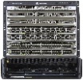
CE Data Center Switch Portfolio (2)
Core Switch
Access Switch
CE12800E
10GE Switch
CE6880-48S4Q2CQ-EI
CE6880-24S4Q2CQ-EI
CE6880-48T4Q2CQ-EI
CE12816E
CE12808E
CE12804E
CE5880-48T4Q2CQ-EI*

Slide 10
CE Switches Help Build a Next-Generation Cloud Data Center Network
Elastic: three-fold capacity of the industry average, helping construct stable network platforms for 10 years
Virtual: industry's highest 1-to-16 virtualization capability, improving ICT resource utilization
Industry-leading high-density line cards: 72 x 100GE and 36 x 40GE
178 Tbit/s super-large capacity, providing 11 Tbit/s bandwidth per slot
24 GB super-large buffer
Virtual system (VS): One device can be virtualized into 16 devices.
Most comprehensive fabric networking in the industry: SVF, CSS, VXLAN, TRILL, and EVPN
Agile: full openness, accelerating agile innovation of cloud services
High-quality: bearing high-value services and providing high-quality experience
Cooperation with the Agile Controller, implementing E2E SDN solutions
Network automation, reducing O&M and management costs of customers
OpenFlow and open APIs, preventing vendor lock-in
Industry-leading orthogonal architecture
Patented front-to-rear airflow design that isolates cold air channels from hot air channels
2-µs extra-low latency, achieving efficient forwarding
Full hot standby for five hardware systems
Agile

Slide 11
Product Positioning
Product Structure
Cards and Modules
Product Features and Application Scenarios

Slide 12
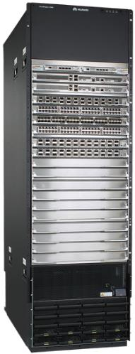
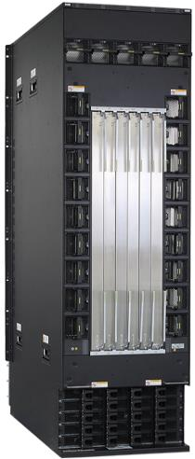
Appearance of the Core Switch CE12816
CMUs: 1:1 backup
MPUs: 1:1 backup
23 fan modules: 1+1 backup
A maximum of 16 LPUs
SFUs: 5+1 backup
Air intake frame
20 power modules: N+N/N+1 backup
5 power frames: 10 AC power inputs
Front view
Rear view
Notes:
CMU: Central Monitoring Unit
MPU: Main Processing Unit
LPU: Line Processing Unit
SFU: Switch Fabric Unit

Slide 13
Slot Distribution on the CE12816
19
20
FAN
19
FAN
20
FAN
21
FAN
22
FAN
23
CMU
CMU
MPU
18
FAN
17
FAN
18
MPU
17
LPU
16
LPU
15
FAN
15
FAN
16
LPU
14
LPU
13
FAN
13
FAN
14
LPU
12
SFU
SFU
SFU
SFU
SFU
......
SFU
......
......
......
LPU
5
FAN
5
FAN
6
LPU
4
LPU
3
FAN
3
FAN
4
LPU
2
LPU
1
FAN
1
FAN
2
Air intake frame
21
22
23
24
25
26
Power ports 17 to 20
PM17
PM18
PM19
PM20
...
...
Power ports 1 to 4
PM1
PM2
PM3
PM4
Front view
Rear view

Slide 14
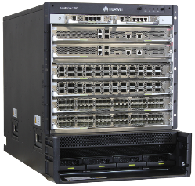
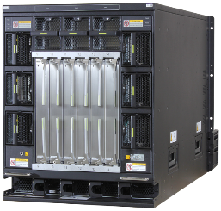
Appearance of the Core Switch CE12804
CMUs: 1:1 backup
MPUs: 1:1 backup
9 fan modules: 1+1 backup
A maximum of 4 LPUs
SFUs: 5+1 backup
Air intake frame
4 power modules: N+N/N+1 backup
1 power frame: 4 AC power inputs
Front view
Rear view

Slide 15
Slot Distribution on the CE12804
7
8
FAN
7
FAN
8
FAN
9
CMU
CMU
MPU
6
FAN
5
FAN
6
MPU
5
LPU
4
FAN
3
FAN
4
SFU
SFU
SFU
SFU
SFU
LPU
3
SFU
LPU
2
FAN
1
FAN
2
LPU
1
Air intake frame
9
10
11
12
13
14
PM1
PM2
PM3
PM4
Power ports 1 to 4
Front view
Rear view

Slide 16
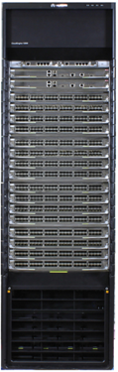
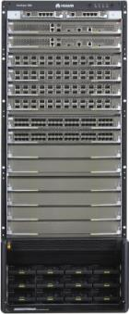
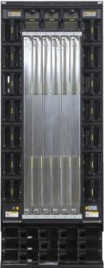
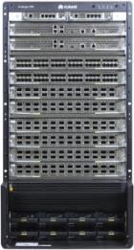
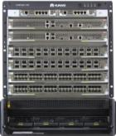
Systematic and Unified Design
Interchangeable* CMUs
Interchangeable* fan modules
Interchangeable MPUs
Interchangeable LPUs
Interchangeable power modules
Only SFUs are not interchangeable.
Notes:
The CE12800 series switches use the unified design, allowing interchangeable components, such as power modules, fan modules, MPUs, LPUs, and CMUs to be used on all CE12800 switches of different models. That is, all cards and modules except SFUs are interchangeable on the CE12800.
The CE12804, CE12808, and CE12812 use the same MPUs, CMUs, LPUs, power modules, and fan modules.
The CE12816 uses the same MPUs, LPUs, and power modules as the CE12804, CE12808, and CE12812 but has its own CMUs and fan modules.
The CE12804S and CE12808S use the same MPUs, SFUs, and fan modules, and their LPUs and power modules are the same as those on the CE12804, CE12808, CE12812, and CE12816.

Slide 17
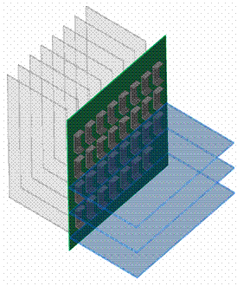
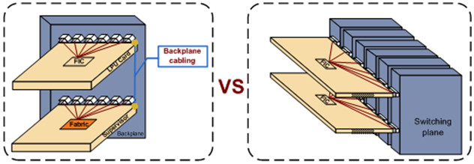
Orthogonal Architecture of LPUs and SFUs on the CE12800
Multi-level and multi-plane data switching architecture and unlimited capacity expansion, implementing large-scale non-blocking switching
SFU
LPU
Traditional architecture
Orthogonal architecture
Notes:
On core switches, cabling between line cards and DFUs is an important factor affecting slot bandwidth. A longer backplane cable and a higher rate indicate a greater loss.
The CE12800 uses an orthogonal architecture, which require no wires on the backplane. This architecture greatly increases system bandwidth and improves the evolution capability. The orthogonal design (three-level Clos architecture) of LPUs and SFUs realizes multi-level and multi-plane data switching architecture and unlimited capacity expansion, implementing large-scale non-blocking switching in data centers.
The Clos architecture has multiple levels, at each of which a switching unit is connected to all switching units at the lower level.

Slide 18

Architecture of CE12800 Series Switches
Industrial-grade reliability
1
Switching architecture
Systematic and unified design
2
5
Hot standby of key components
Orthogonal architecture
Stable and reliable dual power supplies
3
6
Non-blocking Clos architecture
6
7
Control, monitoring, and data planes
4
Dynamic distributed buffer
6
9
On-demand power module expansion and power consumption reduction
Patented airflow design and intelligent heat dissipation
8
Energy conservation
Notes:
The CE12800 provides industrial-grade reliability and supports in-service software upgrade (ISSU) to meet customer requirements for service continuity.
All key components work in redundancy mode and all modules are hot swappable:
MPUs work in 1:1 backup mode.
SFUs work in N+M hot backup mode.
Power modules support N+N and N+1 backup.
Fan modules work in 1+1 backup mode.
Each fan module has two counter-rotating fans working in 1+1 backup mode.
Independent triple-plane design: The control plane, data plane, and monitoring plane of the CE12800 are independent of each other. This design improves system reliability and ensures service continuity.
Super large buffer on interfaces
East-west traffic between servers predominates in cloud-computing data centers. The Map-Reduce framework used for processing a large amount of data increases the incast traffic model in which traffic bursts occur frequently. In this situation, the requirements of the incast traffic model must be met.
The CE12800 series switches use next-generation large-buffer line cards. All service ports (100GE, 40GE, and 10GE ports) support 100 ms buffering. The distributed buffering mechanism on inbound interfaces can effectively handle incast traffic in data centers and absorb burst traffic while providing high-performance forwarding. These advantages enable the CE12800 to effectively handle traffic in the new traffic model.

Slide 19
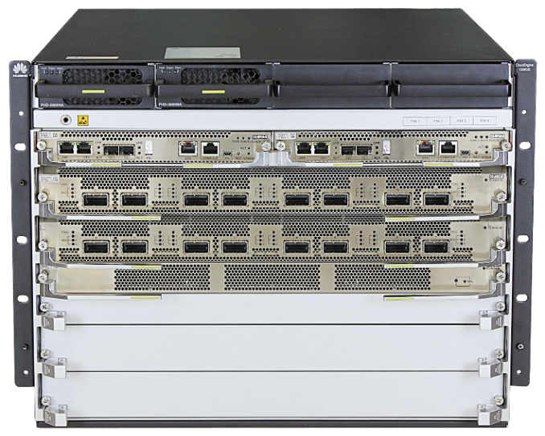
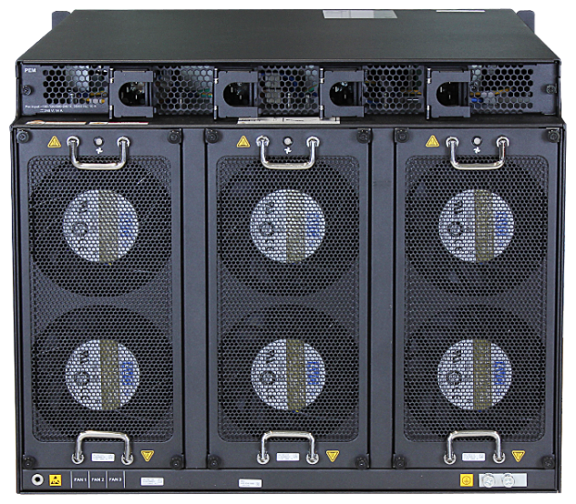
Appearance of the Core Switch CE12804S
4 power modules: N+N/N+1 backup
MPUs: 1:1 backup
A maximum of 4 LPUs
2 SFUs: 1+1 backup
Front view
Rear view
4 power sockets
3 fan modules: 2+1 backup
Notes:
The MPUs of the CE12800S work in 1+1 redundancy mode.
The CE12804S supports two SFUs and the CE12808S supports four SFUs. The SFUs back up each other and load balance traffic. Removing an SFU at any time does not affect normal operations of other SFUs.
Fan modules work in N+1 backup mode. If a fan module fails, the switch still works properly.
Power modules support N+1/N+N backup. If a power module fails, other power modules work properly.

Slide 20
Slot Distribution on the CE12804S
9
10
11
12
Power ports 1 to 4
PM1
PM2
PM3
PM4
MPU1
MPU2
5 -6
FAN
1
FAN
2
FAN
3
LPU
4
LPU
3
SFU
8
SFU
7
LPU
2
LPU
1
13
14
15
Front view
Rear view

Slide 21
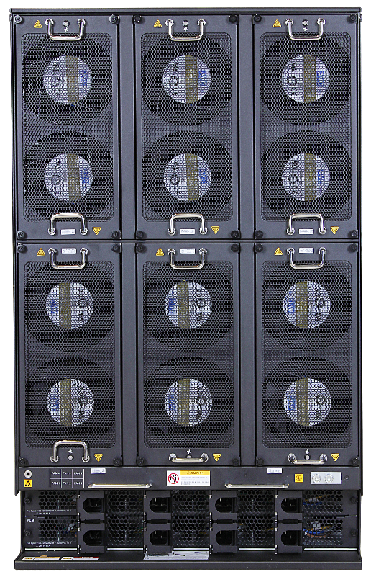
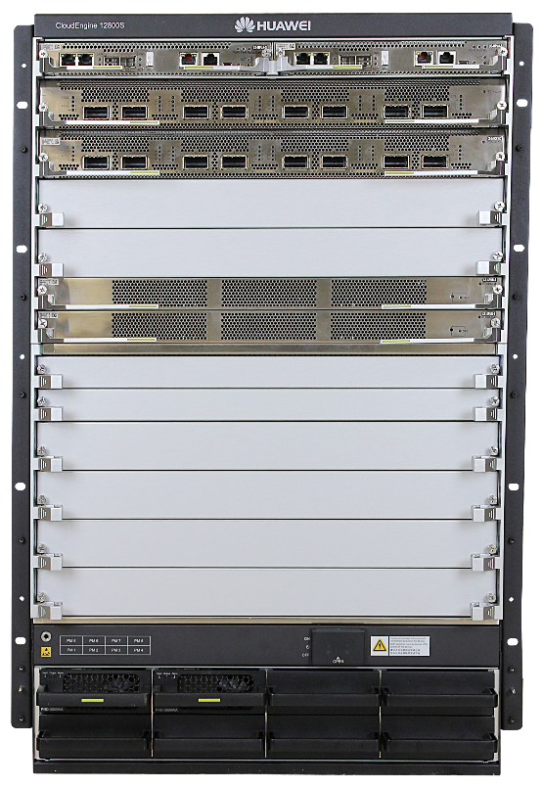
Appearance of the Core Switch CE12808S
2 MPUs: 1:1 backup
4 SFUs: 3+1 backup
A maximum of 8 LPUs
6 fan modules: 2+1 backup
8 power sockets
8 power modules: N+N/N+1 backup
Rear view
Front view

Slide 22
Slot Distribution on the CE12808S
13
14
FAN
4
FAN
5
FAN
6
MPU1
MPU2
LPU
8
LPU
7
LPU
6
LPU
5
SFU
12
SFU
11
FAN
1
FAN
2
FAN
3
SFU
10
SFU
9
LPU
4
LPU
3
LPU
2
LPU
1
PM5
PM6
PM7
PM8
Power ports 5 to 8
PM1
PM2
PM3
PM4
Power ports 1 to 4
Front view
Rear view

Slide 23
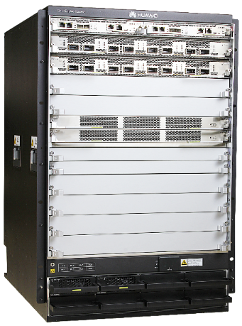
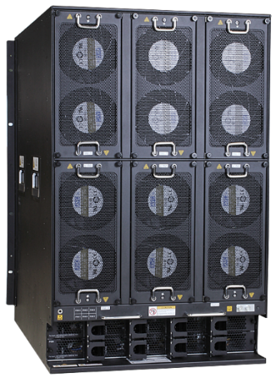
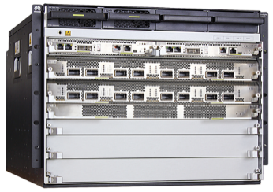
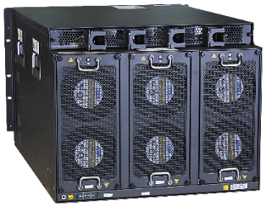
Dimensions of CE12800S Series Switches
Item | CE12804S |  | CE12808S
Dimensions (W x D x H, mm) | 442 x 751 x 352.8 (8 U) |  | 442 x 751 x 708.4 (16 U)
Chassis weight | Empty: 60 kg | Fully loaded: 120 kg | Empty: 100 kg | Fully loaded: 196 kg
CE12808S
CE12804S
The CE12800S chassis is lighter and has lower requirements on the equipment room/cabinet.
The CE12800S can be installed in a 1 m deep cabinet.
The CE12800S is delivered with cards and packed using a cardboard box and a pallet.

Slide 24
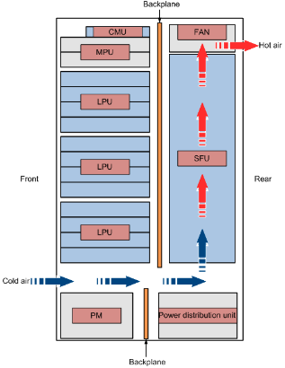
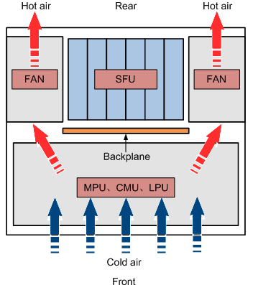
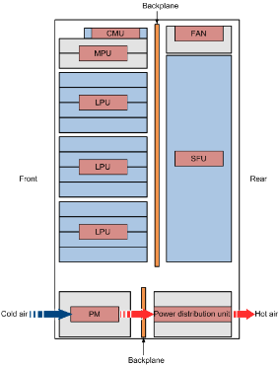
Heat Dissipation Design of the CE12800
Airflow for heat dissipation of MPUs, CMUs, and LPUs (top view)
Airflow for heat dissipation of power modules (side view)
Airflow for heat dissipation of SFUs (side view)
Notes:
Cards on a switch use independent air channels for heat dissipation. SFUs use bottom-to-top airflows for heat dissipation, as shown in the left figure.
LPUs, MPUs, and CMUs use front-to-rear airflows for heat dissipation, as shown in the middle figure.
Fan modules at the same horizontal level is responsible for heat dissipation of corresponding cards and back up each other.

Slide 25
Product Positioning
Product Structure
Cards and Modules
Product Features and Application Scenarios

Slide 26
Card and Module Naming Conventions
Card/Module | Category | Naming Convention
MPU | CE - MPU A CE - CMU A A B C A B C | A: CE series B: card category C: card version
SFU | CE - SFU 04 A A B C D | A: CE series B: card category C: product model (04/08/12/16) D: card version (versions A, B, and C in ascending order of performance)
LPU | CE – L 24 L Q - EC1 A B C D E F | See the next page
Power module | P AC - 2700W A A B C D | A: power module B: power supply type (AC: alternative current; DC: direct current) C: rated power D: power module version
Fan module | FAN - 12C A B | A: fan module B: fan module model

Slide 27
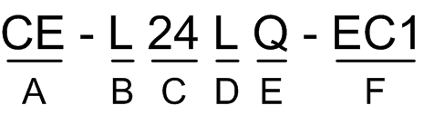
LPU Naming Conventions
Field | Meaning | Description
A | Brand name | It is fixed as CE, representing CloudEngine.
B | LPU type | L: LPU for modular switches F: flexible card for modular switches
C | Number of ports on the LPU | For an LPU with different types of ports, this field represents the number of downlink ports. It has two digits. The first digit is 0 if the card has fewer than 10 ports.
D | Port rate | G: GE port X: 10GE port Y: 25GE port L: 40GE port C: 100GE port
E | Port type | T: Base-T port S: SFP/SFP+ port X: XFP port Q: QSFP+/QSFP28 port F: CFP/CFP2/CFP4 port C: CXP port
F | LPU specifications | BA/EA/EC/EC1: basic specifications ED/EF/EG/FD: enhanced specifications

Slide 28
Main Cards on the CE12800 Series Switches
Category | Name | Overview
MPU | CE-MPUA | MPU for the CE12804/CE12808/CE12812/CE12816 chassis
 | CE-MPUA-S | MPU for the CE12804S/CE12808S chassis, responsible for system control, management, and monitoring
SFU | CE-SFU04A | Applicable to the CE12804 chassis, responsible for line-rate data switching on the data plane
 | CE-SFU04B | Applicable to the CE12804 chassis, responsible for line-rate data switching on the data plane
 | CE-SFU16C | Applicable to the CE12816 chassis, responsible for line-rate data switching on the data plane
 | CE-SFUA-S | Applicable to the CE12804S/CE12808S chassis, responsible for line-rate data switching on the data plane
 | CE-SFUF-S | Applicable to the CE12804S/CE12808S chassis, responsible for line-rate data switching on the data plane
CMU | CE-CMUA | CMU for the CE12804/CE12808/CE12812 chassis
 | CE-CMUB | CMU for the CE12816 chassis, responsible for device monitoring, management, and energy saving
LPU | CE-L48GT-EA | 48-port 10/100/1000BASE-T interface card (EA, RJ45)
 | CE-L48GS-EA | 48-port 100/1000BASE-X interface card (EA, SFP)
 | CE-L12XS-ED | 12-port 10GBASE-X interface card (ED, SFP+)
 | CE-L24XS-EC | 24-port 10GBASE-X interface card (EC, SFP+)
 | CE-L48XT-EC | 48-port 100M/1000M/10GBASE-T interface card (EC, RJ45)
 | CE-L36LQ-EG | 36-port 40GE optical interface card (EG, QSFP+)
 | CE-L36CQ-FD | 36-port 100GE optical interface card (FD, QSFP28)
 | ... | ...
Value-added service card | CE-FWA | 40G NGFW module
 | CE-IPSA | IPS module

Slide 29
Functions of High-Performance MPUs on the CE12800/CE12800S
Function and Feature | Description
Device management and maintenance | The CE-MPUA/CE-MPUAS provides management ports (such as a console port) for operators to manage and maintain the device.
Out-of-band communication between cards | The CE-MPUA/CE-MPUAS integrates a LAN switch module that provides out-of-band communication between cards. The LAN switch module completes control, maintenance, and message exchange between CMUs, SFUs, and LPUs.
Route calculation | The CE-MPUA/CE-MPUAS processes all routing protocol packets, which are sent from the forwarding engine. The CE-MPUA/CE-MPUAS broadcasts and filters packets, and downloads routing policies from the policy server.
Data configuration | The CE-MPUA/CE-MPUAS stores configuration data, startup files, upgrade software, and system logs.
Data saving | The CE-MPUA/CE-MPUAS provides an embedded USB (eUSB) module as a storage device to save data files.
Device monitoring | The CE-MPUA-S integrates a monitoring module. The monitoring module provides the monitoring plane, which allows administrators to remotely power on, power off, and reset cards, upgrade firmware, monitor card temperature, voltage, and power, manage asset information, and diagnose system faults.

Slide 30
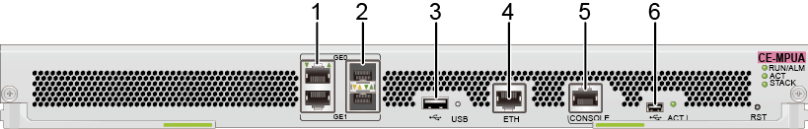
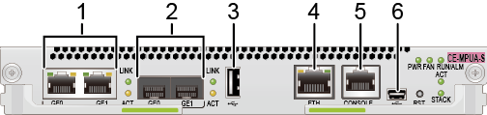
High-Performance MPU Ports on the CE12800/CE12800S
CE-MPUA
No. | Port Description
1 | Two GE electrical ports
2 | Two GE optical ports
3 | One USB host port
4 | One Ethernet port
5 | One console port
6 | One Mini USB port
CE-MPUA-S

Slide 31
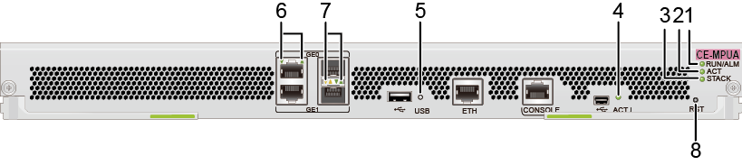
Indicators on the High-Performance MPU of the CE12800
CE-MPUA
*The meanings of indicators on the CE-MPUA-S are the same as those on the CE-MPUA.
No. | Indicator/Button | Color | Description
1 | RUN/ALM: running status indicator | Green | Steady on: The card has been powered on but the system software is not running. Slow blinking: The card is running properly. Fast blinking: The card is loading the system software, resetting, or it is used as the standby MPU and is performing batch data backup.
 |  | Red | Steady on: A fault that affects services has occurred and requires manual intervention, or the card has generated an alarm because the memory size is not equal to the standard specification.
 |  | Yellow | Steady on: The card has been installed in the chassis and the CANbus has been powered on.
2 | ACT: active/standby status indicator | Green | Steady on: The card is the active MPU. Off: The card is the standby MPU.
3 | STACK: stack status indicator | Green | Blinking: The card is not the active MPU of the stack system. Steady on: The card is the active MPU of the stack. Off: The stacking function is not enabled.
4 | ACT: Mini USB port indicator | Green | Steady on: The Mini USB port is active, and the console port cannot be used. Off: The Mini USB port is inactive, and the console port can be used.
5 | USB: USB-based deployment indicator | This indicator is reserved for the USB-based deployment function and will be on only when the USB-based deployment function is used.
6 | One single-color indicator for each port | Green | Steady on: A link has been established on the port. Off: The link on the port is disconnected.
 |  | Yellow | Blinking: The port is transmitting and receiving data. Off: The port is not transmitting or receiving data.
7 | Two single-color indicators for each port | Green | Steady on: A link has been established on the port. Off: The link on the port is disconnected.
 |  | Yellow | Blinking: The port is transmitting and receiving data. Off: The port is not transmitting or receiving data.
8 | RST: Reset button | This button is used to manually reset an MPU. Exercise caution when you press this button.

Slide 32
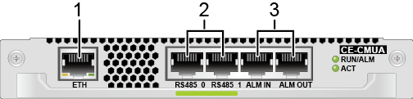
CMUs on the CE12800
Function and Feature | Description
Next-generation monitoring and management architecture | The CMU decouples the monitoring plane from the service plane. Therefore, it can still report device running status and fault recovery events when the service plane fails. With the CMU, the switch supports zero touch device management and maintenance.
Innovative and intelligent management | The CMU can work with the data center management system to realize intelligent energy allocation in a data center and energy saving for the air conditioning system. Intelligent fan speed adjustment: The CMU monitors switch and cabinet temperature in real time and adjusts fan speeds according to the switch temperature. This reduces power consumption of fans and prevents the switch from overheating. Intelligent power management: The CMU monitors power required by the switch and reports it to the management system in the equipment room. In this way, power supplied to the switch can be dynamically adjusted to fully use the designed capacity of the power distribution system and avoid waste of power.
Highly reliable monitoring platform | The CMU supports 1:1 hot standby.
All-round remote monitoring | The CMU uses industry-leading monitoring system on chip (SoC) technology to provide powerful out-of-band monitoring, management, and maintenance for cards. The monitoring plane allows administrators to remotely power on, power off, and reset cards, upgrade firmware, monitor card temperature, voltage, and power, manage asset information, and diagnose system faults.
CE-CMUA
No. | Port Description
1 | One Ethernet port
2 | Two RS485 ports
3 | Two IN/OUT ports

Slide 33





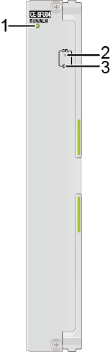
SFUs on the CE12800
Function and Feature
  Line-rate data switching: The CE12800 uses six CE-SFUs. The CE12800S uses two or four CE-SFU-S cards to form the switching core of the data plane and provide high-speed SerDes channels for LPUs.
  Reliability: The SFUs use a single-level multi-plane switch fabric to expand the switching capacity. The system has six switching planes, which work in load balancing mode to ensure nonstop service data transmission.
CE-SFU04
CE-SFU08
CE-SFU12
CE-SFU16
CE-SFU-S
No. | Indicator | Color | Description
1 | RUN/ALM: running status indicator | Green | Steady on: The card has been powered on but the system software is not running. Slow blinking: The card is running properly. Fast blinking: The card is loading the system software or is resetting.
 |  | Red | Steady on: A fault that affects services has occurred. The fault cannot be rectified automatically and requires manual intervention.
 |  | Yellow | Steady on: The card has been installed in the chassis and the CANbus has been powered on.
2 | OFL: Offline indicator | To remove an SFU, hold down the OFL button for 6s. You can remove the SFU until the OFL indicator is steady red.
3 | OFL button
CE-SFU04
*The meanings of indicators on the CE-SFU-S are the same as those on the CE-SFU.

Slide 34
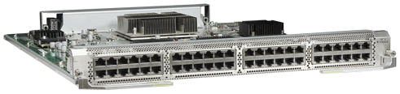
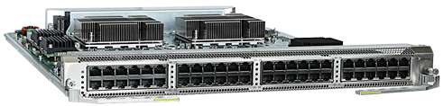
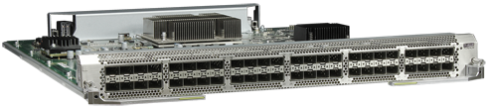
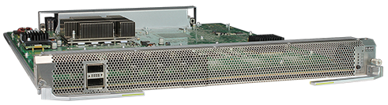
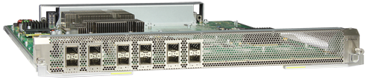
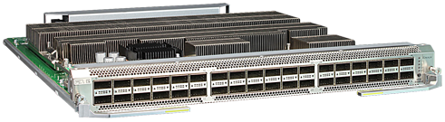
GE/10GE/40GE Interface Card on the CE12800/CE12800S
CE-L48GT series (RJ45)
48-port 10/100/1000BASE-T interface card
CE-L48XT-EC (EC, RJ45)
48-port 100M/1000M/10G BASE-T interface card
CE-L48GS series (SFP)
48-port 100/1000BASE-X interface card
CE-L02LQ-EC (EC, QSFP+)
2-port 40GBASE-X interface card
CE-L12XS-ED (ED, SFP+)
12-port 10GBASE-X interface card
CE-L36LQ series (QSFP+)
36-port 40GBASE-X interface card

Slide 35
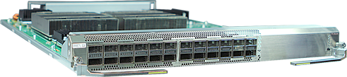
40GE Line Card on the CE12800E
New line card on the CE12800E
Name: CEL24LQED-E
Ports: 24 x 40GE (default)
Notes:
A forwarding chip is removed from this card on the basis of the CEL36LQED-E.

Slide 36
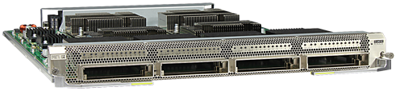
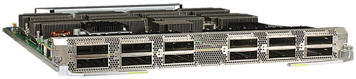
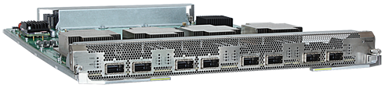
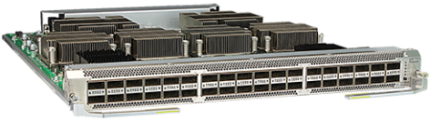
100GE Interface Cards on the CE12800/CE12800S
CE-L04CF series (CFP)
(4-port 100GE optical interface card)
CE-L12CF-EG (EG, CFP2)
(12-port 100GE optical interface card)
CE-L08CC-EC (EC, CXP)
(8-port 100GE optical interface card)
CE-L36CQ-FD (FD, QSFP28)
(36-port 100GE optical interface card)
SFUA, SFUB, or SFUC cannot be used in the same chassis with FD or FDA series LPUs. To use FD or FDA series LPUs in a chassis, replace SFUA, SFUB, or SFUC with SFUF or SFUG.
Due to the limitation of output power, when 2200 W DC power modules work in N+N backup mode, a CE12804 chassis can be configured with a maximum of three CE-L36CQ-FD cards, a CE12808 chassis can be configured with a maximum of six cards, and a CE12812 chassis can be configured with a maximum of 10 cards.

Slide 37


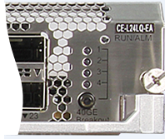

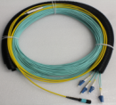
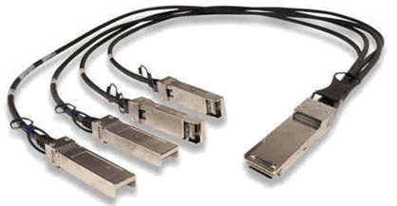
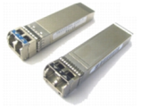
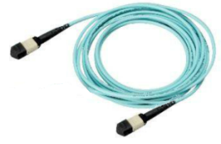





Different Types of Flex Ports
10GE Flex Port
40GE Flex Port
40GE port split into four 10GE ports
SFP-T (RJ45) GE electrical port
AOC
10G copper cable, supporting 10 m interconnection
GE/10GE SFP and SPF+ optical port interconnection
QSFP+, supporting 150 m interconnection
MPO-MPO fiber
40G copper cable, supporting 5 m interconnection
Notes:
CE series switches support different types of ports for flexible applications.
10GE optical ports support GE transceivers and auto-sensing. The port speed can change automatically when a GE transceiver is installed. The 10GE optical ports can also connect to copper cables when they have copper transceivers installed.
40GE ports can connect to Multi-fiber Push On (MPO) optical fibers. MPO optical fibers do not differentiate Tx and Rx ports. The physical ports can prevent the MPO connectors from being reversely inserted to the ports.
40GE ports can connect to copper cables. A 40GE port can be split into four 10GE ports. After configuring 40GE port splitting on an LPU, you need to restart the LPU to make the configuration take effect.
After a 40GE optical port is split into four 10GE ports, the original 40GE optical port does not work. The new 10GE ports support the same configurations and features as common 10GE optical ports, except that their numbers are different from common 10GE optical ports. The split 40GE port can be connected to the peer device using a dedicated 1-to-4 cable. After a 40GE port is split, the split ports can be used as stack ports, and the indicator shows the status of a 10GE port. The sequence number of the indicated 10GE port is identified by indicators 1, 2, 3, and 4.
After the 40GE port is split into four 10GE ports, the 10GE ports are numbered in the 40GE x/y/N:M(10GE) format, where:
The values of x, y, and N are the same as those in the 40GE port number.
The value of M is 1, 2, 3, or 4.

Slide 38












Multiple 100GE Cards Support Different Types of Ports
100GE Flex Port
LC-LC optical fiber
100GE CFP optical module (LC interface)
100GE CFP optical module (MPO interface)
100GE CXP optical module (MPO interface)
100GE CFP2 optical module (LC interface)
100GE CFP2 optical module (MPO interface)
MPO-2*MPO optical fiber
MPO-10*DLC optical fiber
MPO-8*DLC optical fiber
Notes:
After the 100GE port is split into 40GE ports, the 40GE ports are numbered in the 100GE x/y/N:M(40GE) format, where:
The values of x, y, and N are the same as those in the 100GE port number.
The value of M is one of the following:
If the 100GE port is split into two 40GE ports, M is 1 or 2.
If the 100GE port is split into three 40GE ports, M is 1, 2, or 3.
After the 100GE port is split into 10GE ports, the 10GE ports are numbered in the 100GE x/y/N:M(10GE) format, where:
The values of x, y, and N are the same as those in the 100GE port number.
The value of M is one of the following:
If the 100GE port is split into eight 10GE ports, M is an integer in the range from 1 to 8.
If the 100GE port is split into ten 10GE ports, M is an integer in the range from 1 to 10.
If the 100GE port is split into twelve 10GE ports, M is an integer in the range from 1 to 12.

Slide 39






Power Modules on the CE12800 and CE12800S
AC: 2700 W
DC: 2200 W
High-voltage DC: 3000 W
(Supports both AC and DC power inputs)
Notes:
A 2700 W AC power module receives 110 V AC/220 V AC input power and provides 53.5 V DC/2700 W output power.
A 2200 W DC power module receives -48 V DC/-60 V DC input power and provides 48.5 V DC/2200 W output power.
A 3000 W high-voltage DC power module receives 220 V AC/110 V AC or 240 V DC input power and provides 53.5 V DC/3000 W output power.
All the power modules provide input undervoltage protection, input overvoltage protection, input overcurrent protection, output overvoltage protection, output current limiting protection, output short-circuit protection, and overtemperature protection.
All the power modules support hot swap and heat dissipation using fans.

Slide 40



CE12800 and CE12800S Fan Modules
FAN-12C
Applicable to CE12804/08/12
FAN-16A
Applicable to CE12816
FAN-600A-B
Applicable to CE12800S
Notes:
Fan modules are installed at the rear of the CE12804S/CE12808S chassis to cool the chassis.
Fan modules have the following functions:
Noise reduction: When the fan modules are powered on, they rotate at 40% of the full speed for at most 90s. After the fan modules communicate normally with the MPU, the MPU controls running of the fan modules.
Automatic fan speed adjustment: After the fan modules communicate normally with the MPU, the MPU controls the speed of fans according to temperature of cards in the chassis.
Alarm reporting: The fan modules can report alarms on loss of communication, fan failures, abnormal fan speeds, and blocking of a single fan.
Electronic label: The MPU reads and loads electronic labels of the fan modules through I2C buses.

Slide 41

Panel of the CE6800 ToR Switch (1)
CE6855-48T6Q-HI：48 x 10GE electrical + 4 x 40GE optical
Rear view
48 x 10GE electrical ports
4 x 60GE optical ports
Console port
Front view
USB port
FAN1
FAN2
PWR1
PWR2
Combo port
Notes:
Each CE6800 switch provides a total switching capacity of 1.28 Tbit/s, which is the industry's highest performance (in a 1 U ToR). The switch has a 960 Mpps total forwarding performance and supports L2/L3 line-speed forwarding. The CE6800 provides a maximum of 64*10GE ports, which is the industry’s highest 10GE port density (in a 1 U TOR) and meets the requirement for high-density 10GE server access. The CE6800 has 4*40GE QSFP+ ports. Each of the QSFP+ ports can be used as 4*10GE ports, allowing flexible network deployment. Through the 40GE QSFP+ ports, CE6800 switches can work with CE12800 switches to build a non-blocking network platform.

Slide 42


Panel of the CE8860 ToR Switch
CE8860-4C-EI
Rear view
Four half-width cards
Console port
FAN1
Front 45-degree view
Management port
USB port
PWR1

Slide 43




Cards of Huawei CE8860 ToR Switch
Card | Port
CE88-D24S2CQ | 24 x 10GE/25GE SFP28 + 2 x 40GE/100GE QSFP28
CE88-D24T2CQ | 24 x 10GE RJ45 + 2 x 40GE/100GE QSFP28
CE88-D16Q | 16 x 40GE QSFP
CE88-D8CQ | 8 x 40GE/100GE QSFP28

Slide 44


Heat Dissipation Design for CE5800/CE6800/CE7800/CE8800 Series Switches
Cool air
Cool air
Warm air
Warm air
Front-to-back airflow
Back-to-front airflow
Select fan modules based on the heat dissipation design characteristics of data center equipment rooms.
Notes:
The cooling systems of the CE5800, CE6800, and CE7800 series switches have front-to-back or back-to-front airflow depending on the airflow direction of the power modules and fan modules used.
The airflow direction of the power modules and fan modules depends on the direction in which the CE5800, CE6800, and CE7800 series switches are installed in cabinets. Typically, cabinets in a data center have cold air flowing in from the front and hot air exhausted from the back. If switches are installed with the power supply side facing the front, you are advised to use fan modules and power modules with front-to-back airflow in the switches.

Slide 45
Product Positioning
Product Structure
Cards and Modules
Product Features and Application Scenarios

Slide 46


CSS: Cluster Switch System
  Stacking of any models in the CE12800 series
  No need for additional stack cards
  Automatic synchronization of configuration files and system software between active and standby switches
  Managed as one node, simplifying O&M
  No need to run MSTP, 100% bandwidth utilization
  Failure of one physical device will not result in service interruption
  Support for quick upgrade
CSS
Physical devices
Logical device
Many-to-one virtualization
Unified forwarding plane
Inter-chassis link aggregation
Simplified O&M
High reliability
Loop-free network
Link load balancing
Notes:
Cluster Switch System (CSS) virtualizes multiple switches into a single, high-performing logical switch.
CSS offers the following features:
Many-to-one virtualization: CSS virtualizes multiple switches into one logical switch that has a unified control plane and provides unified management.
Unified forwarding plane: CSS uses a unified forwarding plane that shares and synchronizes forwarding information.
Inter-chassis link aggregation: Links between physical switches in a CSS are aggregated to one trunk link for interconnection with downstream devices.
CSS simplifies network topology and greatly improves network performance by offering the following features:
Simplified O&M: A CSS functions as one logical switch, simplifying O&M and reducing OPEX.
High reliability: When one switch in a CSS fails, another switch in the CSS takes over the control and forwarding of packets to prevent services from being influenced by single-point failures.
Loop-free network: CSS supports inter-chassis link aggregation to prevent loops. Therefore, the deployment of complicated protocols, such as MSTP, is unnecessary.
Link load balancing: CSS supports equal cost multiple path (ECMP) across switches, making full use of network links and bandwidths.

Slide 47

SVF: Super Virtual Fabric
  Vertical Stacking
  Vertical stacking at the network layer: Aggregation and access switches form a stack system.
  There are two types of devices: spine switch (also called parent switch) and leaf switch.
  Spine switch: is the core of the stack system and is responsible for control and forwarding of the entire stack system.
  Leaf switch: is used as a line card of the spine switch. The control plane is moved to the spine switch, and the leaf switch only forwards traffic locally.
Spine switch
Leaf switch
Modular switch with distributed forwarding
LPU
Forwarding engine
LPU
  Advantages
  Simplifies network deployment and maintenance.
  Simplifies cabling and reduces costs.
Virtual modular switch
CE5810/
CE6810
CE6850
CE5810/
CE6810
Notes:
Super virtual fabric (SVF) is a vertical virtualization technology that virtualizes access and aggregation switches into one device to simplify network configuration and management.
Compared with traditional access layer networking, SVF networking has the following advantages:
Lower network construction costs: Low-cost switches are used as access switches, so network construction costs are reduced.
Simpler configuration and management: SVF virtualizes multiple devices into one, reducing the number of nodes to manage. You do not need to deploy complex loop prevention protocols, simplifying network configuration and management.
Higher scalability and more flexible deployment: When more access ports are required on the network, you only need to add low-cost fixed switches to the network. Moreover, these low-cost switches are deployed near servers, making network deployment more flexible.

Slide 48


VS: Virtual Switch
VS definition
  VS technology virtualizes one physical device into multiple logical devices, which are isolated from each other.
VS 1
VS 2
VS characteristics
VS 8
  1:N virtualization: One physical switch is used as multiple logical switches.
  VS isolation: Each VS is assigned exclusive system resources and runs independent network services. VSs are isolated and do not affect one another.
Notes:
A virtual machine in a data center switch removes barriers between physical devices, changing physical device resources into logical and manageable resources. These logical resources run transparently on a physical device platform, enabling isolation and on-demand distribution of resources.
As a key feature of Huawei’s CloudFabric Solution, Huawei VS provides the technical architecture of network device virtualization, dividing multiple logical or virtual systems on physical devices. Each VS is a virtual machine on a network device and can be independently configured, managed, and maintained. In addition, each VS is isolated from other VSs, running and processing network services independently. Data center networks process various services and serve various user groups using the VS on physical devices, which enables the following:
Improvements in service isolation, network reliability and security
Increase in device use efficiency
Reduction in user investments
Isolation between and management of user groups
Simplification of network O&M

Slide 49



FCoE: Fibre Channel over Ethernet
Traditional DC network architecture
Converged DC network architecture
LAN
Front-end network
Converged
network
Server cluster
Converged
Server cluster
&
Disk array
SAN
Back-end network
Problems of traditional DC network architecture
Converged network
Complex network, independent LAN and SAN, difficult to expand
Low energy efficiency, at least 4 to 6 network adapters in each server
Simplified network, converged LAN and SAN, unified switching
Reduced TCO, converged network adapters (CNAs) in servers
Notes:
A traditional data center has three independent networks: data network, storage area network (SAN), and high-performance computing (HPC) network.
The front-end network is a high-speed data network, on which interfaces are connected using an Ethernet links.
The back-end storage network is a NAS or FC SAN.
Parallel computing among servers is mostly implemented using an infiniband or Ethernet network.
Each server needs four to six network adapters, two connected to the FC SAN, two connected to the Ethernet network, and two for distributed computing connection.
Different servers use different operating systems, software structures, interfaces, and data formats.
After networks are converged, a data center requires only one network: LAN.
FC switches provide access for FC storage, and storage data is forwarded over the Ethernet network (LAN).
Servers can implement HPC over the Ethernet network (LAN).
Each server needs only one converged network adapter (CNA).

Slide 50

VXLAN Allows for More Than 4K Tenants
4K+ Tenants
16M+ tenants: 24-bit virtual network identifier (VNI)
VXLAN
  SDN-based VXLAN overlay network virtualization solution
Overlay
Overlay solution, transparent network transmission
On-demand resource expansion
Centralized Entry Management
Remove dependency on multicast
SDN
Service Automation
Northbound open APIs for fast service customization and automatic deployment
Notes:
After servers are virtualized, a data center has multiple times more VMs than previous physical hosts, and the number of MAC addresses for virtual NICs of VMs also increases accordingly. This brings great impact on the MAC address table of a single ToR switch. In large-scale data centers and public clouds, VLAN technology can no longer meet the network isolation requirements, because only 4094 VLAN IDs can be used. Moreover, VMs need to migrate over a wide range in a cloud data center. On a VLAN network, VMs can only migrate within a Layer 2 network. To support VM migration, VLANs need to be pre-configured on the Layer 2 network. This wastes VLAN IDs, affects broadcast domain isolation, and reduces the network efficiency.
Virtual eXtensible Local Area Network (VXLAN) is a tunnel encapsulation technology that enables large Layer 2 network expansion. This technology has been made into an IETF standard draft and used as one of mainstream network virtualization technologies.

Slide 51

EVPN: Standard VXLAN Control Plane
L3 core
Dynamic VXLAN tunnel setup
Gateway aggregation
The spine node acts as the VTEP and gateway to terminate tunnels and Layer 2 packets.
MAC routes learned using EVPN
Host routes learned using EVPN
Subnet routes learned using EVPN
L3 access
The leaf node only acts as a VTEP for VLAN network access.

Slide 52


ISSU: In Service Software Upgrade
Old
image
Old
image
Old
image
Old
image
Old
image
New
image
Master
Slave
ISSU ensures uninterrupted services during software upgrades.
Old Image
New Image
SFU
SFU
SFU
SFU
SFU
SFU
SFU upgrade: reset sequentially
Upgrade process: MPU -> LPU -> SFU
MPU: The slave MPU loads the new image and resets. After a master/slave switchover, the original master MPU loads the new image and resets.
LPU: A new process is created on the control plane and loads the new image. After services are switched to the new process, the forwarding plane updates forwarding entries.
SFU: Perform N+1 backup, load new image, and reset sequentially.
MPU upgrade: reset & switchover
(1)
Upgrade of a chassis
(2)
(3)
Upgrade scenarios
Single CE12800 chassis
CSS without specific requirements on networking
CSS with dual-homing networking
SVF system of fixed switches
Control plane
Control plane
Old process
New process
Forwarding plane
LPU upgrade: process switchover
Notes:
In most networks, network devices need to restart after software upgrades, and service running and traffic forwarding will be interrupted during a restart. To relieve the impact of system upgrades on services, you can set up multiple equal-cost links. Services can then be switched to the backup links during a software upgrade. In this case, network configurations must be modified, which increases the error probability and upgrade time. Additionally, services may still be interrupted because some links may be too busy to transmit services.
ISSU is a mechanism that enables a device to be upgraded while services are running. This mechanism minimizes the service interruption time during system upgrades.

Slide 53

Core and Aggregation Layers in DCs: Fat-Tree Networking
Layer 2 or Layer 3 network
In the fat-tree networking model, servers are dual-homed or single-homed to ToR switches through GE/10GE/25GE ports. ToR switches connect to multiple (two or four) core switching planes through 10GE/25GE/40GE uplinks. Each core switching plane has one core switch, which connects to egress routers through 10GE/25GE/40GE/100GE uplinks. In specific scenarios, core switches can also function as egress routers.
Notes:
North-south traffic between external clients and internal servers predominates in the traffic model of a traditional data center. A data center egress has a strict bandwidth limit. Therefore, traditional data centers often use a three-layer architecture consisting of access, aggregation, and core layers. In this architecture, oversubscription ratio between these layers is large.
The wide use of 10GE servers and VM load balancers rapidly increases the volume of east-west traffic in DCs. The traditional three-layer networking architecture cannot meet the requirements of the new traffic model. Therefore, the fat-tree networking based on the CLOS architecture was developed to reduce the oversubscription ratio.
A Layer 2 or Layer 3 network can be deployed between ToR switches and core switches according to service requirements and network design. If a Layer 3 network is deployed, the IGP (OSPF for example) protocol can run between ToR and core switches. Traffic from ToR switches can be load balanced to different core switches using IP-based equal-cost multi-path (ECMP).
If a Layer 2 network is deployed, Multiple Spanning Tree Protocol (MSTP) can run between ToR and core switches to prevent loops. However, MSTP brings risks of link congestion, bandwidth waste, and slow convergence. For improved link efficiency and reliability of the DC network, the Transparent Interconnection of Lots of Links (TRILL) protocol can be used to build a large-scale Layer 2 loop-free network. ToR switches use uplink ports to connect to different core switches through ECMP.

Slide 54

Core and Aggregation Layers in DCs: CSS Networking
Servers are single-homed or dual-homed to ToR switches through GE/10GE ports. You can configure ToR switches one by one or configure multiple ToR switches to form a stack using the iStack function. ToR switches (or the ToR stack) connect to the CSS through the LAG consisting of 10GE or 40GE links. The CSS has two CE12800 switches, which establish a CSS link between service ports (10GE or 40GE ports) to provide inter-chassis connections for horizontal traffic of core switches.
Notes:
CSS virtualizes multiple physical core switches into one logical core switch. This virtualization combines multiple independent links used when ToR switches are dual-homed or multi-homed to multiple devices into a link aggregation group (LAG) of a logical device. Subsequently, ToR switches and the logical core switch establish a point-to-point connection. In this situation, MSTP and other complex protocols do not need to be deployed. Compared to fat-tree, multi-plane networking and TRILL networking, CSS networking is a flexible, lightweight deployment mode, which applies to small- and medium-sized DCs.
In CSS networking, ToR switches (or ToR stack) connect to the CSS in a similar manner to how two switches connect to each other. Therefore, a Layer 2 or Layer 3 network can be flexibly deployed.

Slide 55

Data Center Access Layer: EoR Application
Layer 2 or Layer 3 network
Servers connect to EoR access switches (CE12800) through GE or 10GE uplinks, and EoR switches connect to core switches (CE12800), forming fat-tree or CSS networking.
Notes:
Depending on server deployment density and data center cabling mode, an access switch can be deployed in two modes: top of rack (ToR) mode and end of row (EoR) mode. In ToR mode, an access switch is placed on the top of the server rack. Servers directly connect to the access switch of the local or neighboring cabinet. This access switch is often a fixed switch, which is called a ToR switch. For example, CE6800 series switches can function as ToR switches. In EoR mode, an access switch is placed in a cabinet at the end of a row of servers. This access switch can be a fixed or modular switch, which is called an EoR switch.
Generally, the mainstream 1-U fixed switch with 48 GE or 10GE ports functions as an access witch. When an EoR switch requires more than 48 ports or must have the active/standby switchover capability, the CE12800 can function as the EoR switch, which directly connects to GE or 10GE servers.
A Layer 2 or Layer 3 network can be deployed between EoR switches and core switches, depending on service requirements and network design.

Slide 56
Financial Tenant-Level Security: Microsegmentation
Function | Description | Remarks
Overall | As the source, microsegmentation integrates solutions including microsegmentation, GBP, security group, service chain, and third-party VAS.
Interconnection cloud | Support for GBP model and OpenStack security group model
Group granularity | Based on IP addresses and network segments
Inter-group isolation | Inter-group isolation and communication
Intra-group isolation | Intra-group isolation and communication
Isolation mode | Stateless isolation and communication based on devices
Segmentation
Broadcast domain VLAN/VNI
Microsegmentation
...
Subnet
Discrete IP
VM name/Container
OS type
Organization name
Notes:
1. Microsegmentation has been deployed in the data center of China UnionPay Shanghai.
2. Microsegmentation is implemented using ENP, delivering tenant-level security. ENP has strong specifications: masks support inclusion relationships, and the number of masks is not limited (only three for TD3 chips).
3. For other vendors, microsegmentation can be implemented only through TD3 ACL. The specifications are small (only 256), and the service capability requiring ACL resources together is poor.

Slide 57

Core Layer of a Campus Network: High-End Core Switch
Notes:
The CE12800 series switches are next-generation core switches with high forwarding performance, low power consumption, and high-density 10GE ports. When the campus aggregation layer needs to connect to the core layer through 10GE uplinks, the CE12800 series switches can be used as core switches.
In typical campus networking shown in the figure, access switches connect various terminals to the network and connect to aggregation switches through GE uplinks, and aggregation switches connect to core switches through 10GE uplinks. In most cases, link aggregation group (LAG) and dual-homing mode are used to ensure link reliability.
When functioning as core switches on a campus network, two CE12800 switches are often deployed to provide redundant connections or set up a CSS.

Slide 58
Which components on the CE12800 are replaceable?
What will happen if you remove the active MPU without performing an active/standby switchover when replacing an MPU?
Notes:
Which components on the CE12800 are replaceable?
The CE12800 supports replaceable cards, power modules, fan modules, optical modules, cables, and air filter sponge.
What will happen if you remove the active MPU without performing an active/standby switchover when replacing an MPU?
When the standby MPU works properly, data synchronization between the active and standby MPUs requires a period of time. If the active MPU is removed online, the latest data on the active MPU cannot be completely backed up to the standby MPU even if the system performs an active/standby switchover. As a result, system statistics are incorrect or data is lost.
If the active MPU is removed online when the standby MPU does not work normally, all services on the related modules are interrupted. Partial or all services in the system are blocked.

Slide 59
Product Positioning of CE Series Data Center Switches
Structure of CE Series Data Center Switches
Cards and Modules of CE Series Data Center Switches
Functions and Application Scenarios of CE Series Data Center Switches

Slide 60
Huawei official websites
  Huawei enterprise business: http://e.huawei.com/en/
  Huawei technical support: http://support.huawei.com/enterprise/en/index.html
  Online learning: http://learning.huawei.com/en/
Documentation tool
  HedEx Lite
Simulator
  eNSP

Slide 61
Huawei e-Learning website:
  https://support.huawei.com/learning/en/newindex.html
Huawei support case library:
  http://support.huawei.com/enterprise/servicecenter?lang=en

