Slide 1
HCDCA103
NE40E-X
V6R3
1.5
Yuan Weihua/WX462781
2019.4.10
Liu Lican/00180730
Update
Notes:
1.00
N/A
1.10
The code is changed from “OHCRSS105” to “OHPRS2101”, and the Name of Slide is remove with the “Huawei ” beginning. By wushiwei

Slide 2
NE40E-X Series Router Introduction
Huawei Data Center Series of Courses

Slide 3
Huawei NetEngine40E Universal Service Router (hereinafter referred to as the NE40E) is a high-end router for core and backbone networks. The NE40E is positioned as the edge or convergence router on the IP backbone network.
This course introduces NE40E-X16, NE40E-X8 and NE40E-X3’s hardware features.
Notes:
Meanwhile, in order that you can study Huawei NE series routers in the round, we attach some contents of Huawei NE20E-X6 introduction to the end of this course especially.
Huawei NetEngine20E-X6 High-end Service Router(hereinafter referred to as the NE20E-X6) is a high performance router designed for the following custom, such as finance, power, government, education, enterprise, carrier and so on by Huawei, in order to meet the requirement for Carrier HA of carriers and enterprise aggregation and access network.

Slide 4
Upon completion of this course, you will be able to:
  Describe Positioning of NE40E-X Router
  Describe Hardware Architecture of NE40E-X Router
  List Boards of NE40E-X Router
  Describe Highlights of NE40E-X Router

Slide 5
Product Positioning of NE40E-X Router
Hardware Architecture of NE40E-X Router
Boards of NE40E-X Router
Highlights of NE40E-X Router
Application Scenario of NE40E-X Router

Slide 6







Positioning of NE Routers
Core Layer
(NE40E-X16/X8)
Distribution Layer
(NE40E-X3)
Access Layer
Access Terminals
NE40E-X16/X8 targeted at large enterprise network core or IDC export.
The NE40E-X3 targeted at large enterprise network aggregation, or SMB network core.
Notes:
Huawei HUAWEI NetEngine40E Universal Service Router (hereinafter referred to as the NE40E) is a high-end router with 10-Gbit/s interfaces designed for core and backbone networks. The NE40E is positioned as the edge or convergence router on the IP backbone network.

Slide 7
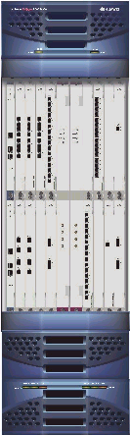



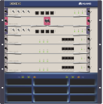



NetEngine Series Router
Forwarding Capability
NE40E-X8/X16
NE5000E
1600
Mpps
Network Processor Based
NE40E-8
NE80E
400
Mpps
NE80
NE40E-4
200
Mpps
96
Mpps
40G/slot
NE40-8
48
Mpps
20G/slot
NE40-4
24
Mpps
NE20/20E
2.5G/slot
Switching Capability
32G
64G
128G
1.28T
2.56T and more

Slide 8
Product Positioning of NE40E-X Router
Hardware Architecture of NE40E-X Router
Boards of NE40E-X Router
Highlights of NE40E-X Router
Application Scenario of NE40E-X Router

Slide 9
Product Overview - the System Architecture
LPU
SRU
LPU
Monitoring plane
Monitoring
Unit
Monitoring
Unit
System
Monitoring
Unit
Monitoring
Unit
Monitoring
Unit
The data plane, management and control plane are separated
The monitoring plane and service plane are separated
Distributed Forwarding
Three-level switch fabric
Management and control plane
Management
Unit
System
Monitoring
Unit
Management
Unit
Management
Unit
Switch Fabric
Control Unit
Management
Unit
Data plane
Forwarding
Unit
Forwarding
Unit
Switch Fabric
Control Unit
SFU
Forwarding
Unit
Forwarding
Unit
LPU
LPU
Notes:
The NE40E-X adopts a system architecture as shown in Figure above. In this architecture, the data plane, management and control plane, and monitoring plane are separated. This design helps to improve system reliability and facilitates separate upgrade of each plane.

Slide 10
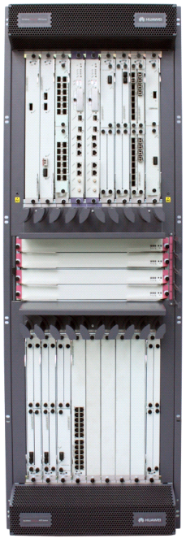
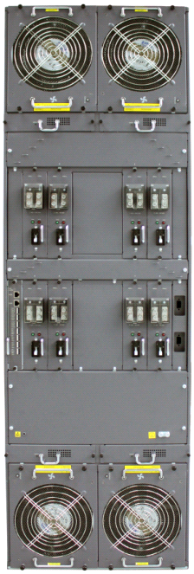
Appearance of NE40E-X16
①
⑥
No. | Module | Quantity
① | Air intake vent | × 2
② | MPUs | × 2
③ | SFUs | × 4
④ | LPUs | × 16
⑤ | Cabling Area | × 2
⑥ | Fan module | × 4
⑦ | Filtering Box | × 4
⑧ | Power Module | × 8
⑨ | CMU | × 1
②
④
⑦
⑤
⑧
⑧
③
⑨
⑧
⑧
⑤
④
⑦
①
⑥

Slide 11
Slot Layout of NE40E-X16
1 | 2 | 3 | 17 | 18 | 4 | 5 | 6 | 7
LPU | LPU | LPU | MPU | MPU | LPU | LPU | LPU | LPU
SFU |  |  |  |  |  |  |  |  | 19
SFU |  |  |  |  |  |  |  |  | 20
SFU |  |  |  |  |  |  |  |  | 21
SFU |  |  |  |  |  |  |  |  | 22
LPU | LPU | LPU | LPU | LPU | LPU | LPU | LPU | LPU
8 | 9 | 10 | 11 | 12 | 13 | 14 | 15 | 16
Slot No. | Remarks
1～16 | Hold LPUs
17～18 | Hold MPUs, working in1:1 backup mode
19～22 | Hold SFUs, working in 3+1 backup mode
Notes:
MPU：Main Processing Unit
SFU：Switch Fabric Unit
LPU：Line Processing Unit

Slide 12
Architecture of NE40E-X16
Control Plane
MPU
MPU
Channels: Each SFU provides 8 pairs of high-speed SerDes links for each LPU. The rate of each pair of SerDes links is 3.125 Gbit/s (LPU).
Redundancy: Four SFUs work in load balancing mode. When one SFU fails, the traffic is switched to the other SFUs automatically.
Interface
Interface
LPU
LPU
Data Plane
Architecture: 3+1 backup of SFUs.
Capacity: 640 Gbit/s for each SFU. The capacity of the entire system is 2.56 Tbit/s.
Features: Large capacity, congestion-free, high reliability, and supporting switching capacity of 40G/slot.
Notes:
The SFU on the NE40E-X16 switches data for the entire system at wire speed of 640 Gbit/s (320 Gbit/s for the upstream traffic and 320 Gbit/s for the downstream traffic). This ensures a non-blocking switching network.
The NE40E-X16 has four SFUs working in 3+1 load balancing mode. The entire system provides a switching capacity at wire speed of 2.56 Tbit/s.
The four SFUs load balance services at the same time. When one SFU is faulty or replaced, the other three SFUs automatically take over its tasks to ensure normal running of services.

Slide 13
Distributed Architecture of NE40E-X16
PEM
Backplane
Fan
Fan
PEM A 1
Filtering box
Filtering box
Area 1
-
48
V A
/
RTN A
PEM A
2
-
48
V A
/
RTN B
MPU1
LPU0
LPU2
LPU3
LPU1
LPU1
LPU1
LPU1
MPU0
PEM B
1
-
48
V A
/
Area 2
RTN A
-
48
V A
/
RTN B
PEM B
2
SFU0
SFU1
SFU2
PEM A
3
SFU3
-
48
V A
/
Area 3
RTN A
-
48
V A
/
RTN B
PEM A
4
LPU7
LPU8
LPU9
LPU10
LPU11
LPU12
LPU13
LPU14
LPU15
-
48
V A
/
RTN A
PEM B
3
Area4
-
48
V A
/
RTN B
PEM B
4
Filtering box
Filtering box
Fan
Fan
Notes:
As shown in figure above, the NE40E-X16 backplane is divided into four areas, with each area having two power inputs. These eight power inputs work in backup mode.
The NE40E-X16 supports either DC or AC power supply.

Slide 14
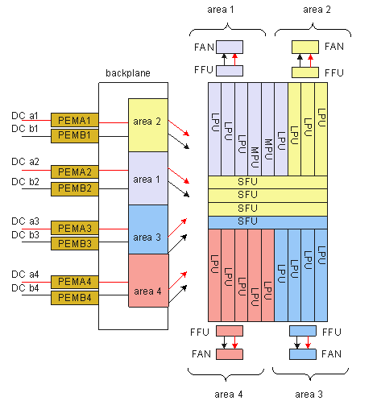
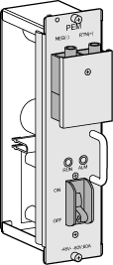
DC Power Supply System of E40E-X16
Appearance of the NE40E-X16's PEM
Notes:
In a DC power supply system of the NE40E-X16, eight 70 A PEMs work in 4+4 backup mode.
Figure above shows details on the DC power supply system:
Two -48V power inputs join on the board.
After the low-frequency filtering, the two -48 V power inputs for fans join inside the fan module.
Each DC power input contains one -48 V power inputs and one RTN inputs. Two separated RTN inputs join on the board.

Slide 15
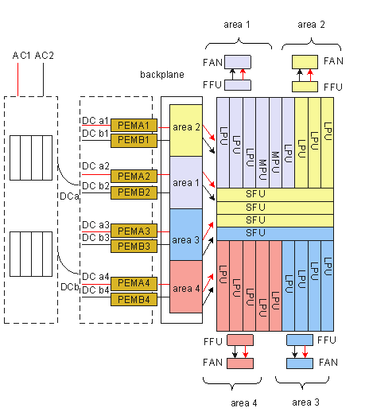
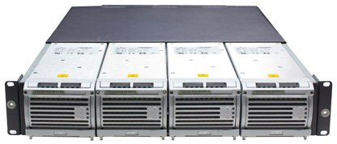
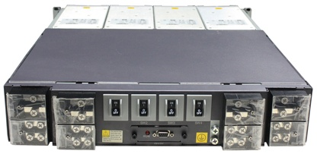
AC Power Supply System of E40E-X16
Front view of the AC rectifier module
Rear view of the AC rectifier module
Notes:
The input AC power is converted into regulated DC power by an AC/DC converter. The resulting DC power output is connected to the PEMs through external cables to supply power for all boards and fan modules.
Two -48V power inputs are joined on the board.
After the low-frequency filtering, the two -48 V power inputs for fans are joined inside the fan module.

Slide 16

Heat Dissipation System of NE40E-X16
Front view
Rear view
Air channel (side view)
Fan area
Air intake vent
Fan modules at the back
2+2 backup of fans
U-shaped air channel for effective heat dissipation
-X16: separate air channels for heat dissipation of the upper and lower frames
Notes:
The NE40E-X16 is divided into the upper chassis and the lower chassis, and draws air from the front and exhausts air from the rear. The air intake vent on the upper chassis resides above the board area on the front chassis; the air exhaust vent resides above the board area on the rear chassis. The lower chassis and the upper chassis are opposites. In addition, the upper chassis and the lower chassis have separate heat dissipation systems.
The middle area of the chassis is for SFU slots. The air intake vent of this area resides on the left of the chassis. Two upper SFU slots in the area draw air from the left. When flowing to the right, the air joins the air from the upper chassis. Two lower SFU slots in the area draw air from the left. When flowing to the right, the air joins the air from the lower chassis.
The NE40E-X16 has three air channels:
The upper and lower chassis have separate air channels that draw air from the front and exhausts air from the rear. The air filters at the air intake vents are vertically installed. The curved face, large area, and small windage resistance of the air filters help to improve the heat dissipation efficiency. The two air filters on the upper and lower chassis are the same.
The air channel in the SFU slot area is located on the left of the chassis. The air filter adopts front access. The depth of the air filter is the same as that of an SFU and the height of the air filter is four times the height of the an SFU.

Slide 17
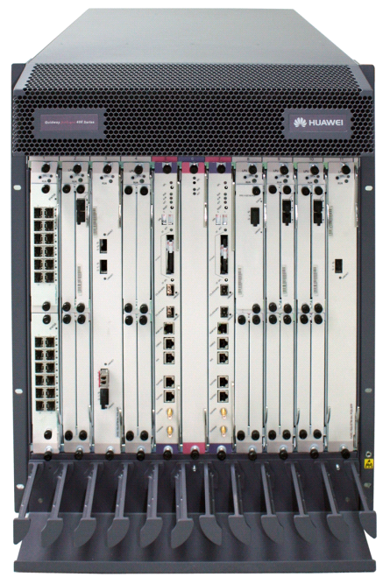
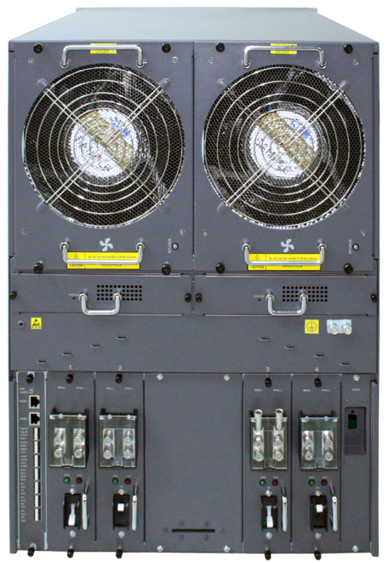
Appearance of NE40E-X8
No. | Module | Quantity
① | Air intake vent | × 1
② | SRUs | × 2
③ | SFUs | × 1 (Totally 3 SFUs, 2 of which are integrated on SRUs)
④ | LPUs | × 8
⑤ | Cabling Area | × 1
⑥ | Fan Module | × 2
⑦ | Filtering Box | × 2
⑧ | Power Module | × 4
⑨ | CMU | × 1
①
②
②
⑥
⑥
⑦
⑦
④
③
⑧
⑧
⑧
⑧
⑤
⑨

Slide 18
Slot Layout of NE40E-X8
1 | 2 | 3 | 4 | 9 | 11 | 10 | 5 | 6 | 7 | 8
LPU | LPU | LPU | LPU | SRU | SFU | SRU | LPU | LPU | LPU | LPU
1 | 2 | 3 | 4 | 9 | 11 | 10 | 5 | 6 | 7 | 8
Slot No. | Remarks
1～8 | Hold LPUs
9～10 | Hold MPUs, working in 1:1 backup mode
11 | Hold SFUs, working in 2+1 backup mode
Notes:
SRU: Switch Router Unit

Slide 19
Architecture of NE40E-X8
Channels: Each SFU provides 12 pairs of high-speed SerDes links for each LPU. The rate of each pair of SerDes links is 3.125 Gbit/s (LPU).
Redundancy: Three SFUs work in load balancing mode. When one SFU fails, the traffic is switched to the other SFUs automatically.
SRU＝MPU＋SFU
Control plane
Interface
SRU
SRU
Interface
LPU
LPU
SFU
Forwarding plane
Architecture: 2+1 backup of SFUs. Two SFUs are integrated on the SRU.
Capacity: 480 Gbit/s for each SFU. The capacity of the entire system is 1.44 Tbit/s.
Features: Large capacity, congestion-free, high reliability, and supporting switching capacity of
40G/slot.
Notes:
The SFU on the NE40E-X8 switches data for the entire system at wire speed of 480 Gbit/s (240 Gbit/s for the upstream traffic and 240 Gbit/s for the downstream traffic). This ensures a non-blocking switching network.
The NE40E-X8 has three SFUs working in 2+1 load balancing mode. The entire system provides a switching capacity at wire speed of 1.44 Tbit/s.
The three SFUs load balance services at the same time. When one SFU is faulty or replaced, the other two SFUs automatically take over its tasks to ensure normal running of services.

Slide 20
Distributed Architecture of NE40E-X8
Fan
Fan
PEM
Backplane
Filtering box
Filtering box
PEM A2
-48V A/RTN A
Area 1
LPU0
LPU1
LPU2
LPU3
SRU0
SFU
SRU1
LPU4
LPU5
PEM A1
-48V A/RTN B
LPU6
LPU7
-48V A/RTN A
PEM B2
Area 2
-48V A/RTN B
PEM B1
Notes:
As shown in figure above, the NE40E-X8 backplane is divided into two areas, with each area having two power inputs. These four power inputs work in backup mode.
The NE40E-X8 supports either DC or AC power supply.
In a DC power supply system of the NE40E-X8, four 70 A PEMs work in 2+2 backup mode. The figure shows details on the DC power supply system:
Two -48 V power inputs join on the board.
After the low-frequency filtering, the two -48 V power inputs for fans join inside the fan module.
Each DC power input contains one -48 V power input and one RTN input. Two separated RTN inputs join on the board.
In the case of an AC power supply system, an AC power frame is placed outside the chassis and installed with rectifier modules based on system power. The AC power frame is then connected to the input terminals on the DC-PEMs to supply power for the system. (In short, an external AC power frame is added to the DC power supply system to constitute an AC power supply system.)

Slide 21
Heat Dissipation System of NE40E-X8
Front view
Rear view
Air channel (side view)
Fan area
Air intake vent
Fan modules at the back
1+1 backup of fan modules
U-shaped air channel for effective heat dissipation
Notes:
The heat dissipation system is responsible for dissipating heat for the entire system. The heat generated by boards is dissipated through the heat dissipation system. In this manner, the temperature of the components on boards are controlled within a normal range, enabling the boards to work stably.
The heat dissipation system is composed of fan modules (one fan in each fan module), fan control boards (FCBs), temperature sensors, air filters, air intake and exhaust vents, and a system air channel.
When a single fan fails, the other fans automatically rotate at full speed. In this case, the heat dissipation system enables the system to work in a short period of time at ambient temperature of 40℃.
Temperature sensors, located on the air exhaust vent and boards, are used to monitor the temperature of the components on boards and adjust the fan speed through the command delivered by the SRU to control the temperature in a normal range.
The power modules of the system have two fans of their own for independent heat dissipation.
As the figure shown above, The NE40E-X8 draws air from the front and exhausts air from the back. The air intake vent resides above the board area on the front chassis; the air exhaust vent resides above the board area on the rear chassis.
The two fan modules of the NE40E-X8 are located side by side at the air exhaust vent, with each module containing one fan. The entire system dissipates heat by drawing air, as shown in figure above.

Slide 22
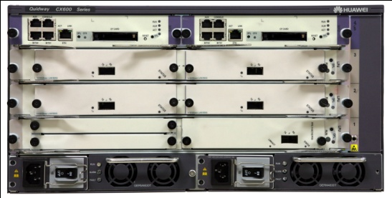
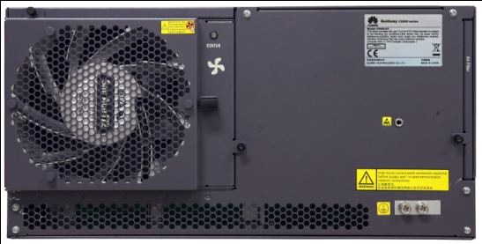
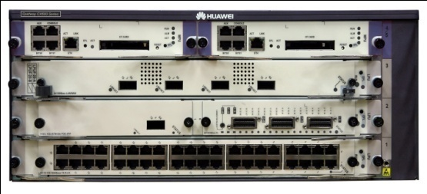
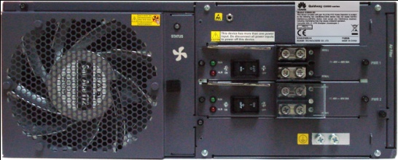
Appearance of NE40E-X3
①
①
②
②
②
③
③
④
No. | Module | Quantity
① | MPUs | × 2
② | LPUs | × 3
③ | Power Module | × 2
④ | Fan Module | × 1
①
①
②
②
④
③

Slide 23
Slot Layout of NE40E-X3
4 | MPU | MPU | 5
 | LPU |  | 3
 | LPU |  | 2
 | LPU |  | 1
Slot No. | Remarks
1～3 | Hold LPUs
4~5 | Hold MPUs, working in 1:1 backup mode
Notice! | No SFU is adopted on NE40E-X3

Slide 24
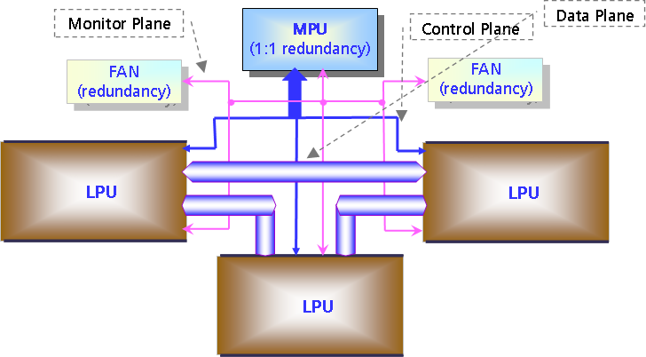
Architecture of NE40E-X3
Notes:
With full-mesh architecture, NE40E-X3 does not need a SFU.

Slide 25
Power Supply System of NE40E-X3
PEM
Backbone
Boards
MPU4 | MPU5
LPU3
LPU2
LPU1
PEM 1
PEM 2
FAN
Notes:
Two AC power modules or two DC power modules work in 1+1 backup mode to improve the reliability of power supply. The figure shows the diagram of the power supply system.

Slide 26
Heat Dissipation System of NE40E-X3
Air Channel (Top View)
Front View
Rear View
Fan area
Air intake vent
Fan module at the back
U-shaped air channel for effective heat dissipation
Notes:
The NE40E-X3 draws in air from the left and exhausts air from the rear. The air intake vent is located at the left side of the chassis and the air exhaust vent is located at the rear of the chassis.
The fan module of the NE40E-X3 is located at the air exhaust vent. The system draws in air for heat dissipation.

Slide 27
Product Positioning of NE40E-X Router
Hardware Architecture of NE40E-X Router
Boards of NE40E-X Router
Highlights of NE40E-X Router
Application Scenario of NE40E-X Router

Slide 28
Types of Boards of NE40E-X
Main Process Unit
  X16: MPU
  X8: SRU
  X3: MPU
Switch Fabric Unit
  X16: SFUI-200-B
  X8: SFUI-200-C
Centralized Monitoring Unit: CMU
Line Processing Unit

Slide 29
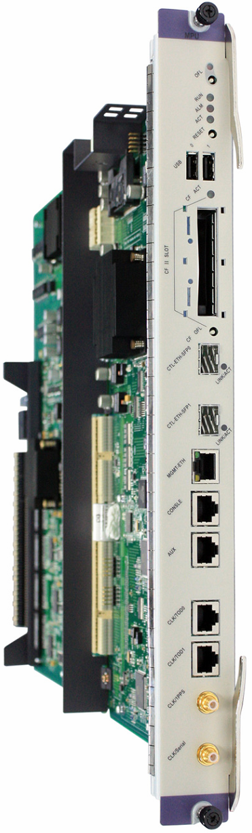
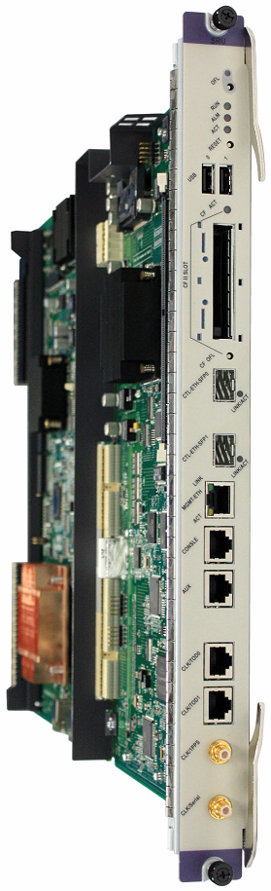
MPU&SRU (1)
USB port
Slot for a CF card of up to 1GB
High performance multi-core CPU
MPU of NE40E-X16
SRU of NE40E-X8(integrated with SFU)
Notes:
The control plane of the NE40E-X16 adopts MPU.
The following USB interface attributes are supported by MPU:
Supports the biggest USB fat32 format, and supports the memory available in the market.
For security reasons not allowed to write USB storage device .
Updates automatically, insert the USB memory without any operating.
Highlights of the MPU
Two USB ports: supporting version downloading through USB devices and power supply for USB devices
CF card with mass storage capacity (up to 1 GB)
Compatible with the design of disks
RJ-45/SMB connector: processing Stratum-3 clock and 1588 clock; supporting input and output of 2MHz/2Mbps/1PPS clock signals
High performance multi-core CPU
The bandwidth of the control bus between the MPU and the LPU is increased to 1 Gbit/s.

Slide 30
Notes:
Providing two 1G or 2.5G SFP interfaces for future expansion into clusters
The architecture is designed to be compatible with the SFU function on future MPUs.
The control plane of the NE40E is separated from the data plane and the monitoring plane. The SRU is adopted on the NE40E-X8. The SRU integrates an SFU used for data switching.
The following USB interface attributes are supported by SRU:
Supports the biggest USB fat32 format, and supports the memory available in the market.
For security reasons not allowed to write USB storage device .
Updates automatically, insert the USB memory without any operating.
Highlights of the SRU
Two USB ports: supporting version downloading through USB devices and power supply for USB devices
CF card with mass storage capacity (up to 1 GB)
Compatible with the design of disks
RJ-45/SMB connector: processing Stratum-3 clock and 1588 clock; supporting input and output of 2MHz/2Mbps/1PPS clock signals
High performance multi-core CPU
The bandwidth of the control bus between the SRU and the LPU is increased to 1 Gbit/s.

Slide 31
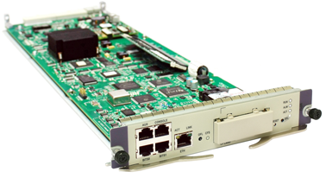
MPU&SRU (2)
CF Card
Eth0
Console & AUX
RJ-45 connector, providing clock information and BITS clock
MPU of NE40E-X3
Notes:
The MPU of the NE40E-X3 controls and manages the system and switches data. The MPUs work in 1+1 backup mode. The MPU consists of the main control unit, system clock unit, synchronous clock unit, and system maintenance unit. The functions of the MPU are described from the following aspects.

Slide 32

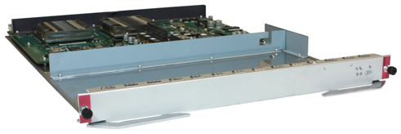

SFU Boards of NE40E-X16/8
Appearance of the panel
Appearance of the Switch Fabric Unit B
(SFUI-200-B) (Adopted NE40E-X16)
Appearance of the Switch Fabric Unit C
(SFUI-200-C) (Adopted NE40E-X8)
Notes:
A switching network is a key component of the NE40E and is responsible for switching data between LPUs.
Switching Board comprises of CPU module, switching module.
Mainly responsible for switching data between LPUs.
NE40E-X16 has four SFUs that work in 3+1 load balancing mode.
NE40E-X8 support 2+1 load balancing mode
Indicators on panel include ACT indicator, RUN indicator and OFL indicator.

Slide 33

CMU of NE40E System (Optional)
Extensive environment monitoring functions
  Alarm detection of the smoke sensor
  Detection of the ambient temperature
  Access control management
  Device alarm output
  Main contact point inspection
  One 232 and 485 serial interface
Perform the system environment monitoring and access control functions
Not require additional devices, saving customers’ investment.
Indicator
RJ-45 connector
Panel connector
Notes:
Extensive environment monitoring functions
Alarm detection of the smoke sensor :Supports the connection to the smoke sensor through the panel to detect the alarm signals from the chassis or equipment room.
Detection of the ambient temperature :Supports the connection to the temperature sensor through the panel to detect the temperature of the chassis or equipment room.
Access control management :Detects whether access control is enabled through magnetic inspection and reports the inspection signal to the device. The remote unlocking function is reserved. You can instruct the CMU to enable or disable access control through the remote control function.
Device alarm output :The CMU provides two-level alarm output signals.
Main contact point inspection :The CMU can provide six main contact points to detect signal input and monitor whether the devices outside the chassis work normally.
One 232 and 485 serial interface :Provides an RS-232 serial interface, which is connected to the panel. You can use it to query or locate information about the CMU. In addition, the CMU provides an R-485 serial port, which is connected to the panel. You can connect an device to this interface. The interface supports full-duplex mode.

Slide 34
Service Interface&Boards
Service&Interface
LPU
LPUF
LPUS
SPU
LPUI
VSUF-10
SPUC
VSUI-20-A
＋
FPIC
Notes:
As the Universal Service Router , NE40E-X series routers supply divers interfaces, such as ethernet, POS, CPOS, E1 and so on.
Boards supplied by NE40E-X for universal service include following types:
LPUF(supply service interface matching corresponding FPIC )
LPUI
LPUS
SPU

Slide 35
LPU
For NE40E-X, types of LPUs are divided into LPUF, LPUI and LPUS.Only matching corresponding FPICs, the LPUF can supply service interfaces, and LPUI and LPUS have intergrated service interfaces on them.
Board Specifications | Board Types | Corresponding Device | Initiative Version
10G | LPUF-10 | NE40E-X3/X8X16 | V3R3C00
20G | LPUF-20/21 | NE40E-X3/X8X16 | V3R3C02
 | LPUS-20 | NE40E-X3/X8X16 | V6R1
40G | LPUF-40 LPUI-40 | NE40E-X3/X8X16 | V6R1C00
 | LPUI-41 LPUS-41 | NE40E-X3/X8X16 | V6R3C00
100G | LPUF-100 LPUI-100 | NE40E-X8X16 | V6R3C00
Notes:
Different specifications of the LPU board is mainly reflected in the QoS.

Slide 36
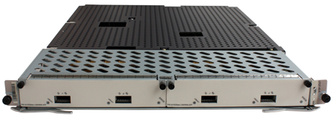
LPUF-40 40G Board
Provides two slots, each of which can hold a flexible plug-in card of the LPUF-40. The cards support hot swap.
Supports a maximum of 40 Gbit/s bandwidth.
Provides two models: LPUF-40-A and LPUF-40-B.
Notes:
High-Queue LPUF-40：Full-service Flexible Linecard, 512K flow queues, supporting features such as BRAS, 1588v2 and enhanced QoS, positioned on complicated service aggregation: BRAS and SR/PE downlink, etc.. V6R3 version will provide new linecards on LPUF-40, including 8-port 10GE oversubscribed card, 40-port GE electronic card and 4-port 10G POS card. In addition, 40G enhanced HQoS and BRAS card will be available in V6R3.
LPUF-40 provides two models: LPUF-40-A and LPUF-40-B
The LPUF-40-A supports all software features
the LPUF-40-B supports all software features except L3VPN, MVPN, and IPv6, and can be upgraded to support all features of the LPUF-40-A through licenses

Slide 37






FPICs of LPUF-40 Board
Type | Description | Remarks | Appearance
LPUF-40 | 4-Port 10GBase LAN/WAN-XFP 20-Port 10/100/1000Base-RJ45 | P40 Flexible Card
 | 2-Port 10GBase LAN/WAN-XFP-E 20-Port 1000Base-SFP-E | P40-E Flexible Card, Supports BRAS, 1588v2, Enhanced QoS
 | 2-Port 10GBase LAN/WAN-XFP-V | P40-V Flexible Card

Slide 38
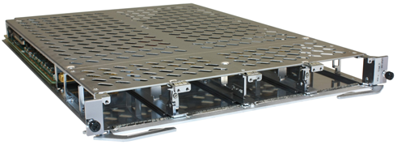
LPUF-100 100G Board
Provides four slots that can hold full-height FPICs or four half-height FPICs
An FPIC supports the following functions:：
  Hot swap
  Automatic recovery of configurations
  Intermixing with other types of FPICs
Notes:
100G linecards include two types: High-Queue LPUF-100 and Medium-Queue LPUI-100. LPUF-100 is Flexible Linecard and provide 512K flow queues, and support flexible configuration of 10GE, GE, 10G POS and 40G POS. LPUI-100 is Integrated Ethernet Linecard and provide 256K flow queues, and meet the requirement of different networking.
100G linecards in V6R3 can provide 8*10GE, 10*10GE, 16*10GE oversubscribed, 96*GE, 8*10G POS, 2*40G POS and 1*100GE. In industry, the interface type of NE40E 100G linecards is most abundant, and the port density of NE40E 100G linecards is highest.
Note：
Provided using 100G Board, we have to switch SFU board(and SRU board on NE40E-X8) to another one with 200G, what’more, the 200G SFU board and corresponding SRU board can’t be used together with 40G SFU, LPUA, LPUB, LPUG at the same time；
The LPUI-100 can be used only on the NE40E-X16 and NE40E-X8

Slide 39
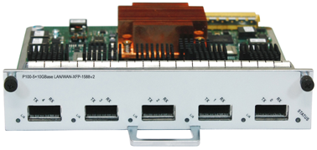
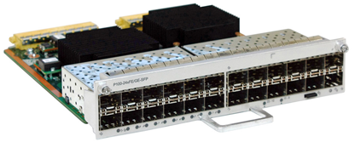

FPICs of LPUF-100 Board
5-Port 10GBase LAN/WAN-XFP Flexible Card A Supports 1588v2
24-Port 100/1000Base-SFP Flexible Card(P100, Occupy two sub-slots)
48-Port 100/1000Base-X-CSFP Flexible Card(P100, Occupy two sub-slots)

Slide 40
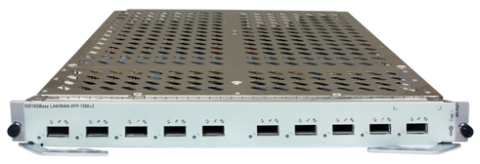
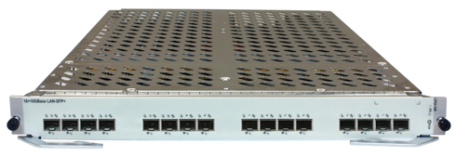
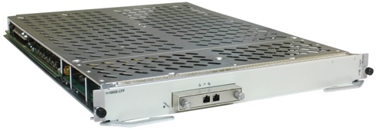
LPUI-100 100G Board
LPUI-100 board is simplified from LPUF-100 board.
10-Port 10GBase LAN/WAN-XFP Integrated Line Processing Unit (LPUI-100, Supporting 1588v2))
16-Port 10GBase LAN-SFP+ Integrated Line Processing Unit(LPUI-100)
1-Port 100GBase-CFP Integrated Line Process Unit(LPUI-100)

Slide 41
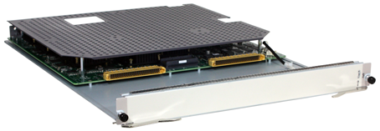
SPUC
3 running modes of SPUC：NetStream mode, Tunnel mode and NAT mode.
In the same SPUC board, NetStream, NAT and Tunnel MVPN are incompatible.
Fuctions achieved by SPUC need GTL License support.
Notes:
An SPUC implements the NetStream function and processes tunnel services related to GRE and NAT and multicast VPNs.
An SPUC does not have any physical interfaces and can be inserted into any LPU slot.
3 running modes of SPUC：NetStream mode, Tunnel mode and NAT mode
NetStream mode
Under the NetStream mode, the SPUC board can implement centralized NetStream mode.
Meanwhile, the centralized NetStream still applys License(NetStream License for SPUC), and each SPUC board need one License.
Tunnel mode
Under the Tunnel mode, the following functions can be provided:
Centralized multicast VPN：If running the multicast VPN in SPUC boards, We need to configurate the same number of MVPN License with SPUC amount.
Tunnel:SPUC board can provide centralized tunnel, including GRE tunnel and 4over6 tunnel currently。If running the tunnel in SPUC boards, We need to configurate the same number of tunnel License with SPUC amount.
NAT mode
SPUC board support NAT, NAT License must form 1:1 with the SPUC.
GTL:Global Trotter License

Slide 42
Product Positioning of NE40E-X Router
Hardware Architecture of NE40E-X Router
Boards of NE40E-X Router
Highlights of NE40E-X Router
Application Scenario of NE40E-X Router

Slide 43



NE40E Product Highlights
Large Capacity & Future Scalability
Industry-leading 400G platform
1320*GE classis double average in density
Compatibility designing & smooth upgrading
Advanced
Solar Chip
Stable, secure and reliable network
Rich High-Availability Technologies
Security Network with High-performance
Business depth Monitoring
Commercial IPv6 solution
VRP Inside
Designed for the real needs of customers
Easy to Deploy
H-QoS
Video Solution

Slide 44
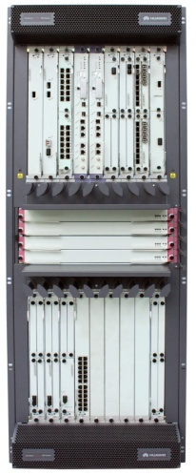
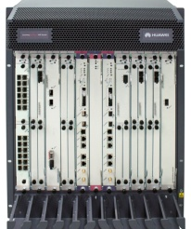

Green 400G Platform
Greenest platform
NE40E-X16
Greenest platform: lowest power consumption, highest efficiency in heat dispersion.
NEW 400G Platform
Power supply by areas, power supply mode can be unmodified.
Lowest power consumption: Power consumption of a 10G interface is 30% lower than that of the other supplier. A device saves power of 10000 kwh each year.
NE40E-X8
Highest efficiency in heat dispersion: innovative U-shaped air channel, greatly improves the heat dispersion system.
NE40E-X3
Compact design, save space by 40％.
High performance and great capacity
Most compact design: 14 U/32 U. Three chassis in a cabinet
Green platform, unified NMS, unified platform
From 10G to 400G, compatible to all boards
Save OPEX and CAPEX, saves TCO by 40％
High interface density: up to 132*10GE
400G platform, backplane capacity up to 30 T

Slide 45


Reliability Feature
Key Module Redundancy
ISSU
In-Service Software Upgrade
NSR
Non-Stop Routing
99.999%
FRR
Fast ReRoute
NSF
Non-Stop Forwarding
BFD
Bidirectional Forwarding Detection

Slide 46
Full IPv6 Support
Basic Feature/Protocol
Evolution Technology
Multicast
IPv6 Address Management
Address Discovery/ Reduplicate Address checking
ICMPv6/Ping6
RIPng/OSPFv3/BGP4+/ISISv6
6over4/6over4 GRE Tunnel
6to4 Tunnel
4over6 Tunnel
4to6 Tunnel
6PE/6VPE
MLD v1/v2
PIM-SMv6
PIM-DMv6
PIM-SSMv6
QOS
Reliability/Security
Access
IPv6 ACL
IPv6 CAR
IPv6 Traffic Shaping
IPv6 HQos
OSPFv3/ISISv6/BGP4+ GR
VRRP v6
Netstream v6
URPF v6
BFD for anything
PPPoE/IPoE
DHCPv6
L2TP
RAIDUSv6
Huawei is ahead of Cisco, so Huawei is the best company in the field of IPv6.
－ Latif Ladid (President of IPv6 Forum)

Slide 47






H-QoS for Multi-Play Service
NE40E
BUINESS FLOW
VOIP
HG
VPLS/RRPP
10GE ring
IP MPLS CORE
VIDEO DATA
Enterprise
NPE
WFQ per service
8 queues per user
Shaping per District
Shaping per user group
WFQ per service
Gold user - 1
Special service VLAN
VoIP
Control flow VLAN
Silver user-2
GE
Port
Video
user
user
Group
IA Pre
VoD VLAN
IA BE
user-n
Premium
IA VLAN
Normal
Centralized control, achieves fine service management in NPE points, more flexible service strategy.
  Gold, silver or bronze medal users have different service experience.
  The control of the Special service is more effective.
Notes:
The NE40E supports entire HQoS solutions, HUAWE is the only vendor that supports HQoS, DS-TE and MPLS HQoS, the other vendors support one or two. Thus, HUAWEI can provide a entire HQoS solution to meet kinds of scenarios of carrier-class services.

Slide 48
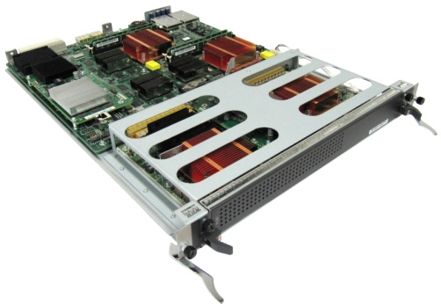






IPSec for High-speed Secure Interconnection
+
IPSec License
IPSec
VSUI-20-A
1:1
Key Message
A secure IPSec communication tunnels for one enterprise HQ and its Branch
High performance：line speed of 10G/Slot(512B), 20K concurrent tunnel
Supports hot standby and loading-balance between boards
Supports NAT traversal
  Entire system supports a maximum of 8
Branch
NE40E
IPSEC inside
IPSEC
IP Bear network
HQ
Work outside
NE40E
NE40E

Slide 49
Product Positioning of NE40E-X Router
Hardware Architecture of NE40E-X Router
Boards of NE40E-X Router
Highlights of NE40E-X Router
Application Scenario of NE40E-X Router

Slide 50




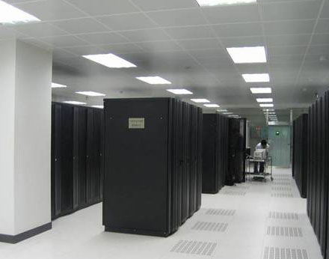














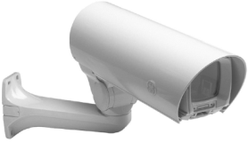
The Main Scenario of NE Series Router
Disaster Recovery Center
Large Branch Access
NE40E
NE40E
WDM
IDC Switch
WAN Key node
IDC Interconnection
Campus Interconnection & Branch Aggregation
NE40E
WLAN
LAN Switch
Power industry, Finance, Oil & GasPipeline, Oilfield, e-Education, Government, etc.
Notes:
The main scenario of NE40E Router: Campus and IDC interconnection, Large branch access, Key nodes of WAN.

Slide 51
Which of the following card types is supported by NE40E-X16 ?
  SPUC
  LPUF
  LPUI
  LPUS
Which of the following is the control plane of NE40E-X3 ?
  A. MPU B. MCU C. SRU D. SFU
Notes:
ABCD
A

Slide 52
Huawei NE40E router located in the core / aggregation layer of a large network
The CLOS Architecture of NE40E-X16/X8, and the Full-Mesh Architecture of X3
Types of Boards of NE40E-X
Highlights of NE40E-X
  Capability, High-Reliability and HQoS
Main Scenario of NE40E-X

Slide 53
Huawei Learning Website
  http://support.huawei.com/learning/Index!toTrainIndex
Huawei Support Case Library
  http://support.huawei.com/enterprise/servicecenter?lang=zh

Slide 54
NE40E Product Documentation
  http://support.huawei.com/ehedex/hdx.do?docid=DOC0100595997&lang=en

