Slide 1
HCDCA101
DC
V1R1
1.5
Yuan Weihua/WX462781
2019-04-10
Liu Lican/00180730
Update
Update
Update
Update
Update

Slide 2
Unveiling DCs
Huawei Data Center Series of Courses

Slide 3
This course describes the development course of data centers (DCs), basic modules of DCs, and evolution trends of cloud DCs.

Slide 4
On completion of this course, you will be able to know:
  DC development course
  Basic modules of a DC
  Network structure
  Evolution trends of cloud DCs

Slide 5
DC Development Course
Basic Modules of a DC
Evolution Trends of Cloud DCs

Slide 6
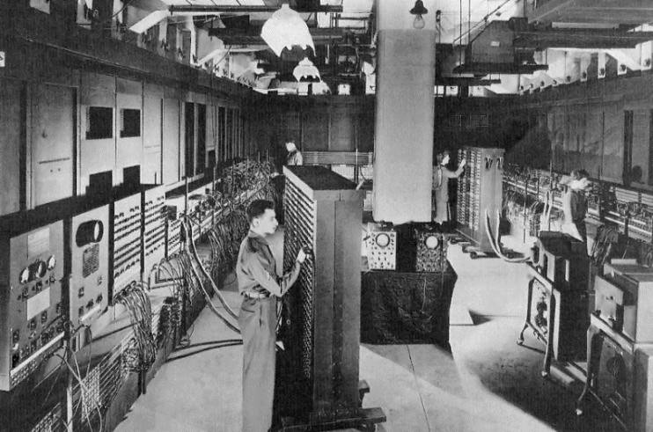
DCs Took Shape - ENIAC
Electronic Numerical Integrator and Computer (ENIAC) was designed in 1946 and primarily used to calculate artillery firing tables for the United States Army's Ballistic Research Laboratory.
ENIAC contained 17,468 vacuum tubes, 7200 crystal diodes, 1500 relays, 70,000 resistors, 10,000 capacitors, 1500 relays, and 6000-plus switches. It could execute 5000 addition operations or 400 multiplication operations per second. It was one thousand times faster than electro-mechanical machines and 200,000 times faster than manual calculation.

Slide 7
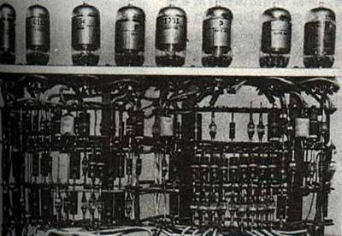
Commercial Use of DC Virtualization Technology - TRADIC
TRAnsistor DIgital Computer (TRADIC) was the first transistorized computer in the USA, completed in 1954. It was put into commercial use in 1960s and led the breakthrough development of mainframe computers (such as IBM System series mainframe computers). Mainframe computers were developed for government departments and militaries and have special requirements on sites and security systems. As the requirements for system performance increased, people hoped to provide additional performance support and resource sharing capabilities on the same systems. To cope with the increasing requirements, virtualization technology came into view.
The concept of virtualization was popularized rapidly, and the multi-task processing mechanism was further improved on mainframe computers. Virtualization technology was first put into commercial use on IBM VM/370 OS in 1972. Virtualization technology, one of the most important technologies of DCs, was integrated into the development course of DCs.
Notes:
Transistorized computers were the second generation of electronic computers. In 1954, Bell Labs in the United States successfully developed the first computer using transistor circuits and called it "TRADIC" with 800 transistors.
In the first generation before the 1950s, electronic tubes were used as components in computers. Too much heat generated by the tube elements during operation, poor reliability, unpleasant operation, high cost, and large size restricted computer development. Thus, the transistor began to be used as a computer component. The transistor could not only realize the functions of electron tubes, but also featured small size, light weight, long life, high efficiency, less heat, and low power consumption. After the transistor was used, the structure of the electronic circuit was greatly improved, making high-speed electronic computers even easier to implement.

Slide 8
Client/Server Computing Model and the Internet
20 years ago, microcomputers ushered in prosperous development. Legacy PCs were replaced by network devices. Especially, the generation of the client/server model contributed to hosting and external DCs.
In the middle of the 1990s, the Internet emerged and had great impact on the market. Additionally, it provided more options for DC deployment in the next 10-plus years. More enterprises needed to support Internet applications, network connections and collaboration services became necessary when enterprises deploy IT services. Network providers and hosting providers developed rapidly in the construction of hundreds of DCs. As a service mode, DCs have been accepted by most enterprises.
Notes:
Client/Server (C/S) structure
The C/S structure is a well-known software system structure. It appropriately allocates tasks to the client and server, reducing the communication overhead. A client is required to perform management operations.
The programs running on a client are different from those running on a server. Users' programs reside on clients. The programs running on a server provide data management, data sharing, data and system maintenance, and concurrency control, and those running on a client process specific services.
Programs are easy to develop and operate. However, it is difficult to upgrade the applications and maintain the client programs.
Browser/Server (B/S) structure
The B/S structure is a change or improved structure to the C/S structure with the emergence of Internet technology. In this structure, the user interface is implemented through the WWW browser.
The client does not have dedicated applications, and applications are basically on the server. Therefore, application upgrade and maintenance are performed on the server, which is convenient. Because the client uses a browser, the user interface is diversified, but functions such as data printing and output are limited. To overcome this disadvantage, the function that is difficult to implement by using a browser is developed into a control, which can be invoked by the client applications.

Slide 9
Energy Consumption Issue
PC prosperity and DC appearance brought a series of problems, for example, occupying more places and increasing energy consumption. Back to 2002, DCs had consumed 1.5% power of the United States and the energy consumption increased by 10% every year. 5 million new servers were deployed in DCs and energy consumption by thousands of households increased every year.
DC owners realized the problems and started to deploy more economical, efficient, and environment friendly infrastructure. In 2007, large-scale DC operators started to use recyclable energy technology (wind energy and solar energy) to support the daily operation of DCs.

Slide 10
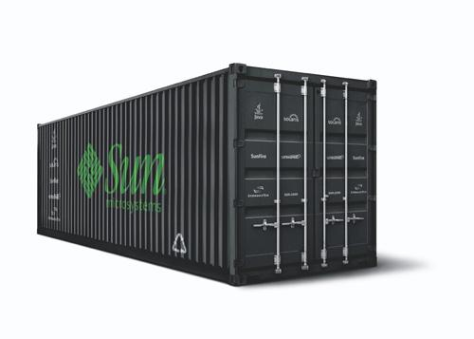
Modular DCs
Modular DCs are also called container DCs because the devices are deployed in containers. Sun BlackBox is one of the most famous modular DCs. In Sun BlackBox, 280 servers are deployed in 20-inch cabinets in the containers and carried to different locations worldwide.
Although modular DCs are not as magnificent as conventional DCs, their construction cost is only 1% of conventional DCs. Additionally, modular DCs are flexible, remarkably reducing the time required for DC deployment.
Notes:
Modular DCs are a new generation of DCs based on cloud computing. To cope with the server development trends, such as cloud computing, virtualization, centralization, and high density, the modular design concept is adopted to minimize the coupling of infrastructure with the equipment room environment. Subsystems, such as power distribution, cooling, cabinet, air flow control, integrated cabling, and power and environment monitoring to improve the overall operation efficiency of the DC and achieve rapid deployment, flexible expansion, and energy saving. In terms of configuration form, DCs can be divided into MDCs and CDCs.
Modular DCs meet the urgent requirements of IT business departments for future DC infrastructure construction, such as standard design, component prefabrication, fast rollout and deployment, effective reduction of initial investment, energy pooling management in modules, high utilization of dynamic IT infrastructure resources, intelligent O&M management, and assurance of important service continuity, shared IT services (such as cross-service infrastructure, information sharing, and application sharing), quick response to service requirement changes, and green DCs.
Advantages of modular DCs
Standard modules with high reliability
The modular DC adopts the modular, standard, and highly reliable design, which ensures the stability of the entire system. Based on customer requirements and actual conditions, the modular DC provides N+1, N+X, and 2N design solutions for core power supply and cooling devices. The design solutions are secure and reliable and meet the standards from Tier 3 to Tier 4.

Slide 11
Notes:
Rapid deployment, greatly shortening the construction period
The MDC improves the planning and design efficiency. The system architecture can be properly configured based on IT service requirements, such as cabinet arrangement of modules, power supply and distribution devices, cooling solutions, and monitoring systems. Micromodules are produced in batches, which improves the supply speed. Standard components reduce the onsite assembly workload and speed up installation. Micromodules can be assembled and tested in factories to ensure the system debugging speed and reliability. With the modular design and integrated delivery of infrastructure and IT devices, the DC deployment period can be shortened to weeks. For the CDC, the joint commissioning can be performed in the factory. After the water, electricity, and network access is complete, the CDC is directly put into operation.
Phased construction and flexible scalability
The modular DC integrates modular components, such as end cooling, end power distribution, and end cabling. In addition to reducing initial investment, the modular DC allows on-demand deployment, avoids waste of idle fixed assets, and ensures that the infrastructure configuration in any IT space of a large DC reaches the optimal state. The MDC significantly reduces the cost in the life cycle of a DC. The MDC can be added rapidly to cope with service growth at any time, meeting the requirements of large-scale IDC construction.
Energy saving
Currently, the power consumption cost of DCs accounts for the largest part of the TCO in the life cycle. Modular DCs achieve on-demand power supply and cooling for IT devices, balancing the capacity and load requirements of the power supply and cooling systems. This improves work efficiency and reduces excessive configurations. The power conversion rate of micromodules is up to 95%. The standard interface and micromodule architecture are used, which greatly reduces power consumption and achieves system energy saving.

Slide 12
Notes:
The modular DC adopts the closed isolation of cold channels. The cold and hot air flows do not interfere with each other. This avoids the heat islands caused by the crosstalk of the airflow and prevents air volume and cooling loss. In addition, inter-column air conditioners and the near-heat source design of cooling devices are used to improve cooling efficiency, solving local hotspot problems and reducing operating costs of DCs. With the water cooling system and natural cooling system, the PUE can be reduced to less than 1.5.
Intelligent management and refined O&M
The modular DC monitors the internal environment and power devices of micromodules in real time, and coordinates IT devices and infrastructure to implement refined O&M of power and environment + IT devices. The intelligent management system provides visualized experience, helping customers implement multi-level and refined energy consumption management in DCs, accurately locating energy consumption points based on multiple reports, and reducing energy consumption. An energy-saving optimization solution is output based on big data analysis, and a green DC is built. Closed-loop management of asset information within the assets' lifecycle ensures timely update and maintenance of data. In addition, help users make an asset maintenance plan, implement proactive warning, dynamically adjust maintenance plans, output optimization solutions based on the actual situation, and build the optimal asset management function.
Easy migration of a container DC
The container DC solution integrates the power distribution system, power and environment monitoring, cooling system, cabinet, cabling, and fire fighting infrastructure. This solution meets equipment room infrastructure requirements of traditional DCs and enables outdoor deployment and migration.

Slide 13
Cloud DC
Software as a service (SaaS) enables the shift from computing resource subscription based on infrastructure to on-demand subscription. Network infrastructure and DC operators work together to provide rapidly-increasing data bandwidth resources, which support a wide array of IT services.
At the beginning, providers did not realize the rapid development of cloud DCs. However, cloud service providers such as Amazon and several other infrastructure service providers had a large number of users based on the cloud DC platform.

Slide 14
DC Development Course
Basic Modules of a DC
Evolution Trends of Cloud DCs

Slide 15
What Is a DC?
Wikipedia: A DC is a facility used to house computer systems and associated components, such as telecommunications and storage systems. It generally includes redundant or backup power supplies, redundant data communications connections, environmental controls (for example, air conditioning and fire suppression) and various security devices.
Google: A DC is a multifunctional facility that can contain multiple servers and other communication devices. These communication devices have the same requirements on environments and physical security.
Huawei: Enterprise DCs are like reservoirs, and DC solutions are like the Dongting Lake.
Reservoir + Lake = DC (data computing, storage, and exchange center)
Pacific + Yangtze River + Yellow River = Carriers' network channels
Tributaries + Urban pipeline networks = Enterprise network channels
Water faucets = Network terminals
Water = Data flows (voice/data/video)

Slide 16
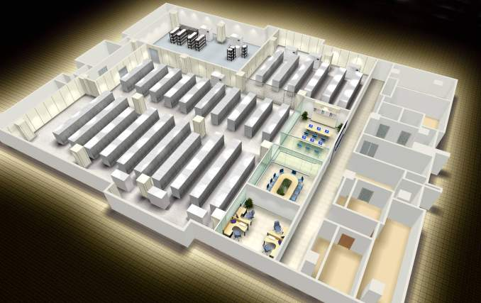
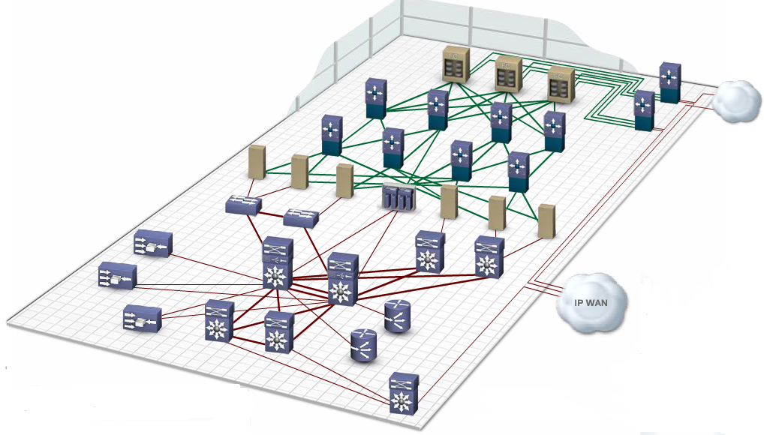
Modules of a DC
DC Layer 1 (infrastructure)
DC Layer 2 (ICT devices)
Power distribution facilities
DC networks
Cabinets + Cabling system
Management and O&M center
Storage
Storage network
Servers
DC interconnection network
Cooling facilities
Computing network
DC equipment room
User
A DC is a service-oriented infrastructure. It supports the operation and growth of enterprise businesses. It consists of the following:
Secure network architecture, reliable support facilities (equipment rooms, generators, UPSs, and air conditioning systems), integrated servers/application platforms, centralized storage and backup, unified system management platforms, and O&M management organizations and processes oriented to customer services.
Functions of DC networks: connects to server, storage, and cross-DC resources. The computing network is the core of the DC networks.
Notes:
Especially Internet Data Centers (IDCs): Wikipedia (Switzerland) is in the underground shelter.
Computing network: connecting to computing resources and users
Storage network: connecting to storage
DC interconnection: connecting to cross-DC resources
L0: building: civil engineering and equipment room building.
L1: infrastructure: equipment room auxiliaries, such as equipment room decoration, power supply, and cooling fire fighting.
L2: IT infrastructure: infrastructure layer of the equipment room, including servers, storage devices, networks, and virtualization software.
L3: application platform, web hosting, and PASS.
L4: service: various services.

Slide 17
DC Infrastructure Development Trend
Enterprise development
DC development
New materials and technologies
Enterprise development is the driving force of DC development.
DC services transform from simple services to multifunctional services.
The DC scale expands.
DCs become increasingly important in enterprises.
DCs shift from pure consumer products to profit-making products.
DC development contributes to enterprise and technology development.
Customers no longer focus only on site infrastructure but pay more and more attention to infrastructure-related IT services (servers, storage, network, security, O&M, DR, migration, and even IT management and service processes).
New materials and technologies make possible DC development.
Customer's Concern
Service support
Enterprise cost
Environmental protection
Flexible expansion
Energy saving
Monitoring management
Modular DC
Green DC
Smart DC
Notes:
As mentioned above, IT systems and informatization construction have become the driving forces behind the development of enterprises. That is to say, the development of enterprises, specifically, the development of their services, continuously raise requirements for IT systems and informatization construction, which is the driving force behind the development of DCs.
The development of DCs — the implementation of various functions and services also promotes the further development of enterprises. Likewise, the development of DCs raises new requirements for related materials and technologies. The emergence of new technologies and materials makes the new requirements of DCs possible, promoting enterprise development.
For example, an enterprise's business expansion makes its DC increasingly large. Daily O&M management becomes increasingly complex, and costs and risks are increasing. The demand for intelligent management of DCs is put forward. The intelligent management of DCs imposes demanding requirements on materials such as automatic data collection as well as technologies such as databases, application processing programs, and front-end exhibition platforms. With the maturity of new materials and technologies, intelligent management of DCs improves DC performance, excludes the bottlenecks of enterprise development, and promotes the further development of enterprise business.

Slide 18
Notes:
From the above example, we can see that the development of enterprise business, DCs, and new technologies/materials are complementary, mutually restricted, and mutually beneficial. Meanwhile, the development of enterprise business is the driving force of DC development. That is, requirements determine the development.
What are the changes to DCs in recent years?
First, DCs undergo the following changes:
DC services transform from simple services to multifunctional services. The early DC services are simple. For example, the early computing center is designed to provide support for the production of enterprises. The current DC provides more comprehensive service functions. It not only supports the production of enterprises, but also provides support for enterprise management, enterprise training, and daily activities of enterprises, and even provides external services.
The DC scale is increasing. Although IT devices have higher computing density and increasingly mature virtualization and cloud computing technologies, they cannot meet the requirements of society and enterprises for information system growth. Large DCs impose demanding requirements on system security and management.
DCs are more and more important because they play an increasingly important role in the production and daily activities of enterprises.
DCs shift from pure consumer products to profit-making products. Nowadays, more and more enterprises consider DCs (including information systems and IT infrastructure and site infrastructure that support their work) as resources. For internal management processes of enterprises, these resources can be used, but they need to be paid. In this way, enterprise management can effectively improve resource utilization. Enterprises can improve the management and development of DCs by improving service content and quality.
The DC project also changes.
As mentioned above, the development of the DC project is changed due to the change of the customer (or construction unit)'s focus on the project. As DCs need to meet more and more requirements, more and more functions need to be implemented, and the scale and system become increasingly complex. To ensure the final results, customers focus on IT services related to infrastructure, such as IT architecture of servers, storage devices, and networks, system security and O&M management, system DR and migration, and even IT management and business processes.
Most customers cannot meet all or part of engineering integration and engineering management requirements on capabilities and resources. Therefore, more and more customers require end-to-end services, general package integration services, or turnkey projects.

Slide 19
Notes:
The focus of customers changes the technical focus of DCs.
As mentioned above, DCs are becoming more and more important for enterprises. Enterprises require DCs to meet their various demands.
What are the key points for DCs to meet enterprises' requirements? The focus is to support the development of enterprise business, reduce the OPEX, and fulfill the corporate social responsibility. All these have great impact on enterprises in terms of the scale and characteristics of DCs.
Enterprise business development is changing and reflects uncertainty in a certain situation. It is necessary for a business support information system to flexibly change (mainly refers to flexible expansion). Flexible expansion is necessary for a basic DC. To reduce investments and improve flexible adaptability to the future, the DC puts forward the concepts of modular structure design and on-demand investment.
To meet enterprises' requirements on operation costs and environmental protection, DCs are increasingly concerned about energy conservation and intelligent management and control.
Therefore, the modular DC, green DC, and smart DC come out.

Slide 20
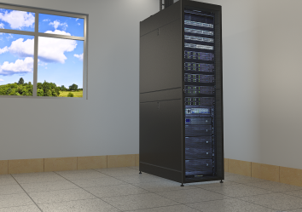
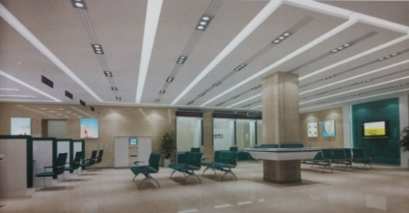
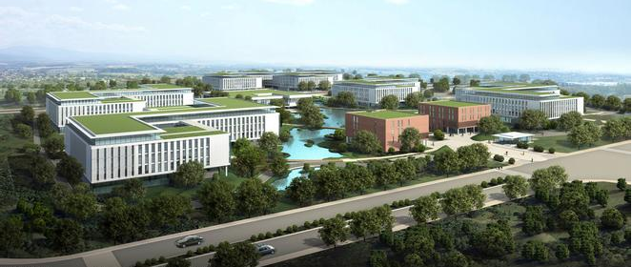
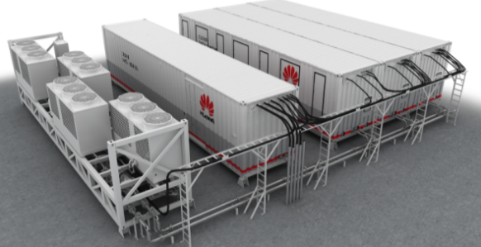
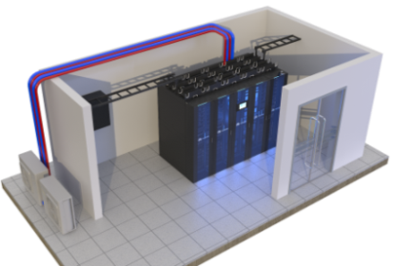
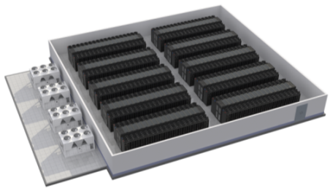
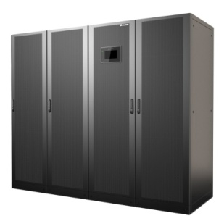
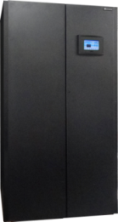
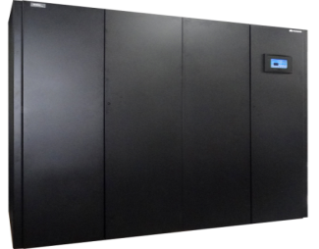
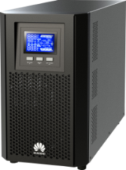
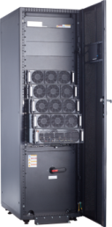



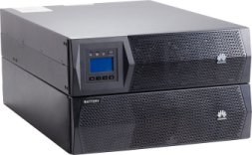

DC Fusion Module Solution
NetEco
Scenario-based data center solution
Mini DC
Small DC
Large or medium DC
Outdoor DC
  FusionModule500
  solution
  FusionModule800
  solution
  FusionModule2000
  solution
  FusionModule1000
  solution
Subsystems
UPS2000-A
(1–10 kVA)
UPS2000-G
(1–20 kVA)
UPS5000
(25–800 kVA)
In-row precision air conditioner
(20–35 kW)
In-room precision air conditioner (50–150 kW)

Slide 21
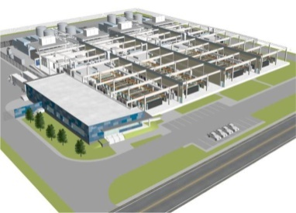
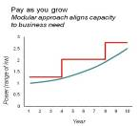
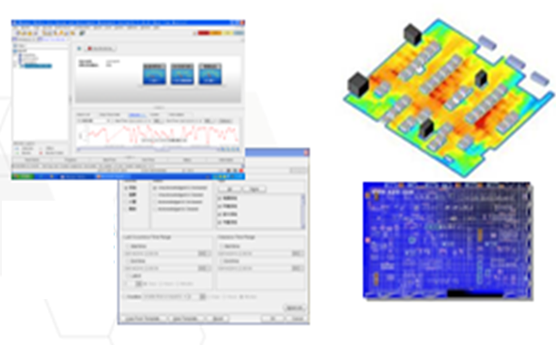

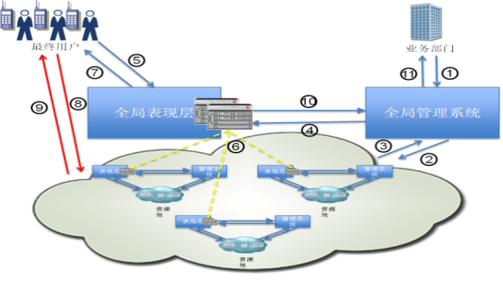
Future DCs
DC
Environment
Environment that ensures the reliable running of information systems
IT infrastructure
IT infrastructure on which information systems depend
Monitoring management
Effective management and O&M of infrastructure
Customer requirements determine the future of DCs.
Copes with unpredictable service and IT growth.
Controls the initial investment and operation cost based on IT requirements.
Modular power supplies and cooling systems enable online system expansion.
Implements the unified management and monitoring of IT devices, site facilities, and IT processes.
Supports energy management and assets management.
Supports various technologies, such as real-time information, simulation, and remote monitoring.
Modular DC
Smart DC
Uses various technologies and measures to effectively reduce the OPEX, especially the Power Usage Effectiveness (PUE) value.
Supports resource sharing, flexible delivery, and dynamic resource management.
Supports the high-density development trend.
Supports standard expansion.
Supports multi-DC O&M.
Green DC
Cloud DC
Notes:
What will DCs in the future look like?
For starters, in terms of enterprise requirements and DC functions, DCs in the future will be no longer of civil engineering concepts. At least the site environment, IT devices, and monitoring management will be included in the DC category. The site environment ensures the reliable and stable running of the information system. The information system operates based on IT equipment. Monitoring management includes the effective management of the site infrastructure and IT infrastructure.
Second, we want to talk about the characteristics of DCs. In the previous slide, we mentioned the modular DC, green DC, and smart DC. Here, we want to add the concept of cloud DC.
Modular DCs meet the requirements of unpredictable service and IT growth and control the CAPEX and OPEX based on the IT requirements at the same time. They use modular power supply and cooling, and do not require service interruptions during system expansion.
Green DCs focus on energy conservation and consumption reduction, that is to say, using multiple technologies and means to effectively lower the OPEX (lowering PUE as the key).
Smart DCs monitor and manage IT devices, site facilities, and IT processes in a centralized manner, manage resources and assets, and implement real-time information, simulation, and remote monitoring technologies.

Slide 22
Notes:
Cloud DCs uses the cloud computing, which features:
Massive computing and storage capacity based on the large-scale infrastructure.
Various virtual technologies to improve the utilization rate of resources.
On-demand access and payment as well as high availability based on the flexible expansion capacity.
Professional O&M support and automation technology.
These basic features require DCs to support resource sharing and dynamic resource management with flexible delivery, high-density development trends, standard extension, and multi-center O&M.

Slide 23
Key Indicators of a Green DC
DC PUE
The ideal PUE ranges from 1.6 to 2.0, or even lower.
The common PUE ranges from 2.0 to 2.5, or even higher.
PUE =
Total power consumption of a DC
Power consumption of IT equipment
Key indicators of a green DC
PUE | DCiE | Level of Efficiency
3.0 | 33% | Very Inefficient
2.5 | 40% | Inefficient
2.0 | 50% | Average
1.5 | 67% | Efficient
1.2 | 83% | Very Efficient
Notes:
The power conversion loss is about 10% when the mainstream UPS and power distribution system are used. The air conditioner cooling energy efficiency ratio (EER) is mostly between 3.5 and 5.5. The ideal PUE is between 1.6 and 2.0 and even lower when the impact of lighting, maintenance, and heat penetration (usually less than 5%) is ignored.
In DC construction, a too low PUE may reduce the return on investment. An effective way to reduce the PUE is to optimize the heat dissipation system design.

Slide 24
DC Infrastructure
In terms of products
Fire detection system
Smoke detection system
Fire extinguishing system
Transient voltage surge suppression equipment
Grounding protection system
Access control
CCTV
Power and ambient environment monitoring
Integration management
Precise air supply cabinet
IT device cabinet
Fire extinguishing system
Lightning protection and grounding
Integration management
Cabinet system
Integrated cabling
Interior fitment
Layout
Door and window
Wall and ceiling
Raised floor
Lighting
Power supply system
Cooling system
Cable rack
Optical fiber distribution frame
Cable and fiber
Identifier
Cable support
Diesel generator & ATS
UPS
DC power cabinet
AC power cabinet
Static transfer switch
Battery and battery rack
Power cable
Precision air conditioning system
Comfortable air conditioning system
Ventilation system
Notes:
We have talked about the function room and classifications of the infrastructure hierarchically. Next, we will talk about its systems and compositions.
As we all know, the DC site infrastructure is an integration of many subsystems. This picture illustrates the L1 infrastructure multi-system in a Huawei DC. It can be seen that we divide the infrastructure into eight systems.
Power supply system: It includes the DG, ATS, UPS. DC cabinet, AC cabinet, static transfer switch, storage battery, battery rack, and power cables.
Cooling system: It includes the precision air conditioner, comfort air conditioner, and ventilation system.
The other six systems include the interior decoration, cabinet, surge protection/grounding, fire-fighting, integrated cabling, and integration management, all of which contain some components. We will skip them here.
We find that the eight systems defined here put much emphasis on products, for example, speaking of the power distribution system, we tend to emphasize the DG, ATS, and UPS under the system. The DC construction is a site engineering project. To meet a certain function or meet a certain requirement of a user, the DC must be considered from the perspective of the system. A single device or the stack of some devices cannot meet the requirements. We must consider the relationship between devices, connections, and devices to ensure that the system design and installation can meet the requirements.

Slide 25
Classification of Infrastructure Systems in a DC
Decoration system
In terms of system
Management system
Electrical system
Air conditioning system
Fire extinguishing system
Light current system
System division by architecture design institutes:
Construction
Structure
Electrical
HVAC
Water Supply and Drainage
Decoration system
Electrical system
Air conditioning system
Fire extinguishing system
Light current system
All systems are connected through the decoration system.
Power supply system
UPS system
Power distribution system
Lightning system
Surge protection and grounding system
Cabinet
Precision air conditioning system
Comfortable air conditioning system
Fresh air system
Smoke exhaust system
Automatic fire alarm system
Automatic fire extinguishing system
Early warning system
Integrated cabling system
Security monitoring system
Environmental monitoring system
Device monitoring system
Management system: monitoring platform, large-screen display, conference system, KVM, and RFID
Notes:
Next, we will talk about the construction of L1 infrastructure in the DC from the perspective of the system.
Generally, building design institutes have several professional domains, including building, structure, electrical, heating, and water supply and drainage. Some design institutes are specially configured with hot energy and economics departments. Due to special characteristics of DCs, a DC is generally divided into decoration system, electrical system, air conditioning system, fire extinguishing system, light current system, and management system. (Some companies or design institutes also incorporate management systems into the light current systems.)
Each system has certain functions.
The electrical system meets the power supply requirements of equipment (including IT equipment, power equipment, and auxiliary equipment). The air conditioning system meets the air conditioning requirements in various environments. The fire extinguishing system meets the fire alarm and fire extinguishing requirements. The light current system meets various requirements, such as data communication, security defense, and environment device monitoring. These systems need to be decorated (including separation and deployment) to achieve effective operation through the management system.

Slide 26
Notes:
It can be seen that the preceding systems jointly comprise the L1 infrastructure of a DC based on proper planning, deployment, and coordination.
Next, let's look at each system.
Decoration system: including the decoration of the ceilings, floors, and walls in various function rooms.
Electrical system: including the power supply system, UPS system, power distribution system, lighting system, lightning protection/grounding system, and cabinet. The cabinet can also placed in the decoration system or in the light current system.
Air conditioning system: including the precision air conditioning system, comfortable air conditioning system, fresh air system, and smoke exhaust system.
Fire extinguishing system: including the automatic fire alarm system, fire extinguishing system, and early warning system.
Light current system: including the integrated cabling system, security monitoring system, environment monitoring system, and device monitoring system.
Management system: including the monitoring platform, large-screen display, conference system, KVM, and RFID.

Slide 27


Logical Zones of a Typical DC
Branch
Cooperator
External user
Remote DR center
Intranet
Extranet (private line network)
DR network
Internet
Unified O&M platform
Intranet access network
Extranet access network
3
Internet access network
DR center access network
Monitoring management
Process management
Change management
Unified portal
1
Core network
Service zone 1
Service zone 2
Others
2
DMZ
……
4
5
Storage zone
Notes:
Two large DCs: active DC in Dongguan and DR center in Nanjing
Vertical layers: external access layer, network core layer, server access layer, and storage layer
Horizontal zones: service zone, production zone, test zone, big data zone, and DMZ

Slide 28












Network Architecture of a Typical DC
External company
Branch
Headquarters
DR center
SDH/VPN
SDH/VPN
SDH/VPN
INTERNET
SDH/WDM
External access layer
3
IPS
Firewall
Firewall
4
Core layer
1
2
Server layer
Unified O&M management zone
Service zone 1
Service zone 2
Others
DMZ
Fibre Channel switch
Storage layer
Tape library
5
IP SAN
FC SAN

Slide 29






Basic Concepts About Cloud DCs
DC
Power supply and ventilation system
Fire extinguishing system
Cooling system
Cabinet, network, and cabling system
Monitoring management
Cooling system
POD 1
POD 2
DC equipment room
DC: A DC implements centralized data processing, storage, transmission, switching, and management in a physical space. Key devices in a DC include servers, network devices, and storage devices, and necessary DC systems include the power supply, cooling, firefighting, and monitoring systems.
Point of Delivery (POD): To facilitate resource pooling in a DC, a DC is divided into one or more physical PODs. PODs are basic deployment units of DCs. One physical device can belong to only one POD.
Availability Zone (AZ): An AZ indicates a fault isolation area. If some hosts share a power supply and network infrastructure but the infrastructure is faulty, the hosts are unavailable. During planning, AZs can be flexibly mapped to DCs based on site requirements. For example, in a large-scale public cloud, one AZ can contain multiple DCs; in one small-scale private cloud, one DC can contain one or multiple AZs.

Slide 30

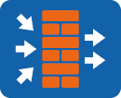



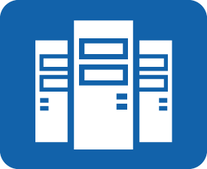

VDC and Tenant
Physical resource
Virtual resource pool
VDC
VDC 1
vFW
vLB
Service/Application/
Department 1
Tenant A
vSwitch
vRouter
VDC 2
Service/Application/
Department 2
VM
VM
VM
Tenant B
VDC 3
Service/Application/
Department 3
Tenant C
Virtual Data Center (VDC): A VDC is a collection of resources available for an organization. Such resources include computing, storage, and network resources.
Tenant: Tenants are created and allocated by system administrators. A tenant owns and manages a VDC. Different VDCs map to different tenants.
A VDC represents a physical DC at the virtualization layer.
In the public cloud scenario, the system administrator can define VDCs and assign the VDCs to tenants. Only the tenant of a VDC can manage resources in the VDC.
In the private cloud scenario, VDC definition is flexible, and VDCs can be assigned to services, applications, or departments. System administrators can use VDCs and resource quotas to manage different services, applications, or departments in an enterprise.

Slide 31
VPC
VDC of tenant A
Logical networking of a VPC
VPC 1
VPC 2
vFW
vLB
vFW
vLB
vRouter
vRouter
vFW
vRouter
vLB
VM
VM
VM
VM
Subnet
Subnet
Internet
VM
VM
VM
VM
VPN
VPN
Department 1 of tenant A
Department 2 of tenant A
Virtual Private Cloud (VPC): VPCs use resources in VDCs. Each VPC belongs to one VDC, and each VDC can have multiple VPCs. Each VPC is a security zone, serving one service, application, or department. VPCs can provide the following functions:
Isolated environment: VPCs provide isolated VM and network environments to meet isolation requirements of different applications and departments.
Diversified services: Each VPC can provide separate services, such as the vFW, vLB, security group, EIP, IPsec VPN, and NAT.
Flexible networking: VPCs provide multiple networking modes, such as direct networks, routed networks, and internal networks.
Notes:
vRouter
vRouter acts as a service subnet gateway for Layer 3 communication between subnets.
Subnet
A subnet is used for isolating Layer 2 broadcast domains and corresponds to one subnet segment.
The Layer 3 gateways of different subnets in one VPC are located on the same vRouter.
Subnets communicate with each other by default and different subnets are interconnected by default. You can also enable isolation through security group.
vFW
As the VPC edge, vFW can control access from extranet to VPC to protect VPC resources, and provide access service from extranet to VPC.
Available features: FW, EIP, SNAT and IPsec VPN.
vLB
vLB is used to provide load balancing between internal servers for external users.
A vLB can carry multiple servers. Users can apply for different servers for different services.

Slide 32

DCN Fabric
Two-tier fat tree
Fabric features
Physical networking
  CE series physical and virtual switches as fabric carrying devices
  No difference between access nodes
  Flat structure
  Flexible networking
  Easy scaling
Virtualization
  VXLAN-based fabric virtualization
  Hardware/Hybrid overlay
Management
  SDN overlay, achieving the automatic deployment of virtual networks
  Underlay network that supports a Layer 2 or Layer 3 network and the IGP routing protocol
  BGP EVPN acting as the control plane of overlay
Services
  Layer 2/Layer 3 mutual communication among access nodes
Spine
DCN fabric
Leaf
Term | Description
Fabric | Basic physical network topology of a DC, comprised of a group of spine and leaf nodes.
Spine | A core node on a VXLAN fabric network, which provides high-speed IP forwarding and connects to leaf nodes using high-speed interfaces.
Leaf | An access node on a VXLAN fabric network, which connects various network devices to the VXLAN network.

Slide 33
DC Development Course
Basic Modules of a DC
Evolution Trends of Cloud DCs
  Transformation Trends
  Huawei Cloud DCs

Slide 34
IT Transformation on the Top of Enterprises' Agenda
Service a
Service b
Service c
Service d
Service e
Service
…
Service x
...
Unit
Unit
Unit
Unit
Unit
Unit
Unit
...
Region 1
Region 2
Region 3
Region x
Non-unified deployments create information islands
Notes:
IT advances expose numerous problems such as information islands in DCs, complicated service management, and low service efficiency, necessitating IT transformation in enterprises.

Slide 35





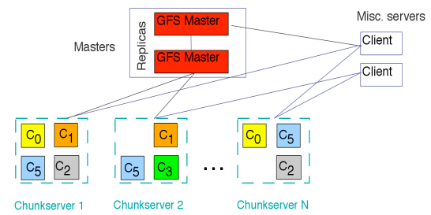
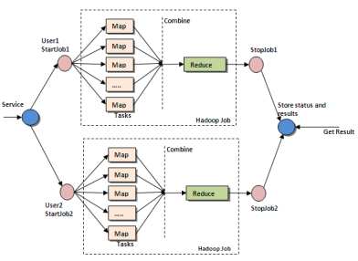
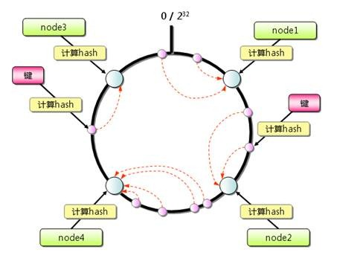
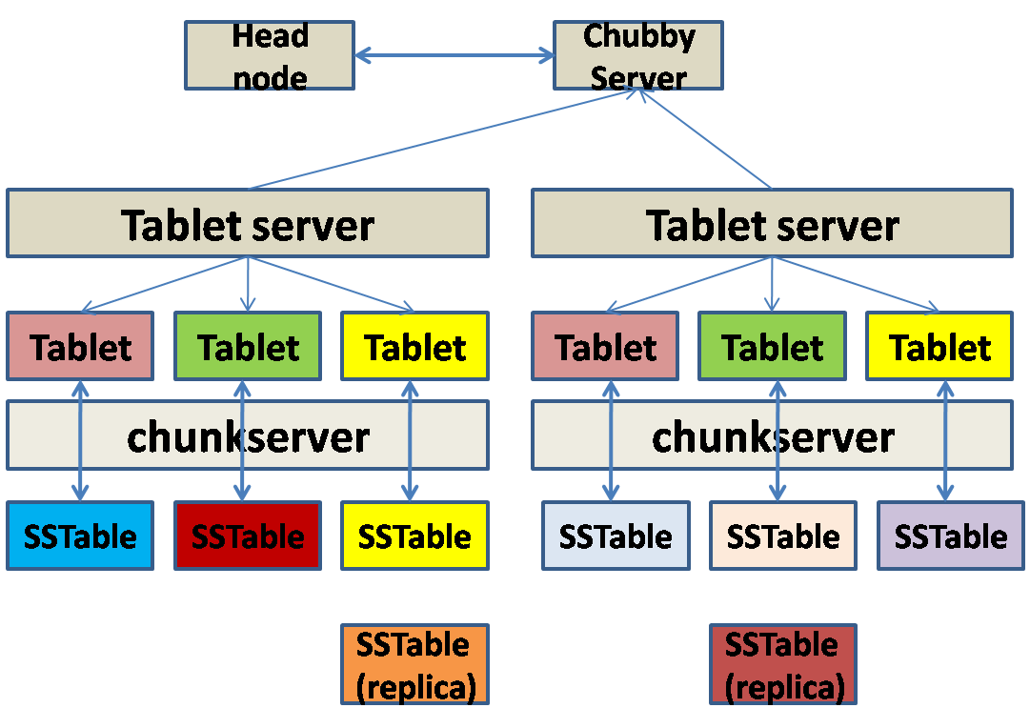
















Technical Requirements of Enterprise IT Transformation
Conventional IT transformation
Native Internet/
Open source architecture
GFS
Map-Reduce
Office
ERM
WebSphere
Oracle RAC
BSS
Exchange
CRM
DB2
WebLogic
OSS
Desktop
SCM
VAS
VS
SharePoint
HANA
Cassandra
Big Table
Cloud OS
…
…
…
Compatible with traditional services
Compatible with existing hardware
Key service running
Self-management and maintenance
Resource pooling
Elastic scaling
Distributed architecture
Centralized management
Notes:
Internet-based modes bring sweeping changes to every line of business. During enterprise IT transformation, the first concern is how to transform traditional IT systems towards cloud and manage the systems. Second, impact of Internet on business modes and technical framework must also be observed.
Google File System (GFS) is a dedicated file system designed by Google to store massive sets of search data.
BigTable is a distributed data storage system designed by Google. It is a non-relational database used to process massive sets of data.
Cassandra is a third-party component and an open-source distributed NoSQL database system. It was initially developed by Facebook and used to store simple data, such as inbox. It combines Google's BigTable data model and Amazon's Dynamo distributed architecture. It was open to the public in 2008. Featuring excellent scalability, Cassandra is widely used by well-known web 2.0 websites, such as Digg and Twitter and becomes a popular distributed structured data storage solution.

Slide 36



Key Step: IT Systems Move to the Cloud
IT development
25%
Offline analysis of massive data sets
Distributed architecture
20%
Analytic application
Increase
Distributed architecture
60%
Access control
35%
Services offloaded to x86 servers that feature high flexibility
Reconstruction
Critical transactional applications
Conventional architecture
80%
Core data processing
Decrease
10%
Conventional architecture
40%
Services carried on mainframe and midrange computers
Non-critical transactional applications
30%
Virtualization
Physical servers replaced by VMs
2015
2020
Source: IDC, Gartner, AWS Workload Estimates
Notes:
Cloud-based IT architecture and Internet-based move drive conventional IT services to the service-driven cloud-based mode. Private cloud is a key step in the current IT transformation.

Slide 37
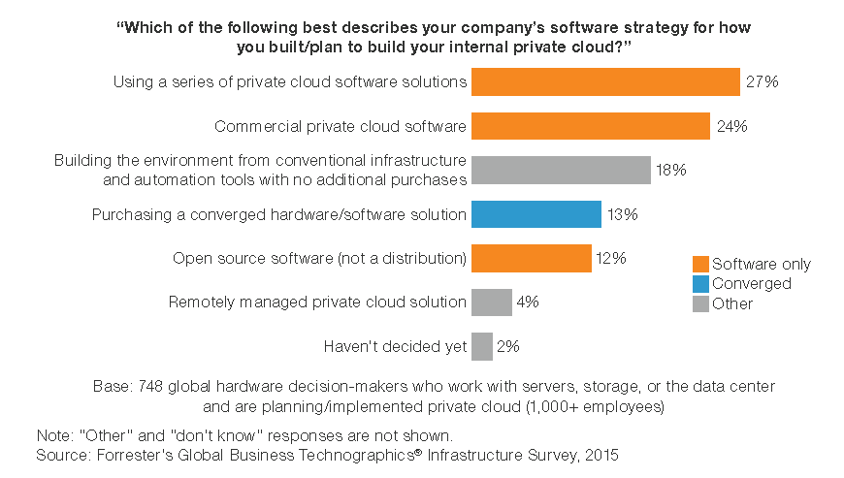




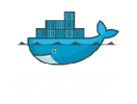

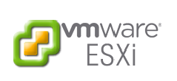


Status Quo and Development Trends of Private Cloud
Network services become mature as IaaS services develop.
Most private clouds support OpenStack.
Developers at different levels require increasingly demanding self-help services.
Private clouds can easily connect to public clouds for unified management.
Suppliers can provide higher levels of services.
Cloud 1.0
Cloud 2.0
Cloud 3.0
Efficiency
Cloud Pilot
Software Defined
Cloud Resource
Container
Cloud Native
Notes:
A cloud-based process can be divided into three phases, namely cloud 1.0 (virtualization-centric), cloud 2.0 (service-centric), and cloud 3.0 (cloud-native architecture).
With private cloud solutions stepping into cloud 2.0, IaaS+, OpenStack, and services are now oriented to developers and hybrid cloud management. Enterprises are going all out to resolve problems that they face during enterprise IT cloud transformation.

Slide 38
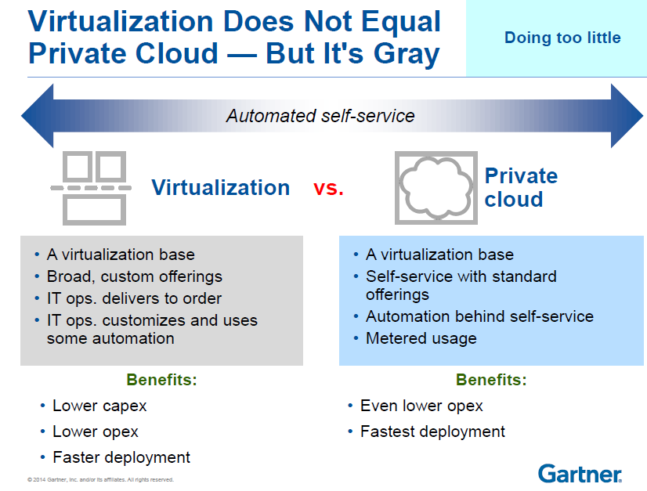
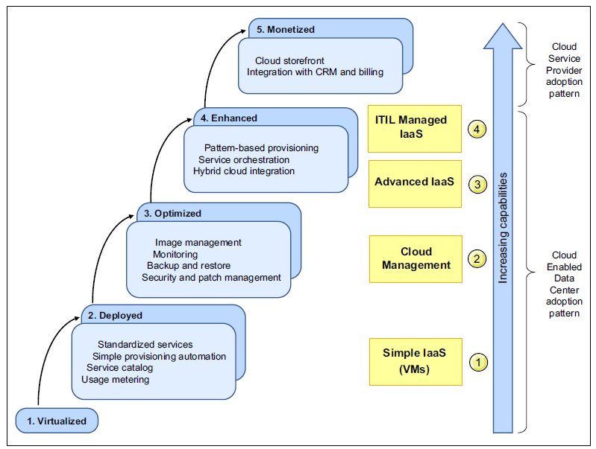
Most Enterprises Are Evolving from Virtualization to Private Cloud
NIST believes that private cloud has five key characteristics: on-demand self-service, ubiquitous network access, location independent resource pooling, rapid elasticity, and pay per use.
Gartner holds that the path from virtualization to private cloud is gray, not absolutes.
Maturity model of IBM's cloud DC
Notes:
Enterprises are evolving from virtualization to private cloud during IT transformation. However, virtualization does not equal private cloud. NIST considers private cloud to have five key characteristics while Gartner and IBM have their own definition.
The whole transformation process is gray, which adds more uncertainties and barriers on enterprises' way to private cloud.

Slide 39





















Problems Faced by Enterprises During IT Transformation
Resources unable to quickly adapt to services
Non-unified management
Virtual chimneys (impossible to share resources)
Large number of internal management and process customization needs
Private cloud deployment = Management software in conventional DCs + Virtualization
Notes:
According to analysis and surveys oriented to global customers, there are four major problems faced by enterprises during IT cloud transformation. The problems are virtual chimneys, resources unable to quickly match service needs, non-unified management, and large number of internal management and customized process needs.

Slide 40


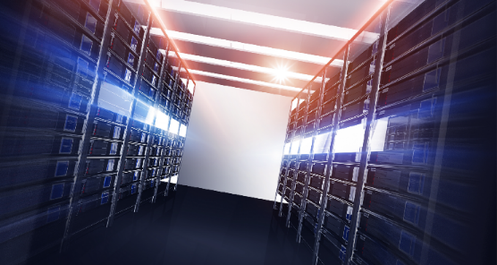
Engines Behind Enterprise IT Transformation
Efficient
Agile
Reliable
Lowered costs and enhanced management efficiency
Flexible resource scheduling and rapid service provisioning
Rock-solid DC reliability
Notes:
Based on Huawei's operations experience and feedback from customers, engines that drive enterprise IT systems to move to the cloud are lowered costs, flexible service provisioning, and rock-solid reliability.

Slide 41
DC Development Course
Basic Modules of a DC
Evolution Trends of Cloud DCs
  Transformation Trends
  Huawei Cloud DCs

Slide 42













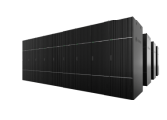

FusionCloud: Future-proof Cloud DC Architecture
IaaS
PaaS
SaaS
DaaS
VDC
VDC
VDC
Resource/Manage/Application
Resource/Manage/Application
Resource/Manage/Application
ManageOne
Computing resource pool
Storage resource pool
Network resource pool
FusionSphere OpenStack
Nova/Ironic
Cinder/Swift
Neutron/SDN
Block storage
Object storage
Physical network
Virtual network
Physical server
VMware
FusionSphere
KVM
Docker
DC 1
DC 3
DC 2
…
DC n
Notes:
Based on customers' requirements, Huawei plans a future-oriented cloud DC architecture (FusionCloud) to provide solutions for cloud services in various service scenarios, including infrastructure, cloud platform, cloud management, and cloud transformation.

Slide 43
Converged Computing Resource Pool Under OpenStack Architecture
Heterogeneous virtual resource pool
Computing resource pool
Storage resource pool
Network resource pool
FusionSphere OpenStack
Physical server
VMware
FusionSphere
KVM
Resource pool
Notes:
Let us look at efficient management first. Resource convergence is the first step to solve the current virtualization chimney. Huawei was elected as a Gold Member Board Director for the OpenStack 2015 Board and built a system framework based on the OpenStack architecture, which solved the problem of unified computing resource management. The system framework supports central monitoring, allocating, and recycling of physical servers, VMware, FusionSphere, and KVM (in the NFVI scenario) resources.

Slide 44













Storage as a Service Based on Heterogeneous Resource Convergence and Application Templates
Big data service
Database service
Storage service
Hybrid cloud service
Object service
Block service
File service
HUAWEI
ManageOne
Converged storage resource pool
Active-active/DR
Application acceleration
Heterogeneous resource management
Data migration
Data protection
Third Party
Third-party storage
OceanStor 18000 high-end storage
OceanStor V3 converged storage
OceanStor Dorado all-flash storage
FusionStorage distributed storage
Notes:
Then, I will talk about the convergence of storage resources. Storage devices of different types and from different vendors are integrated, and serviceability requirements on different storage performance indicators are met, realizing storage SLA.

Slide 45


SDN Automatically and Flexibly Deploys Services Across DCs
OpenStack cascading
SDN
Neutron
Virtual network
Agile Controller
VM
VM
vFW
vSwitch
vSwitch
Core SW
Physical network
VM
TOR
WAN
vFW
vSwitch
TOR
TOR
FW
Hybrid network
Server
Core SW
Server
DC B
DC A
300K
Virtual Private Cloud (VPC)
Virtual network + Physical network
Notes:
Network resources are streamlined with Layer-2 resources through automation, implementing automatic network configuration and cross-domain business deployment. The solutions cover physical networks, virtual networks, and WANs.

Slide 46


Unified Service Access Platform
ECS
EIP
MRS
VBS
EVS
RDS
VPC
Virtual firewall
ELB
BMS
ManageOne
KVM
KVM
KVM
KVM
KVM
Rapid cloud service access and orchestration enable services to be automatically deployed across DCs within minutes.
Notes:
The unified cloud service access platform enables cloud services to be quickly accessed and flexibly orchestrated. Distributed cloud DC management allows services to be automatically deployed across DCs within minutes.

Slide 47
VDCs Based on Organizations and Services
VDC
VDC
VDC
Applications
Applications
Applications
FusionSphere OpenStack
Physical server
VMware
FusionSphere
KVM
Notes:
VDC can allocate resources across resource pools and match customer organizations, to realize rights- and domain-based cloud resource management. VDC has the self-operation capability that the business department allocates cloud resources and centralizes services while the IT department maintains the cloud platform. In this mode, usage and construction is separated so that services can drive resources in a better way.

Slide 48
SLA Policy-based Scheduling Meets Diversified Service Needs
VDC 1
VDC 2
VDC n
Application layer
Financial analysis
…
ERP system
Web application
Computing service
Storage service
Cyber security service
Service layer
Specifications/SLA
Specifications/SLA
Specifications/SLA
Specifications/SLA
Specifications/SLA
Specifications/SLA
SLA: Computing/I/Os
SLA: Computing/
Memory
SLA: Computing/
Memory
SLA: Computing/
Network
SLA: I/Os
SLA: I/Os
SLA: Reliability
OLAP physical server resource pool
OLTP physical server resource pool
General-purpose physical server resource pool
Flexible VM resource pool
Elastic block storage resource pool
File storage resource pool
Object storage resource pool
Resource pool
SDN network resource pool
Converged architecture
FusionCube
High performance
5585 + 18000
General standards
E9000 + FusionStorage
Massive storage
Device layer
Network device
Notes:
Different services have varying requirements on resource performance and functions. With services detected, the system can allocate resources to dedicated services as required by different applications in a strategic way by categorizing the SLA levels of these resources.

Slide 49
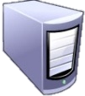

Service-Driven Auto Scaling and Service Scheduling
Time-based policy
Performance-based policy
Time-based scaling
VDC x
App
App
App
OS
OS
OS
Non-real time services: HPC and 3D rendering
App
App
App
App
App
Top-priority services: development and testing services
OS
OS
OS
OS
OS
Hypervisor
Hypervisor
Hypervisor
UVP Server
UVP Server
UVP Server
Resource pool
Resource pool
Daytime
Night
Time- and performance-based policy
  Cross-domain auto scaling reduces redundant capacity in the local DC by 20%.
  Time- and performance-based policies intelligently and automatically schedule resources, meeting service needs during peak hours.
  Efficient resource utilization and energy saving.
DAY
App
VDC x
App
OS
App
App
App
App
OS
OS
App
App
OS
OS
OS
OS
OS
Hypervisor
Hypervisor
Hypervisor
UVP Server
UVP Server
UVP Server
NIGHT
Notes:
During service operation, the system can also dynamically respond to the resource performance and quantity requirements, and can initiate appropriate strategies to realize elastic expansion or scheduling of resources when FusionCloud detecting a specific service requirement.

Slide 50






Unified Hybrid Cloud Management
Unified:
  Lightweight hybrid cloud management
  Centralized service catalog
IaaS
PaaS
SaaS
DaaS
DRaaS
Hybrid cloud
Open:
  Support for OpenStack cascading
  Support for AWS S3 and EC2
FusionSphere OpenStack
Cascading
Cascading
  Flexible:
  Cross-cloud auto scaling based on service workloads
  Cross-cloud VM migration
Bare metal
VM
Container
HWS
Public cloud
Private cloud
Notes:
Unified hybrid cloud management expands the scope of resource scalability and establishes viability solutions for surge in enterprise services and service disaster recovery, ensuring seamless enterprise service expansion.

Slide 51
Cloud DR Solution
Cloud DR
Applications
Applications
Applications
Physical
VMware
FusionSphere
KVM
Docker
DR
Applications
Applications
Applications
Applications
Applications
Applications
Remote DR site or public cloud (HUAWEI CLOUD)
Physical
VMware
FusionSphere
KVM
Docker
Physical
VMware
FusionSphere
KVM
Docker
HyperMetro
  Gateway-free active-active design improves active-active service performance by 30%.
  Visualized and one-click DR reduces service recovery time from 30 minutes to 10 minutes.
  Deduplication backup and public cloud backup.

Slide 52
What are the modularizations of data centers?
What is the relationship between the VDC and the VPC in cloud data center ?
Notes:
What are the modularizations of data centers?
A DC is a service-oriented infrastructure. It supports the operation and growth of enterprise businesses. It consists of the following: Secure network architecture, reliable support facilities (equipment rooms, generators, UPSs, and air conditioning systems), integrated servers/application platforms, centralized storage and backup, unified system management platforms, and O&M management organizations and processes oriented to customer services.
What is the relationship between the VDC and the VPC in cloud data center ?
Virtual Data Center (VDC): A VDC is a collection of resources available for an organization. Such resources include computing, storage, and network resources.
Virtual Private Cloud (VPC): VPCs use resources in VDCs. Each VPC belongs to one VDC, and each VDC can have multiple VPCs. Each VPC is a security zone, serving one service, application, or department.

Slide 53
DC development course
Basic modules of a DC
Network structure
Evolution trends of cloud DCs

Slide 54
Huawei Learning Website
  http://support.huawei.com/learning/Index!toTrainIndex
Huawei Support Case Library
  http://support.huawei.com/enterprise/servicecenter?lang=zh

Slide 55
Cloud DC solution
  http://e.huawei.com/cn/solutions/business-needs/data-center

