Slide 1

Network Virtualization: SDN Overlay Solutions
Student: Ivan Kalashnikov
Email: 244548@niuitmo.ru

Slide 2
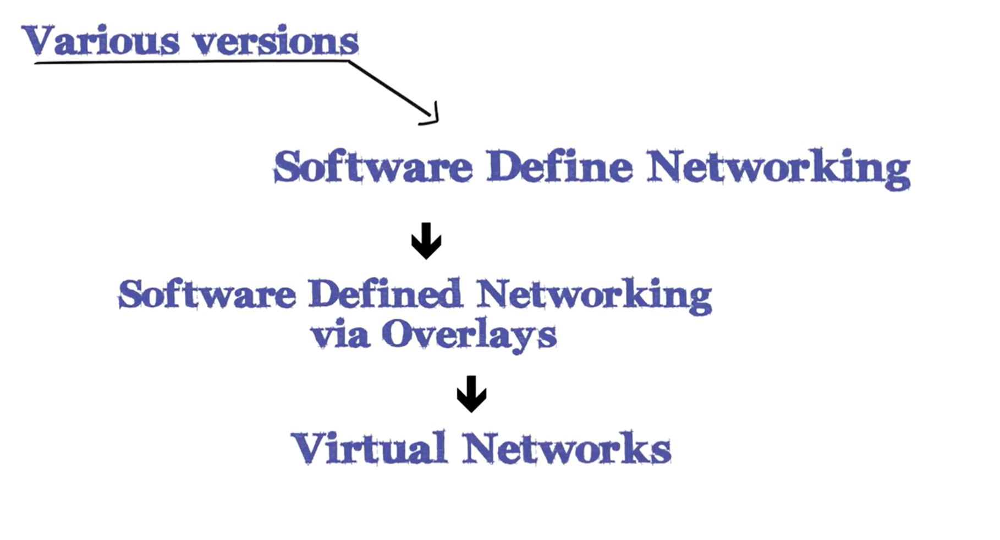

Slide 3

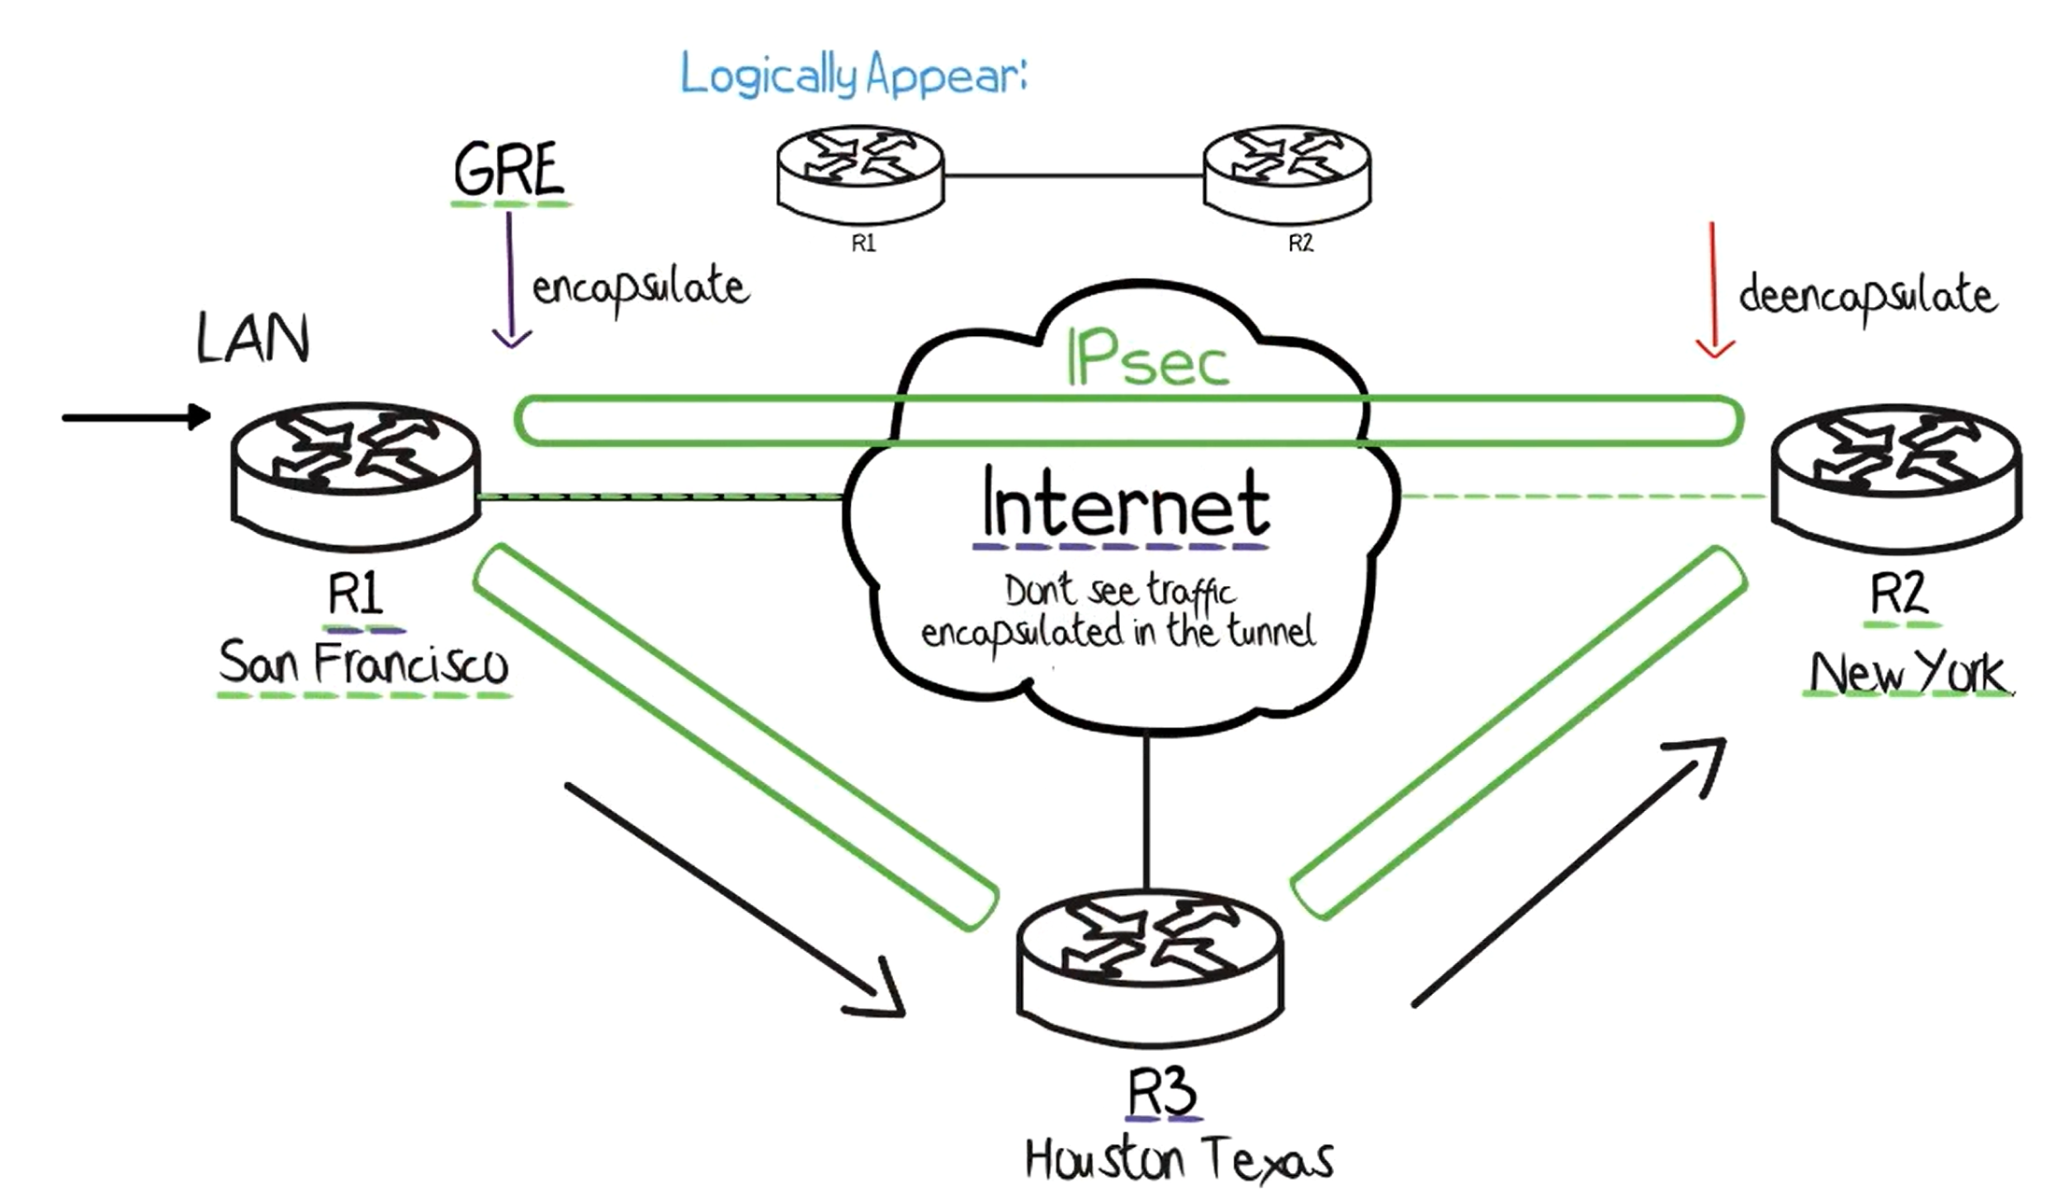
SDN Fundamentals
Notes:
The digitalization of business is taking place all over the world. This allows you to speed up production. Provides transparent reporting for investors, ease of use for employees, increases competitiveness in the market. For example, a pizzeria that will have a business process management system, on the one hand - the convenience of ordering from the client, transparency of work, reporting to investors. It’s easey to count how many pizzas you sold past month, or past year. May be you can analyze dependencies of orders and changes in application.
The relevance of the security of information systems does not require much argumentation. Take our situation as an example. We are sitting remotely from each other and talking over the Internet. We can do this with the zoom app. Do you care about the protection of your data? Do you know where the broadcast is stored, is anyone else listening to us? The answers to these questions are critical for organizations such as the police, medical institutions, the military industry, state secrets.

Slide 4
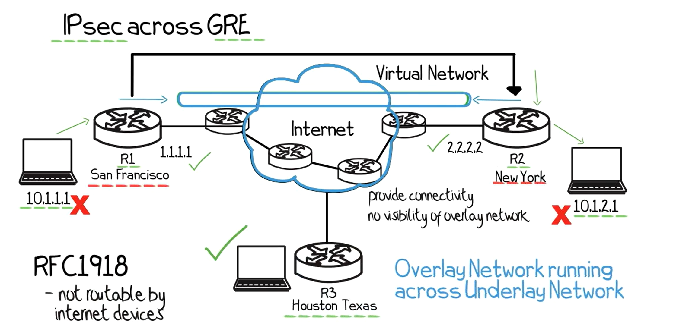

Slide 5
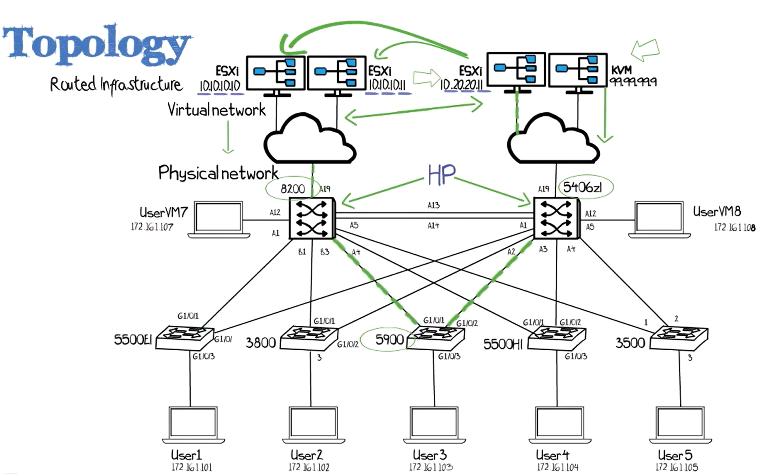

Slide 6
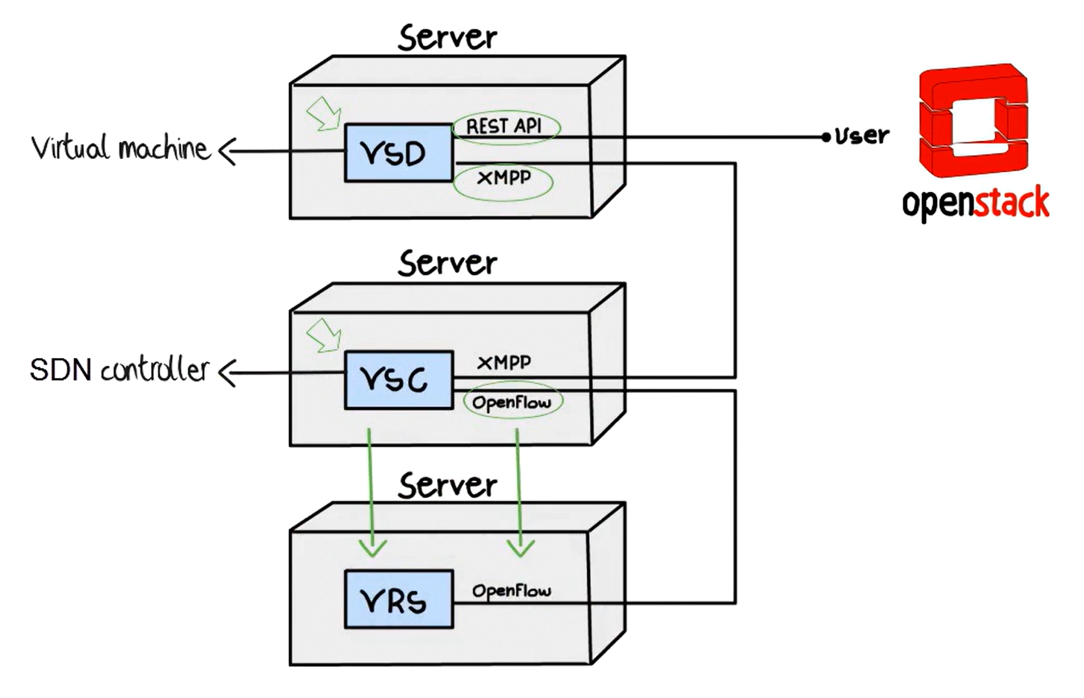
Notes:
Before looking for existing solutions, I highlighted the criteria that companies pay attention to when choosing secure software.
I reviewed the requirements for a military prodaction.
Requirements:
Works without installation, using only an executable file;
Portable database with the ability to use on removable media;
Offline work without connecting to the Internet;
Serverless architecture;
Legal Compliance; meets the requirements of regulators and regulations;
Dynamic configuration of order form fields - should be easy to use

Slide 7
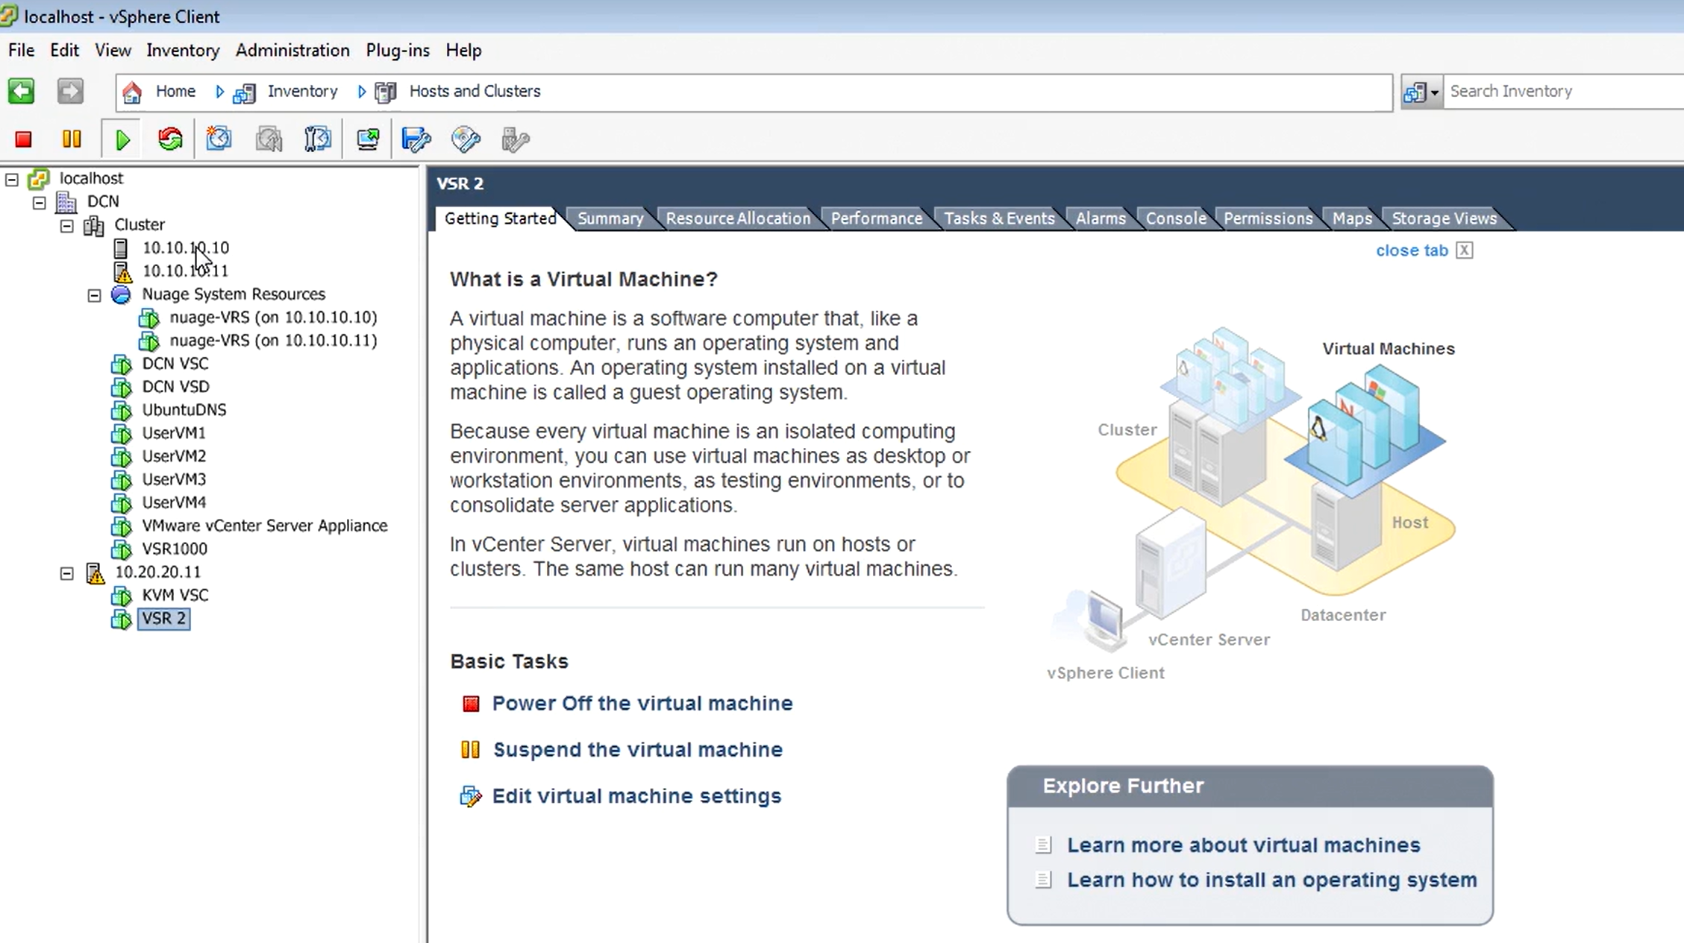

Slide 8
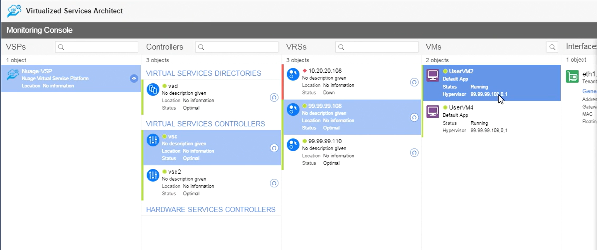
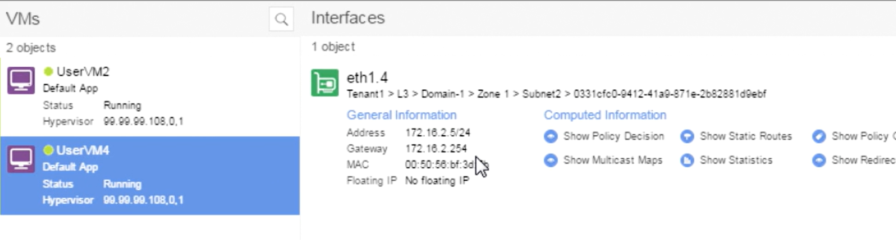

Slide 9
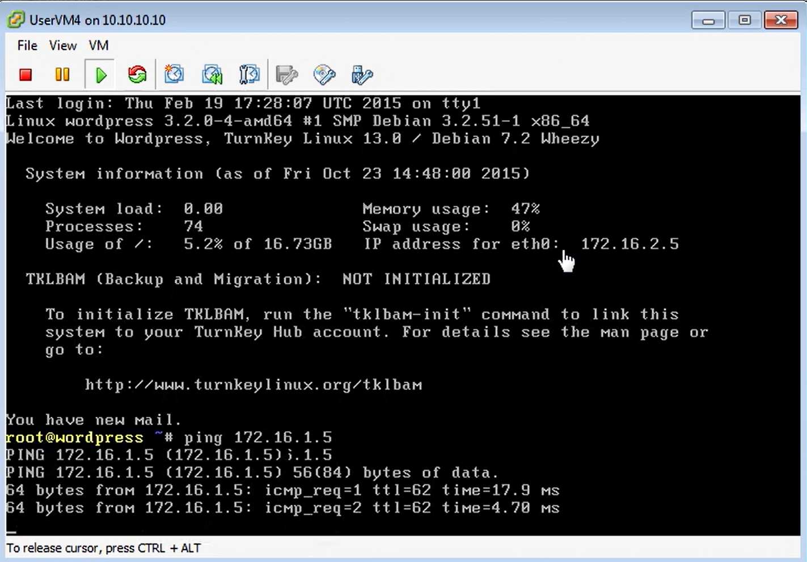

Slide 10
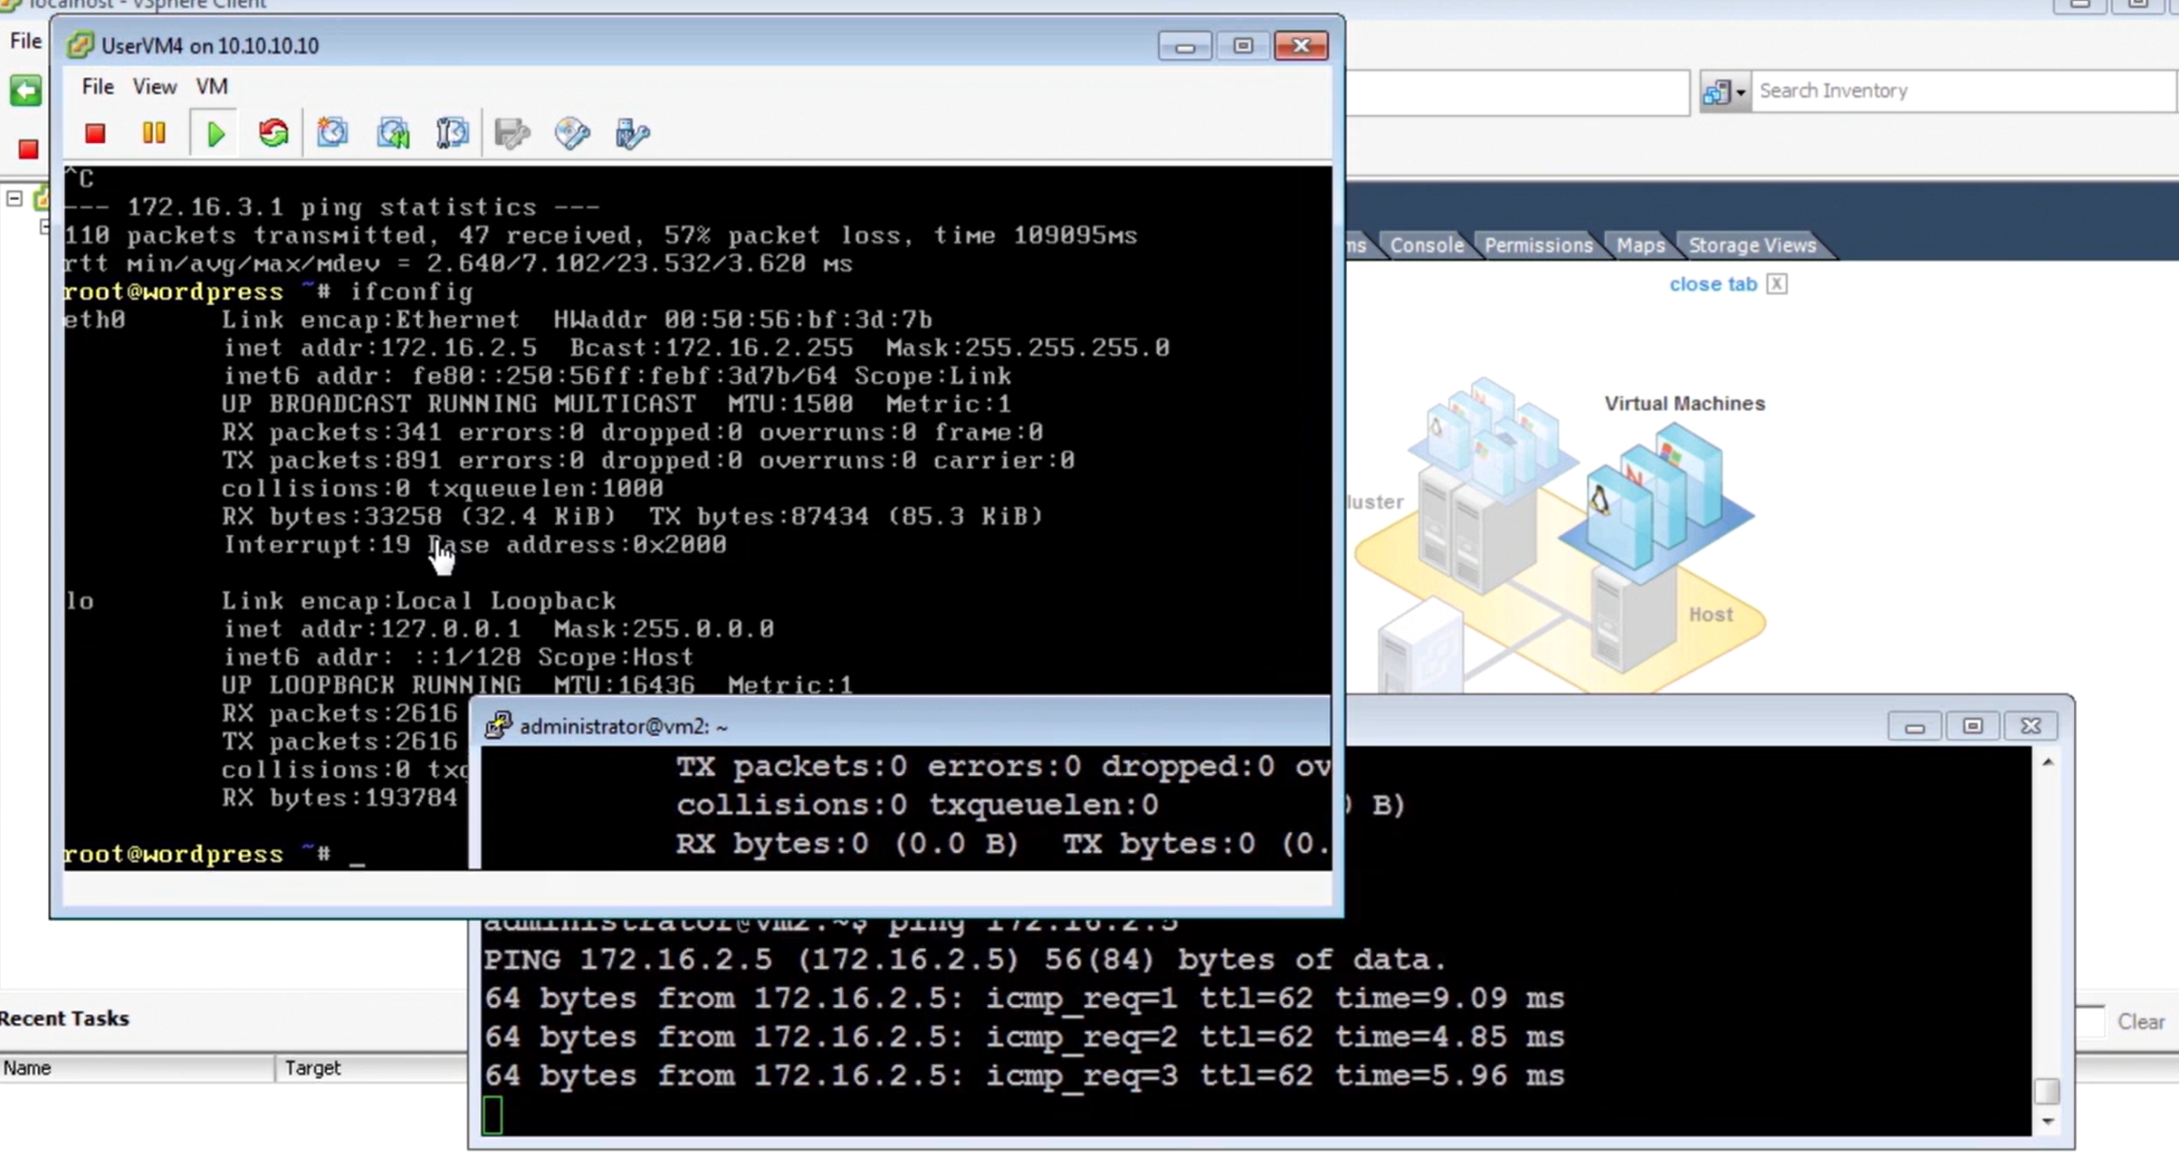

Slide 11
