Slide 1
Course Code
Product
Zhou Shengli/zwx201803
2017.8.28
Liu Lican/00493763
New
Zhang Yue/zwx635169
2019.3.20
Liu Lican/00493763
Update
Author/ID
Author/ID
Update
Author/ID
Author/ID
Update
Author/ID
Author/ID
Update

Slide 2
Huawei ManageOne Solution

Slide 3
This course describes ManageOne in terms of its application scenarios, architecture, and features. After learning this course, you will have a general knowledge of ManageOne.

Slide 4
After learning this course, you will be able to:
  Understand the ManageOne solution architecture.
  Understand the ManageOne system networking.
  Describe the typical ManageOne features.

Slide 5
Trends and Challenges of Cloud Data Center Management
ManageOne Cloud Management Solution
ManageOne Cloud Management Platform Features

Slide 6
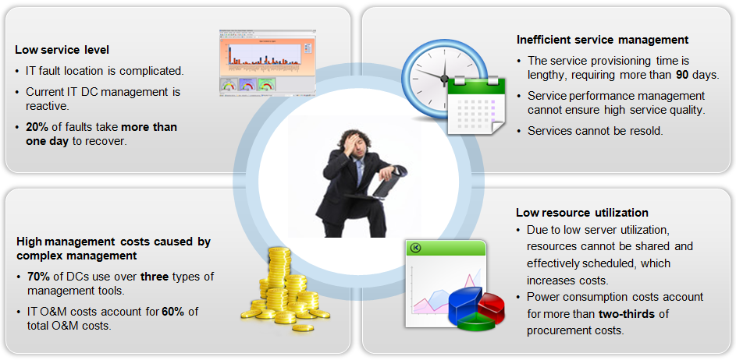
Challenges to DC Management
Notes:
Poor service quality:
IT problems are difficult to be located. For more than 20% IT problems, over one day is required for locating each problem.
Traditional DCs have no unified and open management platform. As a result, resources cannot be centrally allocated to support diversified applications.
Inefficient service management
Services for traditional DCs are deployed from the bottom layer, which requires a long hardware installation phase, complex basic configuration, and more than 30 days for service rollout. This situation cannot meet requirements of rapid service development.
Complex management and high management costs
Traditional DCs have various standards and planning methods. As a result, hardware resources cannot be centrally managed or shared.
Network systems become increasingly complex. Therefore, a large number of professional O&M personnel are required to meet customer requirements.
System maintenance consumes a lot of resources. According to statistics, more than 70% of IT budgets are used for system maintenance, leaving insufficient investment for deploying new IT systems.
Low resource utilization
Resource usage in traditional DCs is generally less than 20%, which indicates that a large number of resources are wasted. Meanwhile, servers in the idle state are consuming power and increasing customers' cost.

Slide 7



Evolution and Demands of Enterprise IT Cloud Migration
2. Converged Resource Pool
4. Agile Service Innovation
PaaS-based enterprise IT architecture optimization
DevOps-based rapid service innovation
Development and testing cloud construction
Throughput growth and tides of Internet services
Rapid rollout of new services
Multiple virtualization service silos integrated into a pool
Unified management
Sharing
DB
Message bus
...
Unified resource management
PaaS
Traditional IT
Physical machine-based deployment, low device utilization, and low energy efficiency
Unified management
Traditional silo
Service Innovation
Data Monetization
Cost Reduction
5. Data Integration and Intelligent Analysis
3. Automation
IT transformation from resource management to service-oriented operation
Responsibility division between the IT platform department and IT use department
IT management efficiency improvement with automation technologies
Business Data Analysis
Massive service data accumulation
Data mining–based new value-added service application development
1. Virtualization
VDC
VDC
Service system virtualization deployment
Improved device utilization
Simplified O&M
Automatic orchestration
+Service-oriented unified management
PaaS
VM
VM
VM
Unified management
IaaS
Resource pool
PaaS
Resource pool
As a unified platform for customers to use, manage, and operate their cloud resource pools, ManageOne needs to consider the coexistence of existing and new IT infrastructure and different operation modes during enterprise IT cloud migration.

Slide 8
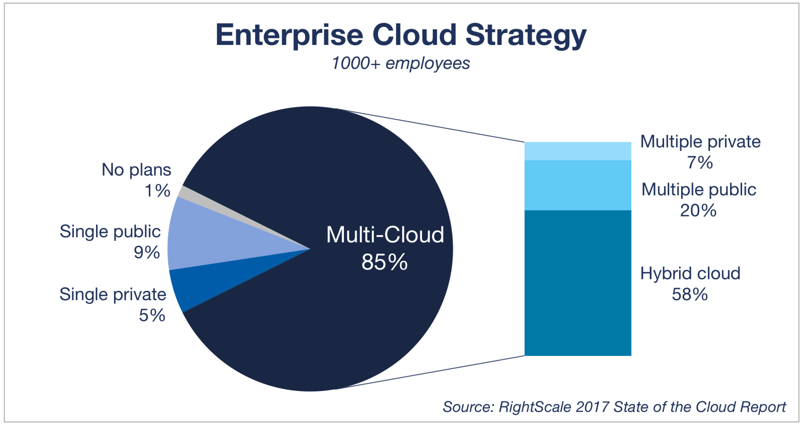
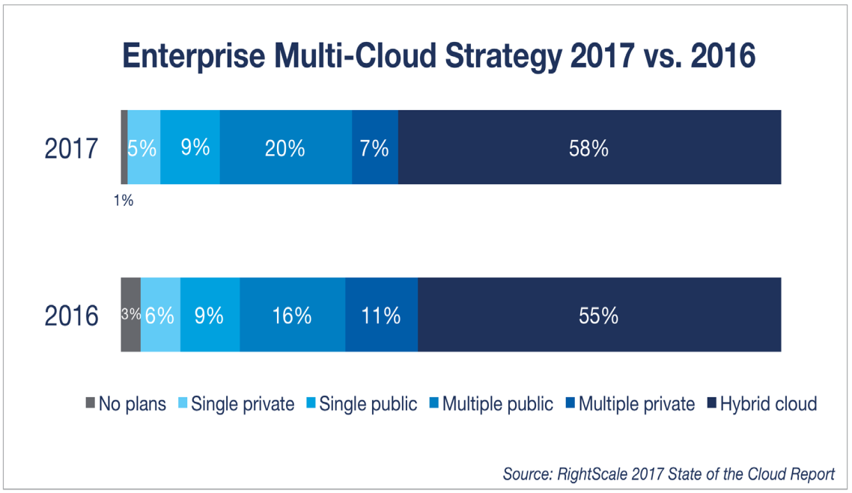
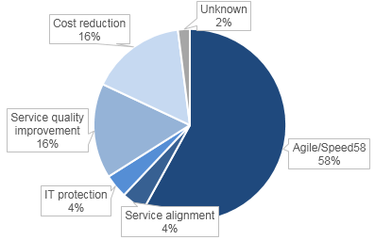
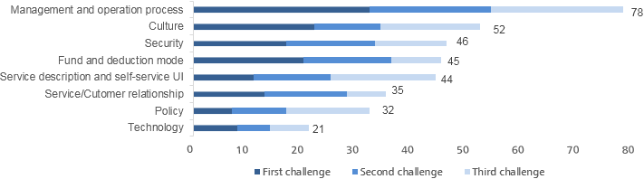
Trends of Cloud Data Center Management
Trend 1: Enterprise multi-cloud management.
Multi-cloud management, especially the hybrid cloud, becomes a new growth point.
Trend 2: The private cloud has entered the implementation phase, which focuses on O&M.
Key factors of private cloud implementation are cloud management and organization adaptation, especially operation and O&M management.
Challenges to private cloud
Driving force of private cloud

Slide 9



Cloud Management Concepts of Huawei
Fine-grained Operations
Centralized Management
Intelligent O&M
Diverse Cloud Services
Multi-Level VDCs
Metering & Charging
Application Orchestration
Unified Monitoring
Intelligent Fault Locating
Visualized O&M
Automated O&M
One Cloud Multi-Pool
Unified Configuration Operation Center
Hybrid Cloud
Unified Multi-Cloud Monitoring

Slide 10
Trends and Challenges of Cloud Data Center Management
ManageOne Cloud Management Solution
ManageOne Cloud Management Platform Features

Slide 11
ManageOne Functional Architecture
ManageOne
Operation
O&M
ManageOne
NBI
Gateway
Management Services
Built-in IaaS-E Cloud Services
Tenant Operation Management
Basic Monitoring
Service Assurance
System Management
VDC
VDC self O&M
ECS
EVS
Product catalog
Console
home
Unified report
Big screen
Dashboard
Tenant monitoring
User management
Console
home
vAPP
AutoOps
BMS
VPC
Cloud service
management
Product
management
Alarm monitoring
Application monitoring APM
Tenant assurance
(Performance optimization)
Customer
operation log
System
run log
Tag
Recycle bin
EIP
EIB
Resource management
tenant
IAM
Cloud service monitoring
(Alarm/Monitoring)
Major
service assurance
System monitoring
System configuration
Process approval
Offline service
customization
VFW
SG
Tenant-customized
role
Tenant
operation log
Device monitoring
(Resource list/Entry/Grouping)
(Alarm/Monitoring/
Topology/Report)
Service SLA analysis
(Service assurance)
SSO
License
Order
Metering
Charging
Alarm cause
analysis
Service impact
analysis
Data
backup/
restoration
Separation of roles
Infrastructure layer
cloud infrastructure
IaaS
Cloud service OM
OpenStack
DR and backup service
Virtual and physical infrastructure
Unified device O&M

Slide 12

Typical Networking Schemes of ManageOne
Upgrade, scaling, and backup and restoration
Service operation (such as service orchestration and service provisioning)
Service O&M (such as alarm management and performance management)
Global
System/Service administrator
OM zone
ManageOne O&M components
ManageOne service components
OM 01
OM 02
Service01
Service02
Service03
Service04
DB 01
DB 02
IAM (tenant authentication) components
LogCenter components
LogCenter 01
LogCenter 02
IAM 01
IAM 02
Networking description:
ManageOne is deployed in the Global OM zone. A total of 12 VMs are required, including two O&M components, six ManageOne service components, two IAM components, and two LogCenter components.
Management scale levels:
Micro-scale: VMs ≤ 200; small-scale: 200 < VMs ≤ 1000; medium-scale: 1001 < VMs ≤ 2000; large-scale: 2001 < VMs ≤ 5000; super large-scale: 5001 < VMs ≤ 10,000
IAM management specifications: 1000 tenants, 20 concurrencies, and concurrency calling interval of 1 minute
LogCenter specifications: 10 logs per second per node per service

Slide 13
ManageOne Deployment Modes
Local cluster deployment
Cross-AZ HA deployment
Remote DR
Server 1
Server 2
Server 3
Region
Region 01
Region 02
Service A instance 01
Service A instance 02
AZ01
AZ02
ManageOne01
ManageOne02
Service B instance 01
Service B instance 02
Service A instance 01
Service A instance 02
DB01
DB02
Zookeeper 01
Zookeeper 02
Zookeeper 03
Zookeeper01
Zookeeper02
DB 01
DB 02
Third-place quorum site
Data backup
Data restoration upon faults
Zookeeper03
SFTP Server
In cross-AZ HA deployment mode, AZ faults do not affect service running.
Power outages in equipment rooms
Fire in equipment rooms
Network faults in equipment rooms in AZ 01
Scenarios
In the local cluster deployment mode, a single point of failure (SPOF) does not affect service running.
Server SPOF
Software process SPOF
VM OS fault
In a remote DR scenario, if a region fault occurs, services are not interrupted.
Natural disaster in a region
Scenarios
Scenarios
Reliability indicators:
Service switchover duration ≈ 0
Database switchover duration < 2 minutes
Reliability indicators:
IAM supports automatic switchover. The switchover duration is less than 3 minutes.
Other services are manually switched over. The switchover duration is less than 10 minutes.
Reliability indicators:
IAM/Operation service RPO < 60 minutes; O&M service RPO < 1 day
IAM/Operation service RTO < 30 minutes; O&M service RTO < 90 minutes
Availability: 99.9%
Notes:
ManageOne instances can be deployed in three modes: local cluster deployment, cross-AZ HA deployment, and remote DR.

Slide 14
Trends and Challenges of Cloud Data Center Management
ManageOne Cloud Management Solution
ManageOne Cloud Management Platform Features
  Fine-grained Operations
  Intelligent O&M
  Centralized Management

Slide 15
Fine-grained Operations
Diverse Cloud Services
  A complete catalog of cloud services (IaaS, PaaS, and SaaS)
  Consistent operation experience for self-developed and third-party cloud services
Multi-Level VDCs
  Up to five levels of VDCs, well suited to complex enterprises
  Multi-level approval process
  Fine-grained authorization, precise control of user rights
Application and Automation
  Graphical template orchestration
  One-click application deployment
Fine-grained Operations

Slide 16
Fine-grained Operations
Diverse Cloud Services
1
Multi-Level VDCs
2
Application and Automation
3

Slide 17
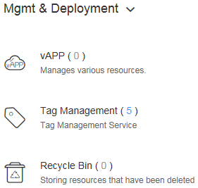
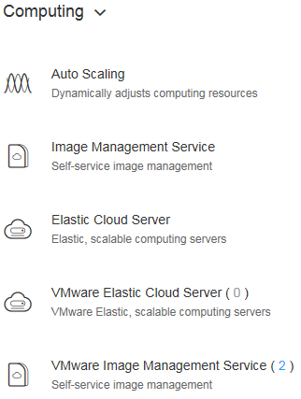
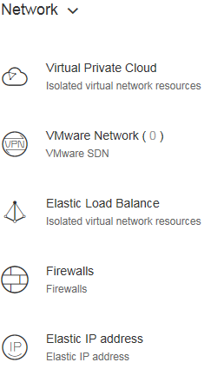
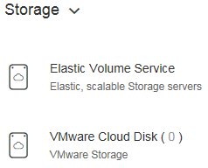
Various Cloud Services
Customer Scenarios (Why)
  Various cloud services are provided to meet the configuration, application, and usage requirements of all service-oriented instances.
Customer Benefits (How)
  All computing, network, and storage cloud computing features and resources are provided in the form of services.
  Resource application, use, and recycling are convenient.
  Monitoring, auditing, and service orchestration (vAPP) services are provided.
  Heterogeneous VMware virtualization service provisioning is supported.

Slide 18
Various Cloud Services — Unified Operation
ManageOne
Operation
Management
Tenant
Management
Product catalog
Subscription
Metering
Process approval
Resource pool
access management
User management
Unified tenant
IAM
Product management
Order
Charging
Resource modification
(recycle bin)
Cloud service
consoles
Role/Permission
management
Tenant operation
log
Unified Product Catalog
Unified Order Management
Unified User/Role Management
Unified Quota Management
Unified Metering and Charging
Products of all kinds of cloud services accessing ManageOne are displayed in the product catalog of ManageOne.
Default products of each kind of cloud services are displayed in the product catalog.
Products created by operation administrators can be viewed and used by all end users.
Products created by a VDC administrator can be published to the current-level or lower-level VDCs. Products brought online by a VDC administrator can be viewed by all users in the VDC to which the VDC administrator belongs.
Orders are generated when resources of accessed cloud services are added, deleted, or modified.
An order contains information such as the operator, operation time, operation type, and operation details.
After an order is successfully implemented, the order includes the list of associated resources. If an order fails to be implemented, the failure cause will be displayed. The whole approval process is displayed during order approval.
A VDC administrator can view all order records in the VDC.
ManageOne supports unified user management. New users can perform operations on all resource pools (including public cloud infrastructure). Logins and password management operations are performed by users only on ManageOne.
ManageOne allows users to customize roles. Permissions of customized roles can be flexibly defined. Users with customized roles can be used on different cloud services.
ManageOne supports unified session management. Accessed cloud services do not require session control.
All cloud service quotas are managed in VDCs, and can be set for regions and AZs.
When a cloud service is created, modified, or deleted, the quota of the cloud service is deducted in real time. If the quota is insufficient, the operation cannot be performed. Resource usage of departments is managed in real time.
If the VDC quota reaches a specified threshold, an alarm is reported.
Metering data of all cloud services can be summarized and displayed by VDC.
Metering data of cloud services can be summarized by region, AZ, and cloud service type, and metering details can be exported.
Charge rates can be set for different services. Charge rates can be set based on cloud service flavors, and then cloud services can be charged based on the charge rates.
The third-party billing system can use ManageOne to obtain original SDR information of each cloud service.

Slide 19
Fine-grained Operations
Various Cloud Services
1
Multi-Level VDCs
2
Application and Automation
3

Slide 20
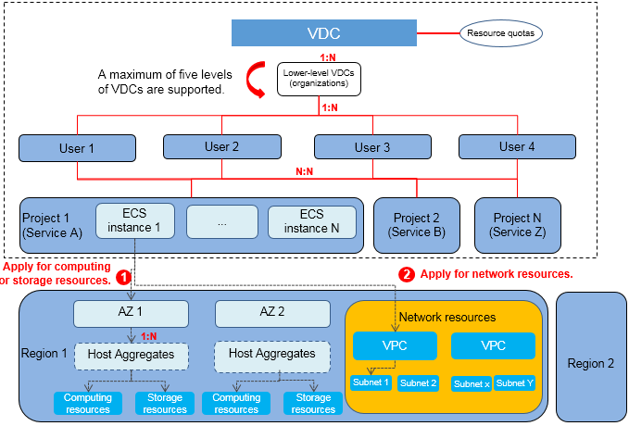
Multi-Level VDCs
VDC (Virtual Data Center)
  A virtual data center (VDC) is a resource allocation unit that matches the structure between an enterprise and its organizations. In VDCs, user management, quota management, project management, product definition, resource provisioning, and service assurance are supported. Multi-level VDCs can be created to meet the requirements for multi-level operation scenarios. For example, a group includes multiple subsidiaries, and each subsidiary includes multiple lower-level departments. In the e-Government Cloud scenario, there are multiple government offices.

Slide 21
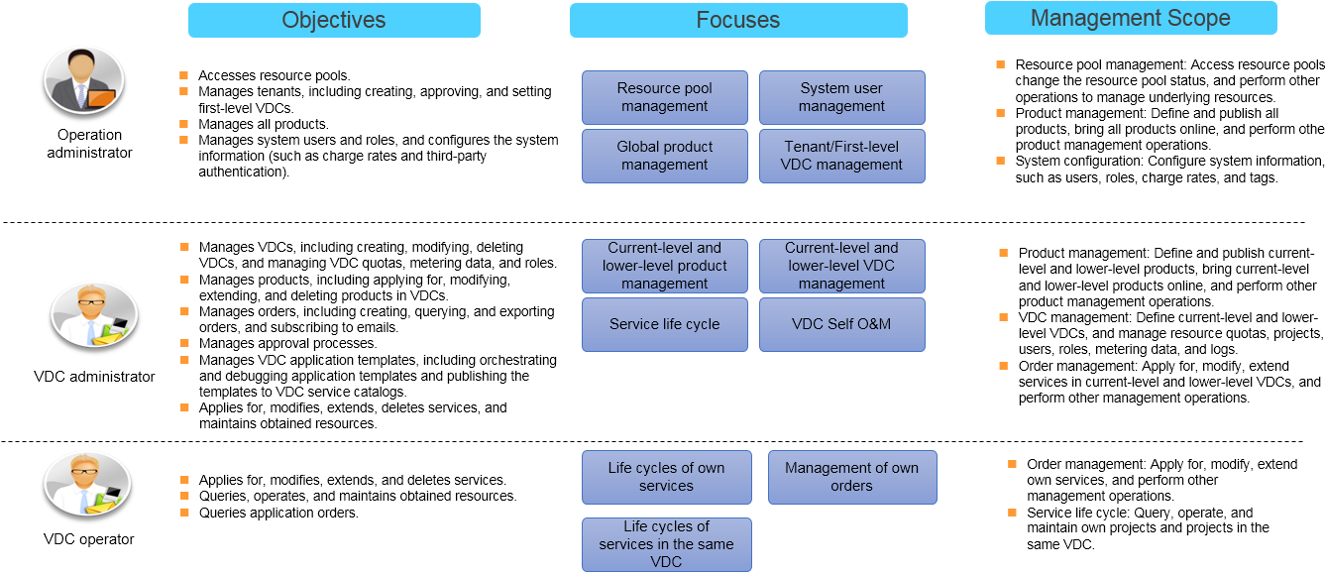
Multi-Level VDCs - Roles and Scenarios in the Operation Field

Slide 22
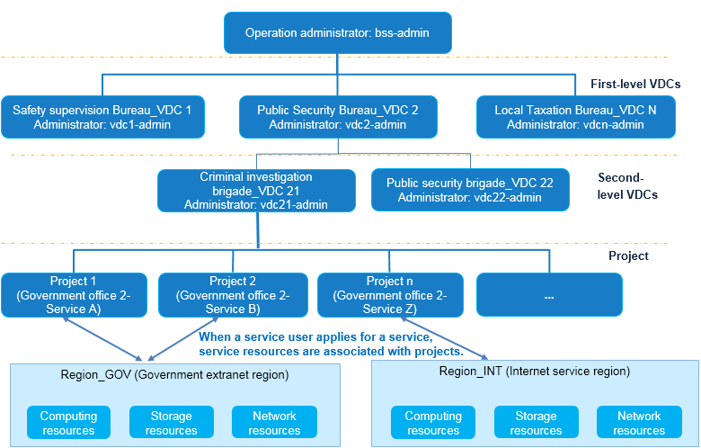
Multi-Level VDCs - Operation Organization Division
  VDC planning:
The government offices want to delegate the operation administrator to manage operation. The operation administrator allocates a tenant (create a first-level VDC by default) for each government office.
A first-level VDC administrator determines whether to create a lower-level VDC based on the organization's structural requirements. Quotas can be set separately for VDCs at each level.
VDC administrators can view provisioned resources and manage and maintain resources in the VDCs they belong to, and their lower-level VDCs.
  Project planning:
Projects are created in VDCs at each level and managed by VDC administrators.
A user can be associated with projects in different lower-level VDCs of a first-level VDC.

Slide 23
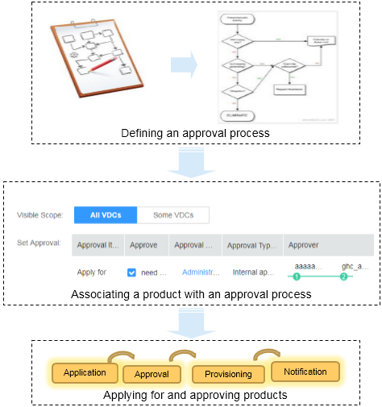
Multi-Level VDCs - Multi-Level Approval
Independent approval processes can be defined on ManageOne. Operation administrators and VDC administrators can define approval processes. Approval processes published by operation administrators are globally visible. Approval processes published by VDC administrators are visible to the VDCs to which the VDC administrators belong and their lower-level VDCs.
An approval process supports a maximum of five levels of approvals. Multiple approvers can be set at each level.
An approval process defined on ManageOne can be associated with a third-party work order system. That is, after the approval process is started, ManageOne sends an approval request to the third-party work order system.

Slide 24

Multi-Level VDCs - VDC Metering
Orders, modifies, and deletes cloud resources.
Product Catalog
Customer Scenarios (Why)
VDC metering data is provided to facilitate audits and control of cloud resources consumed by services.
VDC operator
ECS
VBS
AS
EIP
EVS
SDRs carry cloud resource metering data.
Application Scenarios (What)
VDC Metering
Enterprises allocate VDCs to their internal organizations, and IT resources usage statistics are collected by VDC for internal settlement.
In the e-Government scenario, VDCs are leased to enterprise tenants, and pay-per-use pricing is used.
Cloud resource1
Cloud resource 2
Cloud service metering
SDR
First-level VDC
xxx
xxx
Audits cloud resource metering in VDCs.
Second-level VDC
xxx
xxx
Summarizes metering statistics by VDC.
VDC administrator
Customer Benefits (How)
Third-level
VDC
xxx
xxx
ManageOne metering statistics
Metering files are generated for each cloud service based on the resource life cycle. They are stored centrally, and displayed on the management platform.
Cloud resource metering data generated by cloud services is summarized by VDC.
VDC metering example:

Slide 25
Multi-Level VDCs - VDC Logs
Customer Scenarios (Why)
Operation logs can be queried based on VDCs, which helps VDC administrators audit behavior of users in an organization.
Provides the VDC administrator with a VDC log interface, on which logs of cloud services and ManageOne can be viewed and filtered by criteria.
Portal
VDC Console
Obtains information about the VDC and associated users.
1
Application Scenarios (What)
2
VDC log service
  Trace users' operations on the cloud resources in an organization.
  Assist location and eliminate faults of cloud resources in the organization.
Multi-level VDCs
VDC log service
3
Calls CTS-related interfaces.
Customer Benefits (How)
ManageOne logs
CTS
VDC logs are generated by ManageOne and cloud services in CTS.
  The VDC log service classifies and summaries logs by VDC.
  Only VDC administrators can view VDC logs.
  VDC logs can be stored for 1 year.
ECS
EVS
RDS
…

Slide 26
Multi-Level VDCs - VDC Self O&M
Portal
Console of the ManageOne operation plane
Multi-level VDCs
Obtain VDC information.
Provide VDC administrators with a self-service O&M portal, where they can view alarms and performance data and export reports.
1
2
VDC self O&M
Performance threshold service
Report service
Alarm service
Operation plane
IAM
Obtain tenant information.
Call interfaces related to Maintenance Portal.
3
OM plane
6
Tenant resource management
Resource management
Performance
Reports
Alarms
Obtain virtualization information.
5
4
Call cloud service interfaces to obtain tenant resource data.
FusionSphere OpenStack
Cloud services
ECS
EVS
RDS
... Other
Notes:
ManageOne Maintenance Portal obtains all O&M data and monitors resources by tenant.
Self O&M allows VDC administrators to set and monitor resources, alarms, and performance thresholds for VDCs to which they belong as well as their lower-level VDCs.
The O&M data and basic functions are provided by ManageOne Maintenance Portal. The self-service O&M function of ManageOne Operation Portal only displays service O&M data by VDC and provides the portal for managing the data.

Slide 27

Multi-Level VDCs - Agent Maintenance by Administrators
Customer Scenarios (Why)
Operation administrator/Agent administrator
In the e-Government Cloud scenario, operation administrator applies for resources for resource users on ManageOne. Resource users do not log in to ManageOne. An administrator does not need to repeatedly change accounts to perform the agent maintenance. Therefore, administrators' workload can be reduced.
1. Set resource quotas for the enterprise.
2. Create an enterprise administrator.
Enterprise tenant 1 (enterprise or ministry)
Enterprise tenant n
Quota
Application Scenarios (What)
Resource
An operation administrator creates departments of an enterprise based on the enterprise organization structure, and sets resource quotas for each department.
Quota
…
Resource
Customer Benefits (How)
An operation administrator sets departments based on the enterprise organization structure and sets
resource quotas for each department.
An operation administrator switches to different departments, requests resources for each department, and notifies end users of the resource information offline.
End users of resources do not log in to ManageOne.
Resources requested by operation administrators during agent maintenance in a department occupy the quotas of the department.
Operation administrators or agent administrators must have required permissions to perform operations on all VDCs or certain VDCs.
When applying for a resource, an agent administrator needs to determine the organization to which the resource belongs based on the project of the resource and deduct the quota of the organization.

Slide 28
Fine-grained Operations
Various Cloud Services
1
Multi-Level VDCs
2
Application and Automation
3

Slide 29
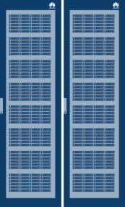
Application and Automation - Application Orchestration (vAPP)
The vAPP service allows users to drag diagram elements on the visualized orchestration interface to quickly and automatically deploy compute, storage, network, and application resources and serves users as a whole, helping quick service rollout. In addition, it allows users to define AS policy to automatically scale ECSs, achieving load balancing and full resource utilization.
Traditional Mode
vAPP
Visualization Template x
Application
Application Software
Network 1
Network 2
Middleware
Computing
Deployment Time
1 day
Deployment Time
1 month
Operating
System
Storage
Network
APP
Middleware 1
Infrastructure
DB
Middleware 2
OS
OS
DB Server (VM)
App server
(Auto Scaling Group)
Virtualization resource pool
Manual Operations
Standardized and Automatic Deployment
Rapid and automatic deployment of computing, storage,
network, application, and other resources

Slide 30
Application and Automation - Offline Service Customization
Offline Service Customization allows customers to customize services, migrate their offline services to the cloud, and request, approve, and provision services implemented offline.
Offline services
Service migration to the cloud
Self-service request
Software deployment
Policy provisioning
Software deployment
Data backup
Firewall policy
Access control provisioning
VDC operator
Computing
Applies for/Deletes
Physical machine
Disk array
Storage
Network
Security device
Tape library
Product catalog
Product A
Product B
Product C
Other resources
NOSQL
Log server
IP resources
Network configuration
Resource import
Product customization
Online request
Quickly Migrates Offline Services to the Cloud

Slide 31
Application and Automation - Unified Certificate Management
Customer CA
CMPv2 and CMC protocols
CMC
RESTful
ManageOne
RESTful
RESTful
RESTful
RESTful
Server
Storage
BM&DR
Arbitration service
FusionSphere
FusionStage
Cloud services interconnect with the ManageOne certificate management module in unified authentication mode that is based on the 10 unified principles, and implement service interaction through RESTful interfaces.

Slide 32
Trends and Challenges of Cloud Data Center Management
ManageOne Cloud Management Solution
ManageOne Cloud Management Platform Features
  Fine-grained Operations
  Intelligent O&M
  Centralized Management

Slide 33
Intelligent O&M
Unified Monitoring
  Provides all-round O&M monitoring from physical devices to cloud resource pools, from cloud services to big data, and from system resources to tenant resources.
Intelligent Fault Locating
  Displays alarms precisely, compresses 80% of repeated alarms and correlative alarms.
  Centrally processes faults based on scenarios, improving fault locating efficiency.
Visualized O&M
  Scenario-specific preset dashboards and reports
  Various customization capabilities
Fine-grained Operations

Slide 34
Intelligent O&M
Unified Monitoring
1
Intelligent Fault Locating
2
Visualized O&M
3

Slide 35
Unified Monitoring
Unified Monitoring can be used to monitor objects such as physical devices, resource pools, cloud resources, VDCs, and tenant applications, proactively monitor the status of cloud DCs, and transform from single-device monitoring to service-based analysis. This function helps enterprises reduce IT costs and improve O&M efficiency.
Overview of the monitoring system:
Physical device monitoring: Centrally monitor and manage hardware devices such as data center servers, storage devices, and network devices; and provide comprehensive monitoring, including alarms, resources, topologies, and performance, helping users quickly locate and rectify hardware faults.
Resource pool monitoring: Take advantage of unified monitoring and analysis of computing, storage, network, and big data resource pools to help you efficiently use resources, identify potential risks and problems, and provide improvement measures or suggestions.
Cloud resource monitoring: Enjoy comprehensive monitoring of cloud resource alarms, resources, topologies, and performance, helping you quickly demarcate and locate cloud resource assurance problems.
VDC monitoring: VDC-based comprehensive analysis and evaluation capabilities help you use resources appropriately and improve resource usage.
Tenant application monitoring: Monitor resources from the perspective of applications, continuously evaluate application resource usage from aspects such as capacity and load, and provides all-round assurance for key services.
Tenant
application
Service system 1
Service system 2
Service system 3
Allocate to services
VDC
Focus on comprehensive analysis and evaluation capabilities.
Department 1
Department 2
Department 3
Allocate to organizations
Cloud
resources
ECS
EIP
EVS
ELB
Resource cloudification
Focus on problem resolution and handling at the resource level.
Resource
pool
Compute resource pool
Storage resource pool
Network resource pool
Big data resource pool
Physical resource pooling
Physical
devices
Storage device
Network device
Server

Slide 36
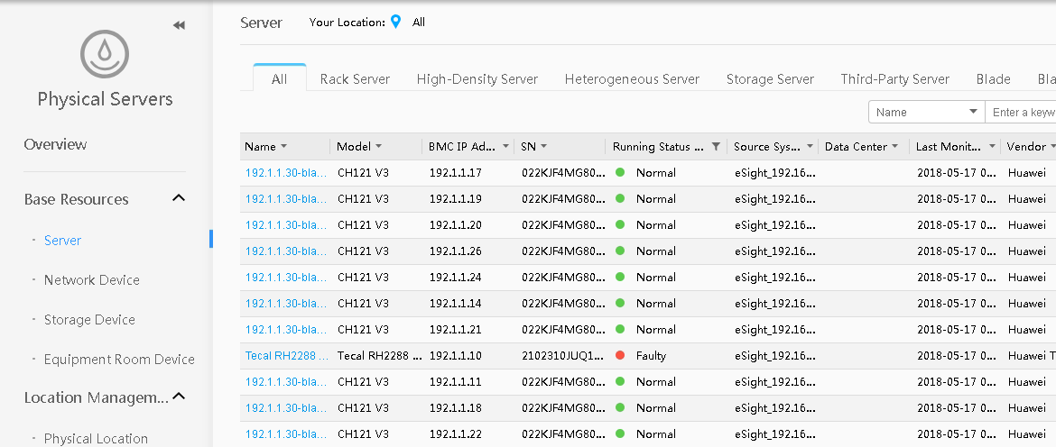
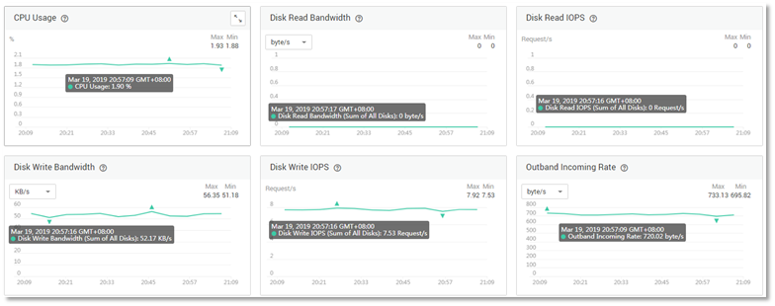
Unified Monitoring - Physical Device Monitoring
Centrally monitor and manage hardware devices such as data center servers, storage devices, and network devices; and provide comprehensive monitoring capabilities. Monitor alarms, resources, topologies, and performance, helping you quickly locate and rectify hardware faults.

Slide 37
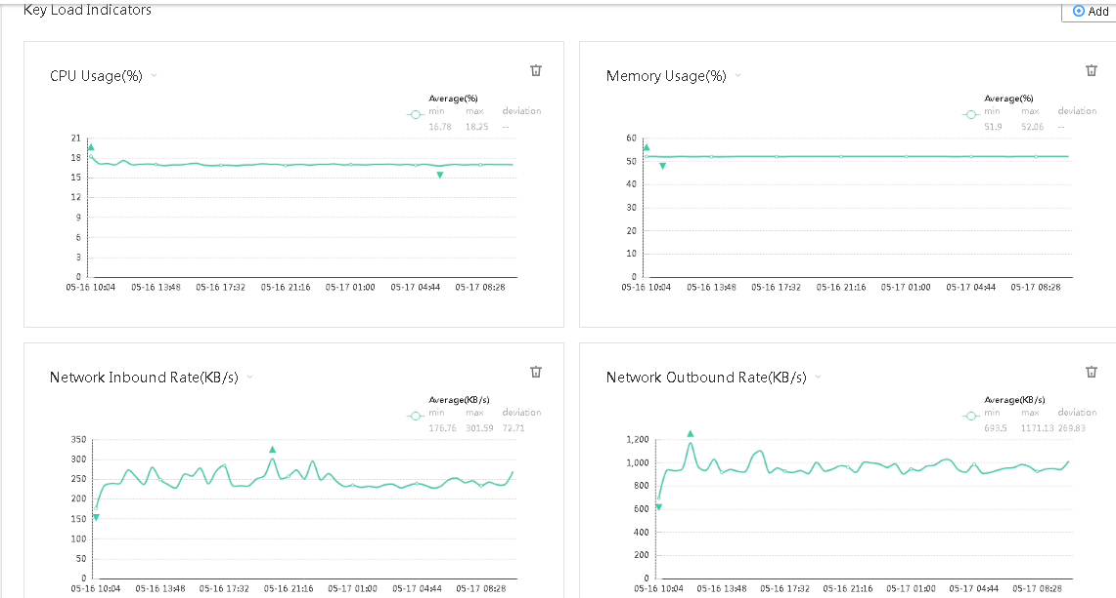
Unified Monitoring - Resource Pool Monitoring
Resource Pool Monitoring continuously evaluates the resource pool load based on KPIs, and provides root causes of high loads.
Load Evaluation

Slide 38
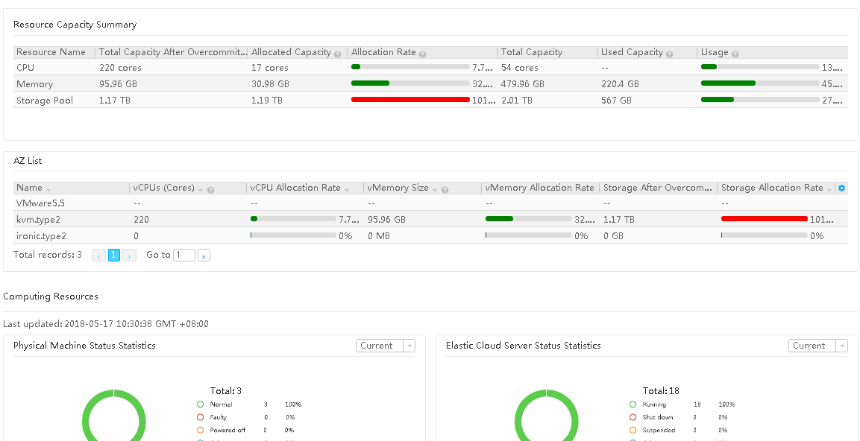
Unified Monitoring - Resource Pool Monitoring
Evaluate the capacity of compute, storage, and network resource pools at multiple layers, such as region, resource pool, AZ, and cluster, to instruct administrators to plan capacity and capacity expansion, thereby improving resource utilization.
Capacity Evaluation

Slide 39
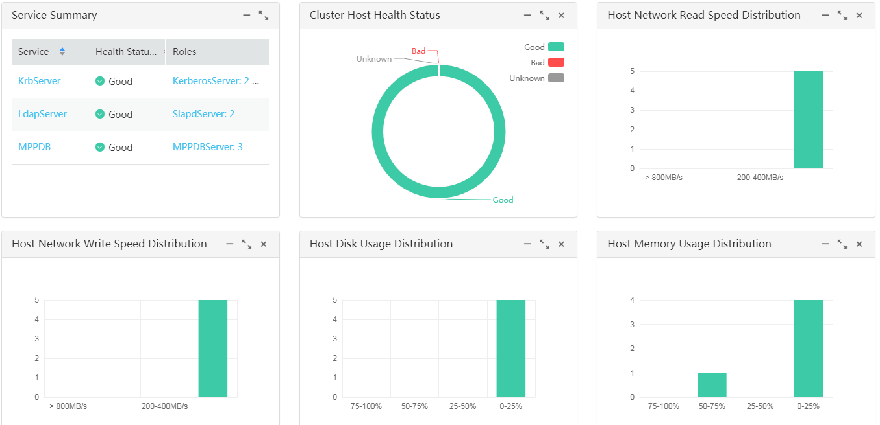
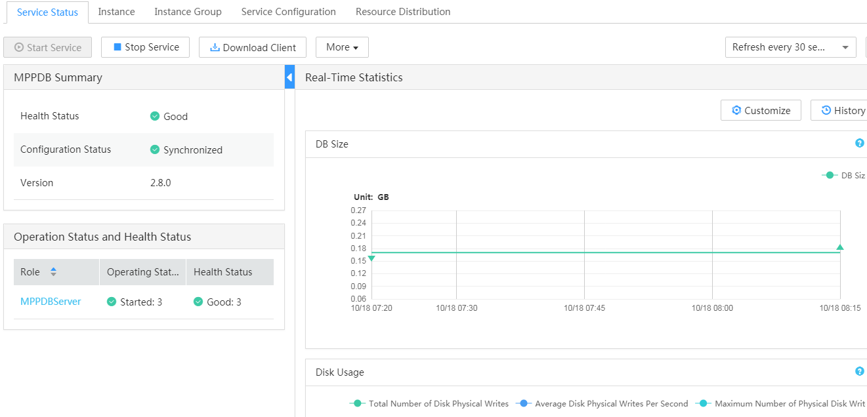
Unified Monitoring - Big Data Resource Pool Monitoring
Multiple big data clusters are analyzed.
Analysis of resource capacities and load in multiple clusters
Overview of services, host capacities, and load in a single cluster

Slide 40
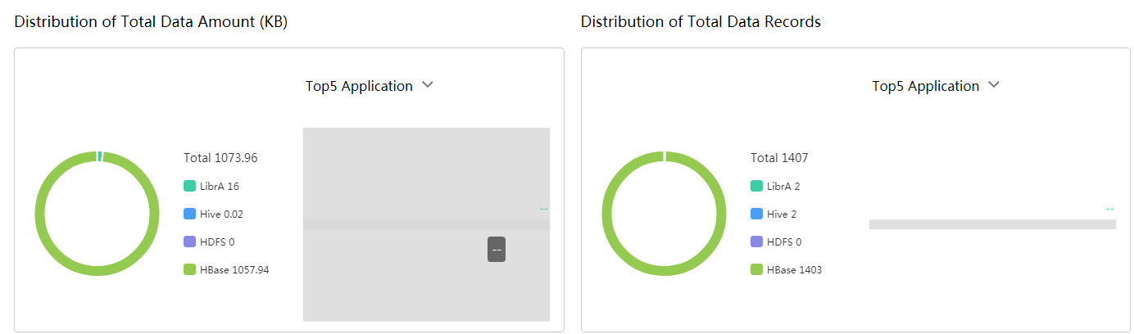
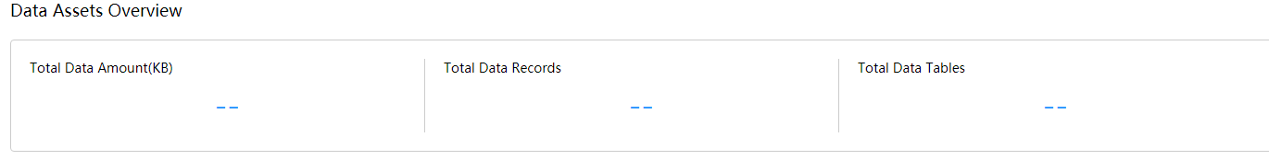
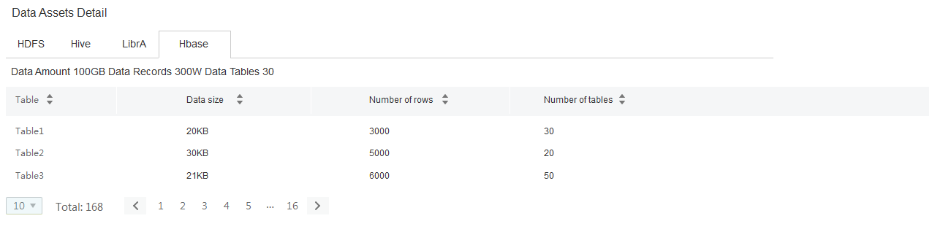
Unified Monitoring - Big Data Resource Pool Monitoring
Data assets are displayed from the perspective of applications based on a logical hierarchy of cluster > physical resource > component (service) > tenant. Users get a big-picture view of overall data consumption.
Big data asset overview
Data asset overview of a single application
Data asset details of a single application

Slide 41
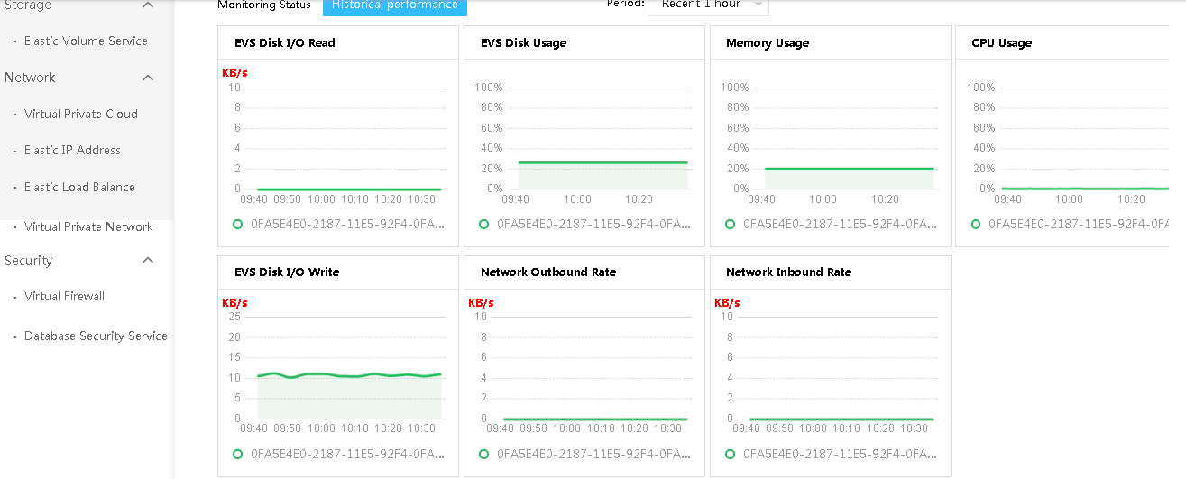
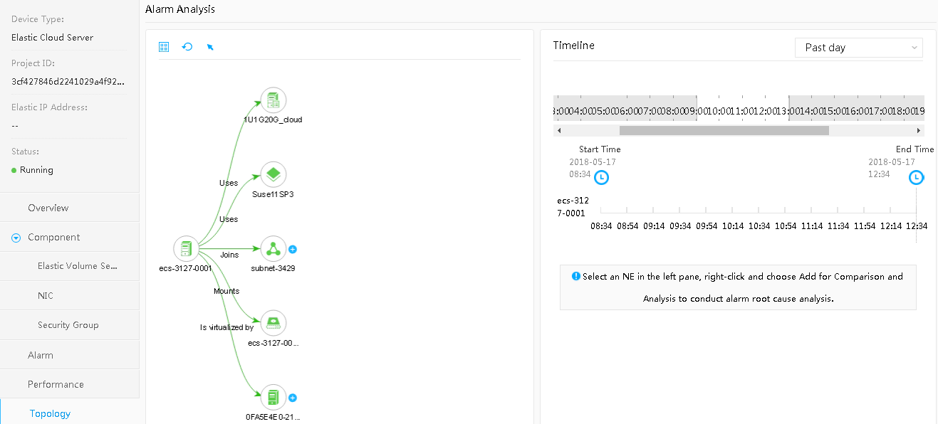
Unified Monitoring - Cloud Resource Monitoring
Cloud Resource Monitoring provides comprehensive monitoring of cloud resource alarms, resources, topologies, and performance, helping users quickly demarcate and locate cloud resource assurance problems.

Slide 42
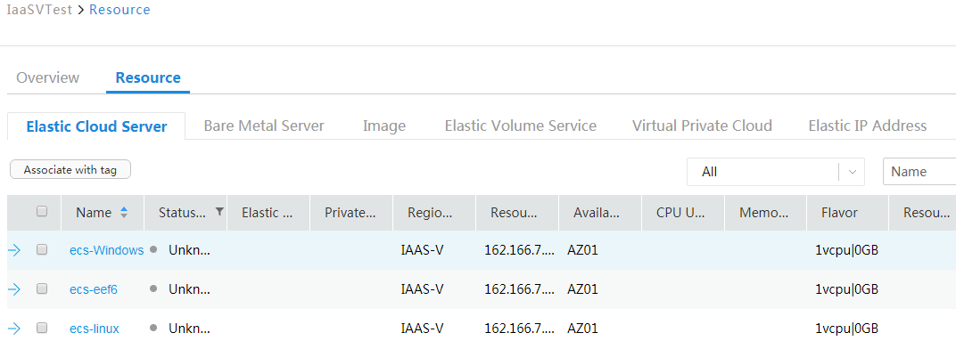
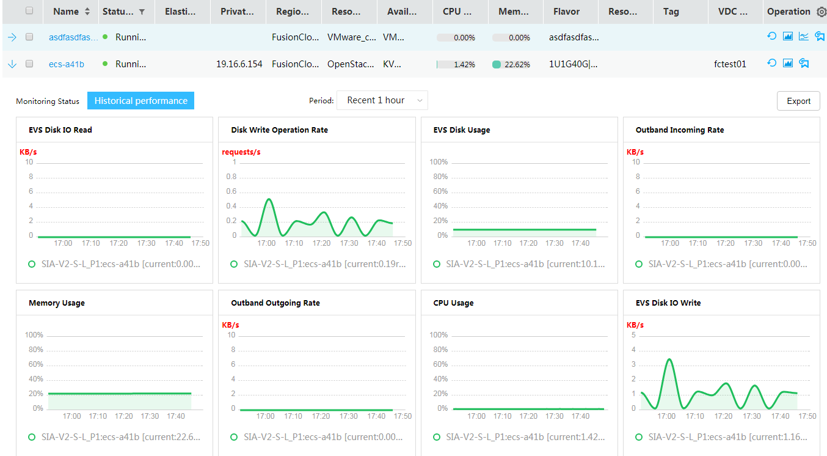
Unified Monitoring - VDC Monitoring
VDC Monitoring provides comprehensive VDC-based analysis and evaluation to help users use resources more appropriately and improve resource usage.

Slide 43
Unified Monitoring - Tenants' Big Data Application Monitoring
This function:
Monitors resources from the application perspective.
Continuously evaluates application resource usage from various aspects such as capacity and load.
Globally controls the overall load of tenants' applications.
Clearly displays the status of key applications.
Provides all-round assurance for applications in terms of load, resource consumption, fault, and associated topology.

Slide 44
Intelligent O&M
Unified Monitoring
1
Intelligent Fault Locating
2
Visualized O&M
3

Slide 45
Intelligent Fault Locating - Alarm Management
Multiple methods are provided to compress alarms in different scenarios, making fault locating more accurate and O&M more efficient.
Layer-based fault monitoring
  Application Scenarios and Benefits
Method
Cache
2
RCA asset management
Redis 1
Redis 2
...
Devices are deployed from a vertical box-shaped to a cross-layer structure, including infrastructures, VMs, and virtual NEs. All layers are closely connected, and seamless integrated and maintained, which brings great challenges for fault demarcation and locating.
Hierarchical decoupling creates risks, complicates O&M, and increases fault demarcation and locating complexity.
3
RCA rule
management
ETL rule
management
RCA model data
RCA running engine
RCA trigger
Data extracting and transforming (ETL)
Alarm filter
Alarm filter
CMDB (resource model data)
Alarm receiving module
  Key Technologies and Specifications
Scenario
1
Intermittent or toggling alarm: O&M personnel can discard intermittent or toggling alarms to improve O&M efficiency.
Alarm aggregation: After an alarm aggregation rule is set, the system automatically aggregates the repeated alarms reported within the specified period into one alarm to improve O&M efficiency.
Alarm correlation analysis: An alarm correlation rule identifies the root alarm and the correlative alarms. When monitoring or viewing alarms, you can set an alarm correlation rules to filter out correlative alarms and focus on root alarms only.
Collection module
App 2
App 1
LDP protocol
Correlative alarm
Correlative alarm
Correlative alarm
VM 4
VM 1
VM 2
Port 1
Port 2
Root alarm
Root alarm
Server 2
Server 1
Network device 1

Slide 46
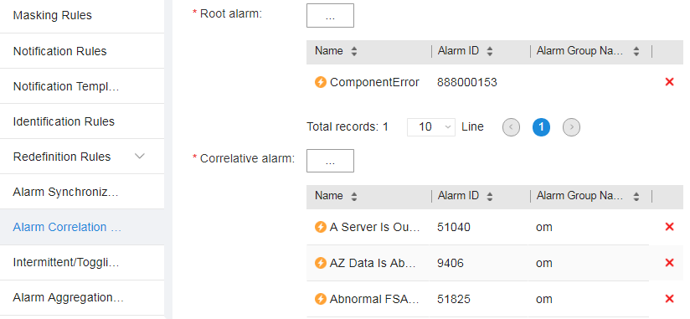
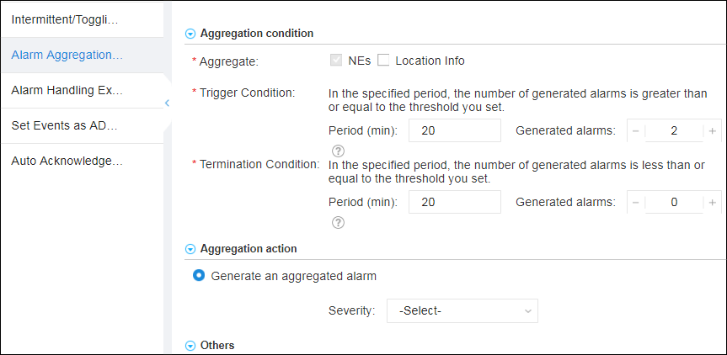
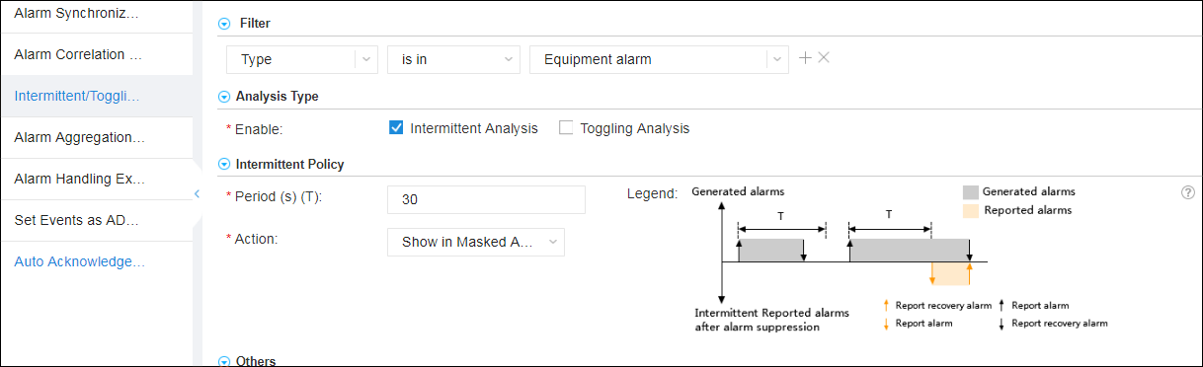
Intelligent Fault Locating - Alarm Management
Multiple methods are provided to compress alarms in different scenarios, making fault locating more accurate and O&M more efficient.
Alarm root cause analysis
Duplicate alarm aggregation
Intermittent or toggling alarm aggregation

Slide 47
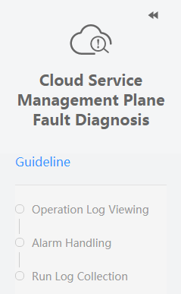
Intelligent Fault Locating - Unified Scenario-based Troubleshooting
Integrated OM WebUI based on typical scenarios used for unified troubleshooting. A variety of O&M tools improve troubleshooting efficiency.
Unified Alarms
Scenario-based OM WebUI integration
You can switch to the log collection tool to view the log details and context.
View the alarm and rectify the fault according to the alarm help.
Operation logs
ManageOne
Log collection
Call Chain
Rectify the fault based on the error code in the log details.
Cloud services
Run
logs
FusionSphere OpenStack (cascading or cascaded)
Call chain logs
Online collection
Centralized Storage
Fast retrieval
Logs can be exported.
KVM
FusionStorage
TraceLog
IT physical infrastructure layer
Query traceID and query the call relationship in the call chain based on the trace ID to quickly demarcate the fault.

Slide 48
Intelligent Fault Locating - Log-assisted Fault Demarcation and Locating
Call Chain
Log Search Portal
Third-party log system
Fault locating
Run logs of different services on each node can be quasi-real-time collected and stored centrally.
Logs in a specific fault scenario can be searched for by keyword.
Logs can be exported.
Logs can be forwarded to third-party log analysis systems and storage systems.
Log search, statistics, and export
Call chain query
Log forwarding
LogCenter (ES Cluster)
Log file
Trace log
Log file
Log file
Auxiliary fault demarcation
OpenStack
Cloud services
ManageOne
Call chain logs can be collected and log search is provided for call chains to facilitate call chain fault demarcation.
Agent
Agent
Agent

Slide 49
Intelligent O&M
Unified Monitoring
1
Intelligent Fault Locating
2
Visualized O&M
3

Slide 50
Visualized O&M - Preconfigured Scenario-based Dashboards
Data Center Overview: collects statistics on physical resources and resource provisioning.
Resource Pool Overview: analyzes resource pool resource usage, capacity, and load.
VDC Resource Overview: analyzes and collects statistics on VDC resource usage and capacity.

Slide 51
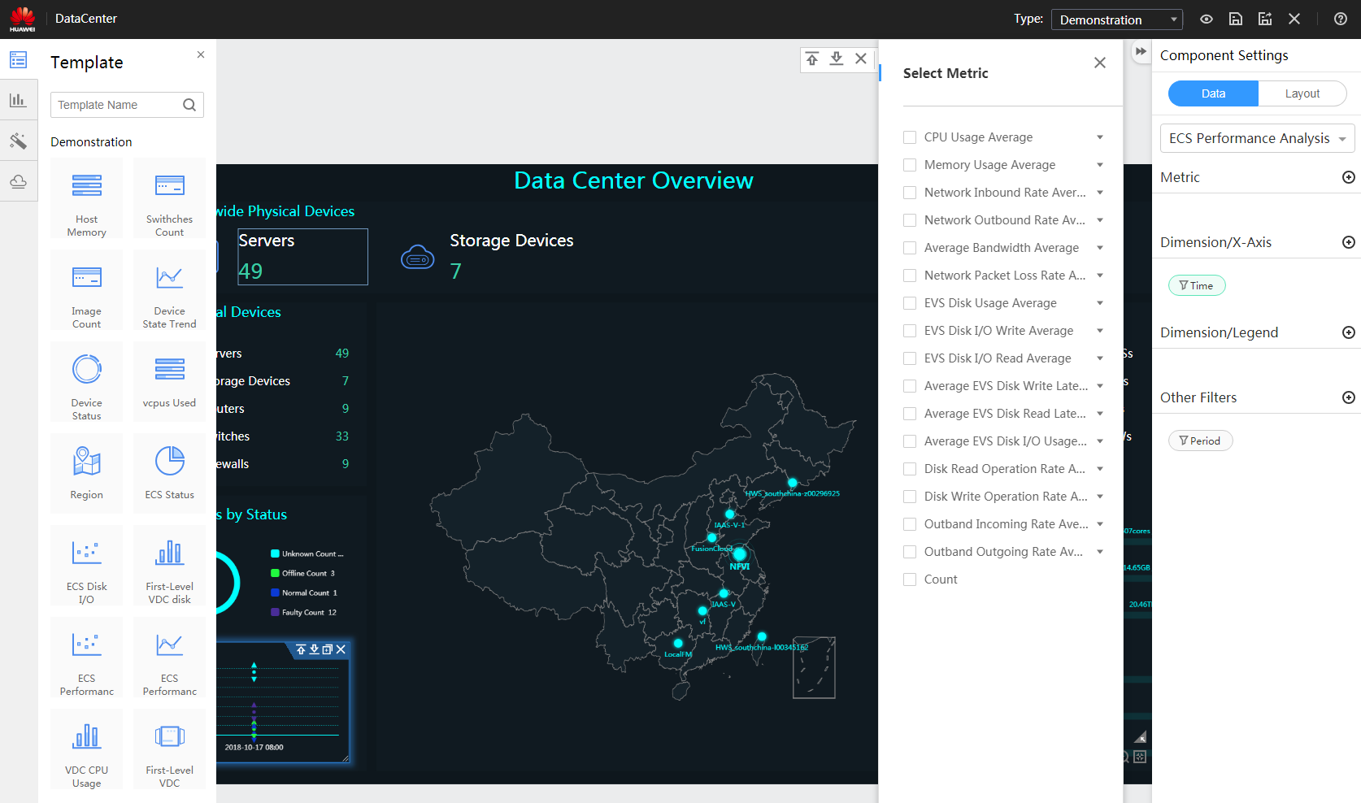

Visualized O&M - Flexible Customization of Dashboards
Configuration Panel
Support for various visual elements
Step 1: Select a dataset.
Step 2: Select metrics.
Step 3: Select items in the Dimension/X-Axis area.
Allows users to filter indicators by top N or specified conditions.
Step 4: Select items in the Dimension/Legend area.
Preconfigured out-of-the-box business controls

Slide 52
Trends and Challenges of Cloud Data Center Management
ManageOne Cloud Management Solution
ManageOne Cloud Management Platform Features
  Fine-grained Operations
  Intelligent O&M
  Centralized Management

Slide 53
Intelligent O&M
One Cloud Multi-Pool
1
Unified Configuration Center
2
Hybrid Cloud
3
Multi-Cloud Management
4

Slide 54













One Cloud Multi-Pool
China District
Germany District
US District
VDC 1
(IT)
VDC 2
(Finance)
VDC 3
(HR)
VDC 1
(IT Department)
VDC 2
(HR Department)
…
VDC 1
(IT Department)
VDC 2
(HR Department)
ManageOne implements unified management and control of cloud data centers.
Cloud management platform ManageOne
Unified Operations
Unified O&M
Unified
Authentication Center
Unified
Service Catalog
Unified
Approval Process
Unified
Product Management
Unified
Metering and Charging
O&M Maps
Unified Alarm
Unified Monitoring
Dashboard and Report
Capacity Management
HUAWEI CLOUD
Unified Services
Huawei IaaS
Enhanced service
Community OpenStack
Service
VMware Service
FusionSphere
service
Hyper-V
Service
Power
Midrange Computer
PaaS
Service
DaaS
Service
Homogeneous
public cloud
Heterogeneous
public cloud
OpenStack
resource pool
OpenStack
resource pool
OpenStack
resource pool
vCenter resource pool
VRM resource pool
Hyper-V
resource pool
IBM midrange computer resource pool
HuaweiCloud
FusionStage
HDFS
HBase
MRS
CSC
Flink
...
Solr

Slide 55
One Cloud Multi-Pool
If a customer already has a VMware resource pool or specifically requires Huawei build a VMware resource pool, VMware Service can be used to take over the VMware cloud services and rent them to tenants, including VMware ECS, VMware EVS, VMware IMS, and VMware snapshot. In this way, the customer can centrally manage their new and inventory VMware resources.
If a customer already has an SCVMM (Hyper-V) resource pool or specifically requires Huawei to build an SCVMM (Hyper-V) resource pool, Hyper-V Service can be used to take over the SCVMM (Hyper-V) resources and rent services to tenants, including Hyper-V ECS, Hyper-V EVS, Hyper-V IMS, and Hyper-V snapshot. This way, the customer can centrally manage their new and inventory SCVMM (Hyper-V) resources.
If a customer already has a Power resource pool or specifically requires Huawei to build a Power resource pool, Power Service can be used to take over the Power midrange servers, allowing tenants to apply for computing services of high-performance Power VMs, and provisions them to tenants. In this way, the customer can centrally manage their new and inventory Power resources.

Slide 56
Intelligent O&M
One Cloud Multi-Pool
1
Unified Configuration Center
2
Hybrid Cloud
3
Multi-Cloud Management
4

Slide 57

Unified Configuration Center - Unified O&M GUI
Scenario-based O&M navigation (wizard-based, focusing on highly performed operation scenarios)
  Applications
Unified O&M
Subsystem access: Log in to each O&M system quickly through SSO.
O&M Maps: Common O&M functions for users to quickly handle routine problems.
Scenario-based O&M: Focuses on highly performed O&M operations and provides wizard-based O&M scenarios.
Product specifications preparation
O&M Maps (common functions)
Alarm Monitoring
IaaS Basic O&M
PaaS and Big Data
PMI
SSO
Centralized configuration
Scenario-based O&M
Centralized monitoring
Specifications and image
Host management
Health check
Alarm handling
Host and BMS
Service management
Information collection
...
VM instance
Microservice management
License management
SSO and quick access
FusionSphere
ManageOne
Big Data and PaaS
Service Tools...
Service OM
eSight
FusionInsight Manager
Call chain
FusionSphere OpenStack web client
HiCloud
FusionStage
Traffic interruption detection
...
...
...
...
Notes:
ManageOne provides a unified O&M portal to resolve issues such as many O&M entries and no E2E scenario, helping users complete O&M based on wizards.
ManageOne improves operation efficiency and user experience. Only one O&M portal is reserved for customers.

Slide 58
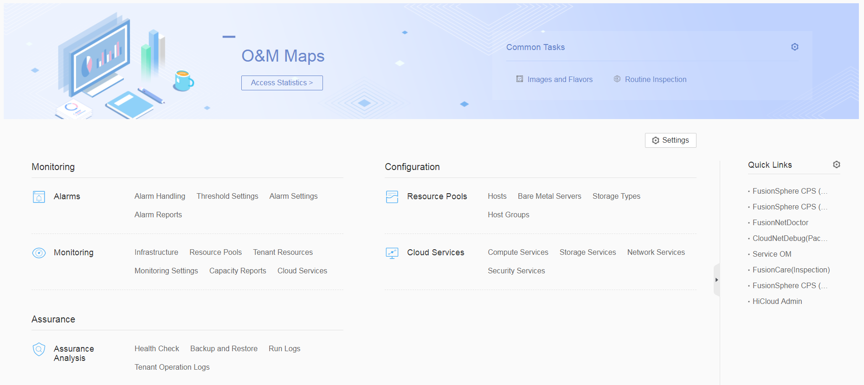
Unified Configuration Center - O&M Maps
O&M map customization
Access to common O&M functions
SSO to common O&M systems

Slide 59
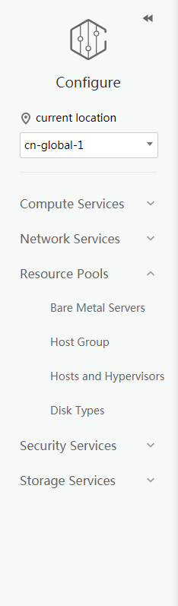
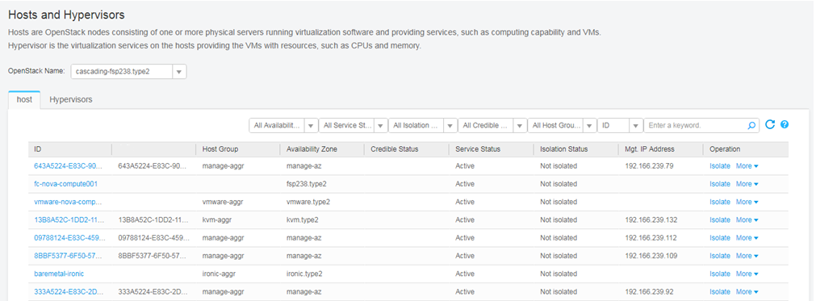
Unified Configuration Center - Scenario-based Configuration
Resource pools
Cloud services
E2E configuration of virtual resource pools
Centralized configuration of compute, storage, network, and security cloud services
Notes:
ManageOne provides scenario-specific configuration capabilities for resource pools and cloud services in data center scenarios.

Slide 60
Intelligent O&M
One Cloud Multi-Pool
1
Unified Configuration Center
2
Hybrid Cloud
3
Multi-Cloud Management
4

Slide 61
Hybrid Cloud - Overall Architecture
Hybrid Cloud with HUAWEI CLOUD:
  A federated cloud allows offline enterprise customers to use a broad set of service catalogs of HUAWEI CLOUD. Resources are available globally.
  A federated cloud rapidly integrates with the public cloud service catalogs through federation authentication.
  A federated cloud provides operation and O&M functions such as unified VDC management and unified monitoring.
Management plane hybrid cloud
Multi-cloud unified O&M
Multi-cloud unified operation
HiCloud
AWS
Azure
Hybrid Cloud with AWS and Azure:
  Management plane hybrid cloud is implemented through APIs, and it provides services such as ECS, EVS, VPC, and EIP to meet the requirements of customers outside China for hybrid heterogeneous public cloud.
Unified VDC management
Unified service catalog
Unified metering
Unified monitoring
HUAWEI
CLOUD Stack
Unified authentication
HUAWEI
CLOUD
IAM (IdP)
IAM (SP)
Core applications
Console
Proxy
Online applications
100+ services
Federated cloud

Slide 62
Intelligent O&M
One Cloud Multi-Pool
1
Unified Configuration Center
2
Hybrid Cloud
3
Multi-Cloud Management
4

Slide 63
Multi-Cloud Management - Unified Multi-Cloud Monitoring
Multi-Cloud Monitoring is a unified O&M monitoring function for provincial, municipal, and multi-cloud systems. It provides global cloud resource query and statistics.
Provincial ManageOne O&M
OpenStack
Provincial cloud (DC)
City operation
City O&M
Yingtan municipal cloud
OpenStack
Provincial dedicated cloud resource pool
AZ 3
...
Emergent service shared resource pool
AZ 1
City operation
City O&M
DR and backup service shared resource pool
AZ 2
Nanchang municipal cloud
OpenStack
City operation
City O&M
Ji'an municipal cloud
OpenStack
City operation
City O&M
City operation
City O&M
Yichun municipal cloud
Ganzhou municipal cloud
OpenStack
OpenStack
…

Slide 64
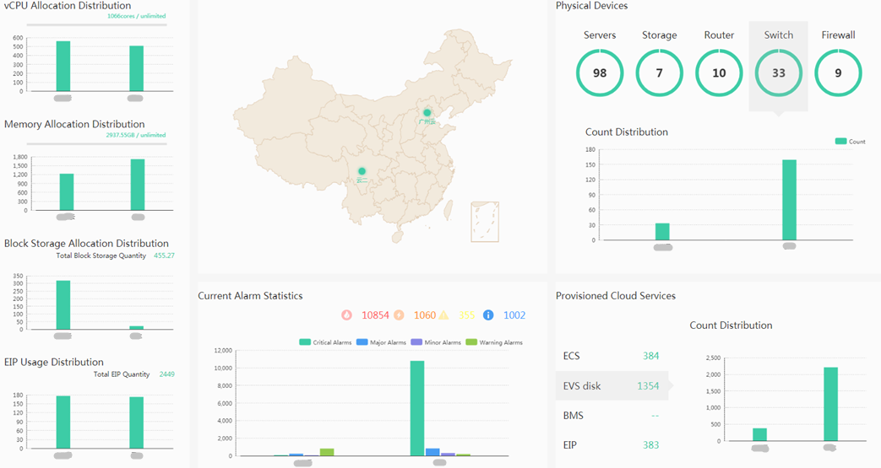
Multi-Cloud Management - Unified Multi-Cloud Monitoring
Have a good command of global resource usage and horizontal comparison and analysis of resource usage of multiple clouds.

Slide 65
ManageOne Overview
ManageOne Network Architecture
ManageOne Feature Description

Slide 66
True or False
  Services created by the system administrator and organization administrator are authorized to the organization or specified VDCs in the organization. ( )
Multiple-Answer Question
  A VDC is the encapsulation and boundary definition of the virtual resources used by a department. It is a collection of virtual resources, including ( )
  A. Compute resources
  B. Storage resources
  C. Network resources
  D. Database resources
Notes:
Reference answer:
True or False: F
Multiple-Answer Question: ABC

Slide 67
Huawei official websites
  Enterprise service: http://e.huawei.com/en/
  Technical support: http://support.huawei.com/enterprise/en/cloud-computing/manageone-sc-pid-21270651?category=product-documentation
  Online learning: http://learning.huawei.com/en/
Documentation tool
  HedEx Lite

Slide 68
Huawei E-Learning website:
  http://support.huawei.com/learning/Index!toTrainIndex
Huawei support cases:
  http://support.huawei.com/enterprise/servicecenter?lang=en

