Slide 1
HCDCA114
HCNA-DC
V1R6
1.00
Zhou Shengli/WX201803
2017.8.28
Liu Lican/00180730
New
Zhang Yue/WX635169
2019.3.19
Liu Lican/00180730

Slide 2
Huawei FusionSphere OpenStack Cloud Platform

Slide 3
This course describes the organizational architecture, functions, and features of OpenStack and product features of Huawei FusionSphere OpenStack.

Slide 4
After finishing this course, you will be able to:
  Understand the background of OpenStack.
  Describe the organizational structure of OpenStack.
  Master functions and features of OpenStack.
  Understand Huawei FusionSphere OpenStack enhancements.

Slide 5
OpenStack Background
OpenStack System Architecture
Functions and Features of OpenStack
Huawei FusionSphere OpenStack Enhancements

Slide 6
Open + Stack = OpenStack
OpenStack is a cloud computing platform project jointly developed by the National Aeronautics and Space Administration (NASA) of the United States and Rackspace and is an open-source project released under the terms of the Apache license. It helps service providers and enterprises to achieve cloud infrastructure services similar to Amazon EC2 and S3.
Notes:
OpenStack is an open-source cloud computing management platform project. It consists of several main components. OpenStack supports almost all types of cloud environments and aims to provide a rich, standard, manageable, and scalable cloud computing management platform. OpenStack provides the Infrastructure as a Service (IaaS) solution through various complementary services, each of which provides an API for integration.
OpenStack is an open-source project aimed at providing software for constructing and managing public and private clouds. The OpenStack community has more than 130 enterprises and 1350 developers. These organizations and individuals use OpenStack as the general frontend for IaaS resources. The primary object of OpenStack is to simplify the cloud deployment process and provide high scalability.
Five open-source protocols (BSD, Apache, GPL, LGPL, MIT)
BSD open-source protocol(original BSD license and free BSD license)
Apache License is a protocol used by the famous non-profit open-source organization Apache. Similar with BSD, Apache License encourages code sharing, respects copyright of the original author, allows code modification and re-release (as open-source or commercial software).
Apache License is also a friendly license for commercial applications. Users can modify code as required and release or sell them as open-source or commercial products.

Slide 7
Open + Stack = OpenStack
The main objective of OpenStack is to manage resources in the data center and simplify resource allocation. OpenStack manages the following types of resources:
  Compute resource: OpenStack can plan and manage a large number of virtual machines (VMs), allowing enterprises or service providers to provide compute resources on demand. Developers can use the APIs to access compute resources to create cloud applications. Administrators and users can use a web browser to access these resources.
  Storage resource: OpenStack can provide required objects and block storage resources for cloud services and cloud applications. Due to the requirements for performance and the price, many organizations are not satisfied with traditional enterprise-level storage technologies. OpenStack can provide configurable object storage and block storage functions based on customer requirements.
  Network resources: Data centers now have a large number of devices such as servers, network devices, storage devices, and security devices, and these devices will be divided into more virtual devices or virtual networks. This causes the explosive increase of IP addresses, route configuration, and security rules. Traditional network management technologies cannot manage the next-generation networks with high scalability and high automation. OpenStack provides plugin, scalable, and API-driven network and IP address management.

Slide 8

























OpenStack Participants
In 2013, Huawei was officially accepted by the OpenStack Foundation as a Gold Member.
In 2017, Huawei was officially accepted by the OpenStack Foundation as a Platinum Member.

Slide 9
Typical Business Models and Vendors of OpenStack
Integrated solution providers
  Representatives: HP, Huawei, Mirantis, IBM, and Oracle
Public cloud carriers
  Representatives: Rackspace and Huawei
Distributions vendors
  Representatives: Red Hat, Canonical, and SUSE
System software vendors
  Representatives: VMware
Hardware device vendors
  Representatives: Dell, EMC, and Cisco
Application and management component vendors
  Representatives: Tesora and Parallels
Notes:
Nebula computing platform of NASA
The following large-scale hardware vendors support OpenStack: IBM, AMD, Intel, and Dell.
In October 2010, Microsoft announced to support the integration of OpenStack and Windows Server 2008 R2.
In February 2011, Cisco officially joined the OpenStack project, focusing on development of OpenStack network services.
Ubuntu will develop cloud network plans focusing on stacks in future.
In April 2012, IBM announced to join the OpenStack project and serve as a major sponsor.
In October 2012, the Viacloud interconnection cloud platform joined the OpenStack project to develop OpenStack-based public and private cloud platforms.
In 2013, IBM announced to provide OpenStack-based private cloud services and related applications in the IBM Pulse conference.

Slide 10
Enterprise-Level OpenStack Requirements
OpenStack is an ideal foundation for enterprise-level private clouds and will necessarily become a new-generation cloud operating system (OS) kernel. However, it is not a complete cloud OS.
At present, OpenStack faces challenges in several key areas. To deal with these challenges, OpenStack is delivered in robust enterprise-level products. These products provided in the industry support technical support, quick installation, and routine management. Without vendors providing these products, OpenStack would never be widely used.
OpenStack is not MySQL. It is similar to Linux kernel which needs a complete OS to run. What does enterprise-level OpenStack exactly need? There are six key factors as follows:
  API availability of 99.999% and scalable control plane
  Robust management and security model
  Open architecture
  Hybrid cloud compatibility
  Scalable resilient architecture
  Comprehensive support and services

Slide 11
OpenStack Background
OpenStack System Architecture
Functions and Features of OpenStack
Huawei FusionSphere OpenStack Enhancements

Slide 12
OpenStack Layers
IaaS+ services
Trove
Sahara
Swift
...
System management
and automation
...
Ceilometer
Heat
Horizon
IaaS services
Nova
Glance
Cinder
Neutron
Ironic
Public infrastructure components
Database
Keystone
Message Queue
Graphical
man-machine interface
Notes:
By now, the OpenStack project covers common service types at the IaaS layer, part of system management and automation services, and some important IaaS+ services.

Slide 13
OpenStack Architecture and Core Projects
Service | Project Name | Description
Console | Horizon | A user can use Horizon to interact with various OpenStack services, such as starting VM instances, assigning IP addresses, and configuring access control.
Compute | Nova | A user can use Nova to allocate and manage VMs on demand.
Network | Neutron | Nova uses Neutron to manage the connection between network settings. Neutron allows end users to create and add network interfaces and supports a large number of network devices and technologies with plugins.
Storage services
Object storage | Swift | Swift can be used to store files, but it cannot be used to mount files.
Block storage | Cinder | Cinder can be used to provide the block storage service for persistent storage.
Shared services
Identity authentication | Keystone | Keystone provides authentication and authorization for OpenStack.
Image service | Glance | Glance provides the VM image registration service. At the same time, Nova uses Glance to dispatch instances.
Metering/Monitoring service | Ceilometer | Ceilometer provides functions such as charging, benchmark tests, and data statistics.
High-level services
Orchestration service | Heat | Heat can use its HOT template or AWS CloudFormation template and REST APIs of each OpenStack service to organize component resources to cloud applications.

Slide 14
OpenStack Background
OpenStack System Architecture
Functions and Features of OpenStack
Huawei FusionSphere OpenStack Enhancements

Slide 15
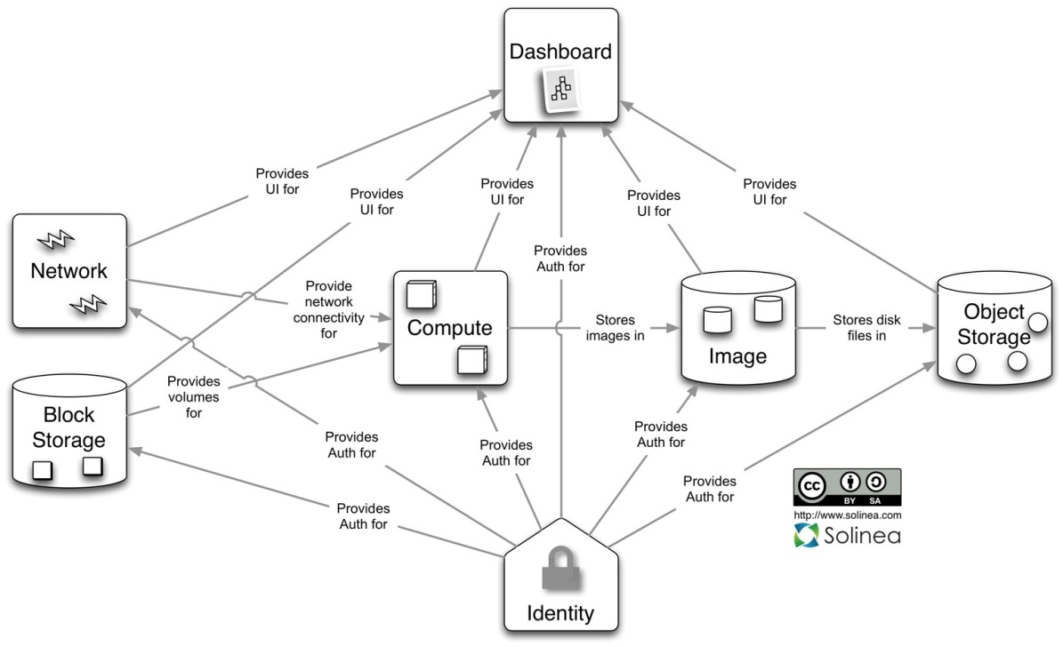
Introduction to OpenStack Modules
Quantum/Neutron (Virtual network management)
Nova (Computing management)
Horizon (Interface management)
Glance (Image management)
Swift (Object storage)
Cinder (Block storage management)
Keystone (Authentication)

Slide 16
Keystone Overview
Keystone provides authentication and access policy services for all OpenStack components. Depending on its REST (identity API) system, Keystone provides authentication and authorization for mainly (but not limited to) Swift, Glance, and Nova. In fact, Keystone authenticates the request from action and message sources.
  User
  Tenant
  Role
  Service
  Endpoint
API server
Identity
Token
Service/Endpoint
Policy
KVS backend
LDAP backend
SQL backend
Notes:
A user refers to a person or program that can access system services using Keystone. Users are authenticated by Keystone using their credentials, such as their passwords and API keys.
A tenant is a collection of resources that can be accessed in each service. For example, a tenant can be machines in Nova, image storage in Swift and Glance, and network resources in Quantum. Users are always bound to certain tenants by default.
A role indicates resource rights that a group of users can access, such as VMs in Nova and images in Glance. Users can be added to any global or tenant's role. For a global role, the role permission of a user is applicable to all tenants, that is, the user can execute the rights specified by the role on all tenants. For a tenant's role, the user can execute the rights specified by the role on only the tenant.
A service can be Nova, Glance, and Swift. According to the preceding definitions (user, tenant, and role), a service can be used to check whether the current user has the rights to access the service resources. If a user attempts to access a service of its tenants, the user must know whether the service exists and how to access it. In this case, different names are used to indicate different services. The role mentioned above can be bound to a service. For example, if the administrator rights are required for Swift to create an object, it is not necessary to access Nova as an administrator for the same role. To achieve this goal, we should create two independent administrators roles. One is bound to Swift, and the other is bound to Nova. In this way, the administrator access to Swift does not affect Nova and other services.
An endpoint can be understood as an access point of a service. If you want to access a service, you must know its endpoint. Keystone contains an endpoint template that provides endpoints of all existing services. You can see the endpoint template in the conf folder during Keystone installation.

Slide 17
Examples
Parameter | Example
User | Hotel guests
Credentials | Room key
Token | Special key
Tenant | Hotel
Service | Service types provided by the hotel such as diet and entertainment services
Endpoint | Services in detail such as barbecue and badminton
Role | Higher VIP level, higher permission

Slide 18
Nova Overview
Nova is a core component of OpenStack. Many other OpenStack components are separated from the Nova project and serve it. All activities in the OpenStack VM instance life cycle are processed by Nova. This makes Nova a scalable platform to manage compute resources, networks, and authentication. However, Nova does not provide any virtualization capability. Instead, it uses the libvirt APIs to interact with supported hypervisors (Xen and KVM). Nova provides services externally through the web services APIs which are compatible with Amazon Web Services (AWS) EC2 APIs and supports message-based asynchronous communication.

Slide 19
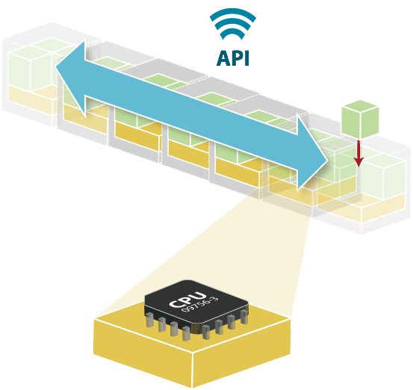
Nova - Compute Virtualization (1)
1. Based on the REST APIs
Friendly service access mode
2. Supports large-capacity horizontal expansion.
The quantity of supported VM instances linearly increases with the quantity of nodes.
3. Independent from hardware and supports multiple types of standard hardware.
No customization requirements for dedicated hardware devices
4. Independent from hypervisor and supports multiple types of hypervisor.
KVM, LXC, QEMU, UML, ESX, Xen, PowerVM, Hyper-V
Supports all mainstream hypervisors and does not depend on a specified vendor.
Notes:
Functions and features:
Instance lifecycle management
Compute resource management
Network and authorization management
REST APIs
Asynchronous continuous communication
Supports various hosts: Xen, XenServer/XCP, KVM, UML, VMware vSphere, and Hyper-V

Slide 20
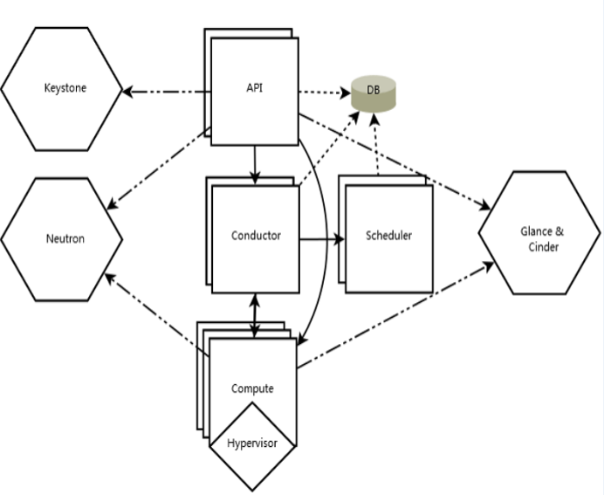
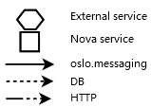
Nova - Compute Virtualization (2)
Nova consists of the following components:
  Nova-api
  Nova-scheduler
  Nova-conductor
  Nova-compute
Notes:
The API server provides an interface for the cloud infrastructure to interact with the outside. It is the only channel for external users to manage the cloud. The API of each EC2 is invoked using the web service, and then the API server sends the request to the target object in the cloud through the message queue for processing. As a substitute for EC2-API, the native API of OpenStack, which is called "OpenStack API", can also be used.
OpenStack uses the message queue for communication based on the Advanced Message Queuing Protocol (AMQP). Nova asynchronously invokes the request response. After the request is received, Nova triggers a callback immediately. Because of asynchronous communication, no action of users is set to the waiting status for a long time of period. For example, the process of starting an instance or uploading an image is time-consuming. The API invocation waits for the returned result without affecting other operations. This asynchronous communication plays an important role in making the system efficient.
The scheduler invokes the nova-API to the target. The scheduler runs as the daemon process named nova-schedule and selects a computing server from the available resource pool according to the scheduling algorithm. Many factors may affect the scheduling result, such as the load, memory, distance between sub-nodes, and CPU architecture. Nova-scheduler uses the pluggable architecture.
The main task of nova-compute is to manage the full life cycle of the instance. Nova-compute receives and executes the request through the message queue, and performs various operations on the instance. In a typical production environment, many nova-computes are deployed. According to the scheduling algorithm, an instance can be deployed on any available nova-compute.

Slide 21
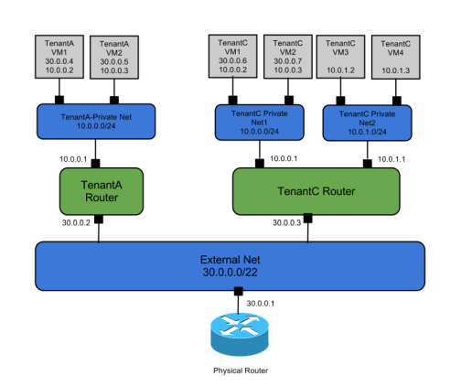
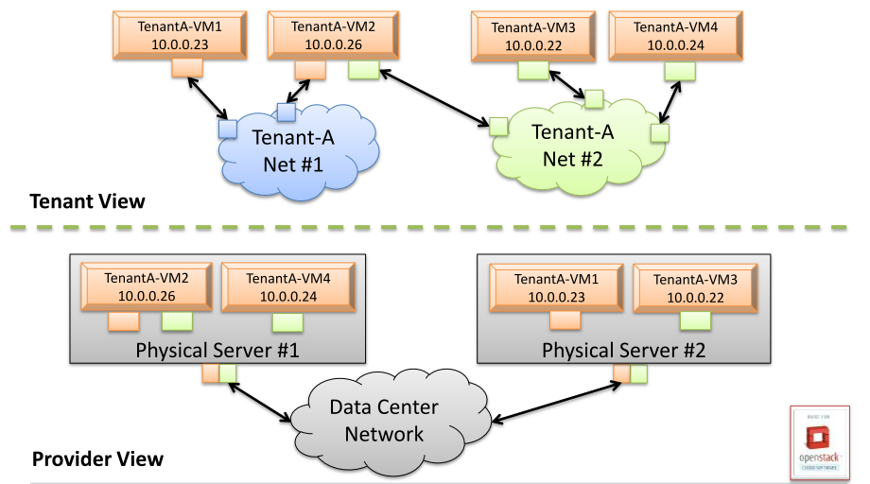
Neutron - Network Virtualization
Mappings between the physical network and virtual network
Multi-tenant virtual network

Slide 22
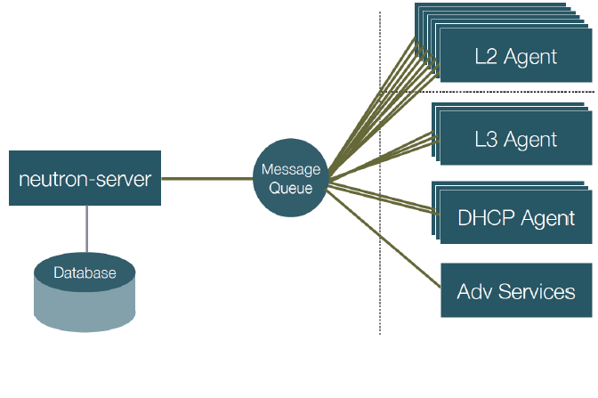
Logical Architecture of Neutron: Components
Neutron-Server
Core plugin
Various advanced service plugins
  L3 service plugin
  LB service plugin
  Firewall
  VPN
Various agents
  L2 (ovs-agent)
  L3 agent
  DHCP agent
  Metadata agent
  Agile Controller-DCN

Slide 23
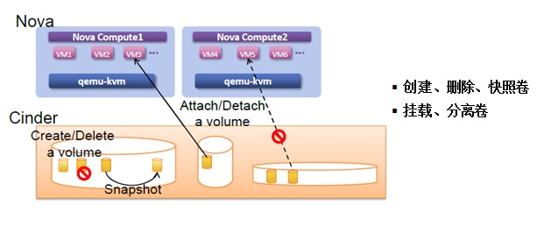
Cinder Overview
The storage resource management system is responsible for providing persistent block storage resources for VMs.
Encapsulates the backend storage resources and provides a unified API externally.
The main core is volume management, allowing operations on the volume, volume type, and volume snapshot.
Create, delete and snapshot a volume.
Attach and detach a volume.

Slide 24
Cinder
Type | Block Storage |  | Object Storage
Name | Temporary storage | Block storage Cinder | Object storage Swift
Purpose | VM root disk and other disks | Mounted to the VM and provides additional disk space to the VM. | Provides backup and archiving data storage space for the VM. Used to store VM images.
Similar Windows OS | Root disk: Driver C Disk: D disk | USB | NAS archive server
Life cycle | Storage is created during VM start and exists in the VM life cycle. Its size depends on the flavor (ECS type). | Storage is created by users, limited by the user quota. It exists until the user is deleted.

Slide 25
Cinder Architecture
Three major components
  Cinder-api externally provides the Cinder REST API.
  Cinder-scheduler allocates storage resources.
  Cinder-volume encapsulates driver. Different drivers control different backend storage systems.
RPC between components is achieved using the message queue.
Cinder development is concentrated in the scheduler and driver to provide more scheduling algorithms, more functions, and more backend storage systems.
The volume metadata and status are saved in the database.

Slide 26
Basic Functions of Cinder
No. | Object | Action
1 | Volume | Create a volume.
2 |  | Use an existing volume to create a volume (clone).
3 |  | Expand a volume.
4 |  | Delete a volume.
5 | Volume – VM | Mount a volume to a VM.
6 |  | Detach a volume from a VM.
7 | Volume – snapshot | Create a volume snapshot.
8 |  | Use an existing volume snapshot to create a volume.
9 |  | Delete a snapshot.
10 | Volume – mirror | Create a volume from an image.
11 |  | Create an image from a volume.

Slide 27
Ceilometer Overview
In OpenStack, Ceilometer can collect operation records and the system running status at the IaaS layer to generate metering data. In FusionSphere OpenStack, Ceilometer provides monitoring and alarm data for upper-layer O&M components. In public cloud scenarios, Ceilometer can be used for charging.
Ceilometer has a flexible architecture, supports distributed deployment, and has high scalability.
Notes:
Objective: In metering, Ceilometer aims to provide unified resource usage data collection function for upper-layer charging, settlement, and monitoring applications.

Slide 28
Glance Overview
Glance is an image service component of OpenStack. It provides VM image discovery, registration, and access to services.
Glance provides the RESTful APIs to query VM image metadata and obtain the image.
VM images made available through Glance can be stored in a variety of locations from simple filesystems to object-storage systems like the OpenStack Swift project.
Glance provides the REST APIs to support the following image operations:
  Querying
  Registering
  Uploading
  Obtaining
  Deleting
  Access right managing
Notes:
Glance has two versions of REST APIs: REST API V1 and V2. The two versions are different from each other.
REST API V1 provides only basic image and member operation functions: Create, delete, and download an image; Query and update the list and detailed information; Create, delete, and list tenant members.
REST API V2 supports all functions of V1 and the following functions:
Add, delete, and modify an image location.
Perform operations on the metadata namespace.
Perform operations on the image tag.
Both REST API V1 and V2 support the image store.
By default, Glance Cli and Horizon use the REST API V1.

Slide 29
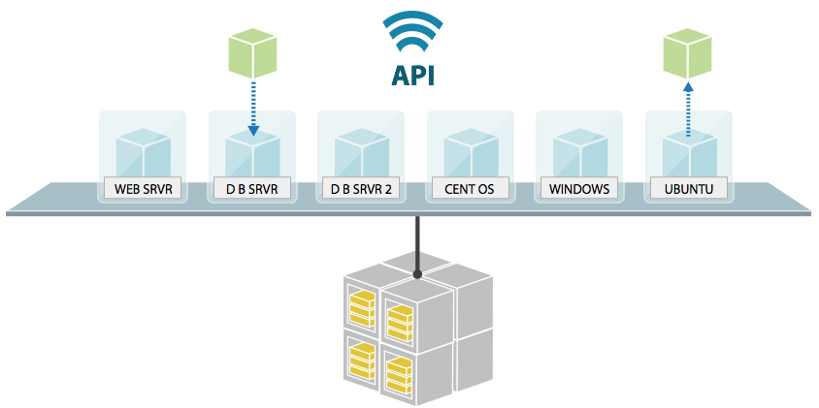
Glance - Image Management
2. VM image storage and retrieval services
1. Based on the REST APIs.
Friendly service access mode
Light load
Independent from the storage technology
4. Supports multiple underlying storage systems (Swift
S3, Http) and local storage.
3. Compatible with all common image formats.
High adaptability
Flexible deployment
Unbound to a specific storage technology
Notes:
The principle and implementation of Glance are easier and more direct than other components.
Image management in multiple data centers
Unified service interface and private and open images
Supports multiple storage backends through the driver and supports isolation of image storage space between tenants (only Swift).
Supports comprehensive image formats.
New features such as local cache of images, multiple data center (MDC) replication, multiple locations, inremental images, and Cinder-Volume backend simplify image management during large-scale MDC deployment, improve the storage space usage and VM provisioning efficiency, and support image backup.

Slide 30
Swift Overview
Swift was originally a high-availability (HA) distributed object storage service developed by Rackspace. In 2010, Swift was contributed to the OpenStack open-source community as the one of the first core sub-projects providing the VM image storage service for the Nova sub-project. Swift is constructed on the standard hardware storage infrastructure that is cheap without redundant array of independent disks (RAID). Swift achieves HA and scalability by using consistency hash and data redundancy at the software layer and compromising a certain degree of data consistency. It supports the multi-tenant mode, container, and object read/write operations, which is suitable for resolving unstructured data storage problems in Internet application scenarios.
Notes:
This project is developed based on Python. It uses the Apache 2.0 license and can be used to develop commercial systems.

Slide 31
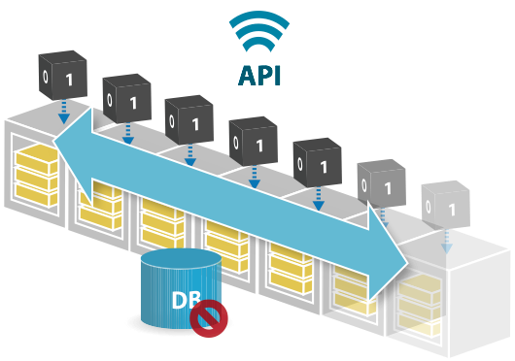
Swift Storage Virtualization - Object Storage
1. Based on the REST APIs
Friendly service access mode
2. Data distributed in the entire system in balanced manner
High reliability and efficient resource utilization
4. Easy to expand
3. Independent from hardware and supports multiple types of standard hardware
No customization requirements for dedicated hardware devices
5. No central database.
No single-point performance bottleneck or single point of failure (SPOF) risks
6. Account/Container/Object
The three-level storage structure does not need the file system and has N (N ≥ 3) copies.
High data reliability

Slide 32
OpenStack Background
OpenStack System Architecture
Functions and Features of OpenStack
Huawei FusionSphere OpenStack Enhancements

Slide 33
FusionSphere OpenStack Commercial Enhancements (1)
High-performance storage I/O acceleration
High-performance distributed storage
Scalability: Extra-large storage pool
OpenStack OM
Application monitoring and alarm (AM&FM)
Web Portal
User management
Heterogeneous hardware adaptation
Security management (IAM)
Keystone
OpenStack
Heat
Nova
Cinder
Neutron
Hypervisor: connecting to FusionCompute
High performance, high reliability, and easy maintenance
Glance
Nova-Compute
Driver
Cinder-Volume
Driver
Neutron
Plugin
Ceilometer
Swift
Ironic
Computing virtualization
Storage virtualization
Network virtualization
FusionCompute
FusionStorage
FusionNetwork
Cluster
scheduling
Advanced expansion features:
HA/live migration...
Storage
offload
Advanced storage features:
Thin provisioning/
snapshot/DR...
SDN controller
Virtual service gateway: vFW/vLB
HA commercial deployment framework
One-click hitless upgrade
Hardware plug and play
Automatic fault recovery
Unified Virtualization Platform (UVP)
Distributed storage engine
Elastic virtual switch (EVS)
Basic OS installation, management node provisioning
Cloud Boot Service (CBS)
Cloud Provisioning Service (CPS)
Open source
Huawei
Notes:
The FusionSphere cloud platform solution is constructed based on OpenStack community. With the OpenStack plugin mechanism, FusionCompute, FusionStorage, and FusionNetwork plugins can seamlessly interconnect with native OpenStack. FusionSphere is an OpenStack-based commercial cloud platform.

Slide 34
FusionSphere OpenStack Commercial Enhancements (2)
OpenStack OM
OpenStack community standard services
Contribution to the OpenStack community with Huawei drives/plugins/bug fixes
Huawei contributes the large-scale distributed cloud cascading solution to the OpenStack community.
Application monitoring and alarm (AM&FM)
Web Portal
User management
Heterogeneous hardware adaptation
Security management (IAM)
Keystone
OpenStack
Heat
Nova
Cinder
Neutron
Glance
Nova-Compute
Driver
Cinder-Volume
Driver
Neutron
plugin
Ceilometer
Swift
Ironic
Computing virtualization
Storage virtualization
Network virtualization
FusionCompute
FusionStorage
FusionNetwork
Cluster
scheduling
Advanced expansion features:
HA/live migration...
Storage offload
Advanced storage features:
Thin provisioning/
snapshot/DR...
SDN controller
Virtual service gateway: vFW/vLB
GUI-based Installation
A GUI-based installation portal is provided, simplifying OpenStack installation and improving the installation efficiency.
Unified Virtualization Platform (UVP)
Distributed storage engine
Elastic virtual switch (EVS)
Basic OS installation, management node provisioning
Cloud Boot Service (CBS)
Cloud Provisioning Service (CPS)
Open source
Huawei

Slide 35
FusionSphere OpenStack Commercial Enhancement Features
Reliability
  System reliability includes the reliability of the entire system, a single device, and data. The cloud platform employs the distributed architecture, which improves the reliability of the entire system and lowers reliability requirements for a single device.
Availability
  System availability is represented by such features as redundancy, high-availability clusters, and loose coupling between applications and underlying devices. This solution employs various measures, including hardware redundancy, link redundancy, and application fault tolerance (FT), to ensure system availability.
Security
  System security complies with the industry security specifications and is designed to ensure the security of data centers. It focuses on the security of networks, hosts, virtualization, and data.

Slide 36
FusionSphere OpenStack Commercial Enhancement Features
Maturity
  FusionSphere OpenStack uses the architecture solution, hardware, and software that are tested in large-scale commercial practices and adopts the IT management solution that complies with the Information Technology Infrastructure Library (ITIL) standards to ensure the solution maturity.
Advancement
  Customer benefits are highlighted using the advanced cloud computing technology and idea. Advanced technologies and modes such as virtualization and dynamic resource deployment are used with services, ensuring the validity and applicability of advanced technologies and modes.
Scalability
  DC resources must be flexibly adjusted to meet actual service load requirements, and the IT infrastructure must be loosely coupled with service systems. Therefore, users only need to add IT hardware devices when service systems require capacity expansion.
Openness
  Built upon the mainstream open-source cloud platform, FusionSphere OpenStack, the solution embraces the industry ecosystem and minimizes the investments on resource pools. With close cooperation with ISVs in the industry, the solution fully unleashes the power of cloud-based applications.

Slide 37







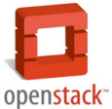










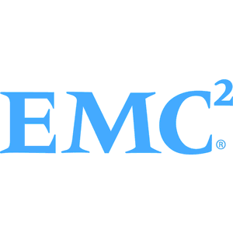



FusionSphere: OpenStack-based Open Cloud Service and Cloud Management Platform
NFV
(IMS/EPC/
vCPE/vSTB/CCS)
Platinum Member in OpenStack Community
VAS/Video
IT App
3rd App
Big Data
Standard OpenStack APIs
Developed based on native OpenStack APIs.
Quickly adapts to new OpenStack releases.
Support for third-party vendors
Compatible with the OpenStack ecosystem chain.
Supports heterogeneous hypervisors and hardware devices.
SOA-based loosely coupled architecture
Compute, storage, and network resources are decoupled from each other.
Supports hybrid networking with multi-vendor resource pools.
Hypervisor
Storage
Network
Server
Huawei, a platinum member of OpenStack community, acquired a seat in the BOD in early 2016.
Huawei ranked second in terms of contribution to OpenStack community in 2019.
With the help from the OpenStack and KVM communities, Huawei cloud platform has been widely accepted by major hardware and software vendors in the OpenStack ecosystem chain, and tends to be compatible with more products.
Notes:
This slide focuses on the fact that FusionSphere is developed based on standard OpenStack APIs. It is open and compatible with all OpenStack-based products, rather than a closed commercial solution.

Slide 38
OpenStack-based Plugin Enhancements
OpenStack
Ceilometer
Heat
Nova.
Nova-api (OS/EC2/Admin)
KeyStone
Swift
Glance
nova-conductor
Nova-Scheduler
nova-console
Cinder
Neutron
nova-novncproxy
MQ/DB
Huawei-En (Host A)
enhanced KVM
VMWARE Virtualization Engine (Host B)
XEN Virtualization Engine (Host C)
Nova-Compute
Nova-Compute
Nova-Compute
ComputeDriver
(FusionComputeDriver)
ComputeDriver
(VMwareVCDriver Virt-Driver)
ComputeDriver
(XENVirt-Driver)
Huawei-Enhanced KVM
vCenter Server
XEN

Slide 39
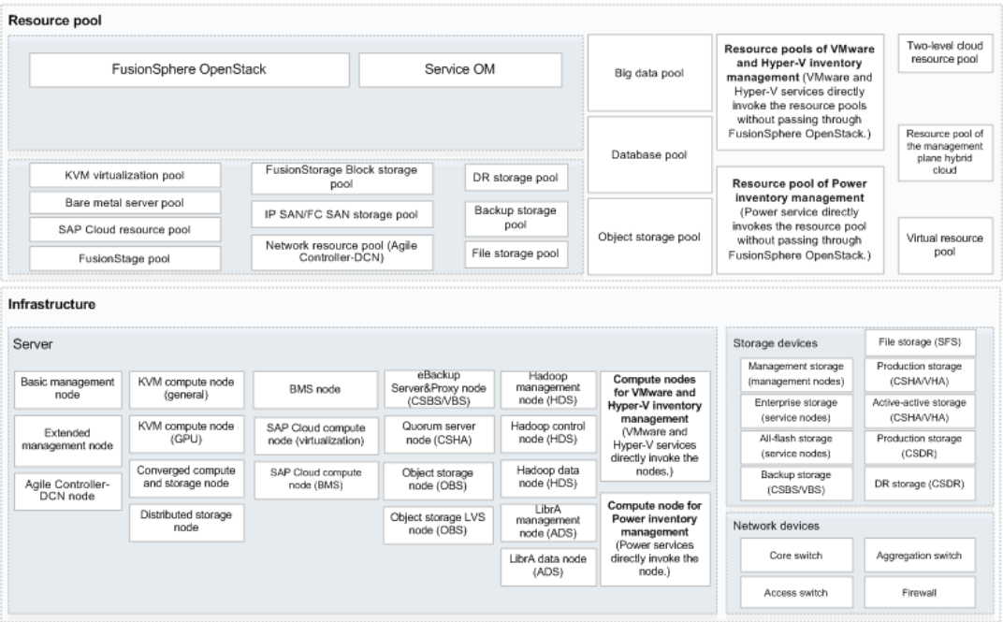
FusionSphere OpenStack Architecture

Slide 40
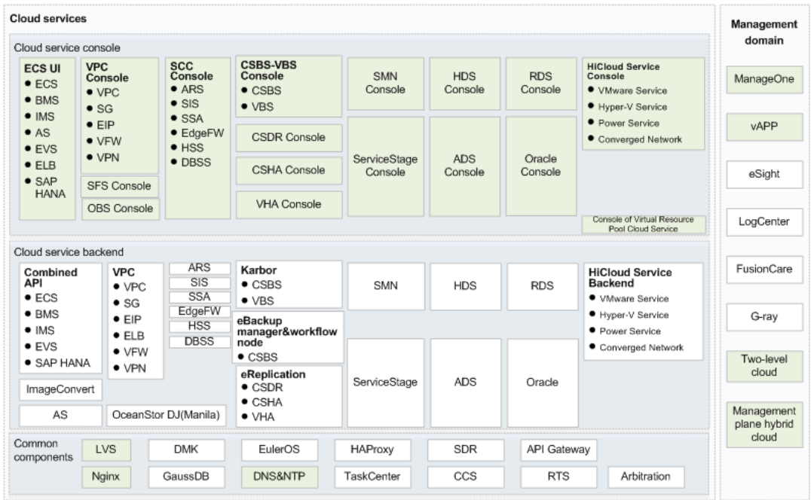
Cloud Service Architecture for FusionCloud

Slide 41




Open Architecture Supports Heterogeneous Virtualization
FusionSphere
FusionSphere provides a full set of OpenStack APIs, modular deployment interfaces, and infrastructure hardware management interfaces to communicate with northbound components.
Southbound heterogeneous compatibility:
Supports compute devices, including general-purpose IT hardware and IT appliances.
Huawei's hypervisor is compatible with industry-leading virtualization software such as KVM, vCenter, and FusionCompute.
Storage devices of different vendors, which can connect to FusionSphere using each vendor's own driver. FusionSphere also supports local storage, IP SAN, and distributed storage modes.
Network and security devices, which can connect to FusionSphere using each vendor's own neutron plugin and driver.
OpenStack API
FusionCompute
FusionStorage
FusionNetwork
Nova.
Cinder
Neutron
plugin
plugin
plugin
KVM/vCenter/FusionCompute
Huawei&3rd
server
Huawei&3rd
Storage
Huawei&3rd
Network

Slide 42
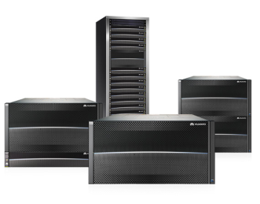
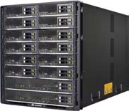
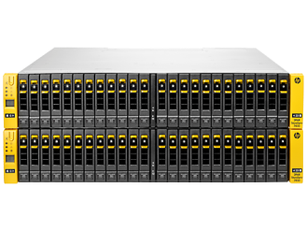
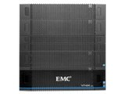
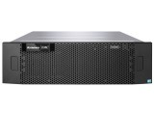
Open Architecture Supports Heterogeneous Storage Devices
Cinder provides persistent block storage services that provision resources on demand through unified interfaces (similar to Amazon EBS).
Various backend storage devices (local storage, network storage, FC SAN, and IP SAN) can be accessed using drivers.
Northbound APIs: OpenStack Cinder APIs support centralized management of storage resources.
Southbound APIs: Different Cinder-Volume drivers are compatible with storage devices of different vendors to prevent vendor lock-in.
OpenStack RESTful API
OpenStack Cinder
Cinder-Volume
Cinder-Volume
Cinder-Volume
Cinder-Volume
Cinder-Volume
Huawei OceanStor Driver
FusionStorage Driver
HP 3par Driver
EMC VNX Driver
... Other Driver
Huawei OceanStor
Server SAN
HP 3PAR
EMC VNX
Other vendors' storage

Slide 43
OpenStack Background
OpenStack System Architecture
Functions and Features of OpenStack
Huawei FusionSphere OpenStack Enhancements

Slide 44
True or False
  Heat of OpenStack provides the resource orchestration capability. ( )
Multiple Choice Question
  Which of the following are true of OpenStack? ( )
  Open-source project
  Ceilometer provides network services.
  Glance provides the image service.
  Horizon provides the UI service in OpenStack.
Notes:
Answers:
1.T
2.ACD

Slide 45
Huawei's official website
  Enterprise business: http://e.huawei.com/en/
  Technical support: http://support.huawei.com/enterprise/en/cloud-computing/fusionsphere-openstack-pid-21100528
  Online learning: http://learning.huawei.com/en/
Documentation tool
  HedEx Lite

Slide 46
Huawei Learning website
  http://support.huawei.com/learning/en/newindex.html
Huawei Support case library
  http://support.huawei.com/enterprise/servicecenter?lang=en

