Slide 1
Zhou Shengli (employee ID: zwx201803)
2017.7.27
Liu Lican (employee ID: 00180730)
New
Zhang Yue (employee ID: zwx635169)
2019.3.18
Liu Lican (employee ID: 00180730)

Slide 2
Introduction to Huawei KVM Virtualization

Slide 3
Kernel-based Virtual Machine (KVM) is a virtualization module in the Linux kernel that allows the kernel to function as a hypervisor.
This slide describes the virtualization technology, as well as the architecture and typical features of Huawei's KVM virtualization.

Slide 4
Upon completion of this course, you will be able to:
Understand the definition, characteristics, and categorization of virtualization technologies.
Understand the KVM architecture.
Understand the relationship between KVM and QEMU and libvirt.
Understand how KVM virtualizes the CPU, memory, and I/O.

Slide 5
Introduction to Virtualization
KVM Background and Architecture
KVM Implementation Principles

Slide 6














What Is Virtualization?
Virtualization is a broad concept. Any technology that virtualizes resources from one form into another can be called virtualization. Virtualization refers to logical abstraction of resources that are free from physical constraints.
Before Virtualization
After Virtualization
APP
APP
APP
APP
APP
APP
APP
APP
APP
APP
APP
APP
APP
APP
APP
Win
Linux
Win
Linux
Win
Linux
Win
Linux
Win
Linux
Win
Linux
Windows
Linux
Linux
Virtualization
Resource Pooling
Virtualization layer
Virtualization layer
Virtualization layer
Server 1
Server 2
Server 3
IT resources are independent.
The OS and hardware are tightly coupled.
Resources are virtulized into a shared resource pool.
The upper-layer OS is decoupled from hardware, and the OS allocates resources from the resource pool.

Slide 7
Important Concepts in Compute Virtualization
Guest OS:
Operating system running in a virtual machine (VM)
Guest Machine:
Virtual machine created through virtualization
Hypervisor:
Virtualization software layer, or
Virtual Machine Monitor (VMM)
Host OS:
Operating system running in a physical machine
Host Machine:
Physical machine
Physical Server
Virtual Machine
Application
Application
Host OS
Guest OS
Guest Machine
Virtual Machine Monitor (Hypervisor)
Host Machine
Host Machine

Slide 8
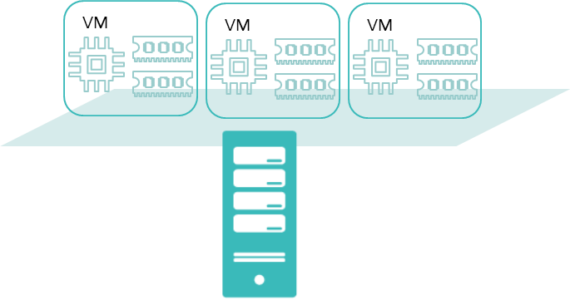
Characteristics of Virtualization
Host OS
Guest OS
Guest OS
Guest OS
Partitioned
Isolated
Encapsulated
Independent
VM
VM
Notes:
Partitioned: indicates the VMM's ability to allocate server resources to multiple VMs. Each VM runs an independent OS (same as or different from the OSs running on other VMs on the same server) so that multiple applications can coexist on one server. Each OS has access only to its own virtual resources (including the virtual NIC, virtual CPUs, and virtual memory) provided by the VMM.
Isolated: VMs that run on the same server are isolated from each other.
Even if one VM breaks down or experiences an OS failure, application breakdown, or driver failure, other VMs can still run properly.
If one VM is infected with worms or other viruses, other VMs will not be affected. It's like each VM is running on an independent physical machine.
Resources can be managed to provide performance isolation. Specifically, you can specify the minimum and maximum resources available for each VM to ensure that one VM does not use all resources, leaving no resources for other VMs residing on the same host.
Multiple workloads, applications, or OSs can run concurrently on one physical server, thus avoiding problems that may occur on the x86 server, for example, application program conflicts or DLL conflicts.
Encapsulated: All VM data, including the hardware configuration, BIOS configuration, memory status, disk status, and CPU status, is stored into a group of files that are independent of the physical hardware. This enables users to clone, save, and migrate a VM simply by copying, saving, and migrating these files.
Independent: VMs run on top of the virtualization layer. Therefore, only virtual hardware provided by the virtualization layer is visible. The VMs are independent of the underlying physical resources. In this way, the VMs can run on any x86 server (IBM, Dell, and HP) without any modification. This breaks the coupling between OSs and hardware and between applications and OSs/hardware.
Therefore, these functions are significant for creating and running VMs.

Slide 9
Virtualization Types
APP
APP
APP
APP
APP
Guest OS
Guest OS
Guest OS
Guest OS
Guest OS
VM
VM
VM
VM
VM
APP
VMM
VMM
Host OS
Hardware
Hardware
Bare Metal Virtualization
(Type I)
Hosted Virtualization
(Type II)

Slide 10
Compute Virtualization Technologies
Compute virtualization includes CPU virtualization, memory virtualization, and I/O virtualization.
Compute virtualization
CPU, memory, and I/O virtualization
Open Source
Closed Source
KVM
Hyper-v
Xen
VMware ESXi
Huawei FusionSphere

Slide 11
Huawei UVP Architecture
DomainU
DomainU
Guest
Application
libvirt interface + OS API
virtio(FE)
Hardware passthrough driver
Virtual watchdog
Virtual serial port
QEMU
VMChannel
SoftBIOS
Linux Kernel
Universal I/O Network virtualization Storage virtualization
virtio(BE)
EVS
Vhost-scsi
Native Driver
NIC passthrough
Inter-VM communication
VT-d/SR-IOV
VM image
Hypervisor (KVM)
Compute Virtualization
vCPU
(QoS/NUMA/hot swap and physical core isolation)
vMem
(hugepage and shared memory)
Scheduling/Interrupt optimization (interrupt coalescing, ExitLess Interrupts, virtual APIC)/Timer
Hardware
CPU (VT-x)
Memory (EPT)
Network (VMDq/SR-IOV)
Storage (NPIV)
Notes:
Guest (VM): The client system, including the vCPU, memory, console, NIC, storage device, is run by KVM in a restricted CPU mode.
KVM: runs in the kernel space to virtualize the CPU and memory and to intercept I/Os of the guest OS. I/Os intercepted by KVM are processed by QEMU. KVM provides /dev/kvm device interfaces to QEMU.
QEMU: is the modified native QEMU code used by the KVM VMs, runs in the user space, and provides I/O virtualization; Communicates with KVM through the ioctl function.

Slide 12
Introduction to Virtualization
KVM Background and Architecture
KVM Implementation Principles

Slide 13
KVM Background
KVM
Open source full virtualization solution
Architecture support
x86 (32-bit or 64-bit), IA-64, PowerPC, and S390
Relies on x86 hardware support: Intel VT-x/AMD-V
Kernel module, which turns the Linux kernel into a hypervisor
Cloud platform support for KVM
OpenStack, Eucalyptus, and AbiCloud support both KVM and Xen.
KVM history
In October 2006, Israel company Qumranet released KVM.
In December 2006, KVM was integrated into the Linux kernel (Linux 2.6.20rc).
In February 2007, Linux 2.6.20 was officially released.
In September 2008, Red Hat acquired Qumranet for US$107 million.
In September 2009, RHEL 5.4 started to support KVM, as well as Xen.
Since November 2010, RHEL 6.0 or later version supported only KVM.

Slide 14
What Is KVM?
KVM is a virtualization module embedded in the standard Linux kernel. KVM consists of a kernel module, kvm.ko, that manages the virtual CPU and memory.
VM
VM
Application A
Application A
User
space
process
Bins/Libs
Bins/Libs
User
space
process
Guest OS
Guest OS
QEMU
QEMU
User space
Kernel space
Linux kernel
KVM module
Physical hardware

Slide 15
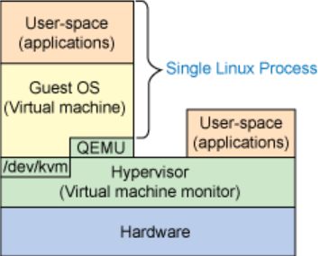
What Is KVM?
Guest: The guest OS, including the CPU (vCPU), memory, and drivers (console, NIC, and I/O device drivers), is run by KVM in a restricted CPU mode.
KVM: Runs in the kernel space to virtualize the CPU and memory and to intercept I/Os of the guest OS. I/Os intercepted by KVM are processed by QEMU.
QEMU: is the modified native QEMU code used by the KVM VMs, runs in the user space, and provides I/O virtualization. Enables communication between dev/kvm and KVM through the ioctl function.
Notes:
KVM can convert a standard Linux kernel into a VMM. The Linux standard kernel embedded with the KVM module can load guest OSs through KVM tools. Therefore, in such an OS platform, the VMM virtualization layer resides directly on the physical hardware layer of the host, and no independent host OS layer is provided. In this case, the VMM functions as the host OS. CPU instructions of the guest OS are executed directly, rather than through QEMU. This greatly improves the speed. KVM exposes the necessary APIs through /dev/kvm. User-mode programs can access these APIs by calling the ioctl function.
The KVM kernel module provides only CPU and memory virtualization. Therefore, it must be combined with QEMU to form a complete virtualization solution, that is, qemu-kvm.
As a hypervisor, KVM focuses on VM scheduling and memory management. I/O peripheral tasks are handled by the Linux kernel and QEMU. With I/O virtualization, storage and network resources are virtualized by the Linux kernel and QEMU.
By integrating KVM, QEMU uses its kernel module to process CPU instructions by invoking the /dev/kvm interface through ioctl. KVM is responsible only for CPU and memory virtualization. QEMU emulates I/O devices (such as NICs and disks). Server virtualization is jointly implemented with KVM and QEMU, so QEMU is called qemu-kvm. QEMU is an emulator that emulates the CPU and other hardware needed by the guest OS. The guest OS believes that it communicates with the hardware directly. In fact, it interacts with the hardware simulated by QEMU. QEMU translates and sends these instructions to the real hardware. The performance is compromised because all the instructions need to be translated by QEMU.
QEMU also emulates other hardware, such as NICs and disks, which also affects the performance of these devices. To address this, pass-through and paravirtualization techniques, such as virtio_blk and virtio_net, are used to improve device performance.
14

Slide 16
KVM Architecture
Management Tools
Virsh
Virt-manager
Virt-viewer
Virt-install
Others
libvirt
Linux Kernel
(KVM module)
QEMU
QEMU
Guest OS
Guest OS

Slide 17
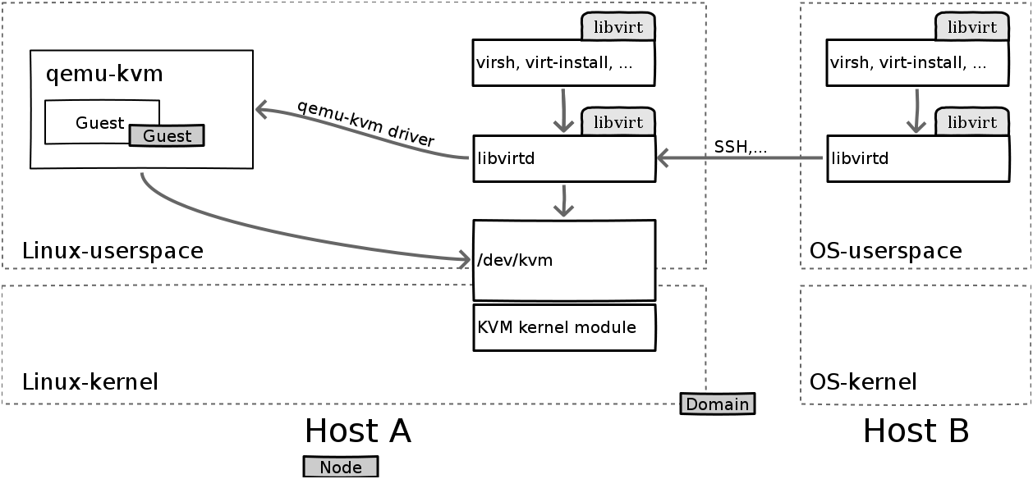
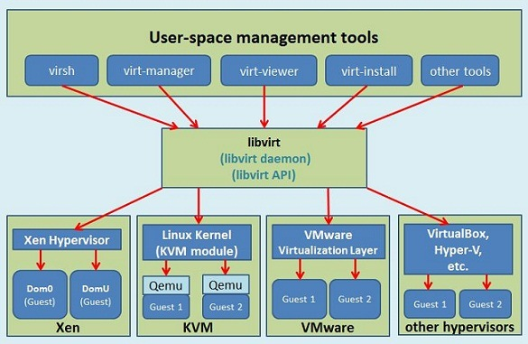
KVM and libvirt
libvirt is the most widely used multi-platform VM management tool and API (multi-language).
In KVM scenarios, libvirtd invokes qemu-kvm to manage VMs.
Both QEMU and libvirtd trigger the kernel module through the character device /dev/kvm.
VM management processes, such as virsh, use libvirt to query VMs.
Notes:
libvirtd is a daemon process that can be invoked by virsh locally or remotely.
qemu-kvm invokes the kernel module of KVM to implement CPU virtualization.

Slide 18
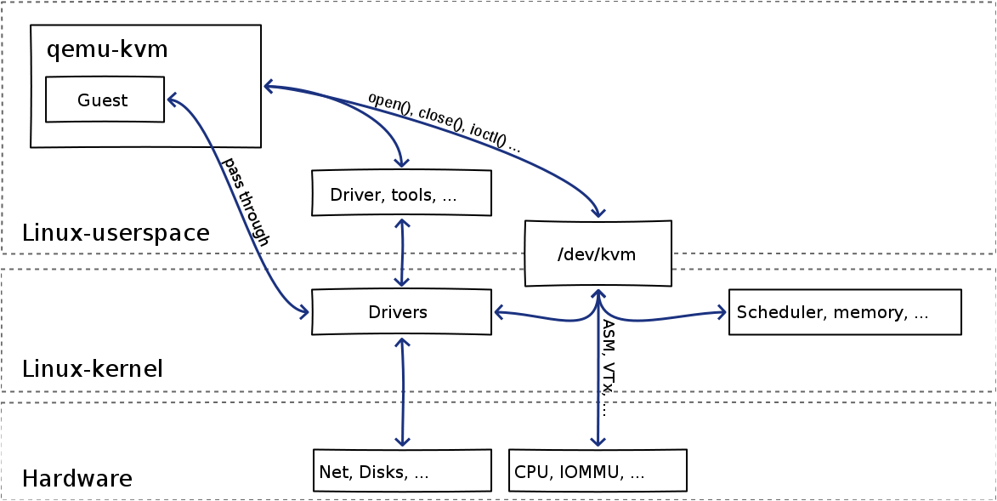
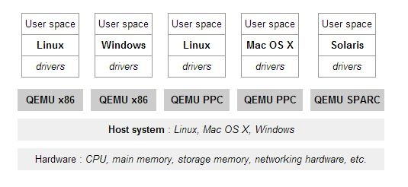
KVM and QEMU
QEMU is an emulator that emulates CPUs of a variety of hardware platforms, but at a low efficiency.
By integrating KVM, QEMU leaves the handling of CPU instructions to the kernel module by calling KVM interfaces through ioctl. This is called qemu-kvm (qemu-system-XXX).
QEMU also emulates other hardware, such as NICs and disks, which also affects the performance of these devices. To address this, pass-through and paravirtualization techniques, such as virtio_blk and virtio_net, are used to improve device performance.
Notes:
Note: qemu-kvm in the figure is different from the native QEMU that does not support hardware acceleration.

Slide 19
Introduction to Virtualization
KVM Background and Architecture
KVM Implementation Principles
CPU Virtualization
Memory Virtualization
I/O Virtualization

Slide 20
CPU Virtualization Challenges
For native OSs, the following CPU requirements must be met:
CPU resources are always ready.
The OS has the highest level of privilege on the CPU.
CPU virtualization leads to the following issues:
Multiple VMs share CPU resources.
Some commands can be used only by hypervisors.

Slide 21
CPU Virtualization - CPU Sharing
How to enable CPU sharing between multiple VMs:
VMs use vCPUs, and the hypervisor schedules vCPUs to physical CPUs, thus implementing time-based sharing of physical CPU resources.
Guest OS 1
Guest OS 2
vCPU
vCPU
vCPU
vCPU
Physical CPU

Slide 22
CPU Virtualization - Rights Management
Sensitive instruction processing
Typically, Privilege Deprivileging and Trap-and-Emulation are used. Specifically, the guest OS runs on the non-privilege level (Deprivileging) and VMM on the highest privilege level, that is, the VMM fully controls system resources. While de-privileged, the guest OS can still execute most of the instructions on hardware. Only the privileged instructions are trapped and emulated by the VMM.

Slide 23
CPU Virtualization - VT-x
VT-x: Intel hardware-assisted virtualization technology, which quickly implements vCPU context switching using mechanisms such as VMCS and VMEntry/VMExit
With Intel VT-x, there are two distinct modes of CPU operation: root mode and non-root mode
Root mode: used to run hosts.
Non-root mode: used to run VMs. VM entry is a VT-x instruction that can switch from the root mode to the non-root mode.
All x86 instructions can run in both root mode and non-root mode. The difference is that when a privileged instruction runs in non-root mode, it is switched to the root mode through VM exit, and the KVM module processes the privileged instruction through simulation. That is, privilege instructions cannot be handled in non-root mode.

Slide 24
CPU Virtualization Modes with KVM
User mode
Kernel mode
Guest mode
Guest VM
Guest VM
Guest mode
Non-root mode
VM exit
VM entry
Lightweight exit
KVM module
Kernel mode
Root mode; privilege level: 0
I/O operations
vCPU
creation/initialization
vCPU
running/exit
Non-I/O operations
Exit
Returned value for ioctl
Returned value for ioctl
ioctl
ioctl
Heavyweight exit
QEMU module
User mode
Root mode; privilege level: 3
vCPU
creation/initialization
vCPU
running/exit
I/O emulation

Slide 25
Introduction to Virtualization
KVM Background and Architecture
KVM Implementation Principles
CPU Virtualization
Memory Virtualization
I/O Virtualization

Slide 26
Memory Virtualization Challenges
For native OSs, the following memory requirements must be met:
The memory starts from physical address 0.
Consecutive memory blocks are allocated.
Virtualization leads to the following issues:
Starting from physical address 0: There is only one physical address 0. The memory space of every VM cannot all start from 0.
Consecutive addresses: Although consecutive physical addresses can be allocated, this way of memory allocation leads to poor efficiency and flexibility.
Glossary
GVA: Guest Virtual Address
GPA: Guest Physical Address
HPA: Host Physical Address

Slide 27
Memory Virtualization Challenges
VM 1
VM 2
VM 3
VM 4
1
2
Guest Physical Memory
3
4
5
Virtual Machine Monitor (VMM)
5
1
Machine Physical Memory
2
3
4
Notes:
The VMM needs to handle the following:
Maintains the physical address mapping between the guest and host.
Intercepts VM access requests, and replaces the addresses in these requests with the physical addresses of the host according to the mapping relationship.

Slide 28
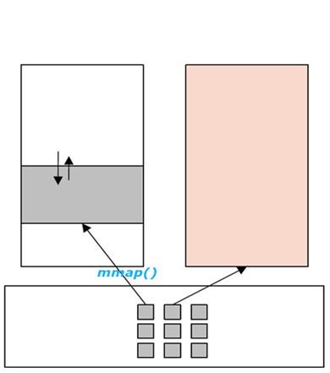
Memory Virtualization with KVM
KVM provisions the VM memory by calling the mmap interface. In the virtual address space of the QEMU main thread, a space of consecutive addresses is declared for the physical memory mapping of each guest machine.
The physical addresses exposed to the VM are consecutive VM addresses in the space.
KVM memory mapping
DMA simulation
Space with consecutive VM addresses
Memory allocated to the guest

Slide 29
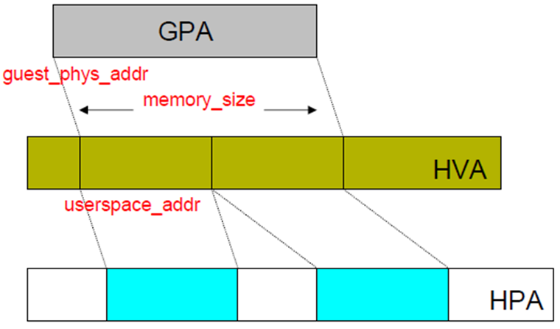
Memory Virtualization with KVM - MMU Virtualization
VM memory allocation
Guest physical addresses are located in the virtual address space of the kvm-qemu process.
The guest physical memory page is allocated by the host on demand.
Two types of MMU virtualization
Software: Shadow page table
Hardware: EPT (Intel)
GPA: Guest Physical Address
EPT: Extended Page Table
MMU: Memory Management Unit
Notes:
MMU: Memory management unit
KVM uses the existing kernel mechanism to manage memory pages and allocate resources on demand. The guest physical memory (GPA) addresses are located in the virtual address space of the kvm-qemu process, and the virtual address space of the guest is mapped to the GPA.
Two ways of MMU virtualization are available: shadow page table and hardware-assisted. Currently, the hardware-assisted mode (Intel EPT/AMD NPT) implements two-level address translation through the hardware, accelerating GPA-HPA conversion and reducing VM exits.
Address space
Physical address space: hardware address space, for example, 4 GB.
Virtual address space: Each process has its own virtual address space.

Slide 30
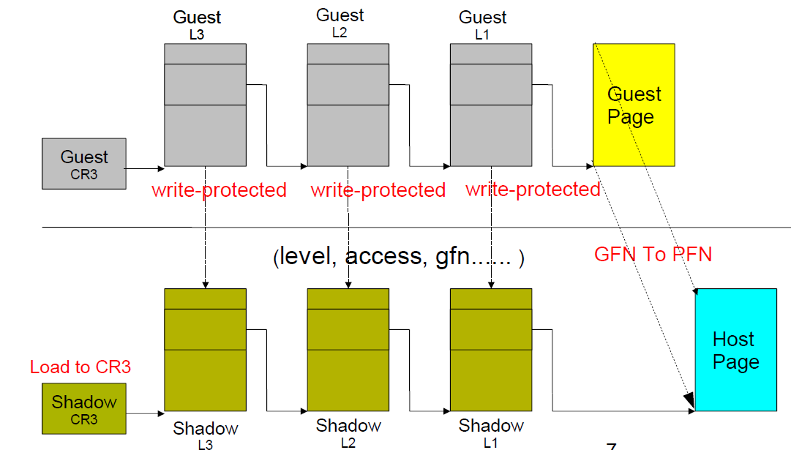
KVM Memory Virtualization - Shadow Page Table
Guest Page Table is set to write-protected to ensure consistency between the guest pages table and the shadow page table.
If the dirty bit of guest PTE is not set, the writable bit of shadow PTE is deleted.
Notes:
The shadow page table is used when there is no EPT. However, CPUs launched by Intel since 2007 and 2008 support EPT.

Slide 31
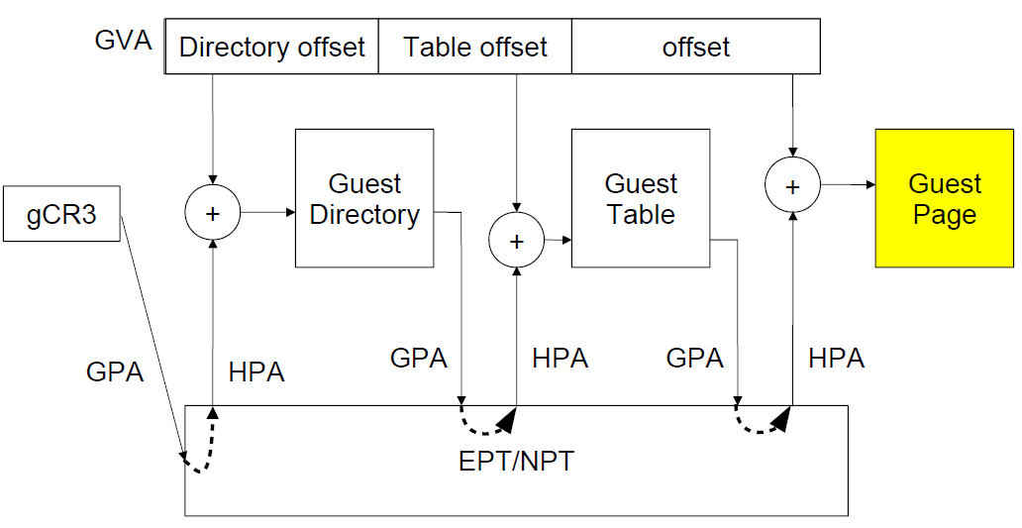
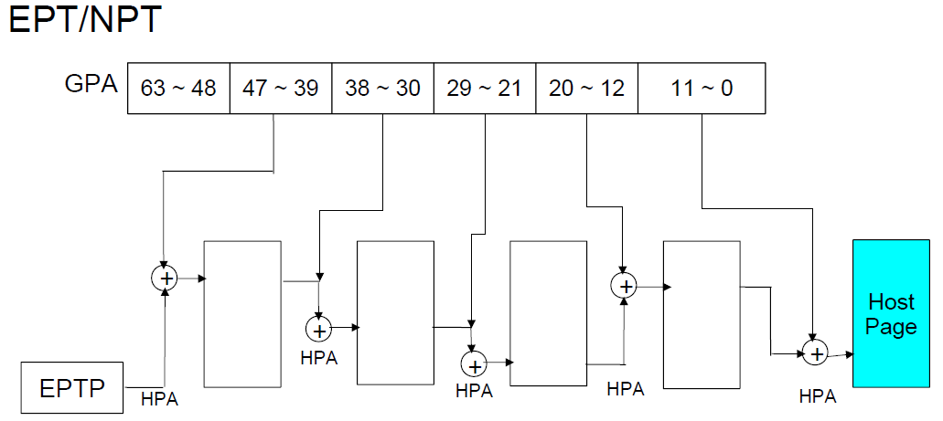
KVM Memory Virtualization - EPT/NPT
Advantage: VM exits are reduced, outperforming shadow page tables.
Converting GPA into HPA
Notes:
EPT: Intel adds EPT based on VT-x as an extension of VT-x. EPT is dedicated to memory virtualization. EPT implements memory virtualization access using hardware.
After the KVM module creates the GPA-HPA page table of the VM, memory access can be completed by only hardware, without the need of simulation and interception.

Slide 32
Introduction to Virtualization
KVM Background and Architecture
KVM Implementation Principles
CPU Virtualization
Memory Virtualization
I/O Virtualization

Slide 33
I/O Virtualization Challenges
I/O virtualization handles the following:
Device discovery
Controls devices accessible to VMs.
Access interception
Accesses devices through I/O ports or MMIO.
Devices exchange data with the memory through DMA.

Slide 34
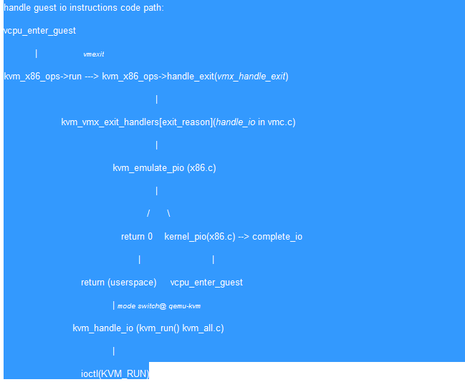
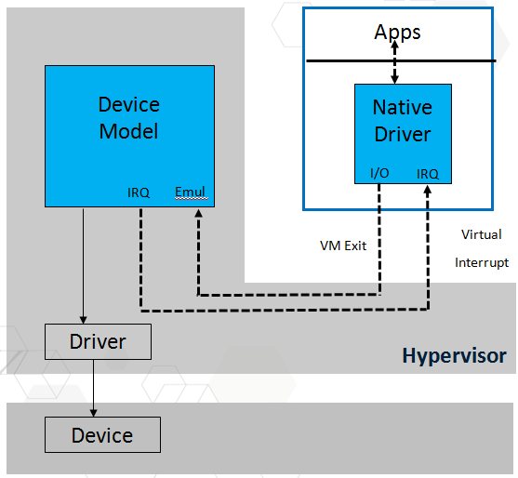
KVM I/O Virtualization - Full Simulation
Use software to fully simulate a specific device.
Keep the same software ports, for example, PIO, MMIO, DMA, and interrupt.
Simulate virtual devices that are different from physical devices in the system.
Multiple context switches are required for each I/O operation.
VM and hypervisor
QEMU and hypervisor
Device simulated by software does not affect the software stack of VMs.
Native drivers
Full simulation involves a lot of data copying. For devices that require frequent I/O operations, such as disks and NICs, full simulation delivers poor performance.

Slide 35
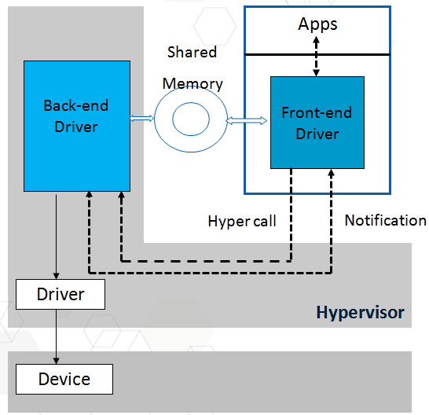
KVM I/O Virtualization Optimization - virtio
Virtualization of special devices
Special device drivers, including the frontend drivers on VMs and the backend drivers on the hosts
Efficient communication between the frontend and backend drivers
Reduced data transmission overhead between VMs and hosts
Shared memory (Virt RING)
Batched I/O
Asynchronous event notification mechanism (wait and notify) between Eventfd lightweight processes
Efficient and standard PV drivers
PCI-compatible: device discovery, configuration, and IRQ
Support multiple virtualization platforms, such as KVM and Lguest.
Device types:
virtio-blk, virtio-net, virtio-balloon, virtio-console, virtio-scsi, and virtio-9p
Notes:
virtio, to be specific, the frontend and backend driver model, delivers high simulation efficiency without kernel modification.
virtio uses vring to store requests and responses. vring can be accessed by both the frontend and backend. The frontend notifies the backend of request receipt through PIO, and the backend notifies the frontend of request completion through interrupt injection. The vring space is requested by the frontend which writes the addresses to the PCI configuration space. As all the memory of the VM is simulated by QEMU, QEMU stores the relationship between the GPA and the HVA. Therefore, the frontend and backend can easily access the memory pointed to by vring. vring is also called virtual object interface. The number of virtual object interfaces varies according to devices. For example, the network driver uses two virtual queues, one for receiving and the other for sending, while the block device driver uses only one virtual queue.

Slide 36
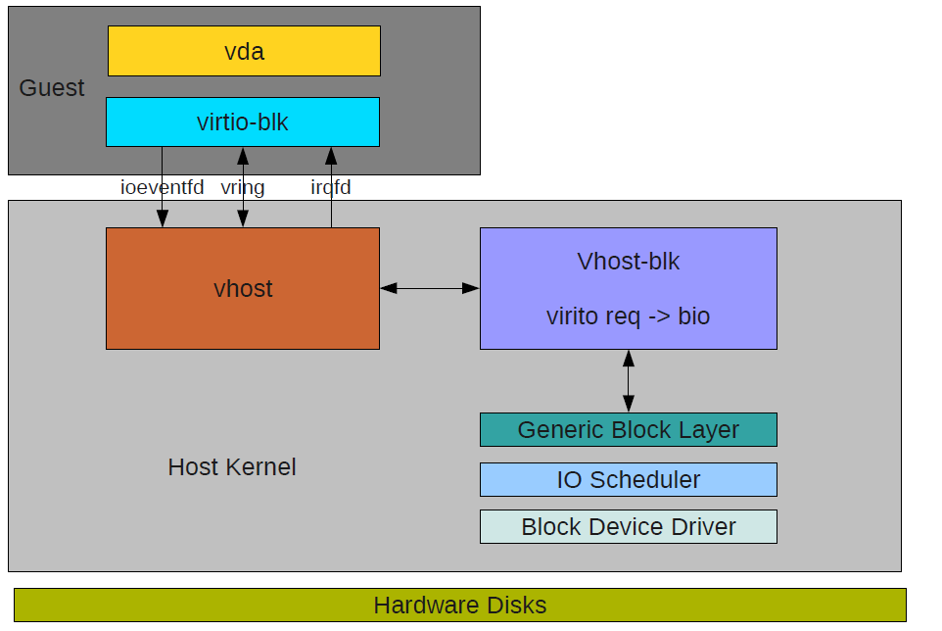
KVM I/O Virtualization Optimization - vhost
vhost optimization covers vhost-block, vhost-net, and vhost-scsi.
The I/O requests from the VM are directly mapped to bio on the host, reducing I/O execution on the VM and delivering better performance. The frontend is fully compatible with vhost.
Notes:
virtio, to be specific, the frontend and backend driver model, delivers high simulation efficiency without kernel modification.
virtio uses vring to store requests and responses. vring can be accessed by both the frontend and backend. The frontend notifies the backend of request receipt through PIO, and the backend notifies the frontend of request completion through interrupt injection. The vring space is requested by the frontend which writes the addresses to the PCI configuration space. As all the memory of the VM is simulated by QEMU, QEMU stores the relationship between the GPA and the HVA. Therefore, the frontend and backend can easily access the memory pointed to by vring. vring is also called virtual object interface. The number of virtual object interfaces varies according to devices. For example, the network driver uses two virtual queues, one for receiving and the other for sending, while the block device driver uses only one virtual queue.

Slide 37
Which CPUs are supported by KVM? ()
A. Inter VT-x
B. AMD-V
C. Power PC
D. s390
Which of the following statements are true? ()
A. KVM does not perform any hardware emulation, which is implemented by QEMU.
B. Since Linux 2.6.20, KVM has become a module included in the Linux kernel.
C. To use KVM, CPUs need to support the virtualization function.
D. KVM is completely open-source.
Notes:
Answer:
ABCD
ABCD

Slide 38
Virtualization Technology
KVM Background and Architecture
Implementation Principles

Slide 39
Huawei official websites:
Enterprise business: http://e.huawei.com/en/
Technical support: http://support.huawei.com/enterprise/en/
Online learning: http://learning.huawei.com/en/
Document tool:
HedEx Lite

Slide 40
Huawei E-Learning website:
http://support.huawei.com/learning/Index!toTrainIndex
Huawei support case library:
http://support.huawei.com/enterprise/servicecenter?lang=en

