Slide 1
HCDCA113
Computing Basics
V1R1
1.00
Zhou Shengli/wx201803
2017.8.11
Liu Lican/00180730
New
Yuan Weihua/wx462781
2019.4.10
Liu Lican/00180730
Update

Slide 2
DC Cloud Computing Basics
Huawei Data Center Series of Courses

Slide 3
This course introduces data center (DC) cloud computing from the perspectives of DC development, cloud computing development, and cloud computing advantages and deployment modes. After learning this course, you are supposed to have a clear understanding of the entire framework of DC cloud computing.

Slide 4
On completion of this course, you will be able to know:
  DC development and evolution
  Virtualization of cloud computing
  Benefits of cloud computing
  Deployment modes of cloud computing

Slide 5
DC Development
Cloud Computing Development
Benefits of Cloud Computing
Deployment Modes of Cloud Computing

Slide 6

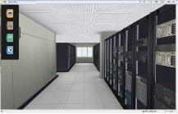
DC Development
DC As A Service
Software-defined DC
SDX service
Planned migration service
Service definition
VDC service
Cloud service
(cloud DC)
Resource mgmt. service
Sharing service center
Auto scaling
Resource
pooling
Resource scheduling
Resource integration
Resource standardization
Virtualization
Hardware decoupling
Resource
centralization
Centralized management
Service capability is a key indicator for weighing DC maturity. Cloud DCs are the future of DCs.
2010
2012
2014
2016
Notes:
A DC involves three types of hardware: server, storage, and network. All of them are defined by software. A software-defined DC is basically an application-defined DC for offering all user-demanded applications.

Slide 7

Key Capabilities of Cloud Computing DCs
Resource pool service
Resource pooling reduces investments.
Feature resource pools allow differentiated configurations.
Resource mgmt. service
1
Automation brings down management costs.
Unified resource pool scheduling enhances resource utilization.
Cloud-sharing DC
2
Key capabilities of cloud DCs
VDC
service
Self-services bring service agility.
Rights-and domain-based management trims management costs.
3
Resources are flexibly allocated for improved resource utilization.
Resource standardization cuts management costs.
4
SDX capability service
Planned migration service
Strategic planning adapts to service development.
Professional service drives smooth business migration.
5
A cloud DC is a shared DC, which is more than a virtualization DC.
Notes:
This slide introduces key cloud DC capabilities: resource pooling, unified resource management, flexible resource definition (SDX, such as SDS and SDN. For details, see the remarks on slide 5), rights- and domain-based management (physical resource pools can be divided into VDCs by department or enterprise), and scheduled service migration.

Slide 8
Rapidly Developing Cloud Computing Is a Preferred Solution to IT Construction
Make preparations
Take off
Grow mature
Public cloud
Private cloud
Cloud computing as infrastructure
Public cloud
Hybrid cloud
Private cloud
The business model was in discussion.
Users were unfamiliar with cloud computing.
Ecosystem building and business model were in practice.
A large number of success cases were surging.
The ecosystem and business model are becoming mature.
Cloud computing is becoming mandatory IT resources.
2007
2010
2012
2015
2020

Slide 9

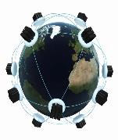
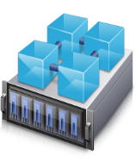






Cloud Computing Development
Hybrid cloud
Private
Public
Virtualization
Private cloud
Multi-DC consolidation
Hybrid cloud
Computing virtualization
Storage virtualization
Network and security virtualization
Automatic management
Elastic resource scheduling
Large cluster-based HA and DRS
Multi-level backup and DR
SDN virtualization
OpenStack/AWS APIs
Hardware/Virtual resource pool management
Software-defined DCs

Slide 10
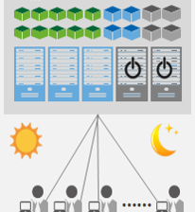


Private Cloud: Automation Helps Simplify Management
Resource recycling: Elastic scaling and time-based resource reuse of application resources achieve resource sharing among applications.
Resource pool management: Resource pool quota management and priority management ensure that prioritized VIP applications always obtain required resources.
DPM: Energy management policies, VM migration, and automatic power-off of idle servers improve energy efficiency.
Resource recycling
Resource pool management
Daytime
Night time
Elastic cluster resource scheduling
DRS: Automatic VM migration and load balancing policies ensure high computing performance.
Storage DRS: Automatic storage migration ensures high I/O performance.
Elastic VM resource scaling

Slide 11




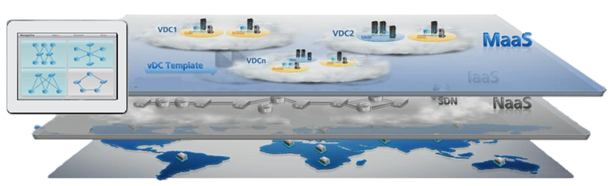

Hybrid Cloud: Makes IT as a Service
Public cloud
Hybrid cloud
Cloud mgmt.

Slide 12



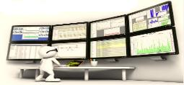


Cloud DC Service System
Planning and design
Shortens deployment time by over 60%.
DR
Ensures data availability and integrity.
Consolidation
Reduces CAPEX by over 40%.
Evaluation and optimization
Improves performance and eliminates potential risks.
Migration
Ensures unchanged high user experience.

Slide 13





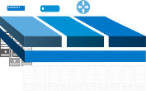

Service-driven Distributed Cloud DC Allows On-Demand IT Resource Usage
Service-Driven Distributed Cloud Data Center
SD-DC²: rebuilding DCs based services
IaaS
PaaS
SaaS
Service and resource matching
Automatic service awareness
Insufficient or excessive resources
Appropriate service support
VDC
VDC
Average resource allocation
Better strategic service support
VDC
Computing
Pool
Storage
Pool
Network
Pool
Computing
Pool
Network
Pool
Computing
Pool
Storage
Pool
Storage
Pool
Network
Pool
SDN
SDN
SDN

Slide 14
DC Development
Cloud Computing Development
  Concept
  Virtualization
Benefits of Cloud Computing
Deployment Modes of Cloud Computing

Slide 15


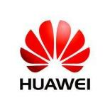


What Contributes To the Emergence of Cloud Computing?
Service demands
Cloud computing
Technological progress
Business model transformation
Service demands, technological progress, and business model transformation contribute to the emergence of cloud computing.
Notes:
Service demands, technological progress, and business model transformation contribute to the emergence of cloud computing.
Service demands
Governments and enterprises are keen for digitalization that requires low costs but generates high performance.
Individual users have strong requirements for Internet and mobile Internet applications and constantly pursue compelling user experience.
Technological progress
Virtualization, distributed and parallel computing, and mature Internet technologies make it possible to provide Internet-driven IT infrastructures, development platforms, and software applications.
As broadband technology and users develop, the Internet-based service mode becomes the mainstream.

Slide 16
Notes:
Business model transformation
The cloud computing services of several cloud computing pioneers (such as IaaS and PaaS provided by Amazon) have been rolled out.
The business model of cloud computing has been recognized by the market as more and more users start to accept and use cloud computing services.
The cloud computing ecosystem is forming, and the industrial chains have developed and integrated.
Cloud computing has evolved from an emerging technology to a popular technology in a few years. Since Google released the core documents of the cloud computing, Amazon Elastic Compute Cloud (EC2) achieved commercial application, to the US telecom giant American Telephone Telegraph (AT&T) launched Synaptic Hosting (dynamic hosting) services, cloud computing has changed from a cost saving tool to a profit promoter that has been widely used by from Internet service providers (ISPs) to telecom enterprises. Now cloud computing has successfully changed from a built-in IT system to a public service.

Slide 17

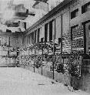







IT Development History
1
2
3
Mainframe era
PC era
Cloud computing era
Notes:
Mainframe centralized mode: processes large-scale applications centrally and is confined to DCs.
Client/Server mode: enables applications to be no longer restricted by DCs but to be used by common users.
PC: Personal Computer.
Cloud computing mode: responds to the explosive growth of information and the demand for a dynamic flexible architecture.

Slide 18
What Is Cloud Computing?
National Institute of Standards and Technology (NIST): Cloud computing is a model for enabling ubiquitous, convenient, on-demand network access to a shared pool of configurable computing resources (e.g., networks, servers, storage, applications, and services) that can be rapidly provisioned and released with minimal management effort or service provider interaction.
Wikipedia: Cloud computing is a type of computing technology based on Internet. By using this technology, users can provide shared software and hardware resources and information for computers and other devices on demand. It relies on sharing of resources to achieve coherence and economies of scale, similar to a utility (like the electricity grid) over a network.

Slide 19
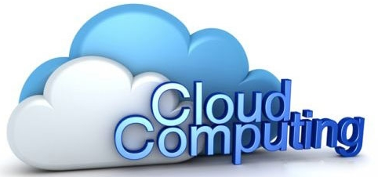
Key Characteristics of Cloud Computing
On-demand self-service
Ubiquitous network access
Location independent resource pooling
Rapid and elastic
Pay-per-use
Notes:
On-demand self-service: Consumers can deploy processing capabilities based on service requirements on servers and network storage, and do not need to communicate with each service provider.
Ubiquitous network access: Various capabilities can be obtained over the Internet. The Internet can be accessed using the standard mode through various clients, such as mobile phones, laptops, and PDAs.
Location independent resource pooling: Computing resources of service providers are centralized for customers to rent. Physical and virtual resources can be dynamically allocated to address customer requirements. Customers generally cannot control or know the exact location of the resources. The resources include storage, processors, memory, network bandwidth, and VMs.
Rapid elastic: Resources can be rapidly and elastically provided to users. Users can also rapidly expand or reduce resources. A user can rent unlimited resources at any time.
Pay per use: The service is charged based on pay-per-use or advertisement to optimally use resources. For example, a user can be charged per month based on the actually used storage, bandwidth, and computing resources. The cloud used by the same organization in a company can be charged between departments.

Slide 20

Cloud Computing Network = Computing and Storage Network
Community
Computing
File
Storage
Applications and services
Service and application software
Search
Price
...
Cloud services
Application service API
Cloud capability service API
Core of cloud computing
Cloud platform software
Cluster mgmt.
Parallel
processing
Automatic mgmt.
and control
VM and OS
Distributed storage
Massive data processing
Servers and storage devices
Cloud devices
...
...
Tens of thousands of servers connected
Ethernet switches
Notes:
From the technical prospective, cloud computing includes cloud devices and cloud services.
Cloud devices include the servers used for data computing and processing, the devices used for data storage, and the switches used for data communications.
Cloud services include the cloud platform software used for managing the physical resource virtualization scheduling and the application platform software used for providing services for users.
Development of cloud computing
Numerous low-cost servers replace dedicated mainframes, minicomputers and high-end servers.
Distributed software replaces the traditional single-host OS.
Automatic management and control software replaces the traditional centralized management.

Slide 21
DC Development
Cloud Computing Development
  Concept
  Virtualization
Benefits of Cloud Computing
Deployment Modes of Cloud Computing

Slide 22

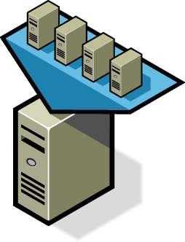



Essence of Virtualization
Zoning
Isolation
Multiple VMs can run on a single physical server concurrently.
VMs on the same server are isolated from one another.
Encapsulation
Independent of hardware
Data on a VM is saved in files. A VM can be moved and replicated by moving and replicating the files.
A VM can operate on any server without configuration modification.
Notes:
Zoning: indicates the VMM's capability of allocating server resources to multiple VMs. Each VM can run an independent OS (same as or different from the OSs running on other VMs) so that multiple applications can run on one server. Each OS gains access only to its own virtual hardware (including the virtual NICs, CPUs, and memory) provided by the VMM.
Isolation: VMs that run on the same server are isolated from each other.
Even if one VM cracks down or fails due to an OS failure, application breakdown, or driver failure, other VMs on the same server can still run properly.
If a VM is infected with worms or viruses, it will be isolated from other VMs. It seems that each VM is located at an independent physical machine.
Resource control helps achieve performance isolation. Specifically, you can specify the maximum and minimum resource usage for each VM to ensure that one VM does not use all resources, leaving no available resources for other VMs in the same system.
Encapsulation: All VM data, including the hardware configuration, BIOS configuration, memory status, disk status, and CPU status, is stored into a small group of files that are independent of physical hardware. This enables users to copy, save, and migrate VMs by copying, saving, and migrating several files.

Slide 23
Important Concepts About Virtualization
Physical machine
VM
OS
Guest OS
OS
Guest OS
VM
Guest Machine
VM
Guest Machine
OS
Host OS
VMM
Hypervisor
Hardware
Host Machine
Hardware
Host Machine
Notes:
Host machine
Indicates customers' resources.
Guest machine
Indicates virtualized resources.
Guest and host OSs
If one physical machine is virtualized into multiple virtual machines, the physical machine is a host machine, and the virtual machines are guest machines. The OS installed on the physical machine is a host OS, and that installed on the virtual machine is a guest OS.
Hypervisor
Through virtualization by the virtualization layer, upper-layer software regards VMs as real machines. The virtualization layer is called virtual machine monitor (VMM) or hypervisor.

Slide 24
Virtualization Technology Classification
By application scenario
  OS virtualization
    VMware: vSphere
    Microsoft: Hyper-V
    Citrix: XenServer
    Huawei: FusionSphere
  Desktop virtualization
    Microsoft: Hyper-V
    Citrix: XenDesktop
    VMware: VMware View
    Huawei: FusionAccess
    By hardware resource allocation mode
  Full virtualization
    Virtual OSs are separated from underlying hardware, and the hypervisor located between them converts the codes sent by the virtual guest OSs to invoke the underlying hardware. Full virtualization requires no changes to the guest OS and boasts excellent compatibility.
    Typical applications include VMware WorkStation, early-stage ESX servers, and Microsoft virtual servers.
  Paravirtualization
    Dedicated virtualization instructions are added to virtual guest OSs for invoking hardware resources through the hypervisor, relieving the performance overhead introduced by the hypervisor. The typical application is Xen.
  Hardware-assisted virtualization
    A new instruction set and processor running mode are added to the CPU for virtual OSs to directly invoke hardware resources.
    The typical applications are Intel VT and AMD-V.

Slide 25
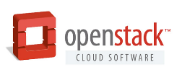








Introduction to Virtualization Products
Open-source cloud OS
Desktop virtualization
Server virtualization

Slide 26
Computing Virtualization Principles
OS
CPU virtualization
  When timer interrupt, the similar mechanism as that of the traditional OS, is triggered, VMM works to schedule VM disks based on the preset scheduling mechanism. Virtual disks can be SSDs, dynamic disks, and differential disks.
Instruction 1
VMM
Instruction (1)
Hardware
CPU
Guest physical memory
Memory virtualization
  The physical memory of physical machines is centrally managed and dynamically allocated to VMs.
VM 1
VM 2
VM 3
VM 4
1
2
3
4
5
VMM
5
1
2
3
4
Machine physical memory

Slide 27


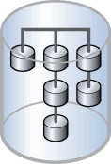


Storage Virtualization Principles
Storage devices provide different performance and use different interface protocols. To address these differences, Huawei storage virtualization formats storage devices and converts various storage resources to centrally managed data storage resources. These data storage resources can be used to store information about VM disks, VM configurations, and snapshots. Users can apply the similar way to manage storage, improving storage management efficiency.
A VM disk can be used only after it is mounted to a VM using disk driver. Disk driver is categorized as user driver, kernel back-end driver, and kernel front-end driver. The process of writing VM I/O data into disk files is as follows: The front-end driver captures all VM I/O operations and forwards them to the back-end driver. Then, the back-end driver converts these operations to I/O operations in the user driver and writes the data into disk files.
VM
VM
Front-end driver
Front-end driver
User mounting driver
Host kernel space
Back-end volume mounting driver
Generic block layer
Image file
NFS file system
File system VIMS
Generic block layer
Driver layer
Host user space
NAS
Local disk
SAN

Slide 28
Three Typical Network Virtualization Methods
Server CPU-based virtual switching
  Advantage: flexibly extends functions.
  Disadvantage: consumes server CPUs and provides low performance.
NIC-based virtual switching
  Advantage: provides high performance and conserves server CPU resources.
  Disadvantage: depends on special NIC hardware.
Physical switch-based virtual switching
  Advantage: inherits functions of Layer 2 switches.
  Disadvantages: features small specifications and poor scalability and does not support hypervisors.
Server
CPU
1
vSwitch
PCI
NIC
2
eSwitch
Network cable
Physical switch
3
QBG

Slide 29






Relationship Between Network Virtualization and Physical NICs
Control domain
Control domain
VM
VM
Control domain
VM
VM
VM
VM
VIF
Bridge
VIF
Bridge
PF driver
VF driver
VF driver
Hypervisor
Hypervisor
Hypervisor
queue
queue
queue
PF
...
 | Common Virtual NIC | VMDq | SR-IOV
Difference | Dom0 bridge queue | Independent VM message queue | Address translation enabled by the SR-ROV hardware technology
 | One-time data copy | Hypervisor consumes a small amount of resources for each address translation. | Hypervisor does not require address translation, thereby reducing calculation consumption.
Characteristic | High host CPU overhead and low VM density Smooth VM migration and snapshot | Little host CPU overhead Smooth VM migration and snapshot | Little host CPU overhead Affected VM migration and snapshot

Slide 30





Distributed Virtual Switches
VM 1
VM 2
VM 3
VM 11
VM 12
VM 13
Hypervisor
Hypervisor
vSwitch 1 (web)
vSwitch 2 (app)
Server A
Server B
Technical features
  Provides a unified interface for configurations and management.
  Supports VLANs, Layer 2 security policies, and bandwidth control.
Benefit
  Supports flexible access control over networks

Slide 31
Development of Cloud Computing: Virtualization Functions Are to Be Standardized
Function standardization
Software
Memory overcommitment
Paravirtualization
Full virtualization
Bare-metal architecture
HA/FT
SDN
Distributed file system
Distributed vSwitch
Live storage migration
SDS
Load balancing
NUMA
SR-IOV
GPU virtualization
EPT
NPT
VMDQ
QOS
VT-X
VT-D
Virtual firewall
...
Chip virtualization
I/O passthrough
Hardware
Notes:
Virtualization is one of important cloud computing technologies.
Software architectures are trend to become the same.
Hardware-assisted virtualization narrows the software performance gap.
I/O passthrough transfers the virtualization software functions to hardware boards.
The rapid development of Microsoft Windows Server 2012 has changed the monopoly position of VMware.
Software-defined storage (SDS)
SDS is a data storage mode, in which all control operations related to storage are performed by the external software. The software acts as a part of a server, OS, or hypervisor but not firmware in the storage device.
SDN: According to the data released by InfoWorld in November 2011, SDN ranked second in the 10 new technologies that will affect the world in the coming 10 years. In July 2012, SDN vendor Nicira, a company focusing on SDN and network virtualization, was acquired by VMware for $1.26 billion. After that, Google pronounced that they had deployed SDN on their 10 IDC networks worldwide. The two cases made SDN draw strong attention.

Slide 32
DC Development
Cloud Computing Development
Benefits of Cloud Computing
Deployment Modes of Cloud Computing

Slide 33





Resource Consolidation for Improved Resource Utilization
Benefits of resource consolidation
Shared hardware resources
Server consolidation
Flexible adjustment of CPUs and memory of virtual servers
Memory overcommitment, improving resource utilization
Server consolidation, improving server utilization
Server consolidation, saving equipment room space
Notes:
Virtualization supports elastic scaling of resources.
Each server is virtualized into multiple VMs, avoiding exclusive server occupation by a specific service.
VM specifications (CPUs and memory) can be flexibly changed to increase or reduce the number of VMs, meeting computing resource requirements of services.
With the virtualization computing technology, physical memory resources can be virtualized into more virtual memory resources, and thus more VMs can be created.

Slide 34
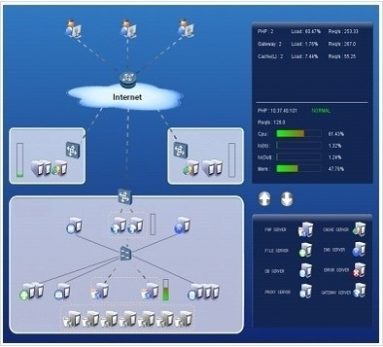

Rapid Deployment and Elastic Capacity Expansion
Batch VM deployment
Elastic resource addition/reduction
Shortening the deployment period of a new service
Center node A
Center node B
Acceleration node
Notes:
At the early stage of deployment, deploy fewer servers because the business scale is small. Scale capacity later if necessary. Scaling is very simple. You only need to use PXE or ISO to install several compute nodes and then add them to the system through the O&M portal.
The cloud-based service system adopts batch VM deployment.
Large-scale resources are deployed in short time, fast responding to service requirements and saving a large amount of deployment time.
Elastic resource addition/reduction adapts to shifting service requirements.
Automatic deployment with minimal manual intervention is promoted.
Customers will no miss market opportunities due to slow service deployment.
The traditional service deployment cycle is month-based whereas the cloud-based service deployment period is shortened to minute or hour levels.

Slide 35





Automatic Scheduling for Energy Conservation and Emission Reduction
Based on the load policy
APP1
APP2
APP2
APP1
APP3
APP4
APP3
APP4
Automatic and intelligent resource scheduling:
  During daytime, resources are monitored according to the load policy to implement automatic load balancing and efficient heat management.
  At nights, resources are adjusted according to the time policy to minimize the power consumption by powering off unused servers.
During daytime: resource monitoring for automatic load balancing
Based on the time policy
APP4
APP1
APP1
APP2
APP2
APP3
APP4
APP3
At nights: automatic scheduling for energy conservation and emission reduction
Notes:
Policy-driven intelligent and automatic resource scheduling enables resources to be automatically allocated on demand and intelligently balanced. This reduces power consumption and emission.
During daytime, resources are monitored according to the load policy to implement automatic load balancing and efficient heat management.
At nights, resources are adjusted according to the time policy to minimize the power consumption by powering off unused servers.
Dynamic Power Management (DPM) helps reduce power consumption in DCs. With DPM, when detecting that the load on a cluster reaches the predefined energy saving policy, the system consolidates the VMs in the cluster to a smaller number of hosts and then power off the idle hosts where no VMs are running. When detecting that VMs require more resources, the system powers on some hosts to provide resources to the VMs.

Slide 36

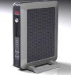




Lowered Temperature and Reduced Noise Create Green Offices
< 55 dB
1 dB
35ºC to 45ºC
≈ Room temperature
300 W
70 W
Note:
1 dB is the lowest sound that people can hear. If the sound is below 20 dB, the environment is quite; if the sound is between 20 to 40 dB, it is like people softly whispering; if the sound is between 40 to 60 dB, people can carry on normal conversations; if the sound is above 60 dB, the environment is noisy.
Note:
Generally, the ambient temperature of a PC ranges between 35ºC and 45ºC. In a dense office environment, the ambient temperature is close to the PC temperature.
Notes:
Hosts of physical PCs are replaced with TCs for greatly reduced heat and improved office environment.
A physical host processes resources locally with powerful CPUs, and disks, and fans configured, thereby generating noise pollution. Compared with the physical host, a local TC only receives instruction inputs and displays interfaces but does not process resources locally (computing resources are processed at the remote DC), which produces little noise and optimizes the office environment.
PC is short for Personal Computer.
TC is short fort Thin Client. It allows access and use of virtual desktops in a cloud computing environment.

Slide 37






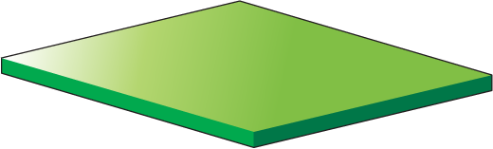



Efficient O&M for Reduced Costs
Desktop
+
Traditional PC
TC
300 W
70 W
Maintenance
Maintenance process: report a fault > assign personnel to handle > locate the fault > rectify the fault
The PC maintenance process takes about two to four hours, resulting in a long downtime and high labor cost.
Maintenance personnel: account for about 3% to 5% of the total number of employees.
Power consumption
Traditional PCs are power consuming and drive high expenses.
Maintenance
Maintenance-free frontend
Maintenance process: failure (crash) > self-service restart > completed
The maintenance process only takes about 3 minutes and the service downtime is short.
Each maintenance personnel can maintain an average of 1000 desktops. The number of maintenance personnel is greatly reduced, which significantly cuts maintenance cost.
Power consumption
Each TC consumes power from several watts to 20+ W, following the policy of energy conservation and emission reduction policy while trimming costs.
Notes:
Traditional PCs may bring the following troubles from PC model selection, procurement, warehousing, provisioning to maintenance:
It will take a long time from project initiation to project launching.
The power consumption of traditional PCs is high, driving high costs.
The repair time of a traditional PC is long, affecting office efficiency.
Traditional PCs cannot be recycled but can only be replaced by new ones every three years.
Traditional PCs are spread across all offices, thereby requiring a large number of maintenance personnel and pushing up labor costs.
In desktop cloud office scenarios, the number of resources to be processed is small and is centrally processed in DCs, eliminating office concerns.
PC is short for Personal Computer.
TC is short fort Thin Client. It allows access and use of virtual desktops in a cloud computing environment.
IT is short for Information Technology. It is used in building enterprise DCs.

Slide 38






Hitless Capacity Expansion
Technical features
  Live migration, automatically obtaining the standby node space
  Automatic pipeline operation mode, easy to use
Benefits
  On-demand capacity adjustment, cutting maintenance costs
  Reduced upgrade costs and risks, ensuring business continuity
To-be-upgraded node
Application migration
Standby node
VM
VM
Data backup
VM
VM
Node upgrade
VM
Data moving back
VM
Application moving back
Notes:
Management node upgrade: There are active and standby management nodes. You can upgrade one first. After performing an active/standby switchover, upgrade the other.
Compute node upgrade: Before upgrading a compute node, migrate its VMs to another node. After the upgrade is completed, move the VMs back.

Slide 39





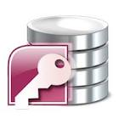



Unified Hardware and Software Management
Physical server
VM
All-in-one machine
Application
OS
Huawei cloud management expert system
Database
Storage
Network
Security
Notes:
Huawei cloud solutions support a unified management over all-in-one machines, servers, storage devices, network devices, security devices, VMs, OSs, databases, and application software.
Huawei cloud solutions support mainstream heterogeneous servers and storage devices.
Huawei cloud solutions can integrate both FusionCompute and VMware virtualization software.
According to the preceding description, it can be seen that the unified software and hardware management can facilitate management and reduce the procurement costs of management systems and the labor costs.
It is assumed that the devices purchased by a company have to be managed by multiple different management systems, then:
The company has to purchase multiple different management systems.
Maintenance personnel have to learn more skills in using the management systems.
System upgrades, skill training, and personnel mobility will drive higher costs.

Slide 40
DC Development
Cloud Computing Development
Benefits of Cloud Computing
Deployment Modes of Cloud Computing

Slide 41





Deployment Modes of Cloud Computing
Private cloud
Enterprise firewall
Hybrid cloud
Public cloud
Notes:
Deployment models of cloud computing include private cloud computing, public cloud computing, and hybrid cloud computing.
Private cloud computing: It is used and operated solely by a single organization. For example, Huawei DCs adopt this model. Huawei serves both as its operation party and its user.
Public cloud computing: It is similar to a switch, which is owned by a telecom carrier and used by general public.
Hybrid cloud: It emphasizes that infrastructure consists of two or more clouds, but it is presented as a complete entity. For example, an enterprise can store its critical data, like finance data, to the private cloud and non-critical data to the public cloud. The private and public clouds together form a hybrid cloud. Another example goes like this: An on-line store has its steady volume of business and it is enough to have a private cloud to handle daily transactions. In Christmas promotion season, it can rent public cloud servers from carriers to cope with the temporary sales surge. All resources in the private and public clouds can be scheduled in a unified manner

Slide 42
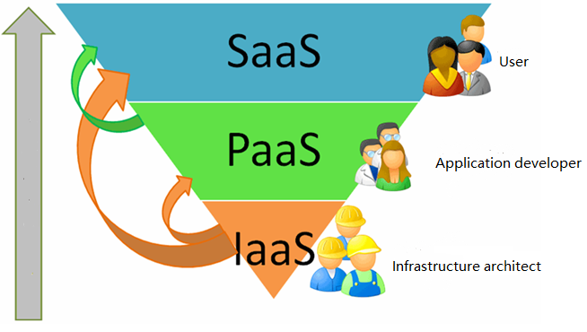
Business Modes of Cloud Computing (1)
Notes:
Infrastructure as a Service (IaaS): The infrastructure is provided to end users as a service. The infrastructure includes computing, storage, network, and other computing resources. Users can deploy and run any software, including OSs and applications. Typical applications are VM leasing and web disks.
Platform as a Service (PaaS): The re-developed platform is provided to end users as a service. Customers do not need to manage or control the underlying cloud computing infrastructure and only need to control the deployed application development platform. The typical application is the Microsoft Visual Studio development platform.
Software as a Service (SaaS): Applications running in the cloud computing infrastructure are provided to end users as a service. The typical application is the enterprise office system.

Slide 43
Business Modes of Cloud Computing (2)
Service Type | Service Content | Profit Model | Instance
SaaS | Internet Web 2.0 application Enterprise application Teleservice | Provides services meeting end-users' requirements on a pay-per-use basis. | Salesforce: CRM
PaaS | Provides the application running and development environment. Provides application development components (such as databases). | Leases IT resources, universal web capabilities, and communication capabilities as a package to application developers and operators on a pay-per-use basis. | Microsoft: Azure Visio Studio
IaaS | Leases IT resources such as computing, storage, and networks. | Pay per use. Makes profits by mass sales. | Amazon: EC2 cloud host
Notes:
Relative to Web 1.0, Web 2.0 is a general term of the new type of Internet applications. The key feature of Web 1.0 is that users obtain information through browsers. Comparatively, Web 2.0 focuses on interaction with the users. Specifically, uses are able to browse and edit web pages, which means users are no longer just readers but also editors of the Internet. In this context, the user participation pattern shifts from "only input" to "input + output + co-construction". Users start to proactively create Internet information instead of receiving only, making the service more personalized.
A web hosting service is a type of Internet hosting service that allows individuals and organizations to provide their own website accessible via the World Wide Web.
CRM is short for Customer Relationship Management.

Slide 44








Intense Competition in the Cloud Computing Industry
Small- to medium-sized ICPs
Cloud computing users
Consumers
SMBs
Industries
Employees
Cloud computing, telecom, IT, Internet service providers compete with each other.
Large-sized enterprises or industries
Internet service providers
Telecom operators
Transformed IT vendors
Cloud computing providers
Cloud computing equipment suppliers
Internet service providers
Network suppliers
Traditional IT vendors
Notes:
The cloud computing industry involves cloud computing equipment suppliers, cloud computing service providers, and cloud computing end users.
Cloud computing equipment suppliers refer to the suppliers who provide software and hardware required for building a cloud computing environment. Hardware suppliers refer to the server, storage device, switch, security device, and TC suppliers. Software suppliers refer to the cloud virtualization platform, cloud management platform, cloud desktop access, and cloud storage software suppliers.
Internet service providers are pioneers of cloud computing and leaders of advanced technologies and innovative business modes. They mainly provide cloud computing-driven low-cost information processing services. Such providers include Google and Amazon.
Telecom carriers use cloud computing to resolve practical problems, such as improving telecom network capabilities (massive computing and storage) and reducing costs. Such carriers include BT and AT&T.

Slide 45
Notes:
The traditional IT giants are forced to introduce cloud computing into superior products and solutions. Such IT enterprises include IBM, Microsoft, and HP.
Network suppliers use their advantages in traditional networks, servers, and massive amounts of software to elbow into the cloud computing field. Such suppliers include Cisco.
Blurry boundary between IT and CT: Technological integration drives communication vendors to enter the traditional IT field. The Datacom technology has become one of the most important cloud computing technologies. Blurry boundary between vendors and service providers: Business model changes are driving some large vendors, such as IBM and Microsoft, to step into the service field. Large Internet service providers, such as Google and Amazon, are developing their own devices and providing services themselves.
ICP is short for Internet Content Provider. ICPs are responsible for providing the website content and the related services.

Slide 46
DC development
Concepts of cloud computing
Benefits of cloud computing
Deployment modes of cloud computing

Slide 47
Cloud computing is a type of computing technology based on Internet. By using this technology, users can provide shared software and hardware resources and information for computers and other devices on demand. (True or False)
(Multiple Choice Answer) What benefits does cloud computing bring to enterprise IT? ( )
  A. Resource reuse, improving resource utilization
  B. Unified maintenance, cutting down maintenance costs
  C. Fast and flexible deployment
  D. Centralized data management, enhancing information security
Notes:
Answers
True or False: T
Multiple Choice Answer: ABCD

Slide 48
Huawei Official Websites
  Enterprise business: http://e.huawei.com/us/
  Technical support: http://support.huawei.com/enterprise/en/index.html
  Online learning: http://learning.huawei.com/en/
Documentation Tool
  HedEx Lite

Slide 49
Huawei Learning Website
  http://support.huawei.com/learning/Index!toTrainIndex
Huawei Support Case Library
  http://support.huawei.com/enterprise/servicecenter?lang=en

