Slide 1
HCDCA112
Data center storage
V2R2
1.0
Yuan Weihua/wx462781
2019.04.10
Liu Lican/00180730
New
Author/ID
xxxx.xx.xx
Reviewer/ID
Type
Author/ID
xxxx.xx.xx
Reviewer/ID
Type
Author/ID
xxxx.xx.xx
Reviewer/ID
Type
Author/ID
xxxx.xx.xx
Reviewer/ID
Type
Author/ID
xxxx.xx.xx
Reviewer/ID
Type

Slide 2
Data Center Storage Technology
Huawei Data Center Series of Courses

Slide 3
In this lesson, we will first learn why enterprises need data and then introduce how data is generated and stored in the enterprise. Next, we will learn about the Redundant Array Of Independent Disks (RAID). Then, we will learn five important ICT infrastructures: Direct Attached Storage (DAS), Storage Area Network (SAN), Network Attached Storage (NAS), distributed storage, and object storage.

Slide 4
After completing this module, you will be able to:
  Explain the importance of data for an organization.
  Understand the difference between structured and unstructured data.
  Know about common Redundant Array Of Independent Disks (RAID) types.
  Describe the features of Direct Attached Storage (DAS), along with its advantages and disadvantages.
  Identify and describe the main Storage Area Network (SAN) components.
  Understand the role of Network-attached Storage (NAS) in Information And Communications Technology (ICT) architecture.
  Master NAS network topology.
  Understand the principles behind distributed and object storage.

Slide 5
Data Management
Traditional RAID Technology
Introduction to DAS Technology
Introduction to SAN Technology
Introduction to NAS Technology
Huawei Distributed Storage
Object Storage

Slide 6
Data Management
SNIA definition: Data is the digital representation of anything in any form.
Three key principles of data management:
  Companies use or produce large amounts of data in the course of running their business.
  Data should be available as long as the business needs it.
  When data is no longer needed it must/can be destroyed.
Notes:
Storage Networking Industrial Association (SNIA) defines data as the digitalized representation of everything. This definition sounds relatively abstract, but when you look at the operation of today's enterprises, you will find that an enterprise generates a large amounts of data every day. All this data is used to maintain business operation and profitability.

Slide 7
Definition of Information
Information is data that is processed to meet user decision-making requirements. Information is extracted from collected data.
Information can:
  provide a company with marketing information and information about customer behavior.
  help to run the business more effectively.
  help to determine risk factors.

Slide 8
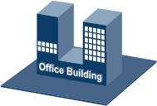

Where Is the Data?
1
1
4
2
3
Notes:
The following figure shows various data flows. 1, 2, 3, and 4 indicate data generation, local storage, data archiving, and remote backup, respectively.
Large enterprises usually cover branch offices, which are distributed in different cities or countries. Even a small company may have multiple offices, and each location generates data from tools such as e-mail programs or Word app. Some companies may use their homegrown professional software to generate data.
For Production-oriented enterprises often use graphic design software (for example, computer-aided design software) to design products, or logistical software to track orders — the transport of parts, materials, tools, and goods. All the data must be saved and secured.
If data is saved only on employees' laptops or PCs, it is difficult to prevent data loss caused by human errors or hardware faults. This is why most enterprise data is stored in the Main Equipment Rooms (MERs) or data centers. Generally, an MER must provide sufficient air flow and temperatures, as well as power facilities, for all equipment. In a well-equipped data center, in addition to sufficient air conditioners and power facilities, backup power supplies such as diesel generators are also required so that the power supply of the entire data center can still be ensured even in the event of a power abnormality.
However, even well-equipped data centers require data protection measures. For example, if a storage hardware fault occurs, or if a disaster —flood, fire, or earthquake — affects the data center or MER, the enterprise data is expected to be complete and available. To prevent loss to data or services, a disaster recovery data center or data backup is required to ensure data security in addition to the original data center.

Slide 9


Who Creates or Uses the Data?
Logistics
Human Resources
Marketing & Sales
Finance
Customers
- e-mail
- purchase orders
Notes:
Enterprises generate structured and unstructured data. Structured data refers to data that is easy for machines and staff to handle, digest, and analyze, making it the most common form of data. Unstructured data is that generated from documents, pictures, web pages, and videos, which is harder to process and extremely time- and resource-consuming to process and mine.

Slide 10
Information and Data
Every company needs information to be able to do business.
Information is extracted from both structured as well as unstructured data.
All data is now generated in a digital form.
Data should be accessible to multiple employees.

Slide 11
Information Lifecycle Management
Issues to be addressed in information lifecycle management:
  What data is needed for every person in the organization?
  In which format should data be presented/kept?
  How long should data be retained?
  What needs to be done with the data that is no longer required?
Notes:
Information can be classified into market data, sales information, along with product, human resource, logistics, and R&D cost. Enterprises must ensure that their employees obtain correct information at the right time.
The information/data saving format is even as important as the ownership of information. For example, if an employee sends an email containing important information to another employee, the recipient needs to have a terminal, email program, and email account to receive the email. If I receive a file, but my application cannot open it, then I can't get the information.
But this leads to another question: how long should data be stored? This is related to specific business and data, but generally government regulations specify how long an enterprise should store the information. Some information may even need to be stored for decades. For example, a construction company that built a bridge needs to keep the architect drawings and designs in the time the bridge remains in use.

Slide 12
Information Lifecycle Management: Hard Copy
What is the format in which data should be available to the organization?
1-Hard copy formats:
  Online data or paper-based data
  Read only/Eyes only/Not reproduceable
  Version control
  Environment requirements for saving hard copies

Slide 13
Information Lifecycle Management: Digital Information
What is the format in which data should be available to the organization?
2-Digital information:
  What software needs to be used to browse or modify data?
  Text storage format (PDF, ODF, or DOC…)
  Picture storage format (JPG, TIFF, DWG, or PNG…)
  Is there any standard that needs to be complied with (ODF, CALS, or BASEL…)?
Notes:
Digital files have their limits. For example, they need the corresponding software to open, read, or modify them. When creating a digital file, you need to select a file format that allows all related users to access and record data.
There are three typical file types: Text files, Bitmap, and Vector graphic.
Text file contains characters (letters or/and numbers) and a small amount of images, such as word documents, spreadsheets, and database files.
Bitmap is where all related graphical elements (or pixels) are stored separately. This means a large amount of storage space is required for storing photos and scanned copies in the bitmap format.
Vector graphic images are defined using mathematics and formulas. Typical examples are documents generated by drawing software such as AutoCAD.
It is best to select a file saving format that allows common software rather than a company's specific software to open the file. Plus, the file format should be supported by common software for many years. For example, a bitmap in the TIFF format, a vector graph in the IGES format, or a file in the SGML format. For text files, the Open Document Format (ODF) format is increasingly used.
Bitmap information is often compressed for storage. Although compression reduces the storage space of files, it also means loss of some information. Sometimes, the file is lossless saved to prevent information loss. TIFF is a lossless format, and the JPG format is not lossless because of the internal compression technology.

Slide 14
Information Lifecycle Management: Hardware
What is the format in which data should be available to the organization?
3-How can data be stored?
  Does the access to information need to be authorized or permitted?
  Does data need to be read-only (without being modified)?
  Can multiple employees access the same data at the same time?

Slide 15
Information Lifecycle Management: Retention Period
Factors that determine the retention period are:
  based on the business requirements of the organization itself.
  based on the general rules for your type of business.
  based on various regulatory regimes that may differ from country to country and region to region.
How to arrange for digital information to be stored for many years?

Slide 16
Information Lifecycle Management: Disposing of Obsolete Information
Who is responsible for data?
  SOX, JSOX, EuroSOX
Information on physical media is destroyed by:
  Shredding
  Burning
Information on digital media is destroyed by:
  Erasing data from the operating system disk.
  Secure erasing
  Disk shredding
Notes:
Data that exceeds its retention period is no longer useful, and enterprises no longer need to save it. So, how can the data be destroyed?
Some regulations stipulate this type of data regulations. For example, the US-based Sarbanes-Oxley (SOX) Act stipulates that a company has the responsibility to preserve or destroy the data generated or used by itself and ensure that no one can copy or bring data out of the enterprise.
If the information is archived in paper form, the paper must be destroyed (e.g. shredded) or burned.
Digital information is not so easy to destroy. Traditional methods such as disk formatting are not very secure, because there may be technical methods to restore the data that you want to destroy. Instead, some software can erase the data on the medium and write random data to where the old data is written (multiple times of rewrite operation may be required). For some government agencies, data erasure or disk crash is required to ensure that no one can reuse the disks.

Slide 17
Value of Data
Recovery Point Object (RPO): 15 minutes
  When a disaster or emergency occurs, data can be restored to a previous time point. This in turn determines how much data is lost when a disaster occurs. In this case, 15 minutes worth of data is lost.
Recovery Time Objective (RTO)
  Refers to the length of time it takes for a system to resume normal operation after a breakdown.
Cost Of Downtime (COD)
  Refers to the cost per hour of service disruption.

Slide 18
Components in the ICT Infrastructure
The following are common terms used in ICT infrastructure:
  Host: A computer system that has a disk, disk subsystem, or file system for data access and storage.
  Storage array: A set of disks or tape subsystems with control software available for access.
  Network: A group of nodes that are interconnected for communication between each other.
  A network can provide an exclusive channel for any two network nodes that connect to itself.

Slide 19



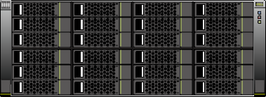
Front View of ICT Infrastructure Components
Host
Host
Switch
Switch
Switch
Network
Storage Array
Storage Array

Slide 20


Rear View of ICT Infrastructure Components
Host
Host
Switch
Switch
Switch
Network
Storage Array
Storage Array

Slide 21
Data Management
Traditional RAID Technology
Introduction to DAS Technology
Introduction to SAN Technology
Introduction to NAS Technology
Huawei Distributed Storage
Object Storage

Slide 22
Basic Concepts and Implementation Methods of RAID
RAID: short for redundant array of independent disks, also referred to as a disk array.
Implementation methods:
  Hardware RAID
  Software RAID
Efficient data organization: striping and parallel access
RAID
Data protection: parity check and hot spare
Notes:
RAID technology was originally used to combine multiple small-capacity disks to form a larger storage space, but now if often used for data protection. That is, if a physical device fails, RAID can be used to prevent data loss.
By stripping the data on the disk to achieve block access of data and reading the data simultaneously from few drives in the array, RAID reduces the mechanical seek time of the drive and improves the data access speed.
By mirroring or storing parity check information, it achieves redundant data protection.
RAID has many forms, but only a few are still in use. In this chapter, we will discuss the most common types of RAID and learn the other related functions, such as data protection, as well as differences in performance or cost.
In a storage device, the RAID function can be implemented in the two ways: hardware RAID and software RAID.
Hardware RAID uses dedicated RAID adapters, disk controllers, or storage processors. The RAID controller has its own processor, I/O processing chip, and memory, which improves resource utilization and data transmission speed. The RAID controller manages routes and buffers to control data streams between the host and RAID. Hardware RAID is usually used on servers.
Software RAID does not have its own processor or I/O processing chip, but is completely dependent on the host processor. Therefore, a low-speed CPU cannot meet the RAID implementation requirements. Software RAID is usually used on enterprise-class storage devices.

Slide 23
Data Organization Units of RAID
Strip: One or more consecutive sectors in a disk form a strip, which is the minimum unit for reading and writing data on a disk. Strips are the elements that form a stripe.
Stripe: Indicates the strips on the same "location" (or with the same number) of multiple disk drives in the same disk array.
Disk 1
Disk 2
Disk 3
D6
D7
D8
Stripe 2
Stripe depth
D3
D4
D5
Stripe 1
D0
D1
D2
Stripe 0
Data strips
on disks
Data strips
on disks
Data strips
on disks
Notes:
Stripe width refers to the number of member disks in a stripe, whereas stripe depth refers to the storage capacity of a stripe

Slide 24
RAID Data Protection Methods
Method 1: Copies of data that are stored on another redundant disk
Method 2: Parity check algorithm (XOR)
  XOR operation is widely used in digital electronics and computer science.
  XOR: true whenever both inputs differ and false whenever both inputs are the same
  0⊕0 = 0; 0⊕1 = 1; 1⊕0 = 1; 1⊕1 = 0
Disk 1
Disk 2
Parity disk
1
1
0
0
1
1
0
0
0
XOR redundancy backup

Slide 25
RAID Status
RAID
group
created
Creation successful
RAID
group
working
correctly
Reconstruction successful
RAID
group
failed
RAID group
degraded
A member disk offline or failure
More failed disks than hot spare disks
Notes:
The RAID technology combines multiple physical disks into a RAID group (sometimes referred to as a disk set). This RAID group maintains its own status.
When all disks in a RAID group work properly, the RAID group is normal state.
If a certain number of disks fail, but the entire RAID group can still prevent data loss and the data recovery process is not started, this state is called degradation.
If the faulty disks are replaced or hot spare disks are available in the system, and data is being restored to the new or hot spare disks, this state is called reconstruction.
Once reconstruction is successfully complete, the RAID group is back in normal state.
If a large number of disks are faulty and the number of faulty disks is greater than the number of redundant disks supported by the RAID type, the data recovery function becomes invalid. This state is called RAID group failure.
Complete data reconstruction depends on the RAID type, the number of faulty disks, and the availability of new disks.
Hot spare disks are used to replace failed member disks of a RAID array. Their tasks are to bear data of the replaced disks.

Slide 26

Common RAID Levels and Classification Criteria
RAID technology combines multiple independent physical disks into a logical disk in different modes. A number of RAID levels exist, corresponding to these modes. This mechanism improves the read/write performance of disks while increasing data security.
RAID 6
RAID 0
Common RAID
levels
RAID 10
RAID 1
RAID 50
RAID 3
RAID 5

Slide 27
Comparison of Common RAID Levels
RAID Level | RAID 0 | RAID 1 | RAID 5 | RAID6 | RAID 10 | RAID 50
Fault tolerance | No | Yes | Yes | Yes | Yes | Yes
Redundancy type | No | Replication | Parity check | Parity check | Replication | Parity check
Hot spare disk | No | Yes | Yes | Yes | Yes | Yes
Read performance | High | Low | High | High | Medium | High
Random write performance | High | Low | Low | Low | Medium | Low
Sequential write performance | High | Low | Low | Low | Medium | Low
Min. number of disks | 2 | 2 | 3 | 4 | 4 | 6
Available capacity (Capacity of a single disk) | N x | 1/N x | (N - 1) x | (N - 2) x | N/2 x | (N - 2) x
Notes:
From the table above, we can see that there is no RAID type that can meet all requirements. RAID types depend on site speed, security, or cost requirements.
Each RAID group should not contain too many physical disks because as the number of RAID groups increases (the number of disks increases), the number of disk failures increases accordingly. RAID 5 supports up to 12 disks, whereas, RAID 6 supports up to 42 disks.

Slide 28
Typical Application Scenarios of RAID
RAID Level | Application Scenario
RAID 0 | A scenario requiring fast reads and writes but not high security, such as graphic workstations
RAID 1 | A scenario featuring random writes and requiring high security, such as servers and databases
RAID 5 | A scenario featuring random transfer and requiring medium security, such as video editing and large databases
RAID 6 | A scenario featuring random transfer and requiring high security, such as mail servers and file servers
RAID 10 | A scenario involving large amounts of data and requiring high security, such as certain banking or finance applications
RAID 50 | A scenario involving random data transmission, security requirements, and concurrency requirements, such as mail servers, and web servers

Slide 29
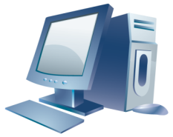
Hot Spare Disk
Hot spare = When one of the disks in a RAID group fails and an idle or standby disk immediately replaces the failed disk, this disk is known as the hot spare.
Hot spare disks are classified as global hot spare disks or as dedicated hot spare disks.
RAID 1/RAID 5/RAID 6/…
……
Disk 1
Disk n
Hot spare disk
Notes:
In most storage solutions, a disk array may have many disks that come in different types. Each disk type has its specific parameters in terms of capacity, rotational speed, access speed, and reliability. By creating multiple RAID groups, you can configure RAID levels and allocate storage capacity using correct specifications. Assume that four RAID groups are in use. How can the administrator configure hot spare disks? How many disks are required for hot spare? It all depends on the actual situation. In normal cases, each RAID group has its own hot spare disk. When one disk fails, a standby disk is available. In four RAID groups, if only one disk is faulty at a time, this hot spare disk can also prevent data loss.
There are global and local hot spare disks.
A hot spare disk shared by different RAID groups is called a global hot spare disk. It will replace any invalid disk in any disk group. The hot spare disk must have equal or greater capacity than the failed disk, and be the same type.
The hot spare disk that is used by only one RAID group is a local hot spare disk. If a disk in another RAID group fails, this hot spare disk will not take effect.

Slide 30
Pre-Copy
Pre-copy: When the system detects that a member disk in a RAID group is about to fail, data on that disk is copied onto a hot spare disk, reducing the risk of data loss.
RAID 1/RAID 5/RAID 6 /…
Disk 1
Disk 2
Hot spare disk
Notes:
Pre-copy is another data protection mode of a storage array. For storage device and service maintenance personnel, pre-copy is a good function that makes maintenance easier (or effortless). Most enterprise-class disk devices are provisioned with the SMART tool for disk self-monitoring, analysis, and reporting. This tool enables the disks to monitor their own health by checking the rotation speed and the condition of the magnetic surface.
With appropriate tools, we can receive messages from smart disks and take corresponding measures. If a smart disk reports that it is not well, it means it is not invalid for the time being, but may fail later.
When the tool receives a SMART message, the device starts to copy data to the hot spare disk from the disk that is about to fail. When the drive fails later, most of its data has been migrated to the hot spare disk. This reduces the reconstruction time. Copying data to the hot spare disk from the disk that is about to fail is pre-copy.

Slide 31

Reconstruction
Reconstruction: When a disk in a RAID group is faulty, the system recalculates all data (user data and parity data) on the faulty disk based on the RAID algorithm and other normal member disks, and writes the data to the hot spare disk or new disk that replaces the faulty disk.
D0, D1, D2, D3, D4, D5
Disk 1
Disk 2
Parity disk
Hot spare disk
D4
D5
P3
D4
D2
D3
P2
D2
D0
D1
P1
D0
Notes:
Reconstruction is another data protection mode of RAID. Hot spare disks can automatically reconstruct failed disks to enhance data protection. Reconstruction does not affect other read and write operations of the RAID group at the same time, nor interrupt host services. The following conditions should be met for optimal reconstruction:
The hot spare disk is working properly and not used by other RAID groups.
The RAID level used is RAID 1, 3, 5, 6, 10, or 50.

Slide 32
Relationship Between RAID and LUNs
RAID is like a large physical volume composed of multiple disks.
We can create one or multiple logical units of a specified capacity on the physical volume. Those logical units are referred to as LUNs. They are the basic block units that can be mapped to hosts.
Logical volume
LUN 1
Logical volumes
LUN 2
LUN 3
Physical volume
Physical volume
One logical volume created on a physical volume
Multiple logical volumes created on a physical volume
Notes:
Data is stored as files on volumes "visible" to the operating system. The Windows operating system uses the drive C:, F:, and others to indicate the volume in use. If the operating system is UNIX or Linux, mount points are used instead. The relationship between the drive letter (or mount point) and the physical disk is as follows:
Physical disks form a RAID group.
A RAID group has a specific RAID type associated with itself.
A LUN is composed of (or a section of) storage capacity of a RAID group. LUNs are mapped to a host to serve as the storage space that can be used by the operating system.

Slide 33
Creating RAID Groups and Logical Volumes
LUN 1
LUN 2
LUN 3
Logical volumes
RAID
Segmentation
Physical disks
Notes:
For example:
There are four physical disks, each of which is 300 GB. If the four physical disks are placed in one RAID group, the total disk capacity is 4 × 300 GB = 1.2 TB. If the disk group is set to RAID 5 for data protection, the actual available space is 3 x 300 GB = 900 GB. The resources of one disk is "drained" because a quarter of the disk capacity is needed to store parity information.
A storage administrator can create one 900-GB LUN as a whole or divide it into multiple smaller LUNs.
The data protection level of each LUN is RAID 5.

Slide 34
Data Management
Traditional RAID Technology
Introduction to DAS Technology
Introduction to SAN Technology
Introduction to NAS Technology
Huawei Distributed Storage
Object Storage

Slide 35
Building an ICT Infrastructure
An ICT infrastructure is the physical solution that allows users to access the digital information they need.
Components of an ICT infrastructure include:
  Host: Computer systems for data access and storage
  Software: Operating System software and application software
  Network devices: Devices that provide channels for interconnection between devices.
  Storage device: Device where user data is saved and can be quickly accessed.
  Backup device: Separate device where backup data is saved.
Three major infrastructural designs can be used: DAS, NAS, and SAN.

Slide 36

DAS Concepts
An ICT infrastructure is the physical solution that allows users to access information they require.
The first ICT infrastructures were based on a simple concept we now refer to as "direct attached storage" (DAS).
DAS definition: One or more dedicated storage devices connected to one or more servers. These storage devices provide block data access service for servers.
Based on the location between storage devices and servers, DASs are classified into internal DASs and external DASs.
HOST
DISK STORAGE
Notes:
DAS is an architecture where a storage device is directly connected to a server. It provides block-level storage services (not file system-level ones) for servers and is used for disks inside servers, tape libraries that are directly connected to servers, and external disk enclosures that are directly connected to servers. Internal DAS and external DAS can be used based on the location between storage devices and servers.
For internal DAS, a storage device is connected to a servers via the serial or parallel bus inside the server chassis. However, due to the distance limitation of the physical bus, internal DAS only supports short-distance, high-speed data transmission. Additionally, there are also limitations on the quantity of devices that can be connected to the internal bus, and storage devices can take up large amounts of space within the servers. This makes maintenance of other parts of the servers difficult.
For external DAS, a server is directly connected to an external storage device. In most situations, they communicate to each other through FC or SCSI protocols. In comparison to internal DAS, external DAS has overcome the limitation of short distance and devices limit faced by internal DAS. Additionally, external DAS can even provide centralized management of the storage devices, making storage device management easier.

Slide 37
Benefits of DAS
Ideal solution for local data supply
High reliability
Rapid deployment for small-scale environments
Simple deployment
Low complexity
Small investment

Slide 38
Benefits of DAS
ATA (IDE) and SATA
  Mainly used for internal DAS
SCSI
  Parallel SCSI (mainly used for internal DAS)
  Serial SCSI (mainly used for external DAS)
FC
  A high-speed network interconnection technology
Notes:
The DAS protocols used for communication between the server and the storage device include IDE/ATA, SATA, SAS, SCSI, and FC protocols. These protocols require the disk controller support. A storage device is usually named by the protocol it supports.
Integrated Drive Electronics, or IDE, is a disk drive that integrates a disk controller and a disk body. Integrating the disk body with the controller reduces the quantity and length of cables connected to the disk interfaces. This enhances data transmission reliability, makes disk manufacturing easier, and improves compatibility with different manufacturers. Generally, the IDE interface is also called the Advanced Technology Attachment (ATA) interface. This interface was developed by several companies, including Compaq and Western Data, in 1986, and was applied to desktop systems at the beginning of the 1990s.

Slide 39
DAS Management
Internal DAS
  The host provides:
    Disk partition (volume management)
    File system layout
  DAS devices are managed through servers and Operating Systems.
External DAS
  Array-based management.
  The TCO of management data and storage architecture is relatively low.

Slide 40
Challenges Faced by DAS
Poor scalability
  The number of ports that can be connected to the host is limited.
  The number of addressable disks is limited.
  Distance restrictions
The system needs to be powered off while the internal DAS is being maintained.
Difficulties with resource sharing
  The array's front-end ports and storage space cannot be shared.
  Resource silos: A DAS with insufficient storage space cannot share the remaining space of a DAS with surplus storage space.
Notes:
DAS has a poor scalability. The quantity of available ports on a DAS storage device is often few. Therefore, the number of hosts that can be connected to the storage device is limited. In addition, a DAS device has lower bandwidth and therefore its I/O performance is not high. If the host connected to the DAS device requires high I/O performance that reaches its upper threshold, the availability of the host service is affected. This also generates a chain reaction — that is, the performance of all hosts connected to the DAS device is affected.

Slide 41
Data Management
Traditional RAID Technology
Introduction to DAS Technology
Introduction to SAN Technology
Introduction to NAS Technology
Huawei Distributed Storage
Object Storage

Slide 42

Ideal ICT Infrastructure
Scalable in capacity
Capable of being extended across the entire world
Highly reliable
Highest possible transportation speeds
Easy to manage and flexible
Interoperable with heterogeneous hardware

Slide 43
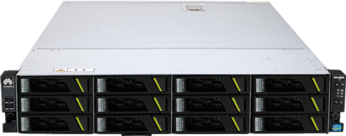
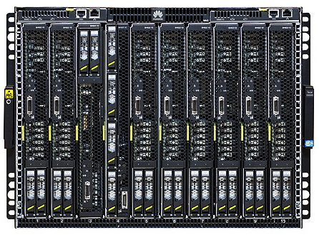
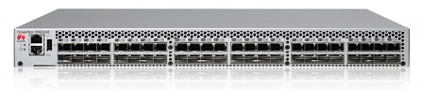
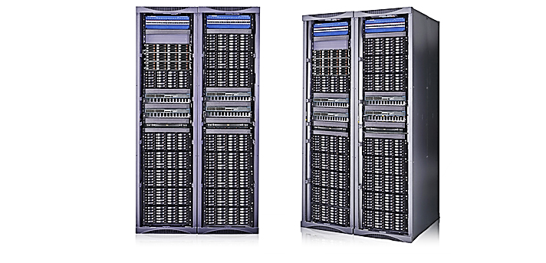
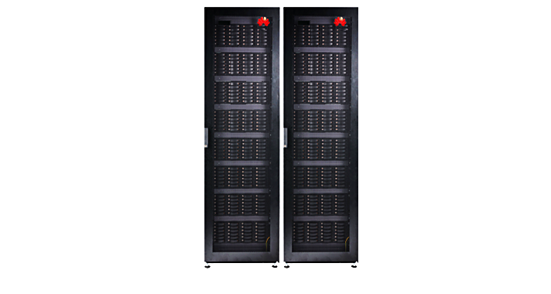
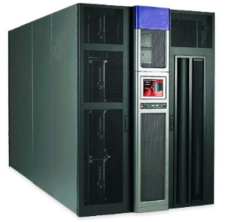
SAN Concepts
SAN Components: hosts, storage devices, and switches.
Notes:
Storage Area Network (SAN) is a high-performance and dedicated storage network used between servers and storage resources. It is optimized for transferring mass original data. It can be considered as the advanced SCSI protocol for long-distance data transmission. SCSI and Fiber Channel (FC) are the typical SAN protocol suite. FC is especially suitable for this application, because it supports long-distance and large-block data transmission. SAN applies to high-end, enterprise-class storage applications, which have demanding requirements for performance, redundancy, and data availability. Components such as storage arrays and backup devices are all storage devices.

Slide 44
SAN Cabling
Cable: copper or optical fiber
Protocol: FC, iSCSI, or FCoE

Slide 45
SAN Components
Components in a SAN are:
  Servers/Hosts
  Interconnect devices:
    switches; routers
  Storage devices:
    Disk arrays; backup devices
Cables are used to connect them all together.

Slide 46
Differences Between DAS and SAN
Item | DAS | SAN
Protocol | SCSI protocol | Multiple protocols: FC, iSCSI, FCoE
Application scenario | Small- and medium-sized organizations that have a relatively small number of servers | Mid-range and high-end storage environments such as key databases, centralized storage, backup, and disaster recovery
Advantages | Easy deployment, small investment | High availability, performance, and scalability, powerful compatibility, centralized management
Disadvantages | Poor scalability, waste of resources, management difficulties, performance bottlenecks | Comparatively large investment

Slide 47





SAN Storage Applications
Centralized deployment of storage devices enables application servers to access and share data in a cost-effective manner.
Storage resources are divided into blocks that are mapped to application servers to implement storage resource sharing.
Data sharing
Storage sharing
Application
Data backup
Disaster recovery
Data backup uses a SAN independent from the service network, making backup possible for diverse forms of data across heterogeneous servers.
SANs employ multiple mechanisms for automatic data backup, allowing data to be immediately recovered after a disaster occurs.

Slide 48
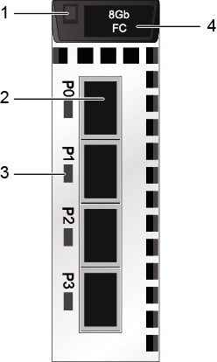
Storage Device with FC Interface
The Fibre Channel (FC) interface modules on a storage device provide service interfaces for connecting to application servers and receiving data exchange requests from the application servers.
Module power indicator
Module handle
FC host ports
FC host port
Link/Speed indicator of an FC host port

Slide 49
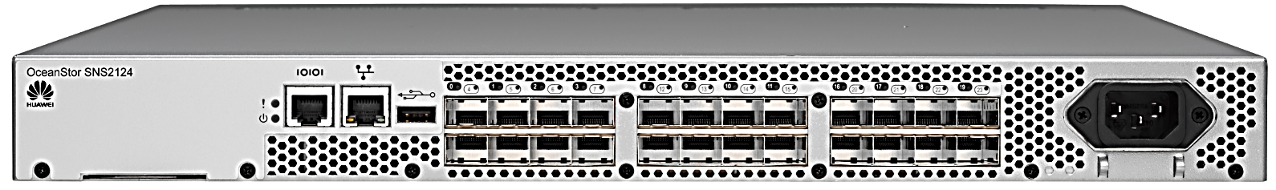
FC Switch
Direct connection to an FC network.
Direct connection to an initiator and a target.
Exclusive use of all optical bandwidths.
Switch-based zoning.
Notes:
Like DAS, SAN transmits data in SCSI blocks from a storage device to a server. There is a significant difference between SAN and DAS — DAS cables support up to a 25-meter transmission distance, while SAN cables supports connection up to hundreds or thousands of kilometers.
SAN encapsulates SCSI blocks (user data or load data) into a data packet or frame and transmits the data packet to a longer distance.
There are many other approaches (that is, protocols) to send SCSI blocks to a cross-SAN connection. Each protocol describes the transmission mode for processing SCSI blocks in a unique way.
The following three protocols are commonly used in a SAN architecture:
FC: The SAN architecture using this protocol is called FC SAN.
Internet SCSI: The SAN architecture using this protocol is called IP SAN.
FCoE: Fibre Channel over Ethernet.
The FC and iSCSI protocols are used in the modern SAN architecture, while the FCoE protocol is used more often when the server needs to integrate SAN and LAN services.

Slide 50
FC SAN and IP SAN
DAS
FC SAN
IP SAN
iSCSI
SCSI
FC
FC
FC
FC
iSCSI
Notes:
FC switches support direct connection through FC network routes. Initiators can directly connect to targets using the routing software on the FC switches, exclusively using all available bandwidth.
An FC switch is the SAN core that connects a host to a storage device. FC switches are classified into entry, workgroup, and core levels. Workgroup FC switches are mostly adopted in small-scale SAN. A large-sized and virtual switch that supports distributed processing and long-distance transmission can be set up by cascading several workgroup FC switches. Core FC switches (also called directors) are located at the center of a large-scale SAN and support the non-FC protocols such as InfiniBand, along with advanced FC services such as security, trunk, and frame filtering. Core FC switches usually use blade-based, hot-swappable circuit boards.
FC switches using the FC protocol are used to build FC networks, while Ethernet switches using the TCP/IP protocol are used to build Ethernet networks.
To isolate some devices, FC switches offers the zoning function. Similar to VLAN of Ethernet switches, zoning logically group devices (hosts and storage devices) in a SAN to different zones. Devices in different zones cannot communicate with each other.

Slide 51

What Is an IP SAN?
An IP SAN is an approach to using the Internet Protocol in a storage area network, usually over Gigabit Ethernet.
The typical protocol that implements an IP SAN is Internet SCSI (iSCSI), which defines the encapsulation mode of SCSI instruction sets in IP transmission.
User A
User B
User C
LAN
Server
Server
HBA
HBA
TCP/IP network
Storage device
Ethernet switch
Storage device

Slide 52





Advantages of IP SANs
IP SANs do not need dedicated HBAs or FC switches. Common NICs and switches for connecting storage devices to servers can be used.
Standard access
IP SANs are available wherever IP networks exist, and IP networks are now the most widely used networks in the world.
Long transmission distance
Enterprises using IP SANs can draw on both the large pool of professionals skilled in IP network technologies, and a range of powerful IP network maintenance tools.
Enhanced maintainability
With the development of the 10 Gbit/s Ethernet, a single port can now support transmission of 10 Gbit/s over IP SAN.
Scalable bandwidth

Slide 53




Challenges Faced By IP SANs
Data security
  Data security during transfer and on storage devices
TCP workload
  Increased latency of user service processing because data sequencing occupies host CPU resources
Challenges
faced by
IP SANs
Block data transmission
  Inferior performance relative to competing protocols when transmitting large data blocks
Notes:
Because IP SAN requires only a small amount of common hardware for network configuration, it is much cheaper than FC SAN. Most hosts have been configured with proper NICs and switches. These NICs and switches are also suitable for iSCSI-based transmission. High-performance IP SAN requires dedicated iSCSI Host Bus Adapters (HBAs) and high-end switches.

Slide 54
FC SAN vs. IP SAN
Indicator | Fibre Channel SAN | IP SAN
Transmission speed | 4 Gbit/s, 8 Gbit/s, 16 Gbit/s | 1 Gbit/s, 10 Gbit/s, 40 Gbit/s
Network architecture | Dedicated FC networks and Host Bus Adapters (HBAs) | Existing IP networks
Transmission distance | Limited by the maximum transmission distance of optical fibers | Unlimited, in theory
Management and maintenance | Complicated technologies and management | As simple as operating IP devices
Compatibility | Poor | Compatible with all IP network devices
Performance | High transmission and read/write performance | 1 Gbit/s (mainstream) and 10 Gbit/s
Cost | High purchase cost (of FC switches, HBAs, FC disk arrays, and so on) and maintenance cost (of staff training, system configuration and supervision, and so on) | Lower purchase and maintenance costs and higher Return On Investment (ROI) than FC SANs
Disaster recovery | High hardware and software costs for disaster recovery (DR) | Local and remote DR available on existing networks at a low cost
Security | High | Medium/Low

Slide 55

Networking in IP SANs
Direct attachment
Single switch
Dual switch
Application server
Application server
Application server
Application server
Application server
NIC
Ethernet switch
Ethernet switch
Ethernet switch
Storage device
Storage device
Storage device

Slide 56
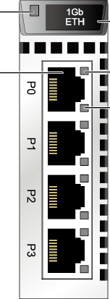
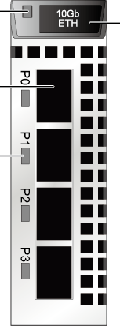
Huawei IP SAN Storage Devices
Module power
indicator
Module handle
Module power indicator
Module handle
Speed indicator of an iSCSI port
1 Gbit/s iSCSI port
10 Gbit/s
TOE port
Link/Active indicator of an iSCSI port
Link/Speed indicator of a TOE port
1 Gbit/s ETH
10 Gbit/s ETH
Notes:
Typical IP SAN networking modes are direct connection, through an Ethernet switch, or dual-switch:
Direct connection: The host connects to the storage device through a NIC, TOE card, or iSCSI HBA. This networking mode is simple and cost-effective, but the storage resources cannot be sufficiently shared by other hosts.
Through an Ethernet switch: The host that has a NIC, TOE card, or iSCSI HBA installed connects to the storage device through an Ethernet switch. This networking mode features high scalability and allows multiple hosts to share the storage resources offered by the same storage device. However, once the switch fails, the storage resources become unavailable.
Dual-switch: A host connects to a storage device through more than one path. This networking mode features high scalability and prevents a single point of switch failure.

Slide 57
FC and TCP Convergence
Ethernet and FC technologies are both developing quickly. IP SANs and FC SANs currently coexist and will continue to serve as complements to each other for the foreseeable future.
SCSI
SCSI
SCSI
SCSI
SCSI
iSCSI
FC
FC
FC
FCIP
TCP
TCP
IP
IP
FCoE
Ethernet
Ethernet
Ethernet
PHYSICAL WIRE
SCSI
iSCSI
FCIP
FCoE
FC

Slide 58
FCoE Protocol
The FCoE protocol is used to transmit FC signals over a lossless enhanced Ethernet.
FCoE encapsulates FC data frames into Ethernet packets and allows service traffic on a LAN and a SAN to be concurrently transmitted over the same physical interface.
Ethernet data link layer frame
Service flow IP
Block storage FCoE
Internet telephony VoIP
Video stream VoIP
Notes:
Convergence in this slide indicates that a system uses the FC and iSCSI protocols at the same time. The first way encapsulates iSCSI data packets into FC frames, and the other encapsulates FC frames into Ethernet frames.
FC and TCP are converged in various ways. Fibre Channel over Ethernet (FCoE) is most widely used. FCoE is an increasingly popular technology that allows simultaneous use of FC and Ethernet technologies. In fact, FCoE, as a low-cost solution, can use one switch to transmit FC and IP information at the same time.

Slide 59
Networking Before the Use of FCoE
……
Storage array
LAN
IP switch
FC
Switch
……
Host
Notes:
FCoE offers standard FC services, including discovery, global naming, and zoning. These services run in the same way as the original FC services with low latency and high performance.
FCoE bears FC on a new type of link, that is, Ethernet Layer 2 link. Note that the Ethernet must be enhanced lossless Ethernet to meet the link-layer transmission requirements of the FC protocol.
VoIP stands for Voice over IP. It is a method for transmitting audio and video digital technologies over the Ethernet.

Slide 60

Networking Simplified By the Adoption of FCoE
……
Storage array
LAN
FCoE switch
FCoE link
……
Host

Slide 61
Data Management
Traditional RAID Technology
Introduction to DAS Technology
Introduction to SAN Technology
Introduction to NAS Technology
Huawei Distributed Storage
Object Storage
Notes:
The FCoE switch sends FC SAN traffic to the storage array and transmits Ethernet service data to the LAN client. When FCoE is used, networking is simplified, and a quantity of network devices is reduced. Plus, cooling, management, and overall maintenance costs of a data center are reduced.

Slide 62
File Sharing Environment
The file system is used to store and organize data structures.
File sharing
  Data is accessed through network storage.
  The file system can be used only after being mounted.
In the traditional C/S model, remote file sharing is implemented through the file sharing protocol.
  FTP
  DFS

Slide 63
File Sharing Technology Evolution
File servers sharing
LAN sharing
Standalone PC
CD file sharing
NAS sharing
Notes:
File sharing involves data storage and access. In a file sharing environment, a user who creates a file can specify other users' read, write, execute, add, delete, and list permissions and control file changes. When files are shared, a protection method is required to maintain data integrity if multiple users access the same file at the same time. The C/S model uses the file sharing protocol and Distributed File System (DFS). The following are some instances:
Although FTP can transmit data on the network, it is a standard file transfer protocol. The TCP protocol is used for transmitting data between the server and client. FTP data is not encapsulated during transmission, so data transmission is not secure. FTP over Secure Shell (SSH) adds security specifications to the FTP protocol.
DFS can be distributed on multiple hosts. Any host can access the entire file system. DFS provides efficient data management and data security assurance.

Slide 64
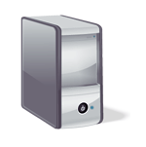



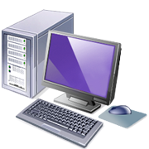
What Is NAS?
NAS is a storage device shared through the network.
Client
OS: Windows
OS: Linux
OS: MAC OS

NAS device

Slide 65
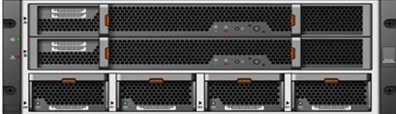

Universal Servers and NAS Devices
Application
File system
Printer driver
Operating System
File system
Network
Operating System
Network
Single-function NAS device
General-purpose server
(Windows or UNIX)
Notes:
A Network Attached Storage (NAS) is an IP-based file sharing device connected to a LAN. It provides storage resources through file-level data access and sharing, enabling customers to quickly share files with the minimum storage management overhead. You do not need to set up multiple file servers. NAS also helps eliminate bottlenecks when users access common servers, and uses network and file sharing protocols to archive and store data. These protocols include TCP/IP for data transmission and CIFS and NFS for remote file services.
The two common data sharing modes are Network Access Server (NAS) and File Transfer Protocol (FTP). For NAS on UNIX systems, use Network File System (NFS), and use Common Internet File System (CIFS) for Windows. NAS can be expanded to offer high performance and reliability demanded by enterprises to access data. NAS devices are dedicated file services and storage systems with high performance, high speed, and single purpose. NAS clients communicate with servers through IP networks. Most NAS devices support multiple interfaces and networks. . An NAS device executes file I/O better than a general purpose server and can connect to more clients than a traditional server. Therefore, a NAS device can integrate traditional servers.

Slide 66
Highlights of NAS
Information can be obtained in a comprehensive manner
Improved efficiency
Improved flexibility
Centralized storage
Simplified management
Higher scalability
High availability achieved by using local clusters
Security integration environment (using user authentication)
Notes:
NAS devices are optimized based on common servers, in terms of file service functions, storage, retrieval, and access to application client files.
As shown in the figure, a general-purpose server runs a general-purpose operating system for any app. A NAS device is dedicated to file services and provides file sharing services for other operating systems by using open standard protocols. To improve high availability of NAS devices, some NAS vendors also support the NAS cluster function.

Slide 67
NAS Components
UNIX
NFS
Network Interface
NAS engine
NFS
CIFS
IP
NAS Device OS
CIFS
Storage Interface
Windows
Storage array
Notes:
NAS provides the following advantages:
Full acquisition of information: NAS implements efficient file sharing and supports many-to-one and one-to-many configuration. The many-to-one configuration allows the NAS device to be accessed by multiple clients at the same time. One-to-many configuration allows a client to connect to multiple NAS devices at the same time.
Improved efficiency: NAS devices provide dedicated operating systems to provide file services, reducing file service operations on common file servers, improving the usage of common servers, and eliminating the bottleneck of file access by common servers.
Improved flexibility: NAS uses industry standard protocols and is compatible with UNIX and Windows clients. Different types of clients can provide services flexibly when accessing the same resource.
Centralized storage: Centralized data storage reduces duplicate data on client workstations, simplifies data management, and provides higher data protection.
Simplified management: A console centrally manages file systems in an effective way.
Strong scalability: Provides expansion with high performance and low latency based on different utilization configurations and service applications.
High availability: NAS devices can use the local cluster technology for failover. NAS provides multi-connection options with redundant network components. The replication function and recovery options are comprehensive, helping to achieve high data availability.
Security: Data security is ensured by authenticating users, locking files, and using the industry standard security architecture.

Slide 68
NFS File Sharing Protocols
Two universal NAS file sharing protocols:
  CIFS – Common Internet File System protocol
    The file sharing protocol in the traditional Microsoft environment is based on the Server Message Block Protocol (SMB protocol).
  NFS – Network File System protocol
    Traditional UNIX environment file sharing protocol.
Notes:
A NAS device consists of the following components:
NAS engine, such as a CPU and memory
One or more network interface cards (NICs) — gigabit Ethernet (GE) and 10GE network adapters — for network connections
An operating system optimized for NAS function management
NAS file sharing protocols, CIFS and NFS
Disk resources using industry standard storage protocols, such as ATA, SCSI, and FC
The NAS environment includes the clients that access NAS devices through IP networks that use standard protocols.

Slide 69
About NFS
C/S applications
TCP-based Remote Procedure Call (RPC) mechanism
Accesses the remote file system through the mount point of the local file system
Accesses the mount point under permission control

Slide 70
NAS File Sharing: CIFS
Universal Internet file system
  Developed by Microsoft in 1996
  Enhanced version of the SMB protocol
  Status protocol
    When the client application has the connection recovery function, the connection can be automatically restored and the interrupted file can be opened again.
    If the client application does not have the automatic connection function, the user must reestablish the CIFS connection.
  Application/Presentation layer working in the OSI model
  It is commonly used in the Microsoft Operating System but is not related to the platform.
  CIFS runs on TCP/IP and uses Domain Name Service (DNS) for name resolution.
Notes:
NFS is a client/server application that uses Remote Procedure Call (RPC) to communicate between computers. Users store and update files on the remote NAS device, just like on their own computers.
The user's system requires an NFS client to connect to an NFS server. The NFS server and client use TCP/IP to transfer files. Therefore, TCP/IP must be installed on both the server and client.
A user or system administrator can leverage NFS to mount all file systems, along with a part of any directory or subdirectory tree. The mounted file systems are controlled with access permissions (for example, read-only or read-write).

Slide 71
Comparison Between CIFS and NFS
If a file system is already set to:
  CIFS share, the file system can subsequently be set to read-only NFS share.
  NFS share, the file system can subsequently be set to read-only CIFS share.
Protocol | Transmission Protocol | Client | Fault Impact | Efficiency | Supported Operating Systems
CIFS | TCP/IP | Integrated operating system without the need for additional software | Large | High | Windows
NFS | TCP or UDP | Additional software required | Small: The interaction process can be automatically resumed. | Low | Unix

Slide 72
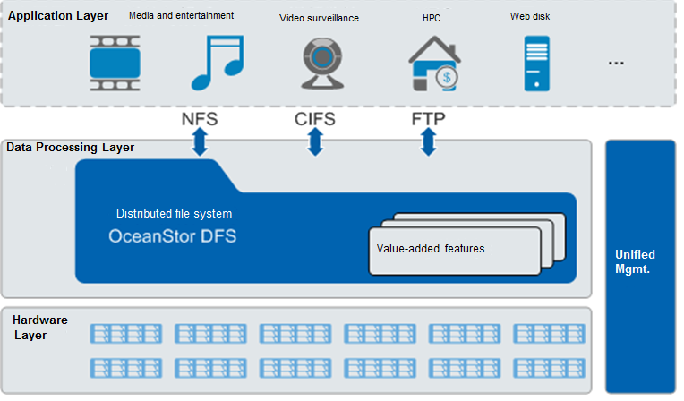
Example of Unified NAS
Huawei OceanStor 9000
Notes:
CIFS is a network-based sharing protocol that has high requirements on network transmission reliability. Therefore, CIFS normally uses TCP/IP. NFS is used for independent transmission, so it uses TCP or UDP.
For NFS the client must be equipped with dedicated software. CIFS is integrated into the operating system, without additional software support.
NFS is a stateless protocol and CIFS is a stateful protocol. NFS can automatically restore connection once the connection fails. However, CIFS cannot. CIFS provides low redundancy, so it has higher transmission efficiency than NFS.
Both protocols need to convert the file format.

Slide 73
Data Management
Traditional RAID Technology
DAS Technology Introduction
SAN Technology Introduction
NAS Technology Introduction
Huawei Distributed Storage
Object Storage
Notes:
OceanStor 9000 is also a unified NAS system. However, unlike a dedicated storage architecture, OceanStor 9000 uses multiple universal x86 servers to build a NAS cluster, with powerful performance, capacity, and scalability.

Slide 74
About Server SAN
Concept
  Server SAN is a storage resource pool that consists of storage units on multiple independent servers. It incorporates both compute and storage resources.
Features
  Purpose-built devices converted to general-purpose ones
  Linear scalability for compute and storage
  Simple management and low TCO
Notes:
Decoupled from the vendor’s dedicated hardware: A traditional storage system highly integrates software and hardware. A Server SAN product is decoupled from hardware. Therefore, it is not bound to specific hardware.
Convergence of storage and compute: Server SAN is built on universal x86 servers, and integrates compute and storage.

Slide 75

Huawei Server SAN Family: FusionStorage
Distributed block storage software
Organizes local storage media, such as Hard Disk Drives (HDDs) and Solid-State Drives (SSDs), of general x86 servers into a large-scale storage resource pool using distributed computing technologies
Provides industry standard SCSI and iSCSI interfaces for upper-layer applications and Virtual Machines (VMs) in non-virtual environments.
Open Application Programming Interface (API)
Compute
Storage
Storage
PCIe
Controller
PCIe
Compute
Compute
Controller
Controller
Storage
PCIe
PCIe
Storage
Controller
Compute
Notes:
Typical use cases of traditional block storage: Various service applications, such as SQL, Oracle RAC, Web, along with industry applications.
Integration with main cloud platforms, such as Huawei FusionSphere, VMware vSphere, and open-source OpenStack; storage resources are allocated on demand.
Huawei’s FusionStorage is the only PB-scale Server SAN product in commercial use.

Slide 76
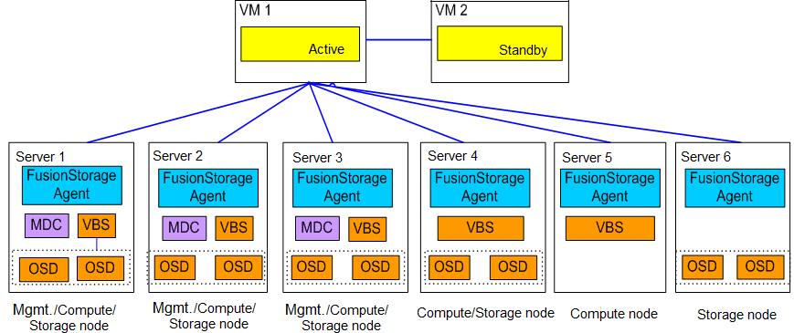
FusionStorage: Logical Architecture
FusionStorage Manager (FSM): FusionStorage management module. It provides O&M functions including alarm management, service monitoring, operation logging, and data configuration. In most cases, FSM-enabled nodes are deployed in active/standby mode.
FusionStorage Agent (FSA): Performs FusionStorage agent functions. It is deployed on each node to enable the node to communicate with the FSM module. An FSA consists of three processes: MetaData Controller (MDC), Virtual Block System (VBS), and Object Storage Device (OSD). Depending on system configuration requirements, different combinations of processes are used for different nodes to implement specific functions.
Notes:
MetaData Controller (MDC): Controls the status of distributed clusters, data distribution rules, and data reconstruction rules. MDCs are deployed on ZooKeeper disks of three nodes to form an MDC cluster.
Virtual Block System (VBS): Manages volume metadata and provides the access point service for distributed clusters so that compute resources can access distributed storage resources through the VBS. A VBS process, by default, is deployed on each node so that these VBS processes can form a cluster. Multiple VBS processes can be deployed on a single node to improve I/O performance.
Object Storage Device (OSD): Performs I/O operations. Multiple OSD processes are deployed on each server. By default, one disk corresponds to one OSD process. When Solid-State Drives (SSDs) serve as the main storage, multiple OSD processes can be deployed on one SSD to maximize the SSD usage and performance. For example, one 2.4 terabyte SSD supports a maximum of six OSD processes, and each OSD process manages 400 gigabytes of SSD space.

Slide 77
Data Management
Traditional RAID Technology
DAS Technology Introduction
SAN Technology Introduction
NAS Technology Introduction
Huawei Distributed Storage
Object Storage

Slide 78
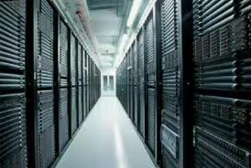


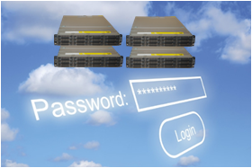
About Object Storage
For enterprises, big data analysis is becoming increasingly important. As big data applications employ ever larger data volumes, enterprises demand larger storage capacity. The primary objective is to store large quantities of data.
Multi-source data
Software and hardware development
Easy access to cloud compute
Stronger compute performance
Higher storage cost-effectiveness
The emergence of distributed processing technologies
Data is generated from daily life
Everyone is creating data
Object storage technology
RAID 2.0
Low-cost data processing
Notes:
Multi-source data
Today’s data comes from more fields than before. The GPS system installed on cars and people’s mobile phones are all data sources.
Software and hardware development
The compute speed of computers increases every year according to Moore’s Law. Storage media density soars so the storage capacity cost-per-unit decreases year by year.
A large amount of unstructured data is a major feature that distinguishes big data from traditional data. Traditional relational databases cannot process the rapidly increasing unstructured data. The Hadoop-based distributed data processing technology makes unstructured data processing impractical.
Easy access to cloud compute
Big data needs to be processed on a powerful software and hardware platform. Building such a platform is expensive. Some small enterprises may not be able to bear the expense. The IaaS and PaaS services of cloud compute can provide pay-on-your-terms software and hardware platform services for enterprises. These services enable small enterprises to process big data.

Slide 79
Object Storage: Technical Structure
Client
Metadata
MDS
Interconnected networks
Data
Management
OSD
Notes:
In an object storage system, the MetaData Server (MDS) is responsible for mappings between files and Object Storage Devices (OSDs), as well as organizing files and directories. The MDS provides all name domain operations of file systems, including file search and creation, along with file and directory property processing. In terms of clients, the MDS acts as a logical file window, while the OSD is a physical file window. When you retrieve a file, the file system obtains the address where the file is stored from the MDS and accesses the file on the OSD. There is no need to access the MDS for the follow-up I/O operations. This reduces loads of the MDS and enables system scalability.

Slide 80
Object Storage: Composition
Object
  It contains file data and related attribute information for self-management. The size of objects, including entire data structures such as files and database entries, varies.
OSD
  Each OSD is an intelligent device that has its own storage media, processor, memory, and network system. As the core of an object storage system, the OSD manages local objects.
File system
  It runs on the client to transfer file system requests from applications to the MDS and OSD. The MDS provides metadata and cache consistency services.

Slide 81
What do RTO and RPO refer to?
What is the relationship between RAID and LUN?
What are the differences between DAS, SAN, and NAS?
Notes:
What do RTO and RPO refer to?
Recovery Point Object (RPO):When a disaster or emergency occurs, data can be restored to a previous time point. This in turn determines how much data is lost when a disaster occurs
Recovery Time Objective (RTO):Refers to the length of time it takes for a system to resume normal operation after a breakdown.
What is the relationship between RAID and LUN?
RAID is like a large physical volume composed of multiple disks.
We can create one or multiple logical units of a specified capacity on the physical volume. Those logical units are referred to as LUNs. They are the basic block units that can be mapped to hosts.
What are the differences between DAS, SAN, and NAS?
DAS:One or more dedicated storage devices connected to one or more servers. These storage devices provide block data access service for servers.
SAN:Storage Area Network (SAN) is a high-performance and dedicated storage network used between servers and storage resources. It is optimized for transferring mass original data. It can be considered as the advanced SCSI protocol for long-distance data transmission.
NAS:A Network Attached Storage (NAS) is an IP-based file sharing device connected to a LAN. It provides storage resources through file-level data access and sharing, enabling customers to quickly share files with the minimum storage management overhead.

Slide 82
Information data management
Traditional RAID technology
Introduction to DAS technology
Introduction to SAN technology
Introduction to NAS technology
Introduction to object storage

Slide 83
Huawei official websites:
  Enterprise business: https://e.huawei.com/en/
  Technical support: https://support.huawei.com/enterprise/en/index.html
  Online learning: http://learning.huawei.com/en/
Document tool:
  HedEx Lite
Simulator:
  eNSP

Slide 84
Huawei Learning website:
  https://support.huawei.com/learning/en/newindex.html
Huawei Support Case Library:
  http://support.huawei.com/enterprise/servicecenter?lang=en

