Slide 1
HCDCA109
OceanStor V5
V5R2
1.0
Cai Wenjun/WX440054
2017.11.11
Liu Lican/00180730
New
Yuan Weihua/WX462781
2019.4.10
Liu Lican/00180730
Update

Slide 2
Huawei Data Center Storage System Product Introduction and Maintenance
Huawei Data Center Series of Courses

Slide 3
This chapter introduces Huawei data center storage products, Including familiarizing with the OceanStor V5 product positioning, hardware architecture, and daily operation and maintenance.

Slide 4
After completing this course, you will be able to know:
Positioning of OceanStor V5 converged storage systems.
Hardware architecture of OceanStor V5 converged storage systems.
Features of OceanStor V5 converged storage systems.
The basic daily operation and maintenance operations.

Slide 5
Product introduction
Hardware introduction
Daily operation and maintenance

Slide 6
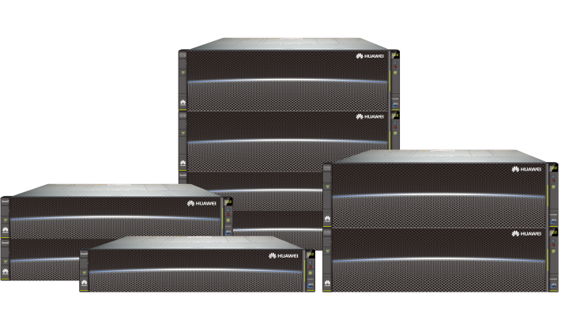
Huawei Storage Products
Storage solution
OceanStor 18000 V5
OceanStor 6800 V5
OceanStor 5300/5500/5600/5800 V5
OceanStor Dorado 2100 G2/5100

Slide 7
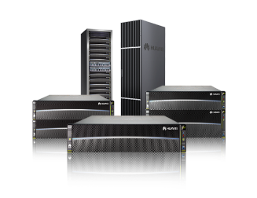

Product Positioning
OceanStor V5 converged storage systems
Centralized
storage
High-density
virtualization
Tiered
storage
Data disaster
recovery (DR)
Brand-new hardware architecture delivering industry-leading performance and specifications: The V5 converged storage systems employ 16 Gbit/s Fibre Channel and 10 Gbit/s FCoE host ports and provide up to 768 GB/s system bandwidth, 16 TB cache capacity, and 27 PB storage capacity.
Convergence of SAN and NAS: SAN and NAS are converged to provide elastic storage, simplify service deployment, improve storage resource utilization, and reduce total cost of ownership (TCO).
Outstanding scalability and reliability: Up to eight controllers and linear growth of performance and capacity are supported. Loads are balanced among controllers that serve as hot backup for each other, achieving higher reliability. Resources are centrally stored, simplifying resource management.
Up to sixteen controllers
IP Scale-out and load balancing
Online deduplication and compression
Higher storage resource utilization
Wide channel
Latest 16 Gbit/s Fibre Channel, 12 Gbit/s SAS, and PCIe 3.0
Virtualization
Block-level virtualization, heterogeneous virtualization, and computing virtualization
High specifications
Large capacity, high cache speed, and large number of ports

Slide 8
Product Positioning
Type
Model
Feature
Application
Scenario
Unified storage
High performance
Large capacity and
flexible scalability
Maximum capacity
optimization
High efficiency
Flash memory optimization
Large-scale consolidation
Layer 1 application
virtualization
Mixed workloads
Multiple application
programs
High-performance
application programs
High-end
storage
18800 V5
6800 V5
High-end storage
Functions first
Large enterprises
5800 V5
5600 V5
5500 V5
5300 V5
Unified storage
Stable performance
Large capacity and
flexible scalability
Maximum capacity
optimization
High efficiency
Flash memory optimization
Enterprise application
programs (Oracle
databases/emails/SAP)
Storage consolidation
Server virtualization
Advanced storage tiering
Data protection
File sharing
Mid-range storage
Functions and
prices balanced
Mid-range
storage
Medium enterprises
Entry-level
storage
Price first
Good performance and
sufficient capacity
Ease-of-use
Cost-effective
Basic consolidation
Microsoft application
Programs
Entry-level server
virtualization
iSCSI SAN
Video surveillance
Small enterprises
2600 V5
2200 V5
Entry-level
storage

Slide 9
Application scenario
High-Performance Applications
On-Demand System Performance Boost
Dynamic Storage Tiering for Hotspot Data
High-Availability Applications
In-Service Routine Maintenance
Tolerance of Single Points of Failures
Resilience Against Disasters
High-Density and Multi-Service Applications
High-Density Virtual Machine Applications
Multi-Service Applications

Slide 10
Product positioning
Hardware introduction
Hardware
Interface modules
Daily operation and maintenance

Slide 11
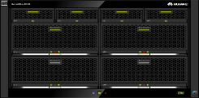



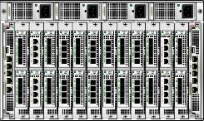
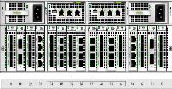

Product Form
OceanStor V5 converged storage systems adopt brand-new hardware platform.
2200/2600/5300/5500 V5: disk and controller integration (2 U).
5600/5800 V5: disk and controller separation (3 U independent engine).
6800 V5: disk and controller separation (6 U independent engine).
Active-active controllers.
6800 V5
2200/2600 V5
5300/5500 V5
5600/5800 V5
S5500T

Slide 12
Product Features
High performance
PCIe 3.0 high-speed bus and SAS 3.0 high-speed I/O channel
Flexible scalability
Hot-swappable I/O interface modules
Support for 4 interface modules and 2 onboard interface modules (2 U)
Support for 16 interface modules (3 U)
Support for 24 interface modules (6 U)
Robust reliability
Full redundancy design
Built-in BBUs+data coffer
Various data protection technologies
Energy saving
Intelligent CPU frequency control
Delicate fan speed control

Slide 13
Common Storage Advanced Technology
SmartThin：Storage space is allocated when it is written. SmartThin allows a host to allocate real space to a Thin LUN when writing data to a Thin LUN.
SmartTier：An intelligent data storage tiering feature can help select an appropriate storage tier for each data block based on the data activity level. This feature improves the storage system performance and lowers the total cost of ownership.
SmartQoS：SmartQoS is an intelligent QoS control feature developed by Huawei that dynamically allocates a storage system's resources to meet specific performance goals of certain applications.
SmartPartition： It allows you to assign cache partitions of different sizes to different applications. The system provides the cache capacity specified by a partition for the corresponding applications, thereby ensuring the performance of the applications in the partition.

Slide 14



OceanStor 2200 V5 Controller Enclosure
Power-fan module
1+1 redundancy
AC or 240 V high-voltage DC
Filler panel
SAS expansion port
Each controller provides two SAS expansion ports.
Port module
One hot-swappable I/O module slot only on the front end
Port type: 8 x 8 Gbit/s Fibre Channel, GE, 10GE electrical port, SmartIO card (16 Gbit/s Fibre Channel, 8 Gbit/s Fibre Channel, 10 Gbit/s FCoE (VN2VF), and 10 Gbit/s ETH (optical port))
Onboard port
Four GE ports on each OceanStor 2200 V5 controller

Slide 15

OceanStor 2600 V5 Controller Enclosure
Power-fan module
1+1 redundancy
AC, -48 V DC, or 240 V high-voltage DC
Port module
Two hot-swappable I/O module slots only on the front end
Port type: 8 Gbit/s Fibre Channel (4 x 8 Gbit/s Fibre Channel or 8 x 8 Gbit/s Fibre Channel), GE, 10GE electrical port, SmartIO card (16 Gbit/s Fibre Channel, 8 Gbit/s Fibre Channel, 10 Gbit/s FCoE (VN2VF), and 10 Gbit/s ETH (optical port)
SAS expansion port
Each controller provides two SAS expansion ports.
Onboard port
Four GE ports on each OceanStor 2600 V5 controller

Slide 16
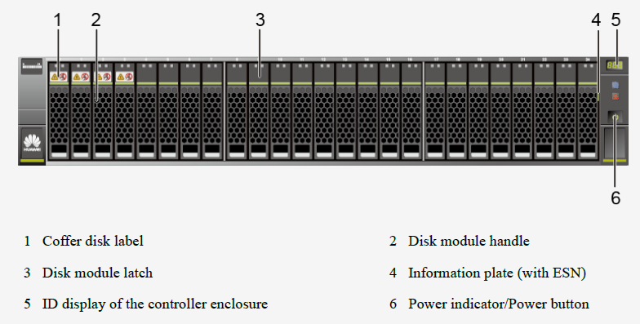
5300/5500 V5 Controller Enclosure (25 disk slots)
Notes:
Note: The disk slots of a 2 U 25-disk-slot controller enclosure are numbered from 0 to 24 from left to right. Coffer disks are in slots 0 to 3.

Slide 17
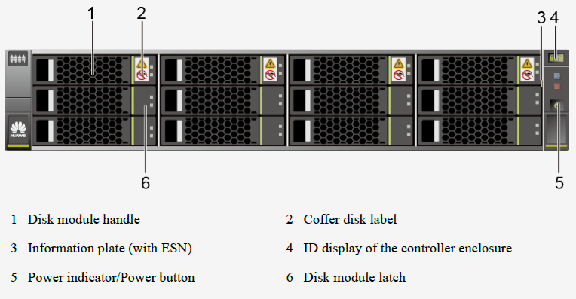
5300/5500 V5 Controller Enclosure (12 disk slots)
Notes:
Note: The disk slots of a 2 U 12-disk-slot controller enclosure are numbered from 0 to 11 from left to right and then from top to bottom. Coffer disks are in slots 0 to 3.

Slide 18
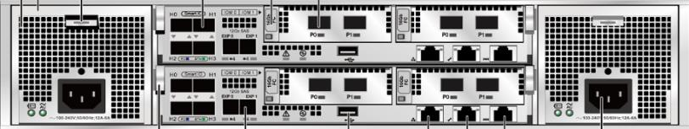
5300/5500 V5 Rear Panel
Serial port
SAS expansion port
Two SAS expansion ports for each controller
USB port
One USB port for each controller (reserved)
Configuration network port
Power-BBU-fan module
1+1 redundancy
Up to 94% power conversion efficiency
Independent BBUs
Support for -48 V and 240 V DC power.
Management network port
Onboard port
5300 V5: 4 x GE ports
5500 V5: SmartIO ports
Interface module
Two interface module slots for each controller
Hot-swappable
Rich port types: 16 Gbit/s Fibre Channel, 12 Gbit/s SAS, GE, 10GE TOE, 10GE FCoE, and 8 Gbit/s Fibre Channel
Notes:
Onboard GE ports are supported by the OceanStor 5300 V5 and onboard SmartIO ports are supported by the OceanStor 5500 V5.
A controller enclosure supports 8 Gbit/s Fibre Channel interface modules, GE electrical interface modules, 10GE electrical interface modules, 16 Gbit/s Fibre Channel interface modules, 10 Gbit/s TOE, 10 Gbit/s FCoE (two ports), 10 Gbit/s FCoE (four ports), 56 Gbit/s IB interface modules, SmartIO interface modules, High-Density 8 Gbit/s Fibre Channel interface modules and 12 Gbit/s SAS expansion modules. The following figure uses a 16 Gbit/s Fibre Channel interface module of OceanStor 5500 V5 as an example.
When the maintenance network port is used for management and maintenance, the maintenance network port can only be used by Huawei technical support for emergency maintenance and cannot be connected to the same network with the management network port. Otherwise, a network loopback may occur, causing a network storm. The initial value for the IP address of the maintenance network port is 172.31.128.101 or 172.31.128.102. The default subnet mask is 255.255.0.0. You are advised to only connect the management network port to the network.

Slide 19
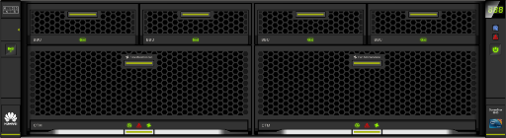
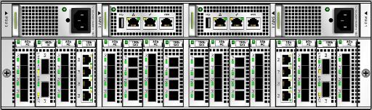
5600/5800 V5 Controller Enclosure
BBU module
5600 V5: 1+1 redundancy (remaining two slots inserted by filler BBU modules); 5800 V5: 2+1 redundancy (remaining one slot inserted by a filler BBU module)
DC/AC power failure protection
Controller module
Support for dual controllers and four controllers
Mainstream server platform
Automatic frequency control and energy saving
Fan module (integrated into a controller module but maintained independently)0
Interface module
16 interface module slots
A maximum of 1250 disks
Hot-swappable
Rich port types: 16 Gbit/s Fibre Channel, 12 Gbit/s SAS, GE, 10GE TOE, 10GE FCoE, and 8 Gbit/s Fibre Channel
Management module
1+1 redundancy
Hot-swappable
Support for multi-controller Scale-out interconnection with a heartbeat mechanism
Power module
1+1 redundancy
Up to 94% power conversion efficiency
240 V high-voltage DC

Slide 20
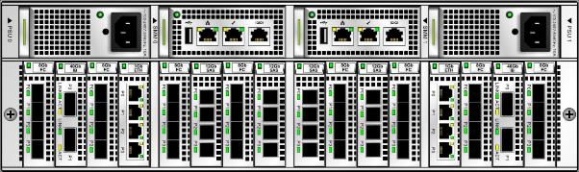
5600/5800 V5 Ports
1
2
3
4
5
6
9
8
7
1
Power module
2
Management board
3
USB port (reserved)
4
Management network port
5
Maintenance network port
6
Serial port
7
12 Gbit/s mini SAS HD
8
8 Gbit/s Fibre Channel port
9
GE port

Slide 21
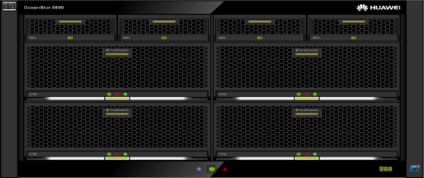
6800 V5 Controller Enclosure (1)
BBU module
3+1 redundancy
DC/AC power failure protection
Controller module
Support for dual controllers and four controllers
Mainstream server platform
Automatic frequency control and energy saving
Fan module (integrated into a controller module but maintained independently)

Slide 22
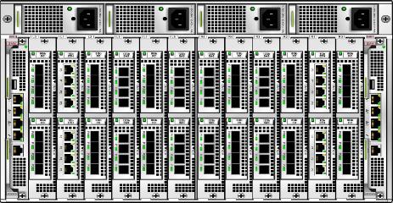
6800 V5 Controller Enclosure (2)
Management module
1+1 redundancy
Hot-swappable
Support for multi-controller Scale-out interconnection with a heartbeat mechanism
Interface module
Dual controllers: 12 interface module slots; four controllers: 24 interface module slots
A maximum of 2000 disks
Hot-swappable
Rich port types: 16 Gbit/s Fibre Channel, 12 Gbit/s SAS, GE, 10GE TOE, 10GE FCoE, and 8 Gbit/s Fibre Channel
Power module
1+1 redundancy
Up to 94% power conversion efficiency
240 V high-voltage DC

Slide 23
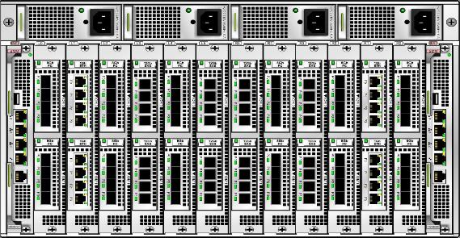
6800 V5 Ports
1
2
3
4
5
6
9
8
7
1
USB port (reserved)
2
Management network port 0
3
Management network port 1
4
Management network port 2
5
Maintenance network port
6
Serial port
7
12 Gbit/s mini SAS HD
8
9
GE port
8 Gbit/s Fibre
Channel port

Slide 24
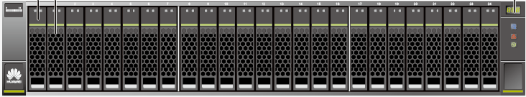
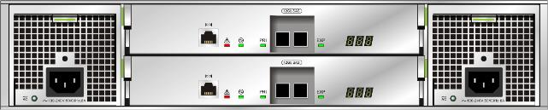
2 U 2.5-inch Disk Enclosure
2.5-inch disk unit
No disk connector
Support for 6 Gbit/s SAS disks, NL-SAS disks, and 6 Gbit/s SAS SSDs
Expansion module
Dual expansion modules
12 Gbit/s SAS uplink and downlink
600 W power module
1+1 redundancy
Fan modules integrated into a disk enclosure (1+1 fan redundancy, namely, each power module equipped with one fan module)
DC/AC power supplies
1
2
3
1
Serial port
2
mini SAS HD expansion port
3
Disk enclosure ID display

Slide 25
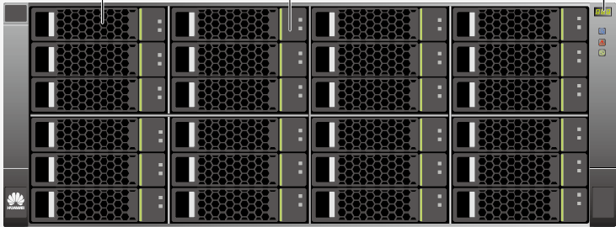
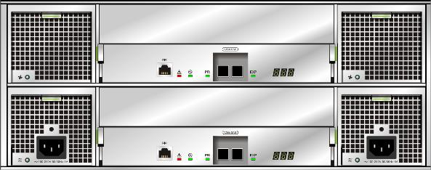
4 U 3.5-inch Disk Enclosure
3.5-inch disk unit
No disk connector
Support for 6 Gbit/s NL-SAS disks
Expansion module
Dual expansion modules
12 Gbit/s SAS uplink and downlink
Fan module
2 fan modules (2 fan modules and 2 power modules compose a heat dissipation module.)
5+1 redundant fan modules in a disk enclosure
High-speed fans
600 W power module
1+1 redundancy
Fan modules integrated into a disk enclosure
Support for DC (-48 V)/AC (90 V to 240 V)
Support for 240 V high-voltage DC

Slide 26

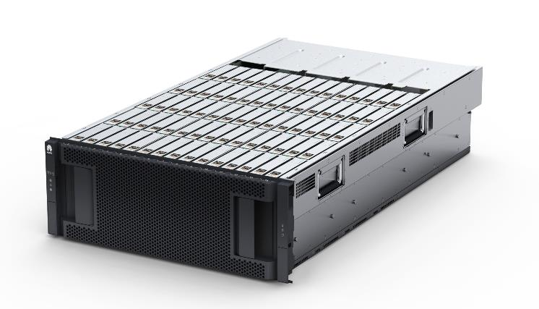
4 U 3.5-inch High-density Disk Enclosure (1)
75 disks arranged in 5 lines and 15 rows
Support for power-on and power-off of a single disk unit

Slide 27
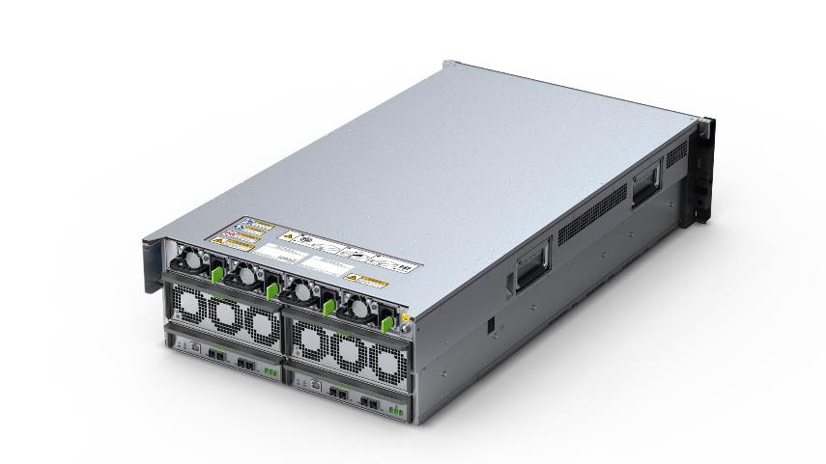
4 U 3.5-inch High-density Disk Enclosure (2)
FRU PSU: 2+2 redundancy
FRU cooling module redundantly configured
16-level intelligent fan speed control, reducing power consumption and noise
FRU SAS expansion module: 1+1 redundancy
Four 4-channel wide 6 Gbit/s SAS data links provided by each I/O module; mini SAS HD port

Slide 28
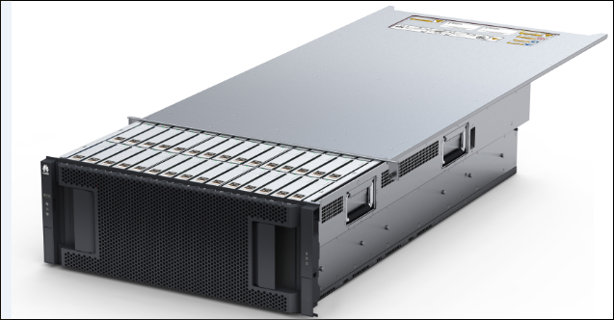
4 U 3.5-inch High-density Disk Enclosure (3)
Disk enclosure cover

Slide 29
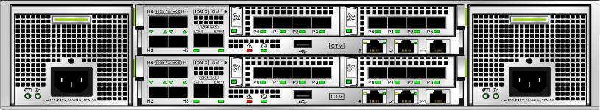
IP Scale-out (2 U)
The smart I/O interface module is required by Scale-out and must be inserted into slot 1.
Back-end port
Front-end service port
Scale-out port
A1
2600 V5
5300/5500 V5
B1

Slide 30
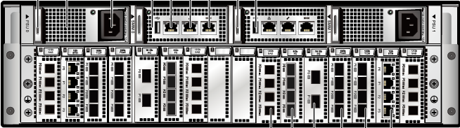
IP Scale-out (3 U)
The smart I/O interface module is required by Scale-out and must be inserted into slot 3.
Back-end port
Front-end service port
Scale-out port
A3
B3
5600/5800 V5

Slide 31
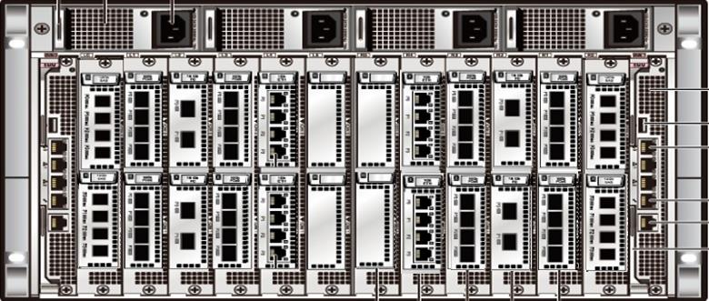
IP Scale-out (6 U)
Back-end port
Front-end service port
6800 V5
6900 V5
A3
B3
The smart I/O interface module is required by Scale-out and must be inserted into slot 3.
Scale-out slots (fixed)

Slide 32
Product introduction
Hardware instruction
Hardware
Interface modules
Daily operation and maintenance

Slide 33
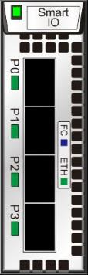
Smart I/O Interface Module
1
4
1 | Power indicator/Hot Swap button
2 | 16 Gbit/s Fibre Channel/8 Gbit/s Fibre Channel/FCoE/iWARP(Scale-Out)
3 | Port indicator (Link/Active/Mode indicator)
4 | Module handle
5 | Port working mode silkscreen
2
3
5
Notes:
Power indicator:
Green on: The module is working properly.
Blinking green: The module needs to be hot-swapped.
Red on: The module is faulty.
Off: The module is not powered on.
Port indicator (Link/Active/Mode indicator):
Blinking blue slowly: The module is working in FC mode with link down.
Blinking blue quickly: The module is working in FC mode with link up and data is being transmitted.
Steady blue: The module is working in FC mode with link up but no data is being transmitted.
Blinking green slowly: The module is working in FCoE/iWARP mode with link down.
Blinking green quickly: The module is working in FCoE/iWARP mode with link up and data is being transmitted.
Steady green: The module is working in FCoE/iWARP mode with link up but no data is being transmitted.

Slide 34
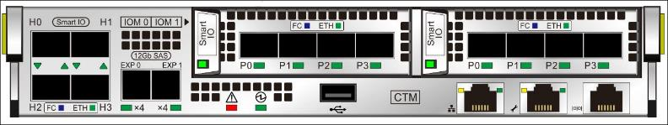
Onboard Smart I/O Interface Module
1
3
2
4
1 | 16 Gbit/s Fibre Channel/8 Gbit/s Fibre Channel/FCoE
2 | Port indicator (Link/Active/Mode indicator)
3 | Module handle
4 | Port working mode silkscreen
Notes:
Port indicator (Link/Active/Mode indicator):
Blinking blue slowly: The module is working in FC mode with link down.
Blinking blue quickly: The module is working in FC mode with link up and data is being transmitted.
Steady blue: The module is working in FC mode with link up but no data is being transmitted.
Blinking green slowly: The module is working in FCoE mode with link down.
Blinking green quickly: The module is working in FCoE mode with link up and data is being transmitted.
Steady green: The module is working in FCoE mode with link up but no data is being transmitted.

Slide 35
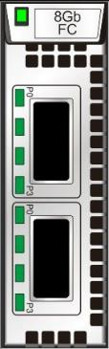
8 Gbit/s Fibre Channel High-density Interface Module (1)
The interface module provides two 4 x 8 Gbit/s Fibre Channel physical ports. The two ports are converted into eight 8 Gbit/s Fibre Channel optical ports using dedicated optical cables (no optical module connected to the eight ports). The eight ports are used as service ports to connect application servers to storage systems and used to receive data exchange commands from application servers.
The interface module contains two 4 x 10 Gbit/s QSFP+ optical modules.
The interface module is equipped with 15 m four-in-one dedicated optical cables.
1
4
2
3
1 | Power indicator/Hot Swap button
2 | 8 Gbit/s Fibre Channel port
3 | Port Link/Active indicator
4 | Module handle/Silkscreen
Notes:
Power indicator:
Green on: The module is working properly.
Blinking green: The module needs to be hot-swapped.
Red on: The module is faulty.
Off: The module is not powered on or can be hot-swapped.
Port Link/Active indicator:
Blue on: Data is being transmitted at the rate of 8 Gbit/s between the storage system and application servers.
Blinking blue: Data is being transmitted.
Green on: Data is being transmitted at the rate of 4 Gbit/s or 2 Gbit/s between the storage system and application servers.
Blinking green: Data is being transmitted.
Red on: A port fault occurs.
Off: The port link is down.

Slide 36
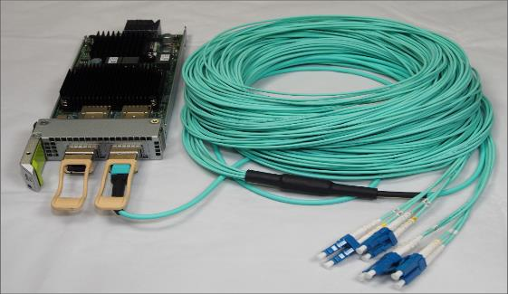
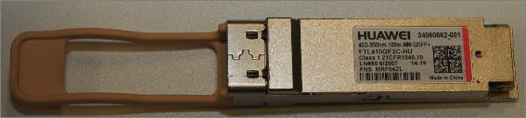
8 Gbit/s Fibre Channel High-density Interface Module (2)

Slide 37
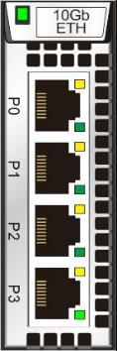
10 Gbit/s ETH Electrical Interface Module
1
5
1 | Power indicator/Hot Swap button
2 | 10 Gbit/s Ethernet port
3 | Port Link/Active indicator
4 | Port Speed indicator
5 | Module handle
4
2
3
Notes:
Power indicator:
Green on: The module is working properly.
Blinking green: The module needs to be hot-swapped.
Red on: The module is faulty.
Off: The module is not powered on.
Port Link/Active indicator:
Green on: The connection between the interface module and application servers is normal.
Blinking green: Data is being transmitted.
Off: The connection between the interface module and application servers is abnormal.
Port Speed indicator:
Orange on: Data is being transmitted at the rate of 10 Gbit/s between the storage system and application servers.
Off: Data is being transmitted at the rate of lower than 10 Gbit/s between the storage system and application servers.

Slide 38
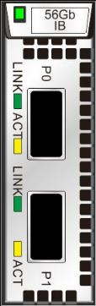
56 Gbit/s IB Interface Module
1 | Power indicator/Hot Swap button
2 | 4 lane x 14 Gbit/s IB electrical port
3 | Port Link indicator
4 | Port Active indicator
5 | Module handle/Silkscreen
1
5
2
3
4
Notes:
Power indicator:
Green on: The module is working properly.
Blinking green: The module needs to be hot-swapped.
Red on: The module is faulty.
Off: The module is not powered on or can be hot-swapped.
Port Link indicator:
On: The connection between the module and application servers is normal.
Off: The port link is down.
Port Active indicator:
Blinking: Data is being transmitted.
Steady on: No data is being transmitted.

Slide 39
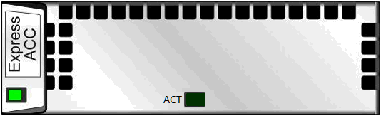
Deduplication and Compression Acceleration Interface Module (ACC)
3
1
1 | Power indicator/Hot Swap button
2 | Port Active indicator
3 | Module handle/Silkscreen
2
Notes:
Power indicator:
Green on: The module is working properly.
Blinking green: The module needs to be hot-swapped.
Red on: The module is faulty.
Off: The module is not powered on or is removable.
Port Active indicator:
Green on: No data is being processed.
Blinking green: Data is being processed.
Off: The module is not working properly.

Slide 40
Product introduction
Hardware introduction
Daily operation and maintenance
Information collection tool
Inspection tool
Upgrade tool
FRU replacement tool

Slide 41
Working Process
Adding devices
Adding devices: Add devices whose information you want to collect.
Setting collection items: Select desired collection items.
Selecting devices: Select devices whose information you want to collect.
Collecting information: Run the commands to collect information and package collected information.
Information collection completed: After the information collection is complete, you can click Open Directory to view collected information.
Setting collection items
Selecting devices
Collecting information
Completing information collection

Slide 42
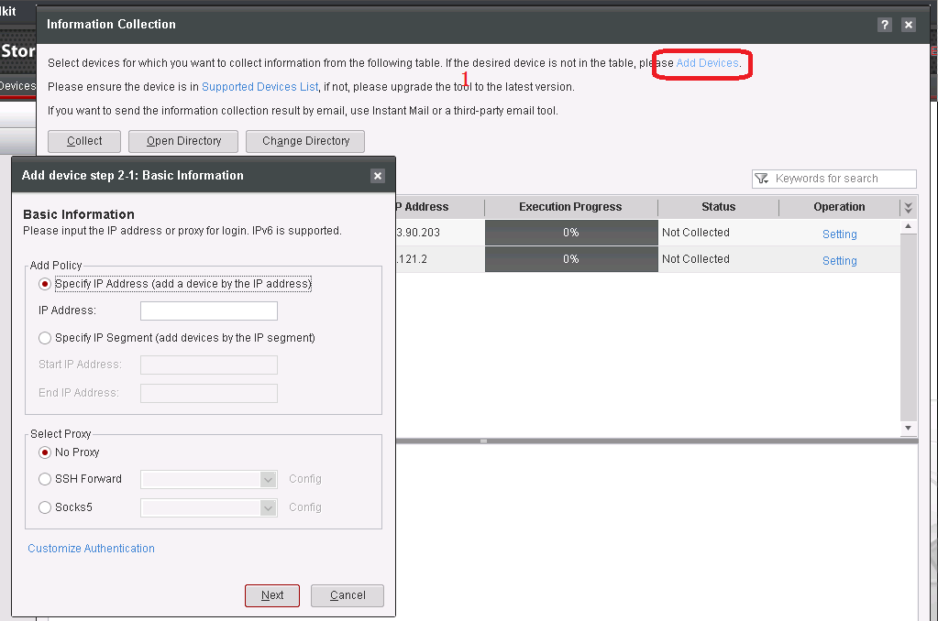
Adding Devices

Slide 43
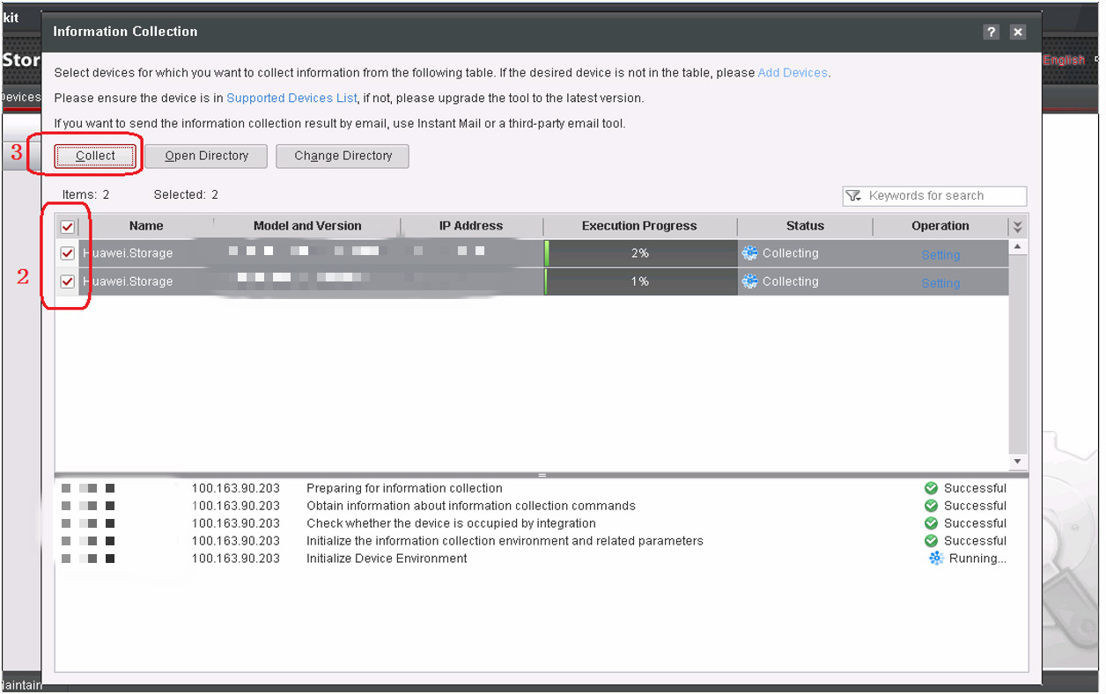
Collecting Information

Slide 44
Product introduction
Hardware introduction
Daily operation and maintenance
Information collection tool
Inspection tool
Upgrade tool
FRU replacement tool

Slide 45
Working Process
Selecting the inspection type
Selecting the inspection type: Select the inspection type for specific scenarios.
Selecting devices: Select devices that you want to inspect.
Selecting check items: Select desired check items.
Setting a check policy: Set a location for saving inspection reports.
Starting the inspection: Run the commands to start the inspection.
Selecting devices
Selecting check items
Setting a check policy
Starting the inspection

Slide 46
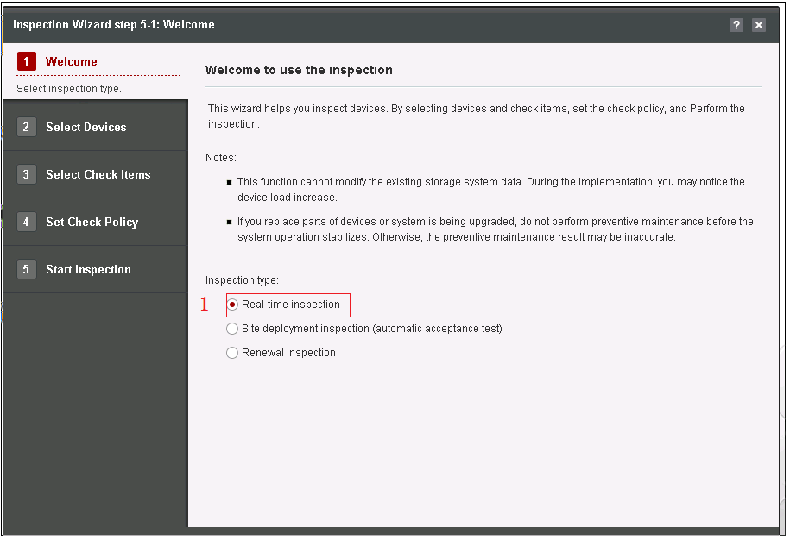
Selecting the Inspection Type

Slide 47
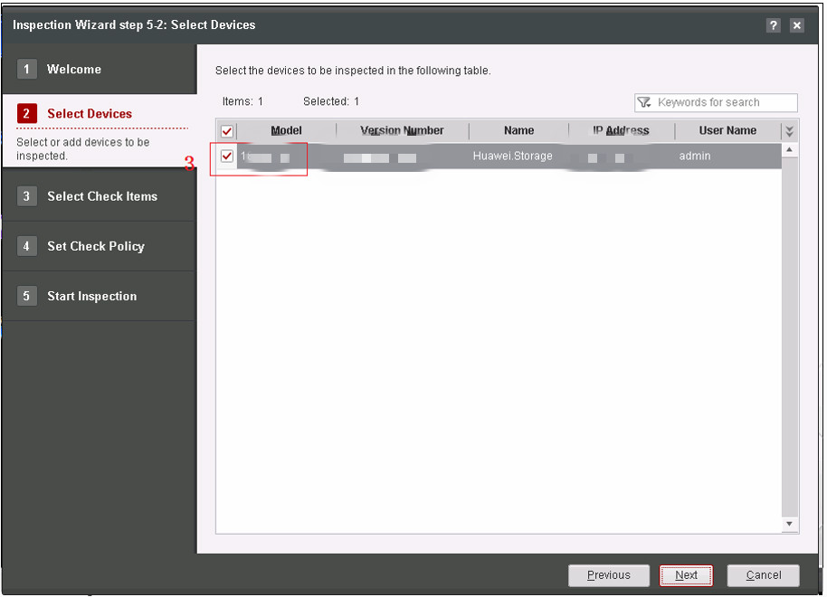
Selecting Devices
4

Slide 48
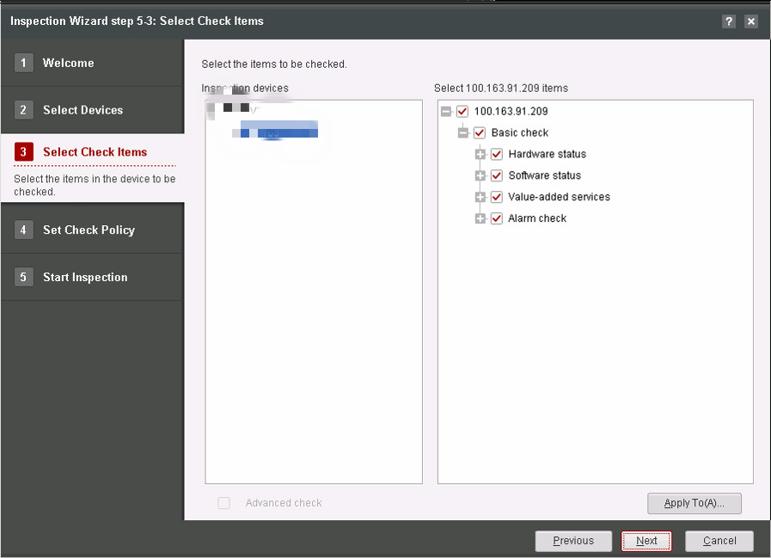
Selecting Check Items
5

Slide 49
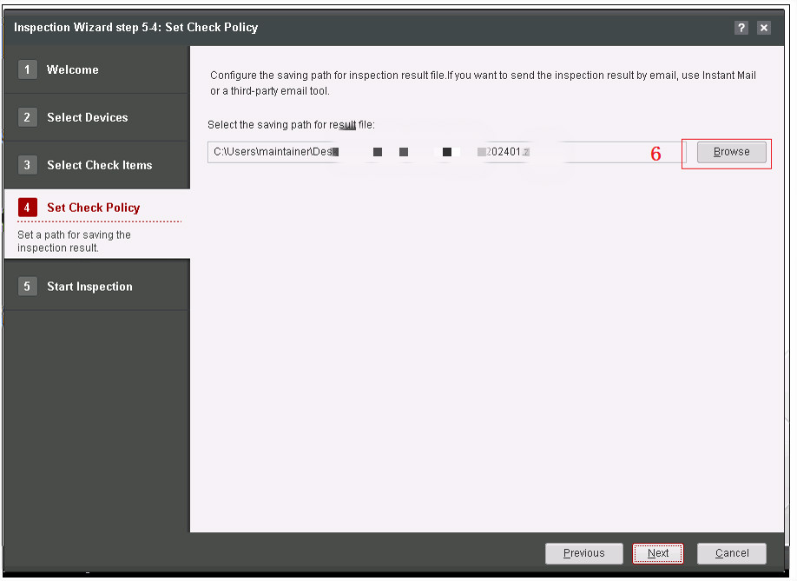
Setting a Check Policy
7

Slide 50
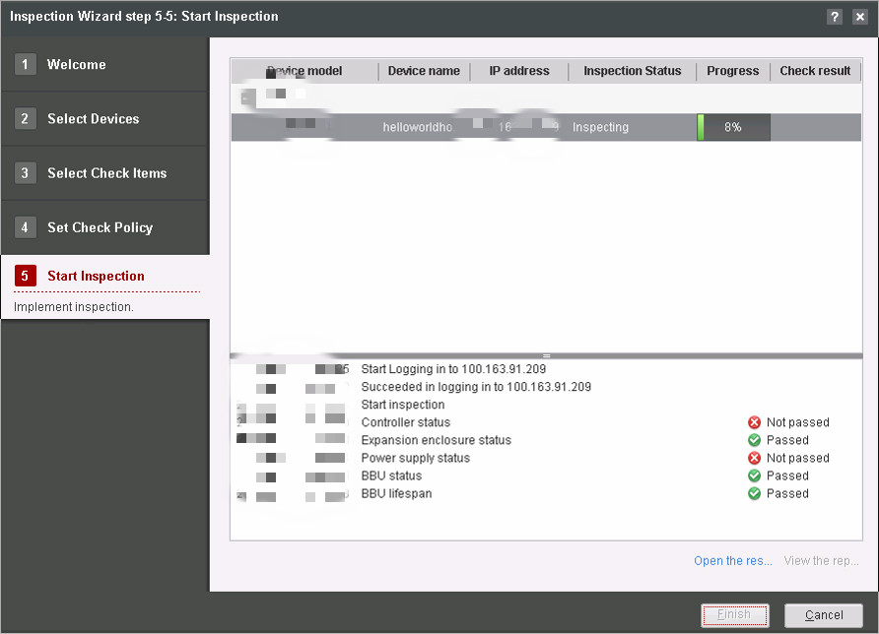
Starting Inspection

Slide 51
Product introduction
Hardware introduction
Daily operation and maintenance
Information collection tool
Inspection tool
Upgrade tool
FRU replacement tool

Slide 52
Working Process
Selecting devices
Selecting devices: Select devices that you want to upgrade.
Setting upgrade information: Set a path for saving the upgrade package, a path for saving backup data, and an upgrade mode (online or offline).
Importing the upgrade package: Import the upgrade package into the storage array.
Performing pre-upgrade check: Check whether issues that may affect the upgrade exist.
Backing up data: Back up the database data.
Performing the upgrade: Notify the storage array to perform the upgrade.
Verifying the upgrade: Check whether issues exist.
Setting upgrade information
Importing the upgrade package
Performing pre-upgrade check
Backing up data
Performing the upgrade
Verifying the upgrade

Slide 53
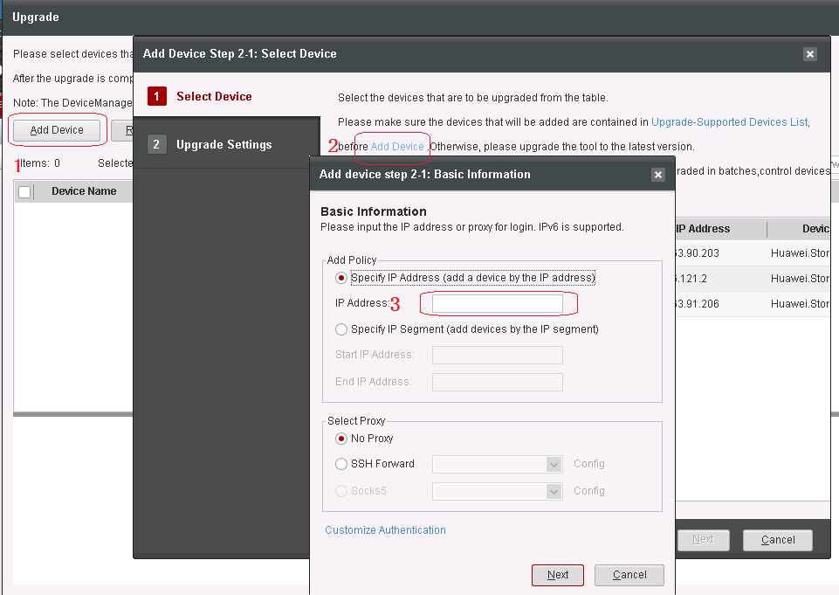
Selecting Devices (1)

Slide 54
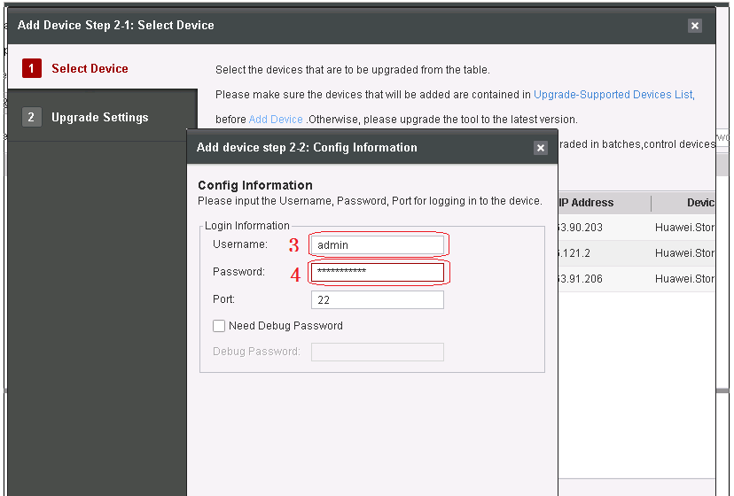
Selecting Devices (2)
4
5

Slide 55
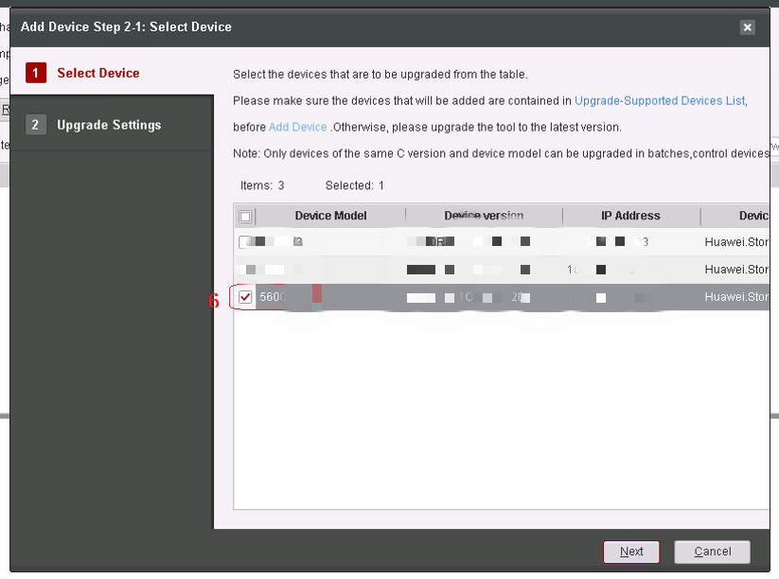
Selecting Devices (3)

Slide 56
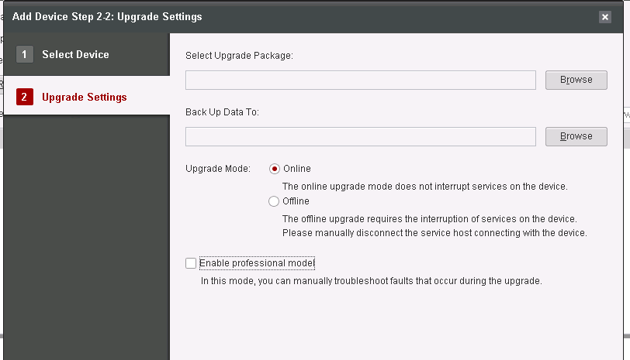
Setting Upgrade Information
7
8

Slide 57
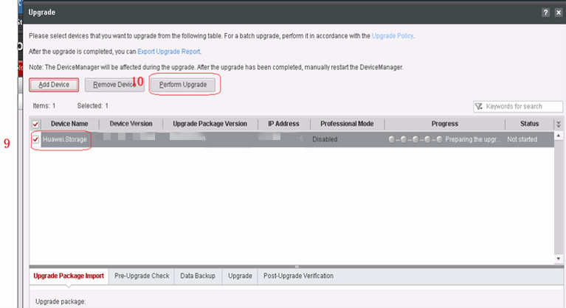
Clicking Perform Upgrade

Slide 58
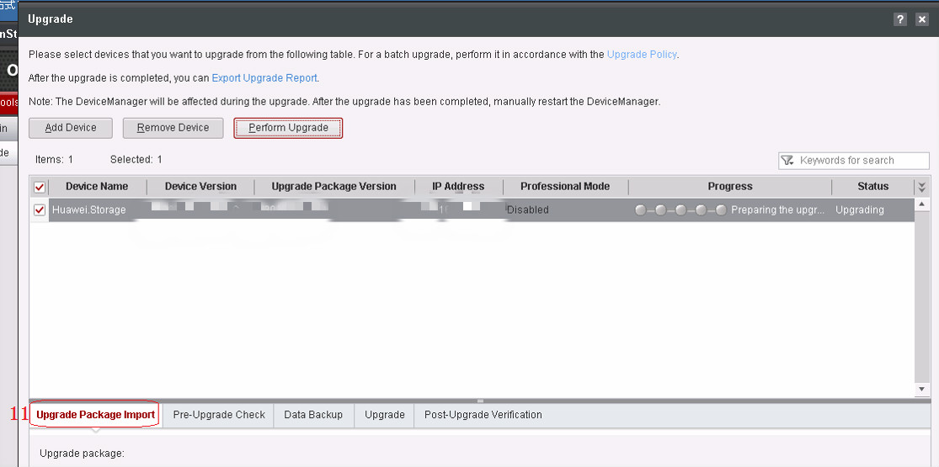
Importing the Upgrade Package

Slide 59
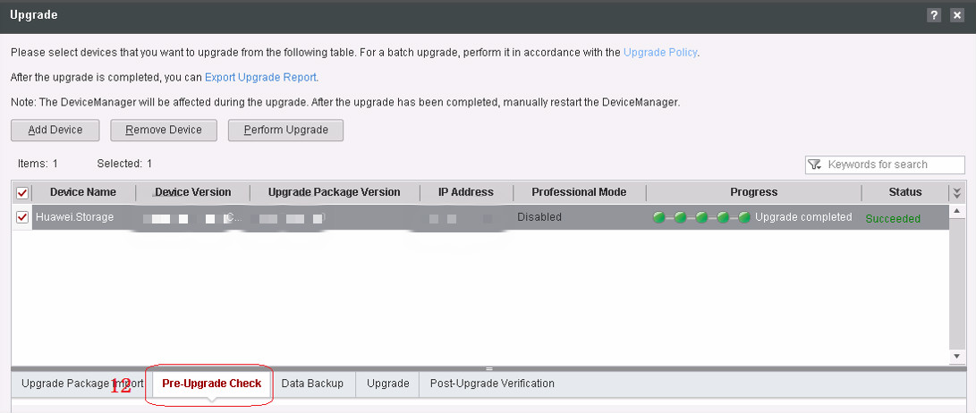
Performing Pre-upgrade Check

Slide 60
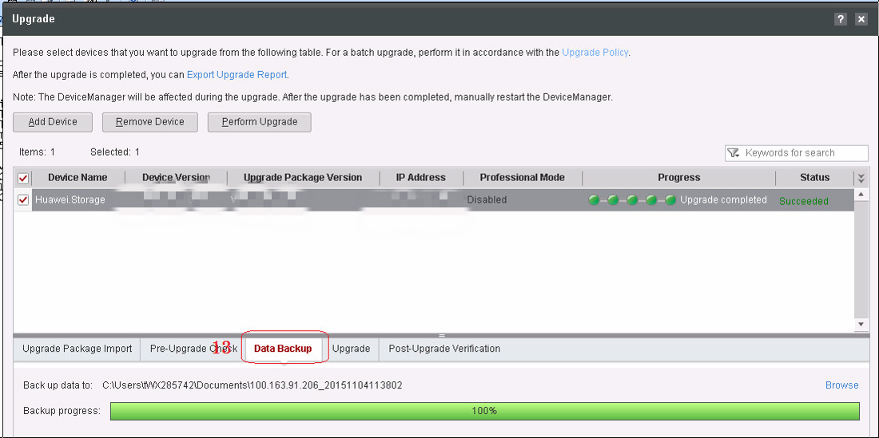
Backing Up Data

Slide 61
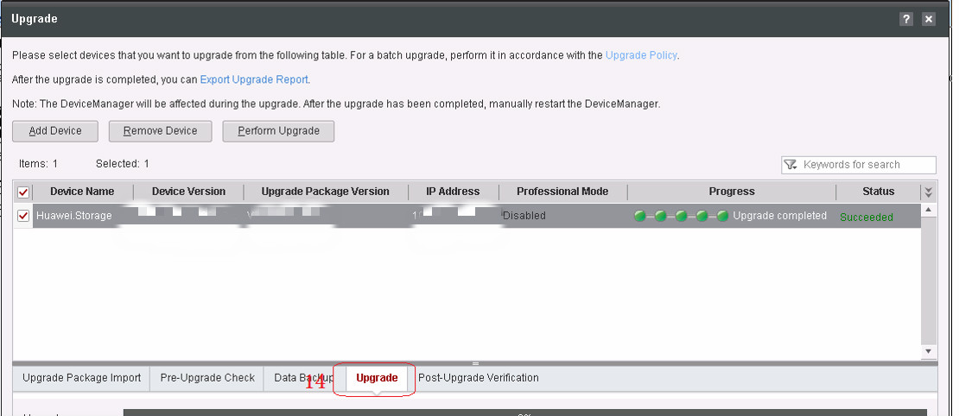
Upgrading the Devices

Slide 62
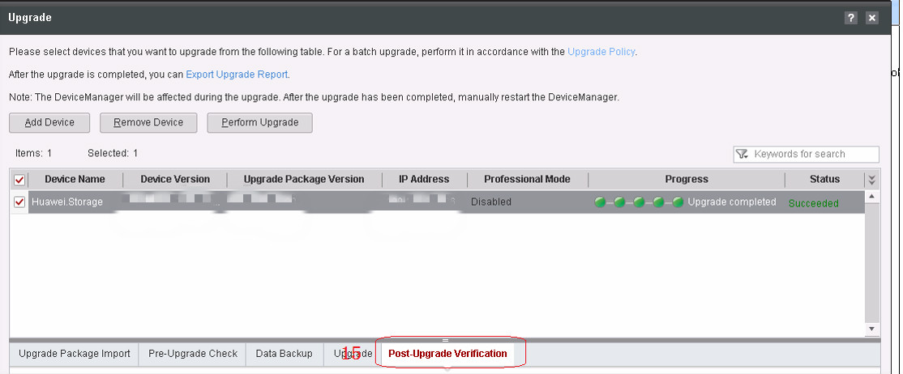
Verifying the Upgrade

Slide 63
Product introduction
Hardware introduction
Daily operation and maintenance
Information collection tool
Inspection tool
Upgrade tool
FRU replacement tool

Slide 64
Working Process
Selecting an FRU
Selecting an FRU: Select an FRU that you want to replace. Replace faulty FRUs first.
Checking status before replacement: Check whether the FRU needs to be replaced. If the FRU does not need to be replaced, an error will be reported.
Replacing the FRU: Replace the FRU following the procedure described in the replacement guide.
Checking status after replacement: Check whether the new FRU is working correctly. If the new FRU is working incorrectly, an error will be reported.
Replacement completed: A message is displayed indicating that the replacement is completed.
Checking status before replacement
Replacing the FRU
Checking status after replacement
Completing the replacement

Slide 65
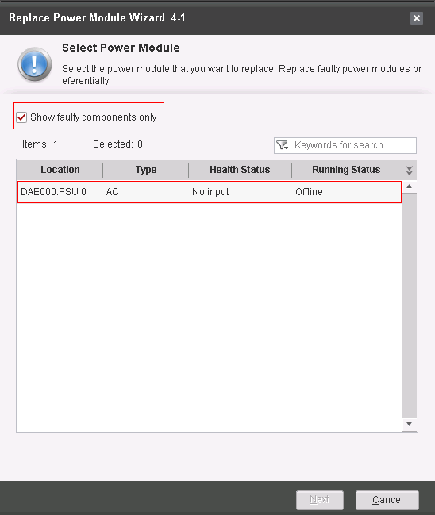
Selecting an FRU
Power modules are used as an example.
By default, only faulty components are displayed. If you want to select other components, deselect Show faulty components only.
Component silkscreens such as CTE0.PSU0 are used to distinguish FRUs.
You can click Next to start the pre-replacement check only after selecting the FRUs that you want to replace.

Slide 66

Checking Status Before Replacement
The number of check items varies with the impact scope of FRUs.
If the check result of one item is negative, causes and recommended actions are displayed. After troubleshooting, you can click Recheck to start the check from the item.
You can click Next to replace FRUs only after the results of all check items are positive.

Slide 67

Replacing the FRU
You can click Replacement Guide to read the replacement guide of the FRU to be replaced.
Strictly follow instructions in the Replacement Guide to replace the FRU.
After the replacement is complete, you can click Replaced to start the post-replacement check.

Slide 68

Checking Status After Replacement
The number of check items varies with the impact scope of FRUs.
If the check result of one item is negative, causes and recommended actions are displayed. After troubleshooting, you can click Recheck to start the check from the item.
You can click Next to complete the FRU replacement only after the results of all check items are positive.

Slide 69

Completing the Replacement
A message is displayed indicating that the FRU replacement is complete.
Click Finish to exit.

Slide 70
What are the common storage technologies used in Huawei's storage solutions?
What is the product positioning of OceanStor V5 storage?
Notes:
What are the common storage technologies used in Huawei's storage solutions?
SmartThin
SmartTier
SmartQoS
SmartPartition
What is the product positioning of OceanStor V5 storage?
Brand-new hardware architecture delivering industry-leading performance and specifications；Convergence of SAN and NAS；Outstanding scalability and reliability；Up to sixteen controllers，etc.

Slide 71
Product positioning
Hardware introduction
Routine Operation and Maintenance of the Information Collection Tool.
Routine Operation and Maintenance of the Inspection Tool.
Routine Operation and Maintenance of the FRU Replacement Tool.
Routine Operation and Maintenance of the Upgrade Tool.

Slide 72
Huawei Learning Website
http://support.huawei.com/learning/Index!toTrainIndex
Huawei Support Case Library
http://support.huawei.com/enterprise/servicecenter?lang=zh

Slide 73
Cloud DC solution
http://e.huawei.com/cn/solutions/business-needs/data-center

