Slide 1
HDCA102
AR G3
V2R9
1.5
Yuan Weihua/WX462781
2019.4.10
Liu Lican/00180730
Update
Notes:
1.01
Update to V2R3
1.10
Change the title “hardware introduction” to “product introduction”, the “software features” will not be updated in the future
Update to V2R5
P5, P6, P7 update to new
Hardware architecture → Key Specifications
P52, Add a comprehensive networking scenario
1.20
Update Layout
Update to VR7
P7,P9,P13 update to new
Add P23,P24. The introduction of SRUX5/SRU40C/SRU100E/SRU200E
Add P51,P53. The introduction of OPS and IAE

Slide 2
AR Router Product Introduction
Huawei Data Center Series of Courses

Slide 3
Huawei AR G3 series routers (AR for short) are the next-generation routing and gateway devices that provide routing, switching, wireless, voice, and security services. The AR G3 series include the AR1200, AR2200, AR3200, AR3600, and AR150&160&200 series routers.
Huawei AR 500 series routers, including AR531 and AR550 series, are new-generation industrial routing gateways that are developed by Huawei under the IoT background and integrate routing, switching, wireless, and security services.

Slide 4
Upon completion of this course, you will be able to:
Describe AR G3 product positioning
Describe AR G3 hardware architecture, common cards, and common modules
Describe AR G3 data forwarding flows
Describe AR G3 usage scenarios

Slide 5
AR G3 Positioning
AR G3 Hardware Architecture, Cards, and Modules
AR G3 Data Forwarding Process
AR G3 Feature Description and Usage Scenarios

Slide 6















AR G3 Positioning
Routing
Abundant access and uplink interfaces
High-density switching card
Switching router
Functioning as PBX to provide various voice application services
Switching
Voice
IPsec VPN/DSVPN/
SSL VPN/MPLS VPN
AR G3
Firewall hot standby (HSB)
VPN
Security
WLAN
Built-in AC and Fat AP
One AR provides six functions.
Notes:
Huawei AR G3 series enterprise routers (AR G3) are next generation routers dedicated for enterprise customers. The AR G3 all-in-one router series integrates multiple services including; routing, switching, 3G, WLAN, voice, and security functions in one device.
These features combine to deliver industry leading performance and extensibility, meeting customer requirements for a robust, reliable and flexible solution
for enterprise-grade network deployments. Due to strict adherence to industry standards, the AR G3 router series are easily integrated into existing networks, accelerating multi-service network deployment while preserving existing network infrastructure investments.
ARs are located between an internal network and a public network. The deployment of various network services over ARs reduces costs in enterprise network construction and long-term operation & maintenance (O&M).

Slide 7

"A-B-C" for AR G3 Routers in Cloud Era
Applications in one box
Reduce the TCO by at least 30%.
A
Better experience
Ensure service continuity.
B
Cooperation platform
Meet customized application requirements.
C

Slide 8

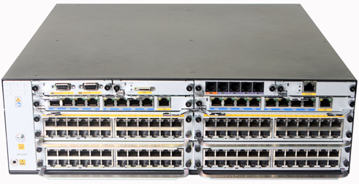
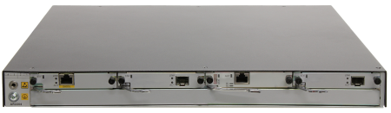
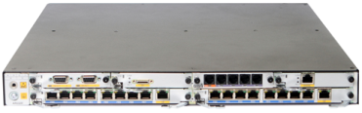
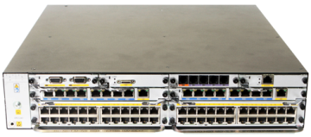


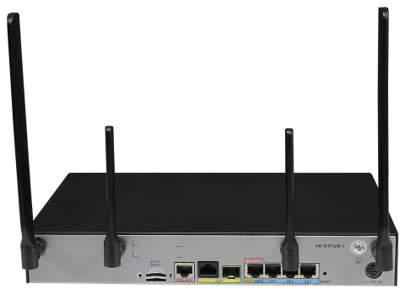
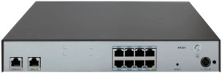


AR G3 Routers Portfolio
AR3200/AR3600 series
AR3260
Headquarters/Large-scale branch (> 600 users)
AR2200 series
AR2204-27G/AR2204-51G
AR2220/AR2220E/AR2220-S
AR2240/AR2240C
Medium-scale branch
(250 to 600 users)
AR1220E-S
AR1220F-S
AR1220C-S
AR1220-S
AR1200 series
Small-scale branch
(150 to 300 users)
AR150&160&200 series
AR201/
AR201-S
AR161FG-L/
AR161FGW-L
AR151-S2
SOHO & SMB
(< 150 users)
AR161FW-P-M5
Notes:
Those models with “V” stand for supporting voice, Those models with “W” stand for supporting WIFI, Those models with “G” stand for supporting 3G upstream. AR2200 series and AR3200 series support voice function only when equipped with the DSP module.
To provide voice services for POTS users on AR1200, AR2200 , and AR3200 series routers, 4FXS/1FXO board is required.
To provide voice services for ISDN users on AR1200, AR2200 , and AR3200 series routers, 2BST board is required.
For AR3670, voice services doesn’t supported for now.

Slide 9
AR G3 Positioning
AR G3 Hardware Architecture, Cards, and Modules
Logical Architecture
SRU and Interface Card
Power Module and Fan Module
Common Interface and Cable
AR G3 Data Forwarding Process
AR G3 Feature Description and Usage Scenarios

Slide 10
AR 150&160&200 Logical Architecture
WAN
The CPU is responsible for complex calculation, it is directly connected to the WAN interface, and to the LSW with a GE bus.
CPU
GE
LSW
The LSW (Switching module) is responsible for forwarding the L2 and L3 Ethernet traffics.
LAN
Notes:
The AR150 and AR200 share the same simple logical architecture, which is consist of CPU and LSW(Switching module).
The CPU is responsible for complex calculation, it is directly connected to the WAN interface, and to the LSW with a GE bus.
LSW is responsible for forwarding the L2 and L3 Ethernet traffics.

Slide 11
AR 1200/2200/3200 Logical Architecture
3 types of bus for each slot
GE/2.5G/10G data Bus
TDM Voice Bus
USB*2
Management Bus
Multi-core
CPU
GE Port
GE Port
CF*2
DSP
Multi Gigabyte
Switching Fabric
TDM Switching
DSP
DSP
Interface module
SIC1
SIC2
SIC3
SIC4
W SIC1
W SIC2
X SIC1
EX SIC
…
Notes:
The AR 1200/2200/3200 has more complex logical architecture.
Bus interface is reserved for the pluggable cards on each slot.
Different to the AR150&160&200, the switching fabric is added to AR1200/2200/3200, which greatly enhances the performance.

Slide 12
AR G3 Positioning
AR G3 Hardware Architecture, Cards, and Modules
Logical Architecture
SRU and Interface Card
Power Module and Fan Module
Common Interface and Cable
AR G3 Data Forwarding Process
AR G3 Feature Description and Usage Scenarios

Slide 13
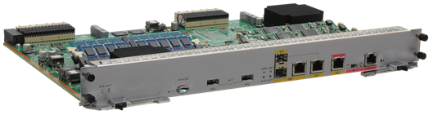
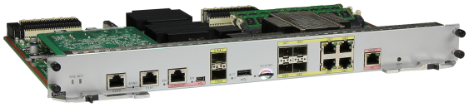
SRU40/SRU60/SRU80/SRU100/SRU200
SRU40/SRU60/SRU80/SRU100
SRU200
SRU specifications:
Card Name | Performance | Function
SRU40 | 600 MHZ CPU with 8 kernels | Does not support traffic management (TM).
SRU60 | 600 MHZ CPU with 8 kernels | Does not support TM.
SRU80 | 750 MHZ CPU with 12 kernels | Supports TM.
SRU100 | 750 MHZ CPU with 12 kernels | Does not support TM.
SRU200 | 1.2 GHz CPU with 32 kernels | Supports TM, two 10GE SFP+ interfaces, and four GE combo interfaces.
When one SRU is installed, it can be inserted into:
Slot 11 on the AR2240
Slot 15 on the AR3260
Notes:
The SRU40, SRU60, and SRU80 panels are identical except for having different silkscreen.
The SRU must be installed on the AR2240 and AR3260. You can install one SRU. Two SRUs can be installed on the router.

Slide 14
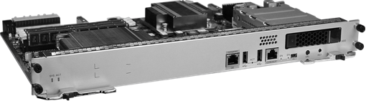
SRUX5
SRUX5
SRU specifications:
Card Name | Performance | Function
SRUX5 | 2.2 GHz CPU with 6 kernels | Supports TM, and does not support the voice function.
The SRUX5 can be installed only on the AR3670.

Slide 15
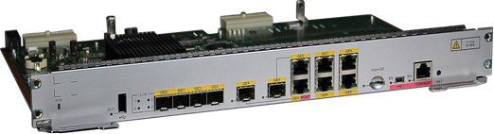
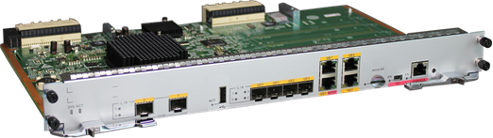
SRU40C/SRU100E/SRU200E
SRU40C
SRU100E/200E
SRU specifications:
Card Name | Performance | Function
SRU40C | 1.2 GHz CPU with 6 kernels | Supports TM, four GE optical interfaces, two GE combo interfaces, and four GE electrical interfaces.
SRU100E | 1.2 GHz CPU with 12 kernels | Supports TM, two GE SFP interfaces, and four GE combo interfaces.
SRU200E | 1.2 GHz CPU with 12 kernels | Supports TM, two 10GE SFP+ interfaces, and four GE combo interfaces.
Notes:
SRU40C only supported by AR2240C.
SRU100E/SRU200E only supported by AR2240 and AR3260.

Slide 16


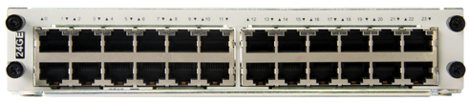
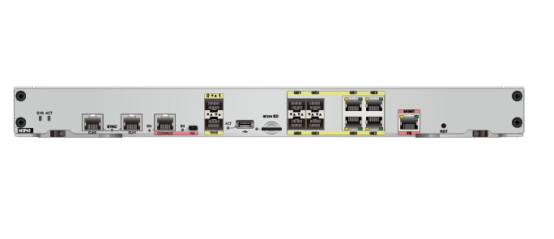
Interface Cards Supported by the AR G3
The AR G3 supports four types of interface cards:
SIC card
WSIC card
XSIC card
EXSIC card
Two SIC slots can be combined into one WSIC slot by removing the guide rail in the middle of the two SIC slots. The WSIC slot width is doubled.
Two WSIC slots can be combined into one XSIC slot by removing the guide rail in the middle of the two WSIC slots. The XSIC slot height is doubled.
Switching capacity per slot:
SIC/WSIC slot: 2 Gbit/s; XSIC/EXSIC slot: 20 Gbit/s
SIC Card
WSIC Card
XSIC Card
EXSIC Card
Notes:
Two SIC slots can be combined into one WSIC slot by removing the guide rail.
The two SIC slots and the WSIC slot below them can be combined into one XSIC slot by removing the guide rail.
Two XSIC slots can be combined into one EXSIC slot by removing the guide rail.
Slots can be combined into one, but one slot cannot be divided into multiple slots.
After two slots are combined into one, the slot ID is the larger one between the original two slots.
In V200R002C00, a WSIC card can be inserted into an XSIC slot with a special component. The WSIC card is in the lower side of the slot and uses the XSIC slot ID as its own slot ID.
The AR2201-48FE and AR2202-48FE have no slot for pluggable subcards, so they do not support subcards.

Slide 17




Combination Mode of AR G3 Cards
Various service cards are combined based on the standard design. The slot resources are fully used, protecting investments.
SIC: Smart Interface card
WSIC: Double-Width SIC
XSIC: Double-Height WSIC
EXSIC: Double-Width XSIC
Two XSIC slots can be combined into one EXSIC slot by removing the guide rail in the middle of the two XSIC slots.
Two SIC slots can be combined into one WSIC slot by removing the guide rail in the middle of the two SIC slots. The WSIC slot width is doubled.
Two WSIC slots can be combined into one XSIC slot. The height of XSIC slot is doubled.
Notes:
Slots can be combined into one, but one slot cannot be divided into multiple slots.
The number of the new merged slot equals to the larger one of the former slots.

Slide 18







AR G3 WAN Interface Modules (1)
E1 SICs:
1/2-port-channelized E1/T1/PRI/VE1 multifunctional interface modules
These modules receive, send, and process data flows on E1 interfaces. They can be configured with VE1 interfaces to transmit voice services, data services, and fax signals.
1E1/T1-M
2E1/T1-M
1E1-F
1/2-port-channelized E1/T1 multifunctional interface modules
2E1-F
Ethernet SICs:
2FE
2-port 10M/100M Ethernet electrical interface module
1GEC
1-port GE Combo Ethernet interface module
Synchronous/Asynchronous SIC:
1-port enhanced synchronous/asynchronous serial interface module
Supporting V.24, V.35, X.21, RS449, and RS530 protocols.
1SA
Notes:
1/2: indicates one or two interfaces.
E1: indicates E1 interfaces.
T1: indicates T1 interfaces.
M: indicates multiflex trunks.
PRI: indicate ISDN primary rate interfaces.
VE1: indicates voice E1 interfaces.

Slide 19





AR G3 WAN Interface Modules (2)
ADSL2+ SICs:
1ADSL-A/M
1-port ADSL over POTS interface module supporting ANNEX A/M
1ADSL-B/M
1-port ADSL over ISDN interface module supporting ANNEX B
4G.SHDSL SIC:
4G.SHDSL
1-port-4G.SHDSL WAN interface module
PON SIC:
1PON
1-port-EPON/GPON interface module
CPOS SIC:
1CPOS
1-port 155 Mbit/s CPOS interface module
Notes:
1CPOS-155M (1-Port Channelized POS Interface Card):
1: indicates one interface. C: indicates channelized interface.
POS: is short for Packet Over SDH/SONET.
155M: indicates a rate of 155 Mbit/s.

Slide 20
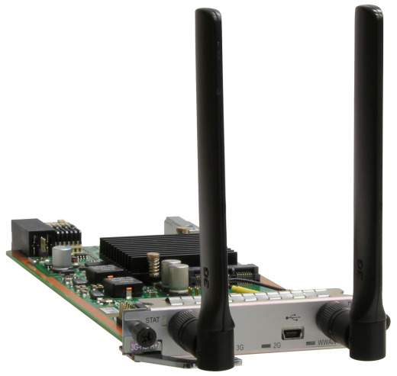
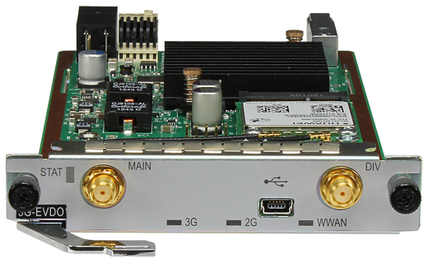


3G/LTE Interface Modules
AR G3 V200R005 supports 3 types of 3G/LTE interface modules, all SIC (similar in appearance)
3G-HSPA+7
3G-EVDO
1LTE-L
Besides, a USB 3G/LTE modem can be installed to the fixed USB port to support 3G/LTE.
Notes:
The 3G-HSPA+7 is a 3G access SIC card. It can function as the primary or backup link of an enterprise to connect to the Internet and transmit voice, video, and data services.
The 3G-EVDO is a CDMA2000 network access module, It is installed in a SIC slot to provide high-speed wireless data transmission, enabling enterprise users to connect to CDMA2000 networks.
The 1LTE-L is a wireless high-speed WAN access module, It is installed in a SIC slot to provide high-speed wireless data transmission, enabling enterprise users to connect to Long Term Evolution (LTE) networks.
Only a list of USB 3G Modems are supported, you can contact Huawei TAC to get the latest list.

Slide 21

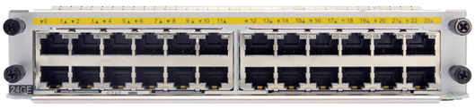
AR G3 Ethernet Switching Interface Modules
WSIC
8FE/1GE
8-port 100 Mbit/s+1-port 1000 Mbit/s Layer 2/Layer 3 Ethernet electrical interface module (RJ45) The module supports line-speed transmission of Layer 2 and Layer 3 packets in full-duplex or half-duplex mode. Each interface can work in auto-sensing mode.
XSIC
24GE
24-port 1000 Mbit/s Layer 2/Layer 3 Ethernet electrical interface module (RJ45) The module supports transmission of Layer 2 and Layer 3 packets in full-duplex or half-duplex mode. Each interface can work in auto-sensing mode.
Notes:
The 8FE1GE can be installed in the WSIC slots of the AR1200, AR2200, and AR3260. On the AR1200 and AR2204, two SIC slots are combined into one WSIC slot.
The 24GE can be installed into the XSIC slot on the AR2220, AR2240, and AR3260. On the AR2220, two WSIC slots are combined into one XSIC slot.

Slide 22



AR G3 Voice Interface Modules
Analog voice SIC
4-FXS-port and 1-FXO-port access interface module, transmitting voice services on the Datacom network
4FXS1FXO
ISDN S/T voice SICs
1BST
1-port ISDN access module, receiving, sending, and processing ISDN data flows
2-port ISDN access module, receiving, compressing, and decompressing ISDN voice signals on the Datacom network
2BST
Notes:
An FXS interface is a simulated subscriber line interface and provides access to AT0 loop trunk of the analog phone, fax, and telephone exchange.
An FXO interface is a loop trunk interface and provides access to the telephone exchange by using regular subscriber lines.
The 2BST is the ISDN module on the AR routers and provides two ISDN S/T interfaces, which transmit voice service.
The 2BST implements the ISDN BRI function and provides the bandwidth of two B channels and one D channel:
B channel: provides 64 kbit/s bandwidth and transmits voice service.
D channel: is a signaling channel and provides 16 kbit/s bandwidth.
The total bandwidth of two B channels and one D channel is 144 kbit/s.
The S/T interface on the 2BST provides a rate of 192 kbit/s, including 144 kbit/s for data transmission and 48 kbit/s for maintenance information transmission.

Slide 23
AR G3 Positioning
AR G3 Hardware Architecture, Cards, and Modules
Logical Architecture
SRU and Interface Card
Power Module and Fan Module
Common Interface and Cable
AR G3 Data Forwarding Process
AR G3 Feature Description and Usage Scenarios

Slide 24
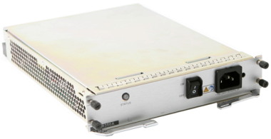
AR G3 Power Modules
Product | Power Module | Module Attribute | Installation | Maintenance
AR1200 | 54 W AC power module in an open rack | AC power module fixed in the chassis | It is fixed in the chassis, so it does not need to be connected to the chassis using cables. | It is maintained together with the chassis.
AR2220 | PWR150A | AC power module | It is inserted into the power supply slot. The device supports only one power module. | It is maintained together with the chassis.
AR2240 | PWR350A | AC power module | It is inserted into the power supply slot. The device supports two power modules. | It uses front-access design and is hot swappable.
AR3260 | PWR350A | AC power module | It is inserted into the power supply slot. The device supports two power modules. | It uses front-access design and is hot swappable.
AR3670 | PWR700B | AC power module | It is inserted into the power supply slot. The device supports two power modules. | It uses front-access design and is hot swappable.
Redundant power module configuration:
The AR2240/3260/3670 support power module redundancy.
The AR2240/3260/3670 is equipped with a default AC power module. When power module redundancy is required, install another power module.
PWR350A
PWR700B
Notes:
Only power modules of the same power can be used on an AR router.
Powering off the AR router before removing and reinstalling power modules.
To power off an AR router, power off all its power modules.

Slide 25


AR1200 PoE Power Module
Interfaces supporting PoE
Interfaces supporting external PoE
The AR1200 provides 8FE LAN interfaces, among which 4FE interfaces support PoE.
To enable PoE, connect external PoE power modules through the PoE power interface on the AR1220.
PoE power module:
90 V AC to 264 V AC input power
48 V/100 W output power when no fan is used

Slide 26
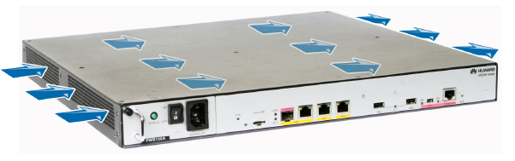
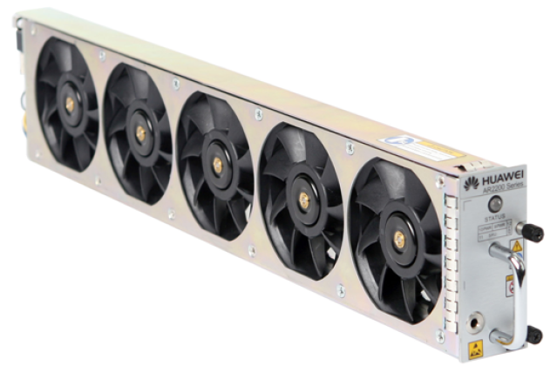
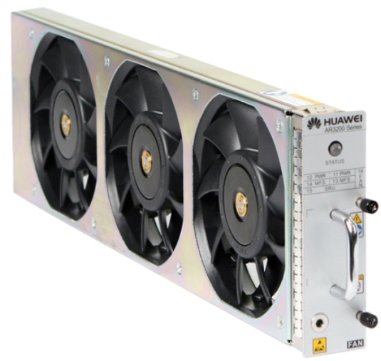
AR G3 Fan Modules
The AR2200/AR3200 uses fans for heat dissipation and the air channel is left-to-right.
Air circulation through the chassis:
Fan module panel of the AR2240:
Fan module panel of the AR3260/AR3600:
Notes:
If a single fan failed, the device will be overheated and its performance is then affected. When this occurs, replace the entire fan module immediately.

Slide 27
AR G3 Positioning
AR G3 Hardware Architecture, Cards, and Modules
Key Specifications and Logical Architecture
SRU and Interface Card
Power Module and Fan Module
Common Interface and Cable
AR G3 Data Forwarding Process
AR G3 Feature Description and Usage Scenarios

Slide 28
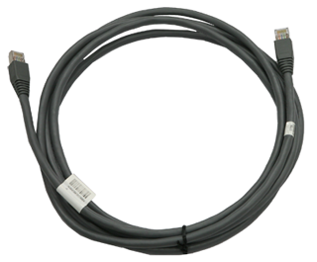
AR G3 Ethernet Electrical Interface
Ethernet Electrical Interface
Connector: RJ45
Cable: UTP/STP
Rate: 10M/100M/1G
Link protocol: Ethernet
Typical cards:
8FE1GE
24GE
2FE
Notes:
A network cable subtends devices, enables a device to communication with other network devices, and allows users to locally or remotely maintain the device.

Slide 29
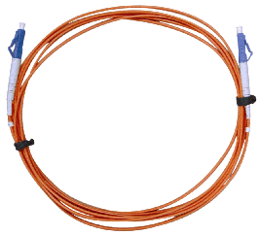
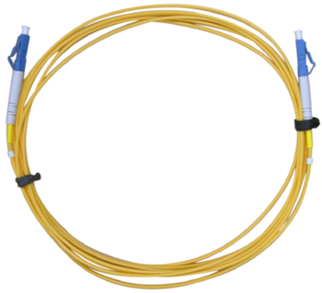


AR G3 Ethernet Optical Interface
Ethernet Optical Interface
Connector: LC or PC
Cable: single-mode or multi-mode cable
Rate: 100M/1G
Link protocol: Ethernet
Typical cards:
SRU
1GEC
Multi-mode optical fiber
Single-mode optical fiber
SFP optical module
LC/PC connector
Notes:
The appearances of the single-mode optical fiber and the multimode optical fiber are the same, but their colors are different. The single-mode optical fiber is yellow, and the multi-mode optical fiber is orange.
The optical transmitting module of the multi-transverse mode is connected to the multimode fiber.
The optical transmitting module of the single-longitudinal mode or multi-longitudinal mode is connected to the single mode fiber.

Slide 30
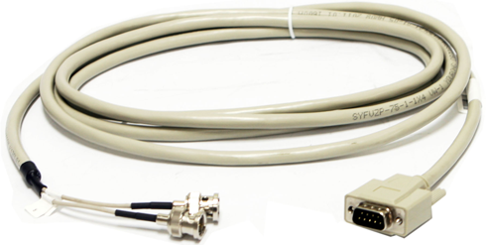
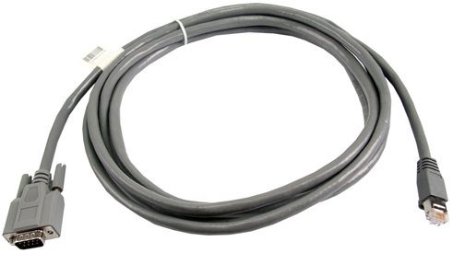
AR G3 E1/T1 Interface
ET/T1 Interface
Connector: DB9
Cable: trunk
Rate: 2.048M/1.544M
Link protocol: PPP or HDLC
Typical cards:
1E1T1-M
2E1T1-M
E1 75-ohm unbalanced coaxial cable
E1 120-ohm or T1 100-ohm balanced twisted pair cable
Notes:
E1 trunk cables are classified into 75-ohm unbalanced coaxial cables and 120-ohm balanced twisted pair cables. The connectors of the cables are as follows:
75-ohm unbalanced coaxial cable (DB9 to BNC):
One end provides a DB9 connector.
The other end provides two BNC connectors.
120-ohm balanced twisted pair cable (DB9 to RJ45):
One end provides a DB9 connector.
The other end provides an RJ45 connector.
A T1 trunk cable is a 100-ohm balanced twisted pair cable. Its appearance is the same as the appearance of an E1 120-ohm balanced twisted pair cable.

Slide 31
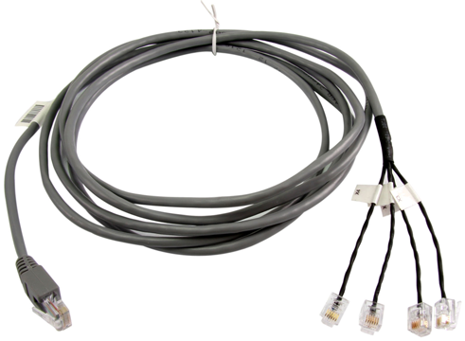
AR G3 xDSL Interface
xDSL Interface
Connector: RJ11 or RJ45 (4G.SHDSL)
Cable: PSTN cable
Rate: 5.696M/8M/12M/24M
Signal processing method: Analog Modulation and Demodulation
Typical cards:
ADSL-A/M
ADSL-B
4G.SHDSL
4G.SHDSL cable
Notes:
The connectors of a 4G.SHDSL cable are as follows:
An RJ45 connector on the local end
Four RJ11 connector on the network side

Slide 32
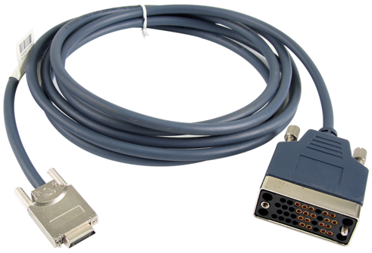
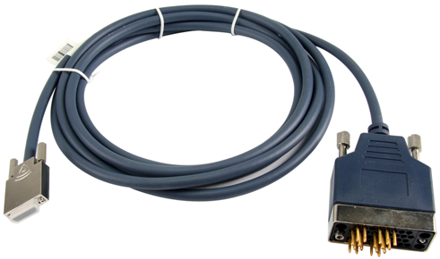
AR G3 Synchronous/Asynchronous Serial Interface
Synchronous/Asynchronous Serial Interface
Connector: DB28
Cable: DCE/DTE
Rate 64 kbit/s to 2.048 Mbit/s
Data processing: Protocol/Flow
Typical cards:
1SA
V.35 DCE cable
V.35 DTE cable
Notes:
A console cable connects the console port of the device to the serial port of an operation terminal to transmit configuration data. A shielded cable or an unshielded cable can be used according to the onsite situation.
A console cable connects the device and terminal as follows:
The 8-pin RJ45 connector is inserted into the console port of the device.
The DB9 male connector is connected to an operation terminal, which is usually a PC.

Slide 33
AR G3 Positioning
AR G3 Hardware Architecture, Cards, and Modules
AR G3 Data Forwarding Process
AR G3 Feature Description and Usage Scenarios

Slide 34
Data Forwarding Process: AR150&160&200
ETH-ETH Layer 2
ETH-ETH Layer 3
ETH-WAN Layer 3
Notes:
L2 traffics between LAN interfaces are forwarded through LSW.
L3 traffics between LAN interfaces, or between LAN and WAN interfaces are forwarded through both LSW and CPU.

Slide 35
Data Forwarding Process: AR1220
Ethernet-Ethernet Layer 2
Ethernet-Ethernet Layer 3
Ethernet-WAN Layer 3
Notes:
L2 traffics between LAN interfaces are forwarded through LSW.
L3 traffics between LAN interfaces, or between LAN and WAN interfaces are forwarded through LSW, switching fabric and CPU.

Slide 36
Data Forwarding Process: AR2200/AR3200/AR3600
Ethernet LAN-Ethernet LAN Layer 2 (in a subcard)
Ethernet LAN-Ethernet LAN Layer 3 (in a subcard)
Ethernet LAN-fixed Ethernet WAN2 Layer 3 (in a subcard)
Notes:
Ethernet LAN-Ethernet LAN Layer 2 (in a subcard): only through LSW
Ethernet LAN-Ethernet LAN Layer 3 (in a subcard): through LSW and Fabric
Ethernet LAN-fixed Ethernet WAN2 Layer 3 (in a subcard): through LSW, Fabric and CPU

Slide 37
AR G3 Positioning
AR G3 Hardware Architecture, Cards, and Modules
AR G3 Data Forwarding Process
AR G3 Feature Description and Usage Scenarios

Slide 38













AR G3 Voice Solution
Communicating with mainstream vendors directly
Integrating the PBX module to provide rich services
SBC
SBC
SIP AG
Local PBX
IPPBX
VOICE
AR
VOICE
IPPBX
AR
SBC
IPPBX
Supporting SNMP and TR069 network management
Independent account and domain management
Flexible interfaces meeting multiple requirements
Easy Management
"All in One" Access
DIFF
Domain
Company A
VOICE
Company B
VOICE
VOICE
VOICE
VOICE
AR
Company C
AR
VOICE
Notes:
Enterprise-class voice communication is flexible and efficient, as the AR voice features integrate with data networks.
Basic voice functions are provided by the built-in PBX, SIP server, and SIP access gateway
Value-added voice services include multi-party communication, IVR automatic connection, ring-backtone, parallel ringing, sequential ringing, one number link you (ONLY), bill management, and subscriber management.
Intelligent call routing enables exceptional voice service reliability.
The AR routers can be connected with the NGN/IMS/PBX/terminal of major vendors.
The Quality of Experience (QoE) feature monitors voice service quality in real time.
Jitter buffer, echo cancellation, and packet loss compensation combine to deliver a superior user experience

Slide 39





AR G3 QoS Features: Hardware-based QoS
Forwarding capability when QoS is disabled
Forwarding capability is not affected when QoS is enabled
Forwarding capability
Forwarding capability
35%
V.S.
QoS disabled
Typical enterprise router
QoS disabled
AR G3
QoS is handled using software. When the system needs to provide differentiated services, the forwarding capability is degraded by 30% to 40%.
The AR G3 uses hardware-based QoS technologies, ensuring service quality without affecting the forwarding capability.
Effective production management
Effective collaborated office
Smooth voice service
Smooth video conference
High-quality unified communications
Notes:
Only SRU80 with TM card supports Hardware-based QoS, all model can support H – QoS.

Slide 40











AR G3 Security Feature: Comprehensive Security
VPN GW
Firewall/NAT/twice NAT
IPS/IDS/AV/P2P traffic limit (11Q4)
ACL
NAC (802.1X, MAC bypass)
AAA and user management
Storm suppression
?To decrease the risks of information damage or theft
?To ensure information security during the network expansion
?To ensure information security during service information exchange
AR G3
Trojan horse
AR G3
Worm
DDoS
Web Applications
Internet
Notes Applications
AR G3
Virus
Headquarters
Email
Remote access
Notes:
While delivering enterprise-class network services, the AR router provides robust network security. Comprehensive security solutions include user access control, packet detection, and active attack defense.
The built-in firewall is the first line of defense.
Port authentication technologies include 802.1x authentication, MAC address authentication, and
portal authentication.
User and device authentication methods include RADIUS and HWTACACS.
VPN technologies include IPsec VPN, GRE VPN, DSVPN, L2TP VPN and SSL VPN.

Slide 41
AR G3 Security Feature: IAE
Intelligence Awareness Engine (IAE) is the collection of all in one security process framework and a series of security features or components, with a variety of security database and security intelligence center real time linkage, IAE is the security services program which makes a variety of products easy to expansion, integration and rapid release content security services. IAE based on NGE framework, also called next-generation high-performance firewall.
In simple terms: IAE = security framework (stream + proxy) + security feature components + security database + security intelligence center real time linkage.
Notes:
IAE focus on solving the following new requirements of the Internet:
Cloud center and large enterprise network need much powerful IPS or UTM.
Strong demand for application identification, control and visualization.
Demand of integrated IPS, automatic detection and action
Demand of intelligent linkage (IPS, AV, URL, etc.)
Demand of content security virtualization (IPS, AV, URL, etc.)
Demand of multi content security platform sharing
IAE core competitiveness is reflected as follows:
High performance
Merge the detection requirements of each services, the application layer only analyze and extract once. Integration strategy merging and execution, Less than 50% performance decline after enable the full threat protection feature.
Multi product rapid release and services expand capabilities.
Focus on professional content security capabilities, to achieve flexible and efficient services processing with reasonable architecture , to meet the various needs of the product.
Independent evolution and development of core security capability
SA library /IPS library /URL library /AV / reputation library, those core security capabilities can be independent development and evolution, decoupling from specific product.

Slide 42
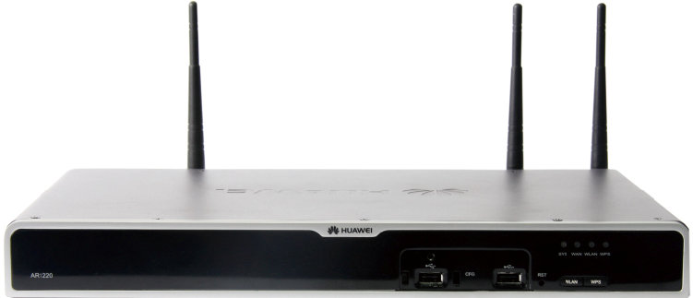


AR G3 Reliability
All types of LPUs are hot swappable
BFD fast switchover
010101010
010101010
+
010101010
Dual SRUs and power supply redundancy
010101010
Multi-core concurrent processing and mutual backup
AR G3 (99.999%)
01010101011010
interface backup, providing links
VRRP, fast fault recovery

Slide 43











AR G3 Management Feature: Free of Manual Configuration
Headquarters
ACS
BSS/OSS
NMS
DHCP server
ACS
AR G3
AR G3
AR G3
Advantages and Values
The AR G3 supports TR069, and implements automatic configuration of "Zero Touch" by working with the ACS and NMS.
The batch configuration and automatic upgrade save deployment and maintenance costs.
The network status is automatically monitored using TR069, implementing simple O&M.

Slide 44
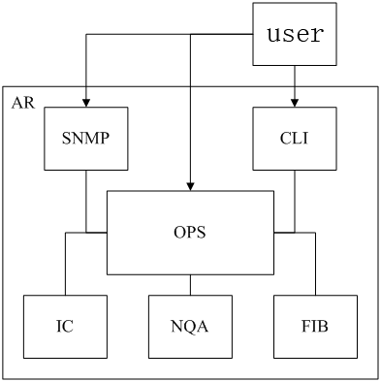
AR G3 Management Feature: OPS
The open programmability system (OPS) is an open platform that provides Application Programming Interfaces (APIs) to achieve programmability, allowing third-party applications to run on the platform.
Notes:
OPS is the new function that being released after V2R7C00. AR1220, AR1220V, AR1220W, AR1220VW and AR1220L do not support OPS
OPS is mainly used in following circumstance.
Intelligence diagnosis
Threshold alarm: diagnostic whether equipment, memory or CPU occupancy rate is over threshold or not.
Interface diagnostic: diagnostic whether the interface is normal or not.
Route diagnostic and analysis: diagnostic whether the route of the equipment is normal or not.
Monitor key route change: Create notification after key routing changes.
Equipment diagnostic and query: diagnostic equipment is normal or not.
Interface flow monitoring: diagnostic whether the flow of the interface is normal or not.
Intelligence configuration
To enter the configuration mode, automatically backup the configure: before starting the configuration, automatically backup the current configuration to the local and remote SSH server.
Configuration change add user information: after change the configuration, record the user name and IP address which change the configuration.
Risk warning: warning the risk before the implementation the configuration which customers consider risky.

Slide 45































AR as the Enterprise Egress Gateway
Enterprise headquarters
AR150/200/AR1200
AR200/
AR1200
Server system
Mini branch
Small-scale branch
WAN
Internet
PSTN
AR3200
Medium-scale branch
AR2200
3G base station
Large-scale branch
3G link
Server area
Server area
Dedicated link
Internet link
PSTN link
Notes:
Application:
AR G3 enterprise router can be applied to
The enterprise headquarters and branch egress gateway to
Provide a cost-efficient, highly reliable, and easy-to-deploy interconnection solution.
Benefits:
The AR integrates routing, switching, voice, security, and WLAN functions. You need to deploy only one device at the egress to meet multi-service requirements, which reduces the TCO and protects investments.
The AR supports high-density voice card 32FXS and high-density Ethernet card 24GE to connect many voice and data terminals.
The AR provides built-in AC, leading in industry. It provides cost-efficient WLAN access solution without deploying extra cards.
The AR supports dual SRUs and hot standby, ensuring nonstop service transmission.

Slide 46











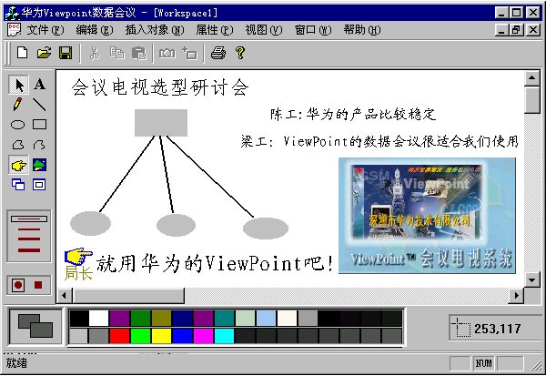
Scenario for Enterprise Broadband Access Routers
Headquarters
WAN
AR3200
Leased line
3G
ADSL2+/G.SHDSL/
Ethernet
AR1200
AR1200
AR1200
AR1200
WLAN
PoE
Accessing the WAN as the enterprise egress router
Meeting access requirements, including leased line, Ethernet, xDSL, 3G, and WLAN
Supporting PoE in compliance with IEEE 802.3af and IEEE 802.3at
Notes:
The AR G3 routers function as the egress routers of enterprise branches and provide flexible access methods to support remote network connections.
An AR G3 meets various access requirements, including leased line, Ethernet, xDSL, 3G, and WLAN. This saves deployment and maintenance costs and provides a large value to customers.
The 100 Mbit/s Ethernet interfaces of an AR1220V and AR1220W (V2R1C01) support PoE in compliance with IEEE 802.3af and 802.3at; therefore, the AR1220V and AR1220W (V2R1C01) can provide power for powered devices (PDs), such as IP phones. An 802.3at interface provides higher than 30 W power, ensuring power for large-power PDs.

Slide 47
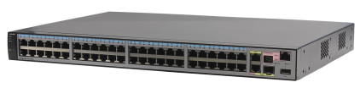
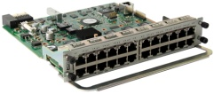








Integrated Routing and Switching for Enterprise Branches
WAN
AR3200
Headquarters
24GE high-density Ethernet interface card
AR2200
AR3200
Branch 1
Branch 2
GE
GE
GE
GE
Department LAN
File server
Access server
Department LAN
Department LAN
File server
Access server
Department LAN
The 8FE1GE and 24GE interface cards on the AR2200/AR3200 support inter-card VLAN switching, spanning trees, link bundling, and Layer 2/Layer 3 data exchange.
Notes:
The 8FE1GECombo and 24GE interface cards on the AR2200/AR3200 support inter-card VLAN switching, spanning trees, link bundling, and Layer 2/Layer 3 data exchange.

Slide 48







Enterprise VoIP
Medium-sized branch
AR 2200
Headquarters
WAN
AR 3200
(PBX and SIP server)
PSTN
AR 1200
Local SIP server
Remote small-sized branch
The AR G3 provides a built-in PBX supporting voice services such as switchboard, IVR navigation, and CDR query.
The AR G3 supports smart call routing and uses the PSTN network as a backup for calls.
The AR G3 provides a built-in SIP server, ensuring reliability of voice services.
Notes:
The AR G3 provides a built-in PBX supporting the enterprise switchboard, IVR navigation, and CDR query functions to enhance corporate image and improve enterprise communication efficiency.
The AR G3 is located in a branch to provide the smart call routing function. When a fault occurs on the WAN, the PSTN network is used as a backup for calls.
When the SIP server at the headquarters is unreachable, the built-in SIP server of the AR G3 implements communication between the branch and the PSTN network. This ensures reliability of voice services.
Note: Only the AR2200/AR3200 (V2R1C01) supports the preceding functions.

Slide 49










Enterprise VPN Gateway
Constructing a VPN through the Internet
Constructing a VPN through the MPLS network
Headquarters
Large-scale branch
Headquarters
AR3200
AR3200 (PE)
AR2200 (PE)
MPLS VPN
IPsec VPN
GRE VPN
AR2200 (PE)
External VPN
LL/FR/X25
AR1200
AR2200
AR2200
Partners
Enterprise branch
Medium- and large-sized branch
Remote branch
Tunnels such as GRE VPN and IPsec VPN are established between AR G3 routers to implement secure data access and transmission. The AR G3 implements fast tunnel deployment and authentication for branches.
As the PEs of an MPLS network, the AR G3 routers are located in the branches. Different types of services are separated by MPLS L3VPN. The AR G3 supports enterprise service operation over
Notes:
The AR G3 provides multiple security access functions such as GRE VPN tunnel and IPsec VPN tunnel, implementing secure data access and transmission. The AR G3 implements fast tunnel deployment and authentication for branches. Using a tunnel, partners can access and share enterprise resources and users are authenticated and authorized.
As the PEs of an MPLS network, the AR G3 routers are located in the branches. Different types of services are separated by MPLS L3VPN. The AR G3 implements flexible deployment, fast distribution, and secure transmission of VPN services, and supports enterprise service operation over networks.

Slide 50














3G/LTE Wireless Access
Headquarters
AR3200
Internet
ISP network
NQA
Wired link
AR1200
AR1200
Branch 1
Branch 2
The AR G3 complies with 3G standards including CDMA2000 EV-DO, WCDMA, and TD-SCDMA.
Users can use a 3G USB card to deploy 3G services on the AR G3, saving service card slots.
The 3G data link can be used as a backup for wired link to protect uplinks.
The AR G3 provides the NQA function to monitor 3G link quality, ensuring the SLA.
Notes:
The AR G3 complies with 3G standards including CDMA2000 EV-DO, WCDMA, and TD-SCDMA, meeting wireless communication requirements between branches and the headquarters.
Users can use a 3G USB card to deploy 3G services on the AR G3, saving service card slots.
In addition, the 3G data link can be used as a backup for wired link to protect the xDSL, FE/GE, ISDN, and CPOS uplinks. The backup link improves network stability and reduces network construction costs.
The AR G3 provides the NQA function to monitor 3G link quality, ensuring the SLA.

Slide 51
What series are the AR G3 routers classified into?
AR3200
AR2200
AR1200
AR150&160&200
AR3600
In terms of the appearance, what types of service cards does the AR G3 support?
A. SIC B. DSIC C. WSIC
D. XSIC E. EXSIC
Notes:
Answers:
ABCDE
ACDE

Slide 52
AR G3 Positioning
Comprehensive Enterprise Gateway
AR G3 Cards
SIC→WSIC→XSIC→EXSIC
AR G3 Feature Description
Voice, QoS, Security, and Reliability
AR G3 Networking

Slide 53
AR Product Documentation
http://support.huawei.com/ehedex/hdx.do?docid=DOC1000032948&lang=zh
AR Router Typical Configuration Examples
http://support.huawei.com/enterprise/docinforeader.action?contentId=DOC0000707956&idPath=7919710|9856750|7923148|9858988|6078842

Slide 54
Huawei Learning Website:
http://support.huawei.com/learning/Index!toTrainIndex
Huawei Support Library:
http://support.huawei.com/enterprise/servicecenter?lang=zh

