Slide 1
Basic introduction to SDN
Liu Chenxing
K4113c

Slide 2
SDN：Software-Defined Networking
Introduction
Software-defined networking (SDN) technology is an approach to network management that enables dynamic, programmatically efficient network configuration in order to improve network performance and monitoring.
In short, SDN refers to the ability of software applications to program individual network devices dynamically and therefore control the behavior of the network as a whole.

Slide 3
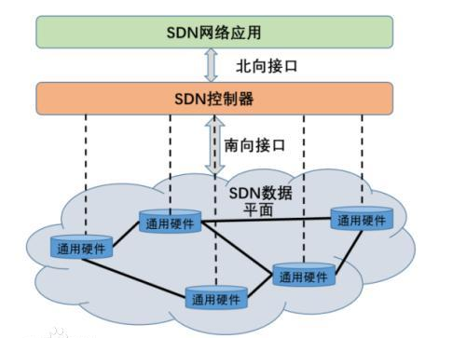
Architecture of SDN
The architecture of SDN is divided into
Data plane,
Control plane,
Application plane

Slide 4
The data plane consists of network common hardware such as switches, and individual network devices are connected to each other through SDN data paths formed by different rules.
The control plane contains the logically-centric SDN controller, which holds the global network information and is responsible for the control of various forwarding rules.
The application plane contains a variety of SDN-based network applications that allow users to program and deploy new applications without caring about the underlying details.
The control plane and the data plane communicate with each other through the SDN control-data-plane interface (CDPI), which has a unified communication standard and is mainly responsible for sending forwarding rules from the controller to the forwarding devices, mainly using the OpenFlow protocol.
Communication between the control plane and the application plane takes place through the SDN northbound interface (NBI).

Slide 5
How does SDN works?
SDN contains several types of technologies, including functional separation, network virtualization and automation through programmability.
Functional separation
SDN separates the network control plane from the forwarding plane, and while the control plane determines how packets should flow through the network, the forwarding plane moves the packets from one place to another.
Network virtualization.
Network virtualization for SDN works through virtual overlays, which are logically separate networks on top of the physical network, allowing users to implement end-to-end overlays to abstract the underlying network and segment network traffic.

Slide 6
Automation through programmability.
If a router's own built-in protocol does not meet the user's needs, it can be modified by programming to achieve better data exchange performance. In this way, network equipment users can modify the network architecture as if they were upgrading or installing software to meet their needs for adjusting, expanding or upgrading the entire network architecture, while the underlying hardware devices such as switches and routers do not need to be replaced, saving a lot of cost while the iteration cycle of the network architecture will be greatly shortened.

Slide 7
Advantages of SDN
Advantages
Network Programmable
Network abstraction.
Reduce hardware footprint and operation and maintenance costs.
Centralized management

Slide 8
Thanks for your attention!

