Slide 1
NETWORK AUTOMATION AND ITS IMPLEMENTATION THROUGH PYTHON
PREPARED BY : ROHAN ABBAS
INSTRUCTOR: PROFESSOR SASHA SHKREBETS
COURSE: SOFTWARE DEFINED NETWORKS (2nd SEMESTER)

Slide 2
In this presentation, we will discuss…
Network Management.
Its difficulties.
Network Automation.
Why do we need it ?
Use of PYTHON in network automation.
Top network automation libraries in PYTHON.
Working with TELNETlib.

Slide 3
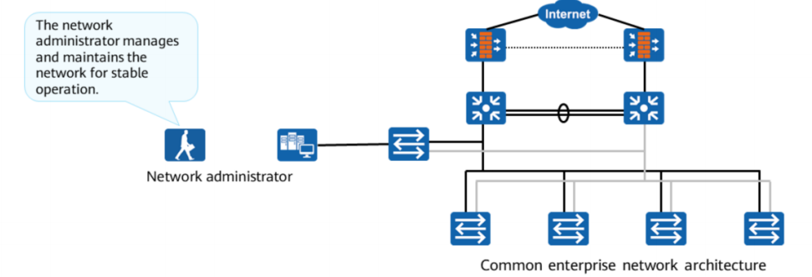
Basic Concepts of Network Management and O&M

Slide 4
Basic Network Management Functions
Configuration Management
Performance Management
Fault Management
Security Management
Accounting Management

Slide 5
Difficulties in Conventional Network O&M
Conventional network O&M requires network engineers to manually log in to the network devices, query and execute configuration commands, and filter command output.
This highly human-dependent working mode is time-consuming, inefficient, and difficult to audit.
TYPICAL O&M SCENARIOS
DEVICE UPGRADES
NETWORK PROVISIONING
CONFIGURATION CHANGES
ONGOING MAINTENANCE
MONITORING & TROUBLESHOOTING

Slide 6
Network Automation
Network automation is the process of using software to automate network and security provisioning and management in order to continuously maximize network efficiency and functionality.

Slide 7
Why we need it ?
ELIMINATE MANUAL TASKS
BUILD A RELIABLE NETWORK
ANALYZE AND RESOLVE ISSUES
MAKE CHANGES FASTER
GAIN NETWORK VISIBILITY
ACCELERATE SERVICE DELIVERY
STANDARIZE PROCESSES WITH TEMPLATES

Slide 8
PYTHON
EXAMPLE
INTERPRETED PROGRAMMING LANGUAGE
SCRIPTING LANGUAGE
COMPILES AT RUNTIME (LINE BY LINE)
MOST POPULAR IN NETWORK AUTOMATION
EASY SYNTAX
ADAPTOED BY CISCO AS LANGUAGE OF CHOICE
SUPPORTS OOP AS WELL

Slide 9
PYTHON
EASY SYNTAX
CAN BE WRITTEN IN ANY TEXT EDITOR AS WELL AS IDE
DESIGNED FOR READIBILITY
USES NEW LINES FOR COMMAND ENDING
NO HARD AND FAST SYSTAX RULES
RELIES ON INDENTATION
USES WHITESPACES TO DEFINE SCOPES SUCH AS FUNCTIONS AND CLASSES

Slide 10
TOP PYTHON LIBRARIES FOR NETWORK AUTOMATION
NCCLIENT
NAPALM
NETMIKO
PARAMIKO
TELNETLIB

Slide 11
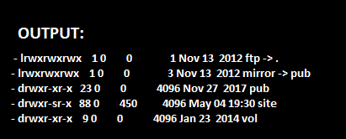
TELNETlib
PYTHON CONNECTION EXAMPLE
TELNET.telnet
TELNET.read_until
TELNET.write
TELNET.read_all()

Slide 12
THANK YOU

