Slide 1
Multiprotocol Label Switching
MLPS
Introduced by:
Karam Mahfod

Slide 2
Before we dive into MPLS, let’s explain how data travels through the internet.
Introduction

Slide 3
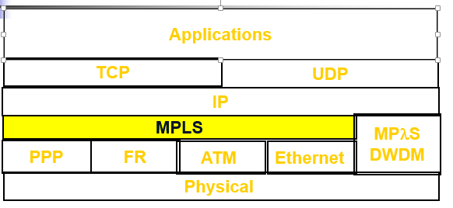
An MPLS network is Layer 2.5, meaning it falls between Layer 2 (Data Link) and Layer 3 (Network) of the OSI seven-layer hierarchy. Layer 2, or the Data Link Layer, carries IP packets over simple LANs or point-to-point WANs. Layer 3, or the Network Layer, uses internet-wide addressing and routing using IP protocols. MPLS sits in between these two layers, with additional features for data transport across the network
MPLS Meaning

Slide 4
Organizations often use this technology when they have multiple remote branch offices across the country or around the world
What Is MPLS Used For

Slide 5
MPLS networks were designed as an overlay tactic to simplify and improve performance. However, routing cloud traffic is not easy with MPLS. To make cloud traffic more efficient, many organizations are exploring how to supplement MPLS with other types of connections
How MPLS Networks Work for Cloud Adoption

Slide 6
Traffic Engineering - the ability to set the path traffic will take through the network, and the ability to set performance characteristics for a class of traffic VPNs - using MPLS, service providers can create IP tunnels throughout their network, without the need for encryption or end-user applications Layer 2 Transport - New standards being defined by the IETF's PWE3 and PPVPN working groups allow service providers to carry Layer 2 services including Ethernet, Frame Relay and ATM over an IP/MPLS core
MPLS Benefits

