Slide 1
Border Gateway Protocol (BGP)
Student : Abdulkader Hajjouz

Slide 2
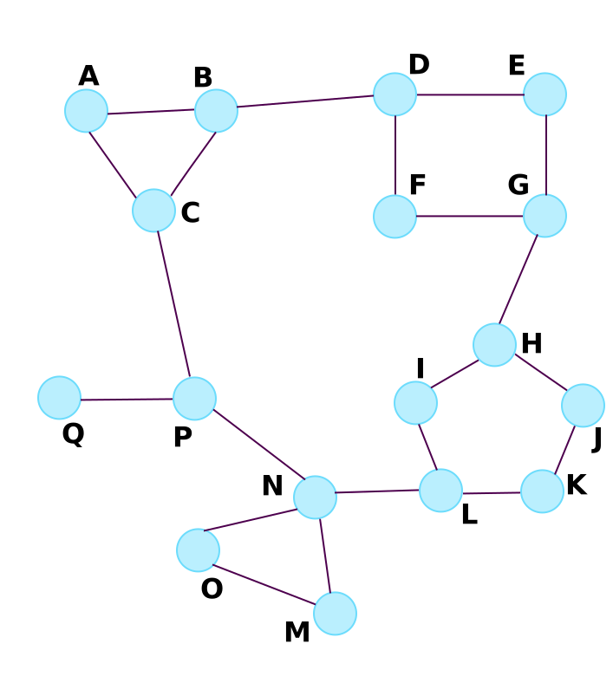
Background:
Routing involves two basic activities:
determination of optimal routing paths. (very complex)
transport of information groups (packets) through an internetwork. (relatively straightforward)
Notes:
Internetwork: mean: Connect several computer networks, so that any pair of hosts in the connected networks can exchange messages regardless of their hardware-level networking technology.

Slide 3
Introduction:
BGP is an exterior gateway protocol (EGP), which means that it performs routing between multiple autonomous systems or domains and exchanges routing
BGP was developed to replace its predecessor, the now obsolete Exterior Gateway Protocol (EGP).
BGP is the standard exterior gateway-routing protocol used in the global Internet.
BGP is specified in several Request For Comments (RFCs):
RFC 1771—Describes BGP4, the current version of BGP
RFC 1654—Describes the ﬁrst BGP4 speciﬁcation
RFC 1105, RFC 1163, and RFC 1267—Describes versions of BGP prior to BGP4
Notes:
And this BGP is specified in several Request For Comments
Since : A Request for Comments is a publication in a series, from the principal technical development and standards-setting bodies for the Internet

Slide 4
Autonomous Systems
Notes:
Figure35-1 Core routers can use BGP to route trafﬁc between autonomous systems.

Slide 5
BGP Operation
Inter-autonomous system routing:
between two or more BGP routers in different autonomous systems.
Peer routers in these systems use BGP
BGP neighbors communicating between autonomous systems must reside on the same physical network.
Notes:
BGP performs three types of routing:
4. The Internet is one example because it consists of independent systems and domains
5. BGP is often used to determine the optimum path within the Internet

Slide 6
BGP Operation
Intra-autonomous system routing:
between two or more BGP routers located within the same autonomous system.
Peer routers within the same autonomous system use BGP
BGP also is used to determine which router will serve as the connection point for specific external autonomous systems.
Notes:
4. BGP provide optimal routing within its own administrative domain or autonomous system.

Slide 7
BGP Operation
Pass-through autonomous system routing :
between two or more BGP peer routers that exchange traffic across an autonomous system that does not run BGP
BGP must interact with whatever intra-autonomous system routing protocol is being used to successfully transport BGP traffic through that autonomous system.
Notes:
2. In a pass-through autonomous system environment, the BGP traffic did not originate within the autonomous system in question and is not destined for a node in the autonomous system.

Slide 8
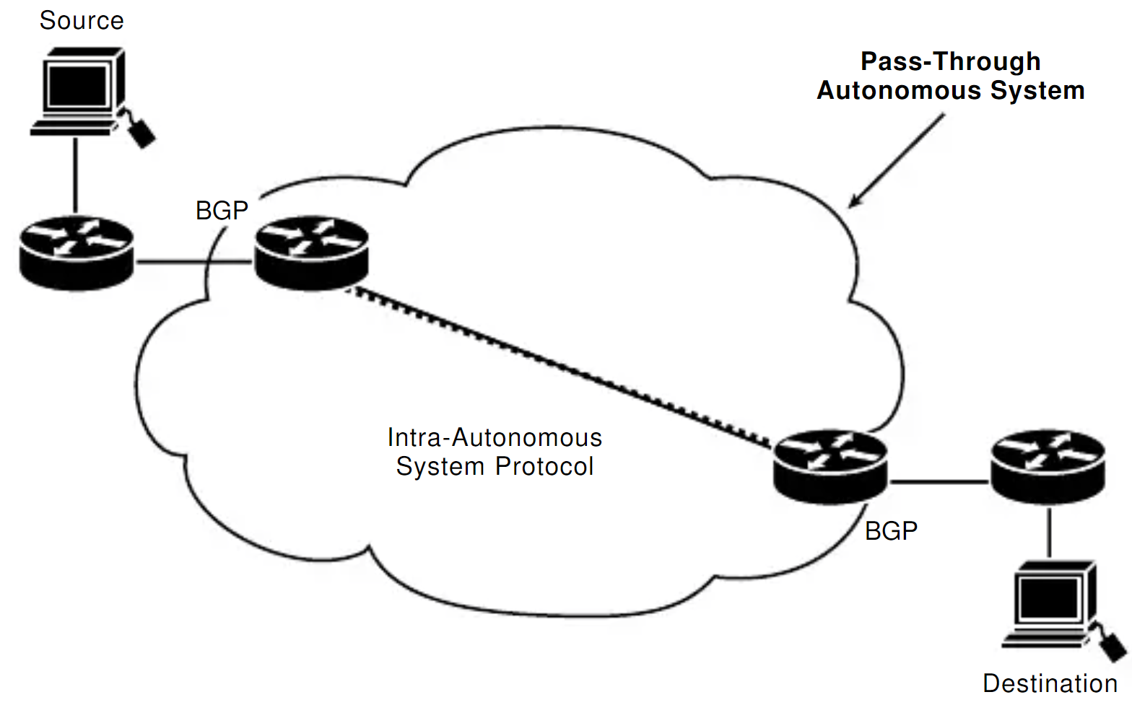
pass-through autonomous system environment:
Notes:
In pass-through autonomous system routing, BGP pairs with another intro-autonomous system-routing protocol

Slide 9
BGP Routing:
As with any routing protocol:
BGP maintains routing tables
transmits routing updates
Bases routing decisions on routing metrics.
primary function of a BGP system:
exchange network-reachability information, including information about the list of autonomous system paths ,with other BGP systems.
Notes:
This information can be used to construct a graph of autonomous systems connectivity from which routing loops can be pruned and with which autonomous system-level policy decisions can be enforced.

Slide 10
BGP Routing Mechanism :
Each BGP router maintains a routing table
The router does not refresh the routing table
Instead, routing information received from peer routers is retained until an incremental update is received.
BGP devices exchange routing information upon initial data exchange and after incremental updates.
When a router first connects to the network, BGP routers exchange their entire BGP routing tables.
when the routing table changes, routers send the portion of their routing table that has changed.
Notes:
BGP routers do not send regularly scheduled routing updates, and BGP routing updates advertise only the optimal path to a network.

Slide 11
BGP Routing Details :
BGP uses a single routing metric to determine the best path to a given network.
This metric consists of a number that specifies the degree of preference of a particular link.
The value-based on the number of autonomous systems through which the path passes, stability, speed, delay, or cost.

Slide 12
BGP Message Types:
Four BGP message types are speciﬁed in RFC1771 in BGP-4
1. open message:
opens a BGP communications session between peers
is the first message sent by each side after a transport-protocol connection is established.
Open messages are confirmed using a keep-alive message sent by the peer device and must be confirmed before updates, notifications,and keep-alive can be exchanged.

Slide 13
BGP Message Types:
Four BGP message types are speciﬁed in RFC1771 in BGP-4
2. update message:
used to provide routing updates to other BGP systems, allowing routers to construct a consistent view of the network topology.
Updates are sent using the Transmission-Control Protocol (TCP) to ensure reliable delivery.
Update messages can withdraw one or more unfeasible routes from the routing table
Notes:
• simultaneously can advertise a route while withdrawing others.

Slide 14
BGP Message Types:
Four BGP message types are speciﬁed in RFC1771 in BGP-4
3. notification message:
sent when an error condition is detected.
used to close an active session and to inform any connected routers of why the session is being closed.

Slide 15
BGP Message Types:
Four BGP message types are speciﬁed in RFC1771 in BGP-4
4. keep-alive message:
The keep-alive message notifies BGP peers that a device is active.
Keep-alives are sent often enough to keep the sessions from expiring.

Slide 16
Header Format
All BGP message types use the basic packet header) Plus other extra parts(
primary purpose is to identify the function of the packet
Marker: Contains an authentication value that the message receiver can predict
Length: Indicates the total length of the message in bytes
Type: Specifies the message type as one of the following:
Open
Update
Notification
Keep-alive
Data: Contains upper-layer information in this optional field.
16

Slide 17
Open Message Format
comprised of a BGP header and additional fields.
provide the exchange criteria for two BGP routers to establish a peer relationship.
Version: Provides the BGP version number
Autonomous System: Provides the autonomous system number of the sender
Hold-Time: Indicates the maximum number of seconds without receipt of a message
BGP Identifier: Provides the BGP Identifier of the sender (an IP address)
Optional Parameters Length: length of the optional parameters field
Optional Parameters: list of optional parameters
17

Slide 18
Update Message Format
comprised of a BGP header and additional fields.
When the router receives the update message, it will be able to delete and add entries to the routing table
Unfeasible Routes Length: Indicates the total length of the withdrawn routes field
Withdrawn Routes: This contains a list of IP address prefixes for routes being withdrawn from service
Total Path Attribute Length: Indicates the total length of the path attributes field
Path Attributes: Describes the characteristics of the advertised path.
Network Layer Reachability Information: Contains a list of IP address prefixes for the advertised routes
18

Slide 19
Path Attributes:
The following are possible attributes for a path:
Origin: Mandatory attribute that defines the origin of the path information
AS Path: Mandatory attribute composed of a sequence of autonomous system path segments
Next Hop: Mandatory attribute that defines the IP address of the border router that should be used as the next hop to destinations listed in the network layer reachability information field
Mult Exit Disc: Optional attribute used to discriminate between multiple exit points to a neighboring autonomous system
Local Pref: Discretionary attribute used to specify the degree of preference for an advertised route
Atomic Aggregate: Discretionary attribute used to disclose information about route selections
Aggregator: Optional attribute that contains information about aggregate routes

Slide 20
Notification Message Format
comprised of a BGP header and additional fields.
used to indicate some sort of error condition to the peers of the originating router
Error Code: Indicates the type of error that occurred.
Error Subcode: Provides more specific information about the nature of the reported error.
Error Data: Contains data based on the error code and error subcode fields
20

Slide 21
Error Code:
The following are the error types defined by the field:
Message Header Error: Indicates a problem with a message header, such as unacceptable message length, unacceptable marker field value, or unacceptable message type.
Open Message Error: Indicates a problem with an open message, such as an unsupported version number, unacceptable autonomous system number or IP address, or unsupported authentication code.
Update Message Error: Indicates a problem with an update message, such as a malformed attribute list, attribute list error, or invalid next-hop attribute.
Hold Time Expired: Indicates that the hold-time has expired, after which time a BGP node will be considered nonfunctional.
Finite State Machine Error: Indicates an unexpected event.
Cease: Closes a BGP connection at the request of a BGP device in the absence of any fatal errors.

Slide 22
BGP Summary:
The characteristics of BGP follow:
BGP is an exterior gateway protocol (EGP) used in routing in the Internet. It is an interdomain routing protocol.
BGP is a path-vector routing protocol suited for strategic routing policies.
It uses TCP port 179 to establish connections with neighbors.
BGPv4 implements CIDR.
eBGP is used for external neighbors. It is used between different autonomous systems.
iBGP is used for internal neighbors. It is used within an AS.
BGP uses several attributes in the routing-decision algorithm.
It uses confederations and route reflectors to reduce BGP peering overhead.
The MED (metric) attribute is used between autonomous systems to influence inbound traffic.
Weight is used to influence the path of outbound traffic from a single router, configured locally.
Notes:
a protocol for exchanging routing information between two neighbor gateway hosts (each with its own router) in a network of autonomous systems. EGP is commonly used between hosts on the Internet to exchange routing table information.
Classless Inter-Domain Routing (CIDR) can be summarized into a network, effectively reducing the number of routing entries.

Slide 23
THANK YOU!
Abdulkader Hajjouz
Phone:
+79693483331
Email:
abdulkaderhajjouz@gmail.com

