Slide 1
Setting Big Data Capabilities Free
How to Make Business on Big Data?
Stig Torngaard, Partner Platon
Notes:
Big Data is a mega trend for sure, or to phrase it more popular – it is the new Black in IT.
The thing is that Big Data is not IT, it is the new paradigm for any industry!
IT has to understand this. I have a long track record of working with data, from management information systems, to DW ad BI.
I’ve worked for in the line of business and I worked in IT, but this time we need to work together – Business and IT to make Business on Big Data.
<номер>

Slide 2

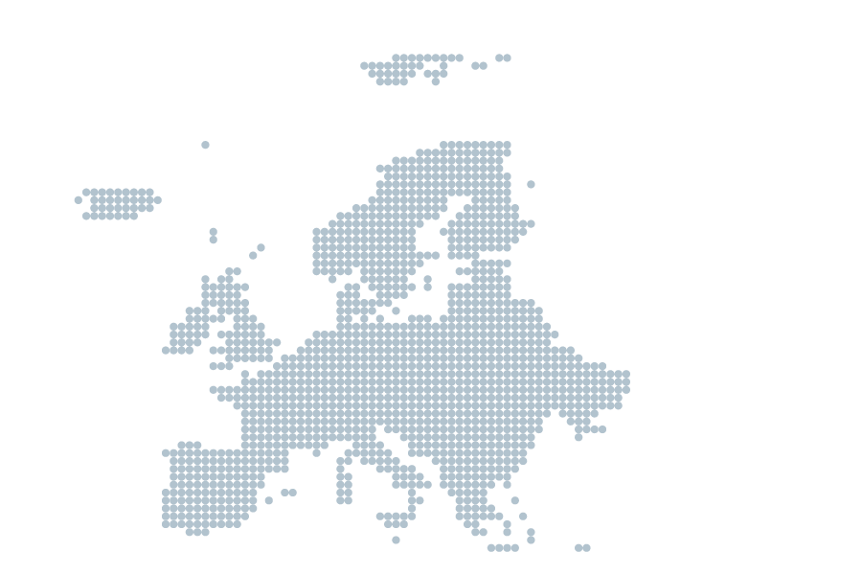



Our facts
A leading independent
consulting company
5
170+
Nordic
employees
offices
500+
Founded in
1999
clients globally
Employee-owned company
© Platon
<номер>
Notes:
<номер>

Slide 3










Big Data - Why? Challenged from many sides
REALTIME
ENTERPRISE
EXPLODING
DATA
VOLUMES
FACING NEW
COMPETITION
THE INTERNET
OF THINGS
FAST
CHANGING
WORLD
BUSINESS
COMPLEXITY
ANY DATA
SOURCE
Notes:
The IM world is under pressure from many sides.
Digitalization has an impact on business processes, so data and analytics will play a major role.
Digital Business Transformation
So this is the golden age of for Information Management! Start working with the opportunities in data.
New demands as questions and new technologies as responses.
<номер>

Slide 4
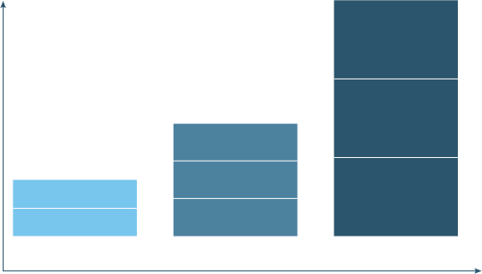
(Big) Data Sources
Likes
Data volumes
Sensors
Web Logs
ERP
Emails
Tweets
Webshop
Click Streams
Transactions
Interactions
Observations
Data variety and complexity
Notes:
A common reaction from customers; We do not have ”Big Data”!!
HortonWorks definition of Big Data:
Big Data = Transactions + Interactions + Observations
Transactions: ERP and other operational applications
Interactions: Web logs, Dynamic Pricing, Search Marketing, Behavioral targeting
Observations: Sentiment, Click streams, Audio, Video, Social interaction, Crowd Sourcing, DataMarkets
<номер>

Slide 5
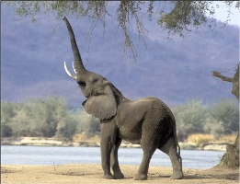




The four V’s of Big Data = Any Data
Volume
Velocity
Data explosion. Multi-layered architecture Non linear scalability.
Data changes rapidly. Events in new pace. Decision window.
Variety
Variability
Many data formats. Complex integration. Non structured sources.
Variable interpretations. Enriching existing views. Virtual models.
<номер>
Notes:
Data in all its forms:
Volume exceeds physical limits of scalability
Velocity - Velocity describes the frequency at which data is generated, captured, and shared. Smaller decision window compared to data change rate. Trends changes rapidly
Variety – many different formats makes integration expensive
Variability – many options or variable interpretations
More V’s to come;
Value, Virality (how fast can it spread – people to people),
Viscosity (How fast can information/data flow into the organization as insights)
Since everybody remembers Big Data as “BIG” data and not all four V’s, I added a picture/animal for each, for you all to remember.
<номер>

Slide 6


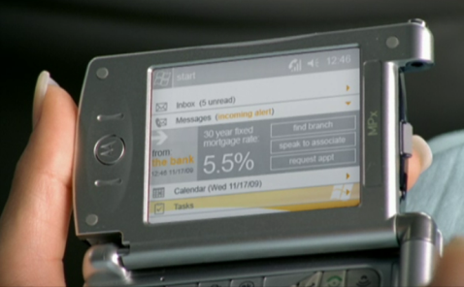

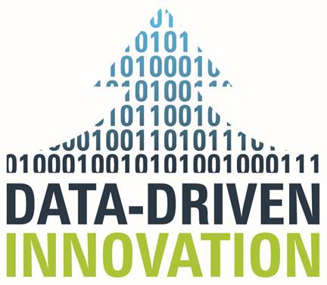

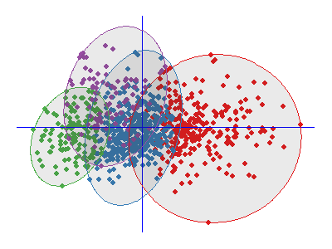
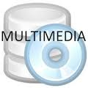
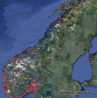

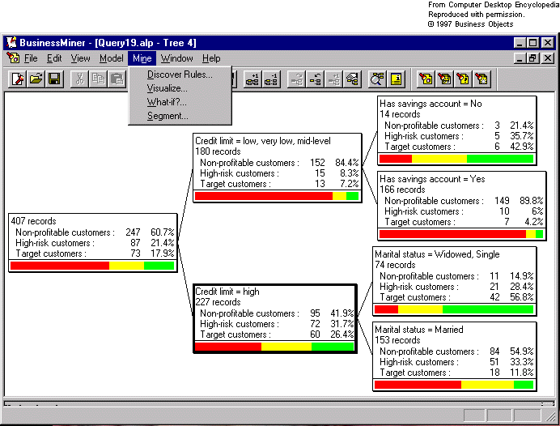
A Platon view on Big Data
Customize actions
Enable experimentation
Automate decisions
Create transparency
Innovate new business model
Interactions
MPP/Appliances
Information Retrieval
Transactions
Streaming
Complex Event Processing
Unstructured
Visualization
Observations
Data Mining
Map/Reduce
In-Memory
Decision engines
Notes:
So putting the ends together, we at Platon view Big Data the combination of the three domains
1. Big Data Technologies. BI vendors are moving in this space…. SAP HANA, Appliances from Oracle, Teradata and recently Microsoft. Hadoop, …
2. Advanced Analytics. Lots of data in various forms needs analytics to make sense of the data
3. And the last domain should really be the first – the most important one. The IUC is the reason why we are interested in Big Data. This is where the title of this talk come in play. Innovation through information
Cause-and-Effect eller kausalitet (sammenhæng mellem årsag-virkning).
PAS PÅ: Der er forskel på
Korrelation = observeret sammenhæng (Salg af solbriller korrelerer til salg af is).
Kausalitet = eksplicit sammenhæng (Vi sælger ikke flere is fordi vi sænker prisen på solbriller)
Mackenzie made a report where they identified the 5 groups indicated.
But I prefer to give a few examples instead (next slide)
<номер>

Slide 7
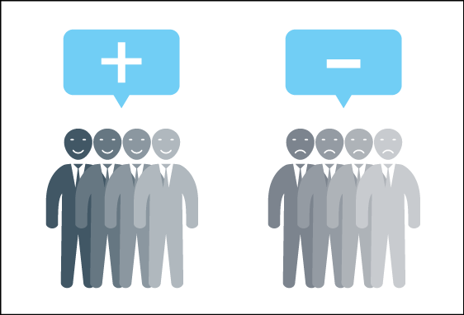

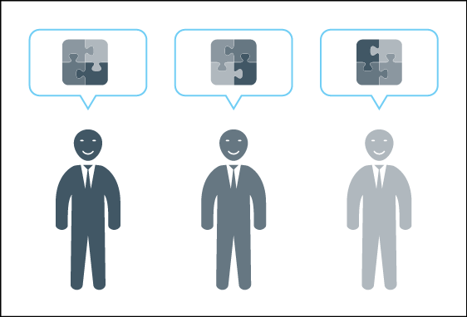

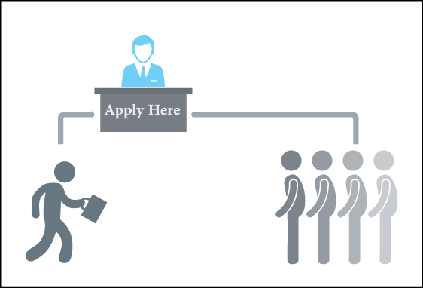
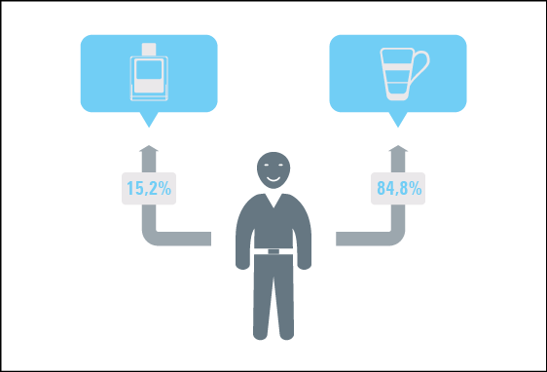
Information use cases
Understand customer sentiments
Test market response
Individualize value proposition
Target equipment maintenance
Automate Application Processing
Predict customer behavior
© Platon
<номер>
Notes:
Stop her og bed folk om at snakke om use cases med sidemanden i ca. 1 min.
Vælg 3 (par) til at fortælle resten hvilken use-case de snakkede om…
Pick a relevant use case for the customer i.e to
Support system and process harmonization in M&A’s
Support innovation and agility for efficient product and market development
Extend the value chain through cross-organizational data integration and analysis
5 ways for big data to create transformational value (by McKinsey)
Create Transparency
Enable Experimentation
Customize Actions
Automate Decisions
Innovate New Business Models
<номер>

Slide 8
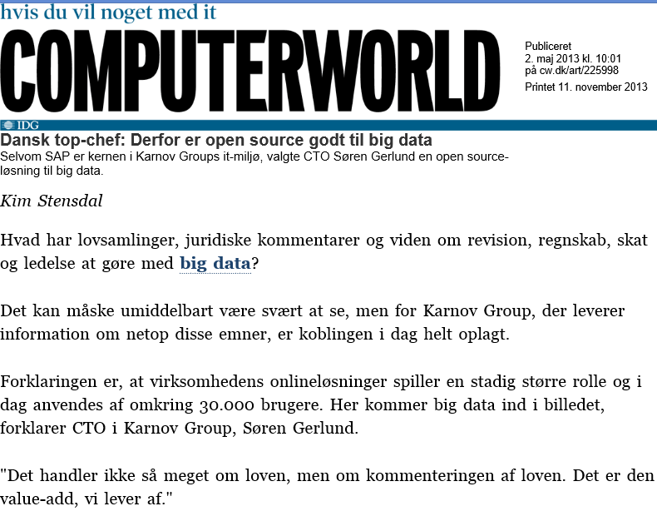
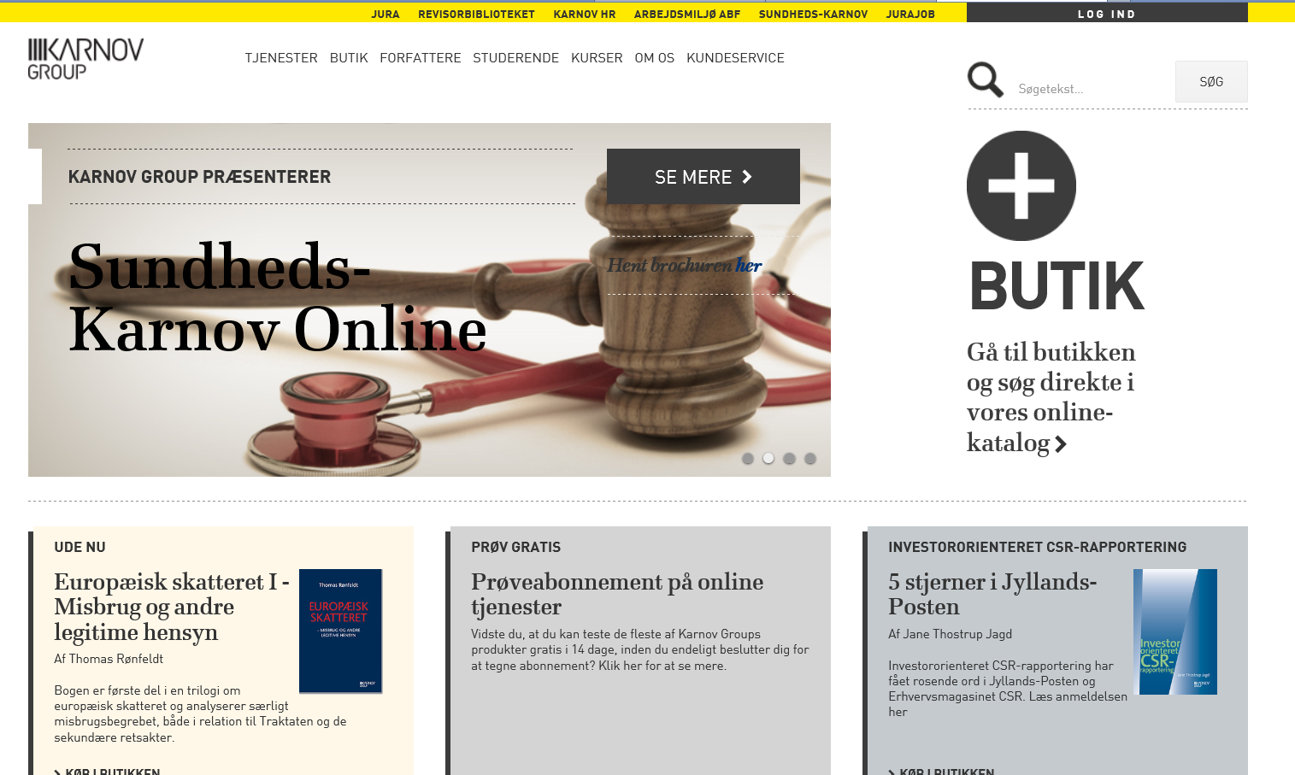

Case: Karnov, Better BI using Big Data
A Digital Transformation, from books to services
Statistics on usage and recommendation
Integrate any data source
JSON
SAP
Transform
Notes:
Essentially it is hard to read constantly changing sourcers (JSON) in a data warehouse
In addition they need to integrate data – DW is not enough and web analytics is not enough
<номер>

Slide 9
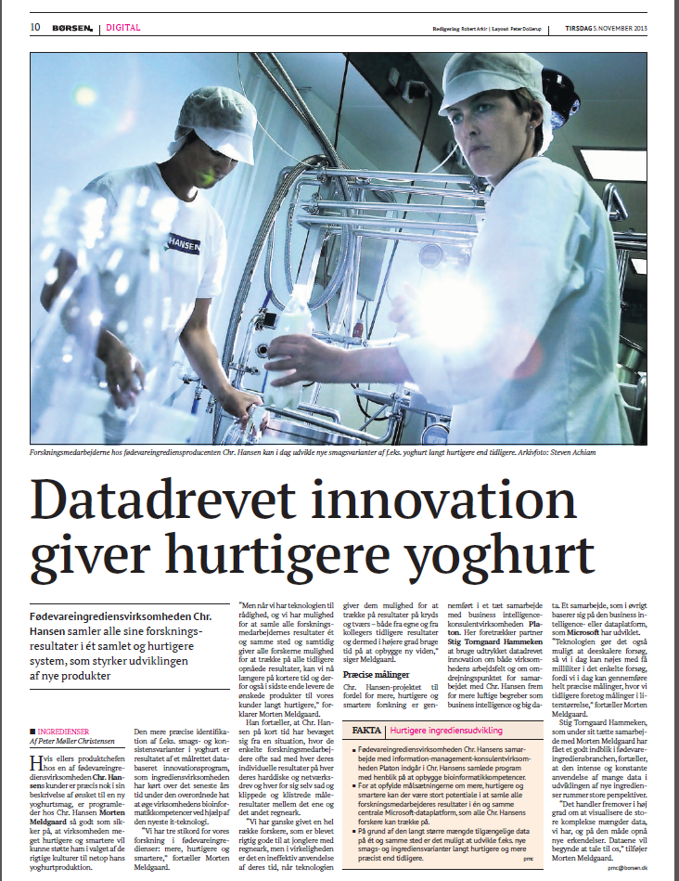

Case: Data-driven innovation at Chr. Hansen R&D
From one-man armies to Collaborative Data in R&D
“Setting data free”, M. Meldgaard
Automatic data capture
Downscaling theme
Finer data granularity
Rethinking R&D

Slide 10
Platon Market Observation
Information Management disciplines and especially Data Management are valuable core capabilities when engaging on a Big Data journey.
Notes:
Data Management is about to get re-engerized
Are you in Data Management, then stay tuned or get on the journey
<номер>

Slide 11
The fundamental (Data) Scientist requirement
Any Question
Tool independence
Loosely coupled
Any Data or Event
Data independence
Notes:
However most of today’s databases have the HUGE disadvantage that the schema needs to be defined, and the data understood, upfront.
Great for simple, well defined business data, but if you’re searching free text, machine generated data or simply a hugely diverse data population
<номер>

Slide 12
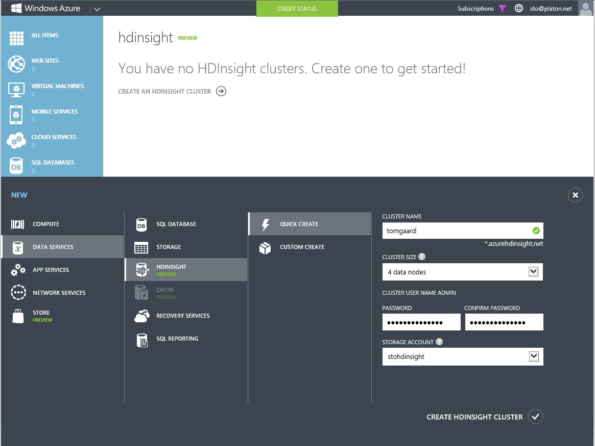
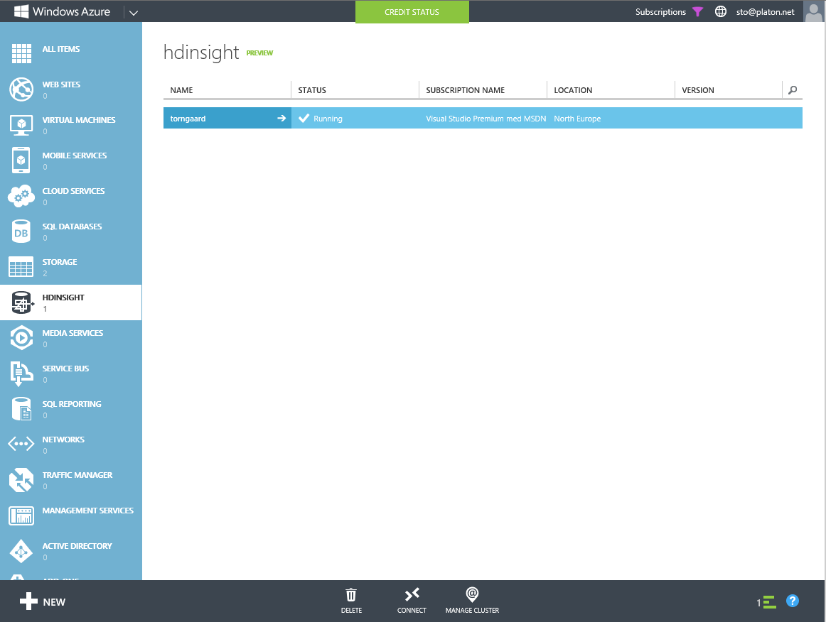
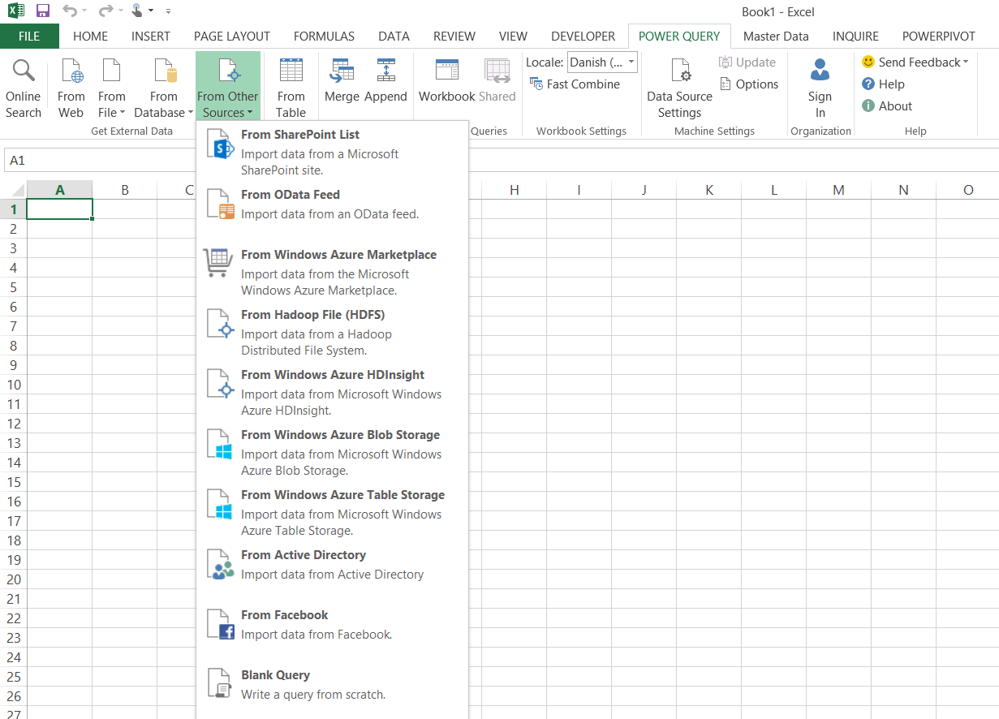
HDInsight; Hadoop for everyone in the Cloud

Slide 13
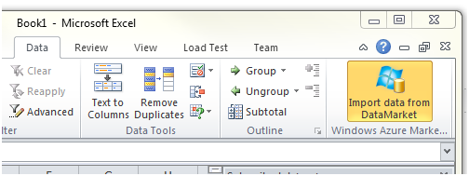
A Microsoft Big Data example
Excel PowerBI
Web Analytics
PowerQuery
PowerMap
PowerPivot
Project X
Y
HDInsight Content
Odata feed
Analytics
Hive (SQL) Query
HDInsight (Compute)
Azure Blob Storage
Azure DataMarket
Data Sources
Upload data, streaming data
Other data, Social etc.
Notes:
Technology pieces of the new puzzle.
Passau, the “City of rivers”
Sharepoint, Data Catalog etc.
<номер>

Slide 14
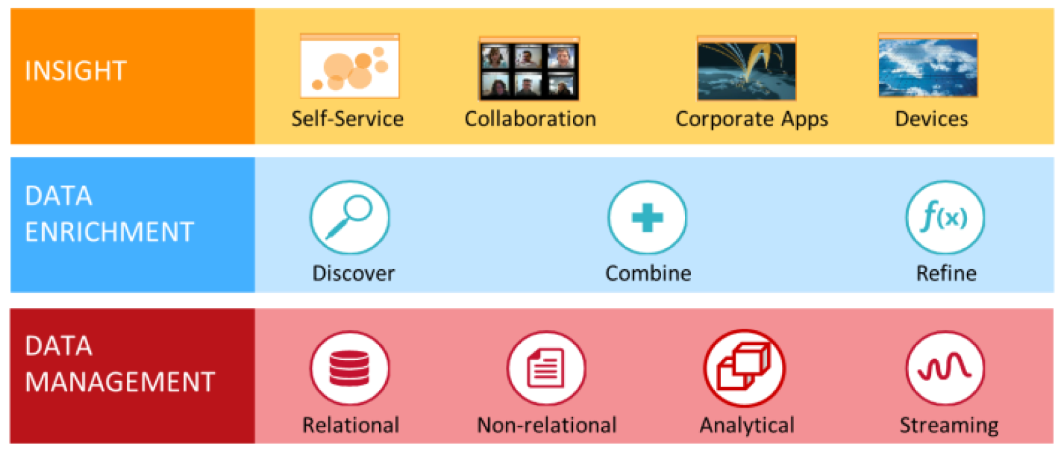
Big Data Architecture Components
Discover, analyze, and visualize with familiar tools
Collaborate and stay connected
Source: Microsoft
Notes:
The Information Supply Chain (Transform, Clean, Share, Govern, Reccomend) -> Operational eller Analytical
Data Management: SQL, Hadoop, Cube/In-memory, StreamInsight/Flume
Enrichment: PowerQuery/Passau, PowerPivot/Analysis Services/Passau, Data Mining, DQS/MDS, Windows Azure Marketplace,
Insight: Office, PowerBI, Sharepoint/PerformancePoint, Hive ODBC, PowerQuery
<номер>

Slide 15



Reimaging the Intelligent Business
Next Level BI
Explore Any Data
Design Hybrid Information Architecture
Leverage new Technologies
Imagine Information Use Cases
Traditional Business Intelligence
Notes:
Leverage data in any form or shape
Really it is not Big data, it is about actively using Information – or as some could say – taking BI to the next level
Better Exploitation though ”Dynamic Schemas”, Mashups, Self-Service, Advanced Analytics, Any Data
On the top of Big Data; Reimaging the Business become an option
<номер>

Slide 16
Big Data is here to stay
Big Data is Disruptive and will change the way we all do business
Not just ”BIG” data (like Volume) – but a focus on ANY data
Cheap storage and “any data availability” means ______ to my business
Understand and leverage technologies – and set them free
Don’t replace your Data Warehouse. Big Data, it’s a complement
(Advanced) Analytics loves Big Data – but you need a business goal
Data-Driven Innovation, it’s a Business Strategy Update!
Get 90% of your inspiration from other industries
Data is the new Business ”fuel”
Rethink your business (as well as some IT)!
Notes:
Setting Big Data capabilities free in the organization
<номер>

Slide 17
Platon Key Observation
“Big Data is a major challenge to our toolsets, but the greatest challenge is to our imagination”
Stig Torngaard Hammeken
Partner
Email: sto@platon.net
Twitter: stigtorngaard
Notes:
We need to find and identify Information Use Cases. It is hard in the beginning, but when you start look for it it becomes aparent.
What is your favorite Use Case in your business/industry?
<номер>

Slide 18









<номер>
Customer Architecture Example
TRANSFORM
HDInsight
(Cloud)
MANUAL
COPY
RAW
CSV
Intermediate
Mart
HIVE (LOAD)
Reference
data
EXTRACT
STORE
TRANSPOSE
SQL Server
Machine
On-Premise
Marts/Models
Databases
© Platon
MatLab
R
Excel Power BI
Notes:
In many ways this architechture can be viewed as a classic DW – but tit is not!
The ETL has been reversed
Client tools hooking in at varies quality levels
The Mart is logical and gets instansiated in the in-memory
<номер>

