Slide 1
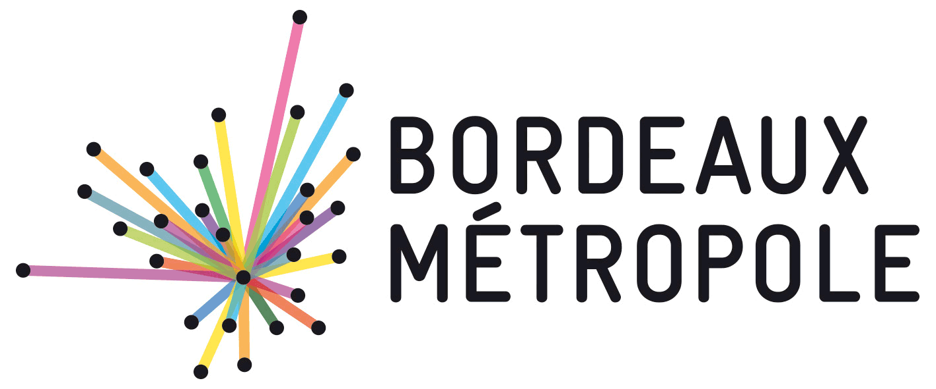
CLEANTECH IN BORDEAUX
THE GREEN GROWTH
1) Advanced sector: green energy
2) Innovation density sites
3) Support for startups
4) Flagship projects
septembre 2016

Slide 2
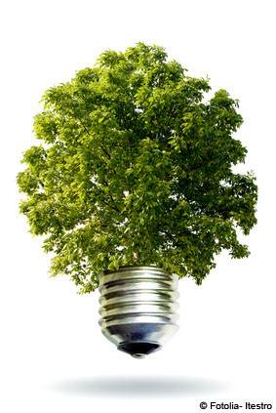
1) Advanced sector in Aquitaine: green energy
16% of the consumed energy in Aquitaine comes from renewable energy
Goal : x 2 = An additional 10 000 GWh by 2030
1st photovoltaic region of France regarding 770MW connected power, biggest Europe’s power plant in Bordeaux – 300MW, representing a 240 000 inhabitants city consumption.
1st France’s methanation region : 11 working units, 230 000 tons of treated waste, production capacity of 34,500 MWh gas / year, which is equivalent to a 11 000 city consumption, 27 additional units in progress.
2nd France’s most powerfull bioenergies parc (154 MW)
Aquitaine achieved a record production PV 2014 with an installed capacity of 770 GWh = 43% in 1 year.

Slide 3
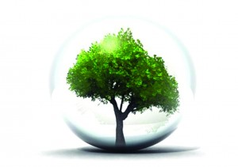
SOME EXAMPLES OF BORDEAUX BASED JEWELS IN GREEN ENERGY PRODUCTION
Solar : NEOEN , SUNNA DESIGN , VALOREM
Methanation : FONROCHE, AIR LIQUIDE
Marine Renewable Energies : BERTIN TECHNOLOGIES, HYDROQUEST, INSTREAM
Biomass : EUROPLASMA, DALKIA
Hydrogen: HDF
Fluvial hydrokinetic turbines : ENERGIE DE LA LUNE
Eolian : VALOREM /VALEOL

Slide 4
2) Innovation density sites in Aquitaine
In every CleanTech sectors, Bordeaux stakeholders are innovating: clusters, R&D platforms, companies, laboratories…
Energetic efficiency / smartgrids
Insul’grid Project (see p.10)
Centre Cap ingelec
Iqspot
Enercoop
INEF4: Institut pour la transformation énergétique
Green energy
Cluster Aquitaine Croissance Verte
Cluster Sysolia – Solaire
Competitiveness cluster Route des Lasers – Photovoltaic, lighting
Competitiveness cluster Avenia – Geothermal energy
Plateforme seeneoh
APESA : Valorisation matière et énergétique (biomasse, déchets)
Urban mobility and SmartCity
Pôle de compétitivité Digital Aquitaine
Technopôle Technowest
Plateforme SAFT
Centre Gertrude
Projet VAHY (cf p.11)

Slide 5
Air | Carbon | Water
Eco-materials | Construction
Centre Chromatotec
ECIC
MT partenaires
Agence de l’eau Adour-Garonne
Cluster CREAHD
Centre d’étude nucléaires
Pôle de compétitivité XYLOFUTUR
Centre Eurovia
Plateforme ITERG
Plateforme Rescoll
NOBATEK : technological resource center for building and sustainable development
FCBA : technological forest institute, cellulose, wood-construction, furnishing (Industry Technical Centre). Organizes “WoodRise” the worldwide congress on high-rise wood buildings
CANOE : Aquitaine technology center of advanced materials and composites
Green Chemical
Cluster Aquitaine Chimie Durable
Cluster Inno’vin
Centre Fermentalg
Waste| Circular economy
Pôle de compétitivité Agri Sud-Ouest innovation
Centre Innoveox

Slide 6
3) Support for CleanTech startups
Incubators:
EcoParc
Parc Newton
Business nursery and co-working space:
Darwin ecosystem
Associations:
FrenchTech Bordeaux
UrbAquitaine

Slide 7
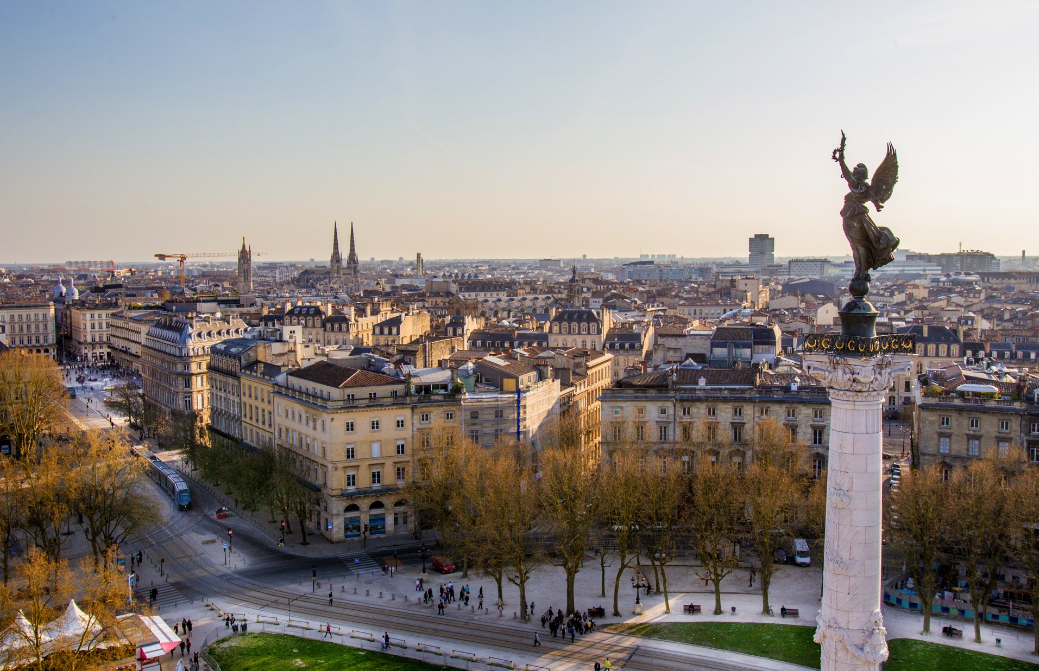
4) FLAGSHIP PROJECTS

Slide 8
INSUL’GRID
Insular power networks
Kit EnR hybride (5 à 30 MW)
Combines real-time intermittent available renewable energy and suitable storage means
The plant operator manages the quality and the injected quantity of electricity in the network
Labeled DERBI (Development of Renewable Energies in Building and Industry)
4,5 M€ invested in the 2013-2016 period, whose 2,5 M€ from government and local authorities subventions
Partners: Areva, Bordeaux Métropole, BPIFrance, Région, Estia, Exosun, Fonroche Energie, Saft, Valorem…

Slide 9
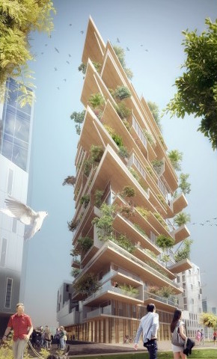
HYPÉRION & SILVA PROJECTS PLANNING AND CONSTRUCTION
THE TWO WORLD’S TALLEST WOOD HOUSING
HYPÉRION • Eiffage
SILVA • Kaufman & Broad

Slide 10
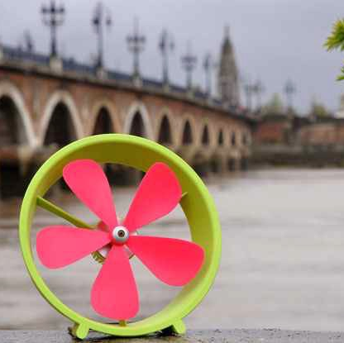
SEENEOH
Un projet unique au monde : un test grandeur nature des prototypes d’hydroliennes développés par les industriels
1er site expérimental d’hydrolienne en milieu estuarien
Puissance disponible par emplacement 100KW; capacité de raccordement au réseau 250KW
Technologies flottantes, portées ou à portance variable
Opérationnel en 2016
Partner: Areva, Bordeaux Métropole, BPIFrance, Région, , Estia, Exosun, Fonroche Energie, Saft, Valorem…

Slide 11
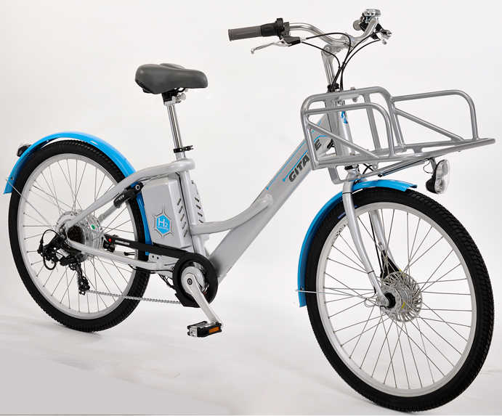
VAHY, 1st HYDROGEN
ELECTRIC BIKE
Development of a supply fuel cell and hydrogen on electric bikes
Planned experimentation in Bayonne and in Anglet (64)
Partners: Ad-Venta, Région, Cycleurope, La Poste, Pragma Industries, Stelia Aerospace Composites, Ventec

Slide 12
BUT ALSO,
PEEPOS STARTUP in Bordeaux Port Atlantique (integrated industrial ecology to port activities)
LIVING LAB intelligent transport systems: two innovative electronic vehicles developed by Akka Technologies and TOPOS Aquitaine cluster (Aquinetic)
CYCLABAT, supported by Aquitaine Croissance Verte, NOBATEK, Bertin Technologies, OUATECO et APESA. This project develops recycling of industrial waste in the construction and building products and offers a demonstrator facility (Full or partly recycled).

Slide 13
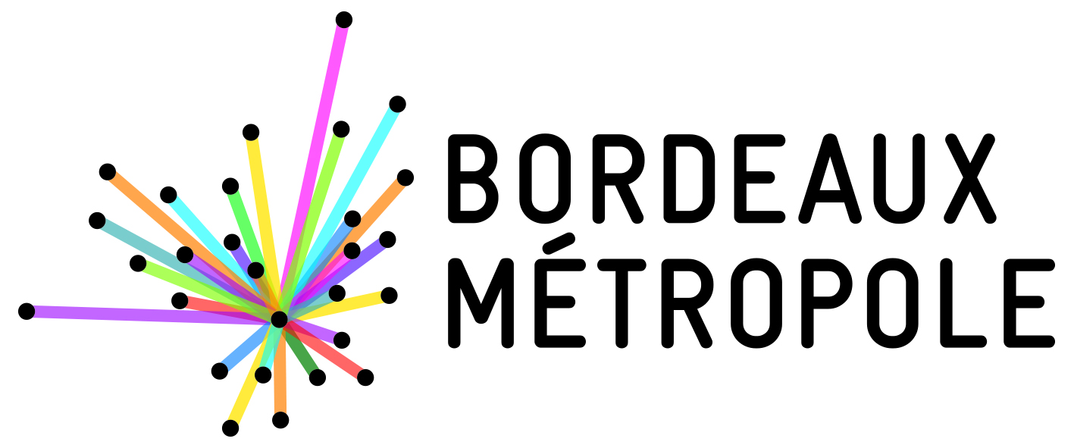
Informations complémentaires:
Mission Attractivité et Croissance numérique
+33 5 56 46 80 75 mgrange@bordeaux-metropole.fr

